Slide 1
Intimate Partner Violence (IPV) and HIV
Notes:
These slides were authored by:
Alexxis Woods, Healthier Relationships Advocate
Kiera Hansen, MSW, Community Based Services Manager
Bradley Angle, Portland, OR

Slide 2
Objectives
At the end of this unit, participants will be able to:
Understand cultural context and intersectionality
Understand the basics of intimate partner violence (IPV)
Understand the intersection of IPV and HIV
Build on community knowledge about the different forms of power/control and IPV as it pertains to survivors with HIV
Use tools and skills to support survivors
Notes:
Read the slide and answer participant questions, if any.

Slide 3
Code of Care
We are speaking about triggering content
There may be survivors participating in this training as well as individuals from all of the communities we will be speaking of.
Speak from your own experience.
Be careful not to mine other people’s trauma.
Attend to impact.
Notes:
Review the slide and answer participant questions, if any.

Slide 4
Acknowledging Limitations
Discussing the lived reality of survivors with HIV is complex. At the completion of this training, you may have more questions than answers. And that’s a good thing!
We do not claim to know everything or be experts on the content we will cover, including: HIV, marginalized communities, intimate partner violence or intersectionality.
We come to this conversation via the lens of our own identities and experiences. We are “professionals” in the fields of HIV, sexual health and DV/IPV.
There is always new information. Continue to learn and grow!
Notes:
Review the slide and answer participant questions, if any.

Slide 5
Intersectionality
Kimberlé Crenshaw (1989) - people have multiple, intersecting, and overlapping identities that complicate their social location when looking at systems of oppression.
We are all coming to this work with our own intersecting identities and we are all supporting people who have their unique experiences living at their own intersecting identities.
Acknowledge, value, and consider the many different ways folks walk through and experience this world.
Crenshaw, K. (1990). Mapping the margins: Intersectionality, identity politics, and violence against women of color. Stanford Law Review, 43, 1241.
Notes:
Review the slide and answer participant questions, if any.

Slide 6
Social Frameworks that Impact the Conversation
Morality and dualism: good/bad; right/wrong
Rape culture
Toxic masculinity
Hypersexualization
Romanticized dominance
Abstinence-only
HIV criminalization
Exclusionary U.S. history/laws/practices
Notes:
Review the slide and answer participant questions, if any.

Slide 7
What is Intimate Partner Violence (IPV)?
The National Network to End Domestic Violence defines IPV/DV as a pattern of acts involving the use or attempted use of physical, sexual, verbal, emotional, economic or other forms of abusive behavior in order to threaten, harm, intimidate, harass, coerce, control, isolate, restrain, or monitor another.
The Northwest (NW) Network reinforces the idea that intimate partner abuse relies on a pattern of power, control, and exploitation established by one person over another.
Source: https://nnedv.org/; https://www.nwnetwork.org/
Notes:
Review the slide and answer participant questions, if any.

Slide 8
Why Intimate Partner Violence (IPV)?
What are some other terms you have heard of that are used instead of IPV?
Why might IPV as a term be challenging?
Why might it be helpful?
Notes:
Ask questions and take a few minutes to get feedback from participants.

Slide 9
Reasons Why Folks May Not Identify Experiences as IPV
Their experience of IPV doesn’t fit with the one often portrayed: cis male as abuser, cis woman as the abused.
Sometimes violence is minimized: violence experienced societally/institutionally can make it harder to demonize romantic relationships/partners.
Consent and conversations about power and control are not normalized.
What are some reasons multiple marginalized communities may not identify experiences as IPV?
Notes:
Review the slide.
Ask the question and take a few minutes to get feedback from participants.

Slide 10
Complicating the Survivor/Abuser Narrative
Violence is cyclical. For many of us who perpetrate violence, we may also come from varying experiences of violence ourselves.
Most survivors love their partners and want them to stop perpetrating violence but may not view their relationship in such simplistic terms. This lived reality disrupts the heavy focus of “fleeing” that we often think of as the solution to the violence.
How do we talk about survivors who use violence as part of their survival?
Notes:
Review the slide and answer participant questions, if any.

Slide 11
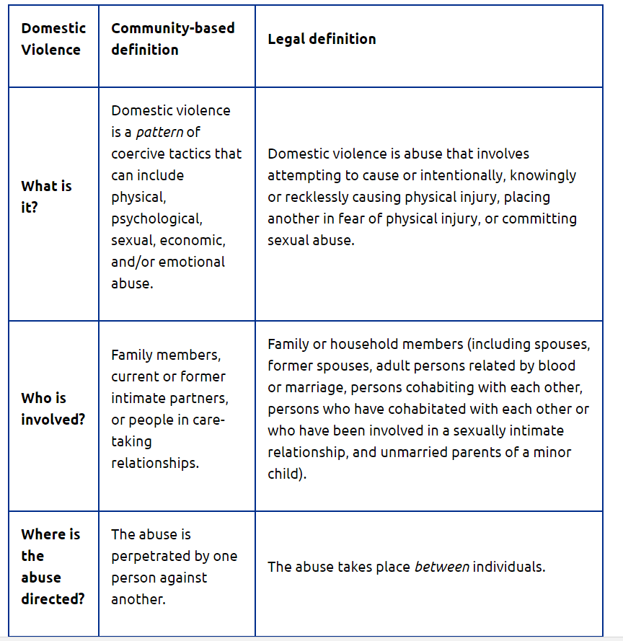
Notes:
Review the slide.

Slide 12
When you think of IPV, what are some examples in your work with clients that come to mind?
Discuss how the violence has impacted their health, well-being, and feelings of control over their lives.
Notes:
Ask the questions and facilitate a discussion.
Remind people to not disclose client’s names and to keep confidentiality in mind so private information is not shared inadvertently with the group.

Slide 13
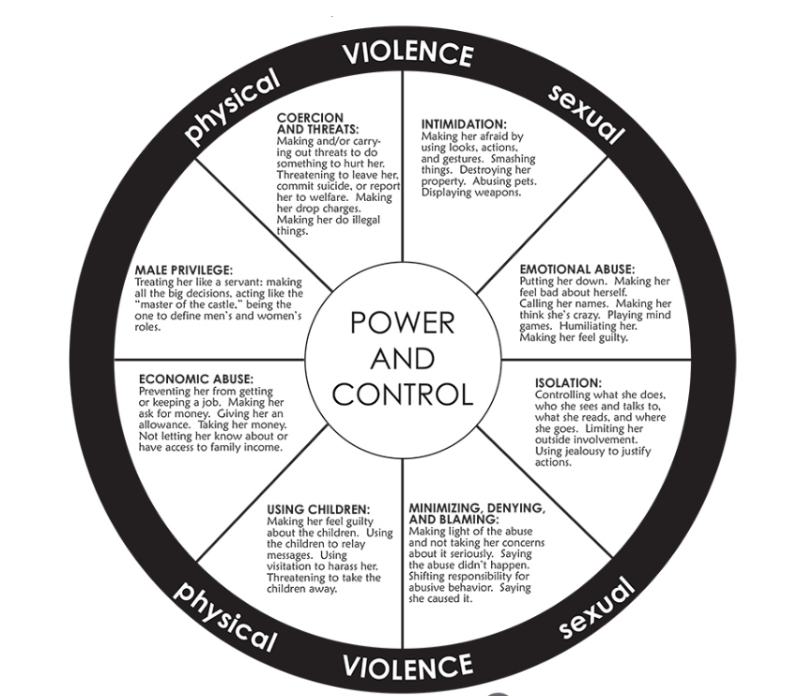
Notes:
Review the slide, or ask volunteers to each read aloud a section of the figure (e.g., Isolation).

Slide 14
Intersections of IPV and HIV
Facts:
People with HIV are more likely to experience IPV.
Survivors experiencing IPV are more likely to contract HIV.
Notes:
Share the hand out on domestic violence and sexual assault. Ask the attendees who is left out of these stats? How does this intersect to make risk different?

Slide 15
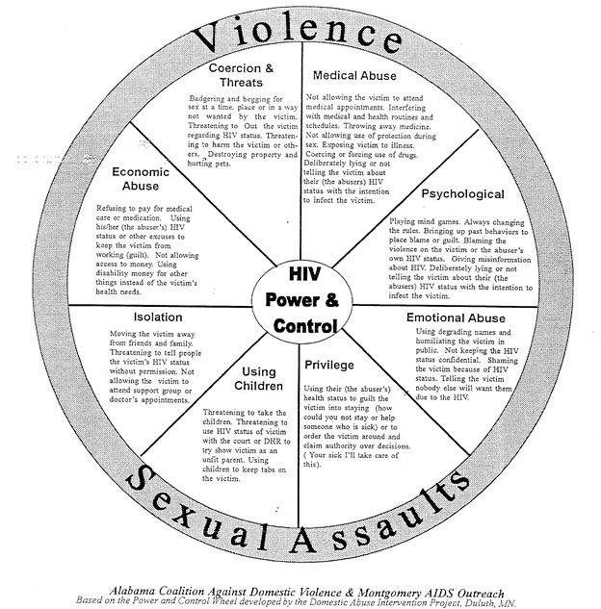
What Can IPV Look Like for People With HIV?
Notes:
Review the slide.
Distribute the HIV Power and Control Wheel handout.

Slide 16
Safety Planning
Review/reference the safety planning resource.
Basics of safety planning
A safety plan is an IPV survivor-driven process. IPV survivors know the most about their own situation, about the behavior of their abuser, and about what they are prepared to do.
Safety planning is a process of supporting an IPV survivors’ process as they stay with an abuser, think about leaving, decide to leave, leave, and after they have left. Safety planning is often necessary after the relationship has ended as well. Survivors know their situation best, so encourage them think through what is best for them and make whatever changes or additions feel right for their situation.
A safety plan can change multiple times during the process.
For an IPV survivor with HIV, the following areas may be of interest when safety planning: emotional, psychological, financial, physical, medical, and spiritual.
We will discuss three scenarios to practice thinking about safety planning.
Notes:
Review the slide and answer participant questions, if any.

Slide 17
Scenario 1
Survivor states that they received a message from their partner that he had been living with HIV for the duration of their relationship. This is the first the IPV survivor has heard of this and is not sure if it’s the truth or another control tactic. The IPV survivor lives with their partner and had recently threatened to leave. The IPV survivor seems inclined to believe it’s a lie and doesn’t feel it’s necessary to get tested. How could a conversation be started about the survivor’s safety?
How could a conversation be started about the survivor’s safety?
Notes:
Ask a volunteer to read the slide.
Facilitate a group discussion around the question on the slide and the questions on the next slide.

Slide 18
Discussion
List a safety concern that stands out for you?
What is one question you have for the IPV survivor?
What is one resource in your community that you can think of?
What is one barrier the IPV survivor may experience when accessing this resource?
Notes:
Ask for a volunteer to read each question.
Facilitate a group discussion.

Slide 19
Scenario 2
You are working with a sex worker and IPV survivor, who hasn't been in your city for long. They disclose that while having sex with a client, the condom broke. The survivor states that they are aware that they are at risk for getting HIV but that they don't feel sick so they are probably fine. The IPV survivor states that they don't know where to get tested here, but stated that knowing for sure won’t make things any better. They say that actually, their relationship with their partner has improved recently and they have been way more calm and kind, and the IPV survivor is afraid that if they tell their partner about the condom breaking or if they test positive, that their partner will get violent again. Their partner collects and accounts for all of their money and without that money, the IPV survivor could be homeless.
How could this conversation go?
Notes:
Ask a volunteer to read the slide.
Facilitate a group discussion around the question on the slide and the questions on the next slide.

Slide 20
Discussion
What is one HIV or IPV myth that stands out to you?
List one form of power or control that is being used by the abuser?
What is one question you have for the IPV survivor?
What is one area of safety you would like to discuss?
Notes:
Ask for a volunteer to read each question.
Facilitate a group discussion.

Slide 21
Scenario 3
You're working with J, a client who is new to your city, accessing services in your clinic, and living with their partner. J shared with you that their partner has gotten increasingly jealous and doesn't want them to go out to dance parties. J comes in for a regular meeting with you and mentions that their last argument ended with their partner belittling and hitting them. J stated that the violence is escalated when they are using drugs. J has a couple of friends who are concerned about their safety, aren’t connected to their partner, and do not know about J’s HIV status.
How would your conversation with J go?
Notes:
Ask a volunteer to read the slide.
Facilitate a group discussion around the question on the slide and the questions on the next slide.

Slide 22
Discussion
What is one emotional safety concern?
What is one physical safety concern?
What is one medical safety concern?
What is one challenge you think may impact your ability to effectively safety plan with this participant?
Notes:
Ask for a volunteer to read each question.
Facilitate a group discussion.

Slide 23
Wrap-Up
What can supervisors do to support CHWs in working with clients with HIV who have experienced IPV?
Name one important thing to keep in mind that you learned today about the intersection of HIV and IPV?
Notes:
Read each question and allow participants to respond.

Slide 24
Relevant Resources in Your Area
Take a moment to brainstorm for yourself one resource in each of these areas in your community:
A DV/IPV service provider
An HIV/AIDS service provider
A mental health provider that would be competent in working with IPV survivors with HIV
Notes:
Review the slide and allow time for participants to jot down some answers for themselves.

Slide 25
Resources
The National Network to End Domestic Violence (NNEDV) Toolkit:
https://nnedv.org/dv-hivaids-toolkit/
Safety Planning: A Guide for Transgender and Gender Non-Conforming Individuals Who Are Experiencing Intimate Partner Violence: https://safehousingpartnerships.org/sites/default/files/2017-01/safety-planning-tool.pdf
Notes:
Share the resources on the slide with participants.

