Slide 1
El VIH y el envejecimiento
Cómo trabajar con y apoyar a las personas mayores de 50 años con VIH/SIDA
Notes:
1

Slide 2
Objetivos
El VIH y el envejecimiento
Al final de esta unidad las participantes podrán hacer lo siguiente:
Identificar y analizar los desafíos especiales entre las personas de 50 años o más con VIH con respecto a:
Salud clínica y física
Salud mental y emocional
Consumo de sustancias
Salud reproductiva
Abordaje de los desafíos con clientes
PrEP
Vida buena con el VIH
Notes:
Review the objectives.
Introduce HIV and aging topic by acknowledging:
Work remains to control the spread of HIV by identifying people with HIV who are undiagnosed.
Development of HAART (i.e. cocktails using multiple drugs) has increased life expectancy of people with HIV.
Annual numbers of HIV diagnosis declined by 5% between 2011 and 2015.

Slide 3
Los números
El VIH y el envejecimiento
Notes:
The next slides will focus on the numbers—the scope and impact of people over 50 with HIV.
Aging is a part of the natural course of life. However, HIV seems to accelerate the aging process. We’re not sure if it is the virus
itself or HIV treatment that influences the aging process, but we will discuss some of these special challenges.
People aged 50 and older accounted for approximately:
17% (6,812) of the 39,782 new HIV diagnoses in 2016 in the United States. Though new HIV diagnoses are declining among people aged 50 and older, around 1 in 6 HIV diagnoses in 2016 were in this group.
35% of people aged 50 and older already had late stage infection (AIDS) when they received an HIV diagnosis 2016
The good news is that as a result of the development of highly active antiretroviral therapy starting in the 1990s and today, life
expectancy for many people with HIV nears that of a person without HIV. The bad news is research increasingly shows that diseases
that typically strike HIV negative people in their 60s and 70s are occurring in people with HIV in their 40s and 50s.
We have seen a decline of 5% in HIV diagnosis nationwide, but we still have special populations where we see increases in the
number of infections.
Growing older with HIV is uncharted territory. This is the first generation of people with HIV who are over 50.
The American Academy of HIV Medicine (AAHIVM), the American Geriatrics Society (AGS) and the AIDS Community Research
Initiative of America (ACRIA) released the first clinical treatment strategies for managing older HIV patients: The HIV and Aging
Consensus Project: Recommended Treatment Strategies for Clinicians Managing Older Patients with HIV in the fall of 2011.

Slide 4
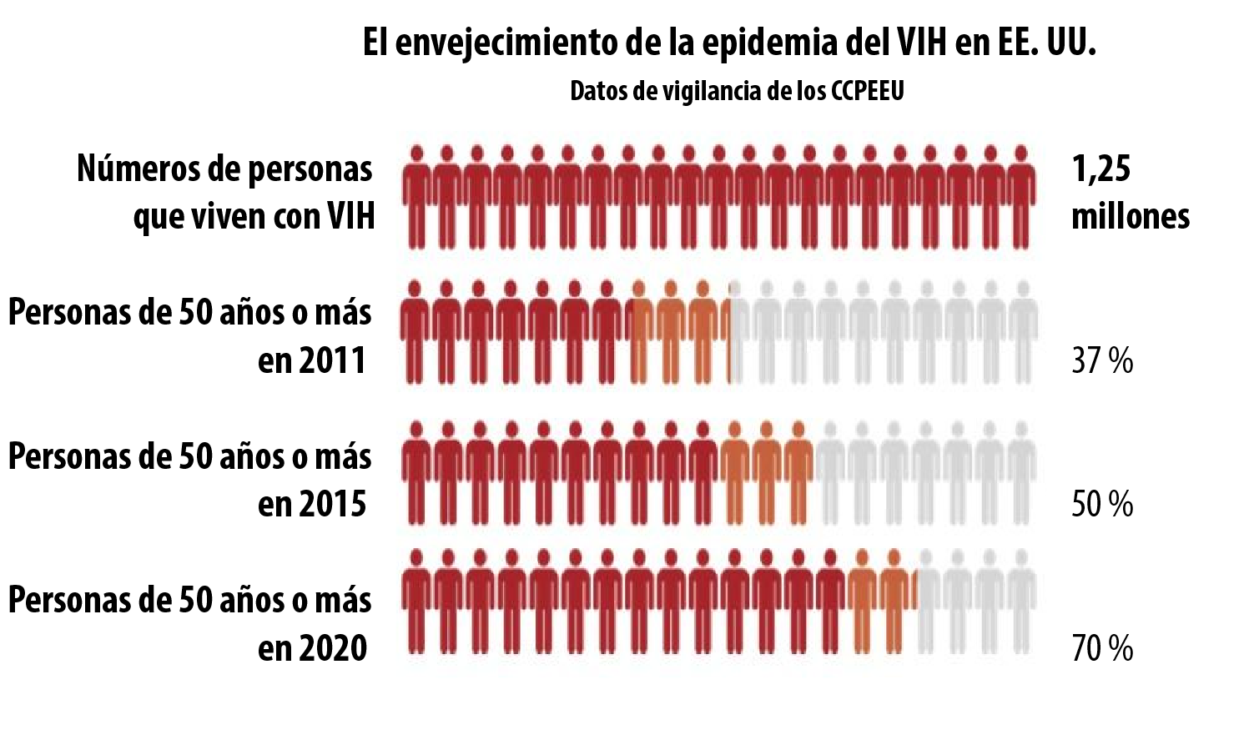
El VIH y el envejecimiento
Notes:
Review the chart.
People with HIV who are over 50 are a growing population. According to CDC surveillance data:
Number of people with HIV is 1.25 million
In 2011 – 37% were age 50 and older
In 2015 – 50% were age 50 and older
In 2020 –70% are projected to be 50 and older

Slide 5
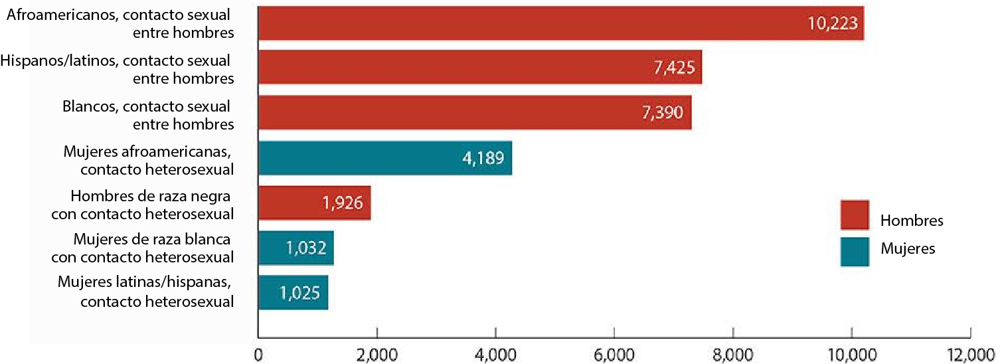
Estimación de diagnósticos nuevos de VIH en los EE. UU. para las subpoblaciones más afectadas, 2016
El VIH y el envejecimiento
En 2016, 39 782 personas recibieron un diagnóstico de VIH. El número anual de diagnósticos de VIH disminuyó un 5 % entre 2011 y 2015
Notes:
Point out the following on the chart:
Disparities: The most impacted sub-populations are:
Black men who have sex with men (MSM);
White MSM; and
Latino MSM; followed by
Black, Latina, and white heterosexual cisgender women.
Among people aged 50 and over, Blacks/African Americans accounted for 43% of all new HIV diagnosis in 2015. Whites accounted for 36%, and Hispanics/Latinos accounted for 17%.
Among people aged 50 and older, 49% of new HIV diagnosis in 2015 were among gay and bisexual men, 15% were among heterosexual men, 23% were among heterosexual women, and 12% were among people who inject drugs.
It’s important to note that this slide only shows subpopulations that represent more than 2% of all HIV diagnoses, so smaller, but
still heavily impacted communities are not reflected.
Let’s take a closer look at some of these disparities. In 2016:
African Americans represented 12% of the population, but accounted for 44% (17,528) of HIV diagnoses. African Americans have the highest rate of HIV diagnoses compared to other races and ethnicities.
Hispanics/Latinos represented 18% of the population, but accounted for 25% (9,766) of HIV diagnoses.
5

Slide 6
Interacción de problemas para las personas de 50 años o más
El VIH y el envejecimiento
Sexismo
Envejeci-miento
VIH
Estigma
Edadismo
ART
Homofobia
Transfobia
Racismo
Notes:
Older people with HIV have to grapple with aging, HIV, and the effects of anti-retroviral therapy (ART), all within the context of
stigma and societal oppression which may include racism, homophobia, transphobia, sexism, and ageism.
6

Slide 7
Actividad: desafíos especiales
El VIH y el envejecimiento
VIH entre personas de 50 años o más:
Salud clínica y física
Salud mental y emocional
Salud reproductiva
Notes:
Group activity: special challenges
Break participants into 3 groups and assign each group one of the 3 topics listed below. If there are fewer than 10 participants then
conduct activity as a large group. Have the group(s) discuss what challenges people with HIV who are 50 or older may encounter
with respect to the topic. Assign a recorder to write on the flip chart and a recorder to share with the larger group. Allow the
groups 5 minutes to discuss before reporting back to the larger group.
Clinical and physical health
Mental and emotional health
Sexuality and sexual health
After the group discussion, the facilitator will close out the activity by reviewing any issues not covered by participants by reviewing
the next slide.
7

Slide 8
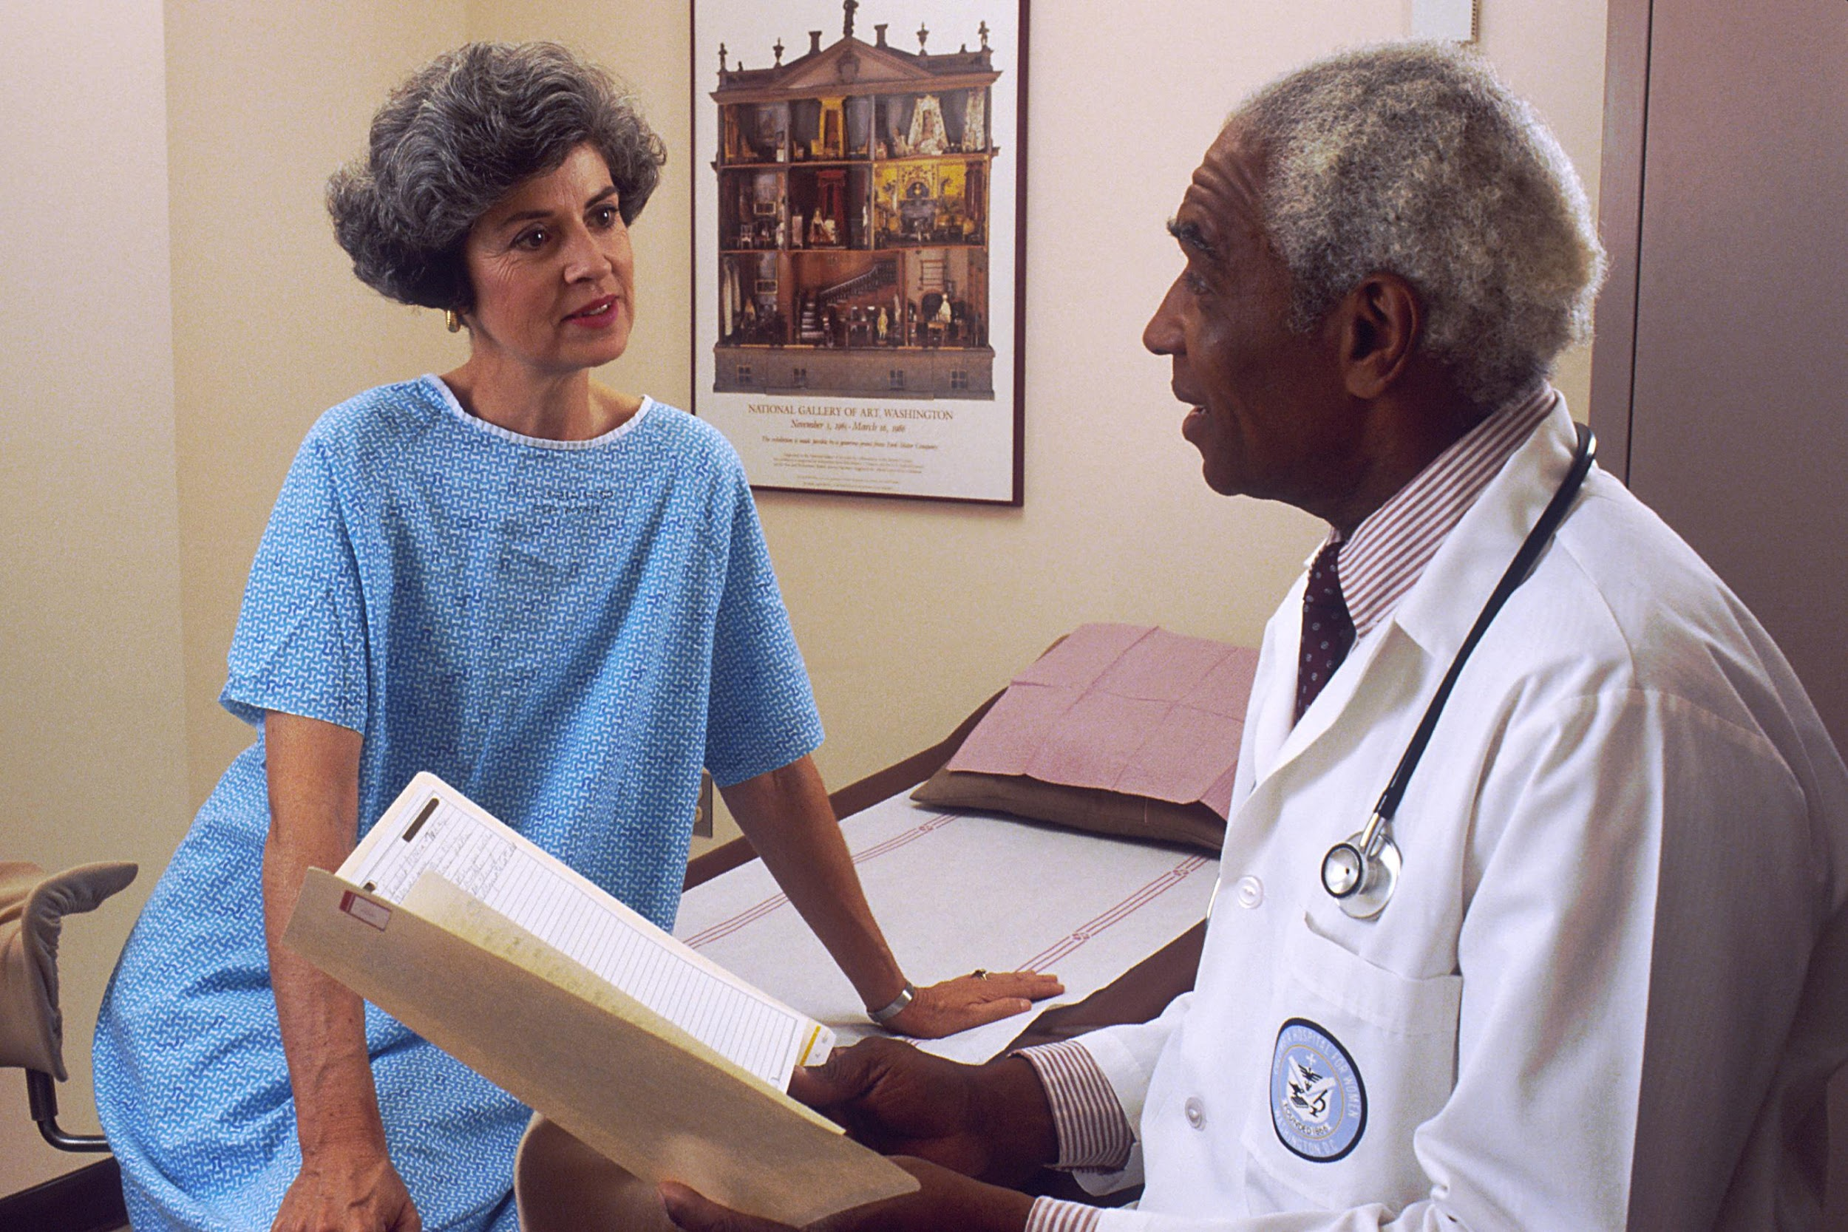
Salud clínica y física
El VIH y el envejecimiento
Inflamación por VIH
Efectos a largo plazo de los medicamentos antirretrovirales
Polifarmacia
Comorbilidades
Notes:
Make sure to cover the following points, or emphasize them during the group discussion:
HIV treatments have decreased the likelihood of AIDS-defining illnesses among people aging with HIV.
HIV-associated non-AIDS conditions are more common in individuals with long-standing HIV infection. These conditions include cardiovascular disease, lung disease, certain cancers, HIV-Associated Neurocognitive Disorders (HAND), and liver disease (including hepatitis B and hepatitis C), among others.
In addition, HIV appears to increase the risk for several age-associated diseases, as well as to cause chronic inflammation throughout the body. Chronic inflammation is associated with a number of health conditions, including cardiovascular disease, lymphoma, and type 2 diabetes.
8

Slide 9
Polifarmacia
El VIH y el envejecimiento
La polifarmacia, el consumo de varios medicamentos, es común.
Las personas con VIH viven más tiempo gracias a la mejora de los tratamientos antirretrovirales.
A medida que los pacientes envejecen, otras afecciones médicas se vuelven más comunes:
Los efectos de las interacciones farmacológicas pueden disminuir la efectividad de los medicamentos contra el VIH o aumentar la toxicidad de los medicamentos.
Enfermedad cardíaca | Osteoporosis
Colesterol alto | Enfermedad renal
Presión arterial alta Diabetes | Cáncer no relacionado con el SIDA
Notes:
Polypharmacy – the use of multiple medications – is common. We talked about polypharmacy when we discussed drug to drug
interactions and drug to condition interactions
The number of medications prescribed for conditions such as heart disease, high cholesterol, and diabetes predicts the number of
drug interactions.
Drug-drug interaction – a reaction between two (or more) drugs.
Drug-condition interaction – a reaction that occurs when taking a drug while having an existing medical condition.
People with HIV are living longer than ever before with improved antiretroviral therapies, so as patients age, other health conditions
become more common.
9

Slide 10
Salud mental y emocional
El VIH y el envejecimiento
Los estudios han determinado tasas altas de depresión entre las personas mayores con VIH
El aislamiento social es un problema importante:
Las personas mayores pueden enfrentar aislamiento debido a una enfermedad o la pérdida de familiares y amigos.
Estigma debido a la infección por VIH y el envejecimiento.
Estereotipos negativos del envejecimiento, incluida la visión de las personas mayores como:
Necesitadas
Seniles y menos útiles que las personas más jóvenes
El estigma puede provocar un aumento de los síntomas y una disminución de la calidad de vida
El aislamiento social se ha relacionado con una disminución de la salud y la calidad de vida
Notes:
Review the slide making sure to emphasize the following points:
People need human connection in order to survive. As people grow older, a chipping away of connections and social life can lead to isolation from family and community.
An increased burden of symptoms, such as fatigue, pain, and depression, are perhaps worse in women with HIV. This can negatively influence everything from daily functioning, to employment, to quality of life.
HIV and dementia can be particularly challenging.

Slide 11
Consumo de sustancias
El VIH y el envejecimiento
Las tasas de consumo de sustancias son más altas en las personas mayores con VIH que entre los pares de la misma edad que son VIH negativos.
Los aumentos en la depresión se han relacionado con un mayor consumo de sustancias, como alcohol, marihuana, cocaína, opioides y benzodiacepinas.
Pueden ocurrir interacciones entre los medicamentos recetados y las sustancias ilícitas. Estas interacciones pueden dificultar que las personas cumplan con los medicamentos recetados y podrían reducir en gran medida la calidad de vida.
Notes:
Review the slide.
Note that veterans are particularly at risk. Homelessness and substance use are huge challenges for the veteran population. This group
of people may not be seen as at risk because of stereotypes associated with being older.
11

Slide 12
Sexualidad y salud reproductiva
El VIH y el envejecimiento
Las personas mayores son sexualmente activas, pero hay tasas más bajas de pruebas de VIH entre los adultos de 50 años o más.
Las mujeres posmenopáusicas corren el riesgo de infección por VIH e ITS debido al mayor riesgo de desgarro vaginal durante las relaciones sexuales.
Los adultos mayores en general tienen tasas más bajas de uso de condones. Es posible que las mujeres que no están preocupadas por el embarazo no usen condones.
Los adultos mayores que están divorciados o que han perdido una pareja debido a la muerte pueden desconocer los riesgos del VIH.
Notes:
Review the slide.
Older Americans are more likely than younger Americans to be diagnosed with HIV infection late in the course of their disease,
meaning they start treatment late, and have more damage to their immune systems.
Older people are sexually active, including those with HIV, and may have the same HIV risk factors as younger people, including a
lack of knowledge about HIV prevention, as well as having multiple sex partners.
Older people also face some unique issues:
Many widowed and divorced people are dating again. They may be less aware of their risks for HIV than younger people, believing HIV is not an issue for older people. Thus, they may be less likely to protect themselves.
Women who no longer worry about becoming pregnant may be less likely to use a condom and to practice safer sex. Age-related thinning and dryness of vaginal tissue may raise older women’s risk for HIV infection.
Although they visit their doctors more frequently, older people are less likely than younger people to discuss their sexual habits or drug use with their doctors. And doctors are less likely to ask their older patients about these issues.
12

Slide 13
PrEP para adultos mayores
El VIH y el envejecimiento
El uso del condón disminuye con la edad; su uso es menor que el 10 % en las personas mayores de 50 años.
Del 15 % al 20 % de los adultos mayores con VIH tienen relaciones sexuales de alto riesgo (sin protección).
En varios estudios, los adultos mayores con VIH informan que sus parejas a menudo no son capaces de usar un condón, debido a la incapacidad de mantener una erección.
Muchas mujeres mayores con VIH informan que ellas y sus parejas masculinas no perciben la necesidad de usar un condón porque son posmenopáusicas.
Notes:
Review the slide.
Although older adults often have sexual relations more with age-matched peers, several studies have shown that there is a
significant amount of high-risk behavior occurring between younger and older individuals. For the older adult with HIV who is
having sex with a younger person, the opportunity to encourage the use of PrEP is evident.
Older adults with HIV, with the support of providers, can be effective advocates for the use of PrEP among their seronegative, at
risk sexual partners, be they casual, short-term, or long-term. Many of these at-risk partners are also among those least likely to be
routinely tested for HIV. The use of PrEP together with “treatment as prevention” and other prevention interventions (condoms and
behavioral interventions) is considered to be an important path toward ending the AIDS epidemic.
13

Slide 14
Escenario posible: Mavis Jones
El VIH y el envejecimiento
Mavis es una mujer afroamericana de 63 años. Es prediabética, posmenopáusica y tiene presión arterial alta. Es miembro del grupo Lively Steppers Dance que se reúne en Elks Club tres días a la semana y participa en bailes los fines de semana. Es muy sociable, fuma un paquete de cigarrillos al día y toma entre tres y cinco cócteles por semana. Le diagnosticaron SIDA cuando su pareja de larga data, Stan, murió de linfoma hace tres años. Mavis comenzó el tratamiento y ha cumplido con el ART. No les ha revelado su estado a sus familiares o amigos debido al lenguaje estigmatizante que han expresado sobre las personas con SIDA.
Notes:
Activity: Case scenario
Ask a participant to read the scenario. Ask participants to reflect and then answer the following questions:
Ask, “What are the challenges that Mavis must face to improve her health?”
Preventing diabetes
High blood pressure
Smoking
Feels stigmatized
Ask, “What are some options, education, and screenings you could possibly discuss with her to address these challenges and
improve her quality of life?”
Diabetes class – diet and high blood pressure
Exercise – weigh bearing
Smoking cessation
Ask, “What are things Mavis is doing that are affirming that you could point out?”
Dance group – aerobic exercise
Social support outreach
Ask, “Do you have other concerns or questions you would want to discuss with Mavis?”
Ask: “How can you as a CHW help Mavis stay healthy?”
Check in with her by phone or visits to see if she is seeing her doctors about managing not only HIV but diabetes and high blood pressure. She may be seeing more than one doctor so it is important for her to keep all her medical appointments. If you agency allows you to accompany her to appointments ask her if there is any thing you can do to help her with appointments and if she would like go to appointments with her.
Discuss options about cutting back the number of cigarettes she smokes.
Talk with her about who she might feel comfortable disclosing her status and if you can help her manage the process. Since she describes herself as social, ask her if she would like to connect with other people who are HIV positive.
14

Slide 15
Cómo vivir bien: adultos mayores con VIH
El VIH y el envejecimiento
Si bien estos desafíos de salud mencionados pueden parecer desalentadores, las personas con VIH ahora tienen vidas lo suficientemente largas y saludables como para experimentar los mismos tipos de afecciones que la población en general.
No existe una solución mágica para envejecer bien, independientemente del estado de salud.
La evidencia muestra algunas estrategias prometedoras y no farmacológicas que pueden ayudar a los adultos.
Actividad física: aumento de la cantidad, intensidad y frecuencia
Mejora la salud cardiovascular
Reduce los síntomas de fatiga
Mejora el funcionamiento cognitivo
Mejora las condiciones de salud crónicas, como hipertensión, diabetes y depresión
Notes:
Close by summarizing: Growing older with HIV is unchartered territory. This generation is the first to live longer and healthier lives.
People with HIV are now living long-enough, healthy-enough lives to experience the same conditions related to aging as the
general population. Living well with HIV is very similar to living with other chronic illnesses, or just “living well.”
There is no magic bullet for aging well, no matter your health status, however exercise can improve lean body mass, decrease fat,
stress, fatigue, and depression, and improve strength, endurance, and cardiovascular fitness. It may also help the immune system
work better. Accessible exercises can include walking, water aerobics, etc.
15

Slide 16
Cómo vivir bien: adultos mayores con VIH
El VIH y el envejecimiento
Comer una dieta nutritiva y equilibrada puede mejorar las afecciones médicas crónicas.
Limitar el consumo de alcohol es importante para envejecer bien.
Las interacciones sociales positivas pueden mejorar el cumplimiento del tratamiento contra el VIH.
El empleo remunerado puede ser beneficioso. La investigación también ha demostrado que el voluntariado, el activismo y la participación en una comunidad espiritual pueden ser una fuente de interacciones útiles.
“Eres tan joven como te sientes”: una actitud positiva hacia la edad puede tener un efecto positivo en la salud.
Notes:
Review the slide.
Other health strategies that can help are eating nutritious meals, having positive social interaction, a positive attitude, and employment
or volunteer work. Being involved in one’s community can be a source of good health. Artistic expression can be beneficial as well.
16

Slide 17
Recursos y referencias
El VIH y el envejecimiento
Notes:
Share resources and references for helping people with HIV who are over 50.
17

