Slide 1
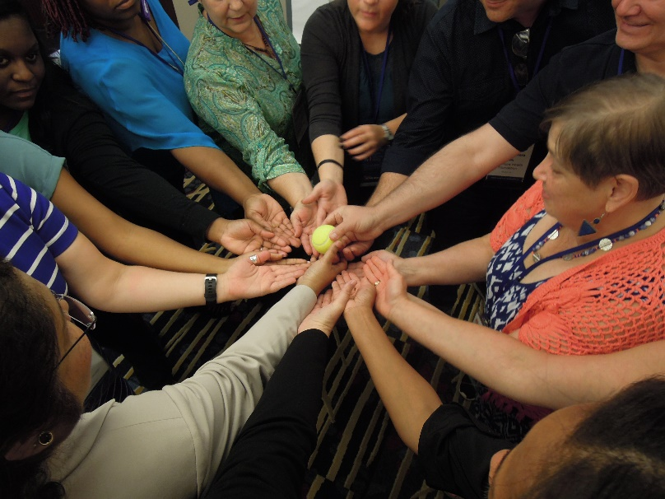
Module 10 – Day 2
8:00am – 8:20am (20 min)
Welcome to the TOT Program
Day 2

Slide 2

Garden

Slide 3
Agenda – Day 2
8:00
8:20
8:45
10:30
11:00
12:30
1:30
4:30
5:15
6:00
Welcome & Reflections
Using Flowcharts
Five Step Model for Creating Effective Training
Break
Performance Measurement
Box Lunch
Individual Training Design and Rehearsal
Experiential Learning: Paper Puppets
‘Aha Moments’ & Evaluation
Adjourn

Slide 4
Fears and Challenges Discussion

Slide 5

Module 10 – Day 2
8:10am – 8:20am (10 min)
TOT Handout-of-Handouts: Module 10
Study Groups

Slide 6

Study Groups

Slide 7
Study Group Exercise
Assignments – all within 10 min:
Come up with a name for your Study Group
Identify one informal leader
Take your calendars out and identify two dates you can meet virtually
  Within 30 days of the TOT session (Study Group Session 1)
  Between 60-90 days out (Study Group Session 1)

Slide 8
Module 11 – Day 2
8:20am – 8:45am (25 min)
Using Flowcharts Effectively

Slide 9





What Is the Value of Flowcharting?
Flowcharting can help a team determine…
“What is going on?”
“Do we even all agree on the current process”?
“Where are there delays?”
“What are the next steps?”
“How can we improve this process?”

Slide 10
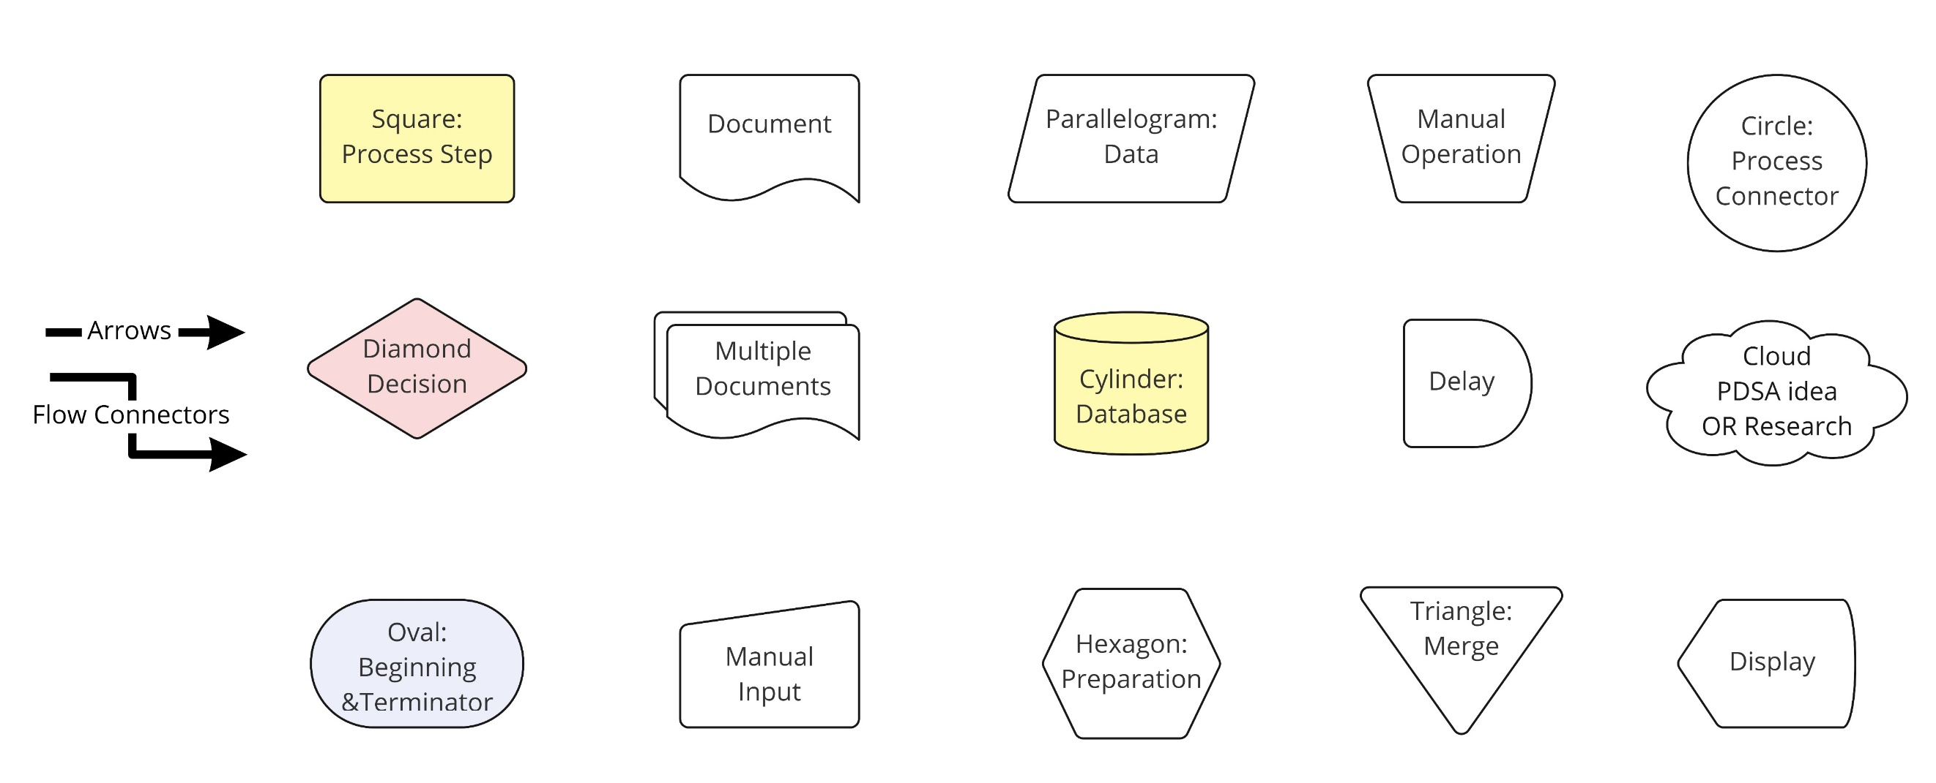
Commonly Used Flow Chart Symbols
Notes:
10
These symbols are in Microsoft Power Point

Slide 11
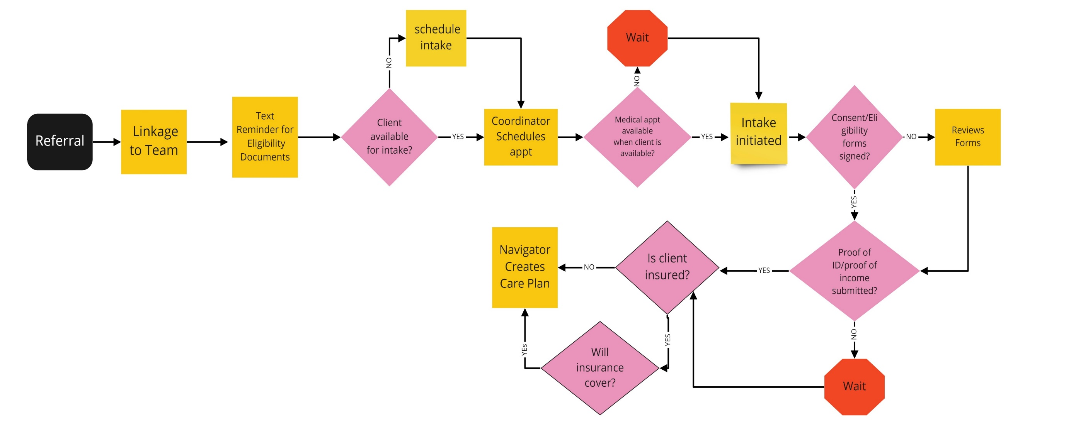
Intake Process for New HIV dx.

Slide 12
Check In
Scenario: a process starts with a primary care provider reviewing a prescription refill request, determining if the medication is for HIV or PrEP, updating the database, and ends with a prescription being sent. Which of the following is correct?

Slide 13
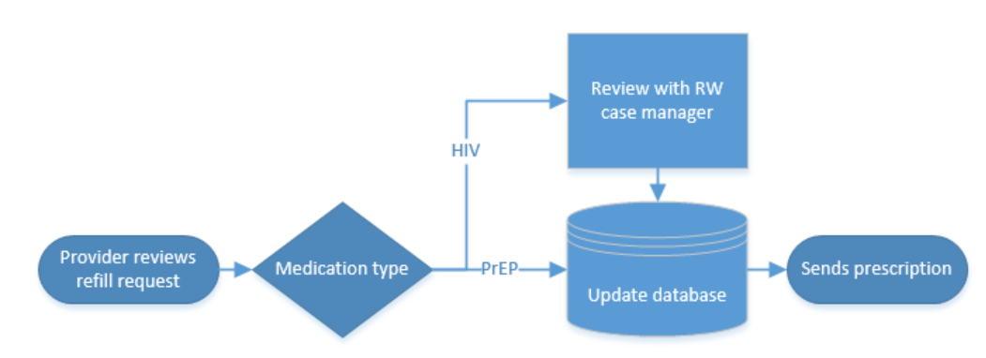
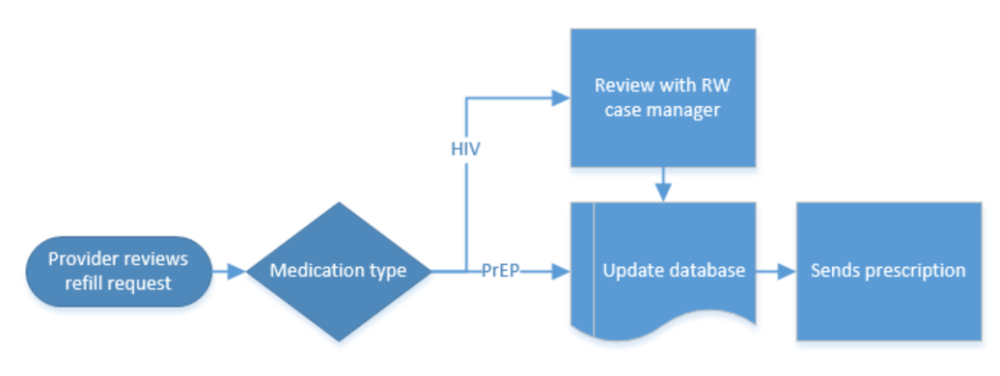
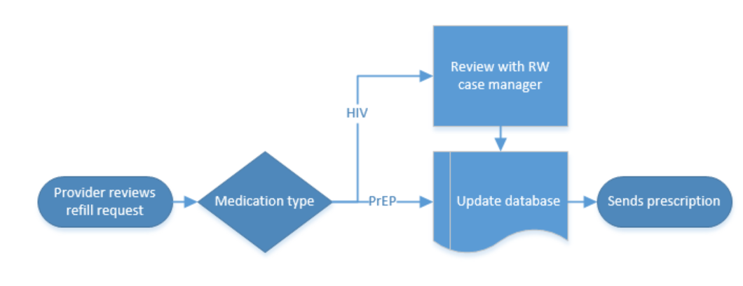
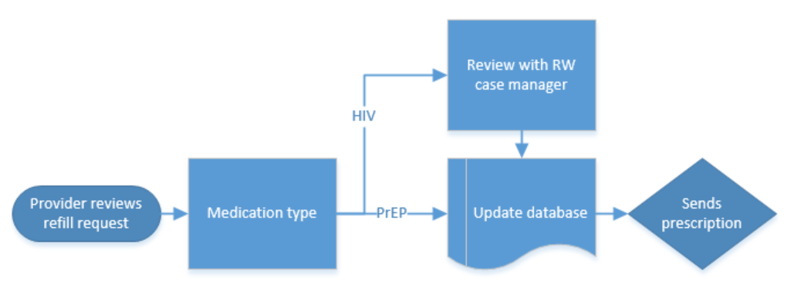
Check In
A)
B)
C)
D)

Slide 14
Tips for Flowcharting
Determine the start and end point first
Use multiple perspectives to gather the full picture
Brainstorm the various steps using a variety of perspectives
Use post-it notes (it is easier to move them around)
Once completed, get further feedback, i.e., frontline staff, patients
Be prepared that the group process can be frustrating task for some
Decide to map out processes you have vs you wish you had
Don’t jump to solutions but document the current process (provide opportunities for learning)

Slide 15
Exercise: Make the Best Pizza in the World
Instructions:
Decide on start and end point
Brainstorm all the steps in the process
Write a single step on a single post-it note
Arrange the post-it notes in order

Slide 16
Module 12 – Day 2
8:45am — 10:30am
TOT Handout-of-Handouts: Module 12
Five-Step Training Model

Slide 17
Adult Education
Development
Design
Delivery

Slide 18
Participant Assessment

Slide 19
Who Is in the Room Today?
By RWHAP Part
By Professional Title
By Proficiency

Slide 20
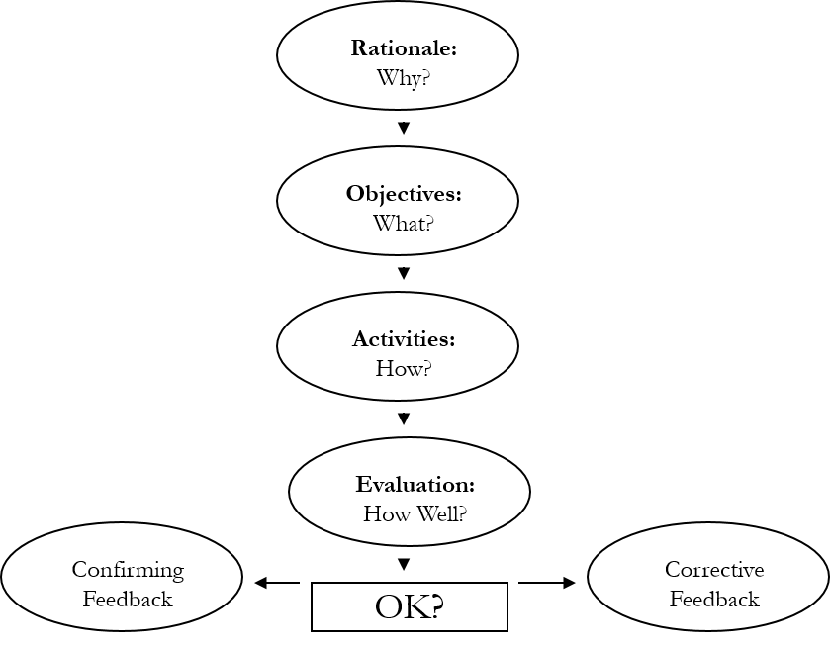
Five-Step Training Model
Using the Five-Step Model to design your training program will help your learners learn and grow to design and conduct effective trainings
Source: Telling Ain’t Training, ASTD, Harold Stolovitch, Erica Keeps, 2006
Notes:
Although those terms are very similar, they are used to describe different concepts.
The term ‘quality management program’ encompasses all grantee-specific quality activities, including the formal organizational quality infrastructure (e.g., committee structures with stakeholders, providers and consumer) and quality improvement related activities (performance measurement, QI project and QI training activities).
A quality management plan is a written document that outlines the grantee-wide quality management program, including a clear indication of responsibilities and accountability, performance measurement strategies and goals, and elaboration of processes for ongoing evaluation and assessment of the program.

Slide 21
Training Development Model:
Read and Discuss
Step 1: Topic & Rationale
Step 2: Performance Objectives
Step 3: Activities
Step 4: Evaluation
Step 5: Feedback
Notes:
The story is not a complicated one, but it has many parts.
First, we’ll take a short look at the history of the Ryan White Care Act, as that affects its approach to quality. Then we’ll see how the Act approaches the issue of quality and how the body that administers the Act, the Health Resources and Services Administration’s HIV/AIDS Bureau, defines quality for Ryan White Care Act grantees, and the components the Bureau wants to see in any quality program. Finally, we’ll talk about some of the Bureau’s activities around quality, and give you information to follow-up on activities that might interest you.

Slide 22

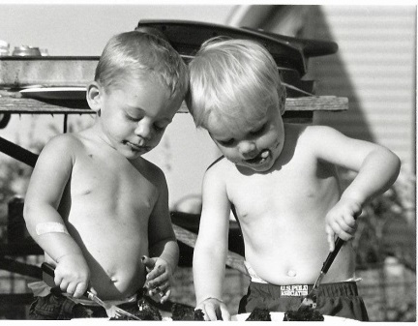
Case Study Activity
Step 1 - Individual (30 minutes)
  Hand Out: Five-Step Model sheets
  Option A
  Option B
Step 2 - Pair Share (20 minutes)
  Share completed handouts
  Get feedback from peer
    Makes sense
    Could improve

Slide 23
Training Development and Design Guide:
Session Plan
Session Title:
Target Audience:
Time Allotted:
Rationale:
Objectives:
Activities:
Evaluation:
Feedback:
Source: Telling Ain’t Training, ASTD, Harold Stolovitch, Erica Keeps, 2006
Notes:
Building on the Institute of Medicine’s work, HRSA/HAB has further clarified five critically important elements of any quality improvement program for health care and services to people with HIV and AIDS, especially those funded by the Ryan White Care Act.
First, organizations need a clearly defined system for managing quality. The system needs leadership support and dedicated resources, people should be held accountable for its proper operation, and it should focus on monitoring, assessing and improving the quality of the care and services provided.
In order to do this, you need numerical goals and data that allows you to measure your progress towards meeting these goals. Quality needs to be data-driven
Keep your focus on the overall aim: to meet client needs and expectations, and to provide evidence-based care and services. Learn from others. Aim to be effective and efficient.

Slide 24
Group Debrief
If and how did the template help you develop your training?
What type of feedback did you give? Receive?
What further thoughts do you have on your first “TOT Workshop” and your potential participants?
What questions or concerns do you have with this initial structure for developing training?

Slide 25
Evaluating Training Effectiveness

Slide 26
Framing Question
How and what do you measure?

Slide 27

Kirkpatrick Model
Reaction
Learning
Behavior
Results
Notes:
Talk about advantages and disadvantages of each level and difficulties

Slide 28
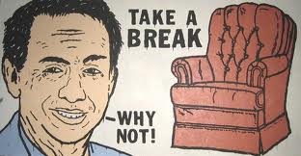
10:30am to 11:00am

Slide 29
Module 13 – Day 2
11:00am – 12:30pm (90 min)
TOT Handout-of-Handouts: Module 13
Performance Measurement:
Overview & Group Exercises

Slide 30
Learning Objectives
Discuss common language of improvement
Apply HIV/AIDS performance measures to identify areas for improvement in your CQM program
Find available resources around performance measurement and benchmarking in HIV care
Share with others lessons learned around performance measurement
Notes:
30

Slide 31
Remember PCN #15-02 Requirements
At least one measure is required for each funded service category with greater than 15% utilization
Two measures are required for “highly-utilized and highly prioritized” service categories

Slide 32
Overall Goal
The best care we know how to give,
for every patient,
at every site,
every day.

Slide 33
Improvement Language
Definitions, Paradigms, and Variation

Slide 34


Slide 35
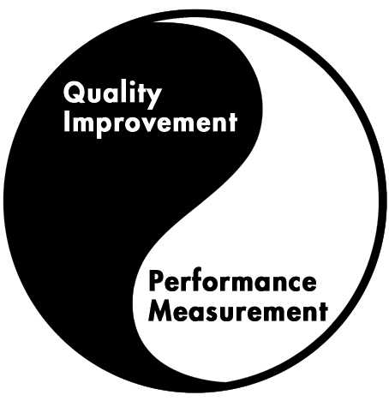
Balance Between Performance Measurement and Quality Improvement Activities
Notes:
Although we focused in this tutorial on how to select effective measures, the ultimate goal is to use performance data results to improve HIV care, balancing performance measurement and quality improvement. Be reminded that measuring the quality of HIV care alone is not quality improvement.

Slide 36
What Is a Quality Measure?
A quality measure is a tool to measure specific aspects of care and services that are optimally linked to better health outcomes while being consistent with current professional knowledge and meeting client needs.
Notes:
36
In Tutorial 2in the Quality Academy, we defined quality as “the degree to which health services for individuals and populations increase the likelihood of desired health outcomes and are consistent with current professional knowledge.”
An measure is a way of measuring whether care and services you provide as well as the activities you perform are linked to improved health outcomes for clients.
An measure takes one aspect of HIV care, and provides a way of assessing how often this specific aspect of care is properly provided.
By defining what “properly provided” means (this is where the “current professional knowledge” comes in), measures enable you to learn about the level of quality in the care your HIV program provides.

Slide 37
“An operational definition is one that is agreed upon for a given purpose.”
Percy Bridgeman (21 April 1882 – 20 August 1961) American physicist

Slide 38
What Makes a Sound Measure?
Accuracy
  Is the measure based on accepted guidelines or developed through formal group-decision making methods?
Improvability
  Can the performance rate associated with the measure realistically be improved given the limitations of your services and resources?
Notes:
The next two criteria are:
Accuracy. How valid is this measure? Does it really reflect “current professional knowledge?” Does it build on accepted guidelines for HIV care? If it deals with an aspect of care not yet covered by a guideline, has there been consensus by professionals and peers?
Improvability: the ultimate goal is to improve the quality of care. As you select measures, focus first on those that will help you improve.
If you answer "no" to any of these questions, the measure—while still relevant to patient care—is probably either too difficult to measure or less than critical to patient care. On the other hand, if you answer "yes" to all of the questions, you have most likely found a viable measure that will give you the most benefit for your measurement resources.

Slide 39
What Makes a Sound Measure?
Relevance
  Does the measure affect a lot of people or programs?
  Does the measure have a great impact on the programs or patients/clients in your EMA, State, network or clinic?
Measurability
  Can the measure realistically and efficiently be measured given finite resources?
Notes:
Clearly, the universe of things that can be measured is vast. How do we begin to select a manageable number of areas to track?
There are four main criteria to use in selecting sound measures. The first two are:
Relevance. Are you looking at something that matters to your program?
And measurability. Can you actually measure this aspect of care, given the resources you have?

Slide 40
Data in Health Care
Aspect | Improvement | Quality Assurance | Clinical Research
Aim: | Improvement of care in system where it is delivered | Comparison, public health, reassurance, spur for change, funding, choice | New knowledge
METHODS
Test observability | Test observable | No test, evaluate current performance | Test blinded
Bias | Accept consistent bias | Measure and adjust to reduce bias | Design to eliminate bias
Sample size | “Just enough” data, small sequential samples | 100% of available relevant data | “Just in case” data
Flexibility of hypothesis | Hypothesis is flexible, changes as learning takes places | No hypothesis | Fixed hypothesis
Testing Strategy | Sequential tests | No tests | One large test
Confidentiality of data | Data used only by those involved in improvement | Data available for public consumption or donors | Research subjects’ identities protected
ADAPTED BY NQC: Solberg “The Three Faces of Performance Measurement: Improvement, Accountability and Research.” Journal on Quality Improvement. V 23 1997.
Notes:
The challenge-how do we start to use accountability data for improvement?
Data for improvement, accountability and research are different
Go thru slide
We are focusing on harvesting learning from accountability data to help us with our improvement work

Slide 41
Data in Health Care
Aspect | Improvement | Quality Assurance | Clinical Research
Aim: | Improvement of care in system where it is delivered | Comparison, public health, reassurance, spur for change, funding, choice | New knowledge
METHODS
Participants | Teams of staff involved in processes being improved | Often through external auditor or supervisory visit; training on technical content | Dedicated research staff
Community Involvement | Ideal | Unusual | Under study
Information Systems | Whatever works: getting started is key | Reporting system designed to send data out | Separate detailed processes
ADAPTED BY NQC: Solberg “The Three Faces of Performance Measurement: Improvement, Accountability and Research.” Journal on Quality Improvement. V 23 1997.
Notes:
The challenge-how do we start to use accountability data for improvement?
Data for improvement, accountability and research are different
Go thru slide
We are focusing on harvesting learning from accountability data to help us with our improvement work

Slide 42
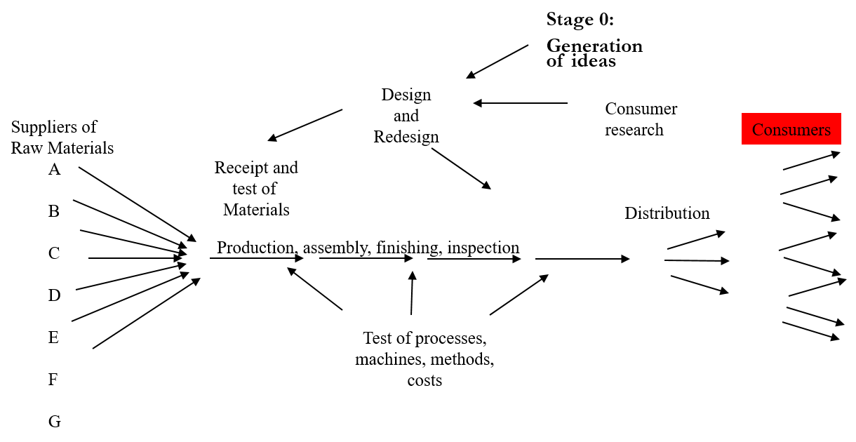
Deming’s View of Production as a System (1994)
Deming and Ackoff (1.46)

Slide 43
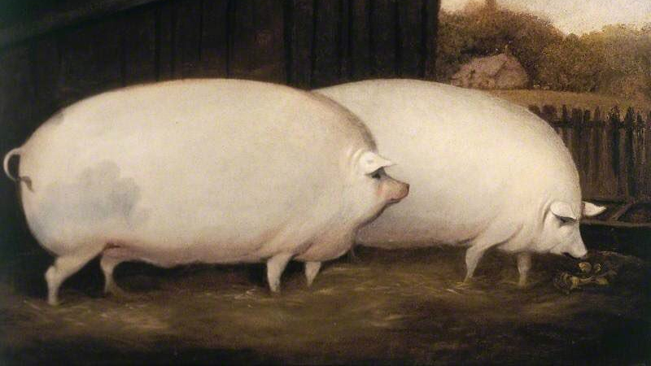
Standard Pig Simulation
Variation Exists...

Slide 44
Step 1: Get A Writing Instrument And A Piece Of Paper
Step 2: Draw A Picture Of A Pig
SORRY! …That’s not the pig the customers wants/needs
Let’s think about this in the “real world” - VOC
How Can We Make Sure We Get Right Thing Every Time?
Notes:
Read instructions – show

Slide 45
N
W
E
S
Notes:
We need to print these sheets for participants

Slide 46
This is our goal...How’d We Do?
1
4
8
12
10
7
5
11
13
9
6
2
3

Slide 47
Let’s Try Again!
Draw a capital M, so the tip of the middle V of the M touches the intersection of the grid lines in the NW quadrant
Draw a capital W, so the tip of the middle V of the W touches the intersection of the grid lines in the SW quadrant
Draw a capital W, so the tip of the middle V of the W touches the intersection of the grid lines in the SE quadrant
Go back to the M you drew in Step 1, and draw a slightly upwardly bowed line that runs from the most eastern point of the M, to the intersection of the grid lines in the NE quadrant.
Continue that line from the intersection of the grid lines in the NE quadrant to the most easterly point of the W that you constructed in the 3rd step.
Draw a downwardly bowed line from the most western point of the W in the SE quadrant, to the most easterly point of the W in the SW quadrant.
In the exact middle of the box between the NW quadrant and the SW quadrant, draw a circle the size of a dime.
Draw an inwardly bowed line from the most westerly point of the M created in Step 1, to the top of the circle you just drew in Step 7.
Draw an inwardly bowed line from the most westerly point of the W created in Step 2, to the bottom of the circle you drew in Step 7.
Draw a horizontal straight line about ½ inch in length starting from the middle of the line you created in Step 8.
Draw a horizontal straight line about 1/3 inch in length starting from the middle of the line you drew in step 9.
Draw a curly-cue about 1 inch in length starting at the upper third of the line you created in Step 5, extending in an easterly direction.
Put two dots in middle of the circle you drew in Step 7, arranged horizontally, and about ¼ of an inch apart.

Slide 48
An organization is made up of thousands of processes.

Slide 49
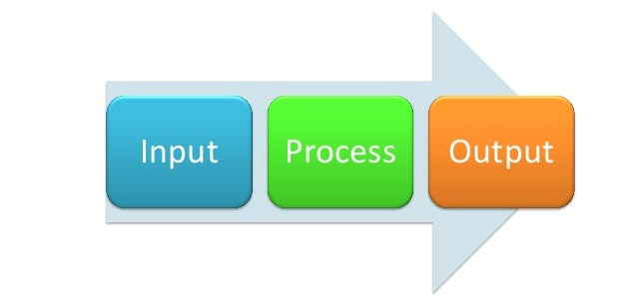
Transformation of the Inputs

Slide 50
Understanding Variation
In quality improvement, we are looking for changes in key measures
But all things vary naturally, there is always some element of randomness in complex service delivery systems with some much human interaction
We need to identify true change (signal) versus natural variation (noise)
We need to identify true change fast

Slide 51

Tools to Measure Variation
These are some of the classic, and basic tools for quality improvement
  Run Charts
  Pareto Diagram – Covered in Beg LL
  Funnel Charts
VARIANCE

Slide 52


Signal and Noise
Signal
Noise
vs.
Statistically significantly different from the dataset
Distinct, assignable cause
special cause variation
Statistically similar to the dataset
Gives no new information, seemingly random
common cause variation

Slide 53



Slide 55

Notes:
Harder to see signal and noise with highly variable processes

Slide 56


Acting on Variation Is Important
Mistakes!
Responding to noise as if it’s signal – overcorrecting or tampering with a process can actually make it worse
  This can happen in highly variable processes with excessive noise
Missing a signal – either there is problem that isn’t clear, or the positive impacts of interventions are missed due to variation
  Here wasteful processes make determining signal from noise tougher as well
Notes:
Over correction example: bread proofing with residual ovenheat.

Slide 57
Linkage to Care – QI Project
Justin's clinic had an AIM to improve linkage to care for newly diagnosed patients from 87% to 90% by January 2022
Was Justin successful in meeting that aim?
How quickly should Justin standardize the intervention?
Notes:
Yes, he was successful.
But shouldn't standardize the process

Slide 58
Variation: The Voice of the System

Slide 59
Practice 1
Cycle Time for Practices 1, 2 & 3:
Example:
The cycle time is the time it takes from the moment you walk into the facility till the time you see your provider
Practice 2
Practice 3
Notes:
59
Getting to see the DR -

Slide 60
Cycle Time for Practices 1, 2 & 3:
Notes:
60
Getting to see the DR -

Slide 61
Addressing Variation
Type of Variation
Course of Action
Method of Action
Change Ideas
Standardization
Special Cause
Reduce unexpected, assignable, glitches
Implementing improvements to resolve outliers
Training
New Interventions
New Resources
Common Cause
Reduce natural variance
Redesigning the system and shifting the mean
Changing Process
Culture Change
Notes:
Some common cause variation is to be expected – that shows a process is controlled, and responsive to random stimuli

Slide 62
Variation Speaks
Run Charts
Control Charts
A run chart, also known as a run-sequence plot is a graph that displays observed data in a time sequence.
No calculations required
Median
Run Chart Rules
  Shift
  Trend
  Astronomical point
Control charts, also known as Shewhart charts or process - behavior charts, in statistical process control are tools used to determine whether or not a manufacturing or business process is in a state of statistical control.
In 1935, the British Standards Institution, under the influence of Egon Pearson and against Shewhart's spirit, adopted control charts, replacing 3-sigma limits with limits based on percentiles of the normal distribution. This move continues to be represented by John Oakland and others but has been widely deprecated by writers in the Shewhart-Deming tradition.
Sophisticated calculations required
The IHI extranet description http://www.ihi.org

Slide 63
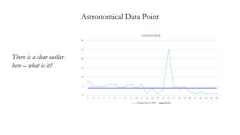
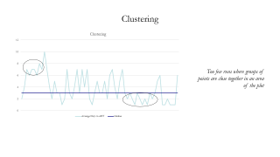
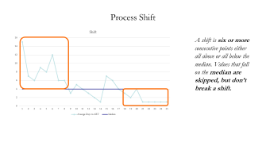
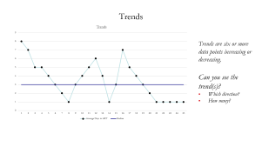

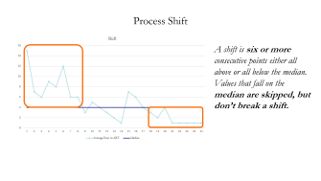
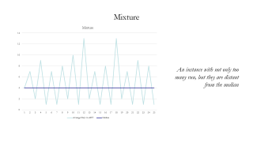
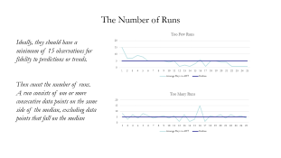

Determining Signal vs. Noise

Slide 64
Process Shift
A shift is six or more consecutive points either all above or all below the median. Values that fall on the median are skipped, but don’t break a shift.

Slide 65
The Number of Runs
Ideally, they should have a minimum of 15 observations for fidelity to predictions or trends.
Then count the number of runs. A run consists of one or more consecutive data points on the same side of the median, excluding data points that fall on the median
Notes:
This gets technical – there is a chart published by Swed and Eisenhart 1943

Slide 66
Mixture
An instance with not only too many run, but they are distant from the median

Slide 67
Clustering
Too few runs where groups of points are close together in an area of the plot

Slide 68
Trends
Trends are six or more data points increasing or decreasing.
Can you see the trend(s)?
Which direction?
How many?

Slide 69
Astronomical Data Point
There is a clear outlier here – what is it?

Slide 70
Remember our Model for Improvement?
Think about the processes that drive the outcome you desire to improve
Have a conversation at your table on how you might measure the processes
How might you hear how those processes are responding to your change efforts?

Slide 71
Got Data, Now What?
Using Data for Quality Improvement

Slide 72
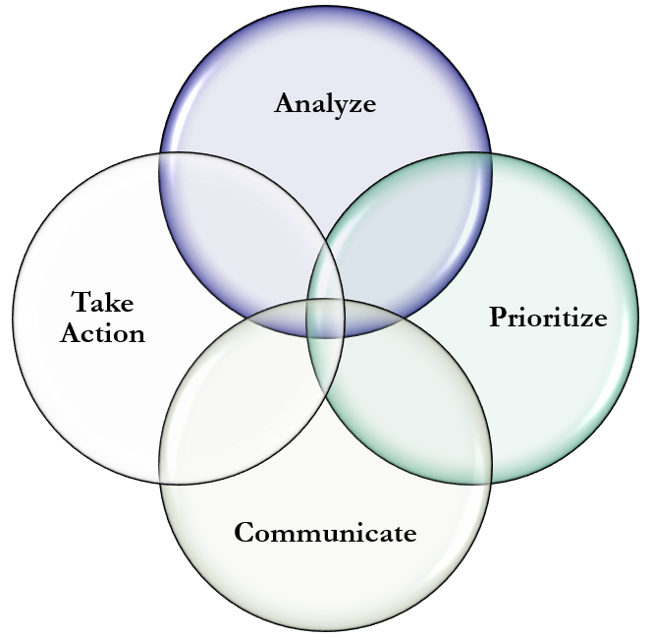
Got Data, Now What?
Next Steps: Linear
Iterative: Non-Linear
Analyze
Prioritize
Communicate
Take Action

Slide 73
Got Data, Now What?
Instructions
Iterative: Non-Linear
Small Group Work
At your tables, choose a facilitator—Ground Rule: all voices heard
Obtain date of data from the State of Euphoria (refer to your Handout-of-Handouts page 13)
Do the assignment
Large group debrief
  Tips and lessons
  Discussion on question

Slide 74
Got Data, Now What?
Assignment: Case Study
Iterative: Non-Linear
First, take a few minutes and individually reflect on the data from the State of Euphoria
After a few minutes begin a group discussion on the four steps and how you might apply them to the State of Euphoria data, take a few notes
From your discussion and your notes create together:
  A tip or key learning to share with the larger group regarding each step
  A question for the larger group on which you would like to have some input

Slide 75
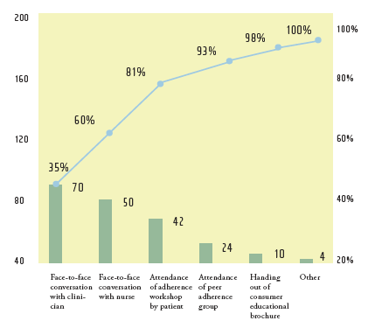
What Do the Data Tell You?
How bad is the problem?
  How many?
  How often?
  How severe?
Is the performance stable, or is there a trend?
  Getting better?
  Getting worse?
How does our performance compare to others’?
What are the data limitations?
Notes:
Data are a raw collection of factual information.
We need to look at the data, and see what these data can tell us about the nature of the problem, the extent of the problem, and whether the problem is getting better or worse.
Different types of graphs and charts can help us gather more information from the data.

Slide 76
Sharing Data
Involve stakeholders when reports are generated and disseminated
Share reports with staff promptly & listen to variance explanations
View performance improvement as a management tool (data are a guide, not a grade…)
Anticipate push-back
Watch out for paralysis by analysis (“we need even better data before we act”)
Notes:
Its not always easy to create data ownership, so here are some tips that will help you.
Involve stakeholders in the process when reports are generated and disseminated. People will be more inclined to take ownership if they feel as though they helped in the process.
Share reports with staff promptly & listen to variance explanations
View Performance Improvement as a management tool. Do not use results for punishment and include outcomes achieved when evaluating staff.
People have a tendency to defend their turf, so communicate data results objectively to avoid defensiveness.
Remember, our goal is to take action on the data to improve, so keep everyone focused on the required action and don’t over analyze the data.

Slide 77

Change Hats
Any thoughts on how you might use this session moving forward?

Slide 78
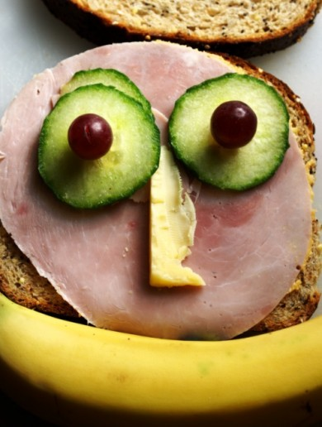
Lunch
12:30pm – 1:30pm

Slide 79
Module 14 – Day 2
1:30pm – 4:30pm (180 min)
TOT Handout-of-Handouts: Module 14
Individual Training Design and Rehearsal

Slide 80
Learning Objectives
Create a high-level training outline, following the Five-Step Training Model
Use a detailed Day-At-A-Glance form to structure a QI training workshop
Practice using a Faculty Notes Form to structure one or more training modules within a workshop
(Tomorrow) Improve the effectiveness of your planned training through practice and feedback

Slide 81
Putting It All Together
This module is designed in six parts over two days:
Step 1: Form small groups and assign roles and responsibilities for the mini-trainings
Step 2: Break out and individually develop your training outline, day at a glance
Step 3: Meet as a small group to either adapt available slides or make your own training slides
Step 4: Rehearse within small groups
Step 5: Large group debrief
Step 6: Each small group delivers mini-trainings tomorrow

Slide 82
Putting It All Together
Use the forms provided in the Handout-of-Handouts to develop your module(s):
  Use the Five-Step Training Model (Module 12) to get clear on the big picture
  Get more detailed using the Faculty Notes Form
  If you will be planning a multi-module training lasting more than 4 hours, you may explore and practice using the Day-At-A-Glance form
  Have finalized slides for a training on one QI topic to be delivered tomorrow (~15 minutes)

Slide 83

Ready, Set, Go!

Slide 84

20 minutes
left!

Slide 85
Large Group Discussion
What are the challenges in designing your training?
How do the forms support your design work?
What 1-2 things have you learned from this module?
What other challenges do you foresee at this stage?
What additional support or practice do you need after these modules?
Notes:
You have no doubt heard about the Ryan White Comprehensive AIDS Resources Emergency – or CARE – act. How big do you think it’s impact has been? Select what you think is the best answer.

Slide 86


Module 15 - Day 2
4:30 – 5:15 (45 min)
TOT Handout-of-Handouts: Module 15
Paper Puppets
http://nationalqualitycenter.org/resources/nqc-game-guide-interactive-exercises-for-trainers-to-teach-quality-improvement-in-hiv-care-pdf/

Slide 87
Module Overview
Teams of 6 participants (5 workers and one timekeeper)
Instructions on how to construct one paper puppet
First round – each team produces as many paper puppets as possible
Short group discussion
Second round – teams produces puppets within specific time period, facilitator performs quality inspection
Short group discussion

Slide 88
How to Construct a Paper Puppet - Step 1
Step 1: Create a perfect square of paper by folding the top left corner of a standard sheet of paper diagonally to the opposite side of the paper. Cut the excess strip off the bottom.

Slide 89

How to Construct a Paper Puppet - Step 2
Step 2: Open the paper back to its square shape and refold the paper on the other diagonal so that you have two crease marks running from corner to corner. Open up the paper.

Slide 90
How to Construct a Paper Puppet - Step 3
Step 3: Grab a corner of the square and fold it to the center of the paper. Repeat for each corner until you have a smaller square of paper with four flaps.

Slide 91

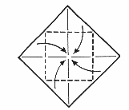
How to Construct a Paper Puppet - Step 4
Step 4: Turn the paper over and again fold each corner into the middle to create an even smaller square with four flaps.

Slide 92
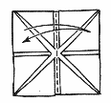

How to Construct a Paper Puppet - Step 5
Step 5: Turn the paper over again so that the four-square flaps are facing up. Fold the paper in half horizontally and unfold. Fold the paper in half vertically and unfold.

Slide 93
How to Construct a Paper Puppet - Step 6
Step 6: To open, use your index finger and thumb of your right hand under the square flaps on the right side. Do the same for the left side. Slowly bring your fingers together and the fortune teller will open.

Slide 94
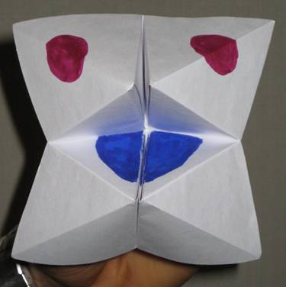
How to Construct a Paper Puppet - Step 7
Step 7: Draw two red eyes and a blue tongue to finish your paper puppet.

Slide 95
First Round
Objective: Each team has to produce as many paper puppets as possible within 3 minutes
Each of the 5 team members assumes one role in the production of the paper puppet
Timekeeper tracks time when each paper puppet is produced
Timekeeper also assumes the role of the quality officer (reject paper puppet if not satisfactory)
Record time on flipchart paper

Slide 96
Role for Each Team Member
Worker 1: Fold the bottom of a piece of 8 1⁄2 x 11 paper to align with the right side to define a square
Worker 2: Cut off the excess paper with a scissors, fold the second diagonal of the square, then fold each corner in to the center of the square to form a smaller square
Worker 3: Turn around and again fold each corner of square inward toward the center to form a still smaller square
Worker 4: Flip the small square over and draws a pair of eyes, one eye on each of 2 neighboring squares with a black marker
Worker 5: Flip the square over again and draw in the tongue with the red marker

Slide 97
Group Debrief
What works well? Which step seemed be the bottleneck?
Why did the team perform in the way they did?
What factors would have contributed to a higher ‘throughput’?

Slide 98
Second Round – Competitive Round
Objective: each team has to produce as many paper puppets as possible within 3 minutes
Rules:
  Each member has to assume a role in producing each paper puppet
  Each paper puppet has to meet the requirements of the quality officer
Timekeeper tracks time when each paper puppet is produced; record time on flipchart paper
The session facilitator will act as the central quality officer and can reject paper puppet if not satisfactory; need to redo unsatisfactory puppets
Be creative!

Slide 99
Debriefing
What are the lessons learned from this game?
  One step in a process affects another – improvement comes from advancing each step in the process
  To change one step does not necessarily make a substantial change to the entire system – to improve HIV care, the system of HIV care needs to be changed
  Team members contribute suggestions for change – embrace the diversity of opinions
  Team support is needed to assist the process – leaders need to support improvements, not resist change
What are the implications for your HIV program?

Slide 100
Module 16 – Day 2
5:30pm – 6:00pm (30 min)
TOT Handout-of-Handouts: Module 16
Aha! Moments & Evaluation

Slide 101
Module Agenda
Personal Highlights or Aha! Moments
Polling Survey
Went Well / Do Differently

Slide 102
Highlights & Aha! Moments
What have been some of your personal highlights or Aha! Moments from today’s session?
Use the next 2 minutes to reflect on today, identify a few ideas

Slide 103
Poll

Slide 104
The way the course was delivered today was an effective way for me to learn.
Strongly Disagree
Somewhat Disagree
Agree
Somewhat Agree
Strongly Agree

Slide 105
I had sufficient opportunity to participate today.
Strongly Disagree
Somewhat Disagree
Agree
Somewhat Agree
Strongly Agree

Slide 106
Materials were useful during the day.
Strongly Disagree
Somewhat Disagree
Agree
Somewhat Agree
Strongly Agree

Slide 107
The agenda and content for today was logically organized.
Strongly Disagree
Somewhat Disagree
Agree
Somewhat Agree
Strongly Agree

Slide 108
Overall, I was satisfied with the session facilitator(s).
Strongly Disagree
Somewhat Disagree
Agree
Somewhat Agree
Strongly Agree

Slide 109
My knowledge and/or skills increased as a result of today.
Strongly Disagree
Somewhat Disagree
Agree
Somewhat Agree
Strongly Agree

Slide 110
The workshop had the right balance of lectures and interactive activities.
Strongly Disagree
Somewhat Disagree
Agree
Somewhat Agree
Strongly Agree

Slide 111
How ready are you to plan and facilitate a QI workshop?
Not Ready
Mostly Not Ready
Ready
Mostly Ready
Very Ready

Slide 112
Additional Comments about Today
What worked well today for you?
What should we do differently tomorrow?

Slide 113
Study Groups

Slide 114
Assignments
Today
Ensure that you have identified the two dates you can meet virtually
  Within 30 days of the TOT session (Study Group Session 1)
  Between 60-90 days out (Study Group Session 2)
Identify how you will meet
  Video – call our office with date/time and we set up a Zoom
  Conference line – do you need a no-cost reservation less conference calling service: www.freeconferencecall.com

Slide 115

Breakfast 7:00AM and Session Start at 8:00AM

Slide 116

Contact Information
Coaches
Justin Britanik, CQII Coach, justin@cqii.com
Khalil Hassam, CQII Coach, Khalil@cqii.com
Learn More
212-417-4730 (phone)
212-417-4684 (fax)
Info@CQII.org
This project is supported by the Health Resources and Services Administration (HRSA) of the U.S. Department of Health and Human Services (HHS) as part of an award totaling $1.5M. The contents are those of the author(s) and do not necessarily represent the official views of, nor an endorsement, by HRSA, HHS or the U.S. Government.

