Slide 1

Curriculum:
Implementing Oral Health Care into HIV Primary Care Settings
U.S. Department of Health and Human Services
Health Resources and Services Administration
HIV/AIDS Bureau
Special Projects of National Significance
October 2013

Slide 2
Directory
Please click on the links below to be directed to the appropriate module.
MODULES
Treating the Whole Patient: The Role of Oral Health in Total Patient Care of PLWHA
Barriers to Oral Health Care in PLWHA
Organizational Models Studied in the SPNS Oral Health Initiative
Glossary of Oral Health Terminology
Clinical Guide to Integrating Oral Health Care in the Medical Setting
Oral Health Care in PLWHA: Know the Facts
Dental Case Management
Provider-Patient Oral Health Education
Peer-Patient Oral Health Education
Taking the First Steps: Building Organizational Capacity for Oral Health Care

Slide 3
MODULE 1:
Session Length: 30 minutes
Materials Needed:
  Computer and compatible LCD projector to play the PowerPoint presentation
  Paper and easel(s) for taking notes
  Colorful markers
  Tape for affixing paper to the wall as necessary
  If desired, hardcopies of the Module 1 PowerPoint slides may be used as a handout to distribute and have participants follow along.
The Importance of Oral Health Care for Total Patient Health

Slide 4

Importance of Oral Health Care in Treatment of PLWHA
“You don’t want a healthy neck-down body.
You want a healthy top of the head to the tip of the toe body.”
- Dr. Howell Strauss, Executive Director of AIDS Care Group of Chester, Pennsylvania, a SPNS Oral Health Initiative grantee
  This module on “The Importance of Oral Health in Total Patient Care” was adapted, in part, from a presentation prepared by Stephen N. Abel, DDS, MS, for the AETC National Resource Center, and available on the AETC Web site at www.aidsetc.com/aidsetc?page=etres-display&resource=etres-542.

Slide 5
Oral Health and Systemic Health
Poor Oral Health
Diabetes
Pulmonary Disease
Stroke
Cardio-vascular Disease
Poor Pregnancy Outcomes
Osteopor-
osis
Poor medication adherence
Difficulty chewing and swallowing
Notes:
Emerging research indicates some links between oral health and systemic diseases.
Recent reports have shown associations between poor oral health—mainly periodontal disease and tooth loss—and increased risk of cardiovascular disease, stroke, pulmonary disease, diabetes, poor pregnancy outcomes, and osteoporosis.
Poor oral health can make it difficult to chew or swallow and can impede food intake, appetite, and nutrition, leading to poor absorption of HIV medications and leaving PLWHA susceptible to progression of their disease. Poor oral health can also interfere with medication adherence.
Oral signs suspected to be indications of systemic illness might be confirmed by the presence of rash, fever, headache, malaise, enlarged lymph nodes, or lesions.
Because there can be a large overlap in the clinical appearance of oral/facial manifestations of various diseases with different etiologies, an accurate diagnosis may require other diagnostic testing.
More will be explored in Module 5, “Oral Health Examination in the Medical Setting.”

Slide 6
The Impact of Xerostomia or
“Dry Mouth”
Causes
Effects
Negative effect on dietary habits, nutritional status, speech, and taste
Treatments
Saliva substitutes
Side effect of many medications
Less tolerance to dental prosthesis
Increased susceptibility to dental and candida infection.
Symptom of cancer therapy, autoimmune disorders, or HIV-associated salivary gland disease.
Salivary stimulants
Drinking plenty of water.
Notes:
The Impact of Xerostomia or “Dry Mouth”
Xerostomia, also known as “dry mouth,” is not a disease itself, but can be a symptom of certain diseases and a side effect of many medications.
Xerostomia can produce serious negative effects on patients’ quality of life—affecting dietary habits, nutritional status, speech, taste, and tolerance to dental prosthesis—and increases susceptibility to dental and candida infection.
Common causes for xerostomia include many medications, cancer therapy, autoimmune disorders, or HIV-associated salivary gland disease.
Saliva substitutes, salivary stimulants, and drinking water regularly have all been found to be effective in the management of xerostomia.

Slide 7
More than the Mouth: Oral Health’s Impact on Quality of Life
“When you’ve got bad teeth, you’re confined.” SPNS Grantee Patient at Special Health Resources of Texas, about the psychosocial impact of poor oral health, which can cause embarrassment and inhibit social activity for PLWHA.
Poor Oral Health = Poor Quality of Life
Low Self-Esteem
Chronic Pain
Caused by concerns over facial appearance and bad odor caused by mouth disease
Limits social contact
Limits career opportunities.
Causes sleep problems
Can have isolating and depressing effects.
Nutritional Challenges
Can profoundly affect appetite and the ability to eat
PLWHA with impaired oral health often prefer soft, easily chewed foods that may be lower in fiber and nutrient density.
Notes:
More than the Mouth: Oral Health’s Impact on Quality of Life
[PATIENT TESTIMONIAL]: “When you’ve got bad teeth, you’re confined.”
--SPNS Grantee Patient at Special Health Resources of Texas, about the psychosocial impact of poor oral health, which can cause embarrassment and inhibit social activity for PLWHA.
Poor oral health in PLWHA can adversely affect quality of life, lower self-esteem, and limit career opportunities and social contact as result of facial appearance and odor.
Oral dysfunction can seriously affect nutritional status because it can profoundly affect appetite and the ability to eat. For example, people with impaired oral health often prefer soft, easily chewed foods that may be lower in fiber and nutrient density.
Sleep problems associated with oral conditions appear to be most closely related to chronic pain, either directly or indirectly in cases where pain and insomnia are exacerbated by depression.
Oral health problems can lead to avoiding social contact as a result of concerns over facial appearance and bad odor caused by mouth disease.
Persistent pain has similar isolating and depressing effects.

Slide 8
Oral Health and Drug-Regimen Compliance
Many HIV medications have oral side effects such as xerostomia.
Predisposes PLWHA to dental decay, periodontal disease, and fungal infections.
Poor Adherence
This is due, in part, to the associated psychological effect of depression or pain when swallowing.
Negative Side Effects of HIV Medications
Patients who experience oral pain or xerostomia are less likely to strictly adhere to their HIV drug regimen.
Patient Self-Medication
Patients may even resort to self-medication to reduce the pain of oral disease and symptoms.
This can include the use of illicit drugs and highly addictive opiates.
Notes:
Oral Health and Drug-Regimen Compliance
Many HIV medications have oral side effects such as xerostomia, which predisposes PLWHA to dental decay, periodontal disease, and fungal infections.
Anecdotal reports suggest that patients who experience oral pain or xerostomia are less likely to strictly adhere to their HIV drug regimen, in part due to the associated psychological effect of depression or pain when swallowing.
In some cases, patients may even resort to self-medication to reduce the pain of oral disease and symptoms, including the use of illicit drugs and highly addictive opiates.
Before moving on to the next slide, ask the class the following discussion questions:
Have you seen any of these problems in the PLWHA served by our clinic?
Which of these problems are most prevalent among the populations we serve?

Slide 9

Oral Health Care as a Gateway to HIV Diagnosis and Treatment
Oral health professionals can help in early diagnosis of HIV infection and referral to care. Oral lesions can be the first overt clinical features of HIV infection.
Early detection can improve prognosis and reduce transmission.
Treatable conditions (e.g., gingivitis or early periodontitis) can become serious quickly if the immune system is weak.
Bacterial infections (i.e., dental decay and periodontal disease) that begin in the mouth can escalate to systemic infections and further stress the immune system and other organs in PLWHA if not treated promptly.
Notes:
Oral Health Care as a Gateway to HIV Diagnosis and Treatment
Oral health professionals can help in early diagnosis of HIV infection and referral to care, as oral lesions can be the first overt clinical features of HIV infection.
Early detection can improve prognosis and reduce transmission, because infected PLWHA may not know their HIV status.
PLWHA may find that treatable conditions such as gingivitis or early periodontitis can become serious quickly if the immune system is weak. Bacterial infections (i.e., dental decay and periodontal disease) that begin in the mouth can escalate to systemic infections and further stress the immune system and other organs in PLWHA if not treated promptly.

Slide 10
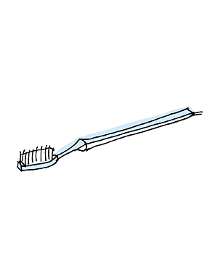
Minimum Recommendations for Oral Health Care
  Providers should discuss minimum oral health care with patients to reduce occurrence and escalation of treatable conditions.
  ANNUAL CARE
    Annual dental examination and teeth cleaning twice per year if possible.
  DAILY/AS-NEEDED CARE
    Brushing 2 times per day with a fluoride toothpaste and a soft toothbrush
    Replacing toothbrush every 2 months
    Flossing daily (gently, taking into account low platelet counts)
    Using a nonalcohol mouthwash
    Avoiding constant snacking
    Avoiding tobacco products and alcohol
    Moisturizing/lubricating lips and mucus membranes when needed
Notes:
Minimum Recommendations for Oral Health Care
Providers should discuss minimum oral health care with patients to reduce occurrence and escalation of treatable conditions.
ANNUAL CARE
Annual dental examination and teeth cleaning twice per year if possible.
DAILY/AS NEEDED CARE
Brushing 2 times per day with a fluoride toothpaste and a soft toothbrush
Replacing toothbrush every 2 months
Flossing daily (gently, taking into account low platelet counts)
Using a non-alcohol mouthwash
Avoiding constant snacking
Avoiding tobacco products and alcohol
Moisturizing/lubricating lips and mucus membranes when needed

Slide 11
MODULE 2:
Session Length: 35-45 minutes
Summary
  The primary objective of this module is to increase understanding of common barriers to oral health care encountered by PLWHA, as well as to improve understanding of the important intersection of oral health and HIV disease.
Materials Needed:
  A computer and compatible LCD projector to play the PowerPoint presentation.
  Colorful markers
  Paper and easel(s), whiteboard, or other means of taking notes
Barriers to Oral Health Care for PLWHA

Slide 12
Oral Health is a Major Unmet Need in PLWHA
PLWHA are more likely to have an unmet need for oral health care than for medical care.
58–64% of PLWHA do not receive regular dental care, according to various studies.
32–46% of PLWHA will have at least one major HIV-related oral health problem (e.g., bacterial, viral, and fungal infections as well as cancer and ulcers) in the course of their disease.
Source: Marcus M, Maida CA, Coulter ID, et al. A longitudinal analysis of unmet need for oral treatment in a national sample of medical HIV patients. Am J Public Health. Jan 2005;95(1):73–75.
Notes:
Oral Health Care is a Major Unmet Need in PLWHA
PLWHA are more likely to have an unmet need for oral health care than for medical care. Fifty-eight to 64 percent of PLWHA do not receive regular dental care, according to various studies.
Between 32 and 46 percent of PLWHA will have at least one major HIV-related oral health problem (e.g., bacterial, viral, and fungal infections as well as cancer and ulcers) in the course of their disease.

Slide 13

Barriers to Oral Health Care for PLWHA
  Many barriers to oral health care for PLWHA are the
  same barriers they face to HIV medical care.
    Financial concerns are the primary barrier to care
      Absence of dental insurance, insufficient insurance coverage, inability to pay out-of-pocket for care, etc. ^{1, 2}
      Dental insurance is not as common in private sector as medical insurance.
        The number of adults without dental insurance coverage is 3 times the number of adults without health insurance coverage.
¹ Marcus M, Maida CA, Coulter ID, et al. A longitudinal analysis of unmet need for oral treatment in a national sample of medical HIV patients. Am J Public Health. Jan 2005;95(1):73–75.
² Heslin KC, Cunningham WE, Marcus M, et al. A comparison of unmet needs for dental and medical care among persons with HIV infection receiving care in the United States. J Public Health Dent. Winter 2011;61(1):14–21.
³ Henry J. Kaiser Family Foundation. Oral health in the U.S. [PowerPoint slides]. June 19, 2012. Available at: http://kaiserfamilyfoundation.files.wordpress.com/2013/01/061912slides.pdf.
Notes:
SLIDE 2-5: Barriers to Oral Health Care for PLWHA
Many of the same barriers to oral health care for PLWHA are the same barriers that prevent them from engaging and staying in HIV medical care.
Financial concerns are the primary barrier to care: absence of dental insurance, insufficient insurance coverage, inability to pay out-of-pocket for care, etc.. ^{1, 2}
Dental insurance is not as common in private sector as medical insurance. The number of adults without dental coverage is three times as large as the number of adults without health insurance coverage.³

Slide 14

Barriers to Oral Health Care for PLWHA, continued
    Lack of transportation for patients to attend appointments
      Particularly challenging in areas with a scarcity of oral health professionals.
    Stigma can occur when trying to find a culturally competent dentist who understands the needs of PLWHA and their concerns about confidentiality.
    Lack of oral health professionals trained and willing to treat PLWHA is a problematic, systemic barrier to care.
Notes:
Lack of transportation for patients to attend appointments is a closely related concern, and can be particularly challenging in areas with a scarcity of oral health professionals.
Stigma can occur when trying to find a culturally competent dentist who understands the needs of PLWHA and their concerns about confidentiality.
Lack of oral health professionals trained and willing to treat PLWHA is a problematic, systemic barrier to care.

Slide 15

Barriers to Oral Health Care for PLWHA, continued
    Patient fear of and discomfort with dentists remains another significant deterrent to dental care for PLWHA, as with the rest of the population.
    Low health literacy and lack of education of the importance of oral health naturally reduces the likelihood that PLWHA will present for oral health care.
    Lack of self-efficacy navigating the health care system can make seeking oral health care a confusing, difficult, and expensive ordeal for PLWHA.
Notes:
Patient fear of and discomfort with dentists remains another significant deterrent to dental care for PLWHA, as with the rest of the population.
Low health literacy and lack of education of the importance of oral health naturally reduces the likelihood that PLWHA with present for oral health care.
Lack of self-efficacy navigating the health care system can make seeking oral health care a confusing, difficult, and expensive ordeal for PLWHA.
After reading through this slide, the trainer should lead the class in discussing the following questions:
Do the statistics given about the prevalence of oral health disease in PLWHA surprise you?
Did you find any of the barriers to care surprising?
What barriers do you think are missing? Why?
Would anyone like to share their experiences in helping PLWHA overcome some of these barriers to care? What did you do? What worked and what didn’t work?

Slide 16
MODULE 3:
Session Length: 60 minutes
Materials Needed:
  Computer and compatible LCD projector to play the PowerPoint presentation
  Internet connection to access the module video
  Copies of the handout referenced in this module should be printed out and distributed to each person.
Organizational Models Studied in the SPNS Oral Health Initiative

Slide 17

Background of the SPNS Innovations in Oral Health Care Initiative
15 demonstration sites across the country
  Ran from 2006–2011
Provided oral health care to underserved HIV-positive individuals in 12 States and one U.S. Territory
Oral Health Initiative information on SPNS site: http://hab.hrsa.gov/abouthab/special/oralhealth.html
Evaluation Center on HIV and Oral Health (ECHO) led by Boston University School of Public Health: http://echo.hdwg.org/.
Notes:
Background of the SPNS Innovations in Oral Health Care Initiative
Sponsored demonstration projects at 15 sites across the country.
Provided oral health care to underserved HIV-positive individuals in 12 States and one U.S. Territory
Ran from 2006-2011
Oral Health Initiative information on SPNS site: http://hab.hrsa.gov/abouthab/special/oralhealth.html
The Health and Disability Working Group at the Boston University School of Public Health was chosen to lead the multisite evaluation, which occurred under the project Evaluation Center on HIV and Oral Health (ECHO). The initiative evaluation center Website can be accessed at: http://echo.hdwg.org/.

Slide 18
Objective of the SPNS Oral Health Initiative and Medical Care Outcomes
Overall Objective: Expand access to comprehensive oral health care provided in accordance with professional standards to improve oral health outcomes of PLWHA.
Other Important Objectives:
  Integrating medical and dental care
  Sustaining programs beyond the life of the grant.
Initiative Outcomes:
  2,500 PLWHA who had been out of oral health care for 1 year or more were served
  14,500 visits occurred
  26,000 dental procedures performed.
Notes:
Objective of the SPNS Oral Health Initiative and Medical Care Outcomes
The overall goal of the initiative was to expand access to comprehensive oral health care provided in accordance with professional standards to improve oral health outcomes of PLWHA.
Other important objectives of the SPNS Oral Health Initiative included integrating medical and dental care and sustaining programs beyond the life of the grant.
Initiative Outcomes
2,500 PLWHA who had been out of oral health care for 1 year or more were served
14,500 visits occurred
26,000 dental procedures performed

Slide 19
Patient Testimonial to the Benefits of SPNS Oral Health Care
    “[Oral health care has] definitely helped me. Because when [the Harbor Health dental staff] did the top teeth, I guess I had an infection in there probably for about a year and a half. So, my T cells once this was all done jumped 100 points. So yeah, and I feel a lot better. Now that I don’t have any pain, I’ve been in pain for like, I don’t know 8 years. I was used to it, you know.”
    – SPNS Grantee Patient at Harbor Health in Provincetown, Massachusetts
Notes:
Patient Testimonial:
“[Oral health care has] definitely helped me. Because when [the dental staff] did the top teeth, I guess I had an infection in there probably for about a year and a half. So, my T cells once this was all done jumped 100 points. So yeah, and I feel a lot better. Now that I don’t have any pain, I’ve been in pain for like, I don’t know 8 years. I was used to it, you know.”
– SPNS Grantee Patient at Harbor Health in Provincetown, Massachusetts

Slide 20

Changing Lives Through Good Oral Health Video
Post-Video Discussion Questions
  What was your overall impression of the video?
  Is there anything you learned about the impact of oral health on PLWHA that you did not know before watching this video?
Video:
http://vimeo.com/13917365
Notes:
1. Watch video, “Changing Lives Through Good Oral Health”: http://vimeo.com/13917365
2. After the video, the trainer should lead group in discussion of reactions to the video.
What was your overall impression of the video?
Is there anything you learned about the impact of oral health on PLWHA that you did not know before watching this video?

Slide 21
Organizational Models Studied
Six organizational models used:
  Increasing services at their existing clinics
  Building satellite clinics
  Collaborating with clinics in dental hygiene schools or community colleges
  Fee-for-service dental reimbursement with contracted providers
  Leasing space at existing private offices/clinics, and
  Purchasing mobile dental units.
Each demonstration site had to determine:
  Which organizational model(s) they would use
  How they would recruit and train clinical staff
  How they would recruit and retain patients into care.
Notes:
Organizational Models Studied
Each demonstration site had to determine which organizational model(s) they would use, how they would recruit and train clinical staff, and how they would recruit and retain patients into care.
Six organizational models were used across the sites (many utilized various combinations):
Increasing services at their existing clinics
Building satellite clinics
Collaborating with clinics in dental hygiene schools or community colleges
Fee-for-service dental reimbursement with contracted providers
Leasing space at existing private offices/clinics, and
Purchasing mobile dental units.

Slide 22
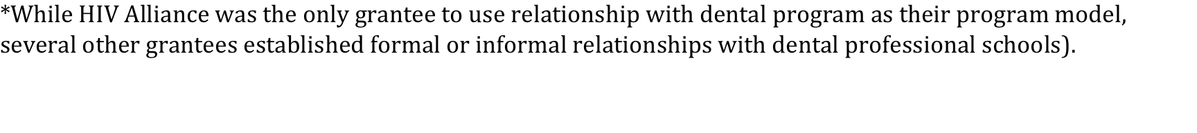
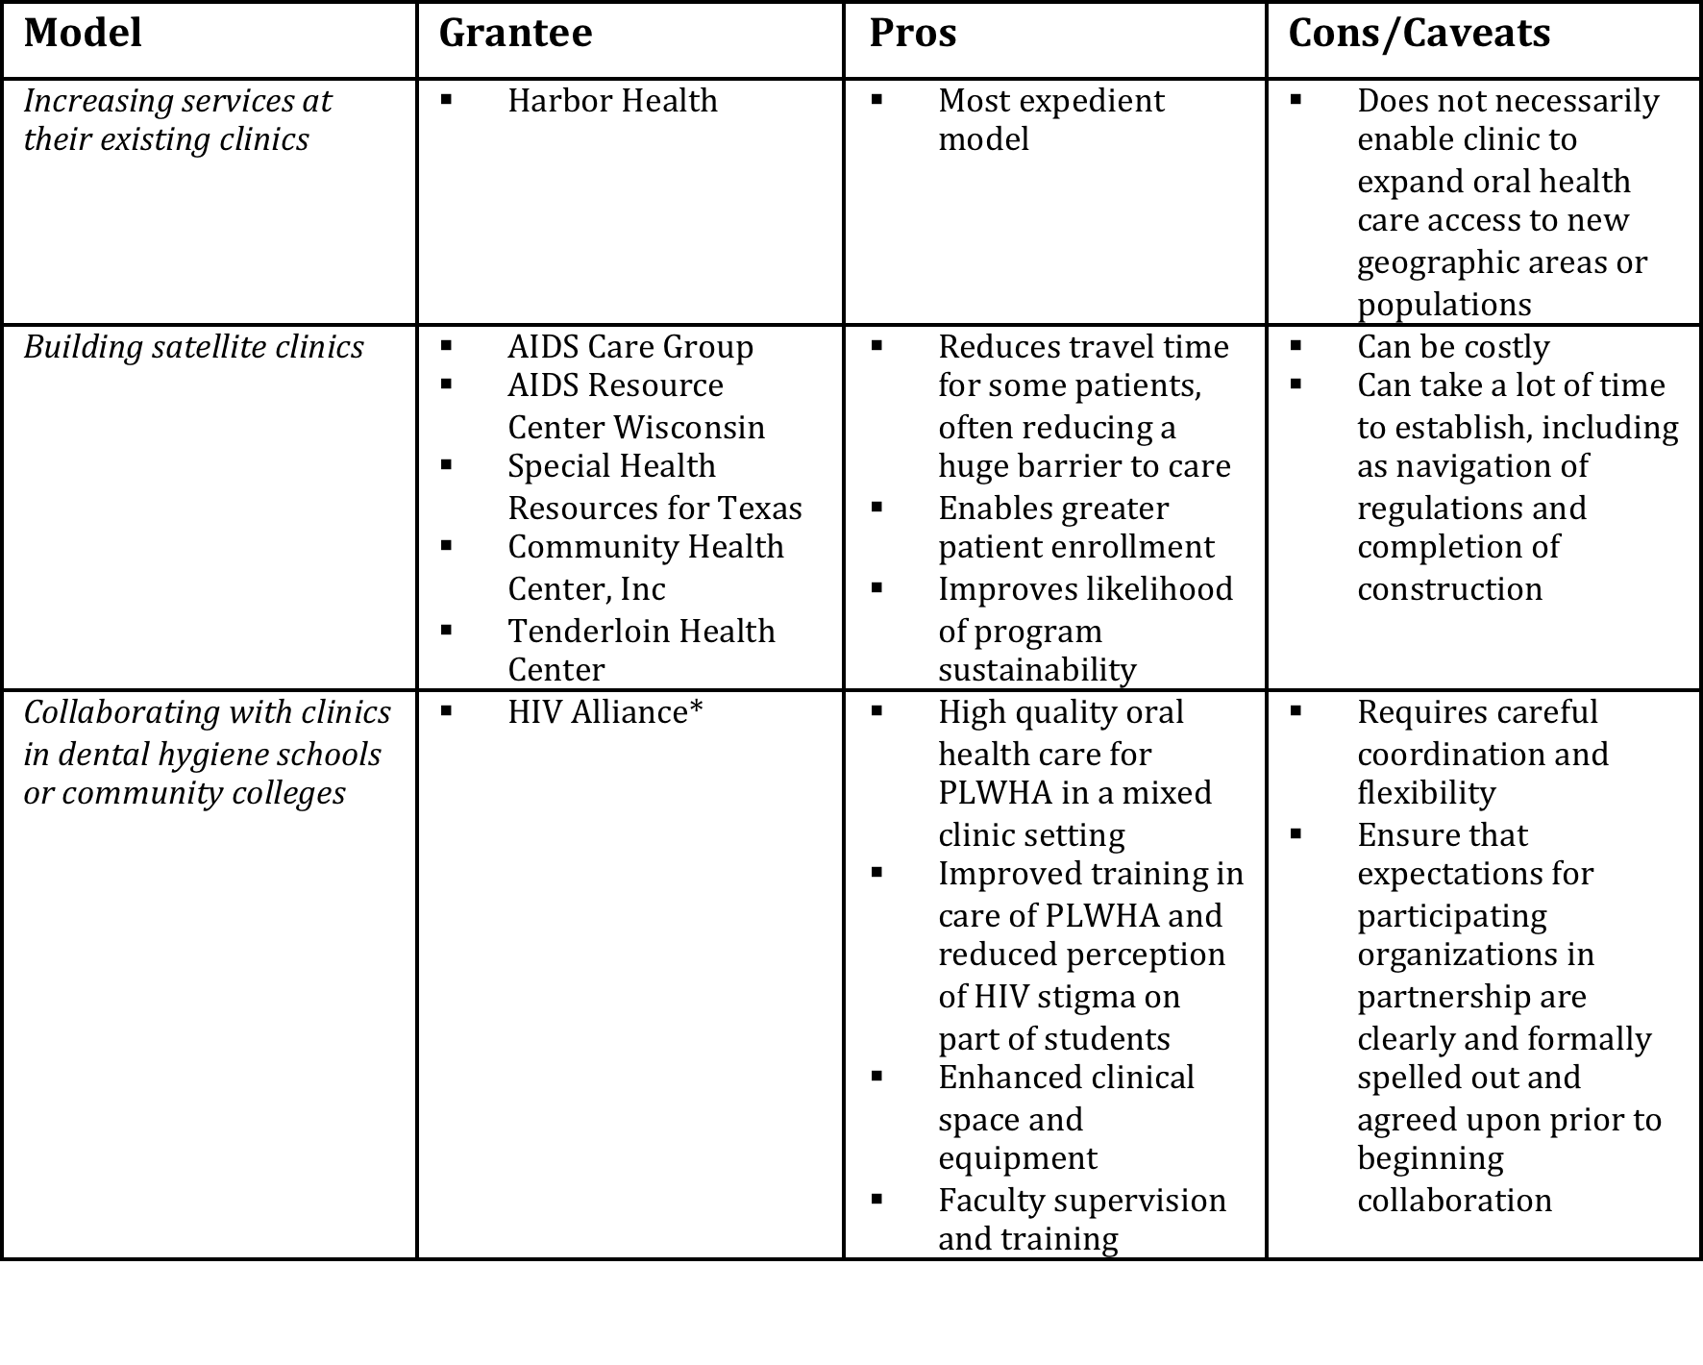
Overview of Pros, Cons, and Important Considerations for the Six Organizational Models (1 of 3)
Notes:
Trainer should distribute table of organizational model pros and cons shown as a handout so that participants can take notes on the models during the following discussion of slides. Please read the pros and cons within the table.

Slide 23
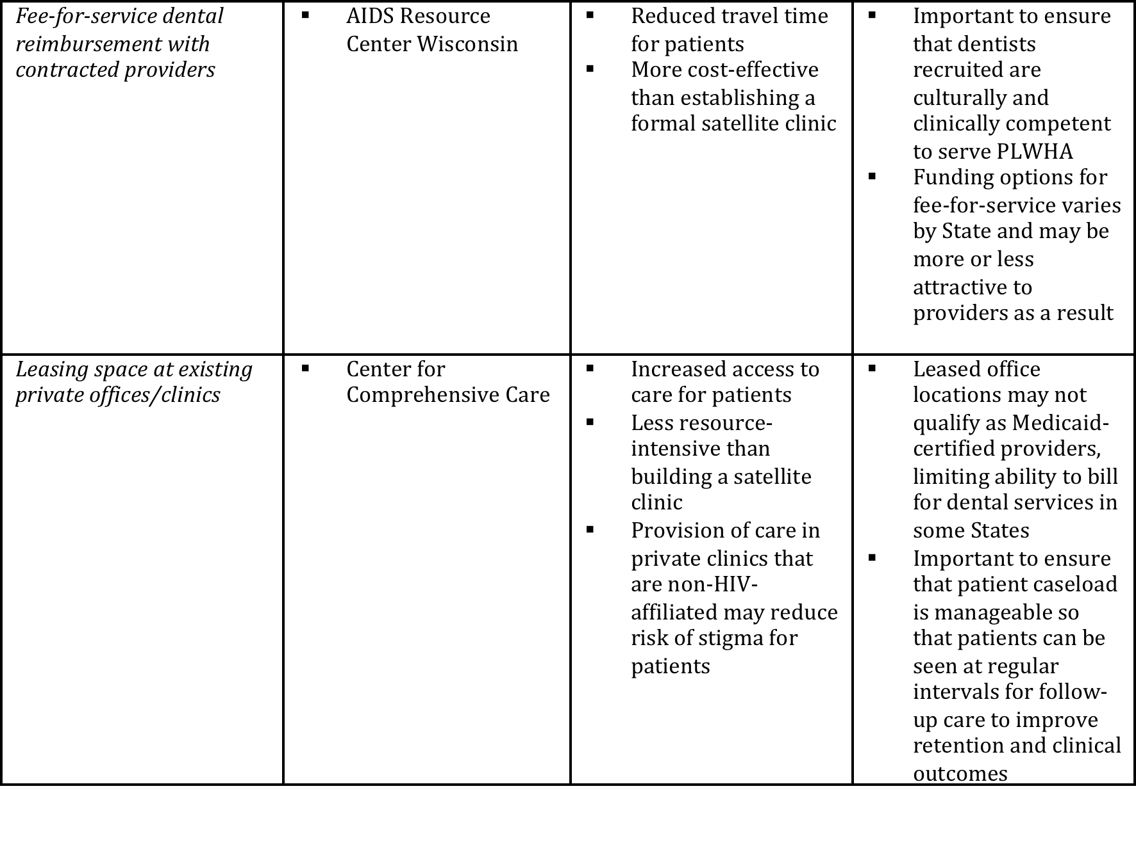
Overview of Pros, Cons, and Important Considerations for the Six Organizational Models (2 of 3)
Model Grantee Pros Cons/Caveats
Notes:
Trainer should distribute table of organizational model pros and cons shown as a handout so that participants can take notes on the models during the following discussion of slides. Please read the pros and cons within the table.

Slide 24
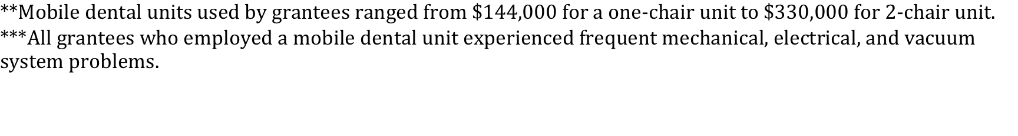
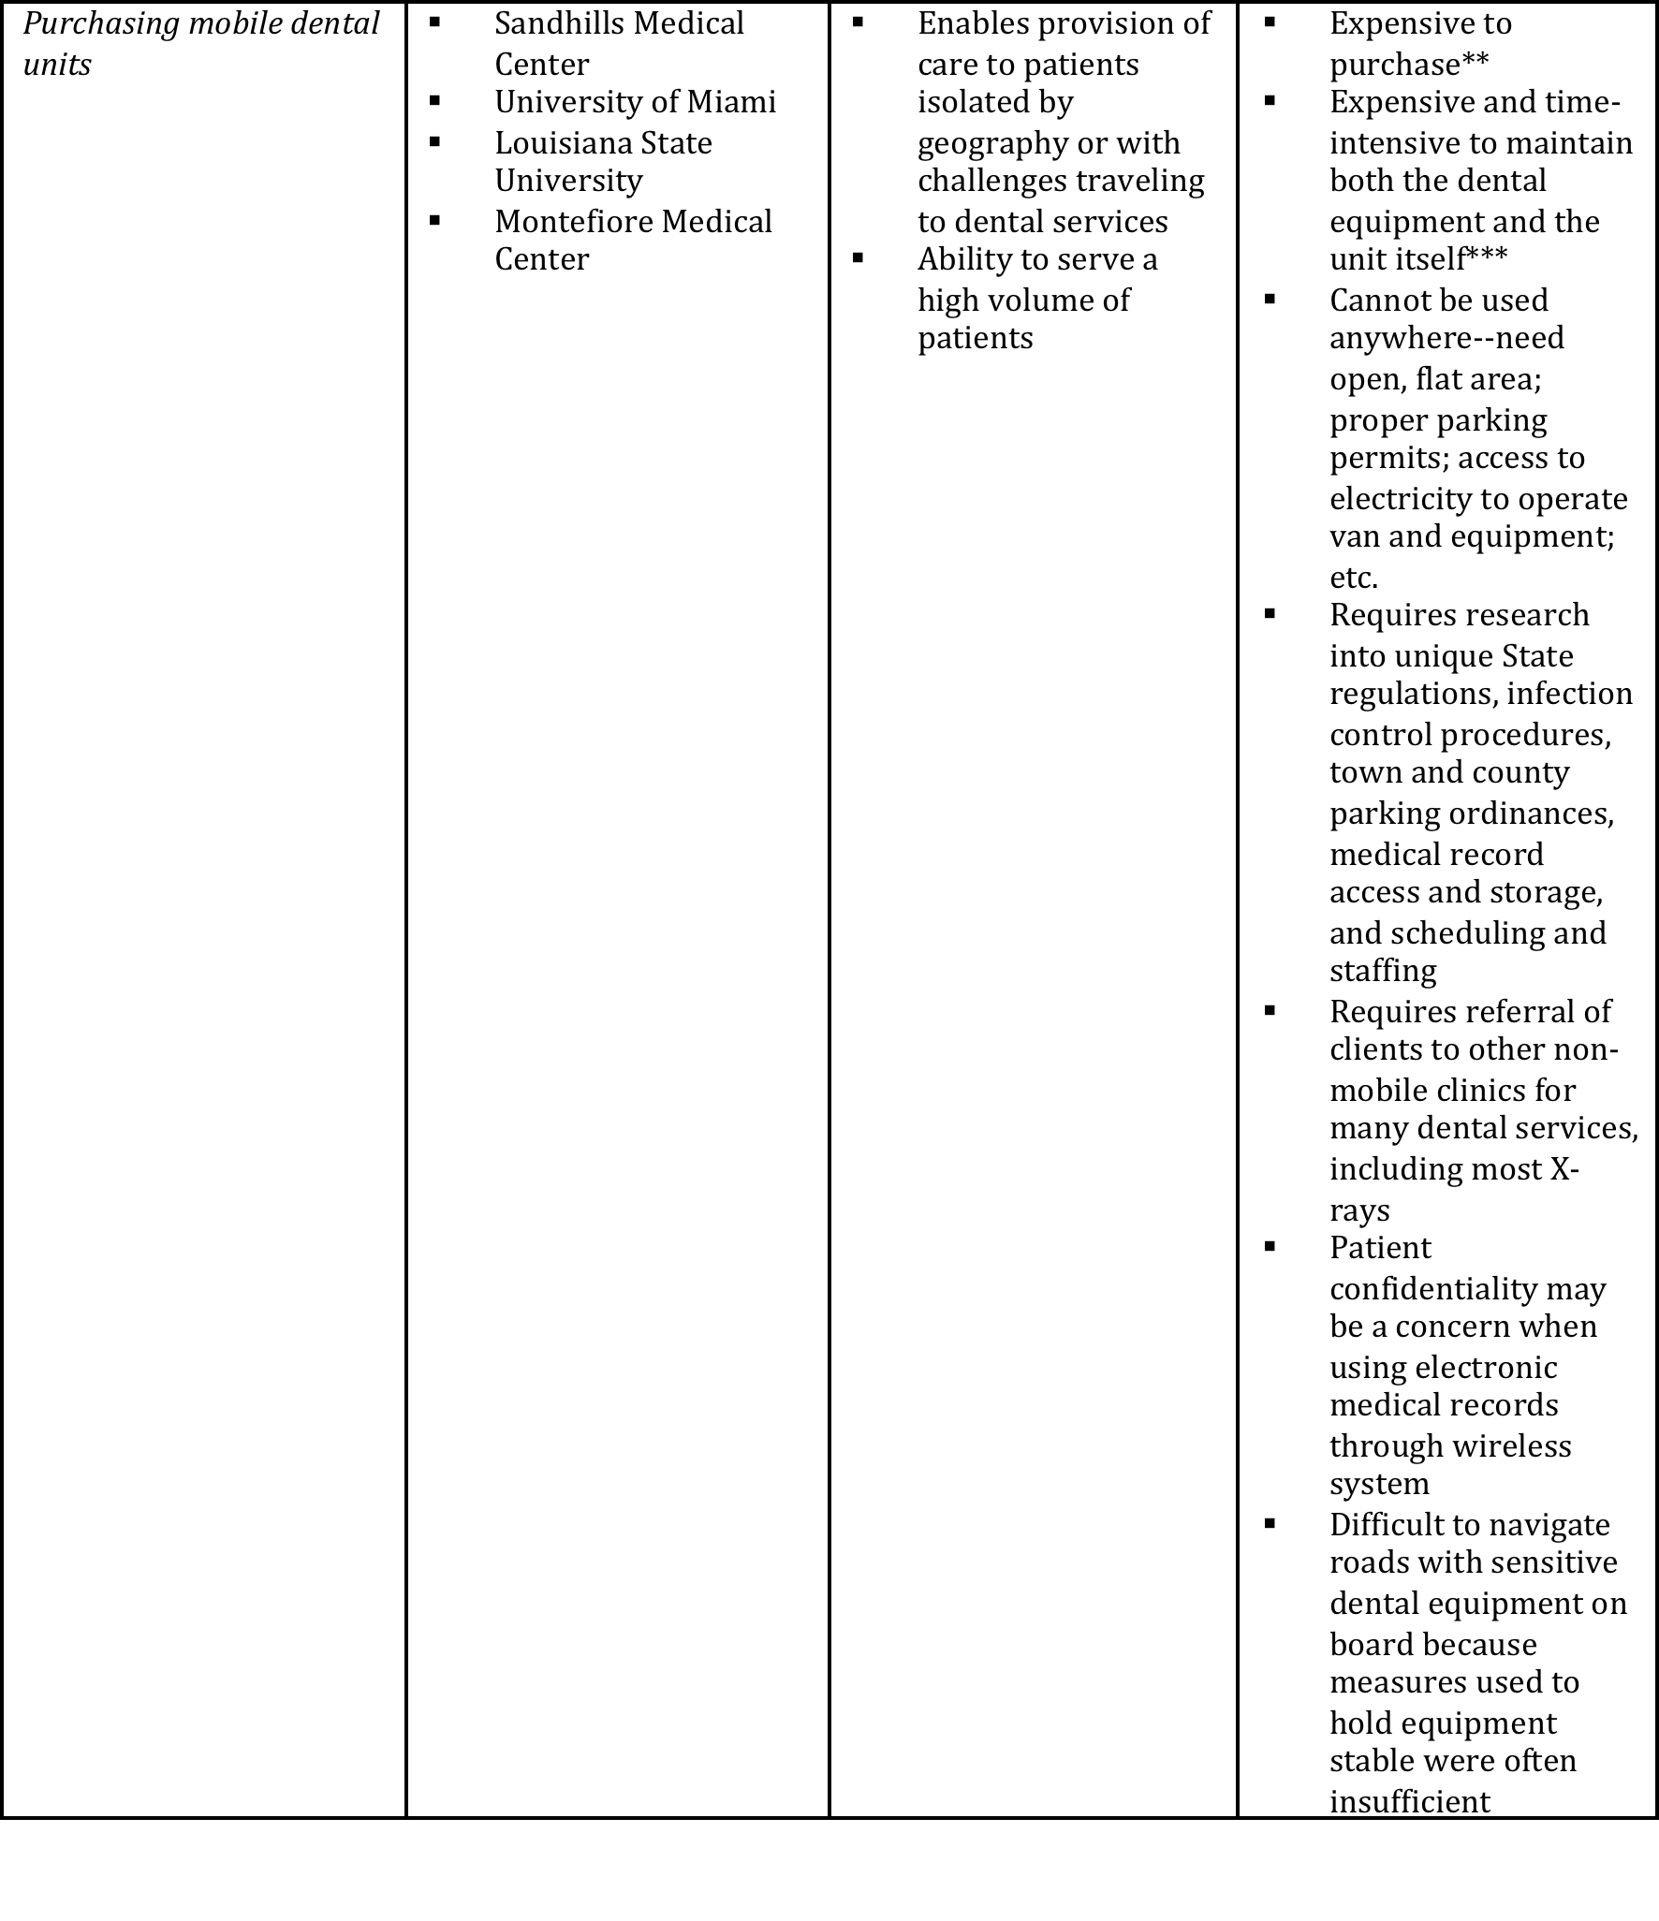
Overview of Pros, Cons, and Important Considerations for the Six Organizational Models (3 of 3)
Model Grantee Pros Cons/Caveats
Notes:
Trainer should distribute table of organizational model pros and cons shown as a handout so that participants can take notes on the models during the following discussion of slides. Please read the pros and cons within the table.

Slide 25
MODULE 4:
Summary
  To increase understanding of the terminology used in oral health care, a glossary has been provided as a handout. The goal of this module is to increase understanding around the terminology of oral health care in general as well as that specific to PLWHA.
  Many of these terms are referenced throughout the curriculum and thus, this module is a useful reference tool to maximize comprehension and utility as well as improve overall oral health literacy for clinic staff, and improve communication between medical providers and dental clinicians. Where applicable, this handout can be modified and provided to patients to include those terms used in patient-provider conversations.
Materials Needed:
  Copies of the glossary handout should be printed for distribution to each person.
Glossary of Oral Health Terminology
Notes:
Please share the “Glossary of Oral Health Terminology” handout with the class.

Slide 26
MODULE 5:
Session Length: Part 1 – 60 Minutes; Part 2 –90 minutes (optional 90-minute Webinar for in-class training or participant homework)
Summary
  This module is designed to provide both visual and descriptive examples of common oral health diseases. At the end of this module, medical providers and primary care staff should demonstrate improved ability to find and identify these diseases in PLWHA.
Materials Needed:
  Computer and compatible LCD projector
  Internet connection
  Video player, such as QuickTime (will be required to be installed in advance on your computer)
  Copies of the handout referenced in this module should be printed out and distributed to each person.
Clinical Guide to Integrating Oral Care in the Medical Setting

Slide 27

Objective of this Clinical Guide to Integrating Oral Care in the Medical Setting
Empower medical providers and primary care staff to be able to find and identify common oral health diseases in PLWHA.
Source: Adapted from a presentation prepared by Cesar Augusto Migliorati, DDS, MS, PhD, Professor and Director of Oral Medicine in the Department of Biologic and Diagnostic Sciences at the University of Tennessee College of Dentistry. The presentation is entitled “HIV Diagnosis and the Oral Cavity” and was prepared for the AETC National Resource Center. The full presentation is available on the AETC Web site at www.aidsetc.com/aidsetc?page=etres-display&resource=etres-542.
Notes:
Objective of this Clinical Guide to Integrating Oral Care in the Medical Setting
Empower medical providers and primary care staff to be able to find and identify common oral health diseases in PLWHA.
Source: Adapted from a presentation prepared by Cesar Augusto Migliorati, DDS, MS, PhD, Professor and Director of Oral Medicine in the Department of Biologic and Diagnostic Sciences at the University of Tennessee College of Dentistry. The presentation is entitled “HIV Diagnosis and the Oral Cavity” and was prepared for the AETC National Resource Center. The full presentation is available on the AETC Web site at www.aidsetc.com/aidsetc?page=etres-display&resource=etres-542

Slide 28
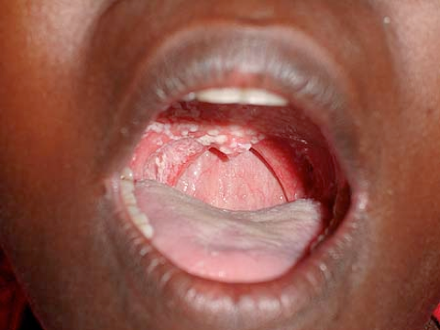
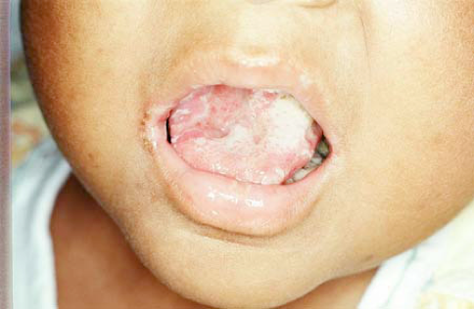
Diseases of the Mouth as Indicator for HIV Infection
Some oral conditions may lead to suspicion of HIV infection.
Common Examples:
    Oropharyngeal candidiasis, commonly known as “thrush,” is a fungal disease of the oral mucosa and tongue and is the most common intraoral lesion among PLWHA (shown in the images below).
Source: www.hiv.va.gov/provider/image-library/oral.asp?post=1&slide=127
Source: www.hiv.va.gov/provider/image-library/oral.asp?post=1&slide=327
Notes:
Diseases of the Mouth as Indicator for HIV Infection
Some oral conditions may lead to suspicion of HIV infection
Common Examples:
Oropharyngeal candidiasis, commonly known as “thrush,” is a fungal disease of the oral mucosa and tongue and is the most common intraoral lesion among PLWHA (shown in the images below).

Slide 29
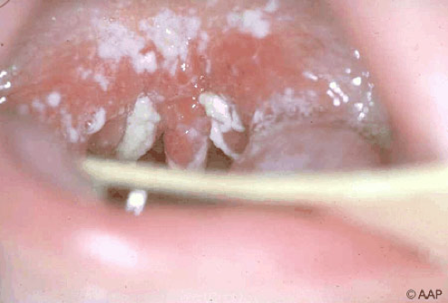
Esophageal Candidiasis
Esophageal candidiasis is candida that infects the esophagus
  Can cause dysphagia, or difficulty with
    swallowing, or dynophagia, pain with swallowing.
Esophageal candidiasis is an AIDS-defining condition.
  Generally occurs in individuals with
  CD4 counts of <200 cells/µL.
    It is the most common cause of esophageal
    infection in PLWHA.
    Picture Source: www.hiv.va.gov/provider/image-library/oral.asp?post=1&slide=128
Notes:
Esophageal candidiasis
Esophageal candidiasis is candida that infects the esophagus, which can cause dysphagia, or difficulty with swallowing, or dynophagia, pain with swallowing.
Esophageal candidiasis is an AIDS-defining condition, generally occurring in individuals with CD4 counts of <200 cells/µL.
It is the most common cause of esophageal infection in persons with AIDS.
Example of Esophageal Candidiasis shown in the image to the right and on the following slide.

Slide 30
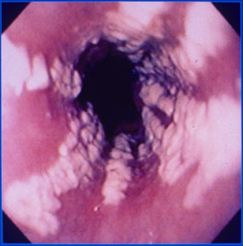
Esophageal Candidiasis
Photo Source: www.hiv.va.gov/provider/image-library/gastrointestinal.asp?post=1&slide=188
Notes:
Example of esophageal candidiasis

Slide 31
Hairy Leukoplakia
Before the era of ART, hairy leukoplakia was considered one of the most common oral diseases in PLWHA
  Occurred in ~ 15 – 20 % of PLWHA
  Often seen in PLWHA with delayed entry to care¹
PLWHA with hairy leukoplakia tend to have moderate to advanced immune suppression, with a median CD4 count of approximately 235 cells/mm³.
¹ Husak R, Garbe C, Orfanos CE. Oral hairy leukoplakia in 71 HIV-seropositive patients: clinical symptoms, relation to immunologic status, and prognostic significance. J Am Acad Dermatol. 1996;35:928–34.
Notes:
Hairy leukoplakia
Before the era of ART, hairy leukoplakia was considered one of the most common oral diseases in PLWHA, occurring in approximately 15 to 20 percent of PLWHA, and is often seen in PLWHA with delayed entry to care. ¹
PLWHA with hairy leukoplakia tend to have moderate to advanced immune suppression, with a median CD4 count of approximately 235 cells/mm3.
Example of Hairy Leukoplakia
¹ Husak R, Garbe C, Orfanos CE. Oral hairy leukoplakia in 71 HIV-seropositive patients: clinical symptoms, relation to immunologic status, and prognostic significance. J Am Acad Dermatol. 1996;35:928-34.

Slide 32
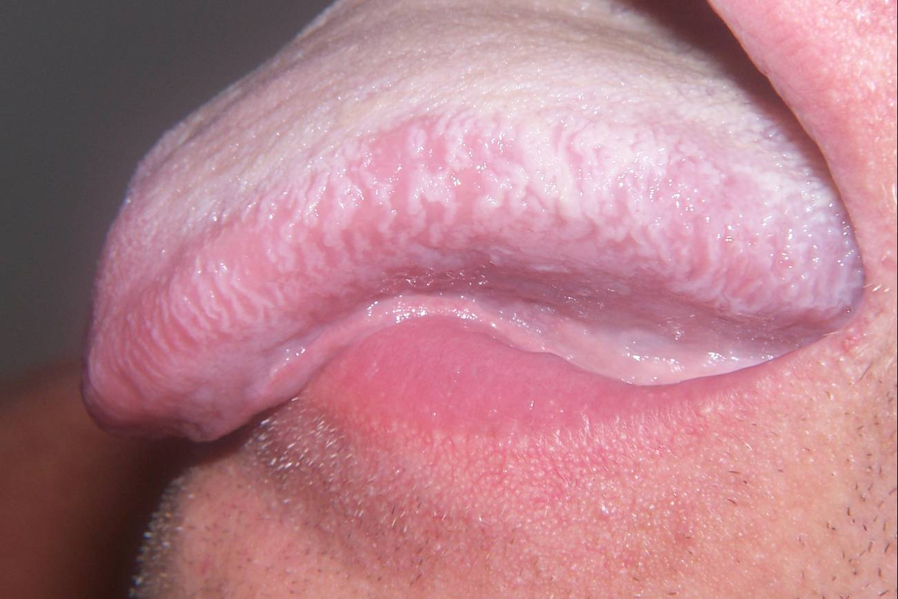
Hairy Leukoplakia
Picture Source: Courtesy of Dr. Steve Debbink, Dental Director, AIDS Resource Center of Wisconsin. Available at: http://www.hivdent.org/_picturegallery_/OralHairyLeukoplakia2.htm.
Notes:
Example of hairy leukoplakia

Slide 33

Kaposi’s Sarcoma
Kaposi sarcoma (KS) is a cancer that develops from cells lining lymph or blood vessels.
  Usually appears as tumors on the skin or on mucosal surfaces such as the oral cavity.
  Tumors can also develop in other parts of the body, such as in the lymph nodes or digestive tract.
~1/3 of PLWHA with AIDS-associated KS develop oral lesions.
  AIDS-associated KS is often much more aggressive than classic KS.¹
KS is considered an “AIDS-defining” illness.²
¹Memorial Sloan-Kettering Cancer Center. About Kaposi Sarcoma. Available at: www.mskcc.org/cancer-care/adult/aids-associated/about-kaposi-sarcoma.
²American Cancer Society. Kaposi Sarcoma. Available at: www.cancer.org/acs/groups/cid/documents/webcontent/003106-pdf.pdf.
Notes:
Kaposi sarcoma (KS) is a cancer that develops from cells lining lymph or blood vessels. KS usually appears as tumors on the skin or on mucosal surfaces such as the oral cavity, but tumors can also develop in other parts of the body, such as in the lymph nodes or digestive tract.
Approximately one-third of PLWHA with AIDS-associated Kaposi’s sarcoma (KS) develop oral lesions. AIDS-associated KS is often much more aggressive than classic Kaposi’s sarcoma.²
KS is considered an “AIDS-defining” illness, which means that when KS occurs in someone infected with HIV, that person officially has AIDS (and is not just HIV-positive).³

Slide 34
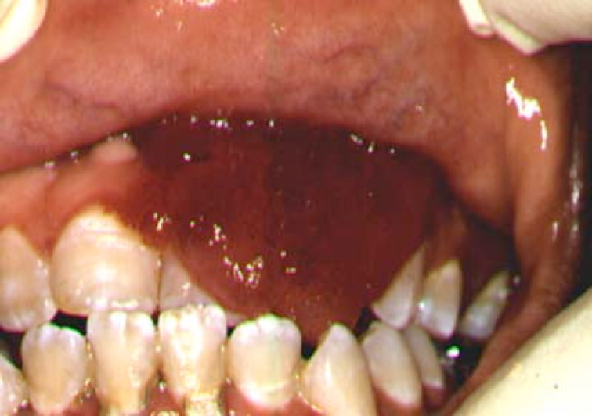
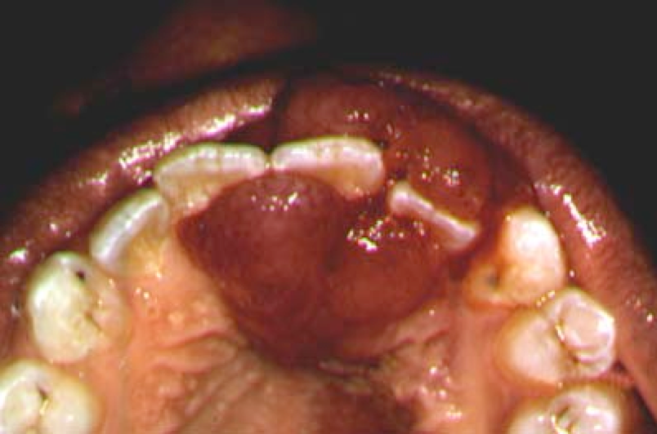
Kaposi’s Sarcoma, continued
  The abnormal cells of KS form purple, red, or brown blotches or tumors on the skin, also called lesions.¹
Picture Source: Copyright David Reznik, DDS. All Rights Reserved. Available at: http://www.hivdent.org/_picturegallery_/KS139.htm.
  Appearance of KS can vary greatly in the oral cavity and, thus, proper recognition is important.
Picture Source: Copyright David Reznik, DDS. All Rights Reserved. Available at: http://www.hivdent.org/_picturegallery_/KS139.htm.
¹American Cancer Society. Kaposi Sarcoma. Available at: www.cancer.org/acs/groups/cid/documents/webcontent/003106-pdf.pdf.
Notes:
The abnormal cells of KS form purple, red, or brown blotches or tumors on the skin, also called lesions.¹ That said, the appearance of KS can vary greatly in the oral cavity and, thus, proper recognition is important. The palate is the most common site.

Slide 35
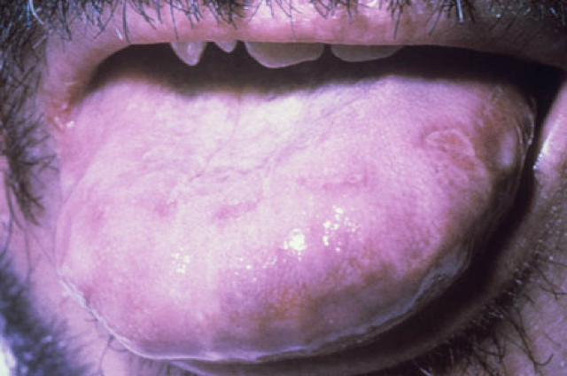
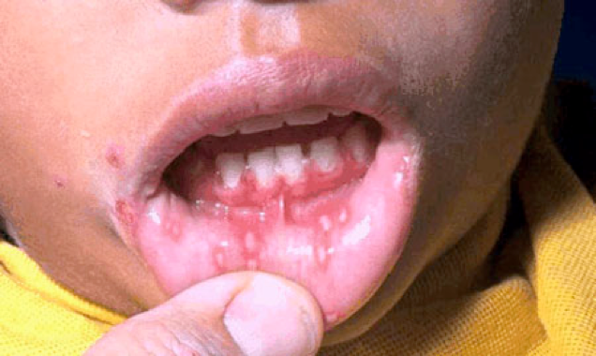
Other STDs and Their Impact on Oral Health
HIV and certain other STDs are common co-morbidities in PLWHA.
  Some of these STDs, like syphilis, herpes, and gonorrhea, can manifest in the oral cavity.
Herpes in the Oral Cavity
      Picture Source: www.hiv.va.gov/provider/image-library/oral.asp?post=1&slide=120
      Picture Source: www.hiv.va.gov/provider/image-library/oral.asp?post=1&slide=254
Notes:
HIV and certain other STDs are common co-morbidities in PLWHA.
Some of these STDs, like syphilis, herpes, and gonorrhea, can manifest in the oral cavity.
Below are pictures of herpes in the oral cavity.

Slide 36
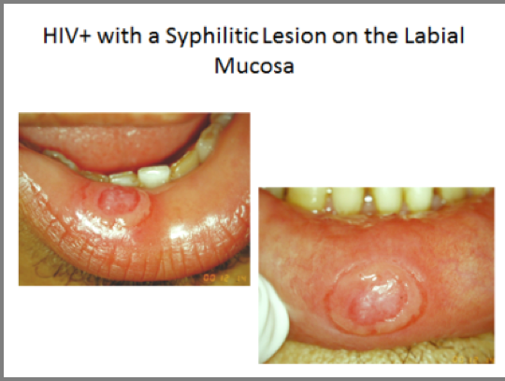
HIV and Syphilis
Syphilis may manifest in the oral cavity presenting with an ulcer-like lesion.
  The lesion may be painful and the only clinical manifestation of the STD.
Picture Source: www.aidsetc.com/aidsetc?page=etres-display&resource=etres-542
Notes:
HIV+ with a Syphilitic Lesion on the Labial Mucosa
Syphilis may manifest in the oral cavity presenting with an ulcer-like lesion.
The lesion may be painful and the only clinical manifestation of the STD.
Below is a picture of Syphilitic Lesion on the Labial Mucosa

Slide 37
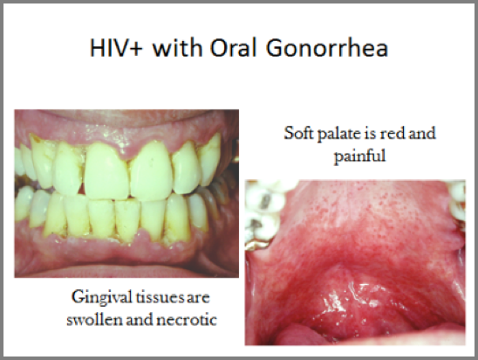
HIV and Oral Gonorrhea
Picture Source: www.aidsetc.com/aidsetc?page=etres-display&resource=etres-542
Notes:
HIV and Oral Gonorrhea
The following patient presented with severe gingival pain and a sore throat. He had oral sex with his partner a few days before. He found out later that his partner had genital gonorrhea.
These are pictures of oral gonorrhea in the patient.

Slide 38
Oral Health Exam Training Video for Clinical Staff
This video presentation provides instruction on performing both external and intraoral patient exams.
Features Carol Stewart, DDS, MS, MS, Dental Director of the Florida/Caribbean AETC and Professor and Director of the Division of Oral Diagnostic Sciences, Department of Oral and Maxillofacial Surgery and Diagnostic Sciences at the University of Florida College of Dentistry
Video
www.aidsetc.org/mpeg/archive/oral_health_03.mpg
Notes:
Trainer should explain to class that this video presentation provides instruction on performing both external and intraoral exams.
Have class watch the video (~12 minutes in length).

Slide 39


Slide 40
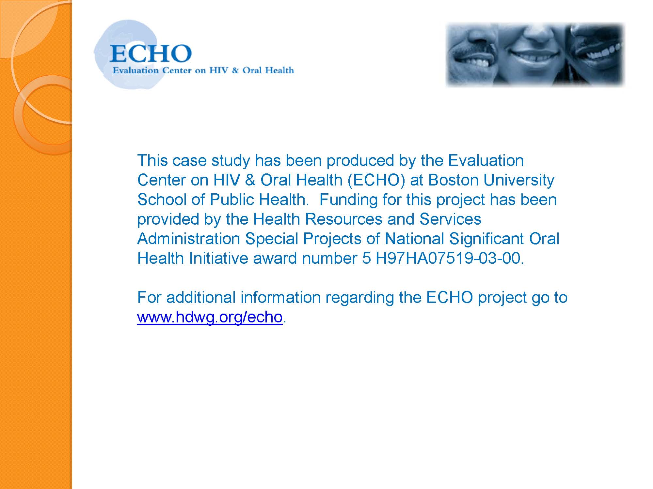

Slide 41
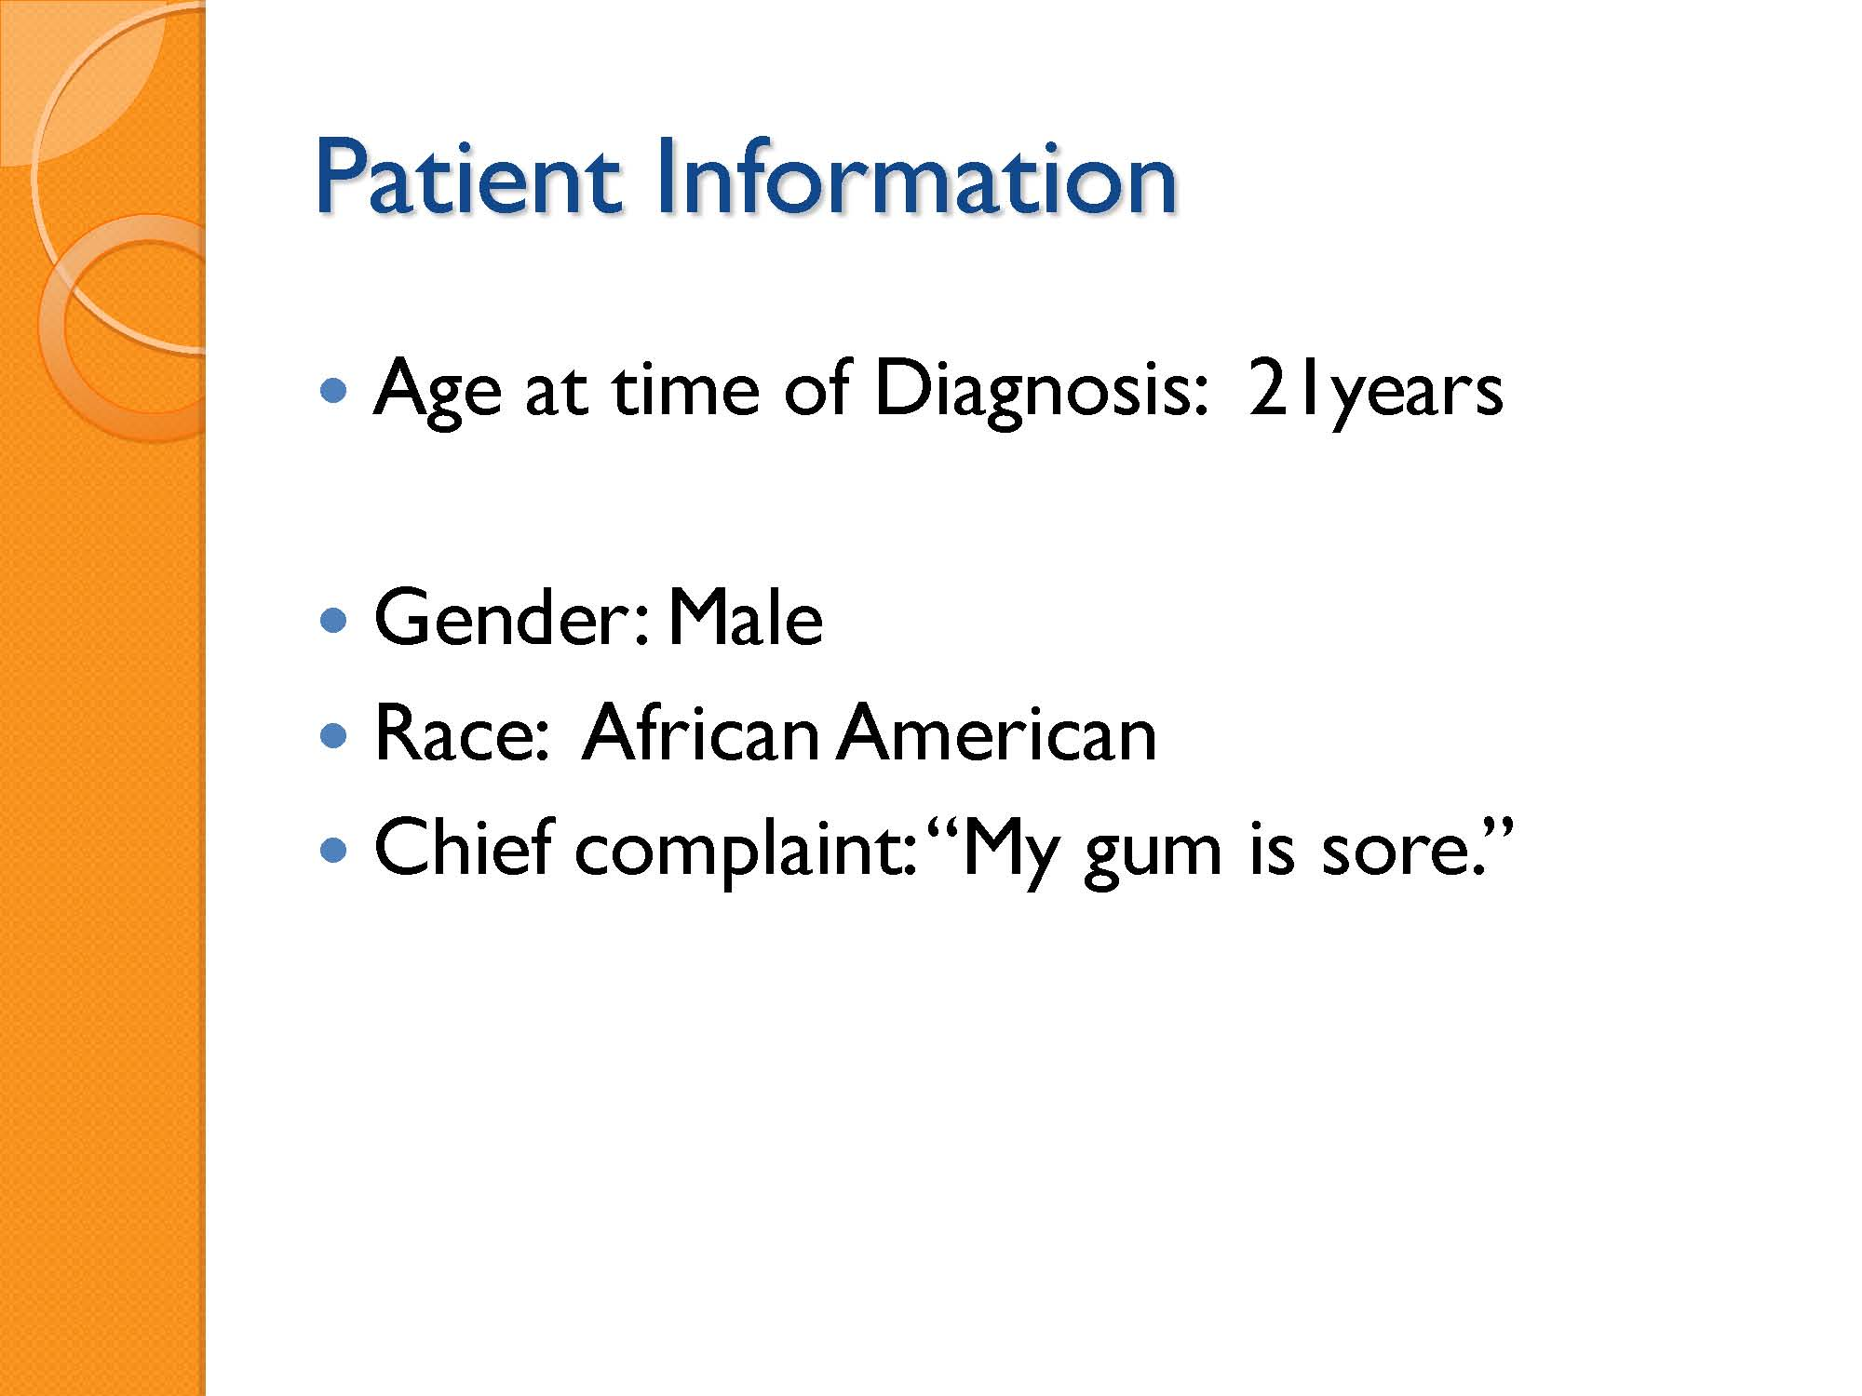

Slide 42
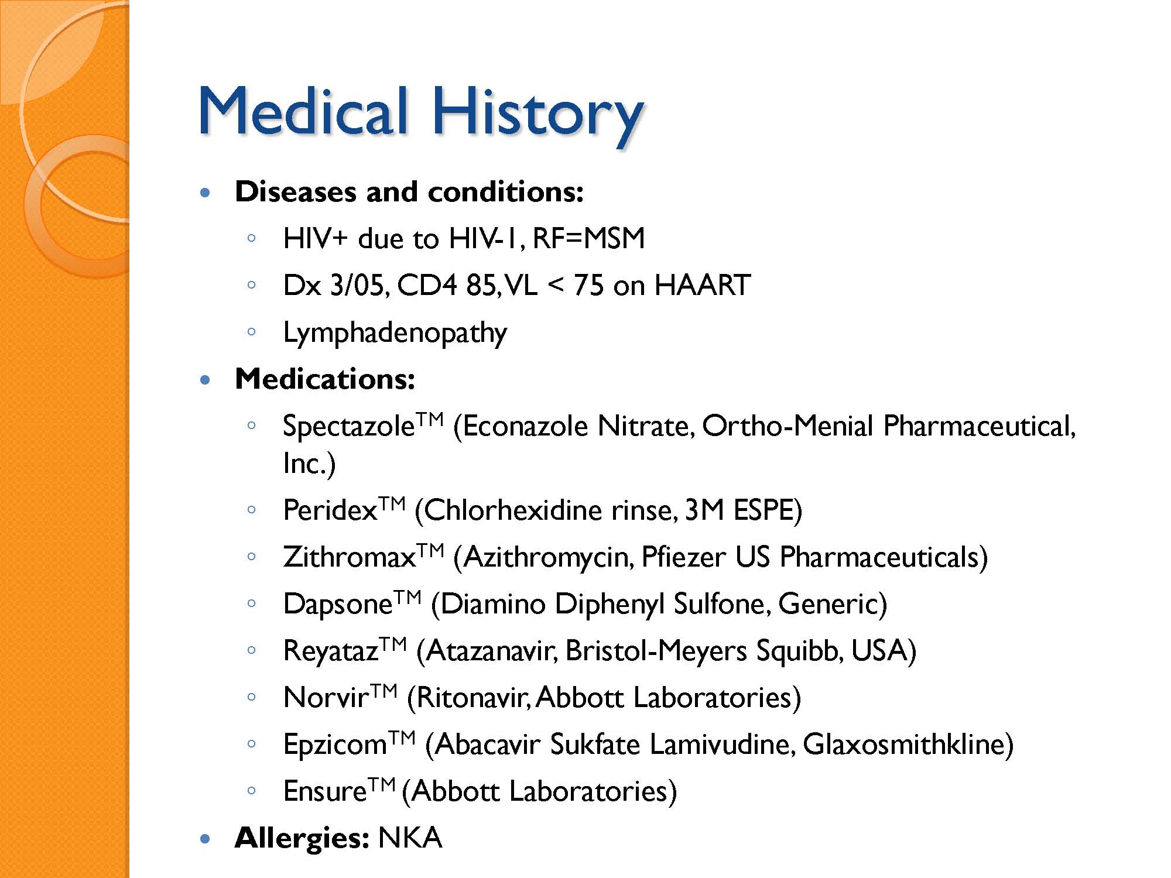

Slide 43
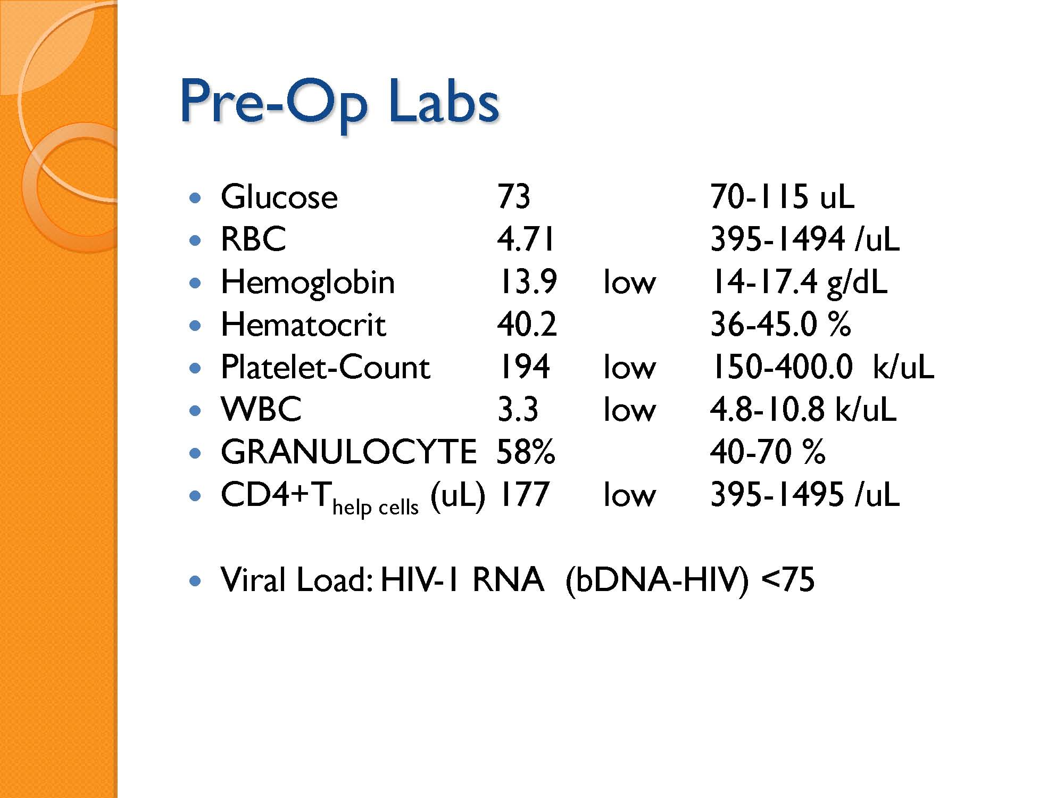

Slide 44
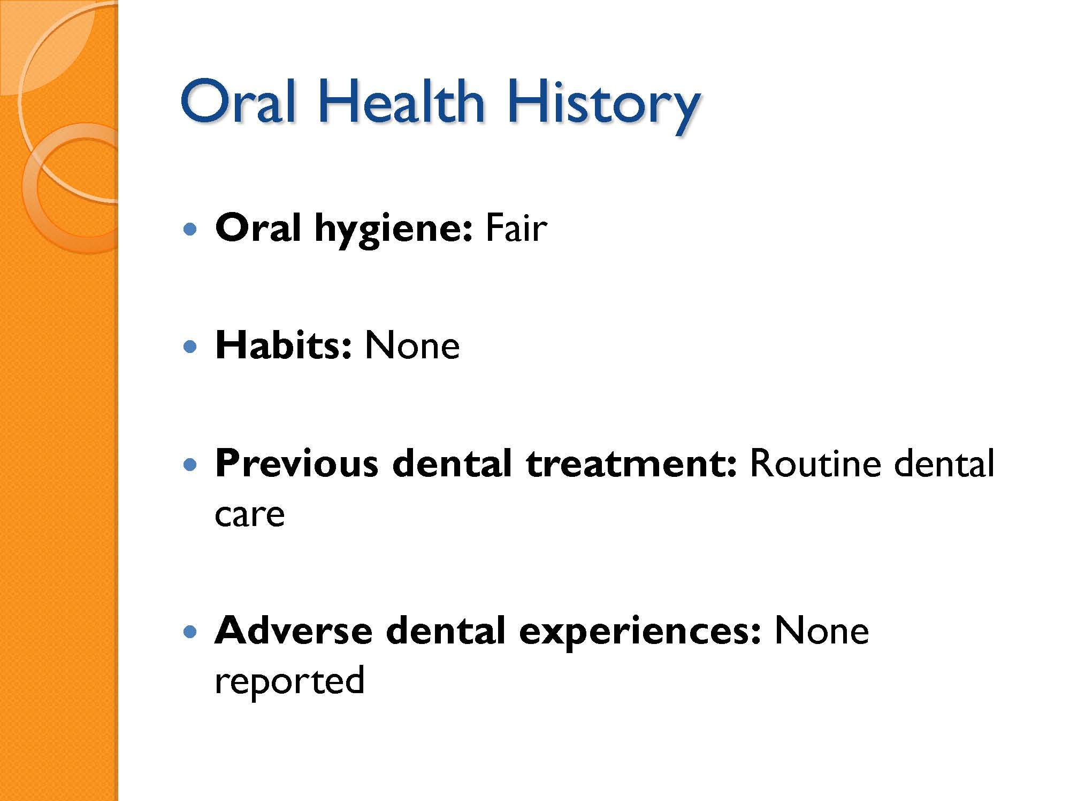

Slide 45
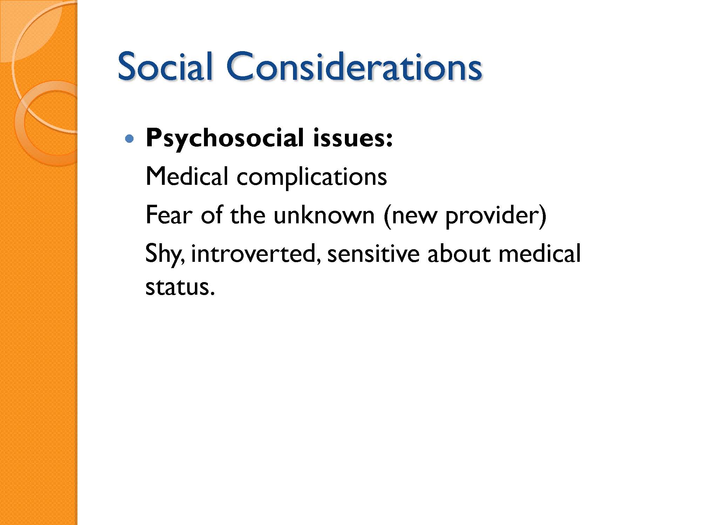

Slide 46
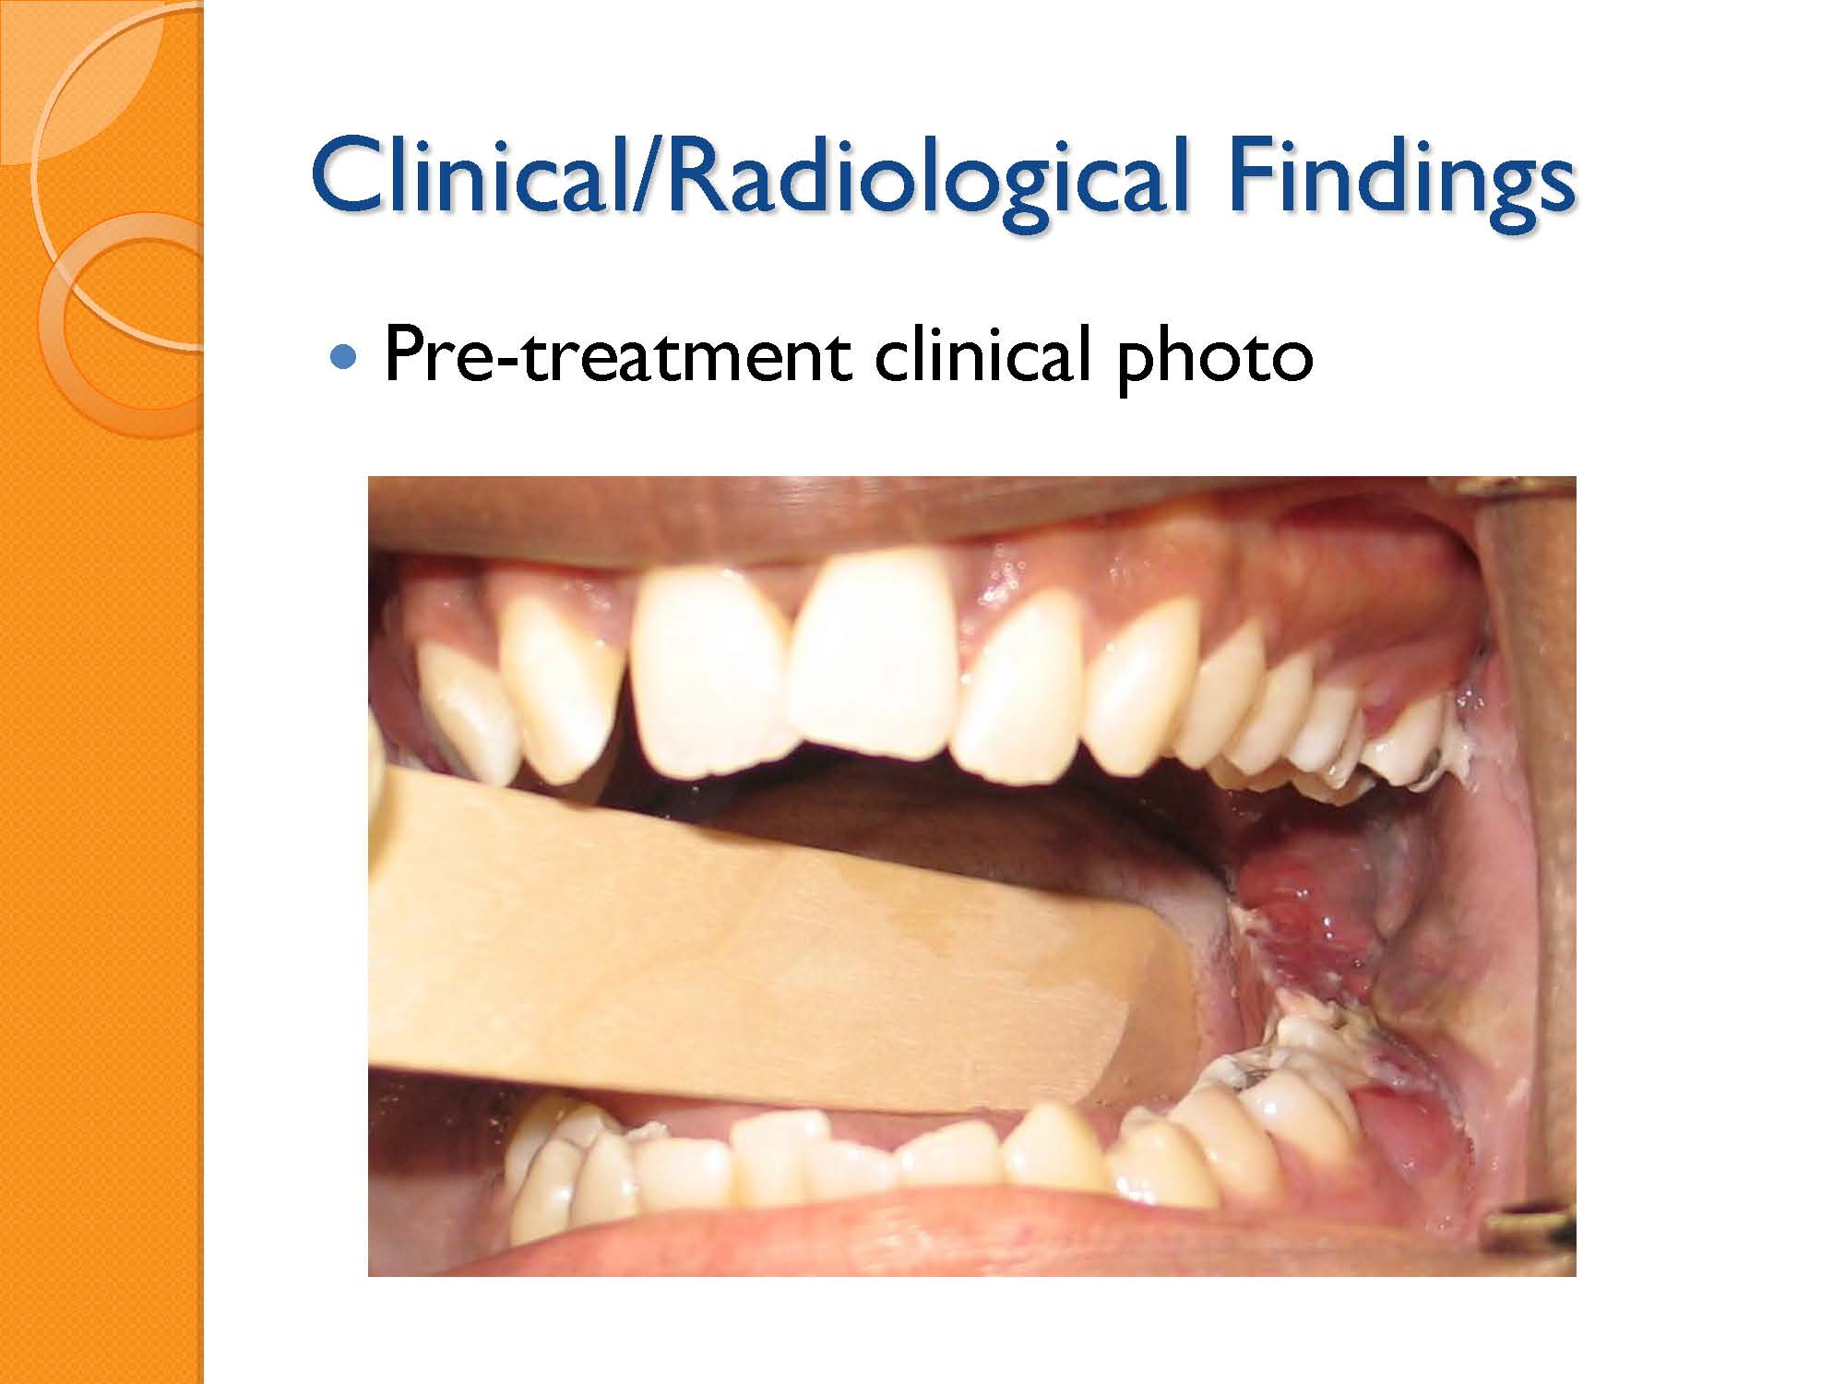

Slide 47
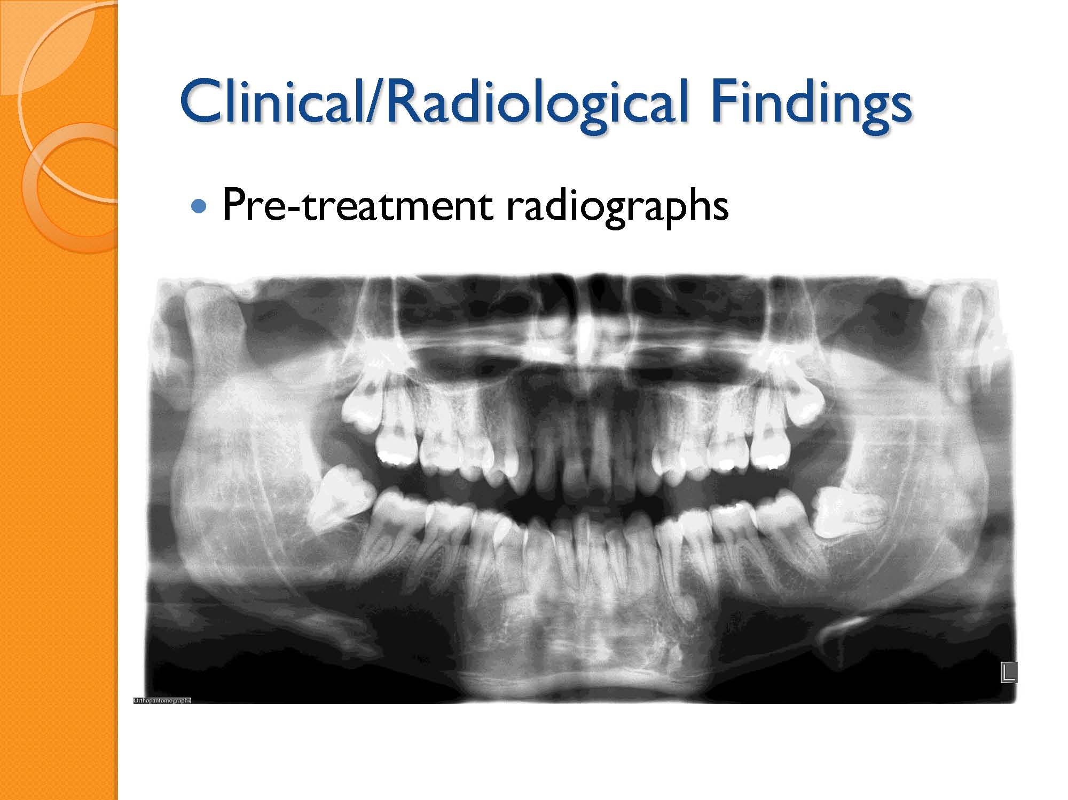

Slide 48
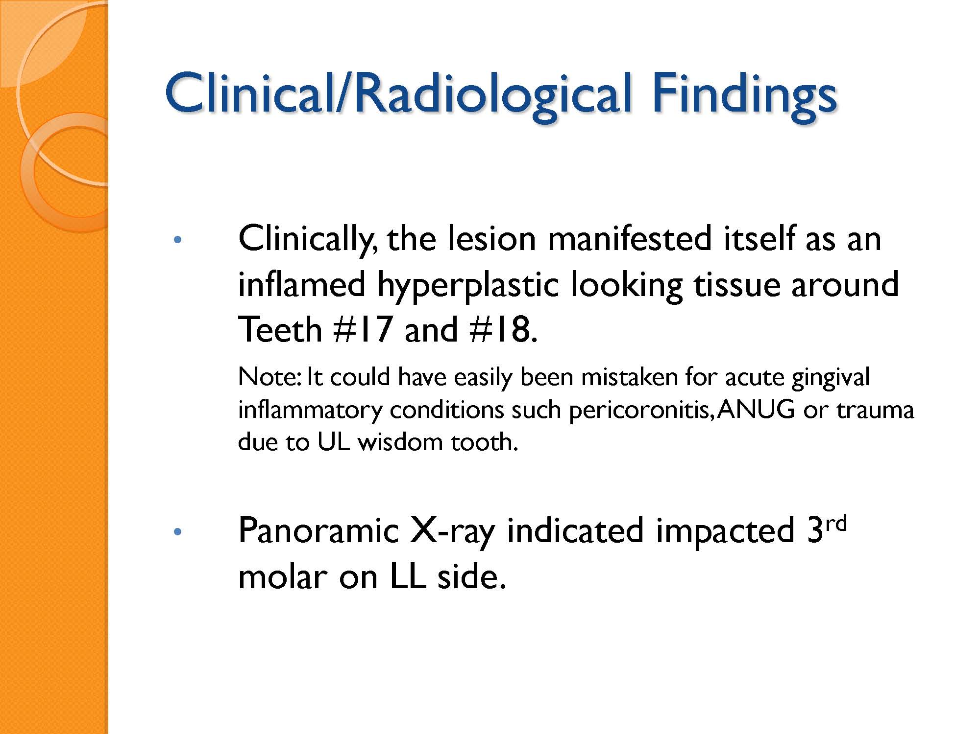

Slide 49
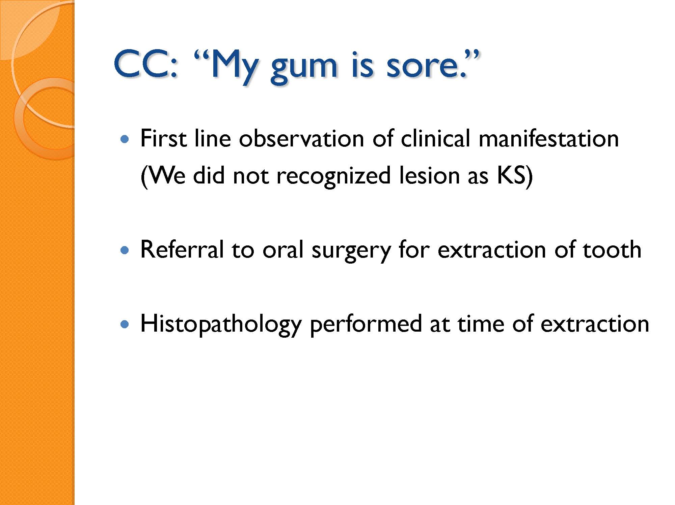

Slide 50
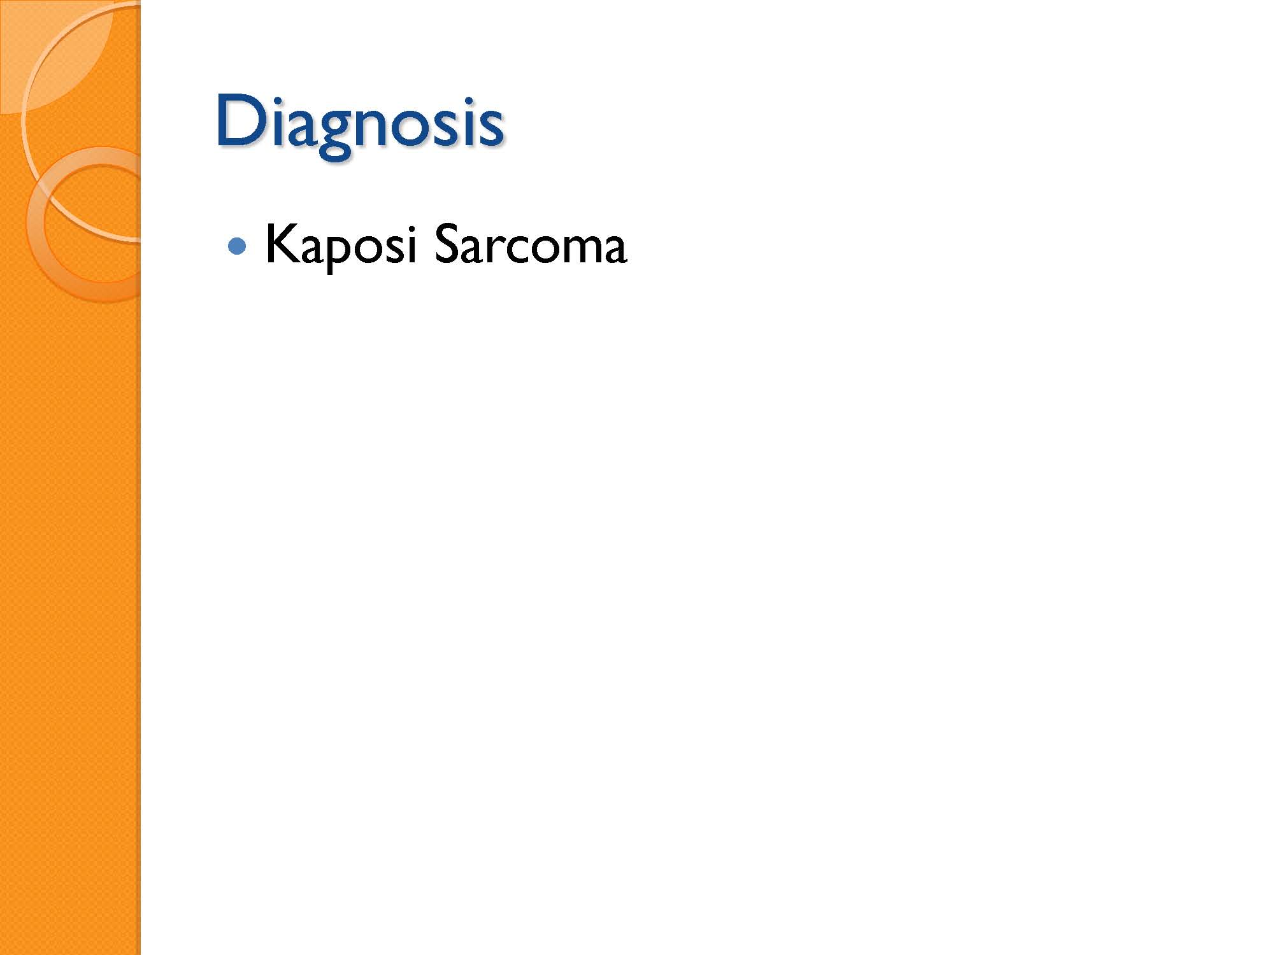

Slide 51
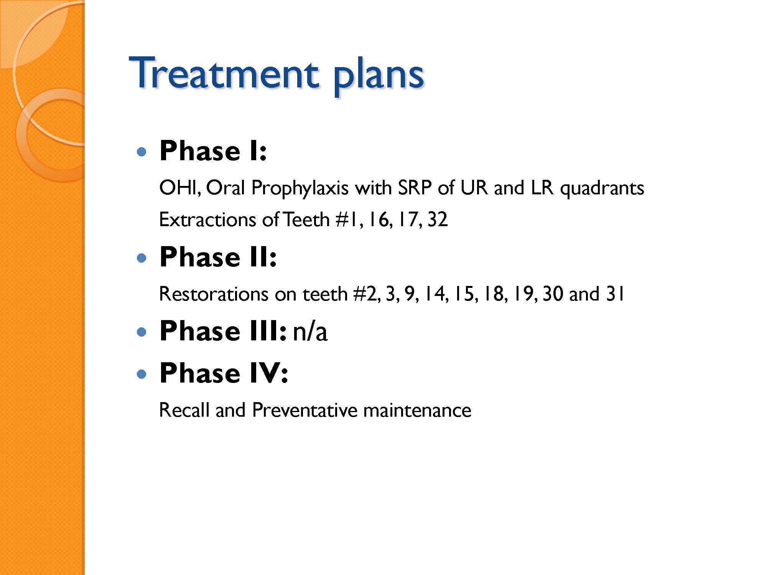

Slide 52
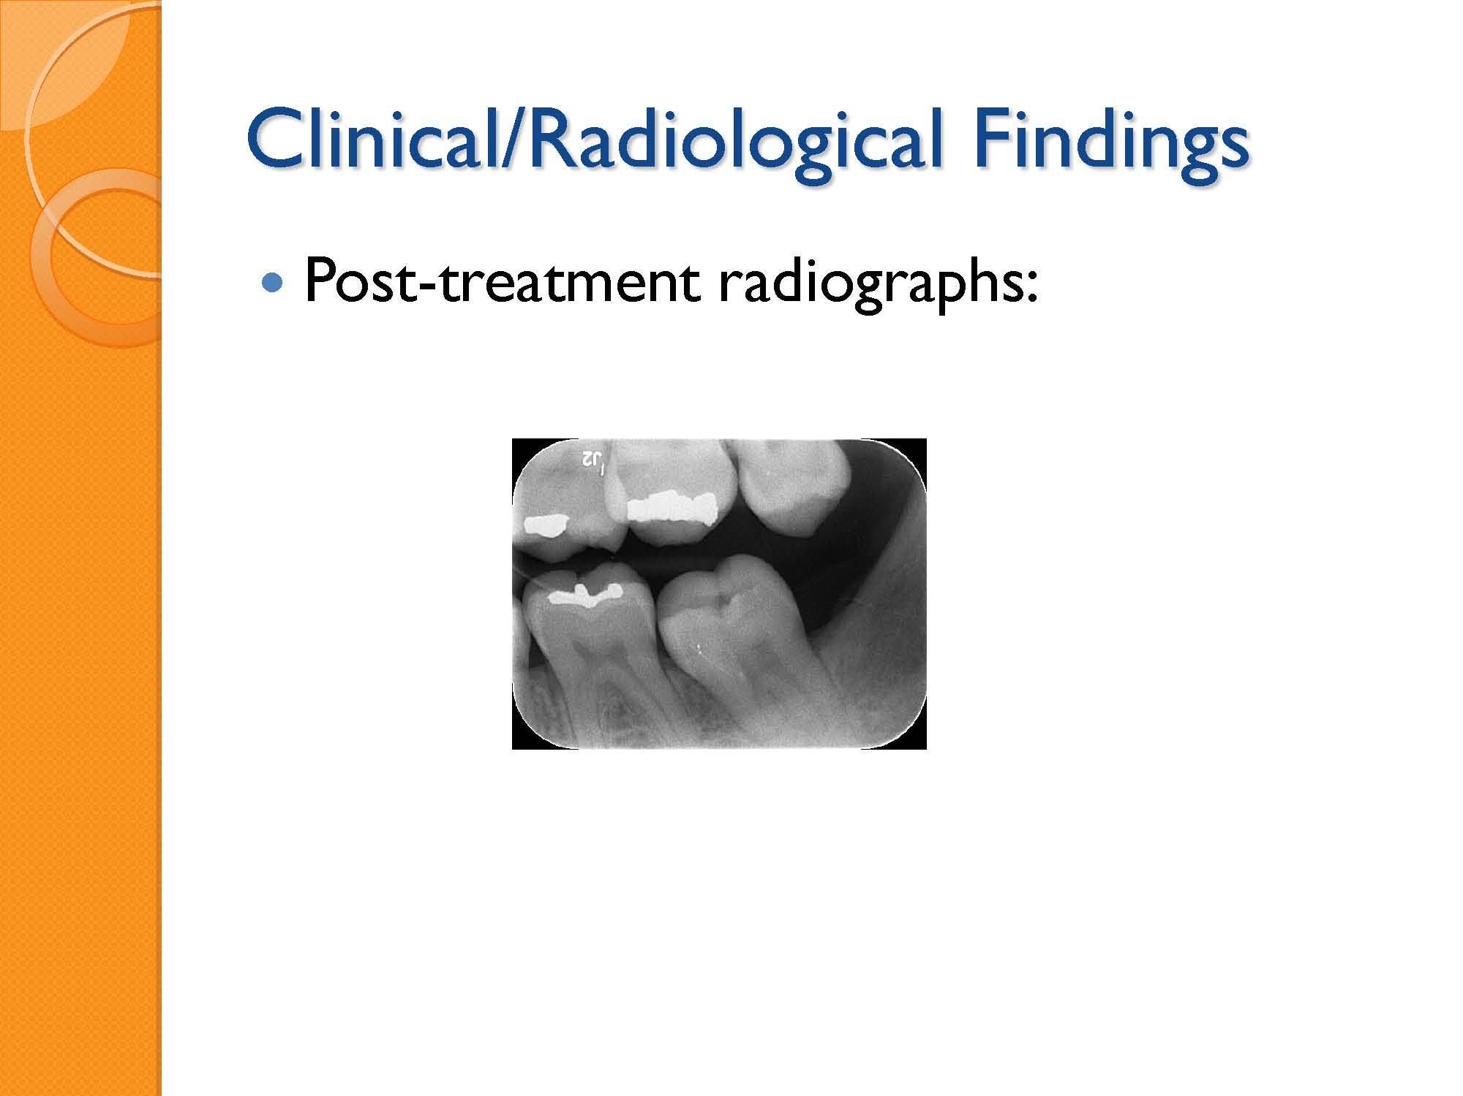

Slide 53
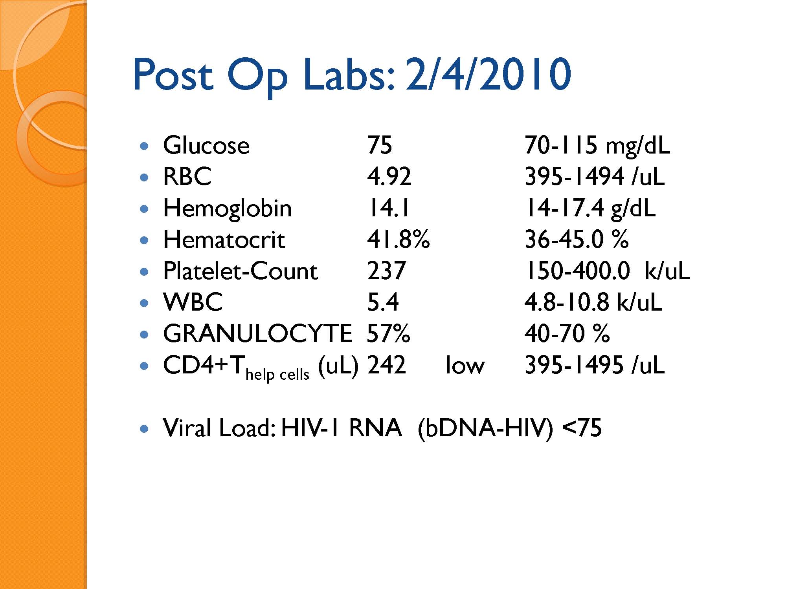

Slide 54
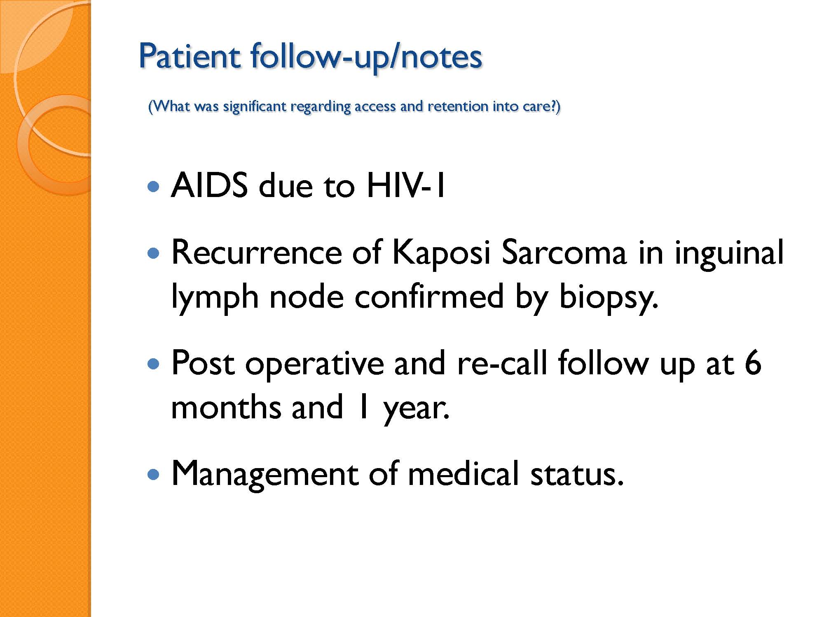

Slide 55
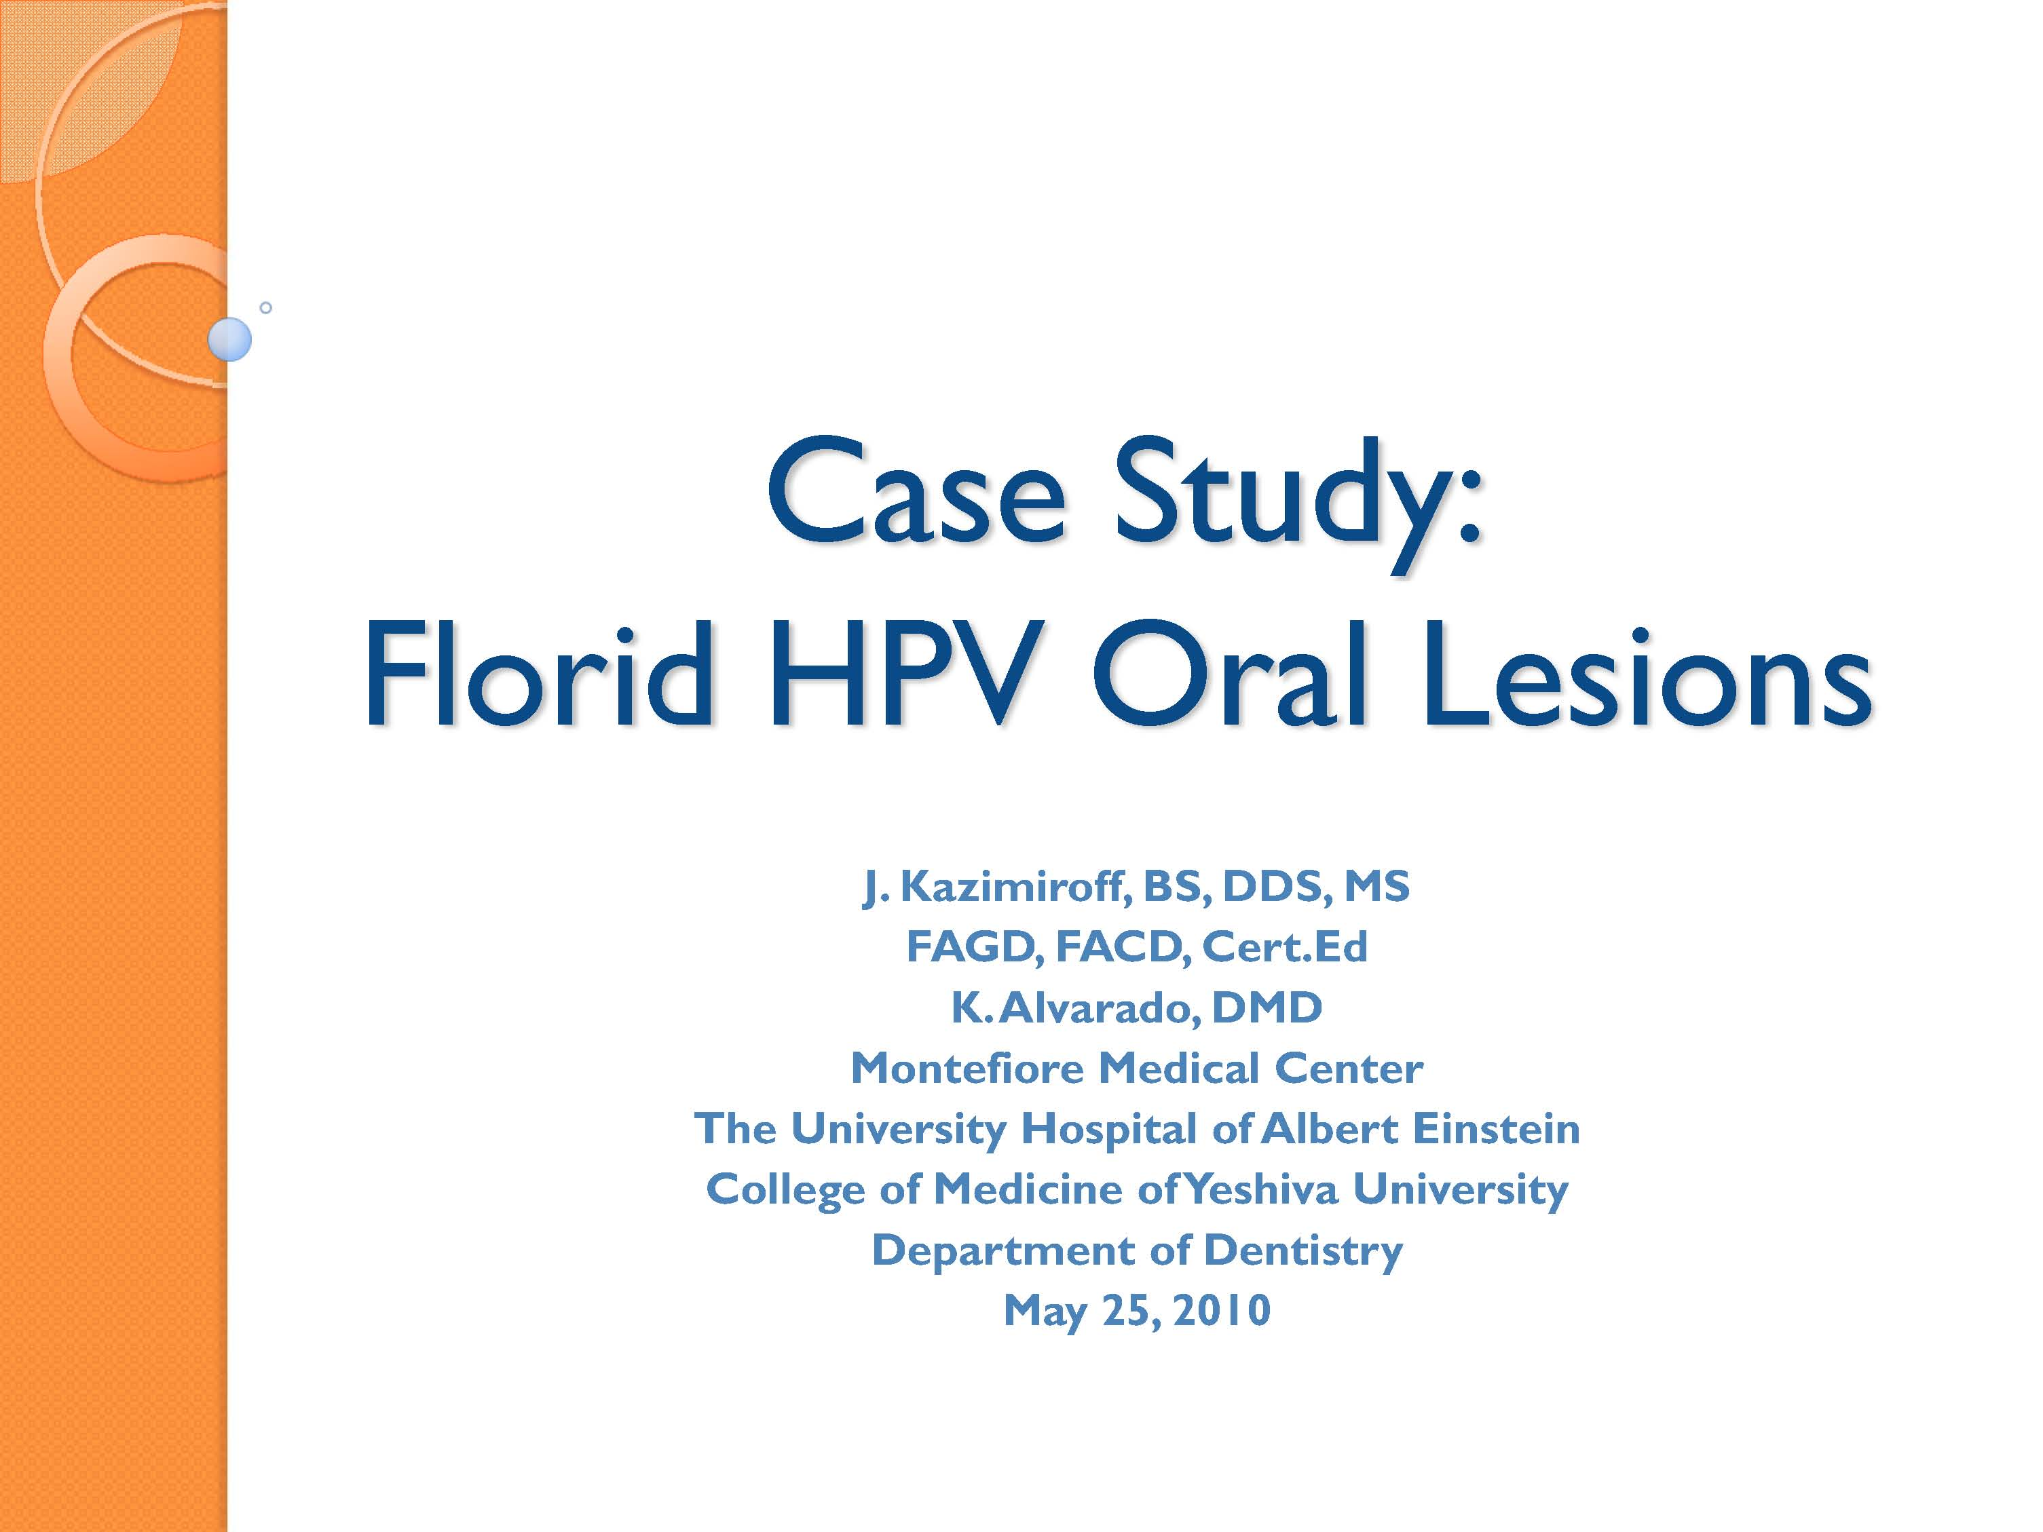

Slide 56
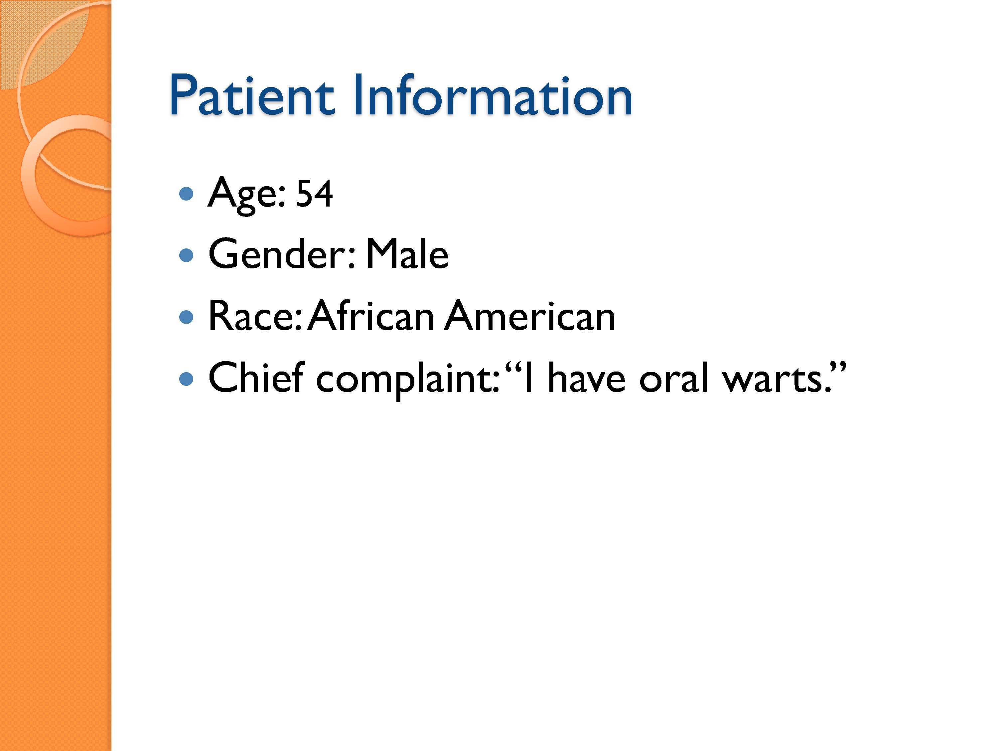

Slide 57
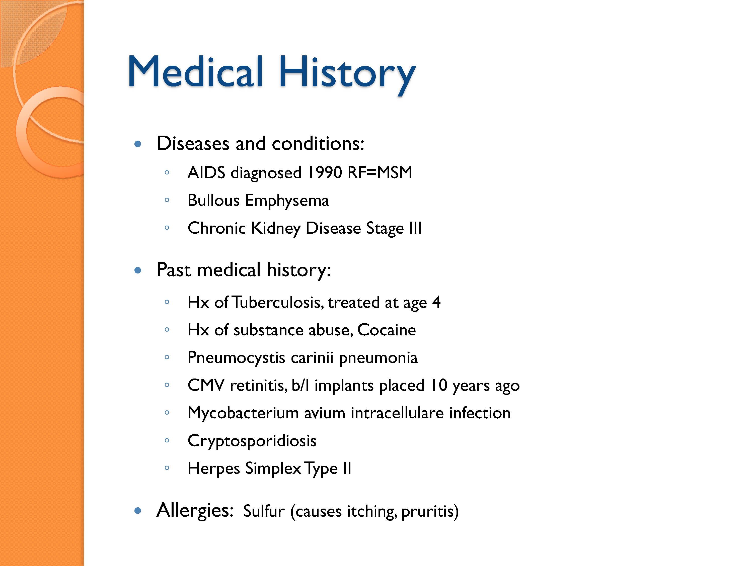

Slide 58
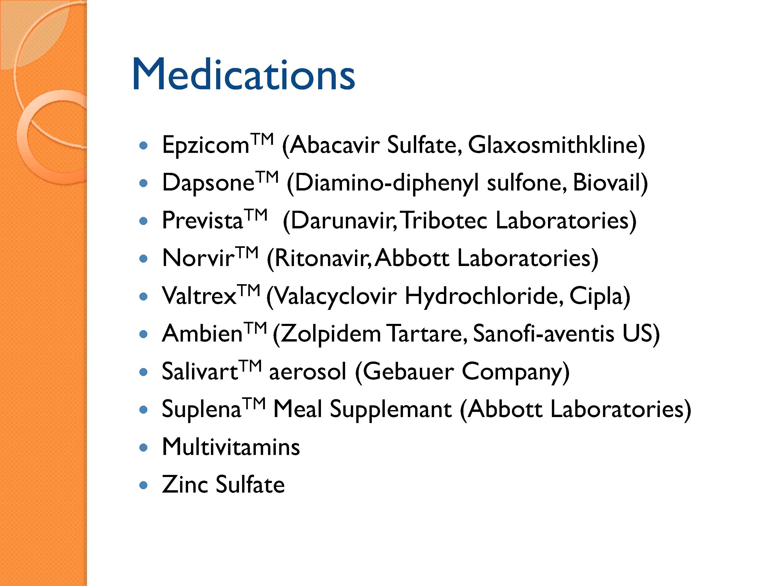

Slide 59
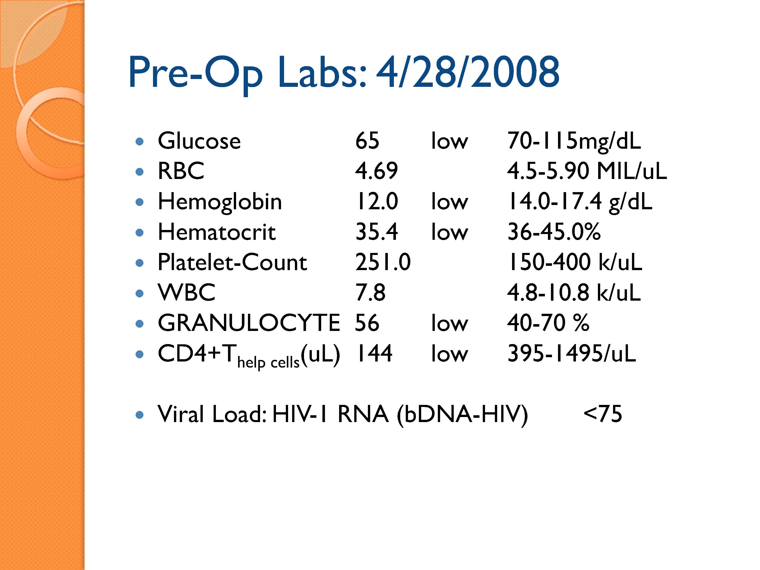

Slide 60
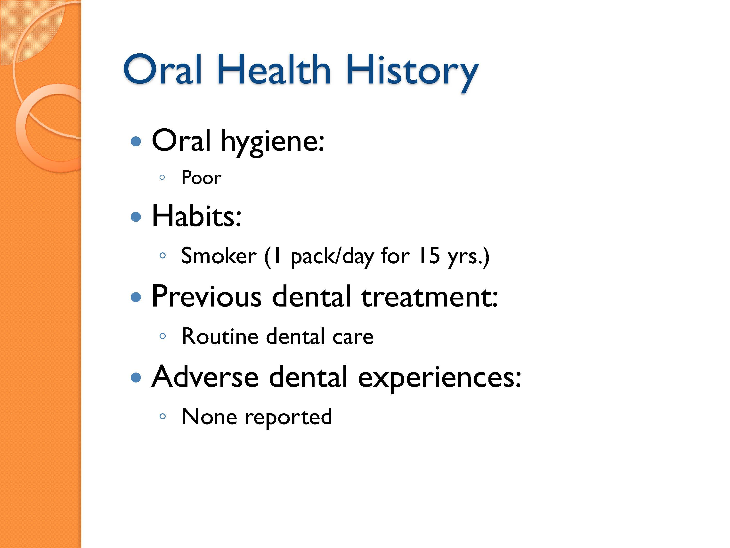

Slide 61
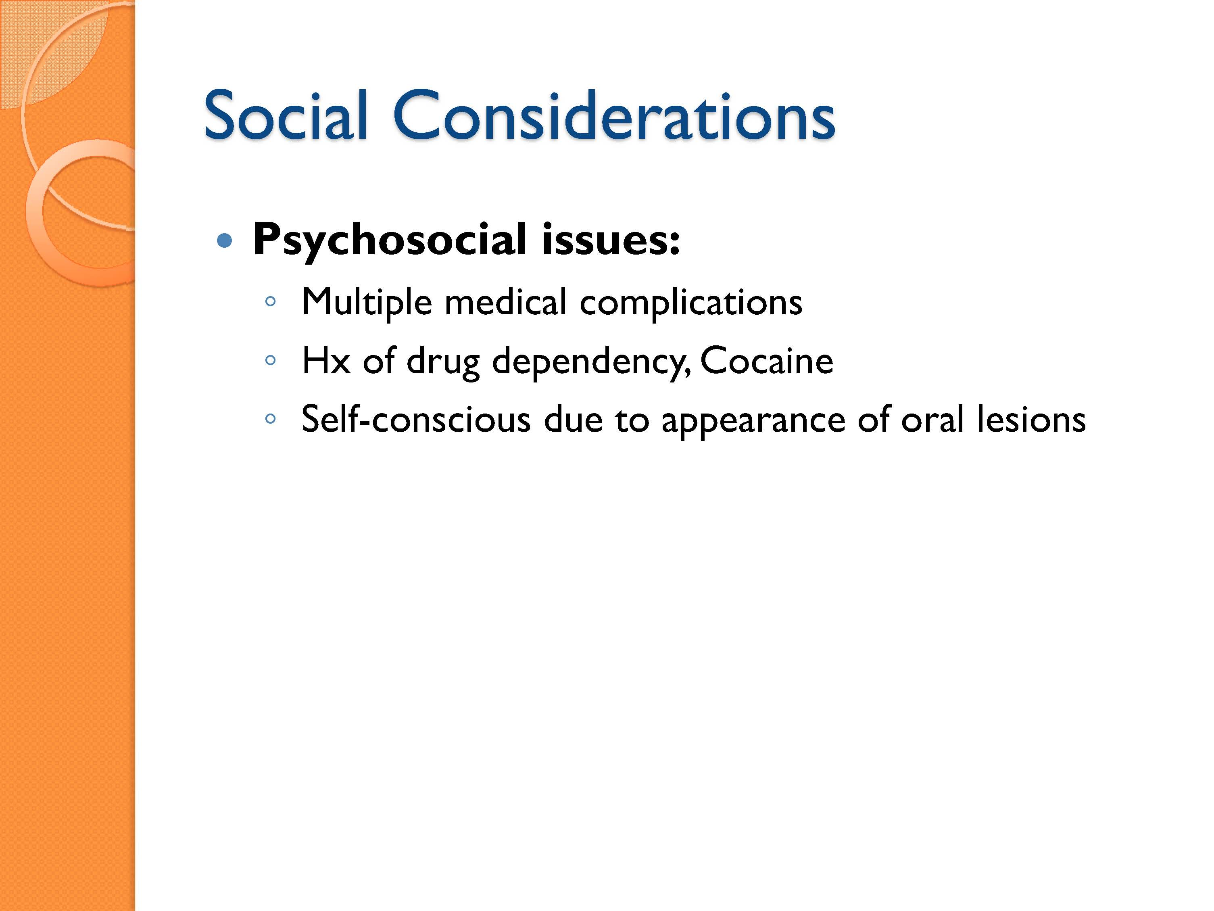

Slide 62
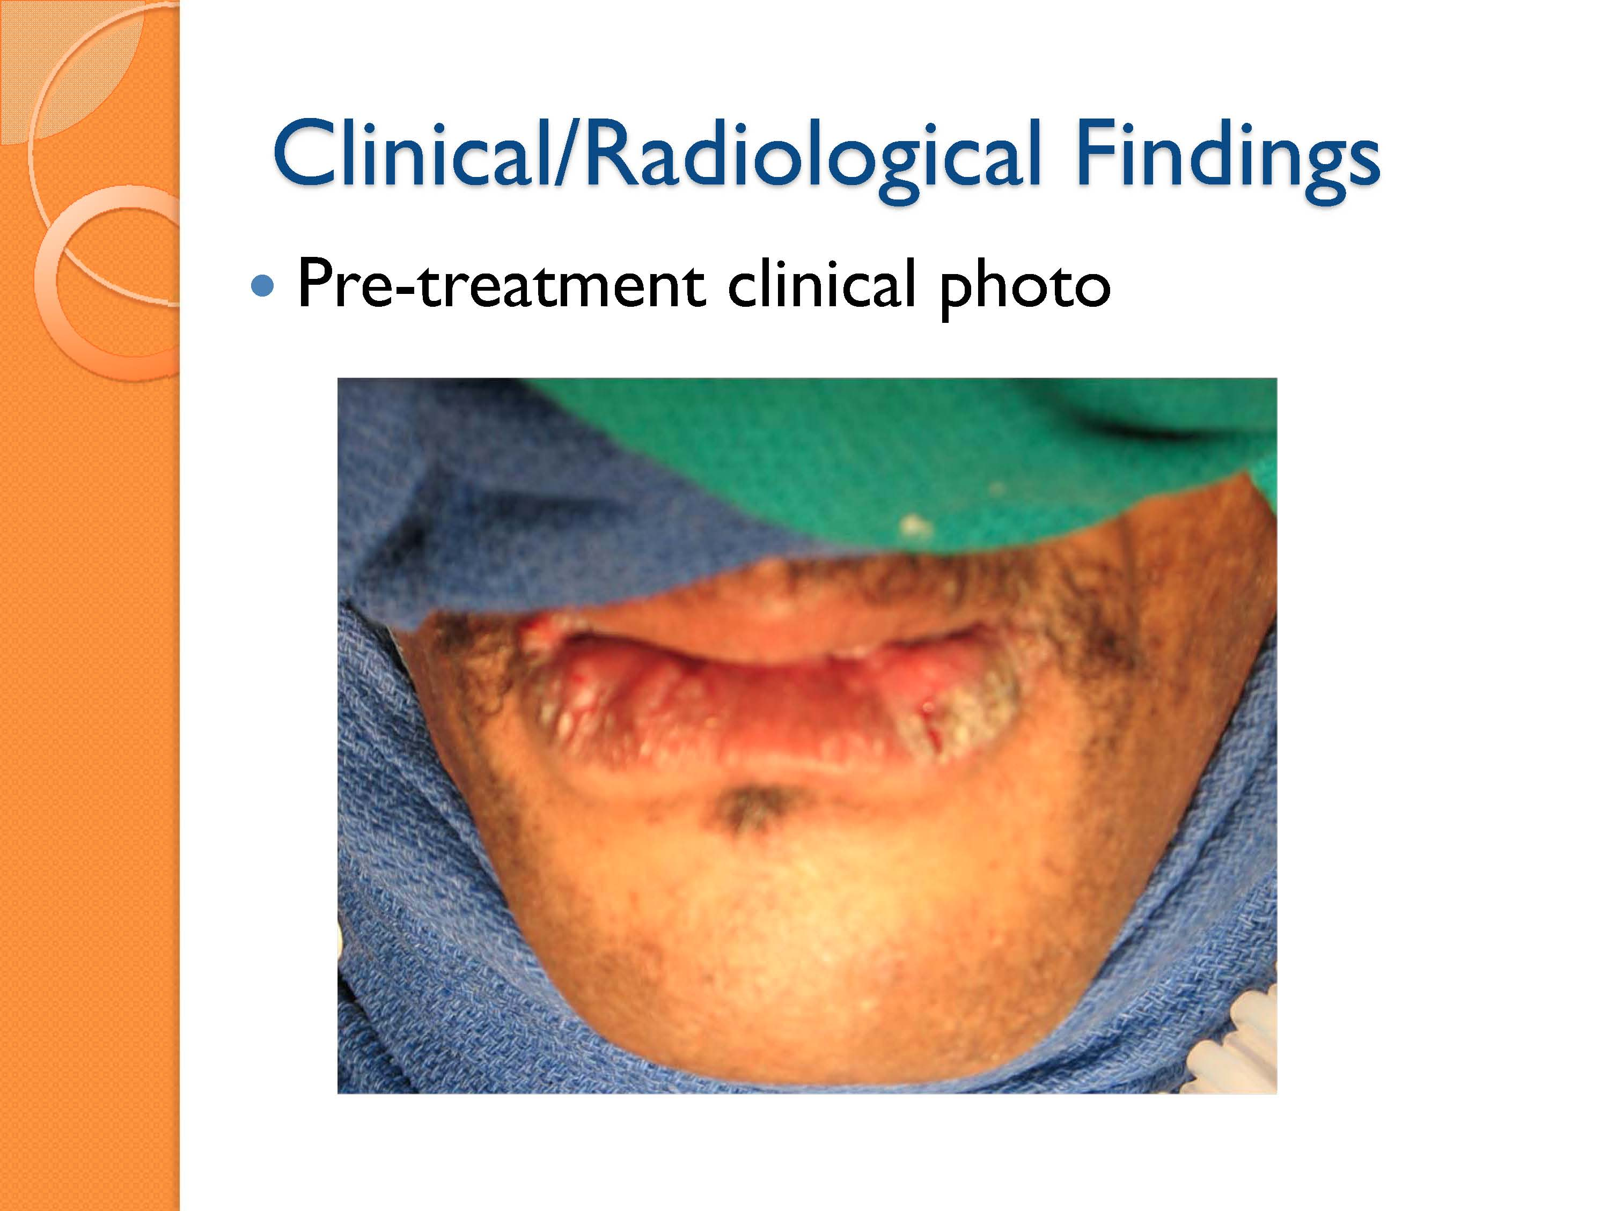

Slide 63
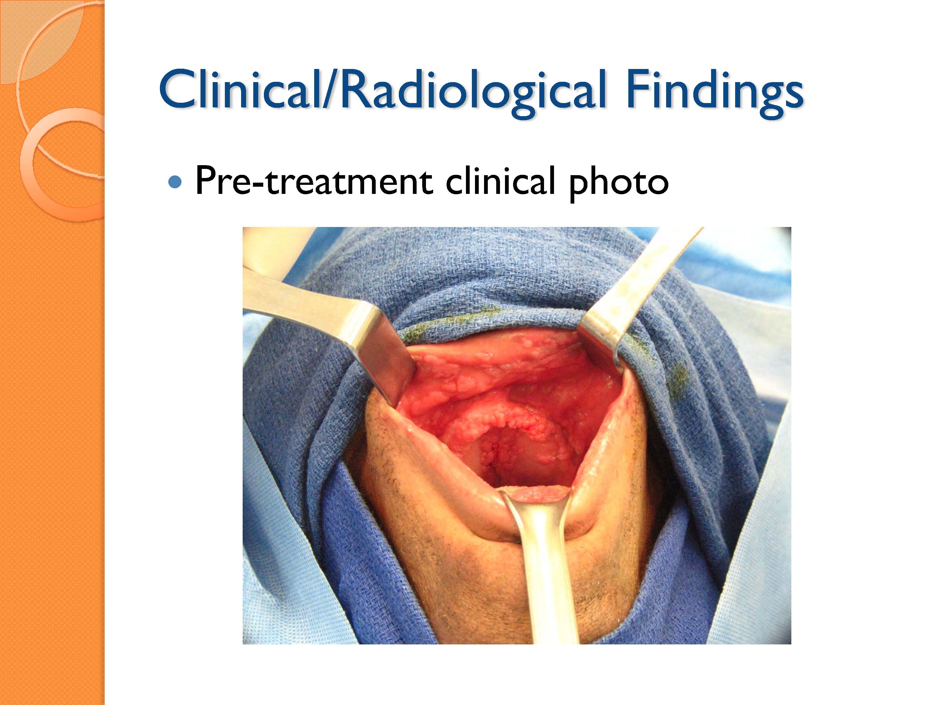

Slide 64
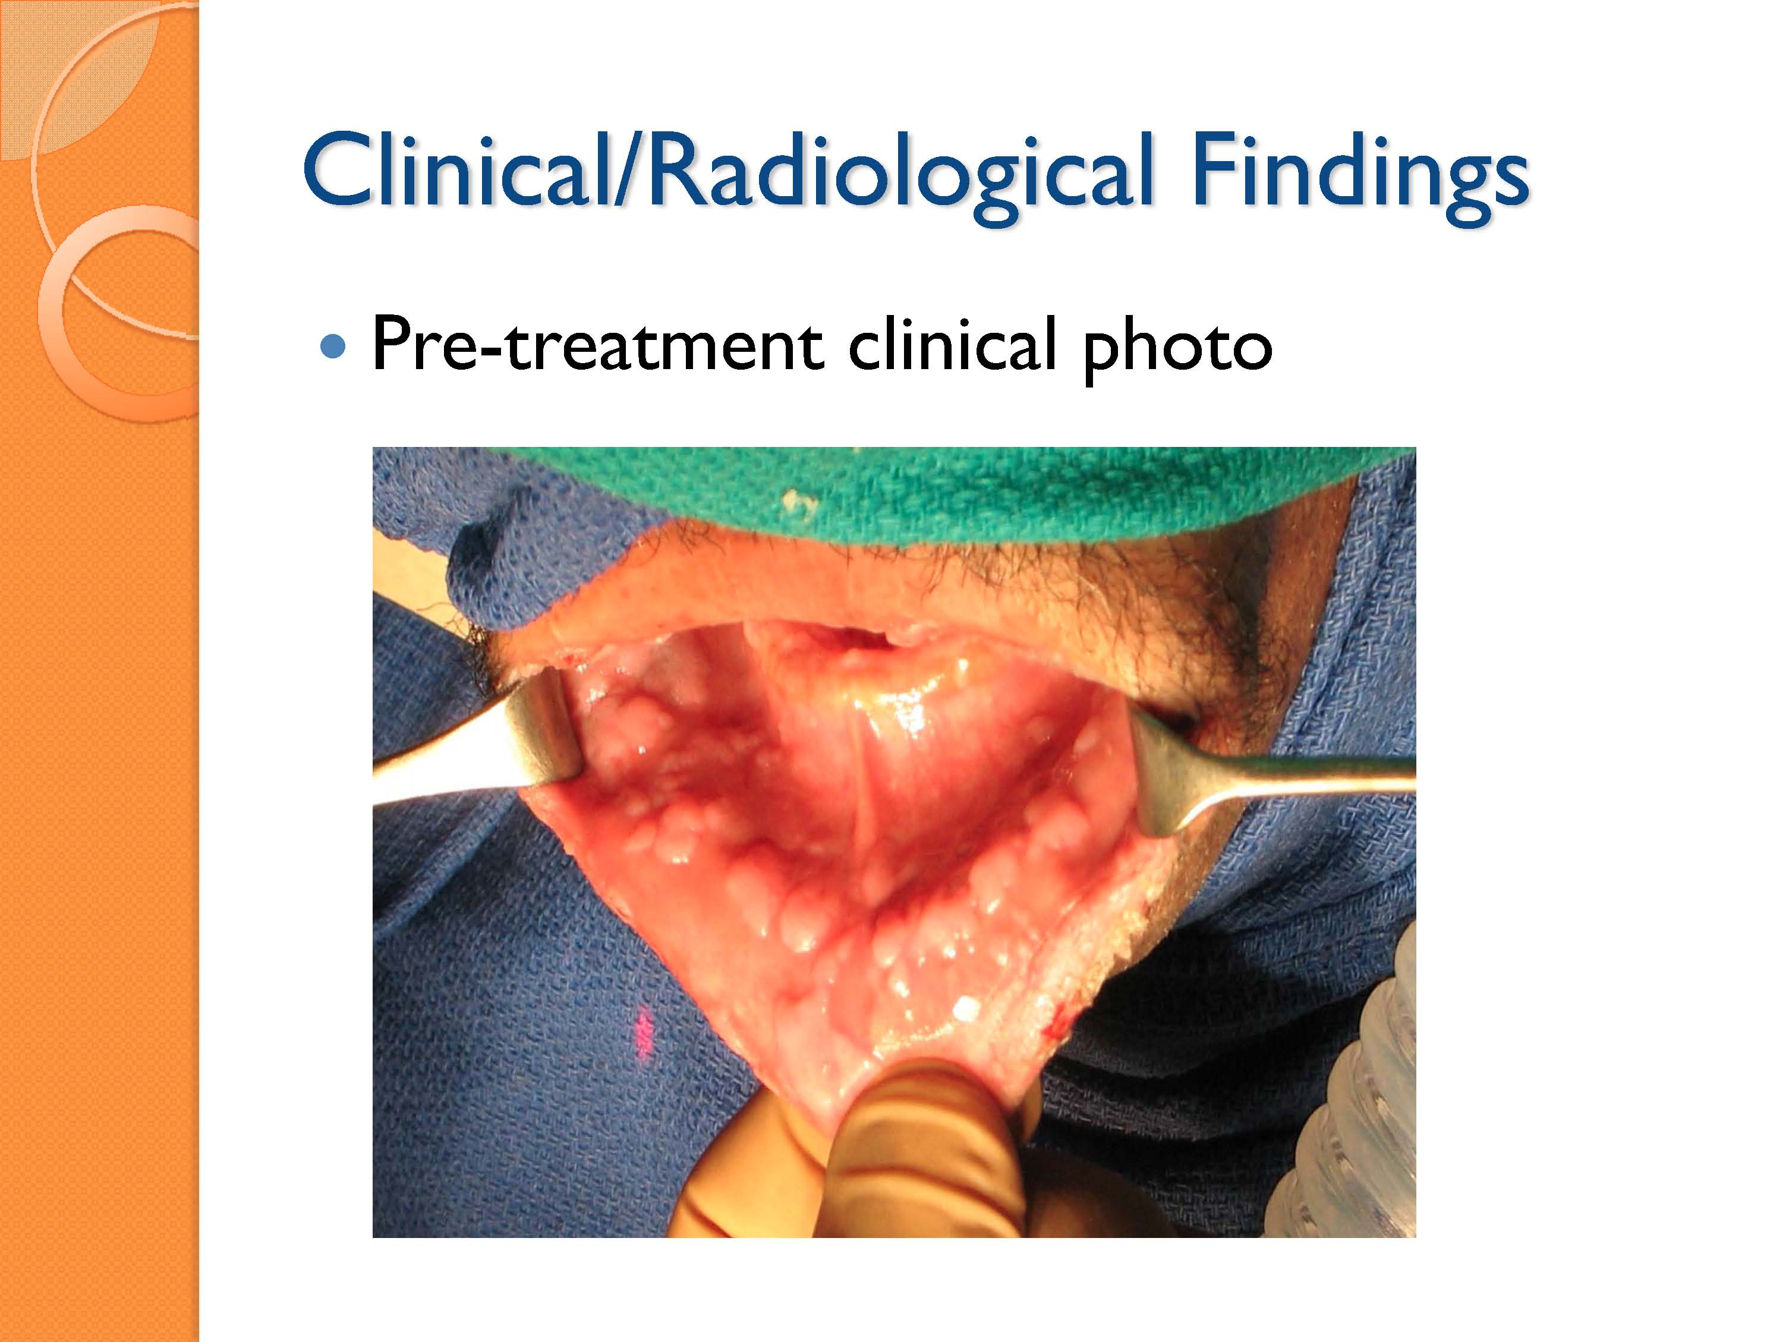

Slide 65
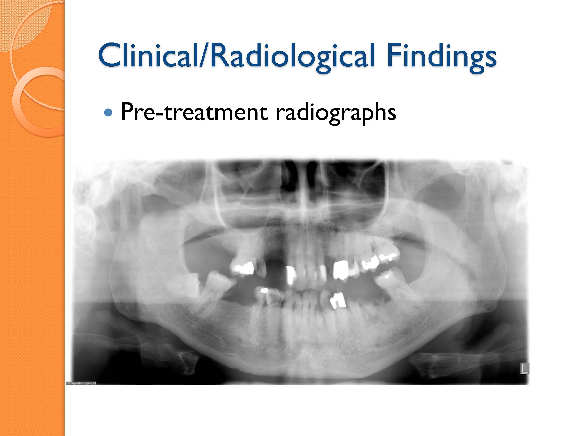

Slide 66
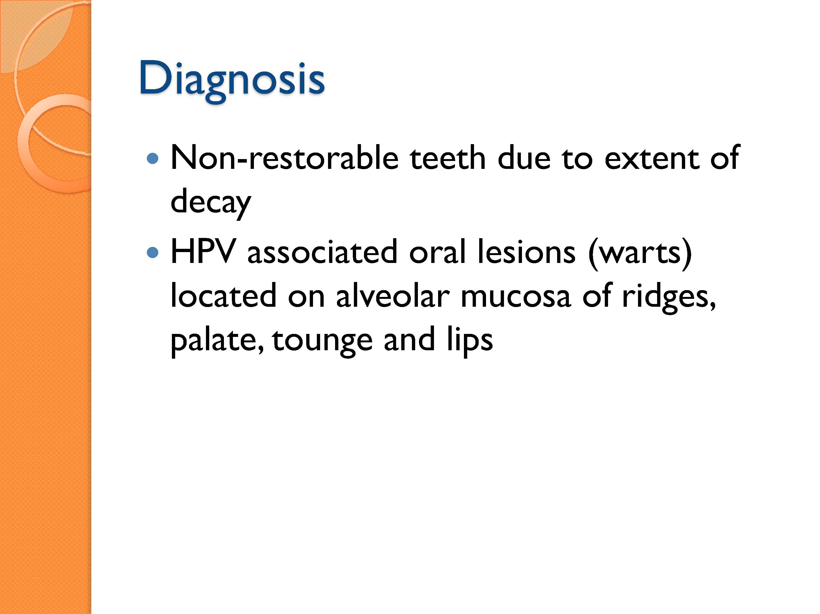

Slide 67
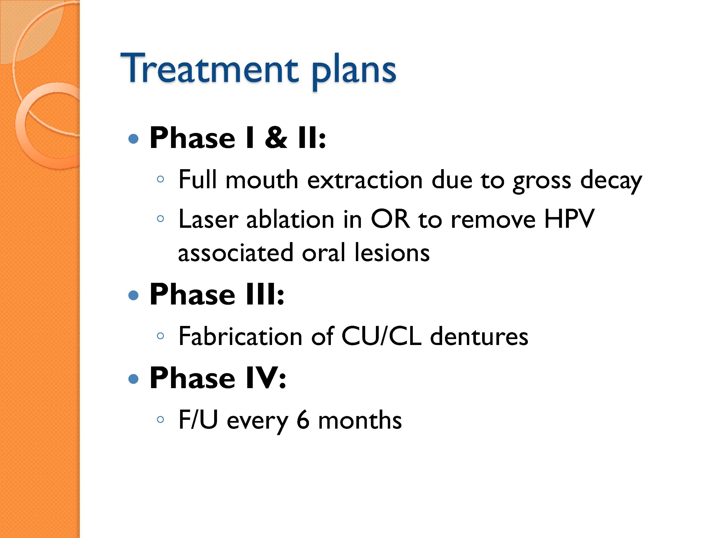

Slide 68
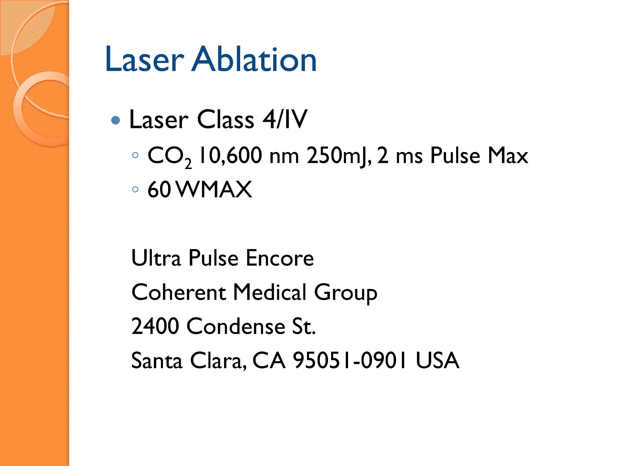

Slide 69
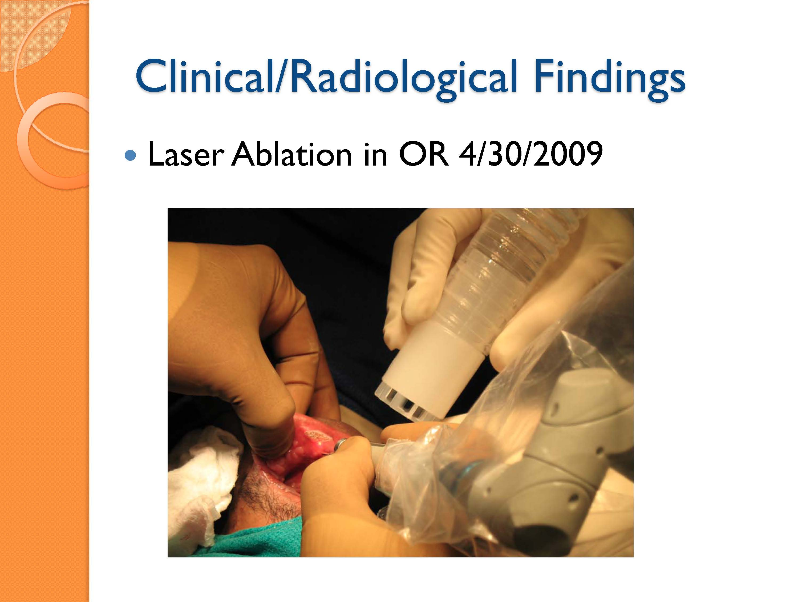

Slide 70
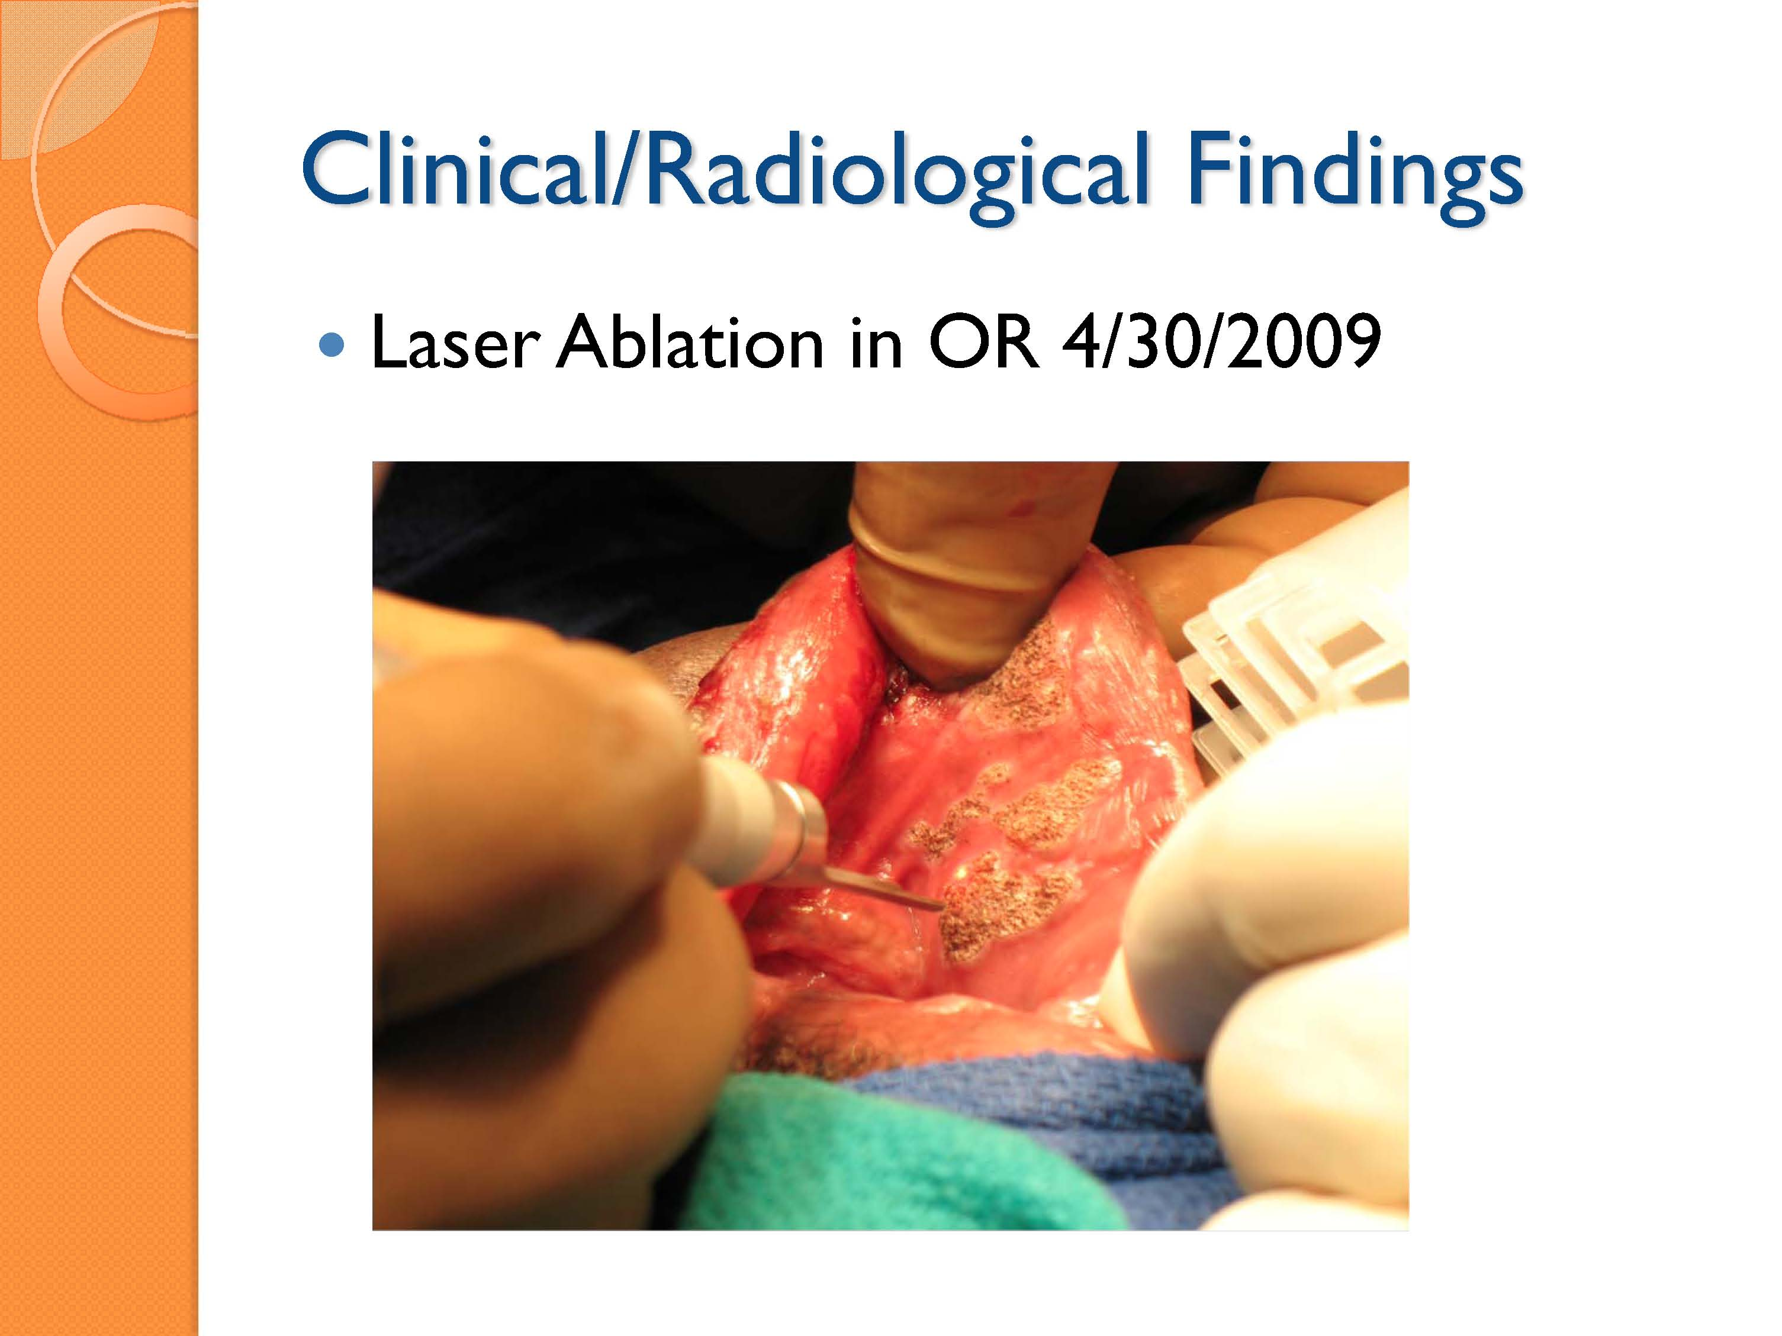

Slide 71
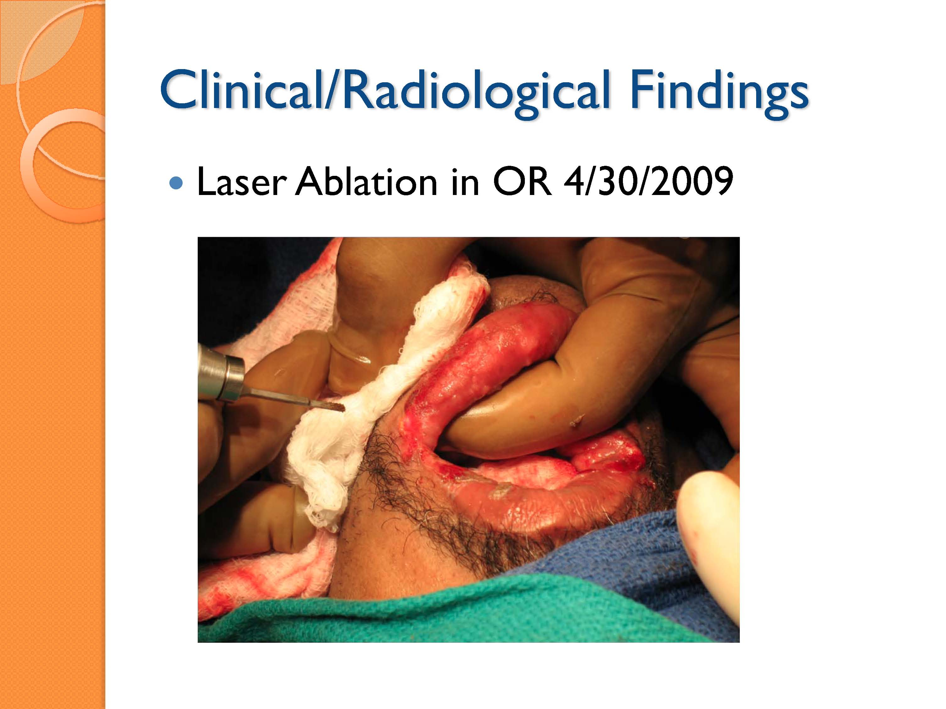

Slide 72
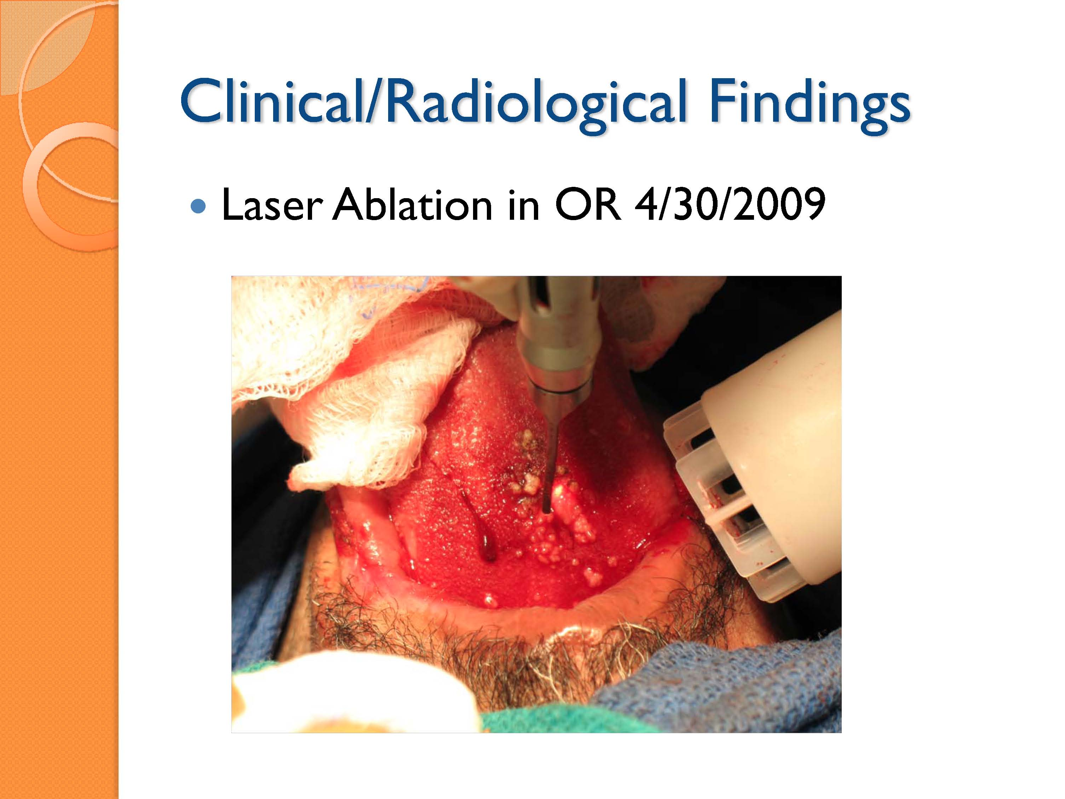

Slide 73


Slide 74


Slide 75


Slide 76


Slide 77


Slide 78


Slide 79


Slide 80


Slide 81


Slide 82


Slide 83


Slide 84


Slide 85
Webinar for Oral Health Screening in Primary Care Setting
  The Webinar recording is approximately 1.5 hours in length and can thus be watched together in the classroom setting or assigned as “homework” for individual student viewing.
  The Webinar was created for providers by HRSA HIV/AIDS Bureau’s Chief Dental Officer, LCDR Mahyar Mofidi, DMD, PhD.
Webinar Recording
https://careacttarget.org/library/oral-health-screening-primary-medical-care-setting
Notes:
The objectives of the Webinar are to enable viewers to:
Describe the impact of oral health disease in PLWHA
Perform oral health screenings on HIV-infected patients, and
Describe strategies for linking patients with HIV to dental care.

Slide 86
MODULE 6:
Session Length: 60 minutes
Materials Needed:
  Computer and compatible LCD projector
  Copies of the handout should be printed out and distributed to each person
  Timer or watch with a second hand
  Calculator
  6 pieces of paper
  3 pencils or pens
  Prizes and/or a buzzer are optional but recommended.
Oral Health in PLWHA: Know the Facts

Slide 87



HIV Oral Health Jeopardy for Providers!!!

Slide 88






QUESTION
BOARD
Team
Condom
Sense
Team Tuff Tooth
Team
Dapper Dentist
Team C

Slide 89
Myth Busters
Lab Values
HIV and Aging
Picture this!
Dental Treatment
Random Facts
100
100
100
100
100
100
200
200
200
200
200
200
300
300
300
300
300
300
400
400
400
400
400
400
500
500
500
500
500
500
FINAL JEOPARDY!!!

Slide 90
Which of the following
is a myth?
HIV can be transmitted via shared eating utensils
HIV can be transmitted via saliva
HIV can be transmitted in an aerosol
All of the above
$100
Scores

Slide 91
The capital of which country has the highest reported prevalence of HIV?
A. USA
B. China
C. England
D. Australia
$200
Scores

Slide 92
Which of the following
is TRUE?
Oral HPV will always result in oral warts or oral cancer
HIV medications work by actively destroying HIV
Receptive anal sex has a higher risk of HIV transmission than receptive oral sex
Standard precautions do not protect against the transmission of HIV
$300
Scores

Slide 93
Which of the following
is TRUE?
Antibiotic prophylaxis is required for all patients with an AIDS diagnosis before invasive dental treatment
HIV is more infectious than viral hepatitis
The majority of HIV cases world-wide are among men who have sex with men
Standard precautions are protective against bloodborne pathogens
$400
Scores

Slide 94
Daily
Double

Slide 95
High speed ultrasonic scalers:
Are always safe to use with a person with an AIDS diagnosis
Never safe to use with a person with an AIDS diagnosis
Sometimes safe and sometimes not safe, it depends on the patient’s viral load
Are not as effective as manual scaling
$500
Scores

Slide 96
One definition of AIDS is
when a HIV+ person’s CD4
count drops below ___?
200 cells/mm³
250 cells/mm³
300 cells/mm³
350 cells/mm³
$100
Scores

Slide 97
Oral manifestations seen in association with HIV disease are more likely to occur when the …
CD4 Count is greater than 500 cells/mm³
HIV viral load is between 200 and 500 copies/mL
CD4 count is less than 200 cells/mm³ and HIV viral load is greater than 3,000 copies/mL
HIV Viral Load is undetectable
$200
Scores

Slide 98
What is the lowest platelet count to safely perform an invasive dental procedure on a PLWHIV?
A. 30,000
B. 40,000
C. 60,000
D. 70,000
$300
Scores
Scores

Slide 99
Procedures involving moderate risk of bleeding such as simple extractions of up to 3 teeth can be safely performed on patients on warfarin if the INR is ____ ?
A. Greater than 3
B. Less than 3
C. Greater than 4
D. Between 1 and 3
$400
Scores

Slide 100
Which of the following requires premedication for dental treatment?
A. A viral load >100,000
B. An INR of 2
C. An absolute neutrophil count of 500 cells/mcl
D. A and C
$500
Scores

Slide 101
What is the major modifiable death risk factor among PLWHIV?
A. Over-eating
B. Smoking
C. Lack of weight-bearing exercise
D. Lack of dental care
$100
Scores

Slide 102
Is the following statement
true or false?
It is estimated that by 2017, and possibly 2015, more than half of all individuals with HIV in the U.S. will be 50 and older
TRUE
$200
Scores

Slide 103
Name 4 out of the 5 A’s that are used for smoking cessation programs?
Ask about smoking,
Advise to quit,
Assess willingness to quit,
Assist to stop,
Arrange for follow up
$300
Scores

Slide 104
Which of the following statements about PLWHIV over age 50 is TRUE?
African-American women make up 11% of women over 50 and 65% of HIV infections among older women
Until recently, people in their 50s and 60s did not believe they were at risk for HIV infection
It is estimated that 15% of all new HIV infections occur in people over 50
All of the above
$400
Scores

Slide 105
Which of the following
is TRUE?
Age has a greater impact on bone fractures in PLWHIV than in people not living with HIV
The pre-treatment CD4 count is significantly lower in PLWHIV over the age of 50
PLWHIV over the age of 50 are hospitalized more frequently than other PLWHIV, but not for HIV-related conditions
All of the above
$500
Scores

Slide 106



What is the most common malignancy associated with HIV that may present like this?
Kaposi’s Sarcoma
$100
Scores

Slide 107

The medical term for the most common fungal infection of the mouth, which includes white patches that wipe away
hivdent.org
Oral Pseudomembranous candidiasis
$200
Scores

Slide 108
How long should oral candidiasis be treated?
A. Treatment should continue until symptoms of candidiasis are gone, 3-7 days
B. 10 days
C. Two weeks
D. The answer depends on whether topical or systemic anti-fungal therapies are used
$300
Scores

Slide 109

What is this?
Oral Warts
$400
Scores

Slide 110

Present two weeks, sensitive to spicy foods, first occurrence, this patient has …
A. Median rhomboid glossitis
B. Erythematous (Red thrush)
C. Trauma
D. A and B
$500
Scores

Slide 111
What are 3 things that can cause Xerostomia?
Radiation
Medication
Chemotherapy
Alcohol consumption
Tobacco use
Sjögren’s syndrome
$100
Scores

Slide 112
What are three ways to help manage dry mouth?
Drink water
Chew on sugarless gum
Suck on sugarless gum
Artificial saliva
Avoid caffeine
Avoid sodas and high sugar products
Avoid mouth rinses with high alcohol content
$200
Scores
Notes:
This question is open. As long as they provide an valid example of an open-ended question, the answer is correct. Any question that cannot be answered with one word (i.e. Do you like your dentist? Are you coming to your next appointment?)

Slide 113
Which of the following is TRUE about medical-grade, alcohol-based hand rubs?
They kill micro organisms more effectively than hand washing with soap and water if there is no visible debris
They are more damaging to skin than soap and water
They are the preferred method of hand hygiene in all situations
All of the above
$300
Scores
Notes:
This question is open to different responses. The key to a correct response involves

Slide 114
Which of the following lesion(s) are only seen in PLWHIV?
Kaposi’s sarcoma
Oral hairy leukoplakia
A and B
None of the above
$400
Scores

Slide 115
Daily
Double

Slide 116
Immediately after an exposure, you should…
A. Milk the wound
B. Wash the wound with bleach
C. Wash the wound with soap and water
D. Go to the emergency room to access appropriate medical follow up
$500
Scores
Notes:
Key points are: brushing the gums, tongue, and dentures

Slide 117

How many Americans experience some anxiety and fear of the dentist?
      A. 1 million
      B. 15 million
      C. 30 million
      D. 55 million
$100
Scores

Slide 118
Which statement about
saliva is TRUE?
It mostly contains bacteria that are bad for your mouth
It can act as a great lubricant for sex
It helps with swallowing food, not the digestion of food
All of the above
$200
Scores

Slide 119
Which of the following
is TRUE?
In the U.S., 1 in 5 people living with HIV infection do not know their status
Saliva is a vehicle for HIV transmission
Kaposi’s sarcoma is only seen in people with CD4 count under 200 cells/mm³
HIV is more infectious than hepatitis B or C
$300
Scores

Slide 120
Which of the following
is TRUE?
The risk of HIV seroconversion after a needle stick injury involving a patient with HIV disease is 13%
The risk of HBV seroconversion after a needle stick injury involving a patient with hepatitis B is between 6% and 30%
There is a vaccine for HIV
Hepatitis C transmission only occurs through use of contaminated needles, unprotected sex is not a risk factor
$400
Scores

Slide 121
Which of the following
is FALSE?
Prince Charles has someone squeeze toothpaste on his toothbrush every day
In 1994, a prison inmate used tooth floss to escape from prison
In an average lifetime, a person produces 10,000 gallons of saliva
The only cheese that is good for your teeth is feta cheese
$500
Scores
Notes:
This final question is an open question and all the teams who provide three valid points should receive points for this question.

Slide 122
FINAL
JEOPARDY

Slide 123
The number of documented cases of HIV seroconversion among dental health care workers following an exposure involving a patient with HIV disease in the dental setting is ----
Zero
Scores
Notes:
This final question is an open question and all the teams who provide five valid points should receive points for this question.

Slide 124
MODULE 7:
Session Length: 45 minutes
Materials Needed
  Computer and compatible LCD projector
  Copies of the Module 7 handout distributed in advance of training.
Dental Case Management

Slide 125

Dental Case Management in the SPNS Oral Health Initiative
9 out of 15 SPNS demonstration sites employed a dental case manager, patient navigator, or an outreach worker as part of their program model.
Having a dental case manager was a key success factor for SPNS Oral Health Initiative projects.
Notes:
Dental Case Management in the SPNS Oral Health Initiative
As part of the SPNS Initiative, 9 out of 15 demonstration sites employed a dental case manager, patient navigator, or an outreach worker as part of their program model.
Having a dental case manager was a key success factor for SPNS oral health initiative projects

Slide 126
The Value of a Dental Case Manager – Testimonials
Provider
“It’s important to find somebody that has that ability to communicate with patients and be trusting with patients, because I think that once you build that trust with the patient, they will always come back for care. - Lucy Wright, Patient Navigator and AIDS Dental Case Manager, Native American Health Center
Patient
“I had bad teeth as a kid, I didn’t want to go [to the dentist]…. They talk you through it. They are so, so cool. Very, very understanding. I hate to say this, you know I’m 50 plus years old, but I was afraid to go to the dentist.” – SPNS Grantee Patient at Harbor Health
Patient
“You need someone to centrally coordinate, so that one person coordinates what is going on or gives direction on what place to go and this eases the peace of mind. – SPNS Grantee Patient at Harbor Health
Notes:
The Benefits of a Dental Case Manager - Testimonials
Provider testimonial: “It’s important to find somebody that has that ability to communicate with patients and be trusting with patients, because I think that once you build that trust with the patient, they will always come back for care.” - Lucy Wright, Patient Navigator and AIDS Dental Case Manager, Native American Health Center
Patient testimonials about benefits of dental case manager:
“I had bad teeth as a kid, I didn’t want to go [to the dentist]…. They talk you through it. They are so, so cool. Very, very understanding. I hate to say this, you know I’m 50 plus years old, but I was afraid to go to the dentist.” – SPNS Grantee Patient at Harbor Health
“You need someone to centrally coordinate, so that one person coordinates what is going on or gives direction on what place to go and this eases the peace of mind.” – SPNS Grantee Patient at Harbor Health

Slide 127

What is Dental Case Management?
Dental case managers ultimately have the same objective as other types of case managers: to increase access to and retention in care.
Where dental case managers differ, however, is that they are able to address barriers to oral health care in a way that other HIV-care providers cannot.
Dental case managers enable HIV case managers to focus on other issues within a client’s service plan without sacrificing access to oral health care.
Notes:
It’s common to find HIV case managers working in medical settings (medical case management) or social service organizations (psychosocial case management), but dental case management in the HIV setting is relatively new.
Dental case managers ultimately have the same objective as other types of case managers: to increase access to and retention in care.
Where dental case managers differ, however, is that they are able to address barriers to oral health care in a way that other HIV-care providers cannot.
Most HIV case managers have a large patient caseload and a series of service areas to address, many of which may be more pressing than oral health care. Oral health often gets pushed to the bottom of the list, if it is on the list to begin with.
Dental case managers enable HIV case managers to focus on other issues within a client’s service plan without sacrificing access to oral health care.

Slide 128

The Essential Functions of a Dental Case Manager
Recruiting patients into care
Scheduling and arranging patient transportation to appointments
Following up with patients regarding missed appointments
Coordinating and referring patients to other services, such as HIV case management, medical care, or support services
Serving as part of a team that helps educate other providers in the continuum of HIV care on the importance of oral health care and how to refer their patients to dental services
Retention services
Language translation services, in some instances.
Notes:
The Essential Functions of a Dental Case Manager
Recruiting patients into care
Schedule and arranging patient transportation to appointments
Following up with patients regarding missed appointments
Coordinating and referring patients to other services such as HIV case management, medical care, or support services
Serving as part of a team that helps educate other providers in the continuum of HIV care on the importance of oral health care and how to refer their patients to dental services
Retention services
Language translation services, in some instances

Slide 129
Integrating Dental Case Management into Your Practice
Employing a dedicated dental case manager can be difficult financially, which is why the dental case managers in the SPNS projects had multiple secondary responsibilities outside of their primary responsibility for dental case management.
  Some of these included:
    Conducting patient surveys
    Entering data
    Driving a mobile van
    Staffing the front desk/serving as receptionist
    While it is not required that a dental case manager have a dental background, those who were dental assistants by training can assist with dental care.
Notes:
Employing a dedicated dental case manager can be difficult financially, which is why the dental case managers in the SPNS projects had multiple secondary responsibilities outside of their primary responsibility for dental case management.
Some of these included:
Conducting patient surveys
Entering data
Driving a mobile van
Staffing the front desk/serving as receptionist
While it is not required that a dental case manager have a dental background, those who were dental assistants by training can assist with dental care.

Slide 130
Other Solutions for Integrating Dental Case Management
There are a number of ways to integrate dental case management into your organization, no matter your size or resource limitations.
Consider creating a network of individuals supporting dental case management.
Have HIV case managers take on dental case management, depending on their existing workload.
  Organizations with multiple case managers can dedicate one case manager to oral health.
Ryan White nurse case managers could be trained to provide basic oral hygiene education and include oral health as part of their clinical assessments.
Notes:
Other Solutions for Integrating Dental Case Management
Distribute the various dental case management functions among other staff, such as receptionists, schedulers, translators, dental hygienists, and so forth. Thus, there would not be one dental case manager, but a network of individuals supporting dental case management.
Organizations that provide both medical and dental care could have their HIV case managers take on dental case management, depending on their existing workload.
Organizations with multiple case managers can dedicate one case manager to oral health.
Ryan White nurse case managers could be trained to provide basic oral hygiene education and include oral health as part of their clinical assessments.
Bottom line: There are a number of ways to integrate dental case management into your organization, no matter your size or resource limitations. The most important thing is to make dental case management an integral part of clinic operations.

Slide 131
MODULE 8:
Session Length: 60 minutes
Materials Needed:
  Computer and compatible LCD projector
  Copies of the handout should be printed out and distributed to each person.
Summary
  This module provides recommendations for providers seeking to educate their patients about the components of a basic oral health care plan, the role of proper dental hygiene for oral and total systemic health, the importance of home dental care, and the management of pain related to oral disease and treatment.
Provider-Patient Oral Health Education

Slide 132




Oral Health Care
Patient Education
Diana Travieso Palow, MPH, MS, RN
Jeanne Adler, MSN, ARNP-C
Carol Stewart, DDS, MS
Claudette Grant, MEd, CCRC, RN

Slide 133

Goals of the Program
Review components of basic oral care plan
Review role of proper dental hygiene for oral and systemic health
Review home care
  Mouth
  Dentures
  Treatment of dentures or partials for candidiasis
Review management of pain
Review management of “dry mouth”
Review “Fact vs. Fiction”

Slide 134
Goals of Oral Health Program
Treat pain, diagnose pathology, and eliminate sources of infection
2. Stabilize and preserve oral tissues
3. Restore oral function
4. Educate patient regarding maintenance
5. Facilitate maintenance of adequate nutrition
6. Contribute to self-esteem and quality of life

Slide 135
Dental Visits
All patients should be encouraged to regularly visit the dentist, at least once every 6 months
Patients should disclose HIV status to their dentists
Preventive, restorative, palliative, rehabilitative services should be provided
Notes:
Disclosure to dentist is important so that they will pay extra attention to examination for oral manifestations of HIV disease
Patients should see dental hygienist for professional scaling at least twice/year

Slide 136
Dental Hygiene
Reduces possible sources of infection and maintains integrity of teeth and gums
Promotes a better appetite
Identifies the correct use of topical and oral medications

Slide 137
Mouth Care
Involves the teeth, gums, palate and tongue
Patients should be encouraged to:
  Brush teeth, at least twice/day or after meals
    Soft toothbrush, replace every 1 – 2 months
  Use toothpaste that contains fluoride
  Floss after meals (be cautious with low platelet counts)
  Regularly use an alcohol – free mouthwash
  Moisturize and lubricate lips and mucosa as needed

Slide 138
Oral Care
Brush 2 times/day with fluoride toothpaste
Floss daily – (gently but thoroughly)
Home fluoride program as appropriate
Avoid constant snacking
Avoid tobacco products
Avoid alcohol

Slide 139
Denture Care
Patients should be instructed to clean dentures and partials as thoroughly and as often as natural teeth, at least twice/day.
A denture brush or toothbrush should be used and all surfaces brushed with toothpaste.
Patient should check the mouth and gums after removing dentures for signs of irritation, redness or swelling.
The entire oral mucosa should be cleaned after removing dentures. If painful or bleeding, oral swabs or saline-soaked gauze should be used.
Dentures should be soaked (use 1.5 % H2O2) for several minutes or overnight.
Notes:
For patients with oral Candida: Teach patients to soak dentures/partials in Chlorhexidine solution (Periogard) then apply thin coating Nizoral cream on the acrylic portion that will be in contact with oral mucosa. If there is Candida under the denture remove the prosthesis before using topical agents to treat the Candida.

Slide 140

Candidiasis Treatment – for Partials and/or Dentures
Remove and thoroughly clean daily
Soak in 1:1 dilution of chlorhexidine
gluconate ( PerioGard or Peridex)
1% sodium hypochlorite (if no metal)
Benzalkonium chloride 1:750 if metal
May use Fungizone on tissue side of
  denture or Nystatin powder before
  insertion
**Get a NEW toothbrush

Slide 141

Nutritional Status
Promote healing with a diet high in protein and calories.
The patient should eat multiple small amounts each day.
Supplement meals with vitamins and minerals
Avoid foods that are coarse, rough, acidic or spicy.
Eat warm foods rather than hot.
Cold or frozen foods such as pops, ice cream, and frozen yogurt are soothing and refreshing.

Slide 142

Xerostomia “Dry mouth”
Inadequate saliva production - common
May occur early in the course of the disease
Dental visit necessary
  ensure health teeth and gums
  frequent recalls to avoid tooth loss
  alcohol-free fluoride rinses

Slide 143
Xerostomia – “Dry Mouth”
Signs and symptoms
Xerostomia is the subjective feeling of oral dryness
  Patient states they can’t eat a meal without water
  Frequent thirst
Often accompanied by objective evidence of hyposalivation
  Gloved hand will stick to mucosa
  No “pooling” of saliva observed in floor of mouth
  Significant dental decay
Salivary gland enlargement sometimes observed

Slide 144
Hyposalivation
Inadequate saliva production - common
Due to HIV infection and medications which contribute to impaired salivation
Treatment with fluorides, good oral hygiene, and frequent recalls are essential to avoid tooth loss

Slide 145

Xerostomia Management
Saliva stimulants
  Sugarless gum ( Xylitol )
  Sugarless hard lozenges
Artificial saliva products -
  Optimoist, Oral moisturizer
  Mouth-Kote (OTC)

Slide 146



Xerostomia Therapies
Biotene mouthrinses – alcohol free and antibacterial
Biotene moisturizers for lips, cheeks
Biotene gum – sugar free

Slide 147
Oral Pain
Use topical anesthetics as needed but especially before meals
*Note – gag reflex may be diminished or lost

Slide 148
Sedative Mouth Rinse
For temporary relief or pain from oral ulcers
Rx: Must be compounded
  80 ml 2% viscous xylocaine
  80 ml Maalox
  100 ml distilled water
Disp: 260 ml
Sig: Swish for 1 minute and expectorate
*Note – gag reflex may be diminished or lost

Slide 149
Fact vs. Fiction
Common Products: beneficial vs. harmful:
1) Lemon and glycerin swabs
Harmful- irritates and dries oral mucosa
2) Mouthwashes without alcohol
Less beneficial if not formulated with an antiseptic agent (no antimicrobial effect)
Can mix non alcohol rinses with saline or H₂O₂ (properly diluted)

Slide 150
Fact vs. Fiction
Common Products: beneficial vs. harmful:
3) Moisturizers
Petroleum-based cannot be used in the mouth (danger of aspiration) and may cause lip inflammation with open wounds
Use of water-soluble moisturizers - absorbed by skin and tissue, provide hydration, and if fortified with Vitamin E can speed healing of ulcers. Saliva substitutes help moisturize the oral cavity.
4) Protective Agents
Substrates of antacids (e.g. Maalox) can be applied to inflamed or ulcerated areas
Carafate dissolved in water can provide a protective coating (swish and swallow)

Slide 151
Additional References
Greenspan, Deborah. Oral Manifestations of HIV. June 1998. <http://www.hivinsite.com/InSite?page=kb-authors&doc=kb-04-01- 14#>.
HIV and the Mouth. January 2001. <http://www.projectinform.org/fs/oral.html>.
Kinn, Mary E., and Mary Ann Woods. The Medical Assistant Administrative and Clinical. 8th Edition. Philadelphia, PA: WB Saunders Co., 1999.
Kirton, Carl. ANAC’s Core Curriculum for HIV/AIDS Nursing. 2nd Edition. New York, NY: Sage Publications, 2003.
Pascoe, Gary P., John McDowell, Lucy Bradley Springer. HIV/AIDS in Dental Care: A Case-Based Self-Study Module for Dental Health Care Personnel. August 2002.
Sorrentino, Sheila A. Mosley’s Textbook for Nursing Assistants. 5th Edition. St. Louis, Missouri: Mosby Inc., 2000.
United States. Department of Health and Human Sevices, Health Resources and Services Administration, HIV/AIDS Bureau. Clinical Management of the HIV-Infected Adult: A Manual for Midlevel Clinicians. March 2003.
United States. Department of Health and Human Sevices, Health Resources and Services Administration, HIV/AIDS Bureau. Health Care and HIV: Nutritional Guide for Providers and Clients. June 2002.

Slide 152
Motivational Interviewing: Knowledge is Power
Motivational Interviewing is….
    An exercise that can inspire change and direct provider-patient education efforts.
    A way of working with a patient that…
      Allows the patient to decide what changes they want to make.
      Puts the burden of change in the patient’s hand.
      Emphasizes the relationship as the primary means of making effective and lasting change.
  “People change when they hurt enough that they have to, learn enough that they want to, receive enough that they are able to.”
  —From “Failing Forward” by John Maxwell
Notes:
Motivational Interviewing: Knowledge is Power
Motivational Interviewing Is….
An exercise that can inspire change and direct provider-patient education efforts.
A way of working with a patient that…
Allows the patient to decide what changes they want to make.
Puts the burden of change in the patient’s hand.
Emphasizes the relationship as the primary means of making effective and lasting change.
A frame of mind, rather than a concrete tool.
A collection of skills and ideas you might already be using, with your patients and in your own life
“People change when they hurt enough that they have to, learn enough that they want to, receive enough that they are able to.” - From “Failing Forward” by John Maxwell

Slide 153

  Source :Slide 10, http://echo.hdwg.org/sites/default/files/MI%20Oral%20Health%20dentist .pdf
Notes:
There are 6 Stages of behavior change as studied by Prochuska and DiClemente, diagrammed here.

Slide 154

  Source: Slide 11, http://echo.hdwg.org/sites/default/files/MI%20Oral%20Health%20dentist .pdf
Notes:
These six stages of change are described here in greater detail.

Slide 155


Slide 156


Slide 157


Slide 158


Slide 159


Slide 160


Slide 161


Slide 162


Slide 163


Slide 164


Slide 165


Slide 166


Slide 167


Slide 168


Slide 169


Slide 170


Slide 171


Slide 172


Slide 173

Notes:
Trainer Note: Trainer can utilize the full motivational interviewing training for providers accessible at this link [Add additional 45 minutes to training]: http://echo.hdwg.org/sites/default/files/MI%20Oral%20Health%20dentist .pdf

Slide 174
MODULE 9:
Session Length: 30 Minutes; 60 minutes, with Peer Jeopardy Group Activity completed in class
Summary
  Module 9 is intended to be a training for providers, consistent with the rest of the curriculum modules. The module is intended to be for providers to discuss how peers can be helpful in engaging PLWHA in care, and to familiarize themselves with a possible tool to use in peer education and training.
Materials Needed:
  Computer and compatible LCD projector
  Copies of the handout printed out and distributed to each person
  Timer or watch with a second hand
  Calculator
  Paper for each group
  Pencils or pens for each group
  Prizes and/or a buzzer are recommended but optional.
Peer-Patient Oral Health Education

Slide 175
Peers Can Plan Important Role in Oral Health Education and Care
Peers can encourage oral health care education and entrance into and adherence to HIV and oral health care for PLWHA, including:
    Providing transportation
    Connecting patients with other social services
    Accompanying patients to dental visits
    Talking to them about their oral health care
    Educating them about the importance of oral health care, including sharing their personal experience with oral health care
    Reminding patients about appointments
    Developing patient trust and reducing their fears of dental care.
Notes:
Peers Can Plan Important Role in Oral Health Education and Care
Peers can encourage oral health care education and entrance into and adherence to HIV and oral health care for PLWHA, including:
Providing transportation
Connecting patients with other social services
Accompanying patients to dental visits
Talking to them about their oral health care
Educating them about the importance of oral health care, including sharing their personal experience with oral health care
Reminding patients about appointments
Developing patient trust and reducing their fears of dental care
After reading through this slide, please share copies of the handout for the “Sandra” case discussion activity with the class.

Slide 176

Case Scenario for Peer Outreach: Discussion Questions
What are some of the biggest challenges Sandra faces to getting regular dental care?
Before you start talking with Sandra, what do you notice about her nonverbal communication (body language)? What does her body language suggest? How might this affect the way you approach her?
What are some ways you can start a conversation with Sandra?
Using open-ended style questions, list three questions that you would like to ask Sandra to learn more about her situation.
Sandra informs you that she doesn’t want the surgery because she doesn’t want them pulling out her teeth and making her look ugly. She doesn’t want to go to work with missing teeth. How can you respond?
Identify three ways you specifically can help Sandra with getting the dental treatment she needs.
Notes:
Keep this slide projected during group discussion and full class discussion as guide.

Slide 177
HIV Oral Health Jeopardy for Peers!!!

Slide 178

Team
Condom
Sense
Team Tuff Tooth
Team
Dapper Dentist
Team C

Slide 179
HIV Oral Health 101
HIV & the Mouth
What’s that in the mouth
Let’s talk hygiene & habits
Peer Talk
Random Facts
100
100
100
100
100
100
200
200
200
200
200
200
300
300
300
300
300
300
400
400
400
400
400
400
500
500
500
500
500
500
FINAL JEOPARDY!!!

Slide 180
Which of the following products always contain fluoride?
A. Toothpaste
B. Floss
C. Water
D. None of the above
Scores

Slide 181
Why is fluoride important for oral health?
Fluoride helps bring minerals back into the tooth structure
Scores

Slide 182
HIV 101:
Which of the following is True?
A. Oral HPV will always result in oral warts.
B. HIV medications work by actively destroying the HIV virus
C. Anal sex has a higher risk of HIV transmission than oral sex
Scores

Slide 183
Describe the HIV Life Cycle using AFRITAB.
Attachment, Fusion, Reverse Transcriptase, Integration, Transcription, Assembly, Budding
Scores

Slide 184
Daily
Double

Slide 185

Name the following three structures?
Enamel.
A
Dentin
B
Pulp
C
Scores

Slide 186
_________ can cause “dry mouth” which contributes to ________ in HIV infected persons....
A. Dental cavities; oral herpes
B. Mouth rinse; healthy gums
C. HIV medications; dental cavities
Scores

Slide 187
Which statement about saliva is TRUE?
A. It mostly contains bacteria that’s bad for your mouth.
B. It can act as a great lubricant for sex.
C. It helps with swallowing food, not the digestion of food.
Scores

Slide 188

A common fungal infection of the mouth seen in connection with HIV infection and it often includes white patches?
Thrush (oral candidiasis)
Scores
Scores

Slide 189
What are three ways to help manage dry mouth?
Appropriate answers include – drink water; chew on sugarless gum; suck on sugarless gum; artificial saliva; avoid caffeine; avoid sodas and high sugar products
Scores

Slide 190
Why is it so important to treat oral health problems?
A. If you don’t treat them, bad oral health can cause AIDS.
B. It can lead to trouble with eating, which can affect your overall health.
C. When there is a problem, dental care is more important than HIV care.
D. All of the above.
Scores

Slide 191
What is plaque and why is it a problem?
Plaque is a film on the teeth
that attracts bacteria and
can cause infections in your
teeth and/or gums.
Scores

Slide 192
Pick a product and explain how it can reduce the build up of plaque?
Flossing helps remove plaque by scraping plaque off
in between the teeth
Brushing the teeth helps remove plaque by brushing it off of the inner, outer and chewing surfaces of the teeth as well as the tongue
Antiseptic mouth rinse helps reduce plaque by killing the bacteria that cause plaque
Chewing on sugar free gum or candy helps to reduce plaque by stimulating saliva flow
Scores

Slide 193
Oral infections often occur when CD4 count is _______ and HIV viral load is _______.
CD4 Count is greater than 500 and Viral Load is less than 200
B. When Viral load is between 200 and 500
C. When CD4 count is less than 200 and Viral load is greater than 20,000
Scores

Slide 194
Name two ways a dental rubber dam is used:
Appropriate responses include (by the dentists for fillings, helps isolate the teeth being worked on, oral sex for females, oral-anal sex, any other terms used to define these acts.
Scores

Slide 195

What is the most common malignancy associated with HIV that may present like this?
Kaposi’s Sarcoma
Scores

Slide 196

Brush me the right way
Which statement is True?
Hard bristles are better than soft
bristles because they clean better.
B. Brush the tongue from back to front.
C. Electric toothbrushes are not as
good as regular toothbrushes.
D. Using someone else’s toothbrush is
okay if you boil in hot water first.
Scores

Slide 197

Which is true about flossing?
A. Flossing is proven to be more important than brushing your teeth.
B. When first starting to floss, bleeding gums can be normal.
C. The “C” effect is achieved by wedging the floss deep into your gums.
Scores

Slide 198
Pick out all the products that are better for good oral hygiene.
soft bristle toothbrush, floss, sugar-free gum with xylitol, mouth rinse, diet soda, sugar-free candy
Scores

Slide 199
Name 3 oral health habits that can lead to poor oral health?
Smoking cigarettes; chewing tobacco; drug use; not brushing and/or flossing daily; eating and drinking sugary products; not going to the dentist for regular cleanings
Scores

Slide 200
Demonstrate how you would examine your neck for swollen glands...What is a cause of swollen glands?
Infections, cancers, diseases of the immune system such as HIV/AIDS
Scores

Slide 201
You are talking with a client about the importance for coming back for his next appointment and the client shrugs and says “well the pain is gone, so why would I come back?” Provide two reasons why regular dental care is important for this individual?
There may be other problems/cavities that if not treated now will results it pain in the future.
If he gets the dental care before there is pain, the procedures will be less invasive.
By going to the dentist regularly, he can prevent further oral health problems in the future.
His dental provider is part of his health care team and can help detect signs of HIV in or near the mouth.
Scores

Slide 202
You want to ask a client about his current oral hygiene practices. Provide an example of an open-ended question you would ask the client?
Any question in which an open-ended response is possible and one-worded responses are avoided
Scores
Notes:
This question is open. As long as they provide an valid example of an open-ended question, the answer is correct. Any question that cannot be answered with one word (i.e. Do you like your dentist? Are you coming to your next appointment?)

Slide 203
A client informs you that she does not want to inform her dentist of her HIV status because she is worried she will be treated differently. Why should her dentist know her HIV status?
As a courtesy, so the dental provider can know he /she is at risk of contracting HIV.
So the dental provider can monitor her lab values and look for any signs of infection in her mouth that may relate to her HIV status.
Because it is required by law that patients need to tell their health care providers their HIV status.
Scores
Notes:
This question is open to different responses. The key to a correct response involves

Slide 204
Your doctor asks you about any drug use in the past 30 days. You feel very uncomfortable answering the question. Demonstrate two forms of non-verbal communication that might express how uncomfortable you feel.
Looking away, folding the arms, raising the eyebrow, crossing the legs, moving away, and any other suggestive gestures using body language
Scores

Slide 205
Daily
Double

Slide 206
Your client makes the following comment: “I have dentures, so I don’t have to worry about brushing my teeth and all that stuff.”
Provide three points of oral hygiene if someone has dentures?
1. brush the gums; 2. brush the tongue; 3. brush the dentures; 4. soak dentures overnight; 5. use special denture brush when brushing dentures
Scores
Notes:
Key points are: brushing the gums, tongue, and dentures

Slide 207
How many Americans experience some anxiety and fear of the dentist?
1 million
15 million
30 million
Dental anxiety and phobia are extremely common. It has been estimated that 9% to 15% of Americans — about 30 million to 40 million people — avoid seeing the dentist because of anxiety and fear.
Scores

Slide 208

Why are people with HIV more likely to have oral health problems?
Weakened immune system
Scores

Slide 209

Oral Cancer
Which is true?
Only chewing tobacco puts you at
high risk of getting oral cancer.
B. HIV does not cause oral cancer but can contribute to it’s progression.
C. Smoking marijuana and smoking
tobacco pose the same risk for
getting oral cancer.
Scores

Slide 210
What is stigma? Provide an example of HIV/AIDS stigma in oral health care.
Any example where a person is prevented from receiving good oral health care because of their HIV status – i.e. dentist won’t treat a person with HIV
Scores

Slide 211
Which of the following facts is FALSE?
A. Prince Charles has someone squeeze toothpaste on his toothbrush every day
B. In 1994, a prison inmate used tooth floss to escape from prison
C. In an average lifetime, a person produces 10,000 gallons of saliva.
D. The only cheese that is good for your
teeth is feta cheese.
Scores
Notes:
This final question is an open question and all the teams who provide three valid points should receive points for this question.

Slide 212
FINAL
JEOPARDY

Slide 213
Identify four examples of how you as a peer could help someone with their oral health care needs?
Transportation, connecting with other social services, accompanying to dental visits, talking to them about their oral health care, explaining the importance of oral health care, describing your own experience with oral health care, appointment reminders, periodically calling them to stay in touch…
Scores
Notes:
This final question is an open question and all the teams who provide five valid points should receive points for this question.

Slide 214
MODULE 10:
Session Length: 45 minutes
Materials Needed:
  Computer and compatible LCD projector
  Whiteboard, large paper and easel, or other means of taking notes
  Markers.
Taking the First Steps: Building Organizational Capacity for Oral Health Care

Slide 215
REFRESHER: Overview of Pros, Cons, and Important Considerations for the Six Organizational Models
(1 of 3)
Notes:
Please read the pros and cons within the table.

Slide 216
REFRESHER: Overview of Pros, Cons, and Important Considerations for the Six Organizational Models
(2 of 3)
Model Grantee Pros Cons/Caveats
Notes:
Please read the pros and cons within the table.

Slide 217
REFRESHER: Overview of Pros, Cons, and Important Considerations for the Six Organizational Models
(3 of 3)
Model Grantee Pros Cons/Caveats
Notes:
Please read the pros and cons within the table.

Slide 218
Finding Solutions to Common Barriers to Organizational Growth
  Which of the model(s) of care would be the best fit for our organization and the populations we serve?
  What will be the biggest barriers to care in implementing this/these model(s) of care in our organization from:
    A systematic/regulatory standpoint?
    A financial standpoint?
    A human resources/staffing standpoint?
    A patient standpoint?
  What strategies or resources are needed to overcome these barriers?
  Do existing staff roles and responsibilities need to be redefined? How?
Notes:
Which of the model(s) of care would be the best fit for our organization and the populations we serve?
What will be the biggest barriers to care in implementing this/these model(s) of care in our organization from:
A systematic/regulatory standpoint?
A financial standpoint?
A human resources/staffing standpoint?
A patient standpoint?
What strategies or resources are needed to overcome these barriers?
Do existing staff roles and responsibilities need to be redefined? How?
GROUP ACTIVITY
Divide the class into 2 or 3 groups and provide each group with a large sheet of paper, markers, and an easel or tape to affix the paper to the wall.
For 20 minutes, have each group address the questions listed in the PowerPoint slide, assigning one person in each group to take notes.
Once the groups have finished taking notes, go through each question with the class, giving one person from each group the chance to share their group’s response to each question.
At the end of the discussion, have the group vote on the top 3 to 5 initiatives or issues that the organization should undertake. Identify the key action items needed to occur to address these initiatives/issues and assign individuals to lead research into and implementation of the initiatives.
Designate someone to schedule a follow-up meeting within the next 1 to 2 months to touch base on progress toward the stated initiatives.

