Slide 1
Motivational Interviewing and Stages of Change
Notes:
This session will cover the Stages of Change and Motivational Interviewing (MI) models in order to support our work as CHWs.
Many of you have already experienced, or perhaps have used, elements of Motivational Interviewing. We invite everyone to share their knowledge and experience.

Slide 2
Objectives
At the end of the session, participants will be able to:
Understand the key components of the Stages of Change model
Define Motivational Interviewing
Identify and make distinctions between positive and negative examples of MI skills in practice
Practice Motivational Interviewing skills, including simple, complex, and double-sided reflections and active listening
Notes:
Review the slide.

Slide 3
Stages of Change
Notes:
To build upon your experience, we would like to first present the Stages of Change model.
Pass out index cards to five volunteers with each stage of change on the card.
Ask volunteers to come up to the front, read their card, and stick it on the wall.
Provide a brief explanation of the different stages.

Slide 4
Stages of Change
Video
The Stages of Change in health psychology explains or predicts a person’s success or failure in achieving a proposed behavior change, such as developing different habits. It attempts to answer why the change “stuck” or alternatively why the change was not made.
Notes:
Show video: https://youtu.be/Twlow2pXsv0
Review the slide.

Slide 5
Stages of Change
The stages of change, currently the most popular stage model in health psychology (Horwath, 1999) — has proven successful with a wide variety of simple and complex health behaviors, including smoking cessation, weight control, sunscreen use, reduction of dietary fat, exercise acquisition, quitting cocaine, mammography screening, and condom use (Prochaska, et al., 1994).
Notes:
Ask for a volunteer to read the slide.

Slide 6
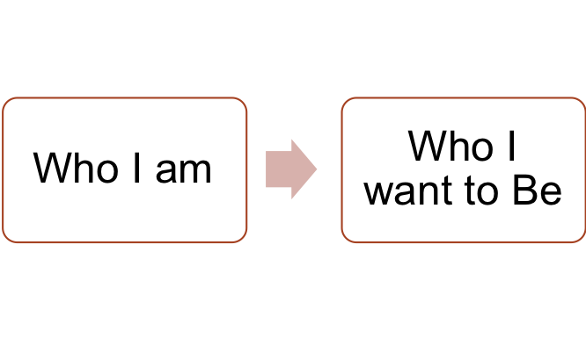
Introduction to Motivational Interviewing (MI)
Motivational Interviewing is a client-centered, directive method for enhancing intrinsic motivation to change by exploring and resolving ambivalence
Ambivalence is a conflicted state of favoring change and supporting status quo
Helps client get “unstuck” from ambivalent feelings
Exploration of client’s personal reasons for making a change
Bringing the client closer to who they want to be from who they are right now
Notes:
Define the following terms:
Client-centered approach: A client-centered approach places emphasis on a client's autonomy and right to choose goals and/or interventions based on his or her identified needs for services.
Intrinsic motivation: Intrinsic motivation can be described as doing something that is motivated from our own passions without the incentive of reward or fear of a negative consequence. Doing the behavior is often its own reward.
Ambivalence: Ambivalence is often described as a state of being “wishy-washy.” It is the gap between who I am and who I want to be.
In many cases, people hold expectations for themselves that favor change while simultaneously supporting the status quo. That inner struggle (ambivalence) often drives indecision and a sense of feeling stuck that is common in all people. Motivational Interviewing is a client-centered, skillful practice that aids people in moving beyond ambivalence to get closer to who they want to be.
Facilitator’s Resource:
Motivational Interviewing Definition, Principles and Approach document
https://www.umass.edu/studentlife/sites/default/files/documents/pdf/Motivational_Interviewing_Definition_Principles_Approach.pdf

Slide 7
Motivational Interviewing (MI) is defined as…
A collaborative, person-centered approach for drawing out and strengthening a person’s motivation to change his or her behavior. MI involves a set of principles and strategies, but more importantly, it is an approach that embodies the spirit of collaboration, empathy, and meeting people where they are.
Bad example
Good example
Notes:
Video: We will view two videos. One video will demonstrate effective MI skills and the other, ineffective MI skills. Participants should take note when they see effective and ineffective MI skills employed.
Bad example: https://youtu.be/kN7T-cmb_l0
Good example: https://youtu.be/-RXy8Li3ZaE
Video Debrief:
What did you observe?
What didn’t work well?
What worked well?
When did you see examples of compassion, client-centered care, acceptance, and collaboration?

Slide 8
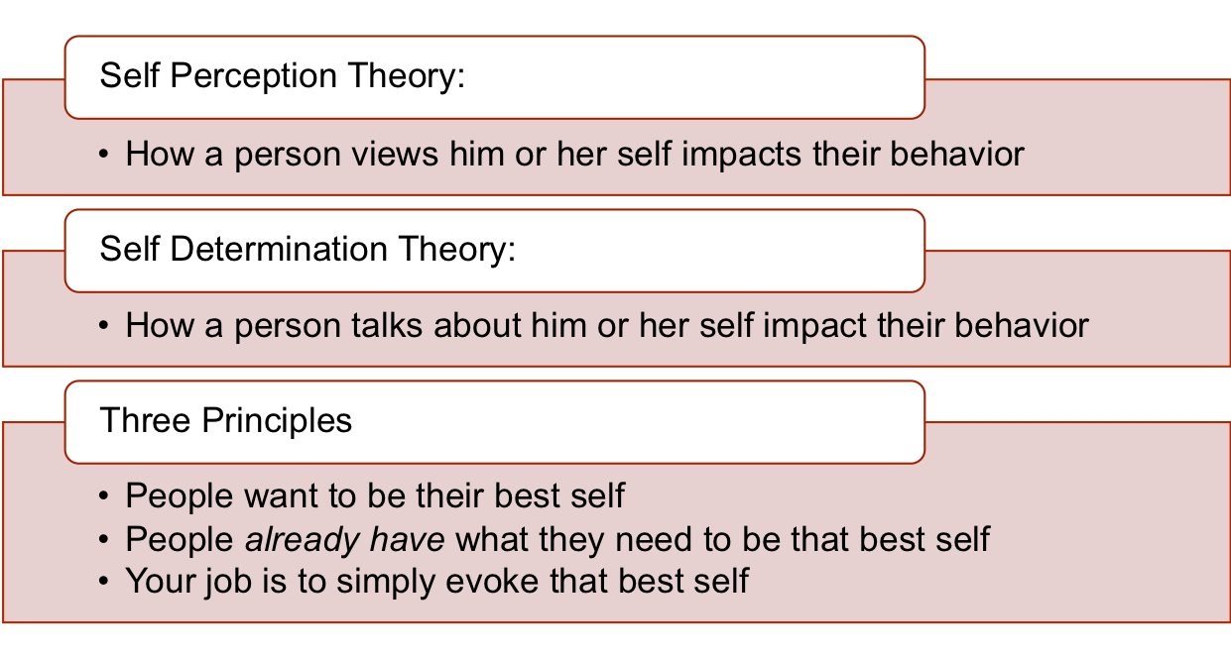
Theory, Principles, and Challenges
Notes:
Review the slide.
We understand that Motivational Interviewing is a way of working collaboratively with people to support their motivation for and commitment to change. The following 2 theories and 3 principles serve as important anchors to ground the CHW’s disposition and perspective when working in partnership with clients.
2 Major Theories:
Self-Perception Theory: A key idea in Self-Perception Theory is how people view themselves impacts their behavior. If a person feels negatively about themselves, they are less likely to take positive action. Consider the influence of your own self-perception and the impact when making changes in your life.
Self-Determination Theory: Self-Determination Theory can be considered generally as the way a person talks impacts their behavior. For example, If they speak negatively, they perform negatively.
These two theories underscore the work of the CHW who uses Motivational Interviewing techniques because they help us see why it is important to support people in talking and feeling more positively about themselves and their challenges when they want to make and sustain changes in their lives.
Read the 3 Principles on the slide.
CHWs work with people whose lives and experiences can be very complicated. It can be easy to propose solutions or prioritize the client’s circumstances according to our own values. These three principles help to ground the CHW in a client-centered approach by honoring the virtue in each statement and being willing to prioritize viewing the client’s concerns through the eyes of the client and not our own. Strong alignment with these principles can have transformative effects in the CHW/client relationship.

Slide 9
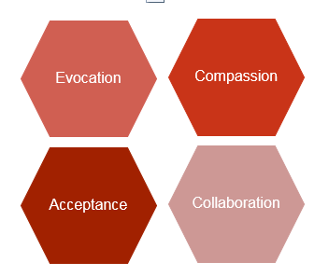
MI Spirit
What are some actions we do that stifle acceptance?
How do you find a balance between your own self-interest and the client’s?
What can we do to learn about our client’s strengths?
What do we do to contribute to conflict and discord?
Notes:
When using Motivational Interviewing skills, the following four qualities should undergird your approach with people. Define each characteristic and briefly explore the questions on the slide with participants.
Acceptance: Embody a disposition of acceptance by recognizing that people have the right to make their own choices free of judgment from others.
Compassion: Employ compassion by extending empathic care without judgment.
Evocation: Be intentional to ask the right questions to help people resolve ambivalence.
Collaboration: Work in partnership with people to examine their situations and ways to respond.
Reflection Questions
What are some actions we do that stifle acceptance?
How do you find a balance between your own self-interest and the client’s?
What can we do to learn about our client’s strengths?
What do we do to contribute to conflict and discord?

Slide 10
Core Strategies to Highlight/Support Someone through Ambivalence
Express empathy
-your effort to “put yourself in their shoes” and feel what they are going through
Develop discrepancy
-pointing out conflicts between stated goals and behaviors
Respond to potential discord
-don’t argue or fight
Support self-efficacy
-reinforcing people’s ability to accomplish their goals
Notes:
Express empathy (your effort to “put yourself in their shoes” and feel what they are going through)
Empathy helps to build trusting and supportive relationships that aide in the CHW/client collaboration.
Develop discrepancy (pointing out conflicts between stated goals and behaviors)
Example: You want to be healthier, but you do not show up for your medical appointments.
Respond to potential discord (don’t argue or fight)
Developing discrepancy or responding to potential discord isn’t synonymous with confronting or wrestling with a client about their behavior. The goal is to empathetically shine light on a situations in such a way that the client can view their own behavior.
Support self-efficacy (reinforcing people’s ability to accomplish their goals)
We understand from the self-perception theory that how we view ourselves can impact our behavior; thus, reinforcing a client’s belief in their ability can have a positive impact and aide change.

Slide 11
Coaching Skills to Promote Behavior Change
Motivational Interviewing
O: Open-ended questions
A: Affirmations
R: Reflective listening
S: Summarizing
Notes:
O.A.R.S. is a set of skills that help to create an open, affirming, accepting environment where the client can explore their feelings, behaviors and beliefs. O.A.R.S. skills help to move MI conversations forward and allow clients to freely express content that can position them to hear and make progress toward change.
Review O.A.R.S. skills and provide examples. (If time permits, invite participants to reflect and share the value of using O.A.R.S. skills.)
Open-ended questions
Use open-ended questions that invite elaboration or descriptive information. Open questions usually require more than a yes or no response and encourages the client to talk more. Examples: What helps you stay on track with your medications? Tell me more about…
Affirmations
Using affirmations helps to reinforce the client’s strengths. Affirmations can be used to validate the client’s experience or feelings.
Examples: You’ve accomplished a lot in a short time. I appreciate your honesty.
Reflective listening
Reflective listening is a way to clarify statements and demonstrate that you heard and understood your client.
Examples: It sounds like you… You’re wondering if…
Summarizing
Summarizing statements link material that has been discussed to reinforce what has been said and demonstrates that you have been listening carefully.
Examples: Here’s what I’ve heard… Let me see if I got this right…

Slide 12
Reflective Statements
Notes:
Define the difference between simple, complex, and double-sided reflections.
Simple: A simple reflection is a basic restatement of the client’s own words, being careful to use the client’s language.
Complex: Complex reflections add meaning, value, or emotion to the client’s words. In essence, you are reflecting a deeper layer of the simple reflection that helps to open new perspective.
Double-sided: The aim of double-sided reflections is to highlight the discrepancy between the client’s words/values and their actions.

Slide 13
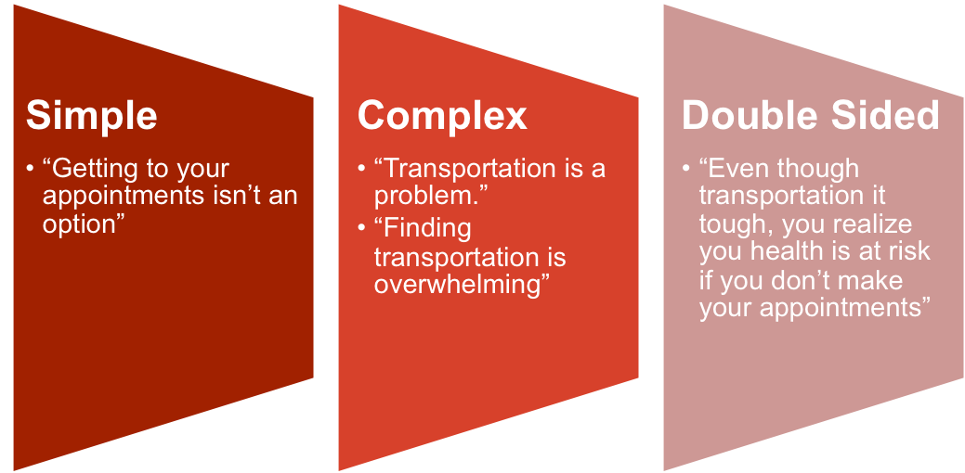
Let’s Try One Together
Client Statement: “Getting to my appointments isn’t an option unless you can give me bus tickets.”
Notes:
Review examples on slide.
Activity: Ask participants to get into pairs. Read a simple reflection below. Ask participants to take turns making complex and double-sided reflections.
“I don’t see how this program is going to help me.”
“I just don’t like wearing a condom.”
“I am not going to take my meds. My meds make me sick.”
“Keeping my appointments is hard for me.”
“I can’t quit smoking.”
“I just can’t commit to exercise.”
“Going to AA is sometimes a hassle.”
“No one understands what it’s like to not be able to pay my bills.”
Summarize and close.

Slide 14
Motivational Interviewing and Active Listening Practice
3 case scenarios with reflection questions and role play
Notes:
Review the slide.

Slide 15
O.A.R.S. Reference
Open ended questions (questions that invite elaboration)
Affirmations (reinforce client strengths)
Reflective listening (clarifying statements that illustrate underlying meaning)
Summarizing (links material that has been discussed to establish common ground)
Notes:
The next activity will allow more time to practice Motivational Interviewing (MI) and active listening skills.
Distribute handouts: Case Scenarios and Strategies of Motivational Interviewing: OARS.
See lesson plan for activity details.
Display this slide as a reference.

Slide 16
References and Resources
Stages of Change https://youtu.be/Twlow2pXsv0
MI Bad example: https://youtu.be/kN7T-cmb_l0
MI Good example: https://youtu.be/-RXy8Li3ZaE
Motivational Interviewing Definition, Principles, and Approach: https://www.umass.edu/studentlife/sites/default/files/documents/pdf/Motivational_Interviewing_Definition_Principles_Approach.pdf
Strategies of Motivational Interviewing – OARS http://www.myacpa.org/sites/default/files/Intervention%20Handout.pdf
Communication Techniques – OARS http://provideaccess.org/wp-content/uploads/2012/09/Communication_Skills_-_OARS_.pdf
Motivational Interviewing & HIV: Reducing Risk, Inspiring Change https://aidsetc.org/sites/default/files/resources_files/etres-441.pdf
Notes:
Share the series of resources and videos for the participants.

