Slide 1
The Living Bridge Center
A Program of the North Georgia Health District Dalton 1-2

Slide 2
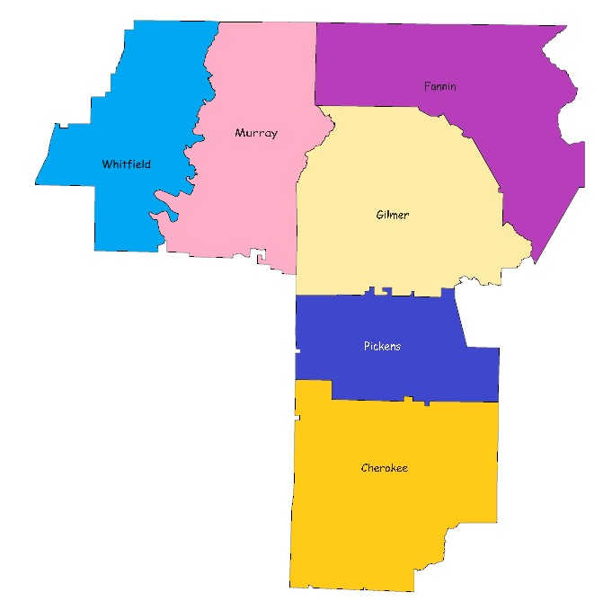
The Living Bridge Center
The Living Bridge Center is a full service HIV specialty clinic, funded with Ryan White Part B and Part C funds, with a smattering of HIV Prevention funds.
TLBC serves the six county Health District, which consists of the following counties: Whitfield, Murray, Pickens, Gilmer, Fannin and Cherokee.
The vast majority of these counties can be considered rural in nature. Most population centers within the District are up to an hour or more apart. To address the transportation barriers associated with the travel distances, we operate two satellite clinics. Twice a month patients are seen in the Canton Health Department and once a month patients are seen in the Fannin County Health Department.
The main clinic is located in Dalton Georgia. Active clinic hours are Monday, through Thursday, 7:30am to 12:00pm.

Slide 3
The Living Bridge Center
F
A
S
T
ind them
ssess them
tabilize them
reat them

Slide 4
The Living Bridge Center
Finding them – HIV Prevention, Education and Outreach
Targeted outreach to high risk populations
Day Reporting Center (Criminal Justice system diversionary program for low level, first time drug offenders) twice a month for all new enrollees
Drug Court education/testing for felony level offenders
Dalton State College – every month while school is in session
PrEP clinic
Health Education and Outreach Program in the southern part of the District
CDS Nurses in southern counties – targeted outreach and education to high risk groups – PrEP evaluation/screening for repeat customers
Epidemiologist – Data driven decision making based on predictive statistics on an on-going basis
Health Educator tasked specifically with identifying high risk groups, provided targeted education and targeted testing to high risk groups.

Slide 5
The Living Bridge Center
Finding them – HIV Prevention, Education and Outreach
HIV testing in the Community (2013 to 2017)
Passive Testing (health departments): 1,813 to 2,932 (62% increase)
Proactive Testing (targeted): 112 to 315 (181% increase)
New Positives: 5 to 15 (200% increase)
HIV Clinic serves as the primary point of contact and entry to the HIV system of care.
Established, strong communication networks with the District’s Emergency Departments, private infectious disease doctors, jails and detention centers, and public health sites.

Slide 6
The Living Bridge Center
Assess them - In take, medical and social assessments
All required eligibility checks
HIV status
Residency checks
Insurance coverage assurances
Proof of income
Initial doctor’s visit – baseline health status
Initial visit with a nurse case manager
Identification of patient barriers and/or problems list
Acuity Scale - medical and social support focused
Individual Service Plan for medium and high acuity cases
Serves as a trigger for Intensive Case Management versus normal Case Management

Slide 7
The Living Bridge Center
Stabilize them – Intensive Case Management Program
Medical Case Management (both Intensive and non-Intensive) became a priority for our clinic. Increasing the interaction allows for a better understanding of the patient’s needs and barriers, and leads to successful interventions that support adherence.
Medical Case Management Visits (inclusive) – 2013 to 2017 Projected
Medically Case Managed Patients (unduplicated): 138 to 147 (7% increase)
Medical Case Management Visits (unduplicated): 211 to 502 (138% increase)
Mental Health Counseling on-site
Newly infected get priority,
Counselor and Intensive Nurse Case Manager work in coordination with all Intensive Case Management patients.

Slide 8
The Living Bridge Center
Treat them – Full service medical care, on site dentistry and mental health counseling
Medical doctor on site Monday through Thursday
1 triage nurse, 2 nurse case managers, 1 intensive nurse case manager, one nurse supervisor, benefits coordinator, data manager, 3 support staff
Two satellite clinics (2 in Cherokee County one in Fannin County)
On site lab for routine blood draws
Dental program at WCHD, augmented by contract dentists off site
On-site nutritionist (cycling through all patients over the course of a year)

Slide 9
The Living Bridge Center
Treat them – Full service medical care, on site dentistry and mental health counseling
HIV Medical and Related Care Services (2013 to 2017)
Total Unduplicated Patients: 187 to 208 (11% increase)
Total New Patients (annually): 22 to 29 (32% increase)
Total Unduplicated Medical Care Visits (annually): 1,658 to 1,971 (19% increase)
Total Unduplicated Oral Health Care Patients: 62 to 79 (27% increase)
Total Unduplicated Oral Health Visits: 77 to 158 (105% increase)
Total Unduplicated Mental Health/Substance Abuse Patients: 70 to 85 (21% increase)
Total Unduplicated Mental Health/Substance Abuse Visits: 262 to 426 (63% increase)

Slide 10
The Living Bridge Center
Stabilize Them – Linkage to Care
Intensive Case Management Program
Dedicated Intensive Case Management Nurse – RN with 7 years working in the Child and Family Services system prior to Ryan White.
Case load for the one nurse is kept low – 20 patients currently (Normal Case Managers have a caseload around 75 patients)
Intensive Case Management Nurse works directly with the District’s Communicable Disease Investigators – near instant linkage upon identifying a new HIV+ patient
Intensive Case Management Nurse serves as the informal Linkage to Care Coordinator
First office visit is often within one week

Slide 11
The Living Bridge Center
Stabilize Them – Retention in Care
Intensive Case Management Program
Intensive Case Management Nurse Secondary Task is to increase adherence to medical treatment plans in High Acuity patients
Designed for patients with multiple barriers to medical adherence
Case load is predominately people with: a) mental health and substance abuse issues, b) consistent interaction with the criminal justice system, c) a documented history of non-compliance (lost to care on multiple occasions, etc.)
Near daily contact via phone, in person, home visits to address identified barriers, Direct Observed Therapy when needed
Current Clinic Wide Retention in Care percentage: 89.94% (State of Georgia = 79.75%, Nation = 75.39%)

Slide 12
The Living Bridge Center
Stabilize Them – Retention in Care
Intensive Case Management Program
Case Study One: BM
51 years old with a long and documented history of non-compliance
Diagnosed in 2006, out of care from 2010 to 2016
History of depression, cognitive delays, significant pill phobia, trouble reading
Drug resistant virus and complicated regimen
Viral Load upon entry to the program: 1,204,050
Weekly visits with on site counselor, 7 referrals to various HIV related and non-HIV related specialists for complex health issues
Medications converted to a pill pack (via Curant), required on site education by ICMN (left to right, not up and down)
Over six month period: 39 phone calls (not including attempts), 15 face to face visits
Patient now reports 99% adherence with taking medications
Viral Load in February 2018: 50

Slide 13
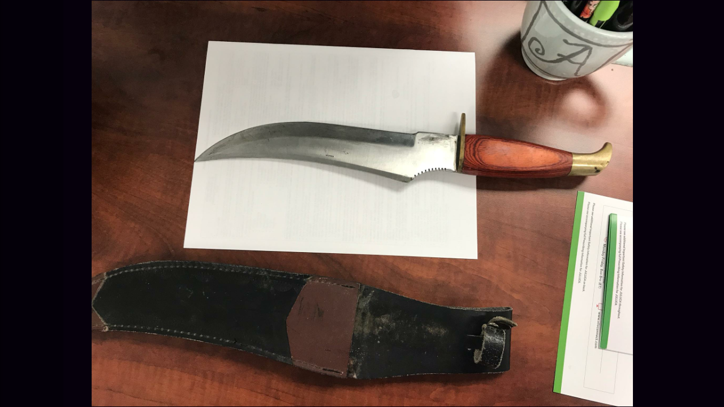
The Living Bridge Center
Stabilize Them – Retention in Care
Intensive Case Management Program
Case Study Two: JG
29 years old
Schizophrenia and polysubstance abuse – methamphetamines and marijuana
Repeated mental health hospitalizations
Frequent incarcerations
History of non-compliance with medications and medical treatment plans
Inconsistent mental health treatment (usually just “tune ups”)
Extensive medications list – 15 different medications daily
Fired from multiple mental health and non-HIV medical providers for behavior and non-compliance
Lived in a forest for about 3 months prior to his last return to the clinic
Sometimes carries his pocket knife to his appointments

Slide 14
The Living Bridge Center
Stabilize Them – Retention in Care
Intensive Case Management Program - JG
Enrolled in Intensive Case Management Program in 2016
Viral Load upon entry to clinic: 585,490
Intensive Case Management Nurse worked with former providers, mental health case managers and re-established access to mental health and specialty providers (second chances)
Works as part of a team with outside providers to ensure JG does not disappear, and to give each other head ups on his behavior and psychosis (sometimes he is fighting the dark forces, sometimes he is the dark force)
ICMN accompanies him to psychiatrist appointments for his monthly Haldol shots
Over six month period: 40 phone contacts, 21 face to face contacts
Adherence to medications and medical appointments is at 70%
Current Viral Load: 20

Slide 15
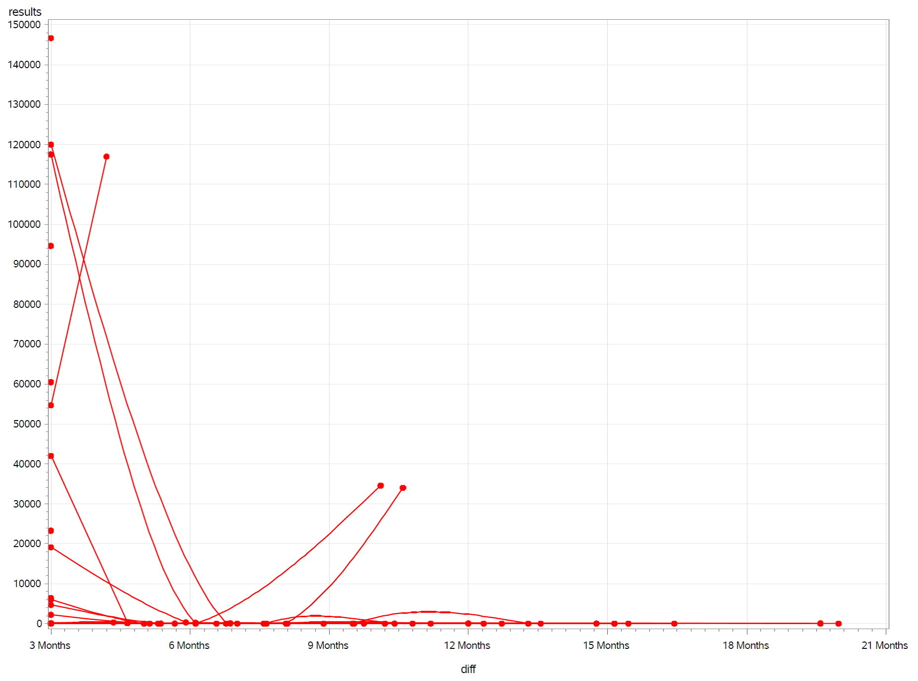
The Living Bridge Center
Stabilize Them – Linkage to Care and Retention in Care
Intensive Case Management Program
Current case load for Intensive Case Management Nurse is 24. 80% have a suppressed viral load (19). The 5 patients with a detectable viral load are newly diagnosed, not yet on medications and have not had a follow up viral load from the initial medical visit.
Documented Clinic Wide Viral Suppression = 90.37%
(State of Georgia = 81.37, Nation = 84.90)
Viral Loads of patients in ICM – from enrollment to date

Slide 16
The Living Bridge Center
Questions?
Jeff Vollman, MPA
District HIV Director
North Georgia Health District, Dalton 1-2
706-281-2360
Jeffery.Vollman@dph.ga.gov

