Slide 1
Southeastern Michigan
HIV/AIDS Council (SEMHAC)
Priority Setting and
Resource Allocation (PSRA) Retreat
DAY 1
<?xml version="1.0"?><AllQuestions />
<?xml version="1.0"?><AllResponses />
<?xml version="1.0"?><Settings><answerBulletFormat>Numeric</answerBulletFormat><answerNowAutoInsert>No</answerNowAutoInsert><answerNowStyle>Explosion</answerNowStyle><answerNowText>Answer Now</answerNowText><chartColors>Use PowerPoint Color Scheme</chartColors><chartType>Horizontal</chartType><correctAnswerIndicator>Checkmark</correctAnswerIndicator><countdownAutoInsert>No</countdownAutoInsert><countdownSeconds>10</countdownSeconds><countdownSound>TicToc.wav</countdownSound><countdownStyle>Box</countdownStyle><gridAutoInsert>No</gridAutoInsert><gridFillStyle>Answered</gridFillStyle><gridFillColor>255,255,0</gridFillColor><gridOpacity>50%</gridOpacity><gridTextStyle>Keypad #</gridTextStyle><inputSource>Response Devices</inputSource><multipleResponseDivisor># of Responses</multipleResponseDivisor><participantsLeaderBoard>5</participantsLeaderBoard><percentageDecimalPlaces>0</percentageDecimalPlaces><responseCounterAutoInsert>No</responseCounterAutoInsert><responseCounterStyle>Oval</responseCounterStyle><responseCounterDisplayValue># of Votes Received</responseCounterDisplayValue><insertObjectUsingColor>Red</insertObjectUsingColor><showResults>Yes</showResults><teamColors>Use PowerPoint Color Scheme</teamColors><teamIdentificationType>None</teamIdentificationType><teamScoringType>Voting pads only</teamScoringType><teamScoringDecimalPlaces>1</teamScoringDecimalPlaces><teamIdentificationItem></teamIdentificationItem><teamsLeaderBoard>5</teamsLeaderBoard><teamName1></teamName1><teamName2></teamName2><teamName3></teamName3><teamName4></teamName4><teamName5></teamName5><teamName6></teamName6><teamName7></teamName7><teamName8></teamName8><teamName9></teamName9><teamName10></teamName10><showControlBar>All Slides</showControlBar><defaultCorrectPointValue>0</defaultCorrectPointValue><defaultIncorrectPointValue>0</defaultIncorrectPointValue><chartColor1>187,224,227</chartColor1><chartColor2>51,51,153</chartColor2><chartColor3>0,153,153</chartColor3><chartColor4>153,204,0</chartColor4><chartColor5>128,128,128</chartColor5><chartColor6>0,0,0</chartColor6><chartColor7>0,102,204</chartColor7><chartColor8>204,204,255</chartColor8><chartColor9>255,0,0</chartColor9><chartColor10>255,255,0</chartColor10><teamColor1>187,224,227</teamColor1><teamColor2>51,51,153</teamColor2><teamColor3>0,153,153</teamColor3><teamColor4>153,204,0</teamColor4><teamColor5>128,128,128</teamColor5><teamColor6>0,0,0</teamColor6><teamColor7>0,102,204</teamColor7><teamColor8>204,204,255</teamColor8><teamColor9>255,0,0</teamColor9><teamColor10>255,255,0</teamColor10><displayAnswerImagesDuringVote>Yes</displayAnswerImagesDuringVote><displayAnswerImagesWithResponses>Yes</displayAnswerImagesWithResponses><displayAnswerTextDuringVote>Yes</displayAnswerTextDuringVote><displayAnswerTextWithResponses>Yes</displayAnswerTextWithResponses><questionSlideID></questionSlideID><controlBarState>Expanded</controlBarState><isGridColorKnownColor>True</isGridColorKnownColor><gridColorName>Yellow</gridColorName></Settings>
<?xml version="1.0"?><AllAnswers />
August 3-4, 2018
Notes:
Review documents in folder to ensure everyone has all documents
Say: Can someone tell me what PSRA is all about, what is accomplished and how?
Day 1 will consist of prioritizing the service categories. Day 2 will consist of allocating funds to service categories.
During this 2 day process we’re going to focus on answering two questions…

Slide 2
Focus Questions
What constellation of priority services will produce the best health outcomes for PLWH in the DEMA?
How much money should be allocated to each priority service to support a continuum of care for PLWH in the DEMA?
Notes:
In order to answer these questions you all must do the following….(next slide)

Slide 3

How are we going to do this?
Review data about the epidemic, services, and needs
in the DEMA.
Discuss those data as they relate to the focus questions.
Create a ranked list of service priorities (today).
Decide amount of funds to be allocated to each
service (tomorrow).
Keep notes on ideas for how services can
be delivered most effectively (both days).
Notes:
Keeping notes as the data is provided is so important. You don’t have to try to remember which points helped you to rank or order the service categories, you can jot them down as we go. In order to do this there is a handout that I recommend you keep out so that you can take notes, it is the SEMHAC Priority Setting Worksheet.
Now, as data is being reviewed and decision are made, there are a few things we must consider (next slide)

Slide 4

.
Notes:
What comes to mind when you view this picture?
We must look at the past in order to know where we’re going. Looking at past data helps to guide us when making decisions for the future.

Slide 5

0
Notes:
What’s the first thing you see when looking at this picture?
We all will review the same data, however, some of us may see or interpret it differently than others, and that’s okay. The differences is what allows for discussion and coming to an agreed upon decision.

Slide 6

0
Notes:
We’re gonna review lots of data. However, we’re hoping that how it’s presented is as simplistic as possible. At any time if you have questions please feel free to ask.

Slide 7

Ground Rules
Be here now
Step up and step back
See with new eyes
and hear with new ears
Remain solution oriented
Engage respectfully
Honor confidentiality
Mind the time
Have fun!

Slide 8


o
SEMHAC
Priority Setting and Resource Allocation
?
Services to PLWHA
and their families
Notes:
Some may wonder, “is this all it takes? We just prioritize services, allocate dollars, and then WAH-LAH, PLWHAs are automatically serviced?” No, there’s more that goes into getting to the point where services are provided to PLWHAs. Let’s take a look at the Big Picture…

Slide 9
The Big Picture
We are
here
SEMHAC
Sets service priorities and resource allocations, and gives directives on how to best meet these priorities
Federal Government (HRSA)
Detroit Health Dept
(a.k.a. The Recipient –
Submits Grant)
$
Southeastern
Michigan Health Association
Detroit Health Dept
(a.k.a. The Recipient –
Administers Grant)
Mayor of Detroit
$
$
Services to PLWHA
and their families
Providers
Notes:
Explain the org. chart
The Recipient does the following:
Apply to HRSA for funding
Issue RFP for services
Select providers
Manage provider contracts and issue payments
Conduct quality management
Comprehensive planning
In order to apply for and hopefully receive grant dollars from HRSA there are expectations that HRSA has of you, the PC, which are…

Slide 10
HRSA Expectations
Establish priorities for allocation of funds within the DEMA
Allocate funds to each of the prioritized service categories for core medical ( > 75% ) and support services ( < 25% ) -percentages can change if a waiver is applied for and approved…will discuss more tomorrow
Develop “directives” as needed for how service priorities should be met (e.g., geographic areas, service models)
Use best available data to inform all decisions
Document the process used and the decisions made
Notes:
Directives – Jotting down notes on your Directives worksheet will help to create the Directives. So please be sure to take notes. I’ll collect this at the end of the day.

Slide 11

The Path to Today
Following 2017 PSRA Retreat Outline
Reviewed 2018 PSRA materials
Received input from Finance Committee, SEMHAC staff, Recipient, and MDHHS
Method approved by Finance Committee
Notes:
In order for us to get to this point today, there were a few activities that took place…

Slide 12

Guiding Principles
Build on the past
Avoid data overload
  Notes handouts
Link data to decisions
Consensus-based

Slide 13

o

Slide 14
Priority Setting
What constellation of priority services will produce the best health outcomes for PLWH
in the DEMA?
How much money should be allocated to each priority service to support a continuum of care for PLWH in the DEMA?
Notes:
Now to try to simplify how priority setting is done, let’s think chocolate chip cookies…

Slide 15

0
Notes:
How many of us enjoy cookies?
When baking chocolate chip cookies from scratch, what are some of the MOST IMPORTANT ingredients needed to make them?

Slide 16
0
Chocolate Chips
Flour
Butter
Sugar
Eggs
Nuts
Sprinkles
Less important
Notes:
Some of us may truly enjoy nuts and sprinkles in our chocolate chip cookies, however, those ingredients are not as important as the ones we most definitely need to create our chocolate chip.
This is an example (on a much smaller scale) of what will take place today
We’re going to look at data that will
help you all to decide which service categories are MOST IMPORTANT and less important (and you will order/prioritize them in that fashion)
The data we review will help you to understand the following:

Slide 17

Services Rank Higher if they…
Address weak areas in treatment cascade
Facilitate access to key services or advances on the treatment cascade
Address barriers identified in needs assessment or ranked high as service needs
Benefit or are used by many PLWH (serv. utilization)
Have greatest impact on health outcomes
Notes:
Segue from here to priority setting activity

Slide 18

o
ACTIVITY TIME
Notes:
Mock priority setting activity
Groups of 4 preferred

Slide 19
Priority Setting
In your folder….
Ranking by Fiscal Year 2018, 2017, and 2016
Priority Setting Worksheet
Notes:
Important to take notes on your priority setting worksheet as you’re taking in the information.
Questions will be asked at the end of every perspective that will focus on how the information presented can help you to make evidence based decisions.

Slide 20
Epidemiological Perspective
Notes:
Introduce Epidemiologist from MDHHS

Slide 21
0
HIV in the DEMA
Ryan White Priority Setting and Resource Allocation
Jacob Watson, MPH
HIV Epidemiologist
HIV Surveillance
MDHHS

Slide 22
o
Epidemiology 101

Slide 23
o
My Purpose
Epidemiological data
Prevention and Care Program Development
Targeted, Effective Programs
Notes:
Information for action: Epidemiology is necessary to support funding and/or new program development.

Slide 24
o
Key Definitions and Relationships
New diagnoses (new dx)
Prevalence
(PLWH)
Deaths
Prevalence is steady
New dx = Deaths
Notes:
This diagram demonstrates the concept of incidence/new dx and prevalence.
Gumballs added to the machine are new dx—they are being added the to overall number of gumballs (gumballs in the globe).
Gumball leaving the prevalence globe represent deaths. If we were talking about a curable disease, those leaving the globe would represent death and cures, but in the case of HIV, the only way to leave the overall prevalence number is through death.
Here the number of incident cases = number of deaths (4 gumballs going in and 4 gumballs coming out) so prevalence would remain stable in this example (because the number entering the machine = the number leaving the machine).

Slide 25
-
Rates
Notes:
The importance of looking at rates over counts

Slide 26
-
Rate of redness per 100 circles
Group 1
15 red circles
30 total circles
Rate = 15/30*100
Rate = 50 per 100
Group 2
15 red circles
50 total circles
Rate = 15/50*100
Rate = 30 per 100
Notes:
Some examples of why it’s important to look at rates rather than counts. You can see the redness has much more of an affect on the first group compared to the second.
Counts are the same, but the 1st rate is higher, so we’d probably want to focus programs on group 1 to start.

Slide 27
-
Rate of redness per 100 circles
Group 1
1 red circle; 4 total circles
Rate = 25 per 100
Group 2
20 red circles
100 total circles
Rate = 20/100*100
Rate = 20 per 100
Notes:
Count = 1 makes the rate bigger than count = 20

Slide 28
-
Overview of the DEMA epidemic
By the end of 2017 there were:
512 New Diagnoses
10,384 PLWH

Slide 29
-
Prevalence continues to rise
because there are more new diagnoses than deaths
2017 Prevalence: 10,384
Count
New Diagnoses
Deaths
Notes:
Let this sit up for a while to digest

Slide 30
-
DEMA New Diagnosis Trends
There’s good new and bad news

Slide 31
-
Check out Detroit!!
Detroit’s new diagnosis rate is dropping significantly
Detroit
Rate of new diagnoses
Oakland, Macomb, & Wayne
Lapeer, Monroe, & St. Clair
Notes:
The good news!
Detroit still has the highest rate of new diagnoses, but it’s decreasing significantly.
It’s actually on track to meet the NHAS goal of reducing the # of new dx by 25%.
This is fantastic!
In order for the DEMA to meet the NHAS goal as a whole, the other counties need to decrease as well
Notes for you in case you’re asked:
-Detroit’s significant decrease: 4 of past 5 years were >3stdev below the mean of the preceding 5 years
-I averaged the rates of Oak, Mac and Wayne and Lapeer, Monroe and St. Clair b/c they’re so similar. That way the graph wasn’t busy and people can focus on Detroit

Slide 32
-
15-29 year old black MSM (YBMSM) is the only group in the DEMA experiencing an increase in new diagnoses.
Number of new diagnoses among YBMSM
Notes:
The bad news
This is a trend statewide.

Slide 33
-
Detroit
YBMSM new diagnosis rate / 100,000
Non-YBMSM new diagnosis rate / 100,000
Notes:
These TRENDLINES show the rate of new diagnoses among YBMSM are huge and have nearly tripled since 2000. Conversely, non-YBMSM have decreased substantially.
One of the NHAS indicators is to reduce the new diagnosis rate disparity among young black gay men – the disparity is increasing all over Michigan!
Non-YBMSM include black MSM over 30, young black persons who aren’t MSM, young MSM who aren’t black (this may be important to emphasize)
Notes for you: The YBMSM rate is an estimate since the denominator is an estimate.

Slide 34
-
Macomb County
YBMSM & other demographic groups are rising
YBMSM
YBMSM new diagnosis rate / 100,000
Non-YBMSM new diagnosis rate / 100,000
Non-YBMSM
Notes:
Same YBMSM trend.
Macomb is one of the very few places where new diagnoses are on the rise in most demographic groups, but YBMSM carries the heaviest burden and is increasing much quicker than non-YBMSM (note axis scale differences and how non-YBMSM wouldn’t even register on graph if they were on the same axis)

Slide 35
-
Oakland County
YBMSM
YBMSM new diagnosis rate / 100,000
Non-YBMSM new diagnosis rate / 100,000
Non-YBMSM

Slide 36
-
Wayne County (excluding Detroit)
YBMSM
YBMSM new diagnosis rate / 100,000
Non-YBMSM new diagnosis rate / 100,000
Non-YBMSM

Slide 37
-
DEMA Prevalence

Slide 38
-
Prevalence in the DEMA, 2017
Black
White
Latinx
Icon Key
Gay & bisexual men
Other men
Women
Notes:
Notes for you:
Grey is “Other”
MSM have the little male-male symbol
There’s one transgender black women (4th row on the right)

Slide 39
-
Most PLWH are over 30
Icon Key
Gay & bisexual men
Other men
Women

Slide 40
-
Most people diagnosed are 20-29
Icon Key
Gay & bisexual men
Other men
Women

Slide 41
-
HIV in the DEMA by age, 2017
Icon Key
Gay & bisexual men
Other men
Women

Slide 42
-
DEMA HIV Care Continuum
Notes:
The HIV Care Continuum was developed by the CDC to assess gaps in care.

Slide 43
-
DEMA Care Continuum, 2017
Notes:
Diagnosed with HIV: Persons diagnosed with HIV. In Care: PLWH who received at least one CD4, viral load (vl) and/or genotype lab test during the given year. Virally Suppressed: PLWH whose most recent viral load test contained less than or equal to 200 copies of HIV virus per milliliter of blood (≤200 copies/mL). Maintained Undetectable: PLWH who maintained VS for at least 4-8 months. Derived from studies supporting U=U (undetectable = untransmittable).
Reminder, there’s ~11,000 ESTIMATED PLWH IN THE DEMA

Slide 44

-
Groups frequently out of care
Proportion of new diagnoses
Proportion of PLWH
Group
Out of Care
~1,872 people
Latino men
23%
Notes:
This shows which groups are out of care more often than the DMA average. The pie chart gives an idea of the overall prevalence and dx of that group. Example, it would be really great to get more Latinos into care, but even if 100% were in care it wouldn’t have much effect on the overall care rate because Latinos only account for 3% of PLWH in the DMA. This doesn’t mean these populations should be ignored, it’s just something to think about.

Slide 45

-
Groups frequently out of care
Proportion of new diagnoses
Proportion of PLWH
Group
Out of Care
~1,872 people
Latino men
23%
Persons who inject drugs
24%

Slide 46

-
Groups frequently out of care
Proportion of new diagnoses
Proportion of PLWH
Group
Out of Care
~1,872 people
Latino men
23%
Persons who inject drugs
24%
Foreign born
31%
Notes:
All these groups account for a small overall proportion of PLWH in the DEMA, and a small proportion of new diagnoses. So, for the epidemic as a whole, it’s probably best to focus on getting people in general into care (like Link Up Detroit), and just keep these populations in mind that they may need additional support to get into or stay in care.

Slide 47
-
YBMSM fall behind
Notes:
YBMSM fall behind non YBSMS
Diagnosed with HIV: Persons diagnosed with HIV. In Care: PLWH who received at least one CD4, viral load (vl) and/or genotype lab test during the given year. Virally Suppressed: PLWH whose most recent viral load test contained less than or equal to 200 copies of HIV virus per milliliter of blood (≤200 copies/mL). Maintained Undetectable: PLWH who maintained VS for at least 4-8 months. Derived from studies supporting U=U (undetectable = untransmittable).

Slide 48
-
YBMSM fall behind

Slide 49
-
YBMSM fall behind

Slide 50
-
YBMSM fall behind
Notes:
That’s a huge VS difference

Slide 51
-
YBMSM fall behind
Notes:
And an even bigger Maintained VS gap

Slide 52
-
How to we improve care &
Viral suppression rates?

Slide 53
-
To improve VS, improve care
VS is 1.5 times higher if interviewed by Partner Services
Notes:
For most populations, VS is improving on it’s own. Raising that care ceiling is most important. The NHAS goal is to increase VS to 80%, and we’re on track, but care needs to be higher than 81% to get there.
There are only a couple groups where care and VS aren’t associated as strongly (groups that have near avg care rates but low VS):
Transgender persons
YBMSM!
These groups need extra help maintaining VS after they’re in care
Another note: in general people who are interviewed by PS have higher VS rates

Slide 54
-
To improve care, link early
Notes:
…So, in general, we improve VS by improving care, but how do we improve care?
A big factor affecting whether a person is in care or not is how quickly they were linked to care.

Slide 55
-
90 day linkage rates are going up!
Notes:
…if linkage is so important, how are we doing linking people to care?
We did pretty good in 2017, the 30 and 90 day linkage rates increased.
1 month linkage improved 4% in 2017,
3 month linkage jumped 7% in 2017
On the last slide I mentioned Transgender persons and YBMSM have average care rates, but low VS rates. They also have average or slightly above average linkage rates. Further showing there’s a disconnect between linkage and care, and VS for these populations. In order to halt the growing diagnoses among YBMSM, they will need to maintain viral suppression

Slide 56
Review
Get PLWH into care
  The largest gap is between diagnoses and care (the initial linkage and retention).
  Most of Michigan is great at achieving viral suppression once PLWH are in care.
Help YBMSM maintain viral suppression
It’s the best way to halt the growing transmissions.

Slide 57
-
Where to find more info
Notes:
I want to know the care and linkage rates for black men 30-39 years old, where do I go?

Slide 58




-
www.Michigan.gov/hivstd

Slide 59
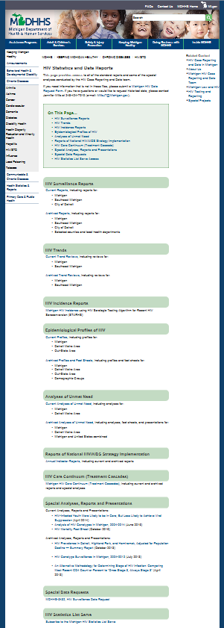

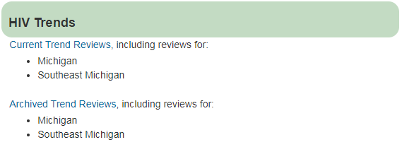
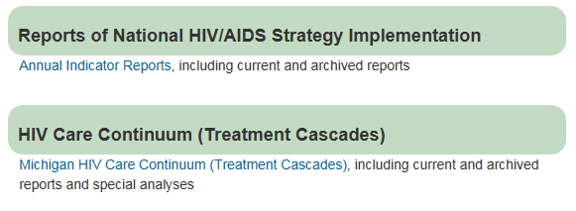
-

Slide 60


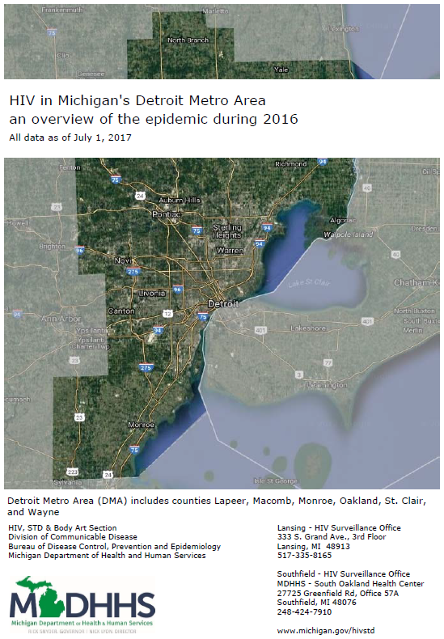
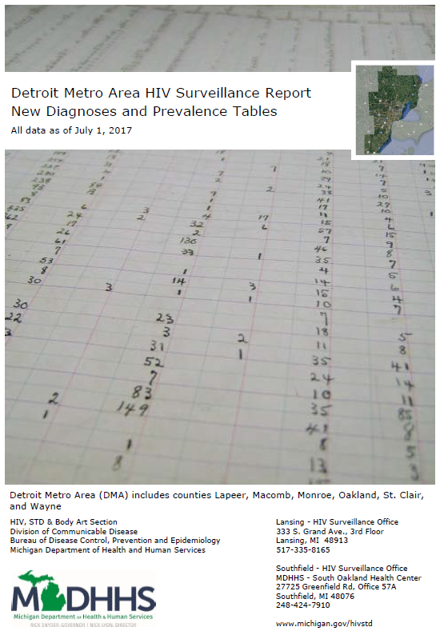


-

Slide 61
Questions?
For more information contact:
Jennifer Miller
MillsJ7@Michigan.gov
248.424.7919

Slide 62

Epidemiological Perspective Discussion
What constellation of priority services will produce the best health outcomes for PLWH
in the DEMA?
Notes:
What information presented will help you decide the most important services that will
Benefit many PLWHAs
Have greatest impact on health outcomes
Address weak areas in the treatment cascade/care continuum
Facilitate access to key services or advances on the treatment cascade

Slide 63

-
Notes:
15 min. break

Slide 64
PLWHA Perspective
Notes:
Important to take notes on your priority setting worksheet as you’re taking in the information.

Slide 65
PLWHA Perspective
Barriers and facilitators to linkage, retention, and medications adherence
Preliminary Findings
Statewide Needs Assessment 2015*
SEMHAC Women’s Focus Group in DEMA, February 2016
SEMHAC PLWH Survey in DEMA, April – May 2016*
Transgender Women’s Focus Group in DEMA, May 2017
Youth Living with HIV Focus Group in DEMA, June 2017
*Based on survey questions developed by SEMHAC Needs Assessment Committee

Slide 66

PLWH Survey
SEMHAC PLWH survey in DEMA, April – May 2016
Surveyed PLWH in care
Questions about barriers and facilitators to linkage, retention in care, and medications adherence
Same questions used in Michigan Department of Health and Human Services (MDHHS) statewide PLWH survey
MDHHS PLWH survey questions developed by
SEMHAC Needs Assessment Committee

Slide 67
PLWH Survey
Source | Number in DEMA | %
MDHHS | 107 | 69%
SEMHAC | 47 | 31%
Total | 154 | 100%

Slide 68
Focus Group Data
SEMHAC Women‘s Focus Groups, February 2016
    Two groups - total 20 women living with HIV
    Participants part of two Ryan White funded support groups for women
Transgender Women’s Focus Group, May 2017
    One group – total 7 transgender women
Youth Living with HIV Focus Group, June 2017
    One group – total 8 youth living with HIV
    Participants of a youth support group

Slide 69
A word of caution…
Findings are not generalizable!
Convenience sampling, primarily through existing service provider locations
Almost all were currently in medical care
Many/most were Ryan White service recipients
Survey participant characteristics do not fully align with epidemiology or geography (e.g., no participants from Lapeer, Monroe or St. Clair)
Limited information from the transgender women and youth focus groups as only one focus group was conducted for each group
Not each transgender women identified as a PLWH

Slide 70

Needs Assessment Data on
Linkage to Care
HIV Infected
Diagnosed
In Care
Viral Suppression
Linkage to Care

Slide 71
Many linked to medical care more than 3 months after diagnosis
80%
70%
70%
60%
50%
40%
30%
30%
20%
16%
13%
< 3 mos
3 mos - 1 year
> 1 year
Never
Time from positive diagnosis to linkage to medical care (n = 150)

Slide 72
Many had difficulty getting medical care first time after testing positive
80%
70%
60%
50%
41%
40%
30%
36%
22%
20%
18%
18%
10%
0%
Very easy
Little easy
Little difficult
Very difficult
Ease of getting medical care the first time (n = 148)

Slide 73

Challenges getting medical care first time
Scared, angry, not comfortable talking to doctor,
not able to accept diagnosis/denial
Didn’t feel supported
Didn’t know where to go
Access to care
  insurance
  transportation
  doctor unfamiliar with HIV resources

Slide 74

How to help get into medical care right away?
At time of diagnosis Immediate access / referrals
to:
    Medical care, medication, insurance
    Case management and community orgs serving PLWH
    Transportation
Information about HIV and available services
Address emotional needs, including offering mental health counseling or peer support
Educating and supporting parents of PLWH

Slide 75


Participant Voices
The doctor that diagnosed me didn't know where to send me and I was in denial. I had to figure out where to go after I was able to deal with it.
SEMHAC Survey Participant

Slide 76
Participant Voices
Transportation [was a problem],
I was unemployed and it was hard to get to and from the doctor’s, even $1 co-pays. Help people get bus tickets and medication.
Housing has to be stable to focus on meds and self care.
SEMHAC Survey Participant

Slide 77
Participant Voices
Disrespect is probably the root of why so many people don't get care. Because how is it that I can talk to you about the most personal things about me but you can't give me the decency to listen, and just listen with an open ear, and hear me and respond to me according to how I'm talking and not according to the things that you've heard?”
Transgender Women’s Focus Group Participant

Slide 78
Participant Voices
They need more programs. There's a lot of people that don't understand. …A person who's under age 18 who's HIV, their parents don't understand. They need a person -- the parent and the child -- so the parent can open their mind with what HIV means, because a lot of parents think their child is going to sit on the toilet and they're going to get the HIV or if they have family members sharing chips and stuff they're going to think their other family is going to get HIV.
Youth Focus Group Participant

Slide 79
Needs Assessment Data on Retention in Care
HIV Infected
Diagnosed
In Care
Viral Suppression

Slide 80
Some had difficulty getting medical care now
80%
70%
68%
60%
50%
40%
30%
23%
9%
20%
10%
7%
2%
0%
Very easy
Easy Difficult
Ease of getting medical care now (n = 153)
Very difficult

Slide 81
Care Barriers
Lack of transportation
Housing and food insecurity
No insurance/ability to pay
Lack of support - peers, family, friends, providers
Lack of knowledge - PLWH, family, providers
Stigma - family, community, providers
Clinic issues - wait times, confidentiality, hours

Slide 82

What services have you NEEDED during the past year? (other than HIV medical care)
Dental care
Mental health services
HIV case management
HIV peer support group
Medicine through ADAP
Transportation
Meals or food services

Slide 83
Participant Voices
Stable housing. When you become
homeless you give up on everything. Make sure there are support systems in place to prevent you from giving up.
SEMHAC Survey Participant

Slide 84
Participant Voices
Transportation, adequate housing, food, and any other current need should be met before they can get to a doctor.
SEMHAC Survey Participant

Slide 85
Participant Voices
Public transportation is the most unsafe thing I've ever been on in my entire life, and I will not ride that roller coaster in the middle of the city. ….A lot of people don't have the means to get on the bus or something like that. They might not have $1.50 or $2.00.
Transgender Women’s Focus Group Participant

Slide 86
Participant Voices
There's a lot of other people in the medical field as far as those who work closely with the doctor, a lot of them still have a stigmatism, like the people that helps doctors. The nurses that work with the doctors. Some of them, just people that work in that field can still be stigmatized.
Youth Focus Group Participant

Slide 87
Barriers and facilitators for women
Focus group data
Women’s roles as care taker influences ability to take
care of HIV-related needs
  Motivation for self-care, welcome distraction from HIV Challenge to juggle responsibilities
Clinic-based childcare helpful, but has challenges
  Concerns about children getting sick or quality of care (may be general concerns about all child care)

Slide 88
Participant Voices
It keeps you going. You don't have time for yourself. The one good thing about it – 'cause there's a positive in everything,
is it don't give you time to focus on what's wrong with you, so it make you kind of overextend yourself with your family, friends, or your mate…. I hide behind helping my kids – they well old enough for me not to do the things that I do. But when I had the free time, I've got too much thinking, so you know, I appreciate helping others.
SEMHAC Focus Group Participant

Slide 89
Participant Voices
I know when I miss appointments it's because I be just so busy. When you're trying to juggle your health and then you've got kids.… A lot of times women don't have time to do what they need to do for their self because we're so busy taking care of everybody else. That's my problem. I'm so busy taking care of everybody in my house and in my family that I don't care of myself.
SEMHAC Focus Group Participant

Slide 90
Ongoing support helps PLWH stay in care
Friends, family and partners
Peers, including peers support groups and peers as
providers (e.g., case managers, EIS)
Mental health counseling
Providers practical support (e.g., appointment
reminders, referrals, information)
Compassion and respect

Slide 91
Participant Voices
Before this group I was in school and I was
like ok, I've got to quit school, get a job, I can't do nothing. But coming here I finished school on time with no stops in between, even with having a new baby at home and a ten year old at home. I found that good paying job that I have been wanting and looking for and it was really because of this group 'cause I had got to a point where I felt like I didn't have that sign across my forehead. 'Cause when I started, oh I felt like everybody could see it.
SEMHAC Focus Group Participant

Slide 92
Participant Voices
Be involved with your patients or clients. My case manager and doctor’s office call and check on me to make sure I'm okay.
They really care even when I feel like I don't. They also helped me early in my diagnosis to get the things I needed help with like food, clothing, medications, and other resources.
SEMHAC Focus Group Participant

Slide 93
Quality of care is important
Culturally competent
Greater LGBTQ experience/sensitivity Respectful, compassionate Knowledge/experience in HIV care Knowledge of/referral to local HIV services

Slide 94
Participant Voices
For me it's like childcare, transportation and maybe like feeling like you're going to be judged at the doctor's office sometimes. Even … some of the staff that specialize in [HIV care] still judging your lifestyle or your situation or whatever.
SEMHAC Focus Group Participant

Slide 95
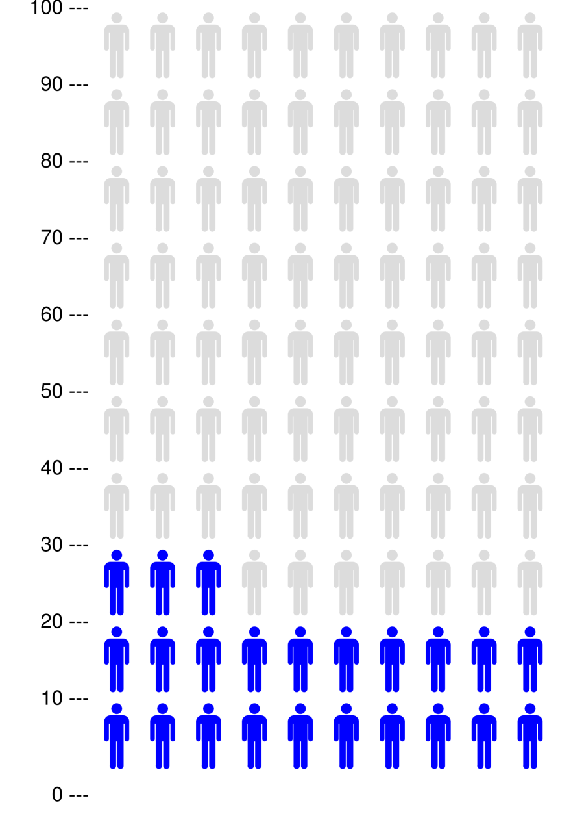
Some PLWH had been out of care previously
23% were out of care for at least 12 months during 2013-2015
All were back in care at the time of the survey

Slide 96

Feelings about HIV, health and access were top reasons for being out of care
0%
10%
20%
30%
40%
50%
60%
Didn't want to think about being HIV+
Felt fine
Forgot/missed appointment
CD4 and viral load good
Transportation
Homeless
Reasons for being out of care (n = 45)

Slide 97
What helped people reconnect to care?
Self-motivation
Felt ill or fear of becoming ill
Transportation assistance
Help from friends and family
Support and encouragement from
care staff

Slide 98
Participant Voices
My peer support helped me or told to me to get back in care and I did. Plus my daughter is a motivation too. Support from family to a degree and family members who have died from HIV.
SEMHAC Survey Participant

Slide 99
Needs Assessment Data on
Medications Adherence
HIV Infected
Diagnosed
In Care
Viral Suppression

Slide 100

Most prescribed HIV medications
Many recently missed or skipped meds
94% currently prescribed HIV medications
Half had skipped or missed a dose of medications in the last 30 days

Slide 101
What helps PLWH take medications?
Reminders (from others)
Remembering by myself
Consequences of not taking meds and the will to live Pre-packaged meds or weekly/monthly pill box Taking medication at the same time everyday

Slide 102
What makes it difficult to take medications?
Remembering to take them
Routines required
Pills too big
Too many pills
Side effects, feel sick after taking them

Slide 103
Participant Voices
My nurse talked with me about missing doses and explained to me I could become resistant. She also let me know that there are medications that I could take to help manage the side effects.
SEMHAC Survey Participant

Slide 104
Participant Voices
Motivation to live, lots of people pulling for you. Timer on my phone and pill box set up by Nurse/Case Manager.
SEMHAC Survey Participant

Slide 105
Participant Voices
I don't have a whole bunch of them to take, but I take at least three to seven other medications outside of that. But I'm not going to lie, I do stop taking the medications, because I get to the point where I'll just be like, "Fuck it. Why take it?
Youth Focus Group Participant

Slide 106
Participant Voices
I was young and I didn't have insurance and all that type of stuff so I just used to pay it and try to find black market stuff or get it from my mother where she got hers. But as I got older and I realized that it wasn't working how I needed it to work and I needed what worked for me… so it was a challenge at first but I overcame it.
Transgender Women’s Focus Group Participant

Slide 107
PLWH Perspective Discussion
What constellation of priority services will produce the best health outcomes for PLWH
in the DEMA?
Notes:
What information presented will help you decide the most important services that will
Benefit many PLWHAs
Have greatest impact on health outcomes
Address barriers identified in needs assessment

Slide 108

-
Notes:
45 min. lunch break

Slide 109
Service Utilization Perspective
(Number of Clients Served)
Notes:
Important to take notes on your priority setting worksheet as you’re taking in the information.

Slide 110
Service Utilization Perspective
Look at number of clients served from FY15-16 to current year
projections (how many clients we think will be served)
Core and support services
Assume that the number of clients served may provide some insight about future demand
But, there are other things that may also affect the number of clients served
Notes:
Slide 65 in master

Slide 111
-

Slide 112
-

Slide 113
Utilization Discussion
What constellation of priority services will produce the best health outcomes for PLWH
in the DEMA?
Notes:
What information presented will help you decide the most important services that will
Benefit many PLWHAs
Have greatest impact on health outcomes

Slide 114
Recipient’s Office Perspective
Notes:
Important to take notes on your priority setting worksheet as you’re taking in the information.

Slide 115
Recipient’s Recommendations Discussion
What constellation of priority services will produce the best health outcomes for PLWH
in the DEMA?
Notes:
What information presented will help you decide the most important services that will
Benefit many PLWHAs
Have greatest impact on health outcomes

Slide 116

Priority Setting Activity
Notes:
All of the wonderful notes you’ve taken can now be used to prioritize or rank the service categories. This isn’t a mock ranking, this is the real thing! Once you all come to a consensus it will be presented to the Full Council for a vote.
(Create 3 groups and have each to prioritize the service categories. Groups must be prepared to provide their rationale for their rankings. Remind group to review slide #17-Services Rank Higher…)
28 HRSA approved service categories to possibly rank (remember, all do not have to be ranked)
FY18, 21 of the service categories were ranked

Slide 117

-
Please don’t forget to complete the evaluation
Thank You!!!!!

Slide 118

We’re Done for the Day. TGIF!
End Day 1
Notes:
Anyone jot down notes on the Directives Worksheet? (if so, collect them)

Slide 119
Southeastern Michigan
HIV/AIDS Council (SEMHAC)
Priority Setting and
Resource Allocation (PSRA) Retreat
DAY 2
<?xml version="1.0"?><AllQuestions />
<?xml version="1.0"?><AllResponses />
<?xml version="1.0"?><Settings><answerBulletFormat>Numeric</answerBulletFormat><answerNowAutoInsert>No</answerNowAutoInsert><answerNowStyle>Explosion</answerNowStyle><answerNowText>Answer Now</answerNowText><chartColors>Use PowerPoint Color Scheme</chartColors><chartType>Horizontal</chartType><correctAnswerIndicator>Checkmark</correctAnswerIndicator><countdownAutoInsert>No</countdownAutoInsert><countdownSeconds>10</countdownSeconds><countdownSound>TicToc.wav</countdownSound><countdownStyle>Box</countdownStyle><gridAutoInsert>No</gridAutoInsert><gridFillStyle>Answered</gridFillStyle><gridFillColor>255,255,0</gridFillColor><gridOpacity>50%</gridOpacity><gridTextStyle>Keypad #</gridTextStyle><inputSource>Response Devices</inputSource><multipleResponseDivisor># of Responses</multipleResponseDivisor><participantsLeaderBoard>5</participantsLeaderBoard><percentageDecimalPlaces>0</percentageDecimalPlaces><responseCounterAutoInsert>No</responseCounterAutoInsert><responseCounterStyle>Oval</responseCounterStyle><responseCounterDisplayValue># of Votes Received</responseCounterDisplayValue><insertObjectUsingColor>Red</insertObjectUsingColor><showResults>Yes</showResults><teamColors>Use PowerPoint Color Scheme</teamColors><teamIdentificationType>None</teamIdentificationType><teamScoringType>Voting pads only</teamScoringType><teamScoringDecimalPlaces>1</teamScoringDecimalPlaces><teamIdentificationItem></teamIdentificationItem><teamsLeaderBoard>5</teamsLeaderBoard><teamName1></teamName1><teamName2></teamName2><teamName3></teamName3><teamName4></teamName4><teamName5></teamName5><teamName6></teamName6><teamName7></teamName7><teamName8></teamName8><teamName9></teamName9><teamName10></teamName10><showControlBar>All Slides</showControlBar><defaultCorrectPointValue>0</defaultCorrectPointValue><defaultIncorrectPointValue>0</defaultIncorrectPointValue><chartColor1>187,224,227</chartColor1><chartColor2>51,51,153</chartColor2><chartColor3>0,153,153</chartColor3><chartColor4>153,204,0</chartColor4><chartColor5>128,128,128</chartColor5><chartColor6>0,0,0</chartColor6><chartColor7>0,102,204</chartColor7><chartColor8>204,204,255</chartColor8><chartColor9>255,0,0</chartColor9><chartColor10>255,255,0</chartColor10><teamColor1>187,224,227</teamColor1><teamColor2>51,51,153</teamColor2><teamColor3>0,153,153</teamColor3><teamColor4>153,204,0</teamColor4><teamColor5>128,128,128</teamColor5><teamColor6>0,0,0</teamColor6><teamColor7>0,102,204</teamColor7><teamColor8>204,204,255</teamColor8><teamColor9>255,0,0</teamColor9><teamColor10>255,255,0</teamColor10><displayAnswerImagesDuringVote>Yes</displayAnswerImagesDuringVote><displayAnswerImagesWithResponses>Yes</displayAnswerImagesWithResponses><displayAnswerTextDuringVote>Yes</displayAnswerTextDuringVote><displayAnswerTextWithResponses>Yes</displayAnswerTextWithResponses><questionSlideID></questionSlideID><controlBarState>Expanded</controlBarState><isGridColorKnownColor>True</isGridColorKnownColor><gridColorName>Yellow</gridColorName></Settings>
<?xml version="1.0"?><AllAnswers />
August 3-4, 2018

Slide 120
Focus Questions
What constellation of priority services will produce the best health outcomes for PLWH in the DEMA?
How much money should be allocated to each priority service to support a continuum of care for PLWH in the DEMA?

Slide 121
Data to Review
Expenditures
  Service category spending in previous years
Utilization
  Number of clients that used services in previous years
Provider Prospective
  Input on anticipated change in need for services
External Forces
  How other programs, such as ACA, can impact the need for RW services

Slide 122

-
Spending Percentages
Support Services
≤25%
Core Services
≥75%
$
$
$
$

Slide 123
-
What if the data tells
us something different?

Slide 124
Waiver Request
What is it?
What happens if approved?
Support Services
What Does the Data Tell Us?
%
Core Services
%
$
$
$
$
Notes:
Yesterday we learned that some of the most used/needed services are:
1.
2.
3.
4.
5.

Slide 125

Expenditures: Where did the money go?
Service category allocations presented two ways
Dollar amounts
  Percentage of overall service dollars
Two Categories
Core ≥ 75%
Support ≤ 25%

Slide 126
Expenditure History
Includes allocations (how much we expect to spend) for the current year (FY18-19)

Slide 127
Expenditures are shown in two ways
Dollar amounts
Percentage of overall service dollars

Slide 128
-

Slide 129
-

Slide 130
-

Slide 131
-

Slide 132
Expenditure and Utilization History Discussion
How much money should be allocated to each priority service to support a continuum of care for PLWH in the DEMA?

Slide 133
Provider Perspective

Slide 134
Provider Perspectives
A survey of providers was conducted in July 2018
The survey asked providers to consider if in the future demand for services would increase, remain the same or decrease
  Change was not due to new HIV cases (more diagnoses)

Slide 135
Provider Survey Findings
42% of the responses indicated anticipating no change in need
Service categories where responses indicated anticipated increase in need (up to 10%) more frequently than no anticipated change in need include:
  Outpatient and Ambulatory Health Services (core)
  Early Intervention Services (core)
  Mental Health Services (core)
  Medical Case Management Services (core)
  Medical Transportation Services (support)
  Psychosocial Support Services (support)

Slide 136
Outpatient & Ambulatory Health Services
4 responses of anticipated increase in need
  Increased number of clients
    Previously diagnosed entering into care
    Referrals for re-entering into care
    Recently diagnosed entering into care
  Increased number of units
    Increased hours of operation

Slide 137
Early Intervention Services
3 responses of anticipated increase in need
  Increased number of clients
    Previously diagnosed entering into care
  Increase number of units
    New intervention models
    New collaborations
    Improved program marketing

Slide 138
Health Insurance Premium & Cost Sharing Assistance
No Responses received

Slide 139
Home and Community-Based Health Services
No Responses received

Slide 140
Mental Health Services
1 response of anticipated increase in need
Notes:
Improved awareness of availability of service by clients and also for referral purposes [OIHN, WSU-Adult (cohn)]

Slide 141
Medical Nutrition Therapy
No responses received

Slide 142
Medical Case Management
1 response of anticipated need to remain the same
3 responses of anticipated increase in need
Notes:
Persistent need: more intense need and long-term needs (UNIFIED)

Slide 143
Non-Medical Case Management
3 responses of anticipated need to remain the same
Notes:
Support with gaining access to health insurance including: completing paperwork (Matrix)

Slide 144
Emergency Financial Assistance
No responses received

Slide 145
Food Bank / Home Delivered Meals
No responses received
Notes:
“We have already seen an increase of 9.7% in unduplicated clients and 7.4% in units of service in the first 4 months of the year compared to last year. Food security remains a significant issue for our client population.” (HELP)

Slide 146
Housing Services
No responses received
Notes:
“Clients continue to have high needs for housing assistance including how to meet the burdens of move-in costs for low income households.” (HELP) HELP also mentioned that the disallowance of security deposit assistance is mitigates the high need, resulting in an anticipated decrease in need.

Slide 147
Medical Transportation
1 response of anticipated increase in need
Notes:
No additional information provided (CHAG)

Slide 148
Psychosocial Support Services
1 response of anticipated need to remain the same
1 responses of anticipated increase in need
  Increase number of units
    New collaborations

Slide 149
Provider Perspective Discussion
How much money should be allocated to each priority service to support a continuum of care for PLWH in the DEMA?

Slide 150

-
Notes:
15 min. break

Slide 151
External Forces

Slide 152
External Forces
Impact of the ACA
Other Programs
Other System-level Issues

Slide 153
Insurance coverage has increased since 2014

Slide 154
MI AIDS Drug Assistance Program
Qualified Health Plan enrollment will continue to slowly increase
(QHP-purchased on the marketplace)
MIDAP anticipates more PLWH will need assistance with drug co-pays and QHP premium costs
Healthy Michigan Plan enrollment will continue to increase
(HMP-expanded Medicaid)
MIDAP has seen a decrease in PLWH who receive full Rx coverage-- likely due to clients moving to HMP

Slide 155
How does this impact Ryan White?
Only some RW services covered under QHP and HMP
Medical Care, Medical Nutrition Therapy, Mental Health, Medical Transportation, and Home and Community Based Health Services
So, increased insurance coverage might decrease RW demand for these services

Slide 156
How does this impact Ryan White?
But….
Inadequate insurance reimbursement for primary care (OAHS) still necessitates RW funding support
Complexity of insurance eligibility and paperwork has added to RW provider workload and client confusion

Slide 157
External Forces
Impact of the ACA
Other Programs
Other System-level Issues

Slide 158
Medicaid Transportation Update
The Recipient’s Office (RO) has no new information from Medicaid

Slide 159

HOPWA
City of Detroit HOPWA expects a slight increase in funding and does not foresee anything that may impact level of need for their services. They fund:
Transitional housing programs for men
Transitional housing programs for women
Rental assistance

Slide 160

MI Dental Program
Clients will remain level or increase slightly in 2018
Assumed to have capacity to meet the
increased demand

Slide 161
Other Ryan White Parts
Part B
  Funds 1 Medical Case Management program in the EMA, which includes outreach to the Michigan Department of Corrections
    No changes expected
Care Coordination
  Funded 3 projects that will start services October 2018
    Details on programs are not yet known
Part C & D
  Funds Medical and Non-Medical Case Management, Mental Health, Medical Care, Health Education/ Risk Reduction, Medical Transportation, Psychosocial Support and Treatment Adherence
  These services are provided across 5 clinics

Slide 162
External Forces
Impact of the ACA
Other Programs
Other System-level Issues

Slide 163
Additional Considerations
Michigan marketplace insurance plan premiums are expected to increase $1,520 in 2019 according to a report released by the Center for American Progress
A bill has been introduced into the Michigan legislature that could increase the amount landlords can charge for security deposits from 1½ months of rent to 2 months of rent
In Detroit, from January-April of 2017 more than 17,000 Detroit households have faced potential water shutoffs

Slide 164
External Forces Discussion
How much money should be allocated to each priority service to support a continuum of care for PLWH in the DEMA?

Slide 165
Resource Allocation

Slide 166
-
Budget = $12
Chocolate Chips
Flour
Butter
Sugar
Eggs
Nuts
Sprinkles
Less important
Notes:
Do you all remember this cookie from yesterday? Yesterday we listed our ingredients from most important to less important. Now today, we’re going to purchase our ingredients but we must be mindful of how we spend because we’re working with limited funds. (click Enter for budget amount to appear)
We’re working with a budget of $12 and when you have a limited budget is it important to make sure you purchase the most important or least important ingredients?
Now, when we think about the cost of ingredients there’s some good news and not so good news. The not so good news is that the cost of sugar has increased. It once cost $2 per bag but now it’s $4, which is going to cut into our budget. The good news is that our next door neighbor of 15 years just purchased chocolate chips and purchased too many. So our neighbor has offered to provide us with chocolate chips free of charge. So this means that we don’t have to put any of our money towards to cost of chocolate chips, which is cost savings.
So now, let’s see how we will allocate/distribute our budget towards the purchase of our ingredients…

Slide 167
-
Budget = $12
$0 Chocolate Chips
$3 Flour
$2 Butter
$4 Sugar
$3 Eggs
$0 Nuts
$0 Sprinkles
Less important
Notes:
Talk about the budget and how the funds were allocated
Now, although our less important ingredients are not included in our budget, we still include them in our ingredient list. Does anyone know why?
So that if we have more money the next time we wanted to make chocolate chip cookies, we can purchase those less important ingredients (unless our neighbor has extra and gives them to us)
This is an example (on a much smaller scale) of what will take place today.
We’re going to look at data that will allow you to
Allocate/distribute dollars to the service categories where there is a monetary need.

Slide 168
Base Allocation

Slide 169

Base Allocations Spreadsheet
Data based: services, costs, surveillance
Limitations: projections v. timeliness
Tool to help chart the course
(not a map)
Notes:
Limitations: Most of the data used is projected data. Looking at your base allocation handout you’ll see FY18 allocation amounts (this total will be used for our level funding scenario). You’ll also see FY18 projected clients and cost data. This data was gathered by the Recipient. The Recipient asked the providers to give them the projected number of clients they will service and the projected cost to service those clients.
Using this information is beneficial to creating a more realistic allocation to the service categories.
Tool to help…: Gives you all a place to start

Slide 170


Basic Components, by service
Number of clients:
FY18-19 (projected)
Unaware-New diagnoses: roughly level from
2012-2016: ~Average of 507 new diagnoses annually in DEMA
Costs: Projected cost per person
NEW COST FACTOR: Fixed cost set by HRSA

Slide 171

Unaware – New Diagnoses
New diagnoses roughly level from 2012-2016:
~Average of 507 new diagnoses annually in DEMA
Increase calculation assumes new diagnoses
will receive RW services at same rate
as all PWLH in DEMA
Notes:
Go to Tab 3 in spreadsheet
Help audience to see how the FY18 Projected Unaware number was calculated
Show that the information leads back to the FY17 Unaware numbers on the Base Allocation handout

Slide 172

Base Allocation: Point of Departure
Destination: 4 Allocation Scenarios (75%/25% and no percentage guidelines)
Level Funding
Modest Increase (approx. 5%)
Respect Funding Guidelines
Part A and MAI
Core and Support
Notes:
Three Allocation Scenarios: When you all create the budget you will create four. One with level funding and another with a modest increase will be created for the 75% 25% guidelines and for the no core and support percentage guidelines
(Recall what Leanne recommended regarding a modest increase)

Slide 173

-
Notes:
45 min. lunch break

Slide 174


-
RESOURCE ALLOCATION ACTIVITY
Notes:
Separate into 2 groups
Provide them with dollars and coins that equal to the BASE/FLAT FUNDING FY Allocation. Have each team allocate dollars to the service categories using the 75%/25% mandate. STRESS THAT THEY MUST USE DATA TO BACK UP THERE DECISIONS
Once they complete the allocation, record each teams allocations.
Next, have each team increase their allocation by however much is stated on the BASE ALLOCATION COIN CALCUATION spreadsheet using the 75%/25% mandate. (recall to them the chocolate chip cookies scenario. Do they purchase more chocolate chips (MOST IMPORTANT ingredients) or do they purchase nuts and/or sprinkles (LESS IMPORTANT ingredients))?
Record each teams allocation.
WAIVER ALLOCATION SCENARIOS: Have the group to decide if they want to…
Used the base/flat funding FY allocation as the starting point and add the increase amount to any service category OR
Start from scratch and allocate base/flat funding amount to the service categories and then add the increase
NOTE TO SELF: for ALL scenarios, PART A CANNOT exceed $7,819,462 and MAI $738,308
Take the averages of each scenario and have the group vote on the best scenario to be presented to the Full Council.

Slide 175
-
Please don’t forget to complete the evaluation
Thank You!!!!!

Slide 176
-
Slides to print for attendees
Day 1
1-3,7-12,14,15,17,19-62,64-107,109-116
Day 2
119-123,125-149,151-166,168-170,172,174

