Slide 1
Setting the Standard: A Comprehensive Overview of Service Standards for Part A Planning Councils/Planning Bodies
Renee November (St. Louis TGA)
Cheryl Barrit (Los Angeles EMA)
Jamal Refuge (Planning CHATT)

Slide 2
Agenda
Welcome and Introductions
Service Standards Overview
Service Standards and COVID-19
Developing, Reviewing, and Updating Service Standards
Resources
Questions and Answers

Slide 3
Webinar Presenters
Renee November
St. Louis TGA
Cheryl Barrit
Los Angeles EMA
Jamal Refuge
Planning CHATT

Slide 4
Objectives
Define service standards in the context of the Ryan White HIV/AIDS Program (RWHAP)
Identify at least three key components of service standard categories
Understand the utility of service standards in ensuring quality care for people with HIV
Locate at least two resources to support the development of service standards
Understand the relationship between COVID-19 and service standards

Slide 5
Service Standards Overview

Slide 6
Service Standards Defined
Written guidelines that outline for subrecipients the elements and expectations for implementing a service category in the EMA or TGA
Service standards are designed to:
Ensure that all subrecipients provide the same basic service components
Establish a minimal level of service or care
A jurisdiction’s service standards include:
Universal service standards that apply to all service categories
Separate standards for each funded service category

Slide 7
Service Standards: A Tool for Many Users
Consumers: Must be easy to understand and readily available
Recipient: Used in Requests for Proposals (RFPs), subrecipient contracts, and monitoring to ensure quality care and consistency
PC/PBs: Used as an opportunity to learn more about services provided and as a troubleshooting tool to identify possible changes or improvements

Slide 8
Service Standards: A Tool for Many Users (cont.)
Subrecipients/Service Providers: Define the core components of a service category to be included in the model of service delivery
Quality Managers: Serve as a framework for how services should be delivered and outcomes are measured

Slide 9
How does having service standards improve care for people living with HIV in your jurisdiction?

Slide 10
Los Angeles
Direct feedback from PLWH
Redefine and modernize criteria for service standards (e.g. emergency financial assistance)
Leverage COVID-19 CARES Act for additional funding due to the advocacy of PLWH

Slide 11
St. Louis
Use service standards as a teaching tool
Importance of consumer storytelling (e.g. client needing utility assistance)

Slide 12
HRSA-Recommended Topics to Address in Service Standards
Service Category Definition
Intake and Eligibility
Key Service Components and Activities
Personnel Qualifications (including licensure)
Assessment and Service Plan*
Transition and Discharge
Case Closure Protocol
*where applicable

Slide 13
HRSA-Recommended Topics to Address in Service Standards
Client Rights and Responsibilities
Grievance Process
Cultural and Linguistic Competency
Privacy and Confidentiality (including securing records)
Recertification Requirements*
*where applicable

Slide 14
HRSA/HAB Guidance: Performance and Health Outcome Measures
Jurisdictions should not include performance measures or health outcomes in their service standards
Use of these measures is the responsibility of the RWHAP Part A Recipient:
Recipients include performance standards in their RFPs
Potential subrecipients indicate in the application their ability to meet the performance standards
Selected subrecipients have performance measures in their contracts
Recipient monitoring addresses whether these measures are being met
The RWHAP Part A Recipient monitoring for compliance is an administrative function

Slide 15
Developing, Reviewing, and Updating Service Standards

Slide 16
What is your process for developing service standards at your jurisdiction?

Slide 17
Developing Service Standards
Assign responsibility, usually to a PC/PB committee (e.g. Care Strategy or System of Care)
Determine priorities for development of service standards
Include all service categories that are currently funded or have been allocated funds for the next program year
Agree on the order of development based on clear criteria, such as a service category’s allocation level or local priority
Set a timeline that fits into your annual calendar
Review and agree on an outline to be used for all service category-specific service standards

Slide 18
Develop Service Standards that Apply to All Service Categories
Include programmatic and fiscal requirements in the RWHAP Part A National Monitoring Standards
Address such topics as:
Access to Services
Agency Policies & Procedures
Client Rights & Responsibilities
Cultural & Linguistic Competence
Grievance Process
Personnel, Training, Licensing & Supervision
Intake and Eligibility
Transition and Discharge
Privacy & Confidentiality
Program Safety

Slide 19
Establish a Process for Drafting Service Standards
Include a review of federal guidelines, standards from other jurisdictions, and relevant state and local requirements
Include ongoing RWHAP Part A Recipient representation/participation
Provide for systematic technical input from providers, consumers, and other experts, including RWHAP-funded and other service providers
Manage potential conflicts of interest by ensuring that subrecipients do not dominate in numbers or influence
Use a combination of meetings and written input and reviews

Slide 20
Develop Service Standards Using A Process
Develop service standards using the agreed-upon process
Reference Universal Standards, but do not repeat their content in service category-specific standards
Present draft standards for review by the PC/PB and recipient
Make necessary revisions, then allow for external review by providers, consumers, and other experts
Consider and integrate external input to draft standards
Finalize service standards by vote of the PC/PB

Slide 21
Service Standards & COVID-19

Slide 22
How has COVID-19 impacted the way you develop and maintain service standards?

Slide 23
Los Angeles
Re-review universal service standards to include telehealth
Partner with agencies to use virtual meeting platforms that are easier to use for consumers who have access to the latest technology (e.g. Zoom)
Sharing of best practices
Bilingual focus groups to get consumer feedback on childcare standards integrated plan
Even more coordinated efforts with grantee

Slide 24
St. Louis
Virtual meetings
Flexibility in training new staff
Strategizing to address changes in service delivery (e.g. home food delivery)

Slide 25
Reviewing and Updating Service Standards
Review and update standards as needed to incorporate:
The need for changes to improve outcomes
Legislative or HRSA/HAB administrative changes in service category definitions and descriptions
Changes in guidelines for HIV care and treatment
New or revised state or local requirements
Review all standards at least every three years, on a predetermined cycle
Obtain technical input and public review from the same types of sources as in original development

Slide 26
Resources

Slide 27
Resources
RWHAP National Monitoring Standards
HRSA HIV/AIDS Bureau (HAB) TA website
HHS Clinical Guidelines for the Treatment of HIV/AIDS

Slide 28
Resources
RWHAP Planning Council Primer
Training Guide for RWHAP Part A Planning Councils/Planning Bodies: A Member’s First Planning Cycle

Slide 29
Questions and Answers

Slide 30
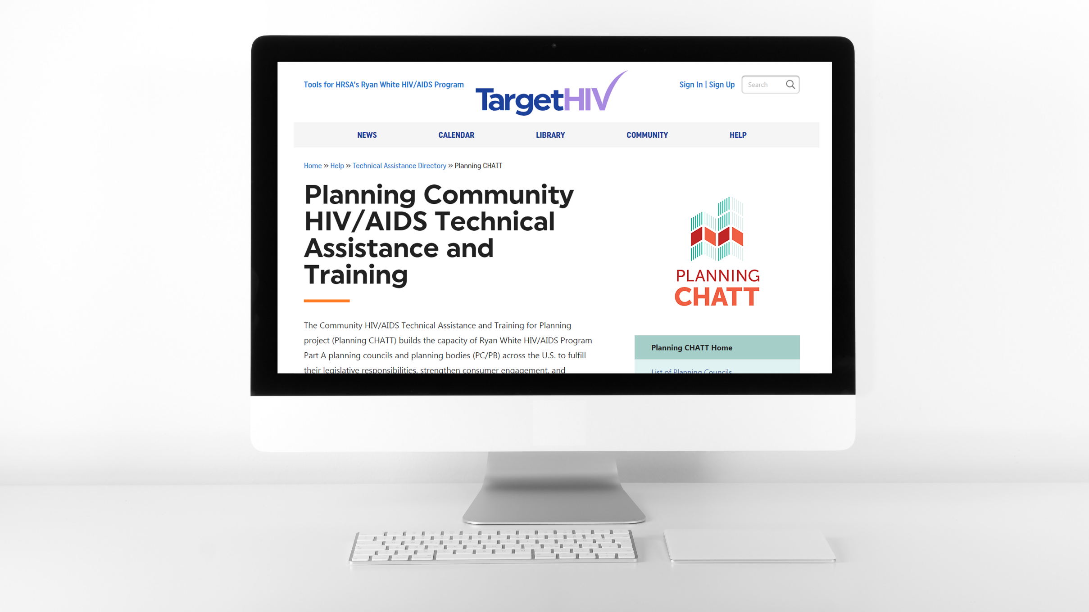
www.targetHIV.org/planning-CHATT

Slide 31
Thank You
Please complete the evaluation!
TargetHIV.org/planning-CHATT
Sign up for our mailing list, download tools and resources, view archived webinars and more…
Contact Planning CHATT: planningCHATT@jsi.com

