Slide 1
In It Together: Improving Health Literacy for Black Men who have Sex with Men
HRSA Innovative Service Models and Best Practices panel
September 7, 2017
Michelle Vatalaro, Health Literacy Lead,
In It Together/ACE TA Center, JSI
Daniel Driffin, Lead Trainer, In It Together
Co-Chair of the Fulton County Task Force on HIV/AIDS, Co-Founder of THRIVE SS, Inc.
Notes:
MICHELLE
Good afternoon, my name is Michelle Vatalaro and I am the Health Literacy Lead for the In It Together project at the JSI ACE TA Center. With me today is Daniel Driffin, who is our Lead Trainer and is also the Co-Chair of the Fulton County Task Force on HIV/AIDS and Co-Founder of THRIVE SS, Inc.
Today, we’re going to be talking about our work on the In It Together Project, which aims to improve health outcomes for black gay, bisexual, same gender loving, and other men who have sex with men by improving health care providers’ capacity to provide health literate services to their clients.

Slide 2
Overview
The case for health literacy in HIV care
In It Together for Black MSM
Training of Trainers
The Community Training
Building the network of health literacy trainers
We’re All In It Together
Notes:
MICHELLE
Let’s just do a quick overview of what we are going to talk about today.
First, we’re going to talk a bit about why it is important for HIV care providers to be concerned about health literacy.
Then, we’ll talk about the In It Together model, and how we have worked to build a network of health literacy trainers across the country that provide the Health Literacy Community Training to health professionals in their communities.
We’ll end by talking a bit about our future plans for the In It Together program.

Slide 3
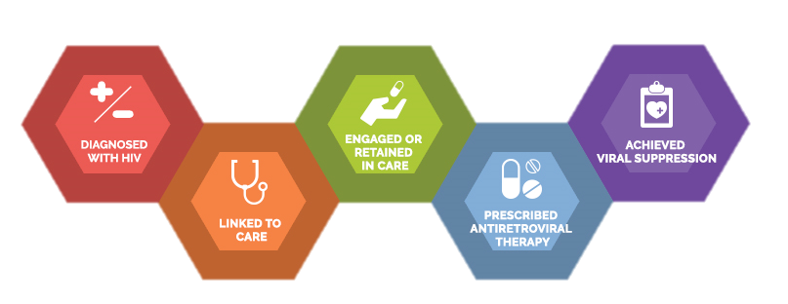
Health literacy and HIV
3
Notes:
DANIEL
[Daniel to talk through experience of health literacy at moment of diagnosis]

Slide 4
Health literacy
The degree to which individuals have the capacity to obtain, process, and understand basic health information and services needed to make appropriate health decisions.
Demands of the health care system
Person’s skills and abilities
Health Literacy
4
Notes:
MICHELLE
Health literacy is defined as the degree to which people have the capacity to obtain, process, and understand basic health information and services needed to make appropriate health decisions.
This definition recognizes that health literacy is a key factor in health care quality, safety, and equity.
A person’s health literacy is the result of both a person’s skills and abilities and the demands placed on the patient by the health care system. The weights of each side of this change all the time, which is why we say that health literacy is dynamic. It can change moment to moment as the patient’s health status changes, or as we ask them to engage with the health care in different ways.
Daniel just gave us a great glimpse into how a person’s health literacy can change moment to moment. Unfortunately, the moments where we really need to be at our sharpest - for example, that moment of diagnosis where you’re getting tons of new, important information at the same time – can often be the moment where we are least able to take in and process health information. A person’s physical and emotional state can affect what a person hears, how he interprets it, and how he acts on it.
It’s easy to think about health literacy as a set of skills that an individual person needs to build up in themselves. And while that’s true – clients should try to learn about their health and improve their health literacy skills, it’s hard to do, and we don’t really have time to wait.
So it’s the responsibility of the organization to address health literacy.
Organizations have a responsibility to provide information to clients in a way that clients understand. If there’s a group of people that isn’t getting that information – for whatever reason – in this case, their health literacy, then we have a duty to address that in the way that we provide care.

Slide 5
The need
Limited health literacy can affect clients’ ability to:
Understand and apply health care information
Interact with the health care system
Get or stay in care
Take medication correctly
Complete forms
Determine which legal documents apply to a specific health care situation
Notes:
DANIEL
Limited health literacy can have a substantial impact on a person’s ability to successfully engage with the health care system or achieve their health goals, and can have a real, tangible impact on people living with HIV.
A person who is experiencing limited health literacy might not be able to understand the basics of HIV. For example, they may not understand that HIV is a virus that attacks the immune system, which means that the body has a hard time fighting off diseases.
The health care system is complicated for everyone, and clients who have limited health literacy may have particular difficulty navigating the system. Because its difficult to understand and navigate, clients with limited health literacy may not be able to get in care, or stay in care. They may not understand how or when to take their medications,
Limited health literacy affects people’s ability to complete basic health tasks. They might not be able to understand or apply information that they get about their health care. They may struggle to get the care they need, to stay in care once engaged, or to take their medication correctly. Medications help to keep the amount of virus in the blood “undetectable” and the person healthy.
A person experiencing limited health literacy may not understand HIV well enough to understand that it has a long latency period, and though they feel fine right now, they need to take their medication every day in order to stay healthy and avoid passing HIV to another person. If a person with HIV doesn’t understand how to take his medication correctly, he won’t be able to fight the virus. People with limited health literacy who have HIV may have more trouble maintaining an undetectable viral load - and may get sick more often.
What we sometimes see is providers misinterpreting sub-optimal medication adherence or missed appointments as an attitude problem. People struggling with limited health literacy may feel embarrassed about not understanding, and may try to hide it from their health care provider. They might not ask questions, because they think the provider will judge them.
Lastly, people with limited health literacy may have a pretty limited ability to be an advocate for their own health.

Slide 6
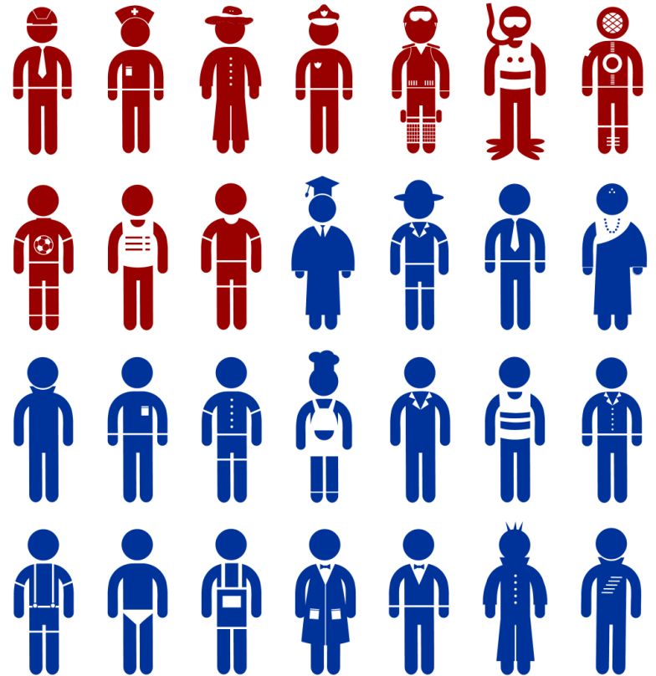
Who is at risk?
Older adults
Racial and ethnic minority populations
People of low socioeconomic status
Recent immigrants or other people whose first language is not English
Medically underserved people
89 million people in the U.S. (36% of adults) have limited health literacy.
6
Notes:
DANIEL
Everyone experiences limited health literacy sometimes. Everyone has had an experience where they had a cold and felt foggy - it was hard to process information. It happens to everyone, especially when we’re emotional, uncomfortable, or in pain.
Health systems must be designed to accommodate the unpredictability of health literacy skills. This means presenting information simply and clearly. Clear communication makes it easier for everyone to understand the health care system and health care information. No one minds when information is easier to understand.
Up until now, I’ve talked about how everyone can experience limited health literacy. While its certainly true that everyone is at risk for and experiences limited health literacy sometimes, some people’s baseline level of health literacy is limited.
In fact, 89 million people in the United States – that is, 36% of the adult population – have limited health literacy.
People at greatest risk for limited health literacy are:
Older adults
Racial and ethnic minority populations
People of low socioeconomic status
Recent immigrants or other people whose first language is not English
People who are medically underserved

Slide 7
Health literacy
Cultural competency
7
Notes:
DANIEL
Health care organizations that serve people living with or at risk for HIV make a real effort to provide culturally competent care - care that addresses all of the physical, emotional, behavioral, and social health needs of clients, while being sensitive and responsive to their unique identity.
Its important to realize that addressing health literacy is an essential part of providing culturally appropriate services.
Moreover, health care organizations cannot provide health literate services without being sensitive and responsive to the client’s unique identity.
For example – some groups use certain language to talk about their health. It may not be that the client doesn’t understand the concept, but that they use different words to describe. It’s the responsibility of the provider to make sure that the client understands; if that means using the client’s words, that is OK.

Slide 8
Responsibility of health professionals in health literacy
Health literacy is an issue of health equity
Health care organizations have a responsibility to address and build clients’ health literacy
Health professionals must provide information in a way clients understand
8
Notes:
DANIEL
As we just discussed, addressing a client’s health literacy is an integral part of providing culturally competent care. Health care providers have a responsibility to ensure that all of their clients get the information that they need to get and stay healthy because at its most basic, health literacy is an issue of health equity. If there is a group of people who is not getting the information that they need – for whatever reason – in this case, their health literacy, then we have a duty to address that in the way that we provide care.
Certainly, individual health care providers play an important role in ensuring that their clients have the information they need to get and stay healthy. But to really address health literacy for our clients, its important that organizations make a commitment to address health literacy. Organizations have a responsibility to provide information to clients in a way that the clients can understand it and use it. Organizations that serve people living with HIV should take steps to meet clients where they are. By doing so, clients can start to understand the basics of their care and grow their health literacy over time.

Slide 9
The In It Together project
Notes:
MICHELLE
So now that we understand the need to address health literacy in organizations that serve people living with HIV, let’s talk about how the In It Together project helps to build organizations’ health literacy so that they can better meet their clients’ needs.

Slide 10
Overview of In It Together
Goal: Improve the capacity of health care organizations to deliver health literate HIV services to black gay, bisexual, same-gender-loving, and other men who have sex with men
Purpose: Build health literacy knowledge of Health Literacy Trainers in communities across the U.S., including capacity to deliver local community training to health care provider organizations
Notes:
MICHELLE
In It Together started in 2014 as a project funded by the Health Resources and Services Administration. Its now in its second iteration.
The In It Together project endeavors to improve the capacity of health care organizations – like health departments and community-based organizations - to deliver health literate HIV services to black gay, bisexual, same-gender-loving, and other men who have sex with men.
To accomplish this, JSI developed a ‘training of trainers”, to develop a network of health literacy trainers in communities across the U.S.

Slide 11
Target Communities
Notes:
MICHELLE
In It Together is currently available in 34 priority communities across the United States. These communities were selected based on HIV prevalence and epidemiological data.
In order to ensure that the In It Together training is responsive to the needs of each individual community, In It Together trainers are recruited from and conduct training in their own community. This is intentional so that the trainers are able to infuse their presentations with that “local flair” or community consciousness that you really only have when you live there. It really helps to get at the culture of that community to help meet the needs of the clients in that community.
OPTIONAL: Our training evaluations show that this is one of the most valuable aspects of the training. The communities appreciate that the trainers are available to serve as health literacy resources in their community. Community training attendees really appreciate the opportunity to learn from people who understand the culture of the community.

Slide 12
In It Together model
Trainers are recruited from target communities
Community-based trainers participate in multi-module, virtual Training of Trainers
Trainers conduct trainings of health professionals in their own communities
Notes:
MICHELLE
In It Together functions on a train-the-trainer model. Potential trainers are recruited from the 34 priority communities. People who are interested in becoming health literacy trainers fill out a short application. Applications are scored, and a group of trainers are selected from the applicant pool.
The selected applicants then participate in a multi-session, virtual Training of Trainer program. These Training of Trainer sessions are intended to give the trainers a deep knowledge of strategies to improve health literacy for the black MSM community. We want to ensure that the trainers are able to do more than just deliver a one-hour training; we are preparing them to be health literacy resources in their community.
Following the Training of Trainers, graduated trainers go out into their community and provide the Health Literacy Community Training to health professionals in their community.
We define “health professional” really broadly, and the In It Together trainers are encouraged to provide the training to any professional who provides services to people living with or at risk for HIV. This would include doctors, dentists, nurses, and intake staff, but it would also include case managers, housing service providers, and other providers of supportive services.

Slide 13
The Community Training
Notes:
Let’s talk about the In It Together Health Literacy Community Training.

Slide 14
How In It Together benefits health care organizations
Builds the capacity of staff around health literacy
Better health outcomes
Inspires use of health literate practices
Increases patient activation and engagement
Addressing health literacy addresses health equity
Notes:
MICHELLE
The Health Literacy Community Training is a great starting point for health care organizations to begin incorporate health literacy tools and techniques into their conversations and services.
The Community Training is about more than raising awareness about the issue of health literacy. Attendees leave the community training inspired, with real, tangible strategies that they can implement right away to improve their communication with their clients.
Because the information is now easier to understand, apply, and use, clients can be more active, engaged participants in their care.
This leads to better health outcomes for all clients, particularly those with limited health literacy.
By addressing the health literacy needs of clients, organizations are really taking steps towards addressing health equity for clients with limited health literacy.

Slide 15
Elements of the Community Training
Introduction to health literacy
How health literacy affects health outcomes
Social and contextual factors
Strategies to improve written communication
Strategies to improve face-to-face communication
Notes:
MICHELLE
The training starts by providing an introduction to health literacy.
We define what health literacy is, the populations most affected by health literacy, and the effect that limited health literacy has on health outcomes and health care costs. Particular focus is placed on the effect that limited health literacy can have on people living with HIV.
We then go into detail on some specific strategies that providers can use to improve their written and face to face communications with clients.

Slide 16
Approaches for health literate communication
Strategies for face-to-face communication
Strategies for written communication
Large, easy-to-read font
Simple words
Short sentences
Familiar words and phrases
Active voice
Universal precautions approach
Ask Me 3™
Teach-back
Notes:
MICHELLE
Written Communication
When we talk about improving the clarity of written materials we mean materials such as: pamphlets, health education materials, prescription instructions, etc. We encourage the providers to create or select written materials that use:
Large, easy-to-read font
Simple words
Short sentences
Familiar words and phrases
Active voice
We want to avoid:
Using ALL CAPS, Italics or underlining
Acronyms and contractions
Technical words/jargon, when possible
Face to Face Communication
We also present three strategies to improve a health care organization’s health literacy.
First, we encourage health care organizations to take a “universal precautions approach” to health literacy. By that we mean that we encourage organizations to employ health literate strategies with all clients, in order to ensure that everyone’s health literacy needs are met. We can’t always tell who has or is experiencing limited health literacy, so rather than guess, we encourage health care organizations to provide simple, clear information to all clients, not just those we think might not understand. In addition to being a practical way to ensure that all clients needs are met, this approach all prevents stigmatization of clients with limited health literacy, who may feel embarrassment or shame around their health literacy skills.
The second strategy we encourage is the National Patient Safety Foundation’s Ask Me 3 approach. Ask Me 3 holds that at the end of an appointment, a client should know the answers to three simple questions.
What is my main problem?
What do I need to do?
Why is it important for me to do this?
The campaign encourages clients to ask these questions of their provider. But we know that clients may not feel empowered to ask questions of their providers, or to ask their providers to explain the information to them again in a simpler way. So, In It Together encourages the providers to frame their conversations with the client using these questions. They should ensure that they are limiting the information to the most important things, and that they are explaining them in a way that the client can understand.
The last strategy that we promote is the use of the Teach-back. The Teach-back is a simple process that helps providers gauge how well they explained themselves. Providers explain the health information to the client, and then they ask the client to explain the information back to them in their own words. This way, the provider knows if the patient really understands the information and what they need to do. If the client doesn’t explain the issue completely or correctly, the provider would then clarify or re-explain the information to the client.
We make a point to stress to providers that the Teachback is not a test of the client or their ability to understand; its actually a check to ensure that the provider explained the information adequately. We stress this to really drive home that it is the responsibility of the health care organization to address health literacy.

Slide 17
Who can benefit from the IIT community training
San Diego, CA
San Francisco, CA
Los Angeles, CA
Birmingham, AL
Little Rock, AL
West Memphis, AR
Hartford, CT
Miami, FL
Atlanta, GA
Chicago, IL
Indianapolis, IN
Baton Rouge, LA
New Orleans, LA
Baltimore, MD
Detroit, MI
Minneapolis, MN
Jackson, MS
North Mississippi
St. Louis, MO
Kansas City, MO
Newark, NJ
Jersey City, NJ
New York City, NY
Raleigh, NC
Charlotte, NC
Cleveland, OH
Philadelphia, PA
Columbia, SC
Memphis, TN
Houston, TX
Richmond, VA
Norfolk, VA
Washington, DC
Milwaukee, WI
Medical provider organizations
Social service provider organizations
Health departments
Organizations that support access to health care
Notes:
MICHELLE
The In It Together Health Literacy Community Training can help a variety of organizations that serve and support people living with or at risk for HIV. The Community Training is available to:
Medical provider organizations
Social service provider organizations
Health departments, and
Organizations that support access to health care
In the communities that you see listed here.

Slide 18
Connect to training
Trainers offer training to health care organizations, drawing upon local connections.
Organizations can request training directly through the In It Together Website.
https://hivhealthliteracy.careacttarget.org/
Notes:
MICHELLE
If your organization is interested in receiving the In It Together Community Training, you can request a training through the In It Together website.
Our trainers also draw upon and leverage their local knowledge and relationships with service providers in their community and provide the training to those organizations.
The Community Training is free of cost to the host organizations.

Slide 19
In It Together Training of Trainers
Notes:
MICHELLE
I want to take a bit of time to talk about the In It Together Training of Trainer program.

Slide 20
The Training of Trainers
Introduction to Health Literacy
Social and Contextual Factors
Improving Face to Face Communication
Improving Written Communication
Fostering Health Literate Organizations
Conducting the Community Training
Notes:
MICHELLE
The Training of Trainers is an interactive, distance-based training program.
It’s made up of 6 one-hour training modules and provides detailed information about:
Introduction to Health Literacy
Social and Contextual Factors that affect health literacy
Improving Face to Face Communication
Improving Written Communication
Fostering Health Literate Organizations
Conducting the Community Training
Even though they take place online, all of the sessions are really interactive and participatory. We use a lot of chat messaging to keep the participants engaged. We encourage them to draw on their own personal and professional experiences to engage with the material. We also include activities, such as case studies and polling to keep the energy and engagement with the material high.

Slide 21
We want you to be an In It Together trainer because you:
Are an experienced training facilitator
Are comfortable talking about Black MSM issues and sexuality
Have great relationships with health care organizations
Interested?
Want to Learn More?
Meet up with us throughout USCA!
Email us at hivhealthliteracy@jsi.com
Notes:
DANIEL
If any of this sounds interesting or exciting, I want to encourage you to apply to be an In It Together trainer. We’re recruiting right now for a new cohort of In It Together trainers.
We are looking for people who ideally are experienced training facilitators, are comfortable talking about Black MSM, the social determinants of health, sexuality, and other topics like that. We would like our trainers to have great relationships with HIV service provider organizations in their communities.
If you’re interested in learning more about becoming a health literacy trainer, Daniel and I will stick around after this session to talk more about it. Daniel will also be hosting short meet-ups at the JSI booth throughout the conference to give more specific information.
You can also always email us at hivhealthliteracy@jsi.com for more information or for the training application link.
The application is a short online form. We’ll go through and review the submitted applications and make our selections. The selected trainers will then attend the ToT sessions, which will take place in mid-November.

Slide 22
Why become an In It Together trainer
Become a health literacy resource in your community
Build the capacity of health care organizations in your community to meet the health literacy needs of their clients
Notes:
DANIEL
Why would you want to become an In It Together trainer?
First, you’ll get to build your own capacity and skills around health literacy. We really want our trainers to be seen as health literacy resources in the community. In this role as a trainer, you’ll really be able to be an advocate for your community – helping organizations to better serve black gay, bisexual, and same gender loving men.

Slide 23
Become an In It Together trainer!
Apply to be an IIT Trainer
Attend Six 1-hour interactive training webinars
Conduct health literacy trainings
Connect with health care organizations in your community
Notes:
MICHELLE
So one more time, here is what will happen.
You’ll apply to be an In It Together trainer.
After you’re selected, you will attend six one-hour interactive training webinars, during which time you’ll learn everything you need to know to conduct the Community Training.
After the ToT ends, you’ll connect with health care organizations in your community to schedule their one-hour Community Training session.
Then, you will conduct the health literacy training!

Slide 24
We’re All In It Together
Notes:
MICHELLE
We will also be adapting the In It Together Curriculum and we’re calling it adaptation We’re All In It Together.
This is going to be a separate program that will operate in addition to the In It Together program focusing on Black MSM.

Slide 25
Spring 2018: We’re All In It Together!
An In It Together curriculum adapted to help HIV providers meet the diverse needs of key populations
Focus on populations facing disparities (e.g., Black and Latino MSM, youth, Black women, transgender women). Adapted resources will include:
Training of Trainers
Community training
Supporting materials
Trainer recruitment will take place in early 2018
Notes:
MICHELLE
We’re All In It Together is going to be an adaptation of the IIT curriculum designed to meet the needs of people living with HIV who receive RWHAP services – moving beyond Black MSM.
We’re going to be focusing on populations that face health disparities, such as:
Black and Latino MSM
Youth
Black women
and transgender women
We’re All In It together will include a new Training of Trainers program, a new community training, and new supporting materials.
If you’re interested in We’re All In It Together – be on the lookout in 2018. We’ll be putting out a call for training applications at that time, with training to occur in the Spring.

Slide 26
Thank you!
Michelle Vatalaro
Health Literacy Lead, In It Together project
michelle_vatalaro@jsi.com
Daniel D. Driffin
Lead Trainer, In It Together project
ddriffin@gmail.com
In It Together
https://hivhealthliteracy.careacttarget.org/
hivhealthliteracy@jsi.com
Notes:
MICHELLE
Thank you very much for listening today. We appreciate your interest and all that you do.
If you have any questions for us, as I said, Daniel and I will stick around for a few minutes. You can also contact us via email – our information in on the screen.
Thank you again.

