Slide 1
HRSA Initiatives to Address Hepatitis C and Health Disparities September 7, 2017
Letha Healey, MD
Pamela Belton
Sara Woody
Division of Domestic HIV Programs
Office of Training and Capacity Development (OTCD)
HIV/AIDS Bureau (HAB)
Health Resources and Services Administration (HRSA)

Slide 2
Health Resources and Services Administration HIV/AIDS Bureau
Vision
Optimal HIV/AIDS care and treatment for all
Mission
Provide leadership and resources to assure access to and retention in high quality, integrated care and treatment services for vulnerable people living with HIV/AIDS and their families

Slide 3
RWHAP Moving Forward
Public health approach to provide a comprehensive system of care
Ensure low-income people living with HIV (PLWH) receive optimal care and treatment
Notes:
FY16: at $2.32 billion
Remember why this program exists. It is to provide high-quality HIV care and treatment services to low-income PLWH.
RWHAP has an important role to play in the public health response to HIV. Our clients achieve higher rates of viral suppression than PLWH receiving services elsewhere.
When a person is virally suppressed, they are far less likely to transmit HIV to others.

Slide 4
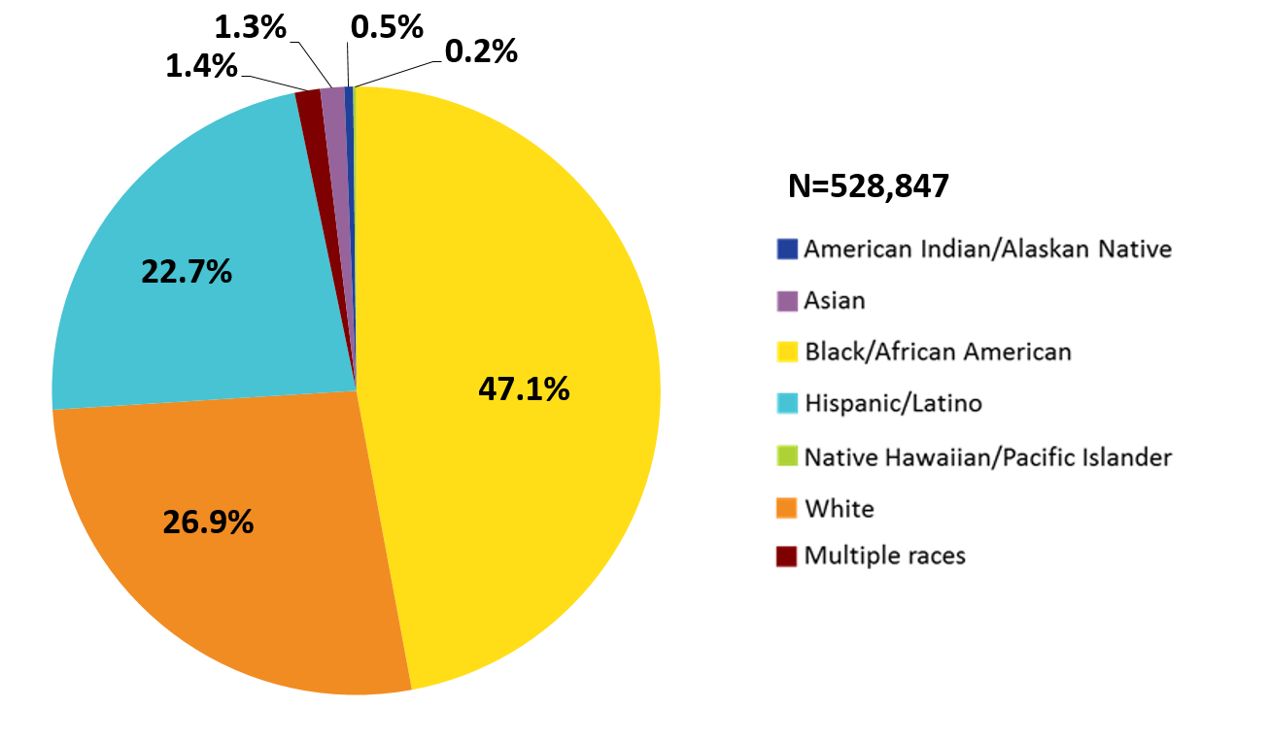
Clients Served by the Ryan White HIV/AIDS Program, by Race/Ethnicity, 2015—United States and 3 Territoriesª
Hispanics/Latinos can be of any race.
ª Guam, Puerto Rico, and the U.S. Virgin Islands.
Notes:
In 2015, of the 528,847 RWHAP clients with reported race/ethnicity information, 47.1% self-identified as Black/African American; 22.7% Hispanic/Latino; and less than 3.5% total for American Indian/Alaska Native, Asian, Native Hawaiian/Pacific Islander, and persons of multiple races. Whites accounted for 26.9% of clients.
Hispanics/Latinos can be of any race.
The three territories include Guam, Puerto Rico, and the U.S. Virgin Islands.
The data source is: HRSA. Ryan White HIV/AIDS Program Services Report (RSR) 2015. Does not include AIDS Drug Assistance Program data.

Slide 5
Ryan White HIV/AIDS Program Clients (non-ADAP) Viral Suppression by Race/Ethnicity 2010‒2015—United States and 3 Territories
Viral suppression (%)
Viral suppression: ≥1 OAMC visit during the calendar year and ≥1 viral load reported, with the last viral load result <200 copies/mL.
Source: HRSA, HIV/AIDS Bureau, Annual Client-Level Data Report, Ryan White Services Report, 2015CCC
Notes:
Looking at the rates viral suppression by race/ethnicity…
The scale for viral suppression is from 63.3% to 90.6%
Viral suppression lowest in Blacks with Asians having the highest rates of suppression.

Slide 6
Why Should HIV Providers Care About HCV?
Many patients have both HIV and Hepatitis C Virus (HCV)
Estimated 20-25% of PLWH in the U.S. are co-infected with HCV
Among HIV+ injection drug users (IDUs): up to 80-90% are co-infected with HCV (HCV is usually acquired before HIV)
If 20-25% are coinfected with HCV, then at least 100,000 HIV/HCV coinfected individuals are served by the RWHAP annually.
Having HIV accelerates liver damage
PLWH are dying of liver disease
Liver disease is a leading cause of non-AIDS death among PLWH
Ragni MV and Belle SH. J Infect Dis 2001;183:1112–5. Weber et al for the D:A:D Study Group. Arch Intern Med. 2006;166:1632-1641. Spradling PR et al. J Acquir Immune Defic Syndr 2010;53:388-396. Platt L et al. Lancet Infect Dis 2016;16(7):797-808.
Notes:
All RWHAP Parts (A, B, C, D, F) will need to work together to leverage the comprehensive public health approach and achieve the goal of curing HCV in the RWHAP.
There is a legislative provision that RWHAP programs, under provision of certain counseling services, that screening and counseling for HCV be provided.

Slide 7
Models of Care for HCV Treatment Among HIV/HCV Coinfected Patients
Primary care delivery with expert back-up
Integrated care without a designated HCV clinic (expert consultation used for severe complications)
Integrated care with a designated HCV clinic internally
Co-located care with specialist who manages treatment at Ryan White HIV/AIDS Program clinical site
Special Projects of National Significance (SPNS) Hepatitis C Treatment Expansion Initiative http://hab.hrsa.gov/abouthab/special/spnshepatitisc.html
Notes:
HRSA released a program letter in 2015 on the importance of the provision of HCV services with RWHAP funds.

Slide 8
HRSA/HAB Priority to Cure HCV in PLWH
New initiatives demonstrate commitment to curing HCV in PLWH through the infrastructure of the RWHAP
Jurisdictional approaches to screening, treatment and cure of HCV
Contract to study barriers to screening, treatment and cure of HCV
Enhancing HCV surveillance systems and treatment of HCV in conjunction with mental health and substance abuse treatment
Notes:
All RWHAP Parts (A, B, C, D, F) will need to work together to leverage the comprehensive public health approach and achieve the goal of curing HCV in the RWHAP.
There is a legislative provision that RWHAP programs, under provision of certain counseling services, that screening and counseling for HCV be provided.

Slide 9
Target Population for HCV Initiatives
Populations of interest include people of color living with HIV that have a high prevalence of coinfection with HCV
Inclusive of blacks/African Americans, Latinos/as, American Indians/Alaska Natives
People who inject drugs (PWID)
Men who have sex with men (MSM)
Notes:
Focus on minority populations is on PWID and MSM

Slide 10
Goals of HRSA HAB HCV Initiatives
Identify existing barriers to care (providers and patients)
Increase capacity of HCV surveillance systems
Establish practice model incorporating mental health/substance abuse treatment with HCV care
Defining the HCV care continuum in the RWHAP

Slide 11
Initiative: Jurisdictional Approach to Curing Hepatitis C among People of Color Living with HIV
Funded by FY 2016 Secretary’s Minority AIDS Initiative Fund
Jurisdictional Sites
Up to $650,000 per year for 3 years
Three RWHAP Part A (New York City; Hartford; Philadelphia)
National Alliance of State and Territorial AIDS Directors (NASTAD) awarded to serve as TA provider to selected RWHAP Part B subrecipients (Louisiana; North Carolina)
Evaluation and Technical Assistance Center
Up to $550,000 per year for three years – RAND Corporation
Notes:
Specifically mention that this funding is provided through FY2016 SMAIF

Slide 12
Purpose: Jurisdictional Sites
Increase jurisdiction-level capacity to provide comprehensive screening, care and treatment of HCV among HIV/HCV coinfected people of color
Increase numbers of HIV/HCV coinfected people of color who are diagnosed, treated, and cured of HCV infection

Slide 13
Purpose: HIV/HCV Evaluation Technical Assistance Center
Technical Assistance/Capacity Building Assistance:
Achieve a centrally coordinated, comprehensive system of HCV screening, care, and treatment among people of color living with HIV
Publication and Dissemination:
Publication and dissemination of best practices, lessons learned, and other findings from the initiative
Multisite Evaluation:
Design and implement a rigorous multisite evaluation to assess the implementation of the five comprehensive HCV screening, care, and treatment systems

Slide 14
Initiative: Curing Hepatitis C among People of Color Living with HIV
Curing Hepatitis C among People of Color Living with HIV
Funds two recipients up to $2,500,000 each per year for 3 years
Recipients expected to sub-award and work with clinical sites
Improve coordination with SAMHSA-funded Substance Use Disorder (SUD) treatment providers to deliver behavioral health and SUD treatment support to achieve treatment completion and prevent HCV infection and re-infection
Enhance state, local, and tribal health department surveillance systems to increase their capacity to monitor acute and chronic coinfections of HIV and HCV

Slide 15
Initiative: Curing Hepatitis C among People of Color Living with HIV
Ryan White HIV/AIDS Program Part F AIDS Education Training Center Program (AETCs)
Train providers through the use of a curriculum and provider competencies developed by AETC NCRC
Collaboration with Regional AETCs and Local Performance Site (LPS) if applicable
Support of practice transformation and other HIV/HCV – specific workforce development activities

Slide 16
Purpose: HIV/HCV Evaluation TA Center
Technical Assistance/Capacity Building Assistance:
Enhance public health infrastructure, including surveillance systems
Publication and Dissemination:
Publication and dissemination of best practices, lessons learned, and other findings from the initiative
Multisite Evaluation:
Assess the implementation of the different comprehensive HCV screening, care, and treatment systems under both initiatives

Slide 17
HRSA-17-047: Curing Hepatitis C Among People of Color
HRSA
and other Federal Partners
Recipient 1
ETAC
Recipient 2
State, Local, or Tribal
PH Dept.
Regional AETC or
LPS
Clinical
Site
Clinical
Site
Clinical
Site
Additional Clinical
Sites
State, Local, or Tribal
PH Dept.
Regional AETC or
LPS
Clinical
Site
Clinical
Site
Clinical
Site
Additional
Clinical
Sites
SUD/MH Provider(s) as applicable
SUD/MH Provider(s) as applicable
Notes:
Recipients expected to partner with or sub-award to three specific entities: a) Their State, Local or Tribal public health department, b) their Regional or Local AETC, c) SUD treatment and mental health provider(s) IF such services are not readily available and accessible at each clinical site
The application period closed on July 28, 2017 and awards will be announced later this month

Slide 18
Study to Identify Barriers to Hepatitis C Treatment among People Living with HIV
Background:
14 month study being conducted by George Washington University Milken Institute School of Public Health
Expected completion date of September 31, 2017
Aims (specific to PLWH coinfected with HCV who receive services through RWHAP-funded HIV care settings):
Identify the rates of screening, diagnosis, treatment and cure of HCV
Estimate the costs related to scale-up of HCV care and treatment
Provide recommendations on strategies to overcome barriers to HCV care and treatment, including ways to save costs
Identify successes and barriers in care and treatment of HCV, including HCV screening, identification of cases, initiation and completion of treatment, and achievement of a cure

Slide 19
Contact Information
Sara Woody
Project Officer
Special Projects of National Significance (SPNS)
Office of Training and Capacity Development (OTCD)
HIV/AIDS Bureau (HAB)
Health Resources and Services Administration (HRSA)
Email: swoody@hrsa.gov
Phone: 301-443-3452
Web: hab.hrsa.gov
Twitter: twitter.com/HRSAgov
Facebook: facebook.com/HHS.HRSA

