Slide 1
Oversight of the 12 Cities Project: How Coordination and Integration are Changing How We Fight HIV/AIDS
Vera Yakovchenko, MPH, HHS/OHAIDP
Stewart Landers, JD, MCP, John Snow, Inc.
RW 2012 Grantee Meeting November 27, 2012

Slide 2
Disclosures
This continuing education activity is managed and accredited by Professional Education Service Group. The information presenting in this activity represents the opinion of the faculty. Neither PESG, nor any accrediting organization endorses any commercial products displayed or mentioned in conjunction with this activity.
Commercial support was not received for this activity.

Slide 3
Disclosures
Vera Yakovchenko, MPH has no financial interest or relationships to disclose
Stewart Landers, JD, MCP has no financial interest or relationships to disclose
CME Staff Disclosures
Professional Education Services Group staff have no financial interest or relationships to disclose

Slide 4
Learning Objectives
To enhance grantees’ understanding of how the 12 Cities Project relates to and differs from ECHPP and the NHAS
To disseminate successful efforts at coordination and integration that have been implemented in the 12 cities
To discuss and brainstorm how to address challenges that arise from increased coordination

Slide 5
Obtaining CME/CE Credit
If you would like to receive continuing education credit for this activity, please visit:
http://www.pesgce.com/RyanWhite2012

Slide 6
Overview of Evaluation
Undertaken by the Office of the Assistant Secretary for Health (OASH), Office of HIV/AIDS and Infectious Disease Policy (OHAIDP), U.S. Department of Health and Human Services (HHS)
John Snow, Inc. (JSI) contracted by OHAIDP to conduct evaluation and prepare report
Conducted August 2011 - July 2012

Slide 7
What is the 12 Cities Project (12 CP)?
Developed by HHS to address the fourth goal of the National HIV/AIDS Strategy:
Achieve a more coordinated national response to the HIV epidemic in the United States

Slide 8
“…an effort to support comprehensive HIV/AIDS planning and cross-agency response in 12 communities hit hard by HIV/AIDS…”
- 2011 HHS Operational Plan: Achieving the Vision of the NHAS
Notes:
U.S. Department of Health and Human Services. 2011 HHS Operational Plan: Achieving the Vision of the NHAS.
Accessed online at http://aids.gov/federal-resources/national-hiv-aids-strategy/nhas-operational-plan-hhs.pdf.

Slide 9
Federal Partners

Slide 10
The 12 Cities*
Representing 44% of the AIDS cases in the U.S.:
* By AIDS prevalence highest to lowest
New York City, NY
Los Angeles, CA
Washington, DC
Chicago, IL
Atlanta, GA
Miami, FL
Philadelphia, PA
Houston, TX
San Francisco, CA
Baltimore, MD
Dallas, TX
San Juan, PR

Slide 11
12 CP/NHAS Principles
Concentrate resources where epidemic most severe
Coordinate Federal resources and actions across categorical program lines
Scale up effective HIV prevention and treatment strategies

Slide 12
Selected 12 CP Activities
Provide a complete mapping of Federally funded HIV/AIDS resources in each jurisdiction
Identify opportunities to harmonize and streamline Federal reporting and other grant requirements
Identify and address local barriers to coordination across HHS grantees
Develop cross-agency strategies for addressing gaps in coverage and scale of necessary HIV prevention, care, and treatment services
Actively promote opportunities to blend services and funding streams across Federal programs
Notes:
Convene an ongoing 12CP workgroup as well as participate in ECCHP Program and SAMHSA MAI-TCE calls
Provide a complete mapping of Federally funded HIV/AIDS resources in each jurisdiction, including Ryan White Care Act-supported services; community health centers; IHS and tribal health care facilities; CDC-supported HIV prevention activities; SAMHSA mental health, substance abuse prevention, substance abuse treatment grantees; and Centers for AIDS Research (CFAR) activities.
Provide demographic data on Medicare and Medicaid clients who are receiving HIV/AIDS services in each of the 12 jurisdictions.
Share data and information across the range of HHS HIV/AIDS grantees in each jurisdiction to inform better locally coordinated planning for HIV prevention, care, and treatment.
Identify opportunities to harmonize and streamline Federal reporting and other grant requirements.
Identify and address local barriers to coordination across HHS grantees.
Develop cross-agency strategies for addressing gaps in coverage and scale of necessary HIV prevention, care, and treatment services.
Coordinate the implementation of and develop the capacity to deliver strategies and interventions addressing HIV prevention, care and treatment.
Develop common measures and evaluation strategies to assess process and outcomes related to the NHAS.
Actively promote opportunities to blend services and funding streams across Federal programs.
Develop and apply lessons learned in these 12 jurisdictions to Federally funded activities in other jurisdictions, including creating technical guidance on the development of statewide plans, as called for in the NHAS.

Slide 13
Purposes of the Evaluation
Answer these two questions:
Has the 12 CP helped achieve a more coordinated national response to the HIV epidemic in the U.S.?
Did local jurisdictions undertake coordination, collaboration, and integration (CCI) efforts of their own?
Make recommendations to improve ongoing and future efforts
Identify and share successes
Notes:
Has the initiative helped achieve a more coordinated national response to the HIV epidemic in the U.S.?
Did local jurisdictions undertake any CCI efforts of their own?
Make recommendations to address challenges and/or enhance activities

Slide 14
Definition of CCI
A more comprehensive and seamless approach to addressing the HIV epidemic
Coordination
Collaboration
Integration
Notes:
Definitions
Coordination: Planning between stakeholders to ensure that their work, while being performed independently, is complementary and non-duplicative in nature.
Collaboration: Two or more parties working together on a defined project/program in order to achieve a more efficient and/or effective outcome that would be difficult to achieve otherwise.
Integration: Provision of seamless services from multiple programs within one setting that can result in the reduction of duplication and barriers to access of needed care.

Slide 15
Primary Evaluation Question
What has been the impact of the 12 CP on CCI among Federally-funded HIV programs at the local level?
Five domains:
planning
resources
programs/services
communication
data systems

Slide 16
Qualitative Approach
Qualitative Focus | General Definition | Application to 12 CP Evaluation
Meaning | Participant perspectives and how they understand phenomena being studied | Local partners understanding of the purpose and role of 12 CP
Context | Situation of participants and how events, actions, and meanings are shaped by local circumstances | Local factors that have affected implementation of 12 CP in each jurisdiction
Processes | How events occurred or actions were undertaken, and how they led to particular outcomes | Activities undertaken by local partners related to 12 CP and purpose or goals of those actions
Explanations | How X plays a role in causing Y, and the process that connects X and Y | Potential impacts of 12 CP and Federal activities on jurisdictions

Slide 17
Data Collection Steps
Materials Review
Federal
Context
Local Experiences
Notes:
Data Collection Steps:
Comprehensive review of background materials- In-depth review and internal discussion of plans and presentations developed by each jurisdiction
2) discussions with Federal agencies to gather information on Federal activities and perspectives on the 12 CP
-Informed data collection at local level (primary focus)
3) Discussions with key stakeholders in each of the 12 jurisdictions for local information
-With 3 groups: (1) health department staff, (2) community planners, including service providers and consumers (HIV-positive community leaders as well as clients), and (3) other stakeholders or groups that had been involved in local 12 CP efforts

Slide 18
Federal Agency Findings
Greater understanding of 12 CP among traditional partners (CDC, HRSA)
Specific activities by each agency
MAI-TCE, CFAR grants, BPHC training, IHS add-ons
12 CP Impact:
Facilitated communication within and across agencies
Supported use of resources for the 12 jurisdictions
Emphasized reducing reporting burden while measuring systems-level changes and outcomes
Notes:
Methods:
8 calls with 27 participants at 5 federal partner agencies (didn’t talk to CMS)
JSI developed standard tool to explain evaluation and purpose of discussions:
Understanding of goals and purpose
Changes in the way an agency works or implements programs as a result
Key successes (to date and anticipated)
Challenges of implementing the project
Additional activities that could enhance coordination, collaboration, and integration at the Federal, state, and local levels
Calls approx. 60 minutes; between one and nine Federal participants
Calls recorded, transcribed
Reviewed and coded to identify themes across the groups

Slide 19
Discussions with the 12 Cities
Assessed the 12 CP overall, not local performance
Explored:
Understanding of goals and purpose of the 12 CP
Progress toward increased CCI of Federally funded HIV/AIDS prevention, treatment, care services locally
Groups, organizations, or individuals involved in efforts to increase CCI
Factors that helped or hindered efforts to improve or increase CCI
Technical assistance received or needed
Monitoring and measurement of CCI activities
Notes:
Local Agency Discussions
Standard tool explaining evaluation, purpose of the discussion, role of discussion groups, and a series of questions/probes
Methods:
Local Agency Discussions
Total of 60 meetings during 11 site visits, 60-120 minutes each
Audio recorded; notes taken by one member of the team
Site visit summaries:
Main themes identified, quotes and examples

Slide 20
JSI identified 7 themes
Notes:
Identify “emergent” themes and sub-themes
Themes grouped initially into the five “domains”
Validate, refine, finalize list of themes and sub-themes
Review, refine draft narratives for each theme, provide further insights based on site visit experiences
7 Themes:
Understanding of 12 CP and goals varied across and within jurisdictions
Ongoing communication between Federal and local partners necessary
Increase in coordination of HIV prevention and care planning
12 CP reinforced and provided a rationale for progress toward integration of HIV care and prevention services
Funding mechanisms have encouraged CCI and new partnerships locally, can be used more effectively
Data are driving decision making in new ways, but data collection and reporting remain challenges
CCI is resources intensive, requiring time, staff, funding, communication, and support

Slide 21
Understanding of the 12 CP and its goals varied across and within jurisdictions
1
Understanding of the 12 CP varied by role and position of the stakeholder
12 CP was perceived primarily as a Federal initiative
12 CP has encouraged new partnerships

Slide 22
Ongoing communication between Federal and local partners is necessary to achieve 12 CP goals
2
Open communication between local and Federal partners is welcome and appreciated
Involvement in local CCI efforts has varied across Federal partners
Many Federal programs can be engaged that have not been
Notes:
More information needed about range of Federal resources available
Federal programs administered in the jurisdictions, that have not typically (non-traditional partners) been engaged in local HIV response (e.g., WIC, SNAP, CMS, and VA), can play an increased role in supporting local CCI.

Slide 23
3
Increased coordination of HIV prevention and care planning has occurred in response
to a range of initiatives, including 12 CP
Community planning activities → a continuum of CCI efforts to bridge care and prevention
New partners have joined community planning efforts.
Data are driving planning efforts in new ways.
Access to information about all HIV resources and services in the jurisdictions can enhance community planning.
Lack of Federal guidance can impede planning.

Slide 24
4
12 CP has reinforced and provided a rationale for jurisdictional progress toward integration of HIV care and prevention services
Some HIV services enhanced and integrated
HIV testing
Linkage to care
Prevention with positives
Perceived need for CBOs to merge with clinical providers, concern about impact of these changes

Slide 25
5
Funding mechanisms have encouraged CCI and new partnerships locally, and can be used more effectively to achieve goals of the NHAS and 12 CP.
Federal guidance for requests for proposals (RFPs), FOAs, and grants are significant tools for communicating 12 CP priorities and encouraging CCI.
Federal funding reporting requirements on service provision a barrier to local CCI.
Local funding initiatives can guide CCI and new service delivery models.

Slide 26
6
Data are driving decision making in new ways, but data collection and reporting remain significant challenges.
Jurisdictions using surveillance data and triangulating data to plan and target resources
Jurisdictions are coordinating and integrating data across systems
Federal HIV prevention and care data systems need to be better coordinated
Lack of consistent definitions of terms and eligibility criteria across Federal funders impedes CCI efforts

Slide 27
7
CCI is resource intensive, requiring time, staff, funding, communication, and support.
CCI was already in place
CCI can be challenging
Resource strain, role of ACA, Ryan White reauthorization
Trust is an important facilitator of CCI

Slide 28
Summary of CCI Progress
Integrated HIV planning
New Federal and local partner participation in local activities
Increased communication between Federal and local partners
Increased access to some data (e.g., local HIV resources)
Coordination and integration of some HIV prevention and care services
Increased use of data to guide planning and decision making

Slide 29
Ongoing Facilitators
HHS leadership
Local leadership and structures that support coordination and de-emphasize competition
Prior CCI-related initiatives (e.g., PCSI, ECHPP, EIIHA)
New and existing local relationships
Funding to support CCI

Slide 30
Ongoing Facilitators
Development of trust through small successes
A history of working together
Data sharing to effectively target services
Integrated data systems for monitoring and reporting
Access to information on HIV resources in local jurisdiction

Slide 31
Ongoing Barriers
Lack of clarity about 12 CP and local role
Variable involvement of Federal and local partners
Lack of coordination across Federal funding streams
Political or administrative “boundaries”
National recession and state budget cuts
Time, resource constraints, and competing priorities

Slide 32
Ongoing Barriers
Disparate Federal and local reporting requirements
Different Federal definitions of terms and criteria
Incompatible data systems
Mastering a large, complicated system

Slide 33
Recommendations
Make any new programs “user friendly” and adaptable to the needs of the jurisdictions.
More support is needed for CBOs that are exploring efforts to integrate clinical services or to merge with clinical providers.
HHS should work with its agencies to identify a common guidance or framework for HIV prevention and care planning.

Slide 34
Recommendations
A consistent practice of notifying state and local jurisdictions of directly funded services and programs
HHS should develop and implement a small number of common indicators
“HIV regional planning areas” that would act to clarify and consolidate jurisdictional issues with respect to Federal funding streams

Slide 35
Questions for HHS
What role could programmatic guidance and benchmarks have in assisting to clarify goals related to future CCI efforts?
How can activities at the Federal level best be viewed through the lens of the needs of local (and state) jurisdictions?
How can information about Federally funded activities at the state and local level best be shared? How local/state jurisdictions use that information to improve CCI?

Slide 36
Questions for Local Jurisdictions
To what extent have localities coordinated or integrated their Federal funding steams in response to the HIV/AIDS epidemic?
What are the major breakdown points and greatest areas of fragmentation?
What methods have been most effective to effect this coordination i.e. a staff person with responsibility, cross-program teams, development of logic model, etc.?
How can local/state jurisdictions communicate clearly with Federal liaisons (POs, regional reps, etc.) regarding further actions required to support CCI at the local level?

Slide 37
Questions for Everyone
How do we better bridge the role and function of the Federal government, state and local health departments and CBOs?
What is the evolving role of CBOs and how should they be redefined?
What steps can be taken to further coordinate these funding streams that would assist us in achieve both locally set priorities as well as the goals of the NHAS?

Slide 38
Acknowledgements
Dr. Ron Valdiserri, Vera Yakovchenko, Dr. Andrew Forsyth, and other OHAIDP staff
Representatives from Federal partner agencies (CDC, CMS, HRSA, IHS, NIH, USPHS, and SAMHSA)
Notes:
• Further, JSI wants to acknowledge the federal partner agencies who participated in interviews.
These include representatives from the Centers of Disease Control, Center for Medicare and
Medicaid Services, Health Resources and Services Administration, Indian Health Services,
National Institutes of Health, U.S. Public Health Services, and Substance Abuse and Mental
Health Services Administration
• At the Department of Health and Human Services, Office of the Assistant Secretary, Office of
HIV/AIDS and Infectious Disease Policy the following staff have been tremendously helpful and
supportive throughout this process: Dr. Ron Valdiserri, Vera Yakovchenko, and Dr. Andrew
Forsyth.

Slide 39
Acknowledgements
ECHPP contacts in each city and other individuals provided information, assisted with meeting logistics, and/or participated in meetings. The following were the initial contacts and for each of the 12 Cities:
Blayne Cutler New York City, NY | Donato Clarke Atlanta, GA | Dara Geckeler San Francisco, CA
Jacqueline Rurangirwa Los Angeles, CA | Marlene Lalota Miami, FL | Heather Hauck Baltimore, MD
Nestor Rocha Washington, DC | Coleman Terrell Philadelphia, PA | Ann Robbins Dallas, TX
David Amarathithada Chicago, IL | Marlene McNeese-Ward Houston, TX | Margaret Wolfe San Juan, PR
Notes:
JSI would like to acknowledge our initial contacts for each of the 12 Cities: Donato Clarke
(Atlanta), Heather Hauck (Baltimore), David Amarathithada (Chicago), Ann Robbins (Dallas),
Marlene McNees-Ward (Houston), Jacqueline Rurangirwa (Los Angeles), Marlene Lalota
(Miami), Blayne Cutler (New York City) Coleman Terrell (Philadelphia), Dara Geckeler (San
Francisco) Margaret Wolfe (San Juan-Caguas-Guaynabo), and Nestor Rocha (Washington, DC).
In addition to these individuals there were many other individuals within each jurisdiction that
assisted in providing information, assisting with meeting logistics and participating in meetings.

Slide 40
Coordinating HIV Prevention & Care in NYC
Graham Harriman, MA, LPC
Interim Director Care and Treatment
Bureau of HIV/AIDS Prevention and Control

Slide 41
How It All Fits Together…
NHAS: (2011-2015)
12 Cities Project: (HHS)
CDC
SAMHSA
NIH
HRSA

Slide 42
ECHPP Phase I in NYC (2010-2011)
Situational Analysis (3-4 months)
Assessment of current NYC landscape
Describe activities underway in each of 24 CDC interventions
Comprehensive review of HIV prevention in NYC:
Development of goals and objectives for project period.
Preliminary modeling results: maximal infections averted
Maximize HIV testing and linkage to care
Condoms, particularly high risk HIV (+) persons
Social marketing to HIV (+) persons
Community level interventions
Screening/treatment of STDS, SU/MH for HIV+
Partner services
Notes:
Comp review of HIV Prevention:
priority populations
epidemiology/surveillance data
prior modeling
community advisory plans
Modelling confirmed ECHPP interventions selected by CDC

Slide 43
Key Shifts Accelerated by ECHPP/NHAS ECHPP Phase II in NYC (2011-2013)
Further Scale Up of ‘Coefficients’ in TLC Strategy:
Testing
Enhance/Expand Jurisdictional HIV Testing
Shift in NYS Testing Law (September 2010)
Rebid of testing portfolio, use of MPAs (2011)
Linkage to Care
Contractual incentives for linkage and navigation (2011)
Required ARTAS training (2011)
Treatment
Medical case management for engagement/retention
(2009)
Early ART recommendation (December 2011)
Notes:
This package averts 20,211 infections over 20 years (or 1,010 approximately infections per year) at a cost of approximately $107 million/year (now spend about one-third to one half that amount per year).
(Cost $2.2 billion over 20 years).
Without PS, avert 20,200 infections over 20 years (or 1,010 approximately infections per year) at almost same cost.
(Cost $2.1 billion over 20 years).
Without linkage and PS avert 19,525 infections over 20 years (976 infections per year) at a cost of approximately $89 million per year.
(Cost: $1.8 billion over 20 years).

Slide 44
Key Shifts Accelerated by ECHPP/NHAS ECHPP Phase II in NYC (2011-2013)
Enhancing Prevention Among HIV (+) Persons
Clinic-based pilot of three PWP risk reduction models (2012)
Condom distribution to HIV (+) ‘universe’ (2011)
The Positive Life Workshop (September 2011)
Enhancement of PS for newly diagnosed and AHI cases
Scale back low yield/high cost interventions
EBIs for low prevalence populations (2012)
Cofactor screening for low prevalence populations (2012)
Deploy relevant structural interventions
Ex: change in NYS testing law (2010)
Early ART (December 2011)
Notes:
PS for AHI cases– for newly diagnosed expanding new diagnoses interviewed. Now at 1/3 of newly diagnoses
STD , hepatitis, mh and sub use screening were scaled back for low prev pops
Clinical EHR prompts-

Slide 45
Key Shifts Accelerated by ECHPP/NHAS ECHPP Phase II in NYC (2011-2013)
RFP Prevention Rebid
Service categories reflect ECHPP/NHAS goals:
Integrated sexual/behavioral health for priority pops
System level/structural change
CLIs/community mobilization
Condoms for highly impacted populations
Demonstration projects in CDC core areas
Biomedical/behavioral interventions that can reduce
HIV incidence
Innovative HIV testing activities
Enhanced linkage to and retention in care
Advanced use of technology
Notes:
This is What ECHPP Funded (Phase II)-2011-2013
Interesting use of new technology, use of innovative pilot projects– advanced use of technology is encouraged, asked them to focus on 4 sub bullets– hard to reach Drug users, migrant, minority women,
PWP
PWP Pilot
The Positive Life Project –peer delivered health promotion & risk reduction
Linkage to Care
Training on ARTAS and MI for all newly rebid HIV testing agencies
Booster training/New staff training biannually
Social Marketing
HIV (+) MSM/Gay Men and Black/Latino Heterosexuals
Raise awareness of FSU/CNAP services for providers and patients
HIV Testing
Public Health Detailing in High Prevalence Neighborhoods
Testing Supplies
Structural Change
HIV Testing Prompts for PCIP Sites
Evaluation of NYS HIV Testing Law
Condoms
HIV (+) universe and high prevalence neighborhoods (including FC2)
Capacity Building

Slide 46
Prevention & Care Collaboration: Examples on the Ground
PWP Pilot
Condom Distribution to HIV Primary Care Universe
Expansion of PS to more newly diagnosed & AHI cases
Testing (Joint RFP-2011)
Data Alignment (E*Share; PCSI data analyses)
Training
Development and Roll out of Positive Life Workshop
Alignment of Training and Technical Assistance Programs

Slide 47
PCSI Grant
$352,000 per year for 3 years to NYC DOHMH
primarily planning/internal infrastructure grant to streamline data analysis and services.
Began Sept. 30, 2010 and ends September 30, 2013.
Coordinated by the DOHMH Division of Disease Control
Opportunities for greater integration of services:
Data cross-match between registries
Partner services
Curriculum integration: HIV, STDs, Hepatitis, TB
Comprehensive sexual health module
Joint HIV/Hep C testing modules
Partner Services

Slide 48
Impact of ECHPP and PCSI in NYC
Enhanced collaboration within BHAPC units
Alignment of research agenda
between academic and public health entities
Data integration between disease registries
Mapping co-occuring diseases
Real-time registry cross-matching
Improved partner services delivery
Lens to focus all stakeholders on NHAS targets
ECHPP/PCSI has helped foster increased attention by planning groups as well as clinical/non-clinical sites and government agencies on achievement of NHAS targets.

Slide 49
Thank You
Graham Harriman
gharriman@health.nyc.gov
347.396.7418

Slide 50
DC 12 Cities Project
Michael Kharfen
Division Chief, Partnerships, Capacity Building & Community Outreach
Interim Division Chief, STD/TB Control
HIV/AIDS, Hepatitis, STD & TB Administration
District of Columbia Department of Health

Slide 51
Changing Public Health Environment
ACA
NHAS
12 Cities
ECHPP PCSI

Slide 52
DC 12 Cities Project Overview
Goal: Develop Integrated Behavioral Health Network for Focus Population
Persons living with HIV or High Risk of HIV with co-occuring conditions of substance use disorder and/or serious persistent mental illness
Objective 1: Integrate linkage and navigation support infrastructure
Objective 2: Increase utilization of services
Objective 3: Improve and expand provider network capacity to serve individuals with multiple needs
Objective 4: Create a mechanism for sharing information across systems (HIE)
Objective 5: Develop a sustainability plan
Objective 6: Develop and implement an integrated prevention risk management plan
Notes:
Objective 1: Integrate linkage and navigation support infrastructure
1.1 Introduce HIV testing/screening at APRA service and assessment sites
1.2 Standardize mental health screening process
1.3 Standardize substance abuse screening process
1.4 Develop connection pathways to service system
1.5 Improve cross‐agency coordination and collaboration
Objective 2: Increase service utilization and access
2.1 Promote understanding of mental health, HIV, and substance abuse services to increase access, including focus on each as a "health issue"
2.2 Address ethnic/racial stereotypes related to conditions and accessing care
2.3 Develop an advertising and marketing campaign to reduce the stigma associated with
HIV/AIDS testing and services
Objective 3: Improve and expand provider network capacity to serve individuals with multiple needs
3.1 Define/describe the network
3.2 Expand care management services/supports
3.3 Cross train agency providers
3.4 Develop common standards
Objective 4: Create a mechanism for sharing information across systems (HIE)
4.1 Create mechanism to identify and track high utilizers of services and develop joint
treatment plans and care management processes for this population
4.2 Match client registries
4.3 Develop joint consent forms
Objective 5: Develop a sustainability plan
5.1 Formalize joint certification process (mental health and substance abuse)
5.2 Identify cost savings from systems integration
5.3 Build on the existing network and funding streams
5.4 Develop "tiered" funding strategy to address high and low users of services (to ensure services are available for low service users)
5.5 Include common language across systems to strengthen linkages among services
5.6 Create MOUs to ensure referral, consent, and service delivery
5.7 Identify clients being served in multiple systems to reduce duplication; track and manage high utilizers of services
Objective 6: Develop and implement an integrated prevention risk management plan
6.1 Add services to APRA Prevention Center scope of work, where appropriate
6.2 Expand school‐based mental health prevention activities
6.3 Conduct "health fairs" and health passports
6.4 Expand STI education (HAHSTA)
6.5 Utilize the Mayor's Summer Fun and Summer Youth Employment activities to expand understanding of risk reduction
6.6 Incorporate HIV/AIDS prevention in services at intake and during service delivery across all three agencies

Slide 53
DC 12 Cities Project Overview

Slide 54
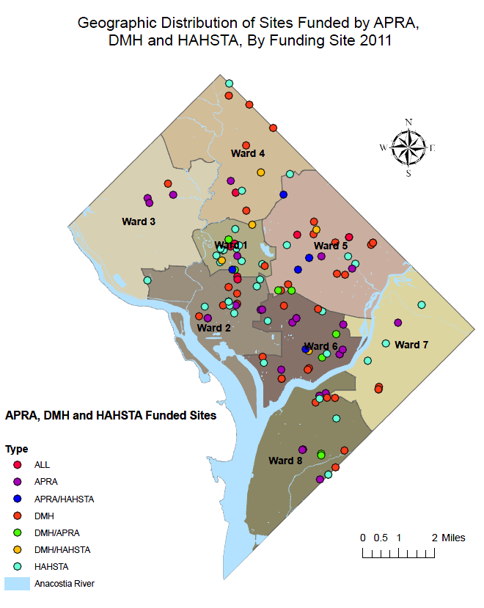
Provider Crosswalk

Slide 55
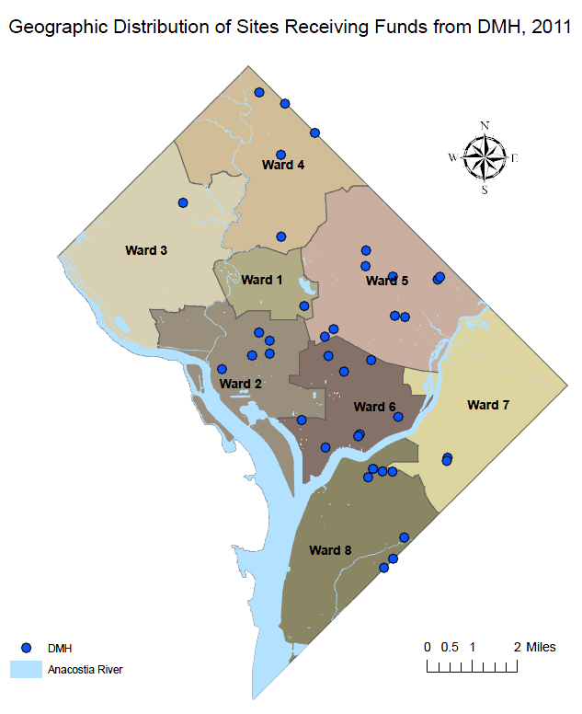
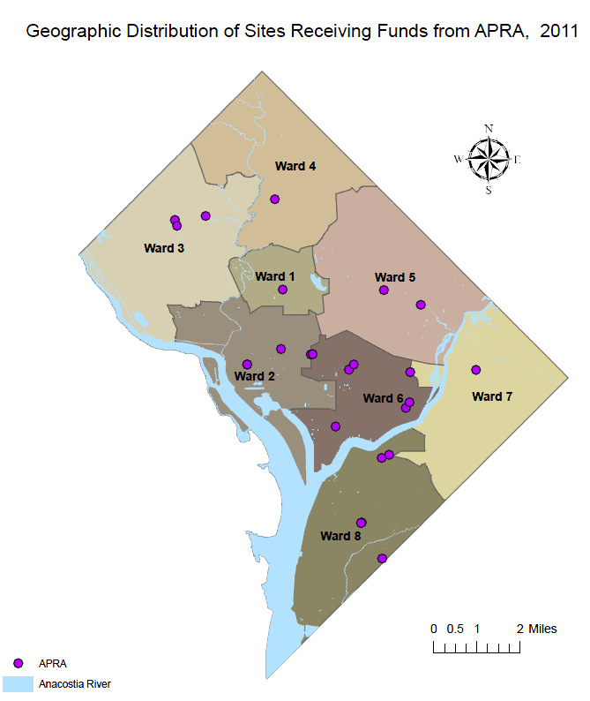

Slide 56
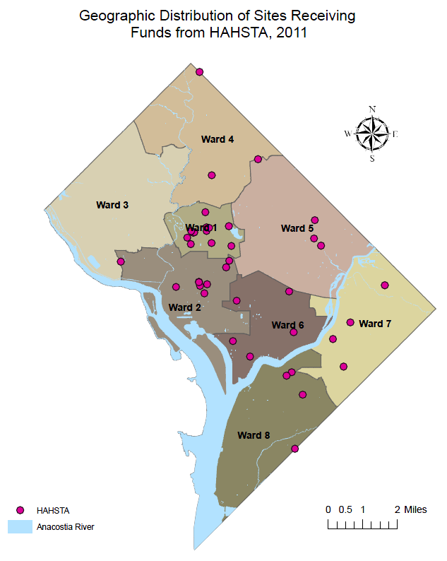
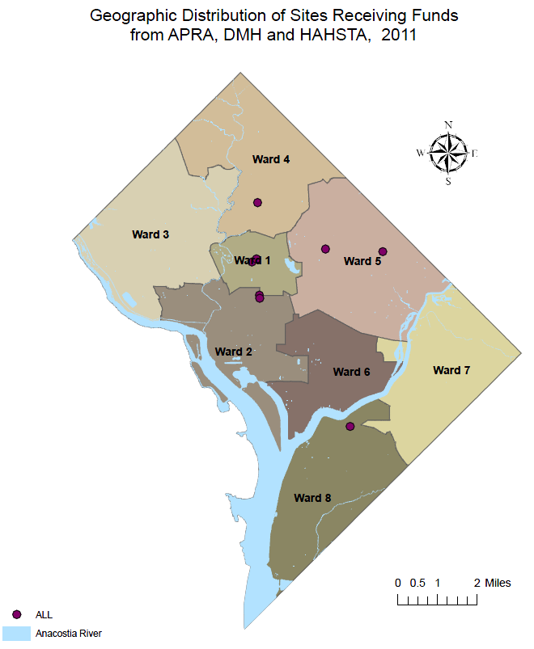

Slide 57
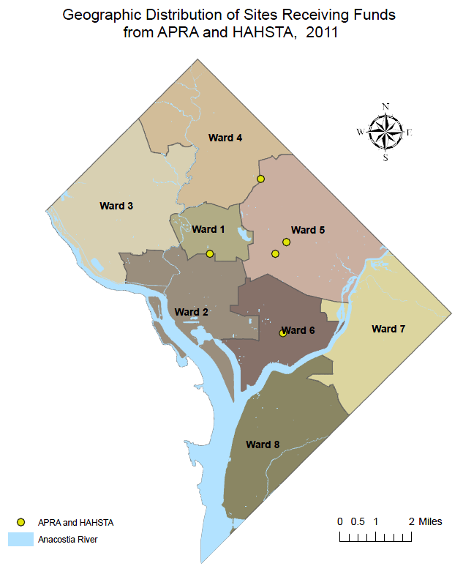
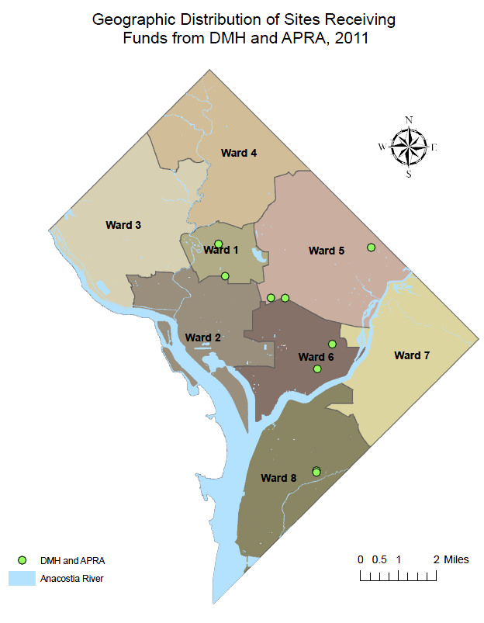

Slide 58
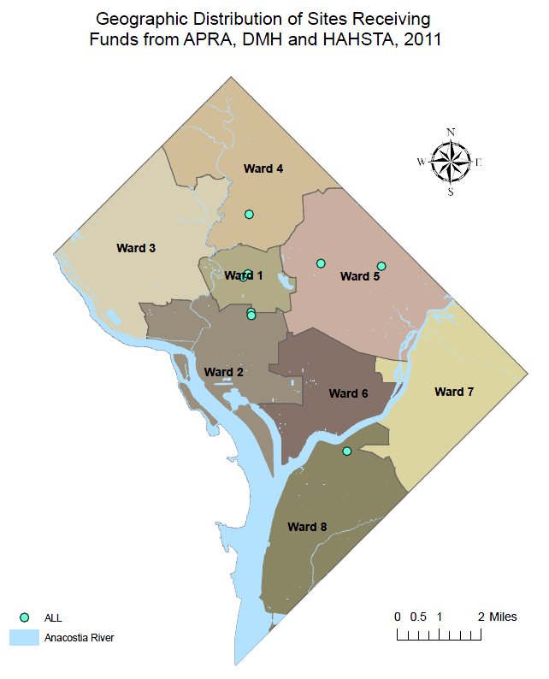

Slide 59
Objective 1: Integrate Linkage and Navigation Support Infrastructure
Introduce HIV testing/screening at Substance Use and Mental Health intake and assessment sites
Standardize mental health screening process
Standardize substance abuse screening process
Develop connection pathways to service system
Improve cross‐agency coordination and collaboration

Slide 60
“No Wrong Door” Approach
GAIN Screen
MH DX
MH
ARC
HIV Test
HIV DX
HIV
GAIN Screen
SA DX
Coordinated Care
UCC
SA
HIV Test
HIV DX
HIV
SA DX
HIV
GAIN Screen
SA
MH DX
MH

Slide 61
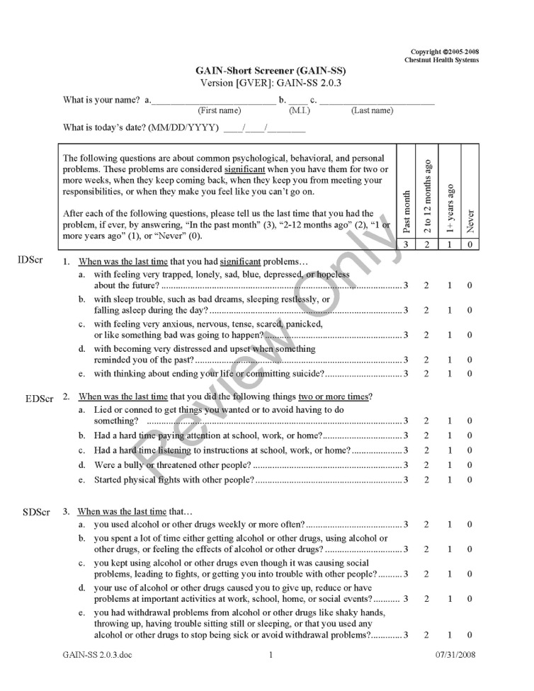
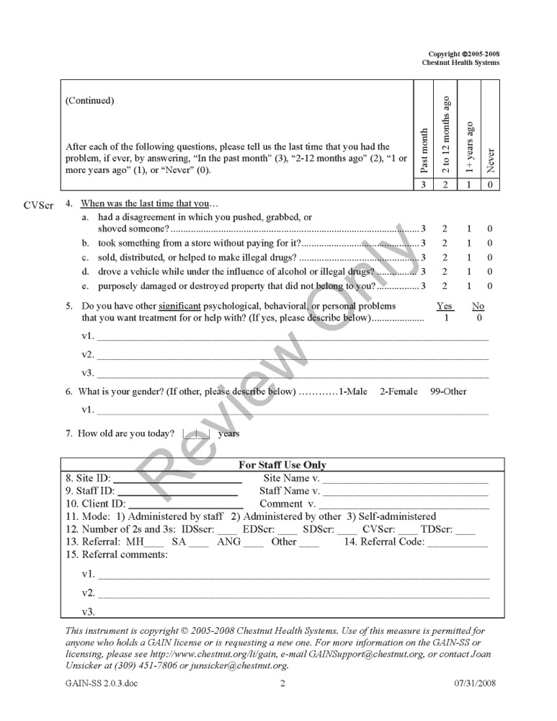

Slide 62
STD Clinic Pilot
2 month demonstration GAIN short screener
Total Surveys | 1,248
MH Referrals | 71
SA Referrals | 31
Pending Follow-up | 37
Refused Surveys | 36

Slide 63
Conclusion
Integration is not easy
Inter/Intra agency collaboration
Separate service networks
Data systems and data restrictions
Different points of entry
Opportunities
Coordinated patient care
Better health outcomes
Leveraging resources
Time and Persistence

Slide 64
Thank You
Michael Kharfen
(202) 671-4809
Michael.Kharfen@dc.gov

Slide 65
Collaboration, Coordination, and Integration (CCI) in San Francisco
2012 Ryan White Grantee Meeting
November 27, 2012
Presentation developed by Tracey Packer, Acting Director of HIV Prevention
Presented by Bill Blum, LCSW, Director of HIV Health Services
San Francisco Department of Public Health

Slide 66
Coordination*
to place or class in the same order, rank, division, etc.
to place or arrange in proper order or position.
to combine in harmonious relation or action.
*Dictionary.com
Notes:
About people working together

Slide 67
Collaboration*
to work, one with another; cooperate, as on a literary work:
creating a culture where agencies are naturally more interconnected and their programs are better aligned.
*Dictionary.com
Notes:
Initiating joint funding initiatives and streamlining data collection and reporting requirements from (NHAS goal #4).
NHAS objectives developed through a collaborative process- developed by a national series of town halls

Slide 68
Integration*
an act or instance of combining into an integral whole.
necessary to the completeness of the whole
*Dictionary.com
Notes:
Hitting our health department and nationally as a response to reductions in funding and revisioning of primary health care

Slide 69
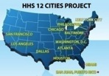
CDC Funding Opportunity Announcement
Epi Data
12 Cities Project
STOP
Study
NHAS
PCSI
2010 HIV Prevention Plan
Biomedical Interventions
Community Input
ECHPP
New Testing
Technology
RFP
Notes:
This funnel represents some of the influences we have experienced
Actually staff put this together as a way to explain the re-org/integration process that HPS experienced.
PSCI- Program Collaboration and Services Integration (CDC funding) – access to screening for multiple disease and databases
ECHPP- Enhanced Comprehensive HIV Prevention Planning
LINCS-Linkage Integration Navigation Comprehensive Services)- mostly CDC funding
STOP Study- study on 4th generation HIV tests compare to RNA testing to identify acute infections also to improve linkage to care. In 3rd year (June) –start to analyze data CDC

Slide 70
CCI in San Francisco – some examples
Collaboration: working with police, and other City departments to explore eliminating condoms as evidence for sex work.
Coordination: syringe disposal in alley outside clinic, Minority AIDS Initiative Targeted Capacity Expansion
Integration: HIV Health Services (CARE funding) and HIV Prevention joint meetings to coordinate treatment as prevention, funding PWP as part of Centers of Excellence as well as coordination and possible integration of the two planning councils
CCI: Health Department reorganization/integration (PCSI)
Notes:
Collaboration - is a pilot program at this point.
Coordination- different sections of DPH (including OSH) to purchase disposal and service syringe disposal boxes and MAI TCE
Integration-
PHP is a DPH Division that is creating a system that is community members can receive services in a integration.

Slide 71
Facilitating Factors of CCI
Funding for CCI Efforts
Required deliverables (ECHPP, PCSI)
Achieving outcomes
Attending to patient needs holistically
Ability to address the social determinants of health
Reduction of data burden (sharing and integrated systems)
Notes:
Requiring cci and providing the support for it allows hd to put the time there.
Social determinants- structural interventions ( housing, poverty)

Slide 72
Barriers to CCI:
“If you think everyone’s in your business, it’s because everyone’s in your business”
“The only thing worse than them talking about you is them not talking about you”
Conflicting scopes
Culture/communication
Data requirements
Decrease in funding
Notes:
Conflicting scopes: NHAS requires HIV prevention programs to see care and treatment as prevention; CARE see care and treatment as own responsibility:
Culture/communication: depts, areas have their own culture. Needs to be defined by each partner to work together, ex., STD, CBHS, police. HPS sees universe of prevention in their domain.
Data: conflicting requirements from each funder. Ex test form?
Laying tracks as we go and sometimes Fed Agencies are also challenged to keep up with integration effortsExample CDC vs SAMPSA required data around HIV testing

Slide 73
Lessons Learned
CCI is an effort unto itself
Focus on areas of commonality (populations)
Practice humility and humor
Take Risks around Change
Develop a common language
Understanding Change (communication)

Slide 74
Lesson #2: This is not new
HIV and STD Prevention
HIV testing
Core Surveillance
Surveillance, Evaluation and Research
Engagement in care
Primary Care and HIV treatment
Linkage to medical care
HIV Care and Support Services
Partner services
STD prevention and treatment
Addressing drivers and co-factors of HIV
Linkage to medical
Risk reduction activities
Community mobilization efforts
Public information efforts
Condom distribution
Syringe access
PEP
Outreach services
Oral health care
Housing services
Legal services
Emergency financial assistance
Client Advocacy-related services
Food Bank / Home-delivered meals
Non-medical case management
Home Health Service
Incidence Surveillance
Medical Monitoring
NHBS
Vaccine studies
PrEP research
HIV drug resistance testing
Treatment Adherence
Medical Case management
ADAP
Community Health Care
HIV specialty medical care
STD and TB
Treatment Guidelines
Behavioral Health Services
Source: Nieves-Rivera, 2010
Notes:
HIV services model as a circle not distinct or a conitnuum

Slide 75
Build and strengthen relationships
Health departments
Clinical providers
Community-based
providers
Community planning
groups
Capacity-building
providers
Researchers
Federal and state
agencies
Notes:
“Bring cake.”
Just 2 days ago, I literally brought a piece of cake over to our Director of HIV Health Services. It was lemon with buttercream frosting. We had a nice chat and I asked a favor – could he arrange it so I could participate in the planning for the development of SF’s application for the NHAS HUD announcement. After we met, he sent a very nice email to the SF Redevelopment Agency, who will be the applicant, and now I’ll be attending the meetings.
Interpersonal relationships and understanding system relationships and key stakeholders and change agents.
The CCI best practice here is to focus on the relationships – all different kinds of relationships and partnerships. And we need to be thinking outside the box. Traditionally, the HPS has not done much with clinical settings. Obviously, with our ECHPP Plan, this must change. Our relationships with clinical providers are key. We are in the process of hiring a new Director of Clinical Prevention who will take this on.
Our private sector partnerships are also critical. Drug companies can help us as we think about PrEP rollout. Pharmacies have been our partners in ensuring access to syringes, and there is potential for partnerships around HIV testing in pharmacies.

Slide 76
Our direction is clear:
“If they [steps in the NHAS] are to have any impact, individuals and groups all over the country will need to follow the path described and produce a more coordinated, collective response to HIV.”
“With government at all levels doing its part, a committed private sector, and leadership from people living with HIV and affected communities, the US can dramatically reduce HIV transmission and better support people living with HIV and their families.”
National HIV/AIDS Strategy, July 2010

