Slide 1
Bridging the System Developers and HIV Programs Gap: Lessons from RDE’s National eCOMPAS (e2) Experiences Jesse Thomas Chief Vision Officer RDE Systems

Slide 2
Users
Recipients
Sub-Recipients
Public Health
Human Services
Health Networks
Harm Reduction
Clinics
CBOs
Planning Commissions
Clients & Patients
Programs
CDC Prevention
HRSA A,B,C,D
HRSA ADAP
HRSA SPNS
HRSA AETC
HUD HOPWA
NIH
ONC

Slide 3
Some Relevant Challenges In Our World Today
Pandemics Pulling Staff Time and Resources
The Great Resignation - Staff Turnover at all levels
Loss of Program Knowledge
Institutional History
Constant Change: Requirements + Emerging Needs

Slide 4
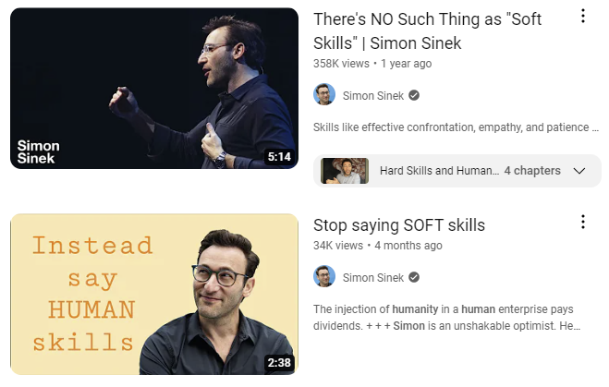
Human Skills
Levels of Impact...
Perspectives
Program Teams
Development / Technical Team
Users / Stakeolders across all partner agencies

Slide 5
Logic Model: Making a Difference with Human-Centered Ingredients
Staff Engagement, Education, Training
Better Methodology
Innovation as a Tool
Attract
Retain
Motivate
Expand Impact
Gratitude and Celebration
Notes:
Better methodology produces better results
Use Innovation to Attract, Retain, and Motivate your Team
The best folks love to apply their talents to innovative work that can advance the state of the art and make a difference
By being innovation-focused, you continuously expand the impact you can make
Better staff engagement, education, and training produces better results in joint team experience and outcomes
Use the Power of Gratitude and Celebration
Positive Reinforcement Works
Make time to celebrate the fruits of hard labors

Slide 6
Engagement, Education, Training
. . .
Better Team Experience and Outcomes

Slide 7
RDE Onboarding Training Videos & Impact Essays
Notes:
We have all of our new hires (developers and non-developers) go through an Onboarding program, one component of which is attending multi-day video training series we invested in an expert to do for us, which covers About HIV Care, Treatment, Prevention, and Housing. This was not only to give folks the background to understand the context and content, but also to fall in love with serving the HIV community like us veterans have. The employees then do a write up about what they learned and what stood out to them.

Slide 8
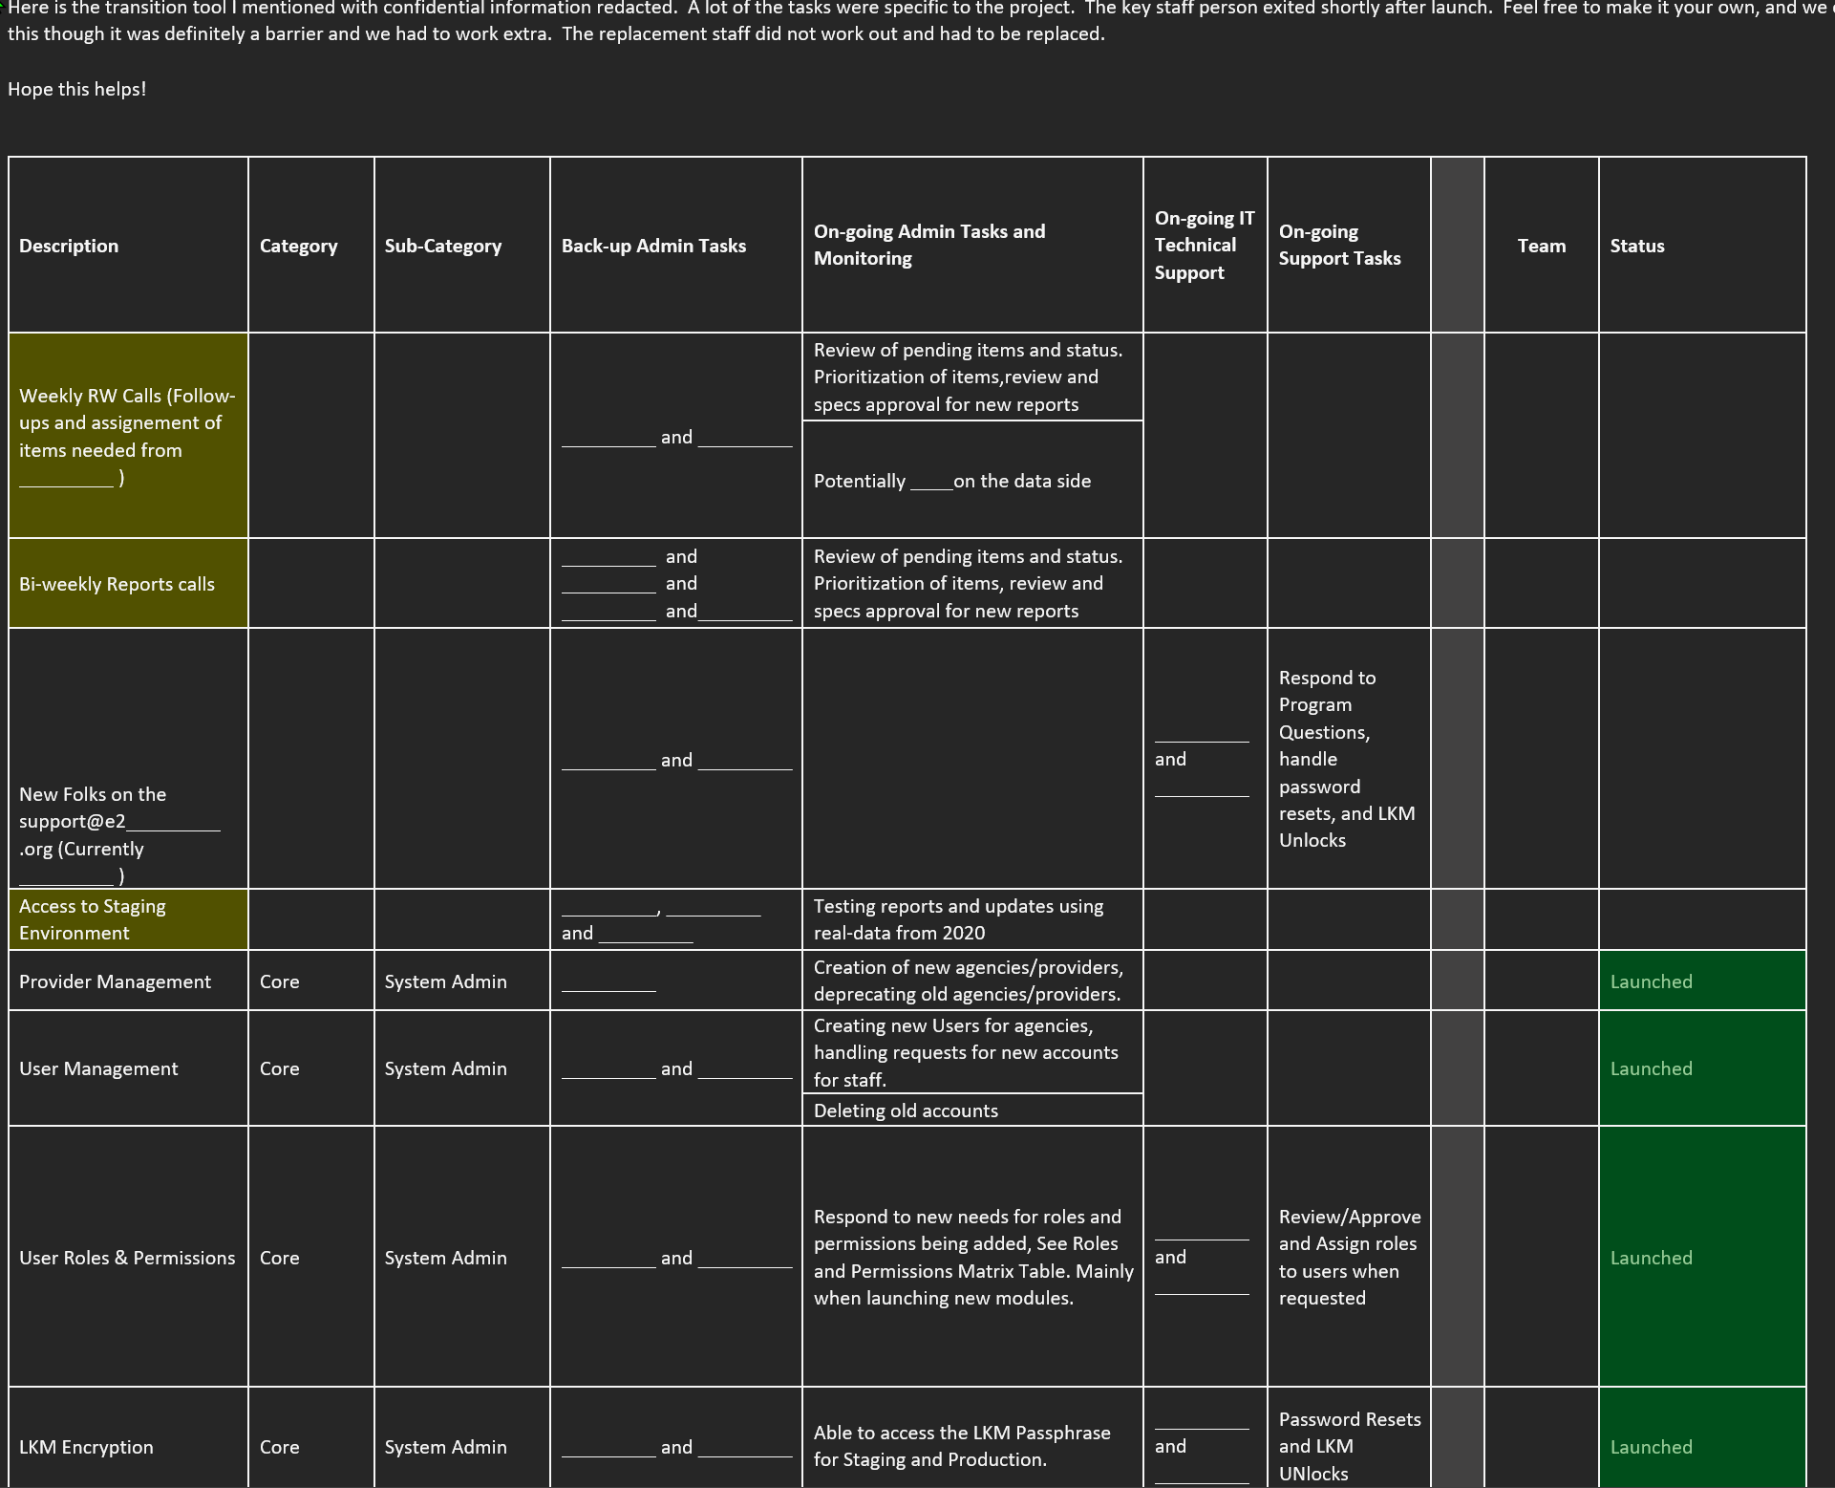
Turnover Support – Helping our Client Teams
Staff Transition Planning Tool

Slide 9
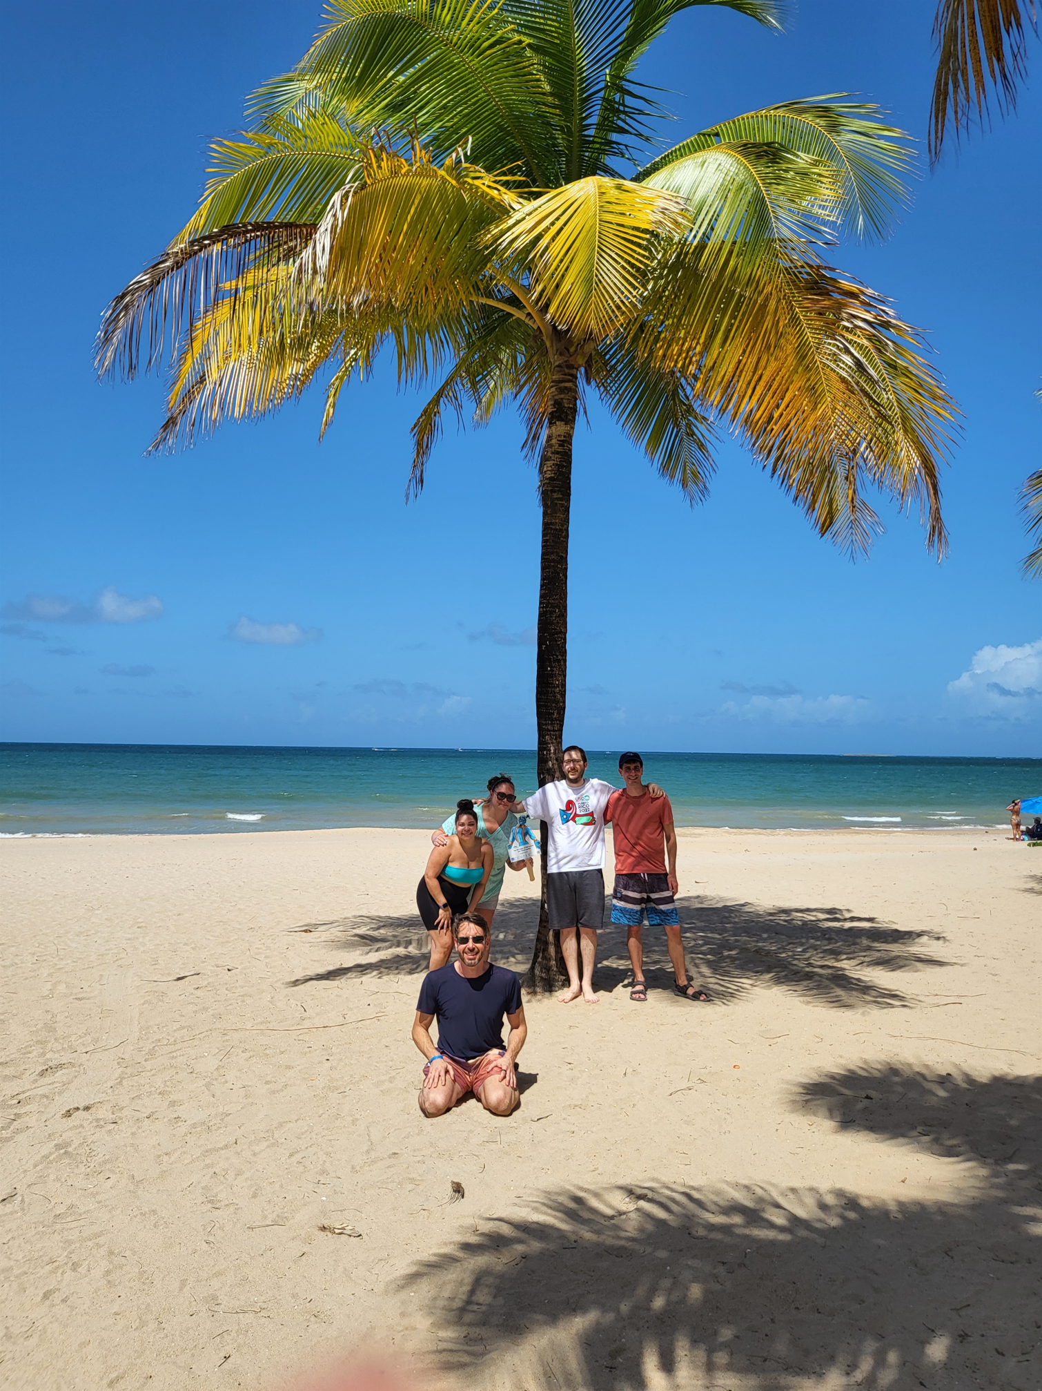
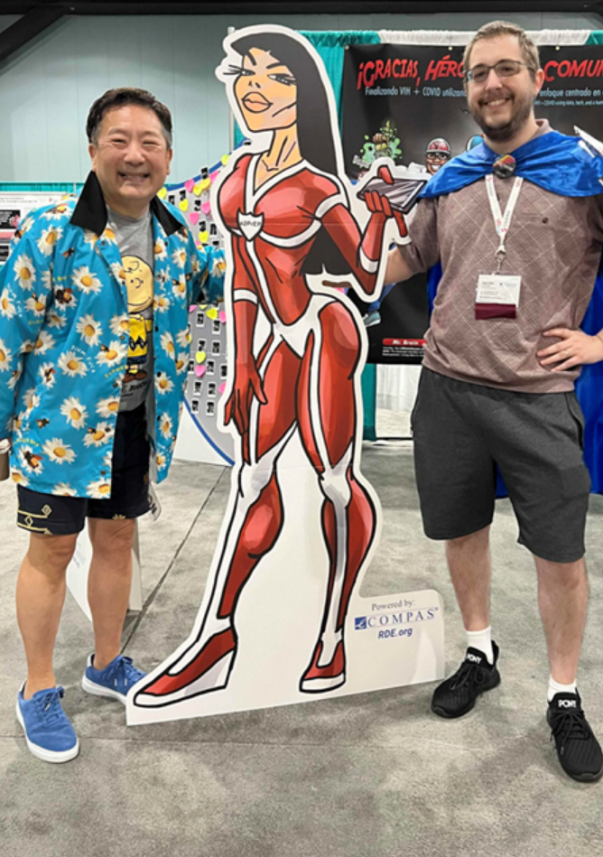
Engineers Attending Conferences
Developers and Implementors @ Conferences
Be Curious, Learn, Cry, Be Inspired

Slide 10
Better Methodology
. . .
Better Results

Slide 11
Ending the HIV Epidemic

Slide 12
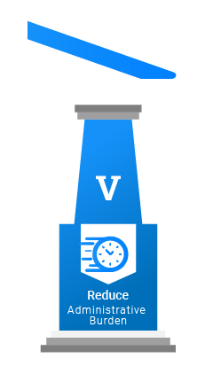
Ending the HIV Epidemic – The Fifth Pillar
Reducing Administrative Burden
Time is our finite resource
Reduce staff stress, burnout, and turnover
Burden → empowerment
Right Data & Right Tools
Quality
Actionable
Useful + Usable

Slide 13
Active Design
Vs. Passive Design
Support vs. Enable
Depth of Understanding of Needs
Proposing Alternate Solutions
Facilitate Catching Issues
Cross-form Validations
Cross-field Validations
Cross Team Coordination

Slide 14
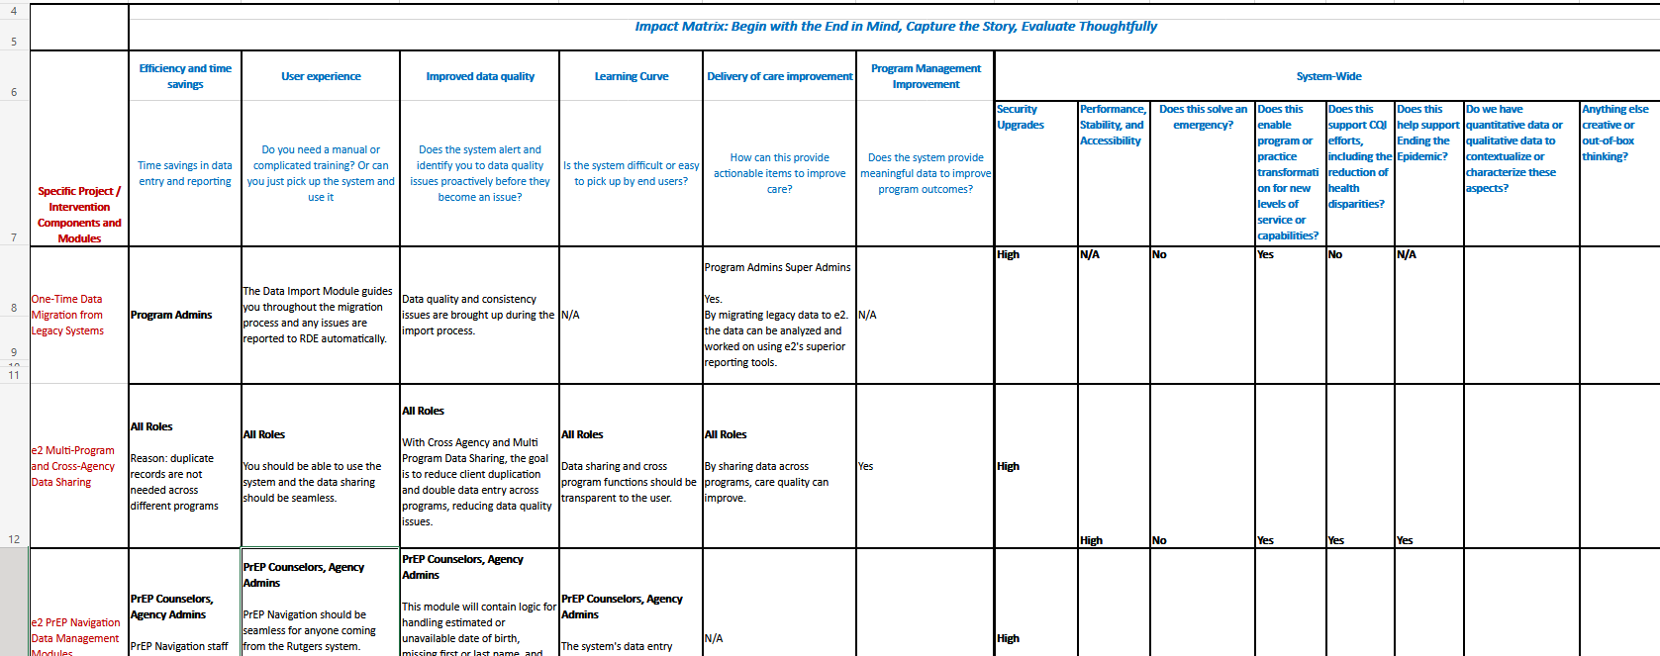
Impact Matrix: Connect the Dots

Slide 15
Creative Tools to Engage non-HIV IT

Slide 16
Innovation as a Tool
. . .
Attract - Retain - Motivate

Slide 17
2002
2004
2006
2008
2010
2012
2014
2016
2018
2020
Evaluate Impact of HIT on Care
e Networks of Care
Capacity building grants*
Parts A & B
Parts C & D
All Parts
HIT for ADAP
19
SPNS Projects:
Innovation
Evaluation
Replication
HIT for HIV Care Continuum
SMAIF HIEs for Care Engagement
SMAIF HIV Care & Housing Data Integration
Direct clinic IT investments:
Medical Home for HIV+ Homeless
Practice Transformation HIV Primary Care
Evidence-Informed Interventions
Social Media HIV Care Continuum

Slide 18
e2Genie

Slide 19
Let’s GeekOut!
e2Genie GeekOut Session
Ryan White Conference 2022

Slide 20
What is e2Genie GeekOut?
A Safe space to geek out about any topic
Where good people can use good systems
To do good work to make a difference

Slide 21
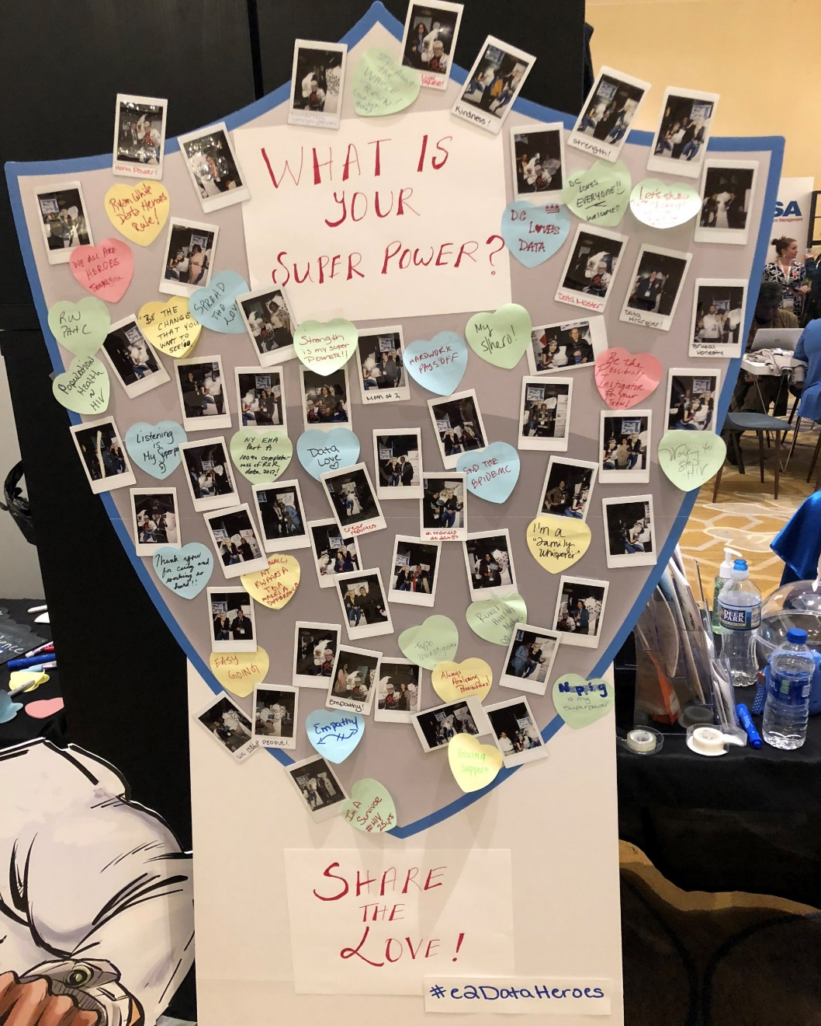
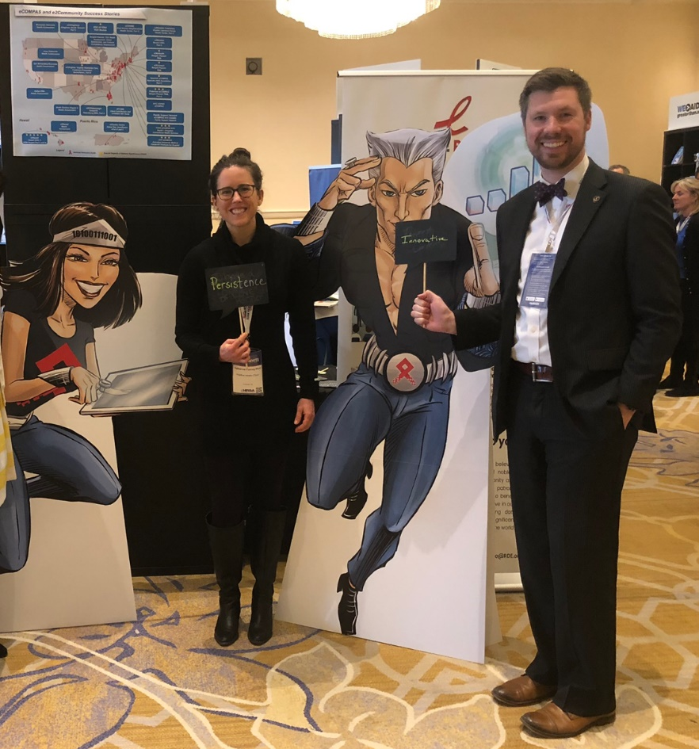
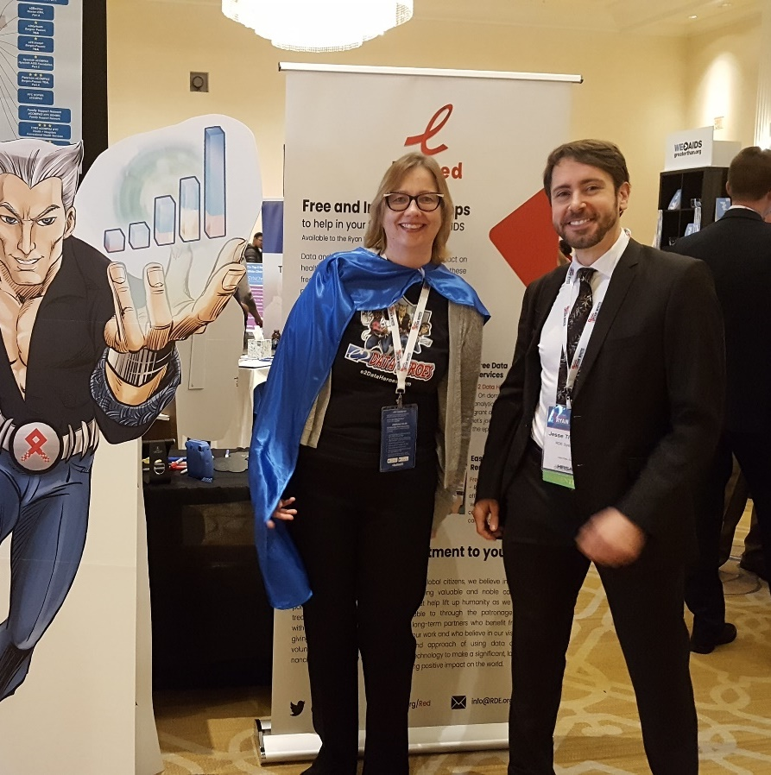
The Why
We’re a group of nerds and geeks fell in love with helping to End the HIV Epidemic, who love to learn and share and geek out.
e2DataHeroes Hangout in 2018

Slide 22
GeekOut Topics
Better client experience with process and systems and paperwork
Better staff experience with process and systems and paperwork
Successful Leadership through Difficult Times: Vision, Principles, Sustainability, Leadership Development
Health literacy
Integrating across funding streams: HRSA, CDC, HUD, …
EHE
Data science and data visualization
Dashboarding
Trauma Informed Care
PrEP Online / Mobile Enrollment, Uptake, and Retention
Data bridges with EMRs
Eliminating or integrating the data silos
Mobile experience in our pandemic world
…
Innovation in
Human-centered approaches
Improving health equity with data-driven approaches and creative engagement
Program Transformation
Systems Transformation
Employee, Workforce, and Client Wellness
Data
PrEP
…What’s
Your Topic?

Slide 23
e2Genie R&D Team Presents a brand-new innovation in client access across service sites

Slide 24
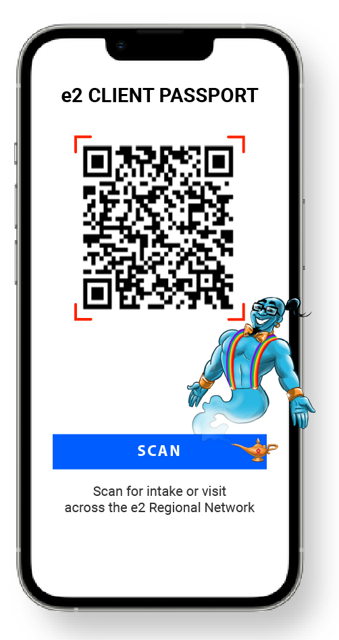
e2Passport

Slide 25
e2Passport
Future Vision Potential Ideas:
Enriched Data Automatically:
Scan of Client QR Code = your e2 system
knows that client made it to the appointment
& can automatically confirm successful referral.
Bridging the Digital Divide
Build simple Digital Divide assessment questions
into Intake to continually assess and bridge the digital divide.
Client Data Portability & Empowerment
Client Can Share. Let your client control who has access to records across sites that outside of the e2 Network.
E.g., Read Only Access of client data collected from disparate networks granted by the Client
New Provider Scans, sets up quick account
Client gets notification to approve access to that account, for how long, or close access at will.
New Provider or Emergency Dept has access.
Audit Trail Access: your clients gets to see who accessed their data, a key best practice in community support.
Vision:
Access. Make it clear to your clients that your e2 system enables seamless access across all sites without lugging around information and doing duplicative work.
Time. Save your clients’ and funded service staff’s time by making your visit experience modern, easy, and fast.
Engagement. Before & After Visit
Push recert questions, initiatives, short satisfaction surveys, risk assessment instruments.
“Thanks for registering! While you wait, would you mind answering a short survey…”
“While you wait would you like to play the Covid-19 Health Literacy game…?”

Slide 26
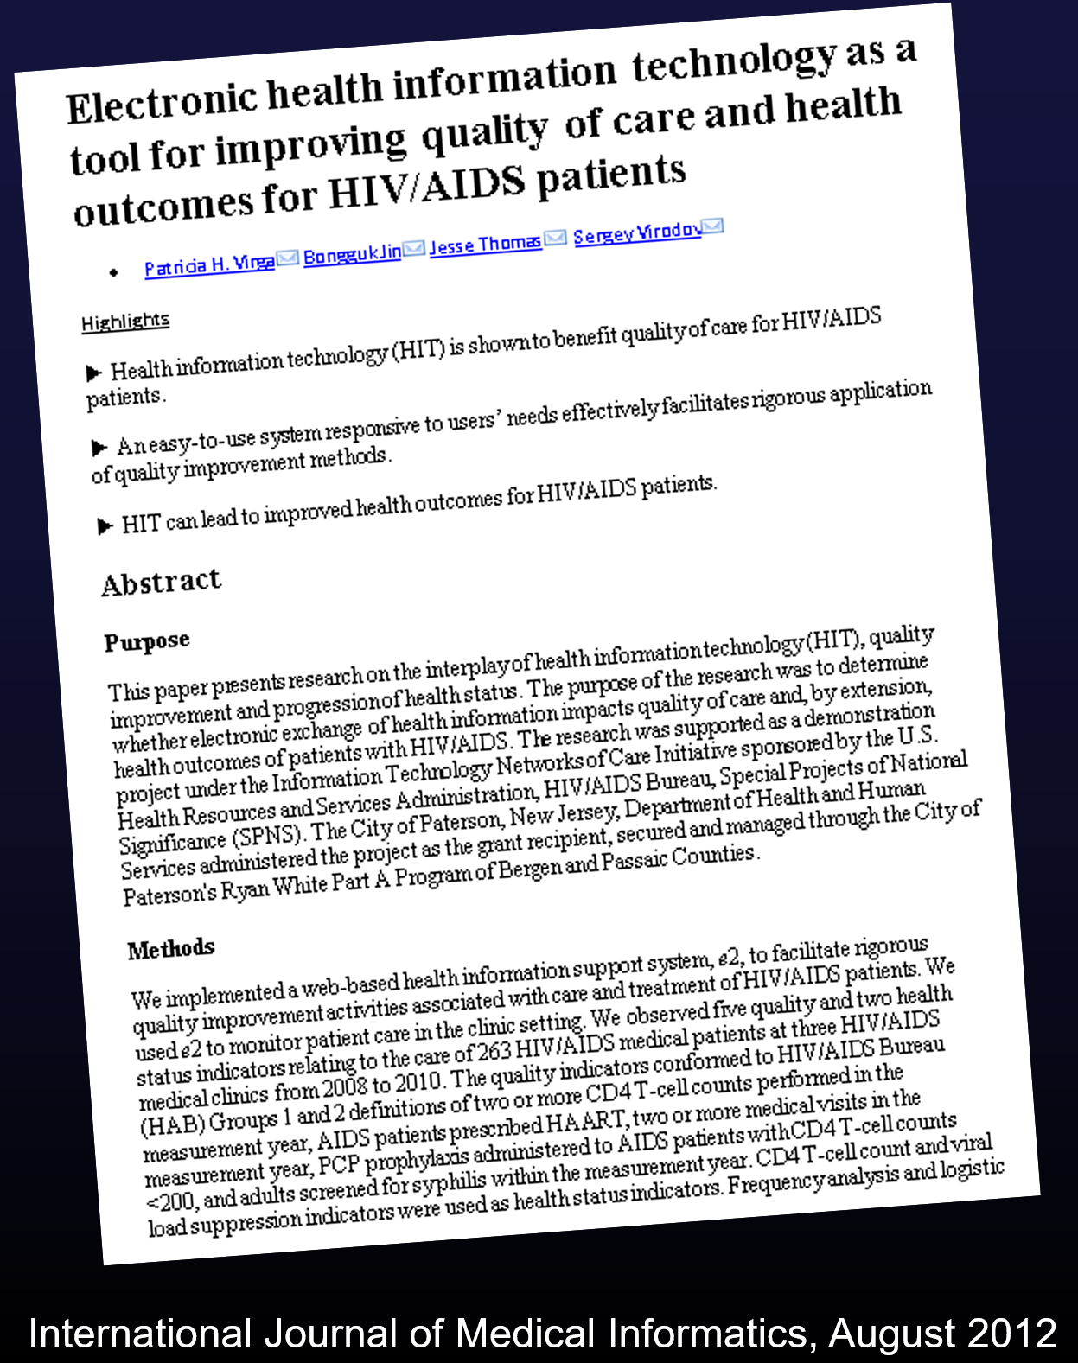
Evaluation and Dissemination
Journal Article
Stepping Back
Standard: Everything Should Be Disseminatable
Advocating for Human-Centered Approach to Tech

Slide 27
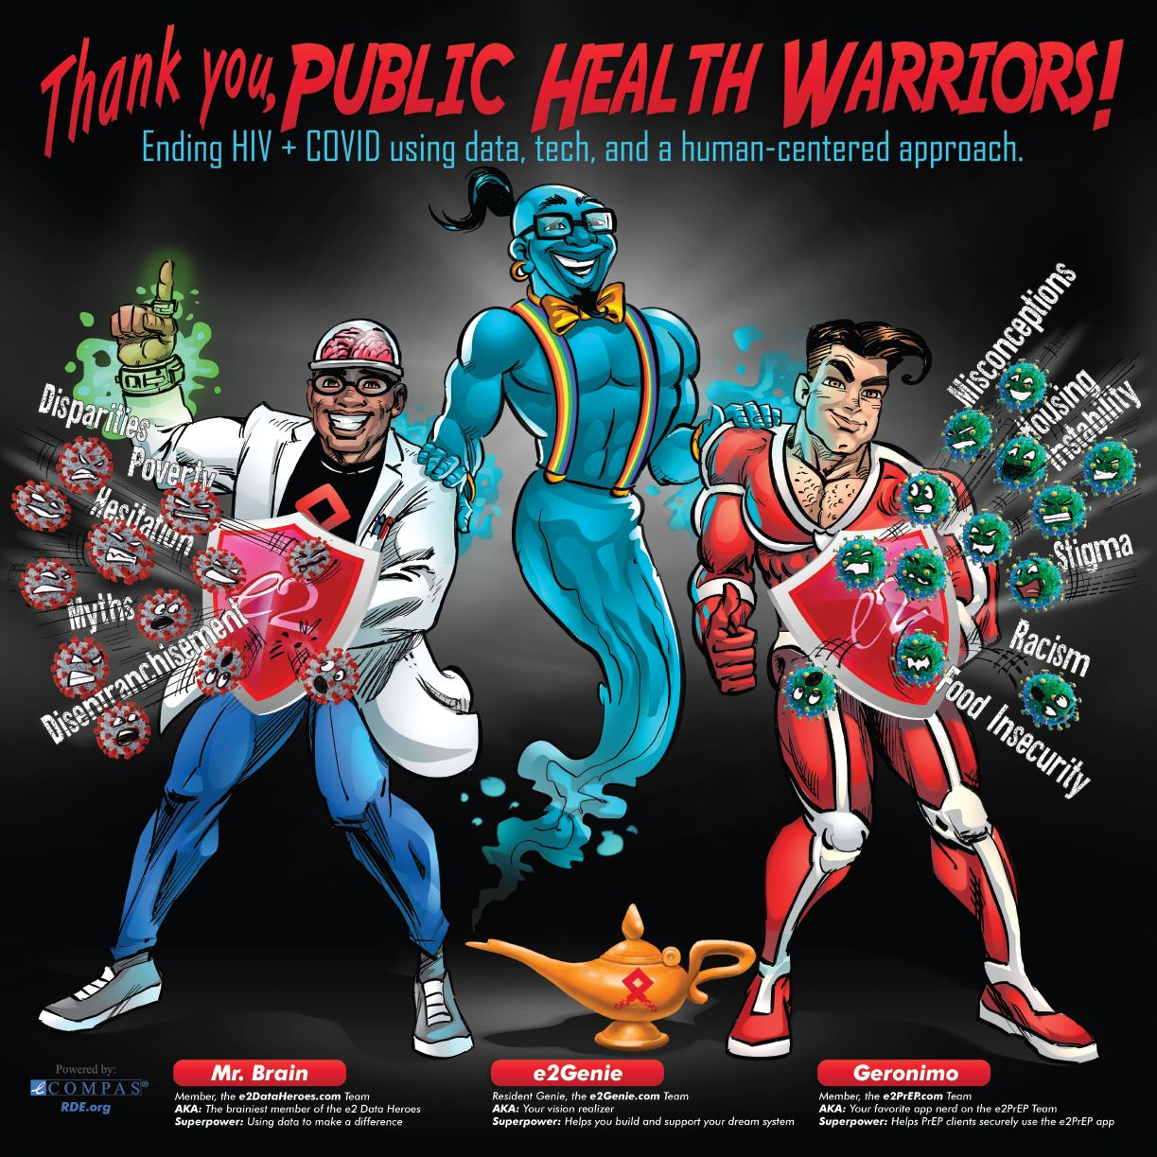

Slide 28
Gratitude and Celebration
. . .
Positive Reinforcement

Slide 29
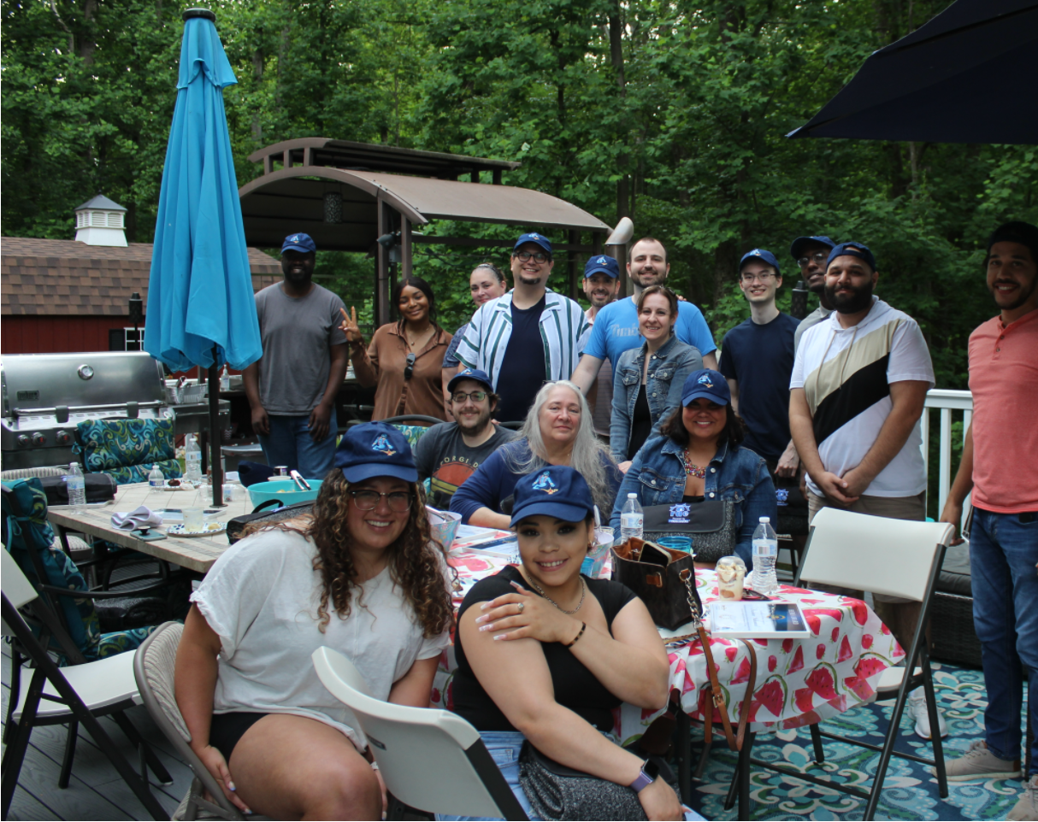
People and Culture
Deep Workdays
Wellbeing Toolbox
Hookey Days
Cultural Gardening
Flexibility
Leadership Cares
Mission-Driven
Surfacing and developing intrigue
Continuous Education

Slide 30
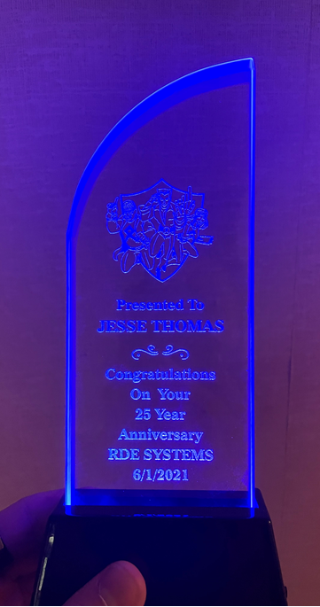
Gratitude
Annual Gratitude session
Customized Per Individual
Based On Peers
Built into meeting structures
Leadership awards

Slide 31
Leadership Values

Slide 32
Conclusion
Only scratched the surface...
People-First Approach
Continuous Learning, Growing, and Improvement

Slide 33
Thank you for your time!
Jesse Thomas
Jesse@rdesystems.com
Free and innovative resources to end the epidemic
www.RDE.org/Red

