Slide 1
RWHAP Part B and Part B Supplemental Expenditures Report
Ryan White HIV/AIDS Program (RWHAP)
HRSA HIV/AIDS Bureau
June 14, 2023
Notes:
Welcome to today’s webinar. Thanks so much for joining us today!

Slide 2
Overview
Expenditures Report Overview
Accessing the Expenditures Report
Completing the Expenditures Report
TA Resources
Notes:
Thanks everyone for joining today’s webinar.
Today, we will go over completing the Part B and Part B Supplemental Expenditures Report. We’ll begin with an **overview of the Expenditures Report which provides some brief background on the report. Then, I’ll go over **accessing the Expenditures Report followed by a detailed walkthrough on **Completing the Expenditures Report. Finally, we’ll end the presentation by reviewing * TA Resources available to assist you with your submission.
Let’s get started!

Slide 3
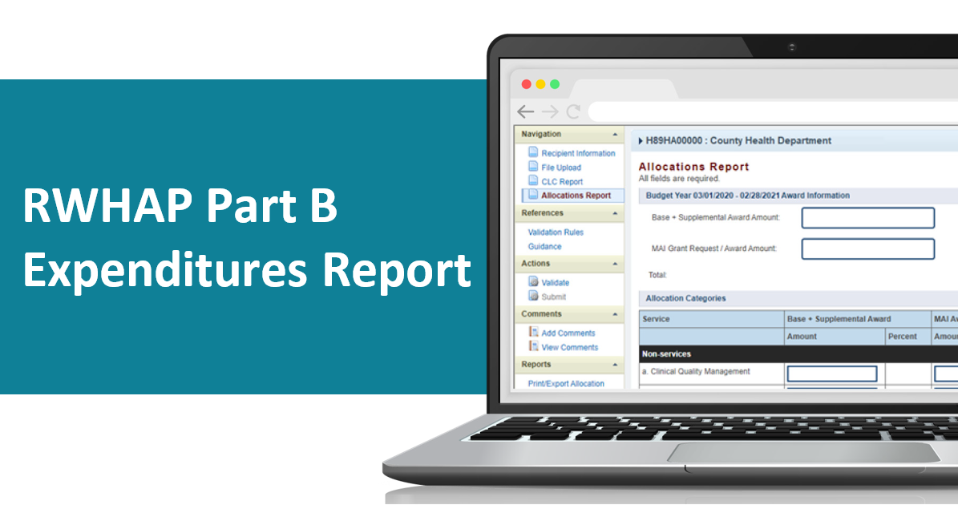
Instruction Manuals
Will be available soon on the TargetHIV website
Notes:
Before we move forward, I wanted to let everyone know that the Part B Expenditures Report manual will be available soon on the TargetHIV website. For Part B Supplemental recipients, the expenditures report manual will be posted to TargetHIV later this year near the opening of the report. This manual is an invaluable resource to use while completing the Expenditures Report and highlights the information discussed in today’s presentation. Additionally, you will receive a link to these resources when Data Support sends the outreach email stating the system is open.

Slide 4
Expenditures Report Overview
All RWHAP Part B (X07) and Part B Supplemental (X08) grant recipients must complete the Expenditures Report
Report serves as a reference for how recipients expended RWHAP funds during FY22
Accessed and submitted via the HRSA Electronic Handbooks (EHBs)
Notes:
Now let’s begin today’s presentation with an overview of the Expenditures Report. All Ryan White Part B and Part B Supplemental recipients must complete the Expenditures Report. This report serves as a reference for how recipients expended their grant funding during FY22.
The Expenditures Report is completed via the HRSA Electronic Handbooks, also known as the EHBs, which we will be going over later in the presentation.

Slide 5
Expenditures Report Overview
Data entry is done directly in the report
No requirement for file uploads
The GCMS is not utilized
Notes:
So, I wanted to highlight some important notes about the format of the Expenditures Report that can be useful during your submission. First, **All data entry is done directly in the report, which I will review later in the presentation. **Also, there is no requirement to upload files. I will display this functionality in the report but note – you are not required to upload any files to this section. Lasty, **the Expenditures Report does not use the GCMS. This means you will not make any contract additions or modifications for the purposes of this report.

Slide 6
Accessing the Expenditures Report
Notes:
Now let’s continue the presentation with reviewing how to access the Expenditures Report in the HRSA EHBs. Please note, these steps are the same for both the RWHAP Part B and Part B Supplemental Expenditures Reports.

Slide 7
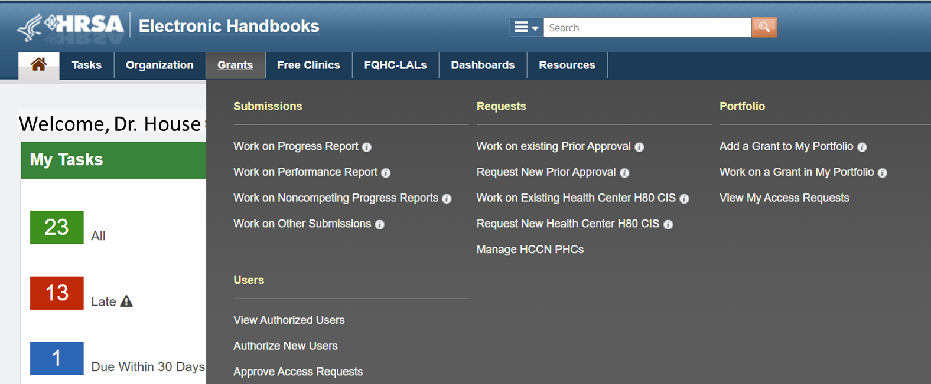
Accessing the Expenditures Report
Notes:
Recipients will first need to log into the HRSA EHBs. After logging in, you will need to hover your mouse over the **Grants tab at the top of the page. From here, a drop-down menu will appear, and you will click on **Work On Other Submissions under the Submissions header.

Slide 8
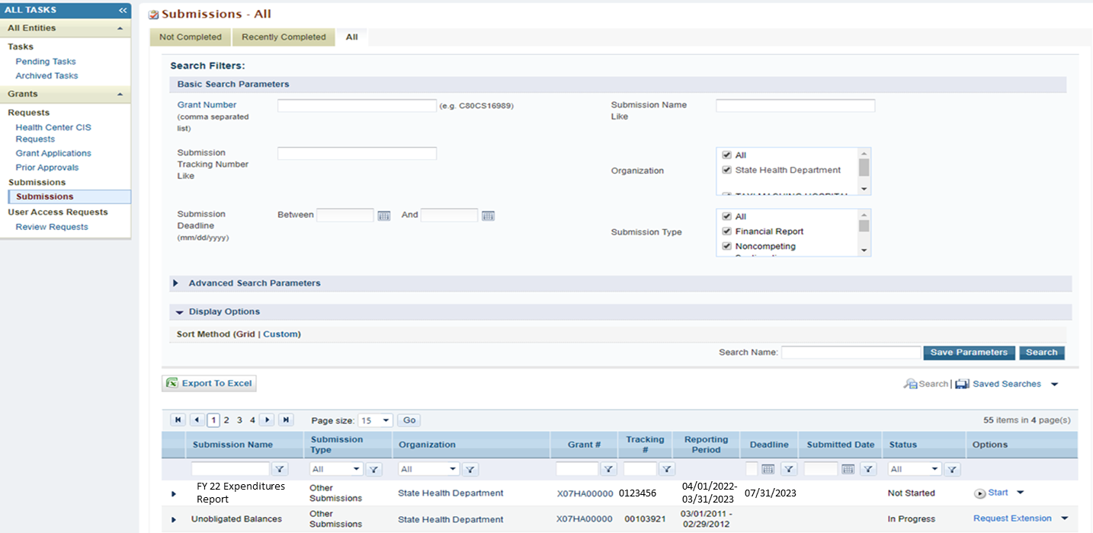
Submissions-All Page
Notes:
After clicking on the Work on other submissions link, you will be navigated to the Submissions-All page, where you will see a list of submissions for your organization. From this page, you will scroll down to locate your FY 2022 Expenditures Report. Once you have located the FY22 Expenditures Submission, you will select **”Start”. However, if you have already started working on your report this link will say “edit”

Slide 9
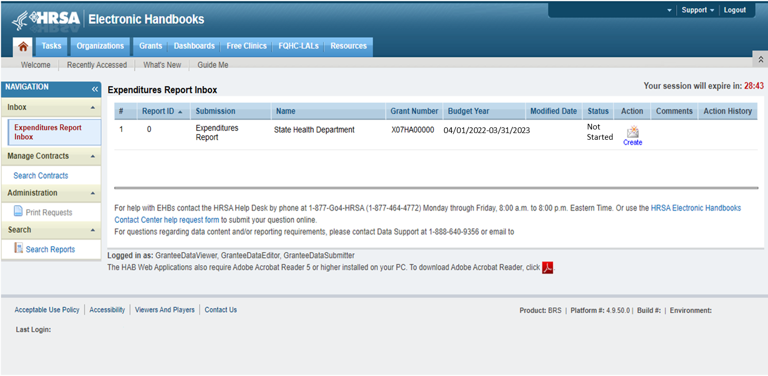
Expenditures Report Inbox
04/01/2022-03/31/2023
Notes:
Once you have selected “start” or “edit”, you will be navigated to the Expenditures Report inbox, where you will see your Expenditures Report listed.
As a reminder, the GCMS and any contract modifications will not be utilized for this report; however, it is available as a reference if you need to review your contracts.
Now we will enter the report by selecting the **envelope icon under the “Action” column. Remember, if you have not started the report this icon will say “create” as indicated here; however, if you have already started the report this will say “open”.

Slide 10
Completing the RWHAP Expenditures Report
Notes:
Now that we have accessed the Expenditures Report, lets walkthrough completing the report for both Part B & Part B Supplemental recipients.

Slide 11
Expenditures Report Sections
Recipient Information
Includes general information about the recipient organization
File Upload
Not required for the RHWAP Part B or Part B Supplemental Expenditures Report
Expenditures Report
Detailed breakdown of funding expended by service category
Notes:
The Expenditures Report is comprised of three sections. This is true of both the RWHAP Part B and Part B Supplemental Expenditures Report.
The first section is the** Recipient Information section, which includes general information about your organization. Next is the ** File Upload section, but this section can be disregarded for the RWHAP Part B and Part B Supplemental Expenditures Report. And lastly, is the ** Expenditures Report. This section includes a breakdown of the funding expended during the budget period by service category.

Slide 12
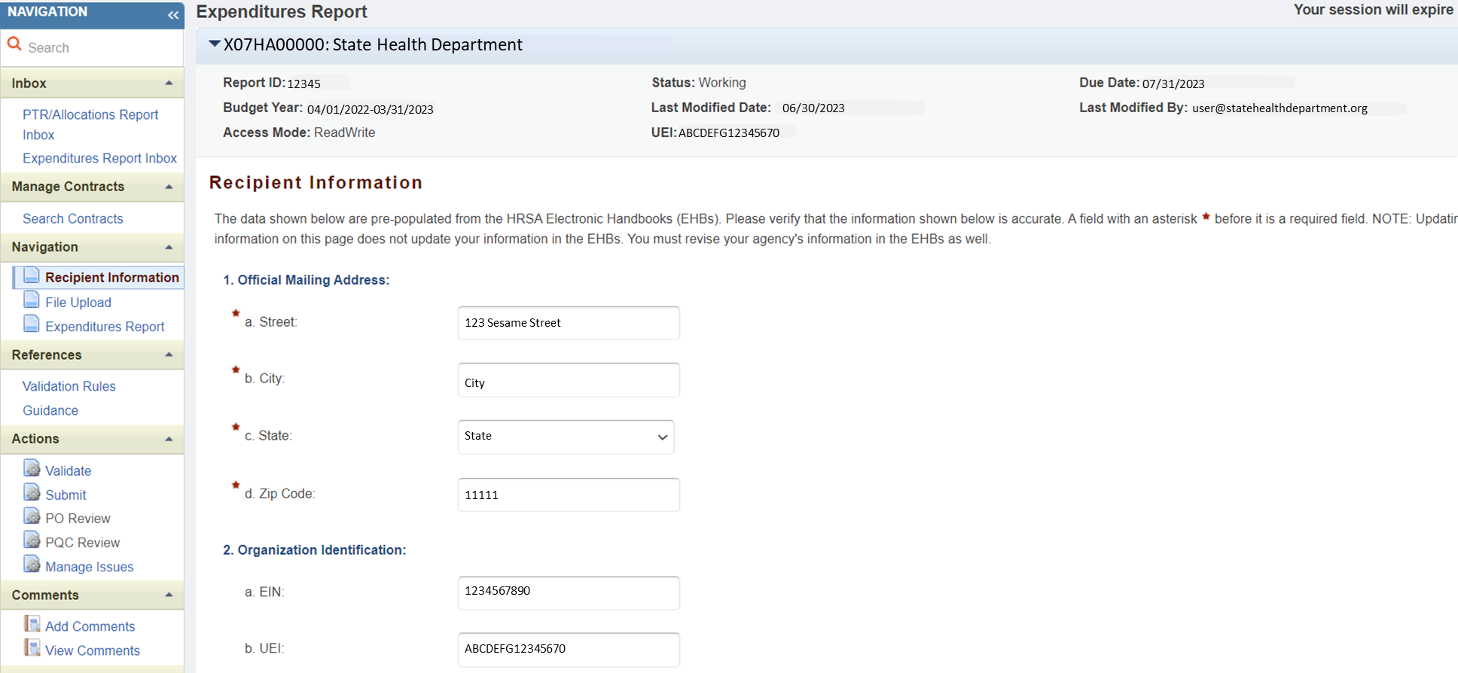
Recipient Information
Notes:
After clicking on the envelope icon, you will be navigated to the first section of the report which is the **Recipient Information. The information listed in this section includes the recipients official mailing address and organization identification information. The information listed here populates from the information listed in the HRSA EHBs. Therefore, we recommend reviewing the information listed for accuracy and saving it if you made any updates before moving onto the next section.

Slide 13
Recipient Information
Notes:
Contact information of the person responsible for the submission is at the bottom of the page.. The information listed here populates from the information listed in the HRSA EHBs. Therefore, we recommend reviewing the information listed for accuracy and saving it if you made any updates before moving onto the next section.

Slide 14
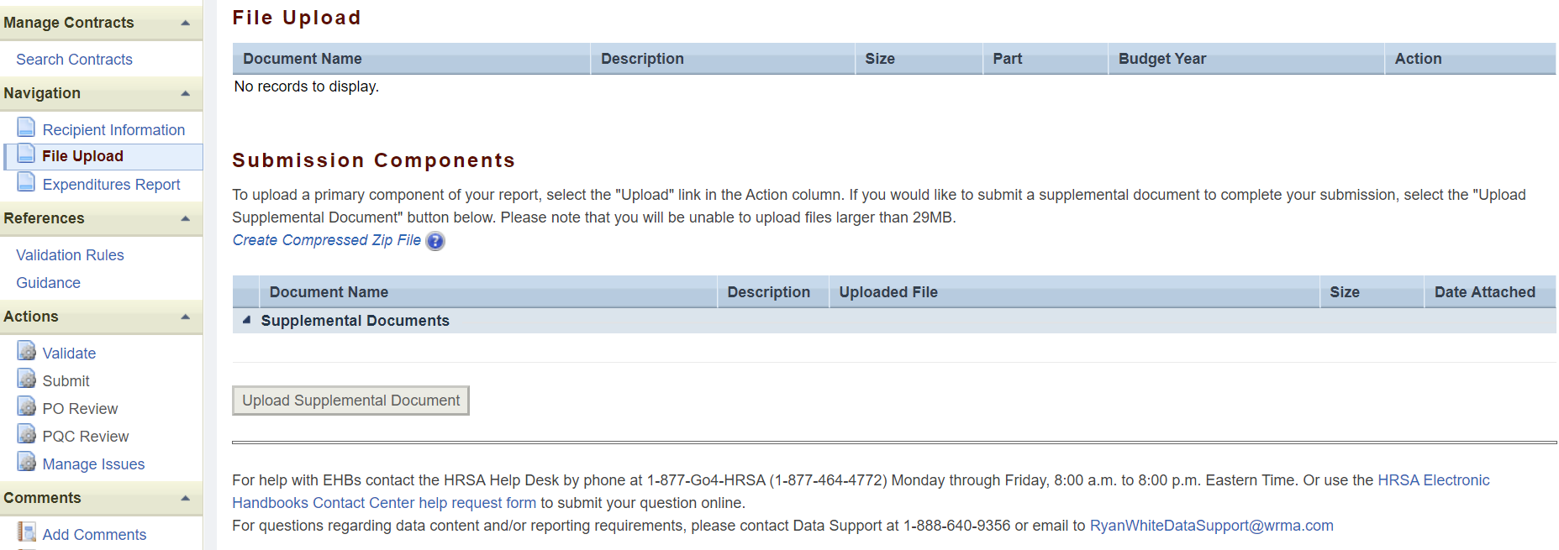
File Upload
Notes:
The next section of the Expenditures Report is the **File Upload section. For both Part B and Part B Supplemental Expenditure Reports, there are **** no required uploads. You may disregard this section of the Expenditures Report.

Slide 15
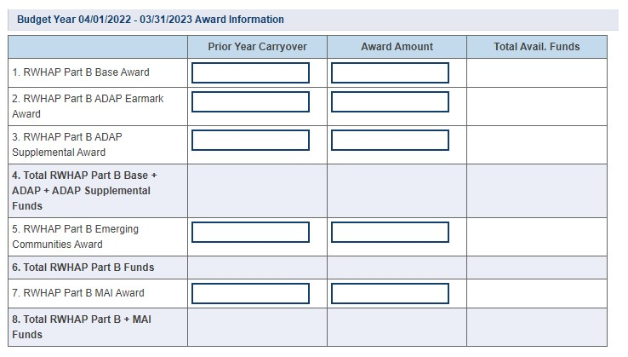
RWHAP Part B Expenditures
Notes:
The last section is the **Expenditures Report, which can be accessed from the left navigation panel. For Part B recipients, the data entry is completed entirely in the Expenditures Report section. All the fields require a response so if you have no expenditures to report, enter a zero. When entering your expenditures please remember only whole number responses are allowed. The Part B Expenditures Report includes four components. As shown on the screen you will begin with the award information where you will enter the amount expended towards the services listed in the table. Each column represents a different funding source which are the prior year carryover and the total award amount. Also, I wanted to point out that the non-editable fields included in the Award Information are automatically calculated once you have saved the Expenditures Report section.

Slide 16
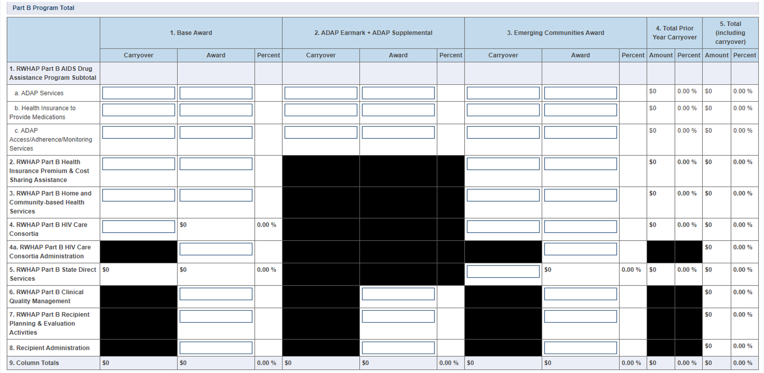
RWHAP Part B Program Total
Notes:
The next section of the Part B Expenditures Report is the Part B Program total. For this section you will enter the amount expended for the listed services using the three funding source columns shown which are Base Award, ADAP Earmark + ADAP Supplemental, and Emerging Communities. All three columns include fields where you will enter funding amounts under Carryover and Award amount. For example, in the first row for **ADAP Services, under **Carryover you will enter the approved amount of Part B base award carryover from the previous budget year that was expended on ADAP medication purchases in the current budget year. Under the ***Award column enter the amount of your agency’s RWHAP Part B base award that was expended on ADAP medication purchases.
As noted for the award information section, the non-editable fields will automatically populate once the report has been saved.

Slide 17
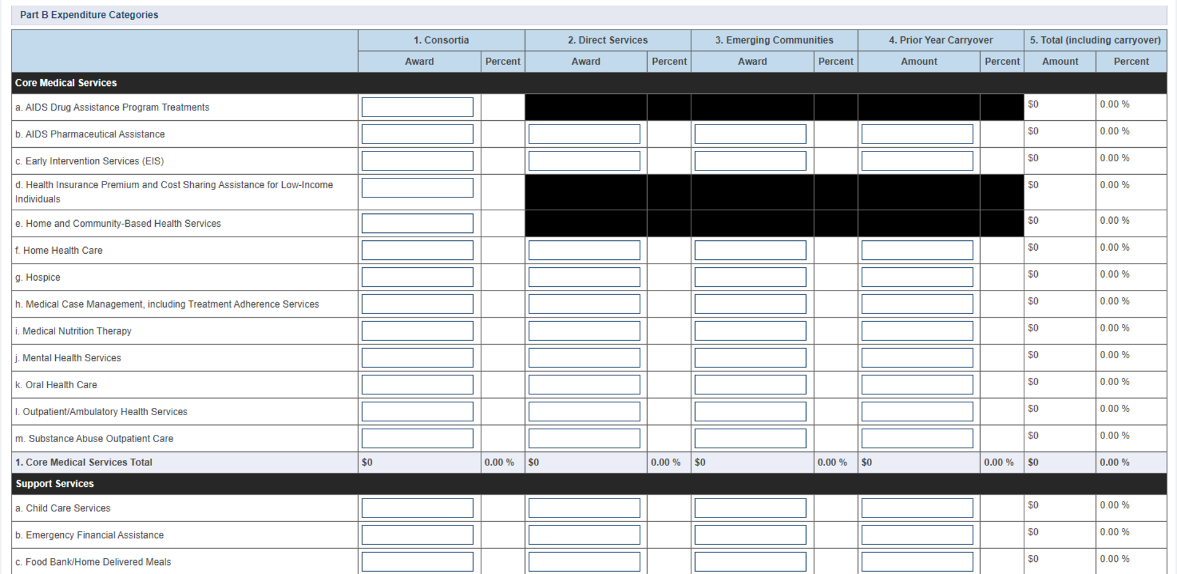
RWHAP Part B Expenditures Categories
Notes:
The next component of the Expenditures Report is the Part B Expenditure Categories which includes the core medical and support services. For this section, you will enter the amount expended towards each service category for each funding source which are Consortia, Direct Services, Emerging Communities, and Prior Year Carryover.
Please note that only consortia funding for **Health Insurance Premium and Cost Sharing Assistance for low-income individuals, and Home and Community Based Health Services goes into this table. If the funding came from a different source for these services, the amount should be entered into the Part B Program Total table.

Slide 18
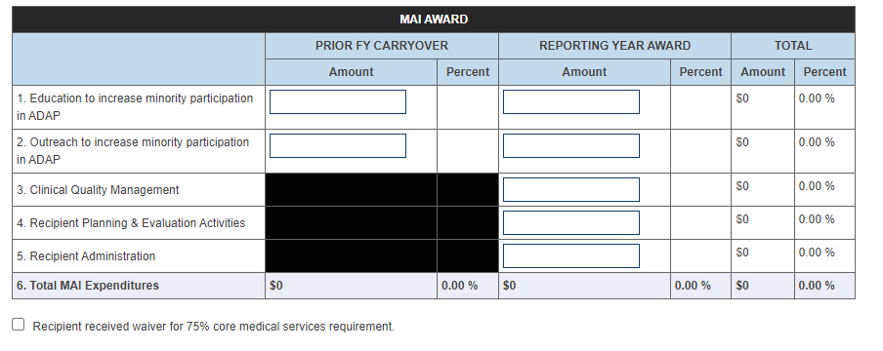
RWHAP Part B MAI Award
Notes:
The final section of the Part B Expenditures Report is the Part B MAI Award. For this table, you will enter the amount expended on each service listed for each funding source which includes carryover in the left column and reporting year award in the right column. Also, as seen under the MAI Award table, there is the **75% core medical services requirement checkbox that you will select if you did receive a waiver for the requirement.
If you're unsure if you’ve received this waiver or have any questions about this waiver, please contact your project officer.

Slide 19
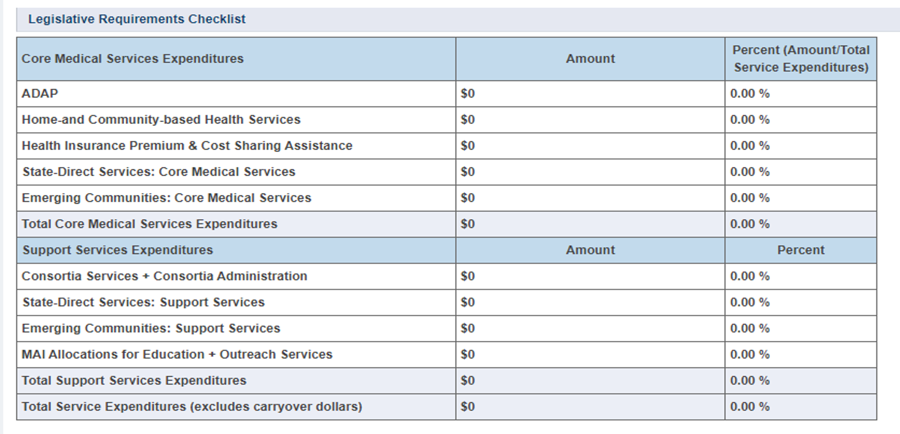
RWHAP Part B Legislative Requirements
Notes:
For Part B recipients, under the MAI Award table, there is a legislative requirements checklist that you can use to make sure that you are meeting various legislative requirements. You can view the capped amounts that pertain to each legislative requirement. The information listed in the table automatically populates once the expenditures report section has been saved.

Slide 20
Completing the RWHAP Part B Supplemental Expenditures Report
Notes:
Now, let’s review the Part B Supplemental Expenditures Report.

Slide 21
RWHAP Part B Supplemental Expenditures Report
Notes:
The Part B **** Supplemental Expenditures Report is also accessed from the left navigation panel and includes three components which begin with the *** Award Information that includes the total award amounts for Part B Supplemental Grant Award and Part B Supplemental Carryover.

Slide 22
RWHAP Part B Supplemental Expenditures Report
Notes:
Now if we **scroll down to the next component which is the Part B Supplemental Program total. This is where you will enter the amount expended for the listed services in the funding source columns which are the total carryover and total award. Just like for the Part B Expenditures Report, the non-editable fields will automatically populate once the report has been saved.

Slide 23
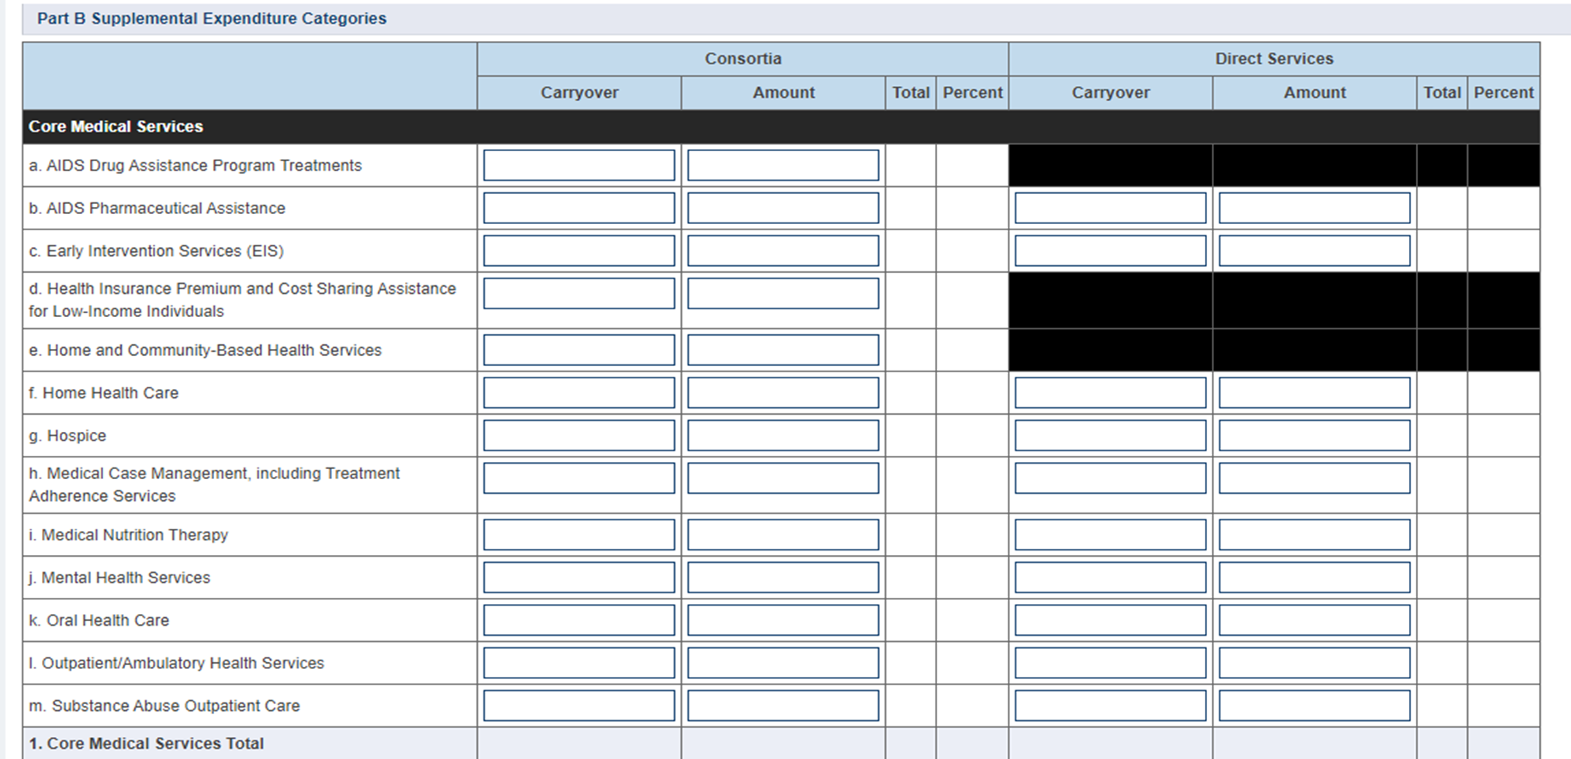
RWHAP Part B Supplemental Expenditures Categories
Notes:
The last section of the Part B Supplemental Expenditures Report is the Part B Supplemental Expenditure Categories which includes the core medical and support services. For this section, you will enter the amount expended towards each service category for the two funding sources which are Consortia and Direct Services.
Like Part B, only consortia funding for **Health Insurance Premium and Cost Sharing Assistance for low-income individuals, and Home and Community Based Health Services goes into this table. If the funding came from a different source for these services, the amount should be entered into the Part B Program Total table.

Slide 24
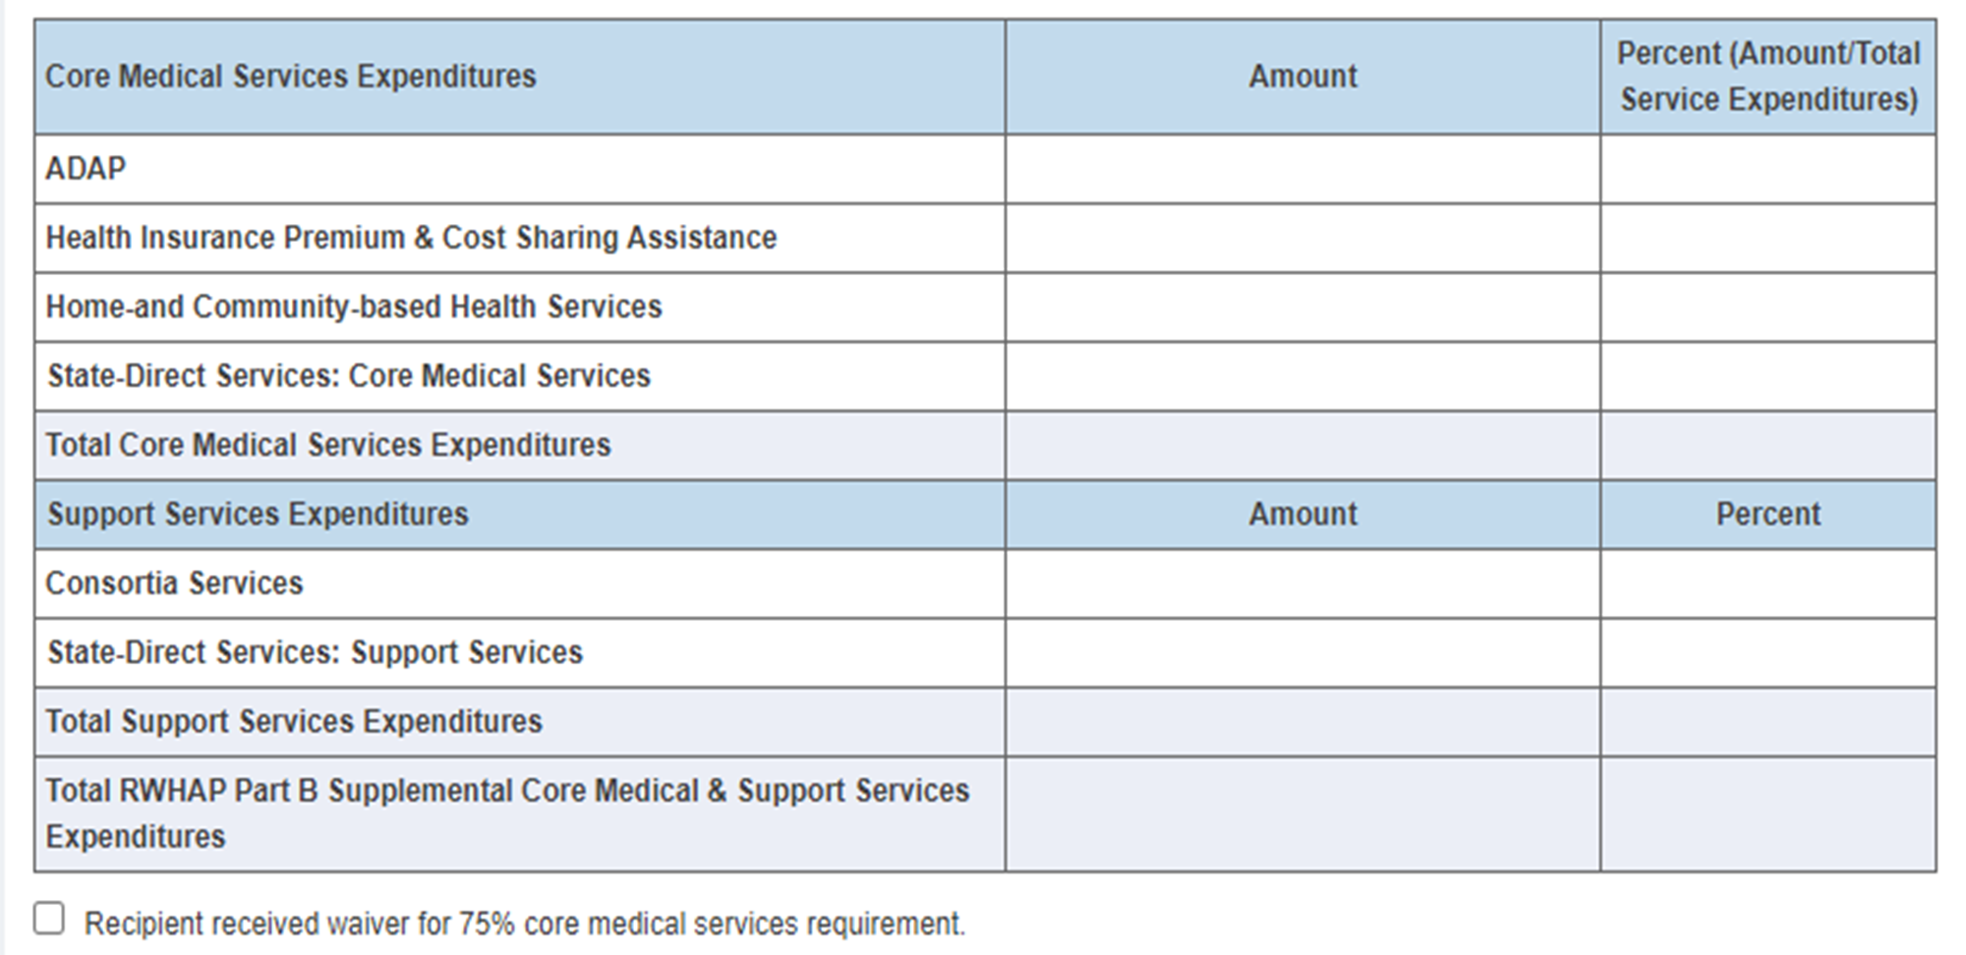
RWHAP Part B Supplemental Core Medical Services Expenditures
Notes:
And finally, below the Part B Supplemental Expenditure Categories, there is an additional table that will automatically calculate your core medical and support services expenditures once the Expenditures Report is saved. This table can be utilized to make sure you are in compliance with the 75% core medical services requirement. If you did receive a waiver for this requirement, **you can select the checkbox below the table. Again, If you're unsure if you’ve received this waiver or have any questions, please reach out to your project officer.

Slide 25
Validating & Submitting the Expenditures Report
Notes:
Now, that we have gone over completing the Expenditures Report, lets review validating and submitting the report. The following steps apply to both the Part B and Part B Supplemental Expenditures Report.

Slide 26
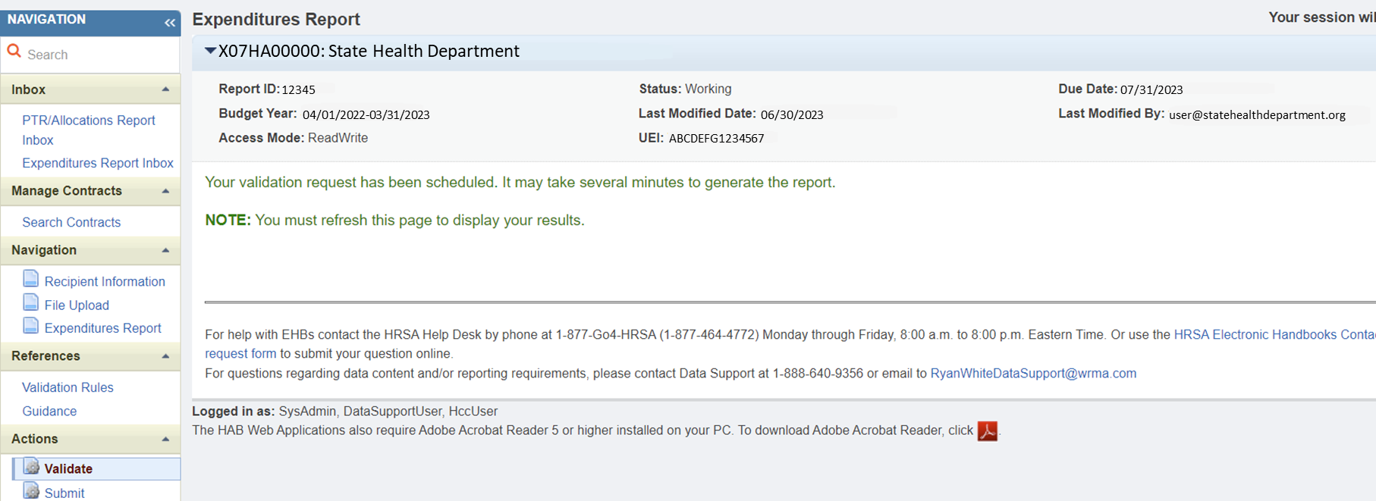
Validation Processing Page
Notes:
Once you have completed the Expenditures Report, you can move forward with validating your report by clicking on **Validate in the left navigation pane. Once you do, the system will let you know that it is processing your validation request and it may take a few minutes to complete. You can refresh the page to see your results by clicking on “Validate” again using the navigation panel or refreshing your browser.

Slide 27
Validation Categories
Error – Must be fixed
Warning – Fix or provide a comment
Alert – Review & attempt to fix
Notes:
Let’s take a moment to go over the validation messages that you may receive. Errors must be fixed, or the system will not allow you to submit. For warnings, you can either fix it, or if you can’t fix it you will need to enter a comment. Lastly, for alerts please review and fix the data, if needed. You do not need to provide comments for validation alerts.
If you have any questions on how to address validation messages received in your report, please contact Data Support. The contact information for Data Support will be displayed at the end of the presentation.
Next, Lets look at what happens if we receive a validation message in the report.

Slide 28
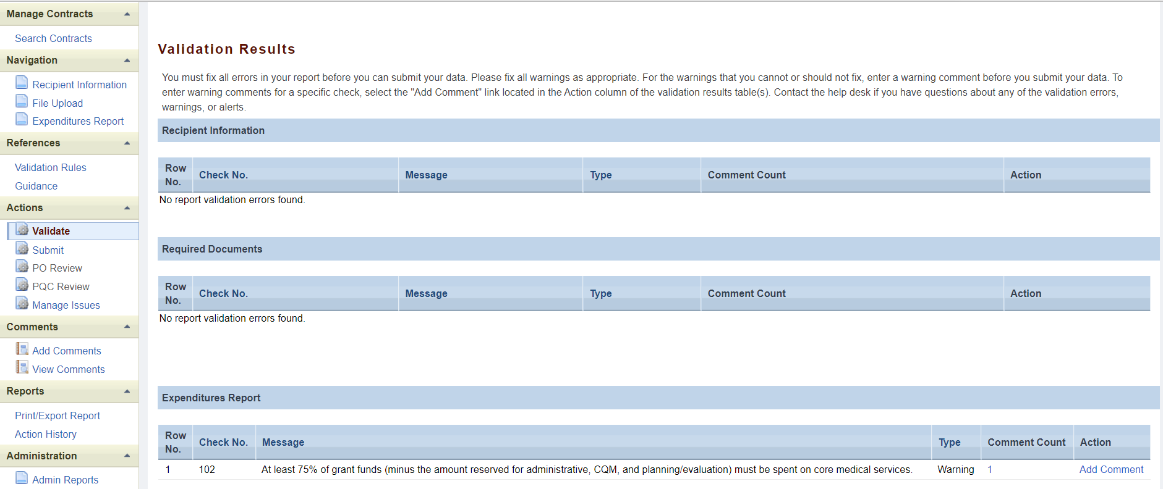
Validation Results Page
Notes:
Once your validation has processed, you will see your results. In the example listed, we see that there is a warning validation message. To add a comment to a warning, you will select on the **add comment link under the action column. Once you have addressed any error, warning, or alert messages you can move forward with submitting your Expenditures Report.
Remember if you any make updates to your report in response to your validation results, you’ll need to validate your report again before submitting. Just click the “Validate” link in the Navigation panel to start the validation process again.

Slide 29
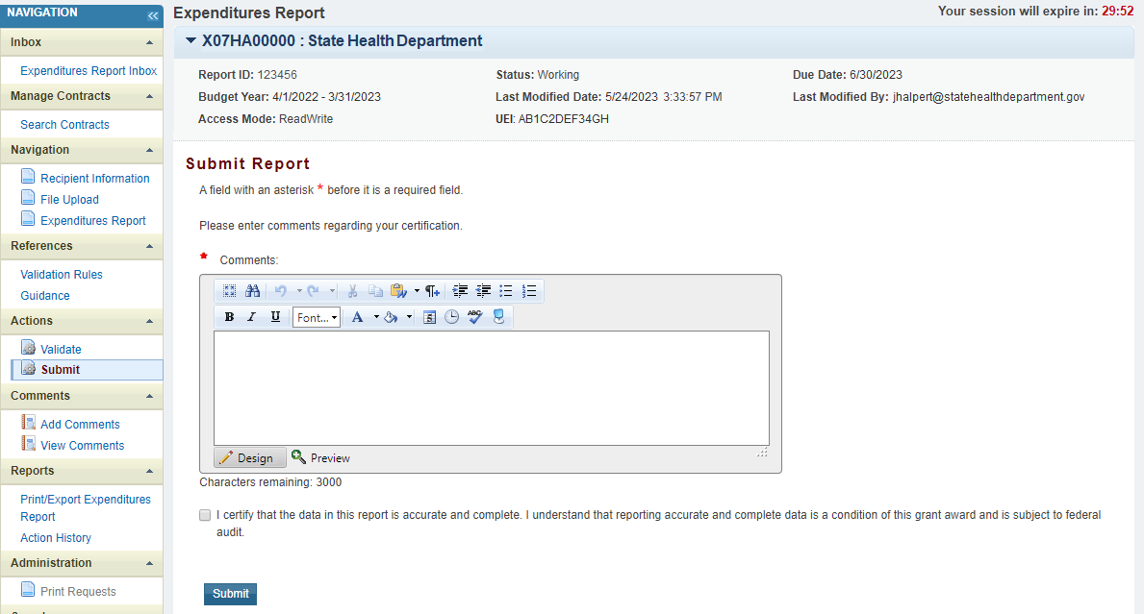
Submitting the Expenditures Report
Notes:
Once you have completed all the required sections, you can move forward with submitting your report by selecting the **submit option in the navigation panel. Selecting submit will bring you to the submission screen as shown here where you will be required to enter a **comment regarding your submission. Once all comments have been entered select the **box stating that the data in the report are accurate and complete. After that click, the **Submit link to submit your report and have your submission sent to your project officer for review.

Slide 30
TA Resources
Notes:
I know we covered a lot of information today, so let's end the presentation by reviewing helpful TA Resources to use while completing the Expenditures Report.

Slide 31
Online Resources
TargetHIV Website
HRSA HAB Website
PCN #16-02
RWHAP Part B Expenditures Report Manual
RWHAP Part B Supplemental Expenditures Report Manual
Notes:
Here are the links for the Part B and Part B Supplemental Expenditures Report Manuals as well as the TargetHIV website which contains a ton of additional resources on the Ryan White HIV/AIDS Program and data reporting requirements. In addition to that, there’s also a link for the HRSA HAB website as well as PCN #16-02 which we didn’t really go over today during the presentation, but that document houses the definitions for all the various core medical and support service categories and is the best resource if you have questions about those definitions.

Slide 32
TA Resources
Ryan White Data Support
888-640-9356
RyanWhiteDataSupport@wrma.com
EHBs Customer Support Center
877-464-4772
Online TA Request
Notes:
Here are a few additional TA resources. Ryan White Data Support can assistance with your Expenditures Report, and any submission challenges you may experience.
If you need assistance with your EHBs account such as account creation, resetting your password, and requesting permissions, the best resource is the EHBs Customer Support Center.

Slide 33
Connect with HRSA
To learn more about our agency, visit
www.HRSA.gov
Sign up for the HRSA eNews
FOLLOW US:
Notes:
Finally, to connect with and find out more about HRSA, check out HRSA.gov.
I’d like to take a moment thank everyone for joining us on today’s presentation and I will now turn it back over to Rachel for the Q&A portion of the webinar.

Slide 34
Questions?
Please use the “raise hand” function to speak. We will unmute you in the order that you appear.
OR
Type your question in the question box.

