Slide 1
MODIFYING EVIDENCE BASED INTERVENTIONS: WHEN LOCAL CONTEXT MEETS EVIDENCE BASED INTERVENTIONS
Speaker : Allison Precht , MA, CADC
Speaker : Karen Phillips , MSW, LCSW, PIP
Speaker : Damiya Whitaker, PsyD, MA
Moderator: Niko Verdecias, MPH
A HRSA SPNS Initiative:
Enhancing Access to and Retention in Quality HIV Care for Women of Color

Slide 2
Introduction to Initiative and Workshop

Slide 3
The Ruth M Rothstein CORE Center
Chicago, IL
Project WE CARE
(Women Empowered to Connect And Remain Engaged in Care)
Experiences with the CDC DEBI
Healthy Relationships
Allison M. Precht, MA, CADC- Project Manager
Marisol Gonzalez, RN, MPH – Principal Investigator
Susan Ryerson Espino, PhD – Lead Evaluator

Slide 4
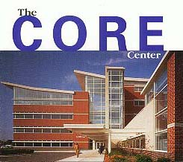
The Ruth M. Rothstein Core Center Chicago, IL
Cook County Health and Hospitals System – Public “Safety-Net” Facility
5,000 active patients, 35,000 primary care visits annually
64% African American and 20% Hispanic/Latino
Frequent history of drug use, incarceration
Approximately 1200 women with HIV annually.
An estimated 70-75% of all HIV infected women and 25-30% of HIV infected children known to be in care in the Chicago area.

Slide 5
Background Healthy Relationships
DEBI (CDC Diffusion of Effective Behavioral Interventions).
5-session (two hours each session), small-group (6-8 people) intervention for men and women living with HIV/AIDS.
Based on Social Cognitive Theory; focuses on developing skills and building self-efficacy to make informed and safe decisions about disclosure and behaviors.
Core & modifiable key components

Slide 6
CORE Preparation
HR has been resource intensive
Large staff training
HR Consumer Advisory Board to oversee adaptation of HR to CORE context and clientele
Significant outreach efforts & incentives to encourage facilitate recruitment & participation
Space
Refreshments/session preparation

Slide 7
Modifications
Film clips
Facilitators
Series Schedule
Incentives
Resource Packets

Slide 8
Experiences
27 participants 20 graduates
Significant impact on all participants (including facilitators)
Increased peer support (incl. developing trust in female friendships)
Disclosures
Increased self awareness and confidence in negotiating safe sex and disclosure

Slide 9
Outstanding Work/Interests
Exploring ways to evaluate (process and outcome)
Considering ways to leverage resources:
Internal & external collaboration to meet needs of a variety of stakeholders and keep costs down for any one program
Consider ways to reduce “commitment threat” and increase HR exposure to more women

Slide 10
“Deadly Secret” by Anonymous
I have a deadly secret its name is HIV
But I’m finally going to share it because it is time that I break free
People will make fun of you the devil whispered in my ear and
From that first day I lived a life of fear. Fear of someone finding out
fear of being pushed away so I chose to keep it a secret I
Couldn’t see it any other way. One day as I was running a still
Small voice spoke to me. I couldn’t begin to understand it was GOD
Speaking to little old me didn’t he know how awful I’ve been,
does he not know that I have HIV. As if I said those thoughts out loud the
LORD began to say of course I do my child. But I love you anyway. Its more
to this then meets the eye its not only you with HIV but millions that continue
to die. They die alone in silence playing their deadly game. Holding in there
secret living with guilt and shame. I could not understand this LORD didn’t you say you care?
OF COURSE I DO MY CHID THAT’S WHY I GIVE YOU NO MORE THAN YOU CAN BEAR!!!!!!!!!!

Slide 11
ACKNOWLEDGEMENTS
We would like to thank all of the project team for their hard work:
L’Oreal Bailey
Seliciano Douthard
Yolanda Duplessis
Debbie Mata
Nichelle Pierson
Wendy Rebolledo
Katherine Roach

Slide 12
Utilizing the ARTAS Strengths Based Case Management Model to Recruit and Retain Rural Women of Color in HIV Care
Karen Phillips, LCSW, PIP
Project Coordinator
Health Services Center, Inc.
Hobson City, AL

Slide 13
Project Team, Collaborators and Contributors
HSC Team
Barbara Hanna, MD
PI, HSC Medical Director
Tawanah Fagan, LBSW
Tiffany Garrett, BSW
Heather Watts, MSW
Mellissa Stearns, BSW
Cathy Simpson, Ph.D..
Evaluator
CDC Original ARTAS Collaborators
Lytt Gardner, Ph.D.
Jason Craw, MS
Christine O’Daniel, RN
Richard Rapp, Ph.D., expert consultant

Slide 14
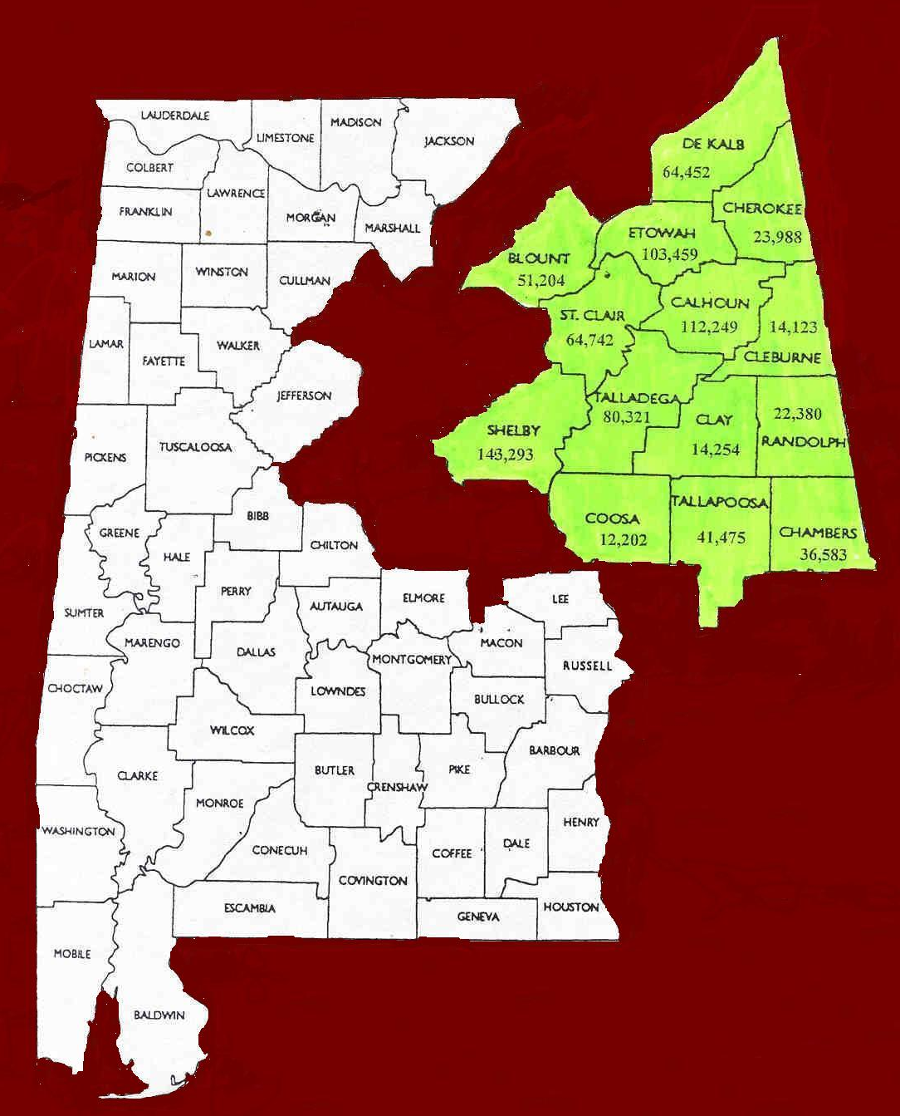
HSC Overview
1987: Began as support agency for persons with HIV/AIDS in the Calhoun County, AL area
HSC Service Area: 14 Northeast Alabama counties=9,001 square miles (AL Public Health Areas V and VI)
Only provider of HIV care in the service area
HSC service area covers 18% of Alabama.
Target population for SPNS WOC project: all women of color, enrollees predominantly African-American

Slide 15
Strengths-Based Case Management: Overview
Originally developed with substance using and MI populations
Utilizes client-identified strengths as basis for behavior change
Case managers assist clients in identification of strengths and prior life successes that may be utilized to meet current life challenges
Uses Motivational Interviewing techniques to help clients identify issues and works with clients to set measurable goals and action steps
Core Assumptions: client-driven, individualized, focus on strengths not deficits/weaknesses

Slide 16
SBCM and ARTAS Linkage to Care
Applied SBCM to HIV/linkage to care issues with the manualized ARTAS model
Original ARTAS model provided brief (> 5 sessions) to link newly diagnosed (only) persons into care
Following sessions, participants linked to ongoing CM
ARTAS Linkage focused on using SBCM to help clients build relationships with medical/ancillary providers, navigate healthcare, encourage appt. keeping, build rapport, honor client decisions
Two multi-site studies indicate that ARTAS SBCM increased initial linkage and long-term retention over standard HIV care (e.g., Craw et al., 2010; Gardner et al., 2005)
HSC Adapted initial ARTAS SBCM to extend access to linkage sessions and to engage women experienced with care but in crisis that threatens retention
Why modify? Nature of women’s issues, clinical experience, drop-out as significant a problem as initial linkage

Slide 17
Application to Linkage to Care for Women of Color
Adapted initial ARTAS SBCM to extend access to linkage sessions and to engage women experienced with care but not optimally engaged or retained
Why modify? Specific rural needs and clinical site experience. Nature of women’s issues, clinical experience, drop-out as significant a problem as initial linkage, drop outs relatively common
Broadly, how was ARTAS adapted?
Linkage CMs stationed at public health departments facilitates quick access to newly diagnosed women and builds staff/DIS relationships
In adaptation, linkage sessions access is ongoing
Focuses on initial linkage
Continues focus on longer-term retention
Troubleshoots resolution of problems that may lead to drop-out/loss to care
Linkage CMs perform linkage functions and meet at least quarterly with clients (more sessions for clients in crisis, based on acuity levels)

Slide 18
HSC Adaptation of Original ARTAS Model
Original ARTAS
Various sites had multiple recruitment streams
Enrolled all genders and races/ethnicities
Model applied only to persons newly diagnosed with HIV
Clients limited to 5 total visits, visits limited to within 1st 3 months following diagnosis
3 visits necessary for adequate “dosage”
HSC Adaptation*
HD caseworker placement and targeted recruitment streams
Enroll women of color only
Newly diagnosed, sporadic in care, and lost to care eligible
Minimum dose: 5 sessions in 4 month period following initial enrollment
No maximum dosage/visit limit
Ongoing minimum dosage: from month 5 onward minimum 1 contact per month
Use of acuity to assist in determining contacts
*Adaptation conducted in
Collaboration with one of original
ARTAS developers, expert consultant,
Richard Rapp, MSW, Ph.D.

Slide 19
Preliminary HSC Multi-site Linkage/Retention Data

Slide 20
Lessons Learned/Experience with Modifications
Clients will utilize much higher levels of CM access than the original 5 ARTAS sessions, if it is provided
Important to work directly with original model developers (e.g., fidelity, appropriate changes to model)
CM/client relationship is critical
Initial rapport building is key
Access to CM services needs to be ongoing
Ongoing relationship management with referral sources is important

Slide 21
Yo me cuido, Tu te cuidas, Nos cuidamos Curriculum
LIFT Project – Cumberland County, NJ
Luz Amparo Pinzon, Ph.D. and Damiya Whitaker, PsyD, MA

Slide 22
LIFT Project Overview
Needs Assessment
Baseline Measures
INTERVENTION
Support Services, Case Management, Referral Network
Curriculum Workshops,
Outreach

Slide 23
Core Elements of SISTA and Yo Me Cuido
Focused on empowerment, modeling, skill building, and gender-specific issues.
Designed for implementation in a community-based setting.
Aimed at reducing HIV sexual risk behaviors by increasing safer behaviors, developing positive attitudes toward safer sex, enhancing communication skills and increasing control over sexual situations.
Sessions build on each other and encourage open group participation.
Incorporate games and other interactive teaching/learning tools.

Slide 24
Overview of Yo Me Cuido
Group level intervention, two 5-hour sessions.
Interactive; culturally appropriate.
Designed to:
Improve HIV/AIDS related knowledge
Promote safe sex behaviors
Increase self-efficacy
Evaluation: Pre- and post-test; 3-month follow-up.

Slide 25
Modifications
SISTA | Latina Adaptation | African American Adaptation
Based on social cognitive & gender and power theories | Based on health belief, social cognitive & gender and power theories | Based on health belief, social cognitive & gender and power theories
Designed for young African American women | Designed for women with low literacy skills and limited English Proficiency | Designed for women with low literacy skills
Delivered in five 2-hour sessions | Delivered in two 5-hour sessions | Delivered in two 5-hour sessions
Focus: Prevention | Focus: Treatment & Adherence (Expanded to include opportunistic diseases, nutrition and exercise) | Focus: Treatment & Adherence (Expanded to include opportunistic diseases, nutrition and exercise)
Focus: Assertiveness Skills | Focus: Negotiation Skills | Focus: Negotiation Skills
Focus: Sexual Risk Behaviors | Focus: Sexual Risk Behaviors with Emphasis on Re-infection | Focus: Sexual Risk Behaviors with Emphasis on Re-infection
Emphasis on partner involvement | Emphasis on self-efficacy | Emphasis on self-efficacy
Use of poems | Use of role model stories | Use of role model stories
Booster sessions at 2 & 4 months post-intervention | Booster session is at 6 months post-intervention | Booster sessions at 6 months post-intervention

Slide 26
Cultural Adaptations
Based on formative findings the curriculum incorporates key issues of Latino culture that put them at risk:
Feminization of HIV (gender discrimination and violence)
Traditional gender roles (machismo/marianismo )
Familialism (self-sacrifice for the benefit of the family)
Passivity (avoiding insisting on safe sex, when this can lead to confrontation)
Fatalism (individual has no control over situations)
Dignity (maintaining honor in the family and group)

Slide 27
Cultural Adaptations
Adaptations for African Americans were based on cultural and behavioral practices that put them at risk:
Traditional gender roles
Pride in devotion and service to others
Religious beliefs
Tendency to self-neglect
Low levels of interpersonal power
Concurrent sexual partners

Slide 28
Lessons Learned
Despite diagnosis, women still lack basic knowledge about HIV/AIDS
Role model stories seem to resonate with participants and facilitate discussions on topics that were previously uncomfortable for participants.
Women with low literacy skills and limited English Proficiency skills benefit from the use of games and other interactive teaching methods.
Women now understand the relationship between nutrition and staying healthy.
Women often do not understand the link between unsafe sexual behaviors and re-infection.

Slide 29
Question & Answer
Thank you!

