Slide 1


Warm Transitions: Linkages to Care for People with HIV Returning Home from Rikers Island Jails
NYC Correctional Health Services:
Alison O. Jordan, LCSW
Ross MacDonald, MD
The Fortune Society: Stanley Richards

Slide 2
Abstract
New York City (NYC) jails are at the epicenter of an epidemic that overwhelmingly affects black and Hispanic men and offers a significant opportunity for public health intervention.
The NYC Department of Health and Mental Hygiene, the Health Authority in the NYC jail system, instituted a program to identify the HIV-infected, initiate transitional care coordination services within 48 hours of jail admission, and facilitate linkages to primary care in the community.
Trained health professionals provide transitional care coordination services using a caring and supportive, 'warm transitions' approach. Post-release, access to care is facilitated with an aftercare letter, discharge kit including condoms and medication, accompaniment and transportation as needed.
Linkages to primary care may be the right first step to facilitate continuity of care for people with HIV returning home from jail and the public health of the community to which they return.
Program outcomes will be highlighted.

Slide 3
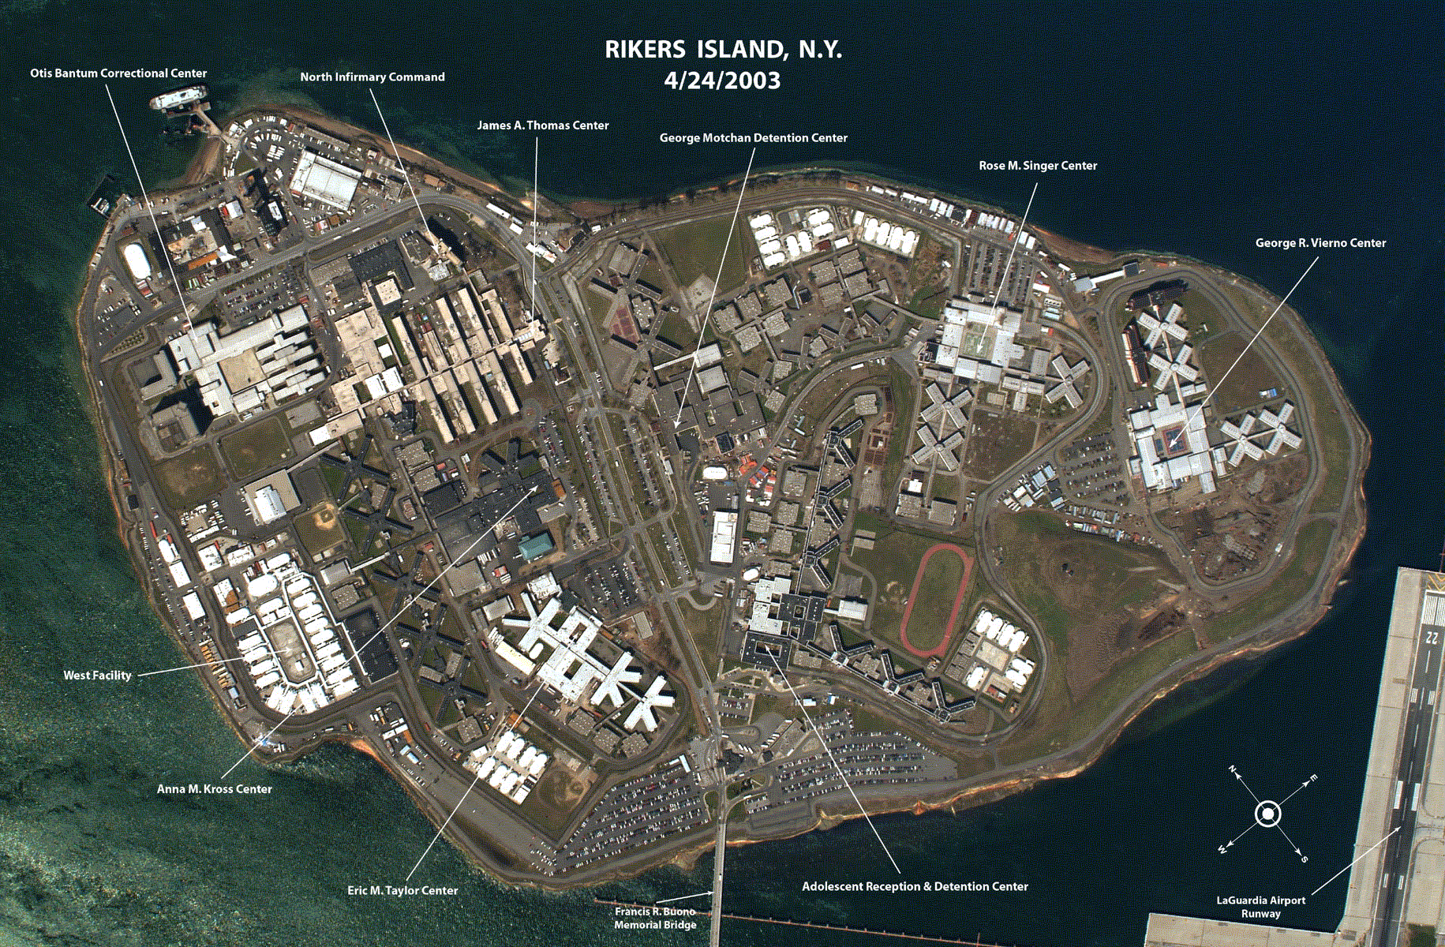


RIKERS ISLAND, NY
NYC Department of Correction (DOC) operates
Rikers Island (9 jails) and 3 borough facilities
NYC DOHMH provides health and
mental health care for all in DOC custody.

Slide 4
Correctional Health Mission
NYC Department of Health and Mental Hygiene oversees health care of inmates with goal to improve the health of incarcerated individuals
Public Health focus on Continuity of Care from jail to the community
Mission to Improve health outcomes in communities

Slide 5
Correctional Health Services
Admissions to NYC jails including Rikers Island
  100,000 admissions per year
  Average daily census of 12,500.
  Approximately 10% are women.
  Short stays are the norm: 25% released in 72 hrs; over 50% in < 1 week
Medical Intake: Within 24 hours, all persons admitted to City jails receive a intake history / exam from a DOHMH-supervised clinician.
Discharge Planning: Connect persons known to be living with HIV, or other chronic illness to primary care upon their release from jail.

Slide 6
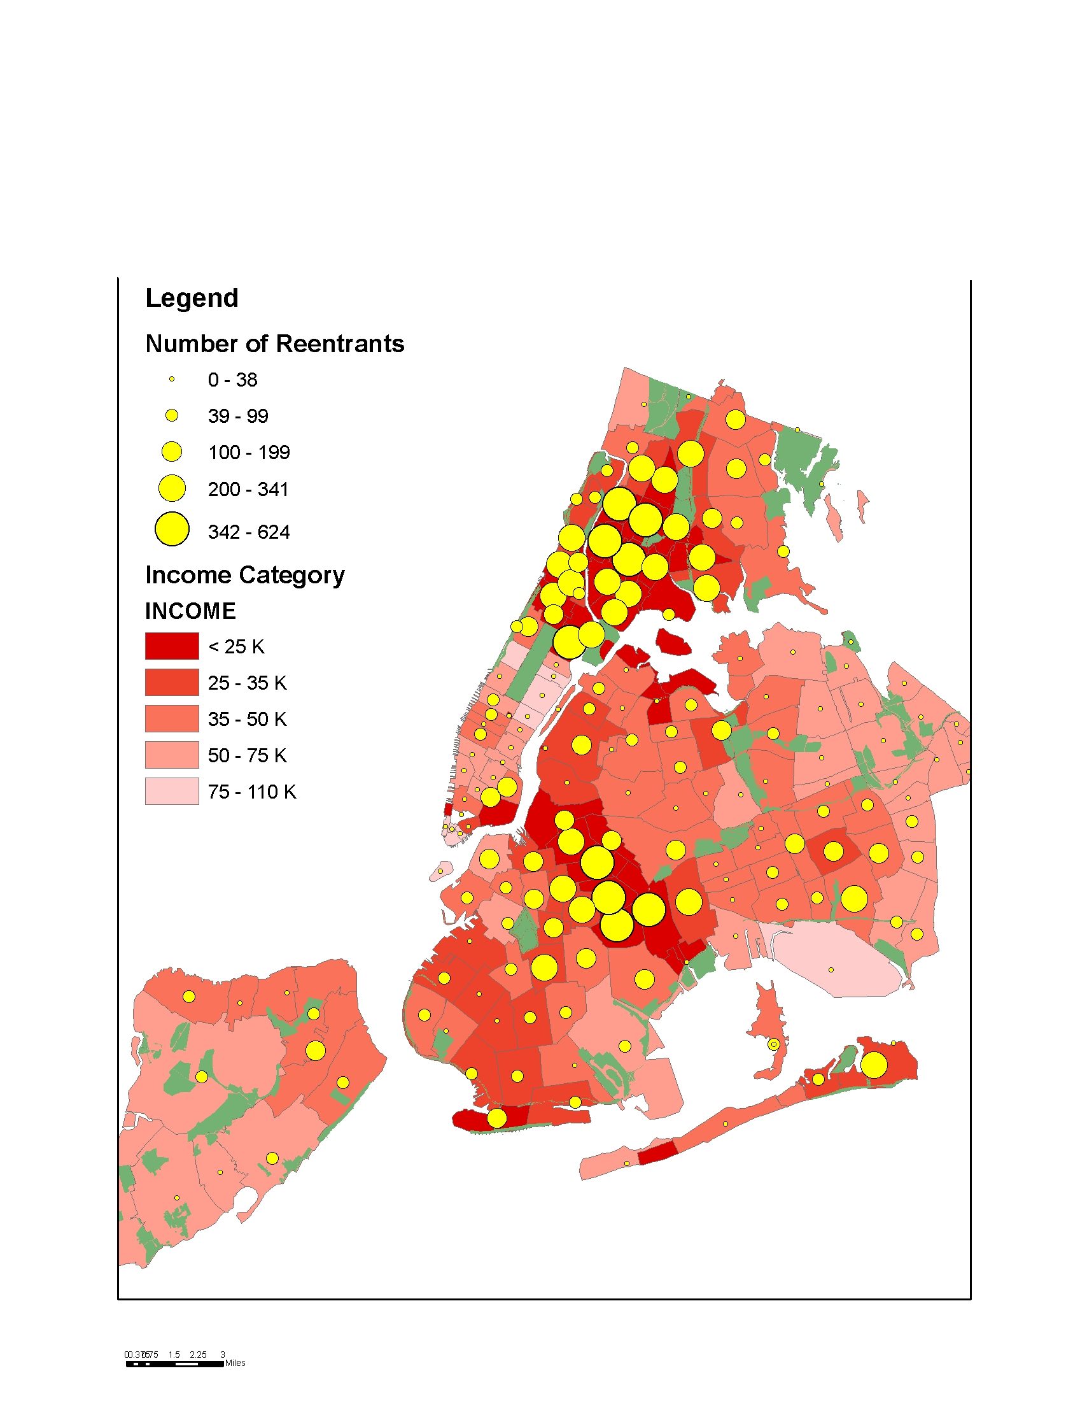
Jail Discharges to NYC Communities
by Zip Code and
Socioeconomic Status 2004
Over 70% of those released from NYC jails to the community return to the areas of greatest socioeconomic and health disparities.
Correctional Health is Public Health

Slide 7
Transitional Care Services
Identify population – use electronic health records
Engage client – access to housing areas
Conduct assessment – universal tool
Screen for Benefits – DSS is a partner
Arrange discharge medications – 7 days + Rx
Coordinate post-release plan – Primary care, social service orgs, Courts, attorneys, treatment providers
Facilitate continuity of care
  Aftercare letters / transfer medical information using RHIOs
  Make appointments / walk-in arrangements
  Arrange transportation / accompaniment

Slide 8
NYC Jail Population
Age Range
Race / ethnicity
Notes:
8
ALISON
13% 16-21
53% 21-40
32% 41+
Racial disparities in community reflected in jails

Slide 9
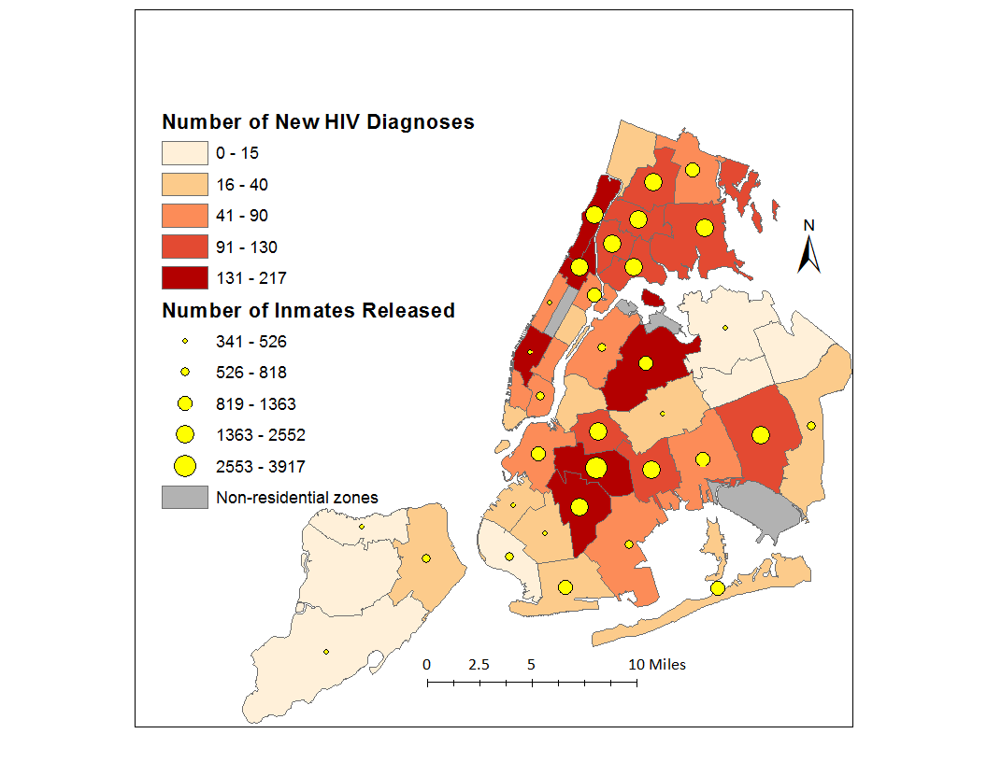
NYC New HIV Diagnoses and Number Released from NYC Jails by Zip Code
New HIV Diagnoses as reported to NYC DOHMH HIV/AIDS Registry (HARS) by June 30, 2011.
Number of Inmates Released reported by NYC DOC. All reports for the FY 2010 (July 1, 2009 to June 30, 2010).

Slide 10

Correctional Health Care
Challenges
Solutions
Short-term stays are norm
  ~25% leave in 2-3 days
  ~50% leave within 7 days
Limited time to diagnose
Limited time to start treatment, maintain care
Paper records
Post-release tracking
Intake History and PE
  universal voluntary < 24 hrs
  ongoing offer thereafter
Work from self-reports
Discharge plan asap
  engage in housing areas
  transport / accompaniment
Electronic Health Records
Health Information Exchange
removing barriers
Notes:
ALISON TO MARIA TOGETHER
1- Assess current and ID approaches to STREAMLINING
FROM JAIL TO COMMUNITY AND COMMUNITY TO JAIL
PCIP Largest # providers

Slide 11

Access to Care Strategies
Participants will be able to identify 5 strategies to facilitating access to care for hard to serve populations
Directly Observed Connections:
Case conferencing prerelease
Medical summary / medications
Accompaniment / transport
Community case manager
Direct connection to community provider
Patient Navigator / Care Coordinator

Slide 12
Continuum of Care Model
Jail-based Services
Opt-in Universal Rapid HIV Testing
Primary HIV care and treatment including appropriate ARVs
Transitional Care Coordination
Community-based Services
HIV Primary Care
Medical Case Management
Linkages to primary care, substance abuse and mental health treatment upon release
Patient Navigation: accompaniment, home visits, transport, and re-engagement in care
Discharge medications
Health information / liaison to Courts
Health Insurance Assistance / ADAP
Treatment adherence counseling
Health education and risk reduction
Linkages to Care
Treatment adherence and Directly Observed Therapy (DOT), as needed
Housing assistance and placement
Health Insurance Assistance / ADAP
Discharge Planning starting on Day 2 of incarceration
Patient Navigation: accompaniment, home visits, and re-engagement in care
Health promotion
Notes:
12
MARIA
Hand out flow cht
Pass baton to mo
No new $

Slide 13
Warm Transitions
An approach to linkages to care
Applies social work tenets to public health activities
Used to connect those with chronic health conditions including HIV-infection to community health care and services.

Slide 14
Implementation Strategies
Participants will be able to implement a 'warm transitions' approach to working with hard to serve populations
Plan for the Unknown
Expect the Unexpected
Apply Social Work tenets
Use Public Heath Principles
Show you care

Slide 15
Practice Tools
Concurrently engage and terminate
Stay or Go? Plan for both possibilities
Motivational Interviewing
Alcohol / Substance Abuse Screening
Evidence-based Tools
  CAGE, Audit or DAST
  Health / Wellness Screening – SF12
  SPECTRM program
Use MOU, FQHC listings, recently award grants to build your network of resources.

Slide 16
Planning for the Unknown
At each session, plans are devised for two possible outcomes, whether the client
  Remains
  Moves on
“Transfer the Juice”
  case conference with the client, current and future provider to transition the helping relationship

Slide 17
Expect the Unexpected
  Act as if each session is your last.
  Obtain consent to contact family members, health providers, health insurance plan, case managers.
For example, jail staff note upcoming court dates and make arrangements in anticipation of release
  two-thirds of detainees are released following a court hearing.

Slide 18
Social Work Tenets Applied
Begin where the client is
  Inquire about the client’s priorities.
Address basic needs
  secure food, clothing
  stable housing
Use “warm fuzzy” attention to reinforce positive behavior (rather than “cold, prickly”)

Slide 19
Public Health Principles Applied
Ask good questions
  Rather than “What’s your address?” try “How may I reach you in the community?”
  Rather than “Who is your emergency contact?” ask “Where shall I send laboratory results?”
Facilitate access to health care and return to care:
  Health insurance
  Transportation
  Medication

Slide 20
Demonstrate Caring
Hire non-judgmental caring staff familiar with community needs
  Bilingual, impacted by HIV, service system
Eye contact / non-verbal communication
Offer undergarments, food, clothes, condoms
Arrange accompaniment

Slide 21
Results
About 4,300 discharge plans were developed in 2011 with those living with chronic health conditions including diabetes, heart disease, hypertension, HIV hep c, liver disease and substance use.
Of those released with a plan nearly 75% are connected to a community provider.
88% not initially connect were located (30% in jail)
82% of those in the community and not initially returned to care were linked by the home visit team

Slide 22
Transitional Care Services
2011 | Known HIV+ | Other Chronic | All
Education session | 2,518 | 3,554 | 6,072
Discharge Plan | 2,518 | 1,763 | 4,281
Released w/ plan | 1,828 | 1,026 | 2,854
Connected | 1,337 | 783 | 2,120
Connected / Release Rate | 73% | 76% | 74%

Slide 23
Jail Linkages (JL) Evaluation
Health Resources and Services Administration (HRSA) Special Projects of National Significance (SPNS) Demonstration Project - Enhancing Linkages to HIV Primary Care & Services in Jail Settings
Ten site demonstration and evaluation of HIV service delivery in jail settings to develop innovative methods for providing care and treatment to HIV infected individuals in jail settings.
Largest jail study conducted to date
  NYC enrolled 40% of 1,021 released to the community and followed by case managers. (Watch for AIDS & Behavior supp.)

Slide 24
Post Release Services
Nearly 80% of clients in who receive a discharge plan were connected to care, post-release. Along with primary medical care, clients were also connected to:
    Medical case management (53%)
    Substance abuse treatment (52%)
    Housing services (29%)
    Court advocacy (18%)
Approximately 65% of clients accept the offer of accompaniment and / or transport to their medical appointment.
The THCC home visit team has been able to locate 90% of people referred to it, finding that approximately one-third of those referred have been re-incarcerated.
Along with primary medical care, Jail Linkages clients were also connected to:
    Medical case management (53%)
    Substance abuse treatment (52%)
    Housing services (29%)
    Court advocacy (18%)
“An ideal community partner offers a ‘one-stop’ model of coordinated care in which primary medical care is linked with medical case management, housing assistance, substance abuse and mental health treatment, and employment and social services.”
Approximately 65% of clients accept the offer of accompaniment and / or transport to their medical appointment.
DOHMH Home Visit team staff search for those who were not known to be linked to care and has located 85% of those referred, finding 30% were re-incarcerated.

Slide 25
Health Liaison to Courts
Assist courts in placing non-violent detainees in medical alternatives to incarceration
  residential substance use treatment, skilled nursing and hospice programs
  requires client consent, defense and court support, and community resources
The Health Liaison brings documentation to the court including a letter from the medical director, EHR summary reports, and program acceptance letters.
Upon court order and client agreement, a CCM or patient navigator accompanies the client and arranges transportation from court to the program.
250 placements to court-facilitated medical alternatives to incarceration since 2010
Placements included residential substance abuse treatment programs that offer on-site primary care and support services

Slide 26
Linkages Evaluation Outcomes
Averages for 249 with 6 month post-release Jail Linkages follow up/clinical review:
Client Level Outcomes
  Improvements shown by increased CD4 count (372 to 419)
  More taking medication (from 62% to 98%)
  Fewer report hunger (from 20.5% to 1.75%)
  Overall health and mental health improved (SF-12 PCS from 47.9 to 50.4; SF-12 MCS from 44.8 to 47.5)
Program Impact
  Treatment adherence improved (from 86% to 95%)
  Improved viral Load (from 52,313 to 14,044)
Systems Implications
  Fewer homeless in month prior: from 23% to 4.5%
  Fewer Emergency Department visits: from .61 to .19
Saving lives
Saving money
Notes:
Baseline, n=249
Follow up, n=249
p-value
Mean CD4 Count
372 (SD: 249)
419 (SD: 275)
0.001
Mean Viral Load
52,313 (SD: 181,000)
14,044
(SD: 23,563)
0.001
On ARV therapy
62%
98%
0.000
Average ARV adherence
86% (SD: 22)
95% (SD: 9)
0.000
Average # of ED visits, per client, prior 6mos
0.61 (SD: 1.21)
(Min: 0–Max: 10)
0.19 (SD: 0.60)
(Min: 0–Max: 4)
0.000
Homeless
23%
4.5%
0.000
Hunger
20.5%
1.75%
0.000
SF-12 PCS
47.9 (SD: 10.6)
50.4 (SD: 8.1)
0.000
SF-12 MCS
44.8 (SD: 9.5)
47.5 (SD: 6.9)
0.000

Slide 27
Break out Session
What systems issue would you need to address in order to implement a “warm transitions” approach?
What existing program services could you incorporate into a “warm transitions” model?
What is the right amount of “warm transitions” supports for your clients?

Slide 28
On-line Resources
http://hab.hrsa.gov/abouthab/files/cyberspnsjuly2012.pdf
http://www.enhancelink.org/
http://www.enhancelink.org/EnhanceLink/documents/Transitional_Care_Coordination--Fall2010.pdf
http://www.jjay.cuny.edu/NYCMappingHeathCare.pdf
http://www.jjay.cuny.edu/Jail_Admin_Toolkit.pdf
http://www.aidsbeacon.com/news/2010/12/03/new-point-of-service-program-will-focus-on-hiv-aids-testing-and-treatment-for-inmates-at-rikers-island/
http://208.112.47.52/library/reentrycare/reentrycarecall.asp
In 2007, THCC was awarded a grant from the Health Resources and Services Administration (HRSA) to participate in the Enhancing Linkages to HIV Primary Care & Services in Jail Settings project, part of the Special Projects of National Significance (SPNS) projects.
This SPNS Initiative is a multisite demonstration and evaluation study of HIV service delivery interventions in jail settings. The purpose of these projects is to develop innovative methods for providing care and treatment to HIV positive individuals in jail settings who are returning to their communities.
The THCC home visit team attempts to follow-up with all eligible (current NYC resident) clients, offering them a home visit and / or accompaniment to their first community-based medical appointment.

Slide 29
Building Linkages
Identify Existing Groups
  Attend National Conferences
  Solicit Grantees
Foster Partnerships
  Meet with Potential Partners
  Develop Partner Agreements
Requires Leadership
  Model for Staff
  Facilitate Networking for Staff
Check out award announcements – perhaps grantees need patient referrals!

Slide 30
Health Insurance
Now:
States encouraged to suspend rather than terminate Medicaid on admission to correctional facilities.
Pre-screening prerelease is permitted.
2014:
Individuals required to have insurance
More eligible for Medicaid enrollment while in jail
Pre-trial detainees may be eligible for the Medicaid or new Health Insurance Exchanges
Utilization of data matching
Facilitation of continuity of care in community
Courtesy of Havusha & Flaherty NCCHC 2011

Slide 31
Medicaid Expansion by State
Buettgens, M.; Holahan J.; Caroll, C. “Health Reform Across the States: Increased Insurance Coverage and Federal Spending on the Exchanges and Medicaid.” Urban Institute Timely Analysis. March 2011.
Courtesy Health Management Associates

Slide 32
Current Medicaid Rules
The “Inmate Exception” (Social Security Act Section 190A) “excludes Federal Financial Participation (FFP) for medical care provided to inmates of a public institution, except when the inmate is a patient in a medical institution.”
1997 CMS letter: FFP permitted for hospital and skilled nursing care for those in custody of corrections if
    the inmate in the medical institution for more than 24 hours and
    the medical institution is not operated by corrections and serves the general public, even if there is a locked ward.
1998 CMS letter: While FFP is not available for awaiting trial inmates receiving care on premises of prisons, jail, detention center, or other penal center, “inmates of a public institution may be eligible for Medicaid…”
Courtesy of Havusha & Flaherty NCCHC 2011

Slide 33
Medicaid Expansion by Population
Min income level 2014: 133%
Courtesy of Havusha & Flaherty NCCHC 2011

Slide 34
ACA Considerations
Permissibility of FFP for services provided by FQHC and look-alikes if the incarcerated patient is eligible (as in Portland, OR and areas in CA).
Impact of Payer of Last Resort on Ryan White funding
Billing and Payment administration
Eligibility determinations
Individual State requirements

Slide 35
Health Home Overview
Identify unmet needs
  Better coordinated referrals to coordinated system of care
Focus on averting avoidable ER and hospital visits
  Right care at the right time and place
Auto-assignment into Health Homes
  HH with both their case management program and provider
Up-to-date information from multiple systems
  Health Home coordinator access to latest medications and treatments
Courtesy of Trish Marsik, NYC DOHMH 2012

Slide 36
HH Healthcare Delivery System
Medicaid Agency
Managed
Care
Organization A
Managed
Care
Organization B
Managed
Care
Organization C
HH Team
HH Team
HH Team
HH Team
HH Team
= Physical and/or
behavioral health care provider
Courtesy of Trish Marsik, NYC DOHMH 2012

Slide 37
Health Homes: Sustained Continuity of Care?
Health Homes for Medicaid enrollees with chronic conditions
2 chronic conditions;
1 chronic condition and at risk for another; or
1 serious and persistent mental health condition
Coordination of primary and acute physical health services, behavioral health care, and long-term community-based services and supports
90% federal match rate (FMAP) for Health Home services
Many detainees will be eligible Health Home enrollees
Health Home providers must be able to bill Medicaid
Systems must be in place to provide care management and continuity of care for health home enrollees that are incarcerated and/or cycle in and out of jail
Courtesy of Havusha & Flaherty NCCHC 2011

Slide 38
Health Homes & Jails:
Considerations
Health homes need jail providers to achieve success
DOJ Policies regarding substance abuse treatment set a promising tone
SPNS Jail Linkages study shows reduced ED visits, improved clinical markers

Slide 39

“It is messy working with Wet Concrete
Still Its Easier than After it Dries.”

Slide 40
Case Studies
48 yo AA male linked to Health Home
44 yo TG M-F latina linked to HIV Services
47 yo latina with TBI accompanied to SNF
59 yo AA veteran linked to VA domicillary
Others from the audience?

Slide 41

What a Team!
Notes:
Update photo

Slide 42
Contact Us
Ross MacDonald, Medical Director
Correctional Health Services
rmacdonald@health.nyc.gov
Alison O. Jordan, Executive Director Transitional Health Care Coordination
ajordan@health.nyc.gov
Jacqueline Cruzado-Quinones, Project Manager
jcruzado@health.nyc.gov

