Slide 1
The Patient‐Centered Medical Home (PCMH) Guidance: Lessons from Ryan White Grantees –
PCMH 201
Ryan White Grantee Meeting 2012
Carolyn Burr, EdD, RN
Deputy Executive Director,
François-Xavier Bagnoud Center
Co-Principal Investigator, HIV-Medical Homes Resource Center (HIV-MHRC)

Slide 2

Lessons from the Field Panelists – AGM
Ruby Chapman, RN, BSN
Harris Health System, Houston, TX
Beverly Lawrence
Inova Juniper Program, Springfield, VA
Rondalya DeShields, RN, BSN
  University Hospital, Newark, NJ

Slide 3
Disclosures
This continuing education activity is managed and accredited by Professional Education Service Group. The information presented in this activity represents the opinion of the authors or faculty neither PESG, nor any accrediting organization endorses any commercial products displayed or mentioned in conjunction with this activity.
Commercial support was not receive for this activity.

Slide 4
Disclosures
Carolyn Burr, EdD, RN has no financial interest or relationships to disclose.
Ruby Chapman, BSN has no financial interest or relationships to disclose.
Beverly Lawrence has no financial interest or relationships to disclose.
Rondayla DeShields, RN, BSN has no financial interest or relationships to disclose.

Slide 5
Learning Objectives
By the end of this session participants will be able to:
Share lessons learned and strategies used by Ryan White HIV/AIDS clinics/practices who have successfully become certified as PCMHs
Discuss barriers and facilitators to changing practice to become a PCMH
Discuss resources and tools available to support this change process.

Slide 6
If you would like to receive continuing education credit for this activity, please visit: http://www.pesgce.com/RyanWhite2012
Obtaining CME/CE Credit

Slide 7
Patient-Centered Medical Home Institute
Ryan White All Grantees Meeting 2012
101 Session | The Patient-Centered Medical Home Guidance: A Model of Care Delivery for People Living with HIV | Tuesday 11/27/12 10 am
201 Session | The Patient-Centered Medical Home: Lessons from Ryan White Grantees | Tuesday 11/27/12 1:30 pm
301 Session | The Patient-Centered Medical Home: How Will We Know When We Get There? | Wednesday 11/28/12 10 am

Slide 8
What is a Patient-Centered Medical/Health Home (PCMH)?
A model for delivering primary care
Personal primary care provider (PCP)
PCP directed medical practice
Whole person orientation
Care coordinated and/or integrated
Hallmarks: quality and safety
  Optimal outcomes / care planning process
  Evidence-based / standards of care
  Accountability for CQI
Notes:
It is a team based health care delivery model led by a clinician/physician that provides comprehensive and continuous medical care to patients with the goal of obtaining maximized health outcomes (American College of Physicians) (American Academy of Family Physicians).
URAC (formerly the Utilization Review Accreditation Commission) definition is broader:
A Patient Centered Health Care Home (PCHCH) is an interdisciplinary clinician led team approach to delivering and coordinating care that puts patients, their families, and caregivers at the center of all decisions concerning the patient’s health and wellness. A PCHCH provides enhanced access to physical health, behavioral health, and supportive community and social services, ensuring patients receive the right care in the right setting at the right time. A PCHCH also:
➢ Utilizes population health management tools to proactively establish wellness and care goals for each patient, aimed at preventing illness and improving individual well being, clinical outcomes and quality of life;
➢ Empowers patients to be active participants in their care, through patient-friendly education and informed shared decision-making that is based on cooperation, trust, and respect for each individual’s health care knowledge and health literacy, values, beliefs, and cultural background;
➢ Is accountable for a patient’s needs, including prevention, wellness, medical and behavioral health treatment, care transitions, and social and community services where appropriate by planning, providing, coordinating, executing, and monitoring a plan of care for each patient;
➢ Optimizes value for patients, payers, and society at large, driven by a commitment to care excellence and customer service.
➢ Provides a rewarding place to work, offering a high level of job training and satisfaction for all members of the team allowing team members to optimize their training and experience.
Now: At least 5 million patients have been enrolled in at least 26 PCMH demonstration projects as of 2009 with current or planned projects backed by diverse funders in almost every state (Bitton et al., 2010). Growing every day!
A number of Ryan White clinics are interested in seeking certification. Many have already become certified or are working toward it.

Slide 9
Change Concepts for the PCMH
Engaged Leadership
Quality Improvement Strategy
Empanelment
Continuous and Team-based Healing Relationship
Organized, Evidence-Based Care
Patient-Centered Interactions
Enhanced Access
Care Coordination
Notes:
These change concepts are necessary to transform a practice to a successful PCMH.
Citation: E. H. Wagner, K. Coleman, R. J. Reid et al., Guiding Transformation: How Medical Practices Can Become Patient-Centered Medical Homes, The Commonwealth Fund, February 2012.

Slide 10
Overview of “Lessons From the Field”
Colleagues who have been through the PCMH certification process
Real life examples of implementing practice transformation
Providers from a range of RW grantees – health departments, academic medical centers, community health centers

Slide 11
How are new ideas or procedures adopted into practice?
Diffusion of Innovation Theory
Knowledge
Persuasion
Decision
Implementation
Confirmation
EM Rogers 1962
Notes:
Applied to many settings including agricultural extension agencies

Slide 12
Rationale for the LFF Panel
Provides models for practice change
Identifies the impact of adopting PCMH
Opportunity to share unexpected learning – “What I wish I’d known”
Provides practical advice for the documentation required
Colleagues’ positive experiences increases motivation

Slide 13
Selection Criteria for LFF Panelists
Needs Assessment data from the agency
  Certified as a Primary Care Medical Home
  Ryan White funding from multiple Parts
  Type of practice: HIV-specific, FQHC, academic
  Examples of successful practice change
Key informant interviews
  Motivation for becoming PCMH
  Impact of RW on PCMH application process
For AGM – the real-time experience of the process

Slide 14

Lessons from the Field

Slide 15
Patient Centered Medical Home
Thomas Street Health Center: How We Got To The Winner’s Podium
Ruby Chapman, BSN RN
Nursing Coordinator
HIV Services
Thomas Street Health Center

Slide 16
Patient Centered Medical Home
Thomas Street Health Center: How We Got To The Winner’s Podium
Ruby Chapman, BSN RN
Nursing Coordinator
HIV Services, Thomas Street Health Center

Slide 17
FACT SHEET
Harris Health System’s 16 community health centers comprise the largest network of public primary care clinics in Texas.
Harris Health unites those with seven school-based clinics, a dental center, dialysis center, five mobile health units, and three hospitals.
Smith Clinic, opened in Fall 2012, provides specialty outpatient services.
Harris Health System provides for more than one million outpatient clinic visits a year.
Harris Health also provides teaching facilities for Baylor College of Medicine and The University of Texas Health Science Center at Houston (UT Health).

Slide 18
FACT SHEET
VOLUME STATISTICS - FY 2012
Hospital admissions 35,343
Births (babies delivered) 6,643
Emergency visits 173,263
Outpatient clinic visits 1,054,770

Slide 19
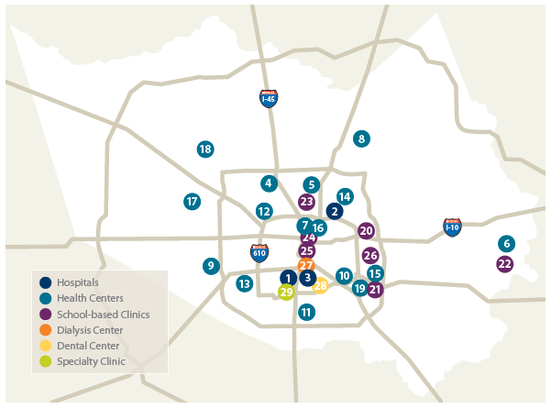
FACT SHEET OUR LOCATIONS

Slide 20
FACT SHEET
COMMUNITY HEALTH PROGRAM
Sixteen (16) community health centers, including the nation’s first freestanding HIV/AIDS treatment center
One free-standing dental center
Seven school-based clinics
Fifteen (15) homeless shelter clinics
Immunization and medical outreach program with five (5)mobile health units

Slide 21
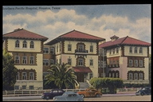
Thomas Street Health Center
History
1989, first free-standing HIV clinic in US
  2011, serviced 5,483 unduplicated clients
      3,732 Male (68%)
      1,751 Female (32%)
Services provided on site
ENT, Endocrinology, Neurology, Psych, Dermatology, Oncology, Rheumatology, MCM, OB/Gyn, Anal Dysplasia, Hep C
Southern Pacific Railroad Hospital

Slide 22

Thomas Street Health Center
Age Categories | Count | %
13-24 | 225 | 4%
25-44 | 2321 | 42%
45-64 | 2757 | 50%
65 & Over | 180 | 3%
 | 5483 | 100%

Slide 23
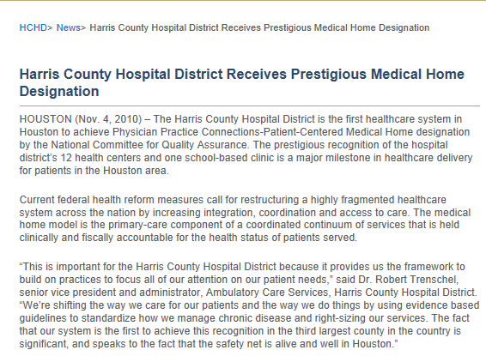

Slide 24



WHAT EVENT AND WHAT COLOR MEDAL

Slide 25

WHAT COLOR MEDAL ???

Slide 26

How Do We Prepare???
Decide on the accrediting agency
Know the rules for participation
Develop a strategy for reaching the goal

Slide 27
How Do We Prepare???
Select those who know the most about the organization, processes, policies and procedures
Involve those committed to be the best at what they do

Slide 28
How Do We Prepare???
Collaborate –you cannot do it along
Make sure all participants are motivated to get the job done
Who will lead your your team???

Slide 29
Ruby Is Our Athlete PCMH Event
She has competed on many other Olympic teams
  30 plus years as RN
  20 plus years in quality performance improvement
  Previous Joint Commission liaison
  Lead IT educator with EMR rollout
  Patient education
  Management

Slide 30
Patient Centered Medical Home Decathlon
Our Athlete Skill Set
Our Athlete Skill Set
Quality Management
Performance Improvement
Interpretation of standards
EMR Super-user
Clinical background
Utilization Review
Joint Commission Liaison
Management (leadership)
Project Management
Interpersonal and Coaching Skills

Slide 31
Ruby PCMH Decathlon Competitor
100 METERS
    NEED FOR A QUICK START
DISCUS THROW
    ABILITY TO RID
POLE VAULT
    ABILITY TO LEAP OVER
JAVELIN THROW
    ABILITY TO FOCUS IN A SPECIFIC AREA
400 METERS
    STRENGTH AND ENDURANCE ABILITY

Slide 32
Ruby PCMH Decathlon Competitor
100 METERS HURDLES
    NEED FOR A QUICK START AND JUMP OVER (overcome barriers)
LONG JUMP
    LONG EXTENDED HOURS
SHOT PUT
    ABILITY TO MEET OR EXCEED TARGET
HIGH JUMP
    ABILITY TO REACH ABOVE OBSTACLES
1500 METERS
    ABILITY FOR ENDURANCE AND TO KEEP GOING THE DISTANCE REQUIRED TO WIN!!

Slide 33
Training Schedule (Timeline)
March 15, 2011 (notification)
March 25, 2011 introduction to staff
April
  Initial training
  Development of template for notes in EMR
  Development of forms

Slide 34
Training Schedule (Timeline)
May
  Initial chart review access compliance
  Refinement of documents
  Review and revision of policies and procedures

Slide 35
Training Schedule (Timeline)
  June
      Ongoing meetings with coordinator
      Development of forms
      Assessment of implemented processes
  July
      Continued meetings
      Chasing staff, running marathon
    August
      36 records reviewed for submission
      Notification missing document

Slide 36
WE RECEIVED THE GOLDMEDAL !!!
E-mail notification 9/16/11@ 4:21 pm

Slide 37
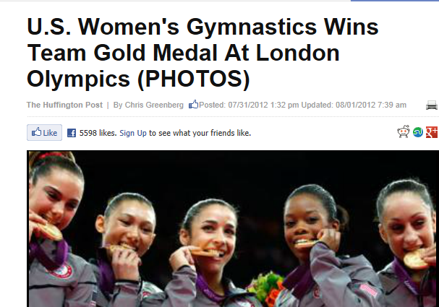
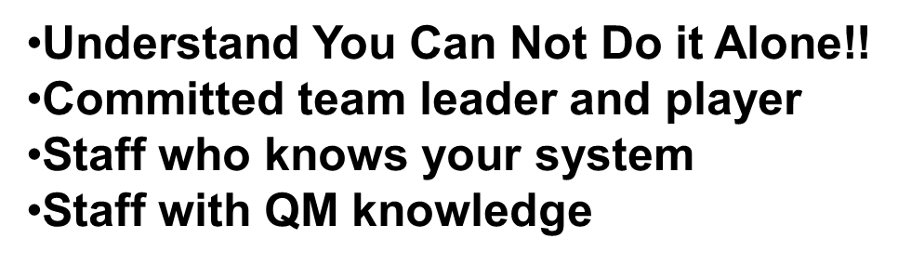
What Do You Need To Win

Slide 38

You Can Do It
“Pick battles big enough to matter, small enough to win”. ~Jonathan Kozel
“Do what you can, with what you have, where you are”. ~Theodore Roosevelt

Slide 39
Olympian Team Members
Irma Alvarado-Samaniego, PhD, RN
Thomas P. Giordano, MD, MPH
Pete Rodriguez, RNBSN, ACRN
Kimberlynn Luke MBA/HCA, RN

Slide 40
Questions
Thanks
Ruby Chapman, BSN RN
Nursing Coordinator Thomas street Health Center
Ruby.Chapman@harrishealth.org

Slide 41
Inova Juniper
Beverly Lawrence

Slide 42
Starting at the Beginning
Rondayla DeShields, RN, BSN
Infectious Disease Practice
University Hospital
Newark, NJ

Slide 43
How did you start the process? Steps?
Leadership attended a 2 day training
Selection of an agency to secure certification
  NCQA
Educated the providers and staff to obtain their buy-in
Selected a CORE Team to work on initiative
  Who and what roles are the best fit for the team?
  Creation of Team Charter
Established a Strategic (STRAT) Group to assist with handling barriers and resolving challenges

Slide 44
Steps continued…
Reviewed NCQA materials, standards and elements with providers/staff
Performed a Readiness Assessment of the practice
  Identified areas of weakness
  Results shared with CORE/STRAT teams
  Development of workgroups, work plan, timeline, and resources

Slide 45
Who are the key players?
Medical Director and Manager
Ambulatory Care Administration
HIT
Providers/Staff (physicians, nurses, medical case managers, dietitian, medical technicians, front desk personnel)

Slide 46
What are the biggest barriers? Facilitators?
Barriers
Staff Turnover (positive and negative)
Staff availability for meetings
New EMR implementation deferred
Current EMR is limited
  Unable to make changes/additions
  Unable to perform E-prescribing
Facilitators
Working in a patient centered model
Management and Staff with longevity

Slide 47
What is the impact of being a Ryan White-funded agency?
Provides primary medical care to population
Has a Patient centered model
Addresses Patient Satisfaction
Set Continuous Quality Improvement Program
  Performance HAB Measures

Slide 48
Lessons from the Field Panel: Questions
How did you start the process? What motivated your agency?
Who were the key players?
What were the biggest barriers? Facilitators?
What was the impact of being a Ryan White-funded agency?
How have patients responded?
What was the best advice you received? Best tool?
What is the biggest reward for becoming a PCMH?
How did you start the transformation?
How has staff satisfaction changed?
How did you keep your team motivated?
How long did the process take?
What do you know now that you wish you had known early in the process?

