Slide 1
Why an ice cream label?
3 minutes to administer
Easy to document
Validated tool in English and Spanish
Assesses
  Prose literacy
  Numeracy
  Document literacy

Slide 2
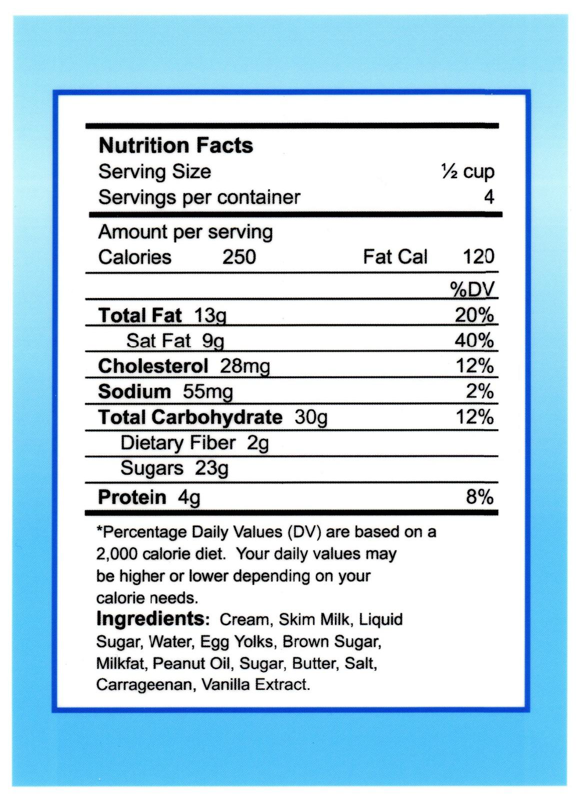
The Newest Vital Sign (Pfizer, Inc)

Slide 3
Score Sheet for the Newest Vital Sign
Questions and Answers READ TO SUBJECT: This information is on the back of a container of a pint of ice cream.
1. If you eat the entire container, how many calories will you eat?
Answer: 1,000 is the only correct answer
2. If you are allowed to eat 60 grams of carbohydrates as a snack, how much ice cream could you have?
Answer: Any of the following is correct: 1 cup (or any amount up to 1 cup), half the container. Note: If patient answers “two servings,” ask “How much ice cream would that be if you were to measure it into a bowl?”
3. Your doctor advises you to reduce the amount of saturated fat in your diet. You usually have 42 g of saturated fat each day, which includes one serving of ice cream. If you stop eating ice cream, how many grams of saturated fat would you be consuming each day?
Answer: 33 is the only correct answer
4. If you usually eat 2,500 calories in a day, what percentage of your daily value of calories will you be eating if you eat one serving?
Answer: 10% is the only correct answer
READ TO SUBJECT: Pretend that you are allergic to the following substances: penicillin, peanuts, latex gloves, and bee stings.
5. Is it safe for you to eat this ice cream?
Answer: No
6. (Ask only if the patient responds “no” to question 5): Why not?
Answer: Because it has peanut oil.

Slide 4
Interpretation
Number of correct answers: Tally up ‘Yes’ answers
  Score of 0-1 suggests high likelihood (50% or more) of limited literacy.
  Score of 2-3 indicates the possibility of limited literacy.
  Score of 4-6 almost always indicates adequate literacy.

Slide 5

How St. Mary’s HIV Clinic uses results
Health literacy assessed once ever.
Score of <=3, patient to receive intervention.
Intervention = Teach back. Goal is teach back done at end of each medical appointment.
Started using teach back consistently in August 2011. 2012 will be first full year of data for complete HIVQUAL health literacy measure.

