Slide 1
Co-management of HIV/AIDS by Community Health Care Providers and Specialists
Hesborn Wao, PhD Joanne J. Orrick, PharmD, AAHIVE Jeffrey Beal, MD Theresa C. Skipper, MPH
Sean McIntosh, AS
Florida/Caribbean AETC Center for HIV Education and Research, University of South Florida

Slide 2
Disclosure statements
The following have no financial interest or relationships to disclose:
Hesborn Wao, PhD
Joanne J. Orrick, PharmD, AAHIVE
Jeffrey Beal, MD
Theresa C. Skipper, MPH
Sean McIntosh, AS

Slide 3
Outline
Introduction
Session description
Learning objectives
Program overview
Program implementation
Evaluation
Data collection
Data analysis
Preliminary results
Challenges and future direction

Slide 4
Session Description
Discuss the use of F/C AETC-Project ECHO™ (Extension for Community Healthcare Outcomes)
to co-manage HIV/AIDS
patients through distance
learning

Slide 5
Learning Objectives
By the end of the session, participants will be able to:
Describe how F/C AETC-Project ECHO™ was implemented, the challenges encountered in that process, and how to model the program in their respective centers
Describe the impact of F/C AETC-Project ECHO™ on health care providers’ knowledge, skills, behavior and other potential outcomes of this educational intervention
Discuss the value of mixed methods approach in the evaluation of F/C AETC-Project ECHO™ program

Slide 6
Program Overview
Problem: Access to high-quality care by HIV/AIDS-infected patients in rural and underserved areas is a challenge for care providers and patients
F/C AETC-Project ECHO™ (Extension for Community Healthcare Outcomes) addresses this challenge by linking specialists and care providers
Project Period: November 2011- Ongoing

Slide 7
The F/C AETC Project ECHO™
F/C AETC-Project ECHO™ uses Adobe Connect, a live audio-video-based platform, to create a learning network of clinicians (expert-novice) serving HIV/AIDS patients in our region (Florida, Puerto Rico, and U.S. Virgin Islands)
Aim: Develop care providers capacity to safely and effectively treat patients with HIV/AIDS in rural and underserved areas
Thus, increasing patients’ access to and retention in care

Slide 8
F/C AETC-Project ECHO™ Team
Jeffrey Beal, MD, AAHIVS
Clinical Director & Principal Investigator
Kimberly Molnar, MAcc
Director
Joanne J. Orrick, PharmD, AAHIVE
Associate Director
Hesborn Wao, PhD
Evaluator
Adis Kreso, BS
Statistical Data Analyst
Anna Mayor, MA
Marketing Support
Sean McIntosh, AS
Program Coordinator
Theresa C. Skipper, MPH
Logistical Management
Christine Makar, BA
Continuing Education Support
Danchelle Jones
Program Support
Nathan McMullen, HND
Technical Support

Slide 9
Program Implementation
F/C AETC site visit to University of New Mexico Project ECHO™
Monthly implementation meetings with F/C AETC program staff
Technical assistance from University of New Mexico Project ECHO™
Polycom vs Adobe Connect platform
Provider interest gauged at Annual F/C ATEC conference and through email contact

Slide 10
Implementation
University of New Mexico Project ECHO™

Slide 11
Training Platform
VS
Adobe® Connect™

Slide 12
Training Platform

Slide 13
Session Overview

Slide 14
Program Implementation
Session Overview
Sessions scheduled twice per month
15 minute didactic presentation by a F/C AETC faculty member
Remainder of time (1-1.5 hours scheduled per session) spent discussing patient cases submitted by providers throughout the region
F/C AETC faculty member facilitates discussion among participants and other F/C AETC faculty

Slide 15
Case Presentation Form Interactive Fillable PDF

Slide 16
Program Evaluation
Purpose of the evaluation
Determine extent to which F/C AETC-Project ECHO™ helps in developing capacity among health care professionals in rural and underserved areas of Florida, Puerto Rico, and the U.S. Virgin Islands to safely and effectively treat HIV/AIDS and to monitor outcomes of this treatment
Learn from program implementation experience to better manage performance and improve program design

Slide 17
Program Evaluation
Type of evaluation
Needs evaluation: Determine care provider needs
Process evaluation: Assess program activities/processes
Outcome evaluation: Assess program effects/impact
Time points
Participant registration: Prior to scheduled session
Immediate post-training: ≤1 week (All participants)
Follow-up evaluation: 4-6 months (Case presenters)
Methodology: Mixed-methods approach
Quantitative component
Qualitative component

Slide 18
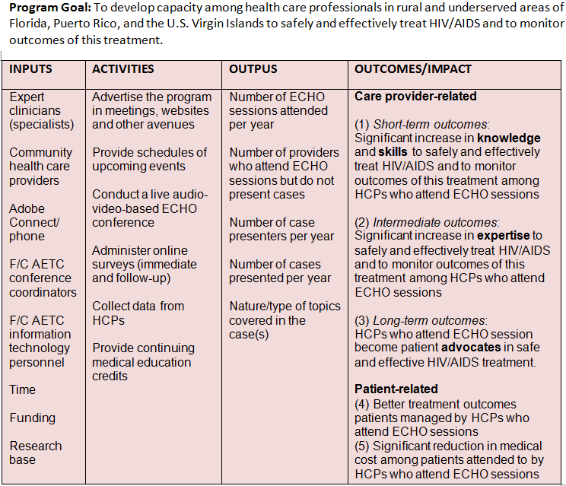
Evaluation: Logic model

Slide 19
Evaluation: Data Collection
Immediate post-training
Demographics
Objectives for attending
Kirkpatrick's levels:
Satisfaction/reaction
Intention to change Knowledge, Skills, & Attitudes (KSA)
Learning (change in KSA)
KSA transfer to workplace
Improved patient outcome
Suggestions for improvement
Follow-up evaluation
Patient benefited?
Change in KSA
KSA learned used to manage other patients?
KSA learned shared with others at workplace?
Challenges faced while implementing suggestions
Kirkpatrick, D. L. (1994). Evaluating training programs. San Francisco: Berrett-Koehler Publishers, Inc.

Slide 20
Evaluation: Data analysis
Questions:
To what extent:
are care providers satisfied with the program?
do care providers’ knowledge of HIV care change as result of participating in the program?
is knowledge acquired transferable to workplace?
does the program impact patient outcomes?
Procedure:
Retrieve data from NEC Custom Survey (CSV file)
Quantitize qualitative data (frequency & intensity)
Present results (graphs, charts and qualitative data)
Solicit feedback to inform program implementation

Slide 21
Evaluation: Preliminary results

Slide 22
Evaluation: Preliminary results
Notes:
Note: 97% achieved their objective

Slide 23
Evaluation: Preliminary results
Level 1: Participants’ satisfaction/reaction
Notes:
Kirkpatrick's levels:
Level 1: Satisfaction/reaction
Intention to change in KSA
Level 2: Learning (change in KSA)
Level 3: KSA transfer to workplace
Level 4: Improved patient outcome

Slide 24
Evaluation: Preliminary results
Level 1: Participants’ satisfaction/reaction
Notes:
Kirkpatrick's levels:
Level 1: Satisfaction/reaction
Intention to change in KSA
Level 2: Learning (change in KSA)
Level 3: KSA transfer to workplace
Level 4: Improved patient outcome

Slide 25
Evaluation: Preliminary results
Intention to make changes in practice
Theme | Sample significant statements
1. Adherence | - Work on compliance - Try to implement some of the adherence tactics
2. Health literacy | - I intent to keep up with learning - Continue to learn more
3. Education | - Network with persons with similar duties - “..comfortable presenting difficult patient for review”
4. ART | - Focus on pregnancy issues and ARVs - Update treatment plan
5. Mental health | - Increase screening of mental health issues - Being more aware of depression issues
6. Pediatric/ perinatal HIV | - Focus on pregnancy issues and ARVs - Change tx options for pregnant patients
Notes:
Kirkpatrick's levels:
Level 1: Satisfaction/reaction
Intention to change in KSA
Level 2: Learning (change in KSA)
Level 3: KSA transfer to workplace
Level 4: Improved patient outcome

Slide 26
Evaluation: Preliminary results
Level 2: Change in Knowledge (Learning)
Notes:
Kirkpatrick's levels:
Level 1: Satisfaction/reaction
Intention to change in KSA
Level 2: Learning (change in KSA)
Level 3: KSA transfer to workplace
Level 4: Improved patient outcome

Slide 27
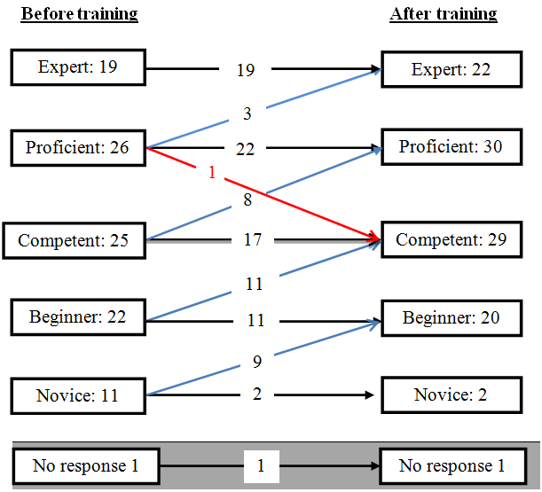
Evaluation: Preliminary results
Level 2: Change in Knowledge (Learning)
Before Training
After Training
Notes:
Kirkpatrick's levels:
Level 1: Satisfaction/reaction
Intention to change in KSA
Level 2: Learning (change in KSA)
Level 3: KSA transfer to workplace
Level 4: Improved patient outcome

Slide 28
Evaluation: Preliminary results
Level 3: Pre-transfer of knowledge to practice
Notes:
Barriers to implementation cited:
Multiple social barriers with this patient and family situation
Intention to change in KSA
Time and language
Time and effort on my part Patient/parental refusal of psychiatric evaluation, lack of insurance for psch eval. We work with a very difficult population that has many secondary problems.

Slide 29
Evaluation: Quantitization
Theme | Sample significant statements
1. Learn | To learn something new Learn from every clinical case
2. Increase knowledge | “Increase knowledge,” “Broaden my knowledge about HIV resistance testing” To increase my knowledge on perinatal HIV
3. Education/CME | Increase education To educate myself so I can provide better care to my clients
4. Update knowledge | “HIV updates,” “Stay updated and learn from others’ experience” Keeping up with advances in management
5. Obtain expert opinion | Obtaining advice from experts Getting expert information on a difficult case
6. Provide expert opinion | Educate and update on providing holistic care to HIV patients Teaching/provide consultation

Slide 30
Evaluation: Quantitization cont.
Theme | Sample significant statements
7. Apply knowledge | To educate myself so I can provide better care to my clients To improve care of clients
8. Discuss/participate | Discuss perinatal care Discuss ideas for increasing medication compliance
9. Gain knowledge/skills | Gain additional information on appropriate service to our clients To gain more knowledge and insight.
10. Network | Network with other HIV providers Participate and network
11. Observe | Observe the new ECHO session offered by F/C AETC Observe the TeleECHO clinic
12. Help | To help other sites Assist in patient management

Slide 31
Evaluation: Quantitization
Read entire text data
Identify “significant statements” and code them
Aggregate codes with similar statements into themes
Assign a theme a score of “1” if a participant made a statement classified under it, “0” otherwise
Obtain Participant X Theme (interrespondent) matrix
Compute theme frequency (% of participants endorsing a particular theme)
Theme Frequency ₌ Number of participants who mention a particular theme x 100
Total number of participants in the group

Slide 32
Evaluation: Quantitization
Assign a theme a score of “1” if it contains a significant statement, else score “0”
Obtain Unit X Theme (intrarespondent) matrix
Compute theme intensity (% of statement referring to a particular theme)
Theme Intensity = Number of statements referring to a particular theme x 100
Total number of statement cited for all themes

Slide 33
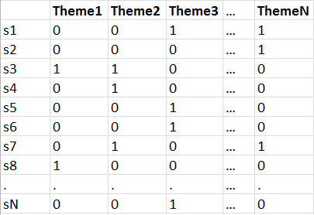
Evaluation: Quantitization
Interrespondent matrix
Intrarespondent matrix
Notes:
- For each theme:
How many participants cited it? (Frequency) – interrespondent matrix
How many statements described it? (Intensity) –intrarespondent matrix
- A theme may be less frequently cited BUT more intensely cited
- High frequency and high intensity ES preferred
- The two descriptors may sometimes yield different research findings
- Decide apriori whether to focus on either or both

Slide 34
Evaluation: Preliminary results
What participants liked MOST and how to improve program
Notes:
What participants liked the most 1. Environment: (1) Active participation of attendants, warm atmosphere (2) Collegial environment; collaborative atmosphere
2. Environment: (1) Active participation of attendants, warm atmosphere (2) Collegial environment; collaborative atmosphere
3. Cases: (1) Discussion of the case (2) Real case presented
4. Session content: (1) Very interactive and I like Dr. ­____[name taken out] as a moderator (2) Hearing from experts, discussion with logic behind it, the different opinions 5. Cases: (1) The format: Didactic and case presentations (2) Face-to-face interaction
How the program can be improved 1. Session content: (1) Maybe limit to one presentation and two cases 2. Session format: (1) Find a way to have recommendations typed and sent to the participants 3. Cases: (1) Have more information presented on cases (2) Have the cases to be presented sent before the session

Slide 35
Factor analysis: “Like most” themes
Interactive
Discussion
Knowledge
 | Factor1 | Factor2 | Factor3 | Factor4 | Factor5
Different opinions | 0.9012 | -0.2529 | -0.2195 | -0.2053 | -0.1671
Interactive | -0.6933 | -0.4978 | -0.3978 | -0.2297 | -0.2346
Expert advice | -0.1014 | 0.9666 | -0.1298 | -0.1320 | -0.1263
Nature of discussion | -0.0673 | -0.1042 | 0.9803 | -0.0996 | -0.0994
Format | -0.0771 | -0.0991 | -0.0880 | 0.9826 | -0.0922
Convenience | -0.0099 | -0.0185 | -0.0171 | -0.0203 | 0.5593
Knowledge gained | -0.0099 | -0.0185 | -0.0171 | -0.0203 | 0.5593
Knowledge update | -0.0099 | -0.0185 | -0.0171 | -0.0203 | 0.5593
Expert advice
Format
Notes:
Factor pattern
Goals for running PROC FACTOR 1. Determine minimum number of factors that can adequately account for the variance in the data
2. Find simpler, easier to interpret factors through rotating the factors
3. Determine a meaningful interpretation of the factors that provide insight into the data for use with further analysis

Slide 36
Challenges and Solutions
Troubleshoot technical difficulties
Check list for each program
Increase participation using webcams
Engage more participants in the discussion
Increase the number of faculty facilitators
Increase the number of participating clinics and providers

Slide 37
Future Directions
Curriculum outlined through June 2013
Includes Pediatric/Adolescent specialty sessions
Develop curriculum and brochure detailing all programs for December 2012-June 2013 AETC grant year
Expand to include other sub-specialty sessions
HCV/HIV co-infection
Mental Health
Pediatric/Adolescent
Perinatal
Logistics for collecting patient outcome data
Collaborate and share resources with other AETCs using the Project ECHO™ model

Slide 38
Contact information
Hesborn Wao, PhD USF Center for HIV Education and Research Florida/Caribbean AETC 3515 E. Fletcher Ave., MDT 1200 Tampa, FL 33612 Office: 813.974.9248 E-Mail: hwao1@health.usf.edu | Joanne J. Orrick, PharmD, AAHIVE USF Center for HIV Education and Research Florida/Caribbean AETC 13301 Bruce B. Downs Boulevard, MHC 1716, Tampa, FL 33612 Office: 813.974.6002 | Cell:813.784.8904 E-Mail: jorrick@usf.edu
Jeffrey Beal, MD USF Center for HIV Education and Research Florida/Caribbean AETC 2804 Del Prado Blvd. S., Suite 106 Cape Coral, FL 33904 Office: 239.541.0504 E-Mail: JBeal@usf.edu | Sean McIntosh, AS USF Center for HIV Education and Research Florida/Caribbean AETC 2804 Del Prado Blvd. S., Suite 106 Cape Coral, FL 33904 Office: 239.541.0504 E-Mail: SMcIntosh@usf.edu

Slide 39
Questions/Comments
Thank You

Slide 40
Obtaining CME/CE Credit
If you would like to receive continuing education credit for this activity, please visit: http://www.pesgce.com/RyanWhite2012

