Slide 1
Web and Social Media Institute 301:
Measuring Value
Ryan White All Grantees Meeting
November 28, 2012

Slide 2
Today’s Presenters
Judy Collins
  Program Coordinator of Social Media
  AETC National Resource Center
  Nicolé Mandel
  Deputy Director—UCSF Center for HIV Information
  Website Manager—AETC National Resource Center and TARGET Center
  Veronica Jones, MPH, CHES
  Program Manager, AETC National Resource Center

Slide 3
Learning Objectives
By the end of this session, participants will be able to:
Use Google Analytics and other Web metric tools to examine the reach and use of their websites and social media tools.
Select 5 key metrics for their project.
Describe 1-2 qualitative evaluation methods for online programs.

Slide 4
Overview of Session
Measuring Value: Why would we want to do this?
Facebook Insights and HootSuite
Google Analytics
Small Group Activity: Reading and Using a Metrics Report
Qualitative evaluation
Questions and Answers

Slide 5
Tell Us About You
How long have you been working in the Ryan White Program?
0-1 years
2-5 years
5-10 years
10-20 years
20+years

Slide 6
Tell Us About You (continued)
At your Ryan White site, do you have a:
(choose all that apply)
Website
Facebook profile
Twitter account
None of the above

Slide 7
Tell Us About You (continued)
Rate your comfort level with Facebook Insights:
Very comfortable
Somewhat comfortable
Neutral
Somewhat uncomfortable
Very uncomfortable
Don’t use it at all
Never heard of it

Slide 8
Tell Us About You (continued)
Rate your comfort level with HootSuite:
Very comfortable
Somewhat comfortable
Neutral
Somewhat uncomfortable
Very uncomfortable
Don’t use it at all
Never heard of it

Slide 9
Tell Us About You (continued)
Rate your comfort level with Google Analytics:
Very comfortable
Somewhat comfortable
Neutral
Somewhat uncomfortable
Very uncomfortable
Don’t use it at all
Never heard of it

Slide 10
Tell Us About You (continued)
Rate your comfort level with SurveyMonkey:
Very comfortable
Somewhat comfortable
Neutral
Somewhat uncomfortable
Very uncomfortable
Don’t use it at all
Never heard of it

Slide 11
Tell Us About You (continued)
Rate your comfort level with qualitative evaluation:
Very comfortable
Somewhat comfortable
Neutral
Somewhat uncomfortable
Very uncomfortable

Slide 12
Tell Us About You (continued)
Why did you select this session?
(choose all that apply)
I am responsible for evaluation activities at my site.
I am responsible for the website and/or social media at my site.
My colleague dragged me here.
Other

Slide 13
Why are metrics important?
Metrics tell you how you are delivering your digital services and information
  Performance
  Customer satisfaction
  Engagement
  Need
Metrics inform your quality improvements

Slide 14
Social Media Evaluation: What can you learn about your activities?

Slide 15
Terminology
Likes, followers
Page views, unique page views
Facebook EdgeRank
Post reach
@Connetions = retweets, mentions

Slide 16
Facebook Insights
Track user interaction
Insights are only provided for pages with 30+ “likes” or users
Only available to Facebook page administrators
Data are aggregated according to Pacific Daylight Time (PDT), 48 hour turn-around

Slide 17
Facebook Insights (continued)
What do you want to know?
Who are your followers?
  # of “likes” or users, demographics
Are they engaged?
  Page views, unique page views, post reach
What posts were most popular?
  Talking About This

Slide 18
Example 1: AETC NRC & Facebook Insights

Slide 19
Twitter & HootSuite
Twitter page analytics:
  # of followers
  @Connections: who’s mentioning you & retweeting your information
  This information is available for all Twitter accounts

Slide 20
Twitter & HootSuite (continued)
HootSuite
  Free custom analytics report: Ow.ly Click Summary
  Low-cost, advanced reporting also available
    Link to Facebook Insights, Google Analytics

Slide 21
Example 2: AETC NRC & HootSuite

Slide 22
Why are these tools useful?
Learn about your audience: Who is responding to your information?
Learn about your activities: What kind of information receives the most attention?
Spot trends or changes
Develop marketing strategies
It’s just nice to know!

Slide 23
More social media analytics tools
TweetDeck
Tweet Reach
Simply Measured
Klout
Google Analytics

Slide 24
Website Evaluation:
Traffic Reports

Slide 25
What do you want to know about your website users?

Slide 26
Website: Clinical Evaluation
Traffic statistics : Laboratory Tests
Qualitative data : History & Exam

Slide 27
Traffic Statistics: The Visit & The Visitor
# Visits
# Visitors
# Page views
Top pages viewed
Error codes

Slide 28
Traffic Statistics: Next Steps
Traffic sources
  Referrers
  Search terms
Time on site
Time on page
Visitor demographics
  City and state
  New vs. returning

Slide 29
Traffic Statistics: Technical
Broken pages
How long pages take to download
The technical profile of your visitors
  What web browsers they use
  What kind of computer they use
  Size of their monitors

Slide 30
How do you get these stats?
Some web hosting companies provide this information
Otherwise, there are many programs
  Google Analytics, Webtrends, Piwik
You may need help from a tech person to set it up
Try to set up a regular report

Slide 31
What do you do with the information?
File reports!
Fix broken things
Learn about your audience
Get a baseline to measure changes
Plan any upgrades or changes

Slide 32
Did our traffic stats tell us what we want to know?
Discussion

Slide 33
Small Group Activity

Slide 34
Instructions
Divide into 3 groups
Each group will read and analyze a report
Discuss the following:
  What is the report telling you?
    Where are you doing well? Where is there room for improvement?
  What action steps would you take based on what you learned from this report?
  What additional information would you want (if any)?

Slide 35
Beyond the Numbers…
Qualitative Data

Slide 36
"[Qualitative] data analysis is the process of bringing order, structure and meaning to the mass of collected data. It is a messy, ambiguous, time-consuming, creative, and fascinating process. It does not proceed in a linear fashion; it is not neat. Qualitative data analysis is a search for general statements about relationships among categories of data."
- Marshall and Rossman, 1990

Slide 37
Types of Qualitative Data
Audio recordings and transcripts from in-depth or semi-structured interviews
Structured interview questionnaires containing substantial open comments including a substantial number of responses to open comment items.
Audio recordings and transcripts from focus group sessions.
Field notes (notes taken by the researcher while in the field [setting] being studied)
Video recordings (eg, lecture delivery, class assignments, laboratory performance)
Case study notes
Images
Documents (reports, meeting minutes, e-mails)
Diaries, video diaries
Observation notes
Press clippings
Photographs
Anderson, Claire. Am J Pharm Educ. 2010 October 11; 74(8): 141

Slide 38
Pros and Cons
Strengths of Qualitative Data
Limitations of Qualitative Data
Issues can be examined in detail and in depth.
Interviews are not restricted to specific questions and can be guided/redirected by the researcher in real time.
The data based on human experience that is obtained is powerful and sometimes more compelling than quantitative data.
Less expensive
Flexibility (location and time)
Hard to generalize findings.
Difficulty reproducing results .
The volume of data can make analysis and interpretation time consuming.
Issues of anonymity and confidentiality can present problems when presenting findings
Subjective (researcher as observer—bias)

Slide 39
Example 1: SurveyMonkey

Slide 40
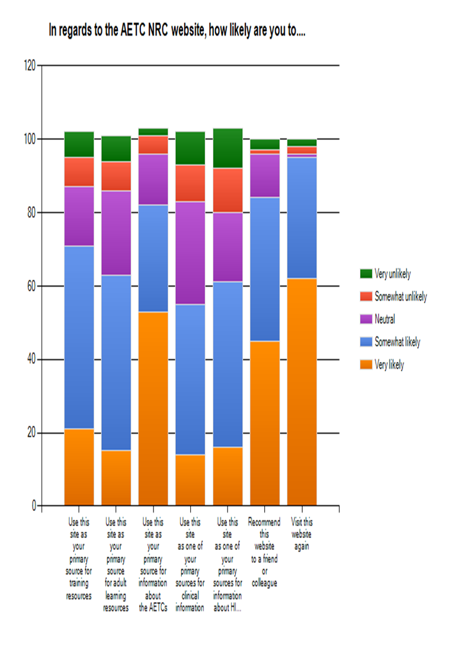
“At workshops/trainings where Wireless internet service is available, I have accessed the web site and highlighted certain attributes to participants, as well as used information as part of training. When I am able to show how easy it is to access the NRC website and navigate, I get the sense many of the participants are more likely to utilize it. Much more so than me just giving them the web address.”
“I hate to admit that I don't use the AETC NRC website. It's not something that ever comes up in my work, nor is it mentioned often in staff meetings etc. I should, and will, consult it more often.”
vs.

Slide 41
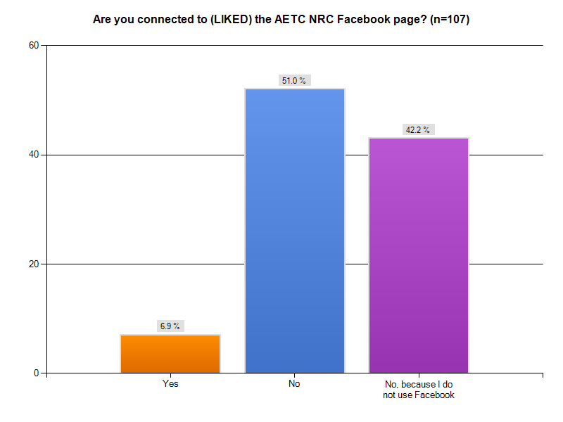
Social Media - Facebook
Insights Data….
September 1, 2011 – June 6, 2012 VS.
110 Likes
980 posts
3,678 page views

Slide 42
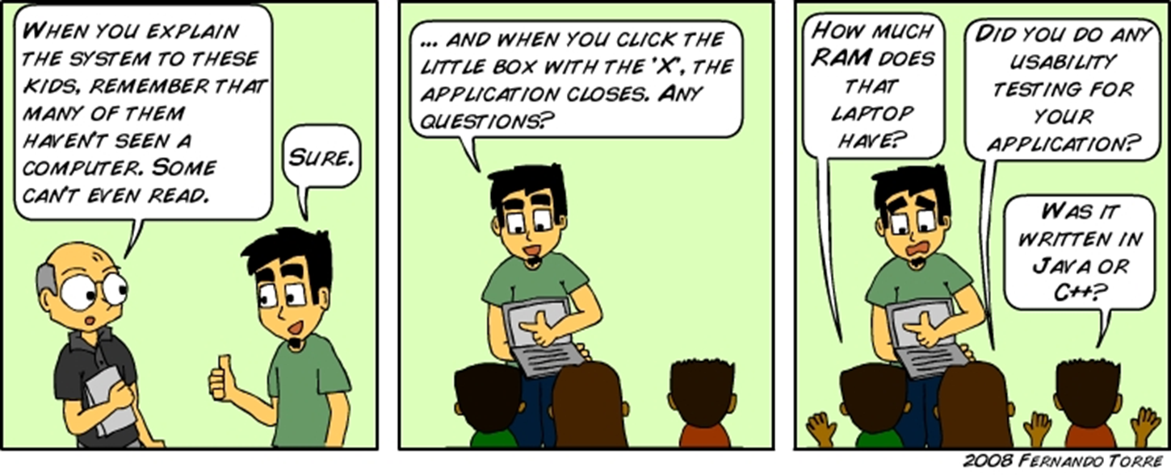

Example 2: Website Usability

Slide 43
What is it?
Why use it?
  To ensure that your website is:
    Easy to navigate
    Relevant to your audience
    Visually pleasing
  To ensure that your website users are:
    Able to complete tasks they came to the site to accomplish
  Quality assurance strategy used to test how people really use a website

Slide 44
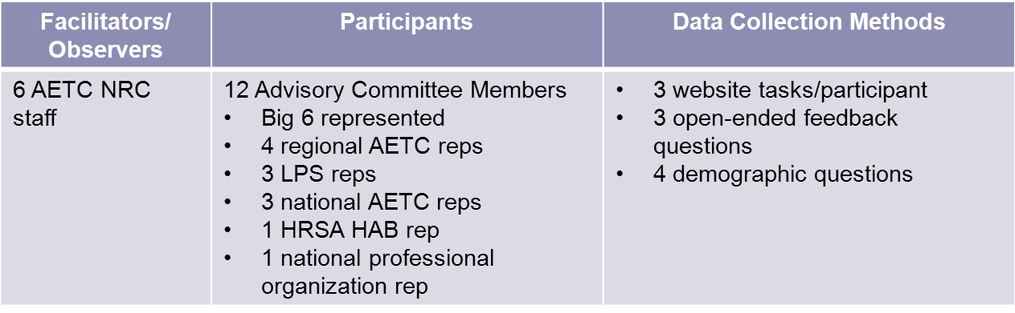
How did the AETC NRC use website usability testing?
  Implemented at in-person Advisory Committee Meeting in June 2011
  Tested website design for navigation and look

Slide 45
Timeline
Planning
Develop goals
Identify audience
Develop methods
Pilot test methods
Adjust methods
Arrange logistics
Recruit participants
Train facilitators
Implementation
Conduct testing
Log data
Enter data
Data Analysis & Action
Develop report
Prioritize changes
Implement changes
Consider re-testing

Slide 46
Methods
Allotted ~ 20 minutes with each person
Started with explanation of process (1 min)
Assigned 3 tasks (10 min)
  1 task for each major content area
  Tasks meant to be typical, not exceptional
  Tried to expose known weaknesses
Asked open-ended questions for general feedback (5 min)
Asked demographic questions (1 min)

Slide 47
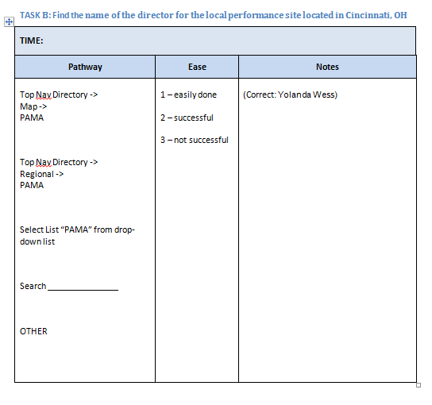
Note-taking

Slide 48
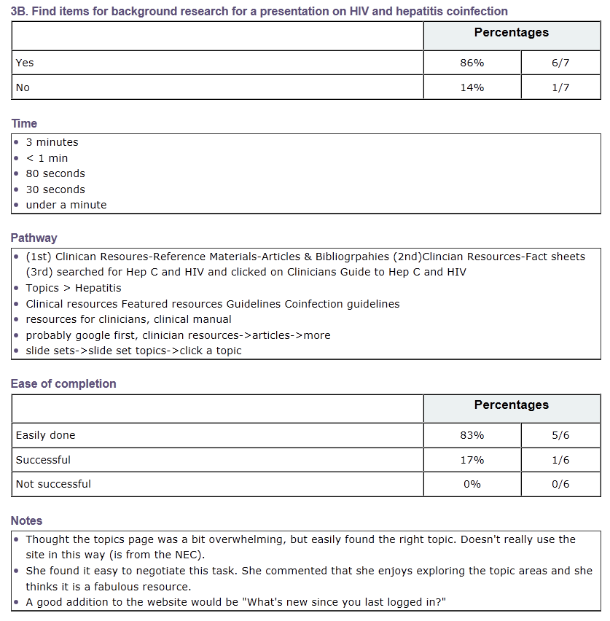
Reporting

Slide 49
What We Learned….
Most participants were familiar with the site, time to complete tasks varied from a few seconds to 10 minutes
Engaging & efficient way to assess website functionality
Adding the names of states served by each region would be helpful to website users
User pathways varied for given tasks so resources should be linked under multiple navigation options
Clinician & trainer resources listed as most important website function

Slide 50

Questions

Slide 51
Helpful Resources
HowTo.gov

Slide 52
THANK YOU!

