Slide 1
Coordinating Care Across Funded Providers to Support Retenion in Care: The In+Care Campaign in RI.
Aadia Rana, MD
Assistant Professor of Medicine
Dan Zarcizny, BA
Brian Montague, DO MS MPH
Assistant Professor of Medicine
Miriam Hospital
Alpert Medical School of Brown University
Ryan White 2012 Grantee Meeting, Washington DC. November 27-29, 2012

Slide 2
Outline
High risk groups and key messages
Aadia Rana, MD
Need for effective collaboration
Brian Montague, DO MS MPH
Small group discussion
Report Back
In+Care Campaign in RI: A Collaborative Process to Enhance Retention
Dan Zariczny, BA
Questions/Discussion

Slide 3
HIGH RISK Groups and Key Messages

Slide 4
The importance of engagement with HIV care
Individual¹⁻⁶
ART receipt and adherence^{1,2}
Immunological & virologic response
Survival benefit
Population⁷⁻¹⁰
Decrease in HIV transmission
Potential impact on racial and socioeconomic disparities
1.Berg MB et al. Nonadherence to medical appointments is associated with increased plasma HIV RNA and decreased CD4 cell counts in a community based HIV primary care clinic. AIDS Care. 2005;17(7):902–7.
2. Park WB et al.One-year adherence to clinic visits after HAART: a predictor of clinical progress in HIV patients. JIM. 2007;26(3):268–75.
3. Bani-Sadr F, et al.. Does early antiretroviral treatment prevent liver fibrosis in HIV/HCV-coinfected patients? JAIDS. 2009;50(2):234–6.
4.Mugavero MJ, et al. Early retention in HIV care and viral load suppression: implications for a test and treat. JAIDS 2012;59(1):86–93.
5. Giordano TP, et al. Retention in care: a challenge to survival with HIV infection. CID2007;44 (11):1493–9.
6. Mugavero MJ, et al. Missed visits and mortality among patients establishing initial outpatient HIV treatment. CID 2009;48(2):248–56.
7. Lohse, N., et al. "Survival of persons with and without HIV infection in Denmark, 1995-2005." Ann Intern Med 2007 146(2): 87-95.
8.Metsch LR, et al. HIV transmission risk behaviors among HIV-infected persons who are successful linked to care. CID2008;47(4):577–84.
9. Cohen MS, et al. Prevention of HIV-1 infection with early antiretroviral therapy. NEJM Aug 11 2011;365(6):493-505.
10. Moore, R. D. et al. "Improvement in the Health of HIV-Infected Persons in Care: Reducing Disparities." CID 55(9): 1242.

Slide 5
The “Blueprint”
Re-engagement in Care
Retention in Care
HIV Dx
Linkage to Care
ART Receipt
ART Adherence
Outcomes
Adapted from: Ulett et al AIDS Patient Care and STDs 2009; 23; Mugavero et al CID 2011 52 (S2)

Slide 6
HIV Treatment Adherence Cascade
75-77% Linked to care within 6 months of diagnosis
50% are in regular care
30-45% on ART
24-35% have supressed viral loads
Gardner et al, CID 2011; 52 (6): 793- 800
CDC MMWR 2011 December 2, 2011 / 60(47);1618-1623

Slide 7
Barriers to Care: Targeting individuals at risk for inconsistent engagement with medical care
Barrier | Example
Financial | Lack health insurance; unable to afford required medications/ devices/therapy/treatment; good health is a low priority because of competing needs and limited resources.
Logisitical/ system | Inconveniently located health care resources; transportation unavailable or difficult to obtain; conflicts with work; misinformation; lack of information
Cultural Barriers | Mistrust, stigma, alienation; health care providers lack cultural sensitivity; patient’s have different expectations and understandings of providers
Environmental Stressors | Physical and psychological stressors; living conditions; harsh environment/neighborhoods; sleep deprivation; lack social support
Personal | Health literacy, substance abuse, depression, medication side effects
Notes:
7

Slide 8
Who are high risk groups for loss to follow-up?
New diagnosis
Co-morbidities
Substance use
Mental Health Issues
Structural Issues:
Homeless/unstable housing
Transportation
Uninsured/underinsured
Recently incarcerated
Minorities
Non-English speaking
Stigma
Horstmann E, et al. Retaining HIV-infected patients in care: Where are we? Where do we go from here? CID. 2010 Mar1;50(5):752-61.

Slide 9
Retention Strategies
Strengths-based case management
Patient navigation
Transportation to medical appointments
Co-location of services (i.e., ancillary services and medical care)
Bilingual/bicultural health care team
Consistent reminder calls
Brief messages from health providers during medical visits
Posters and brochures in waiting rooms
Peers as part of the health care team
Text-messaging/mobile health

Slide 10
Sample Retention Strategies
Patient Navigation (SPNS) Initiative: >1100 patients involving more than 1100 patients who were inconsistently engaged in care.
The proportion of patients with at least 2 visits in the previous 6 months increased from 64% at baseline to 87% at 6 months and 79% at 12 months in the intervention group (reference).
The Antiretroviral Treatment and Access Study (ARTAS): multisite RCT comparing strengths-based case management w/passive referrals among patients w/recently diagnosed HIV infection
Up to 5 contacts within 90 days
Visit with HIV clinician at lease once within 6 months: 78% in intervention arm vs 60%
Visit with HIV clinician at 12 months: 64% in intervention arm vs 49% control
Cost: $599 per client, $3,993 per additional client linked beyond standard
Brief targeted messaging for retention via brochures
Pre/post intervention comparison using (1) print reminder materials, including brochures and examination and waiting room posters; and (2) brief verbal messages to be used by all clinic staff.
Overall relative improvement was 7.0% for keeping 2 consecutive visits and 3.0% for the mean proportion of all visits kept (P < .0001).
Bradford JB, et al HIV System Navigation: an emerging model to improve HIV care access. AIDS Pt Care and STDs 2007;.
Gardner LI, et al. Efficacy of a brief case mgmt intervention to link recently diagnosed HIV‐infected persons to care. AIDS 2005
Gardner LI, A Low-Effort, Clinic-Wide Intervention Improves Attendance for HIV Primary Care. CID Oct 2012

Slide 11
The need for effective Collaboration in efforts to address retention

Slide 12
Reaching Those Out of Care
Passive
Wait for follow-up and reinforce the message of the need to be in care
Typical
Add reminder phone calls and our letters for those missing visits
Can we do better?

Slide 13
Shared Investment in Retention
The ultimate goal of all providers is to maintain patients in care and on treatment
Patients may be served by multiple providers within a region, at times with overlapping scopes of service
The successes of one provider may improve the efficiency of service delivery for others

Slide 14
Cross Part Collaborative Concept
HRSA Sponsored Pilot Initiative
Goals: develop strengthened partnerships and communication strategies, statewide data collection systems, quality improvement priorities and projects and a unified statewide written cross-Part quality management (QM) plan
Five States: CT, NJ, PA, TX, VA followed by DC
http://nationalqualitycenter.org/index.cfm/5659

Slide 15
Goals of Collaboratives
Alignment - Strengthening statewide collaboration across all US federally funded HIV providers
Priority Setting - Shared quality improvement goals
Data Collection - Standardized data collection, reporting, and monitoring processes across the state
QI Projects - Statewide joint improvement project
Capacity Building - Capacity building activities for quality improvement statewide
Alignment - Strengthening statewide collaboration across all US federally funded HIV providers
Priority Setting - Shared quality improvement goals
Data Collection - Standardized data collection, reporting, and monitoring processes across the state
QI Projects - Statewide joint improvement project
Capacity Building - Capacity building activities for quality improvement statewide
Clemens Steinbock http://aidsetc.org/target/rw2010/papers/J-21.pdf

Slide 16
Where Are Patients In Care?
Needs/Contacts
Housing
Food
Social services
Mental health
Substance abuse tx
Urgent care
Primary Care
Specialty care
Hospitalizations
Corrections
Sites / Agencies
HOPWA, HUD
Food banks
DHS, Ryan White
Mental health centers, providers
Methadone clinics, other providers
Urgent care clinics, hospitals
General medical clinics, HIV providers
HIV providers, other specialists
Hospitals
Prisons, jails, community corrections
Patient
Between visits with providers, patients may contact the system at multiple points, each of which is a potential missed opportunity for reengagement

Slide 17
Who is Missing?
Medicaid
Private insurance based case management resources
Non-HIV care providers (including primary and specialty care)
Mental health centers
Hospitals
Corrections

Slide 18
Why Don’t We Work Together
Working in Silos
Service based reimbursement
Supporting activity of another agency may not be reportable and therefore reimbursable
Narrow vision, narrow goals
Indicators of success in HIV care reflect only a small portion of what is required to remain stably in care
Always having to do more with less (money, resources, time)
Turf battles

Slide 19
A Model for Coordinated Action
Medical Providers
Hospitalizations
Urgent care visits
Detox
Incarceration
Housing / homelessness
…
Clinical Status and Identified Needs
Social status and indicators of gaps in care or treatment
Other Service Providers
Referrals
ADAP, AIDS Service Organizations

Slide 20
Aligning Quality and Reporting
Making time to coordinate across providers requires enhancing efficiency in other domains
Key first step is aligning reporting measures with quality metrics
Establish common indicators across programs
Align state requirements with HRSA requirements
Establish standards for communication between providers that minimize need for reprocessing of data for reporting

Slide 21
Small Group Discussions
Which groups represent the most important targets for retention and what are the key messages that need to be given?
What is needed to make a successful collaborative?
How can we engage consumers as part of retention activities?

Slide 22
Report back

Slide 23
Rhode Island Initiative
Community groups assembled as part of Part B funded statewide quality initiative (2010-2011)
Goals:
formalize standards of care for part B funded providers
establish common set of quality indicators
In+Care Campaign offered potential for a initial cross-parts quality initiative
Part C (medical providers)
Part B (medical providers, case management, housing, other support services)

Slide 24
In+Care Campaign in RI: A Collaborative Process to Enhance Retention

Slide 25
In+Care Campaign
National campaign sponsored by the National Quality Center
Identified 4 common retention measures
529 providers participating serving 445,475
Key methods:
Establish common framework for assessing retention
Common messaging for providers and consumers regarding importance of retention in care
Support intervention through coaching, indentification of champions and establishment of community action groups

Slide 26
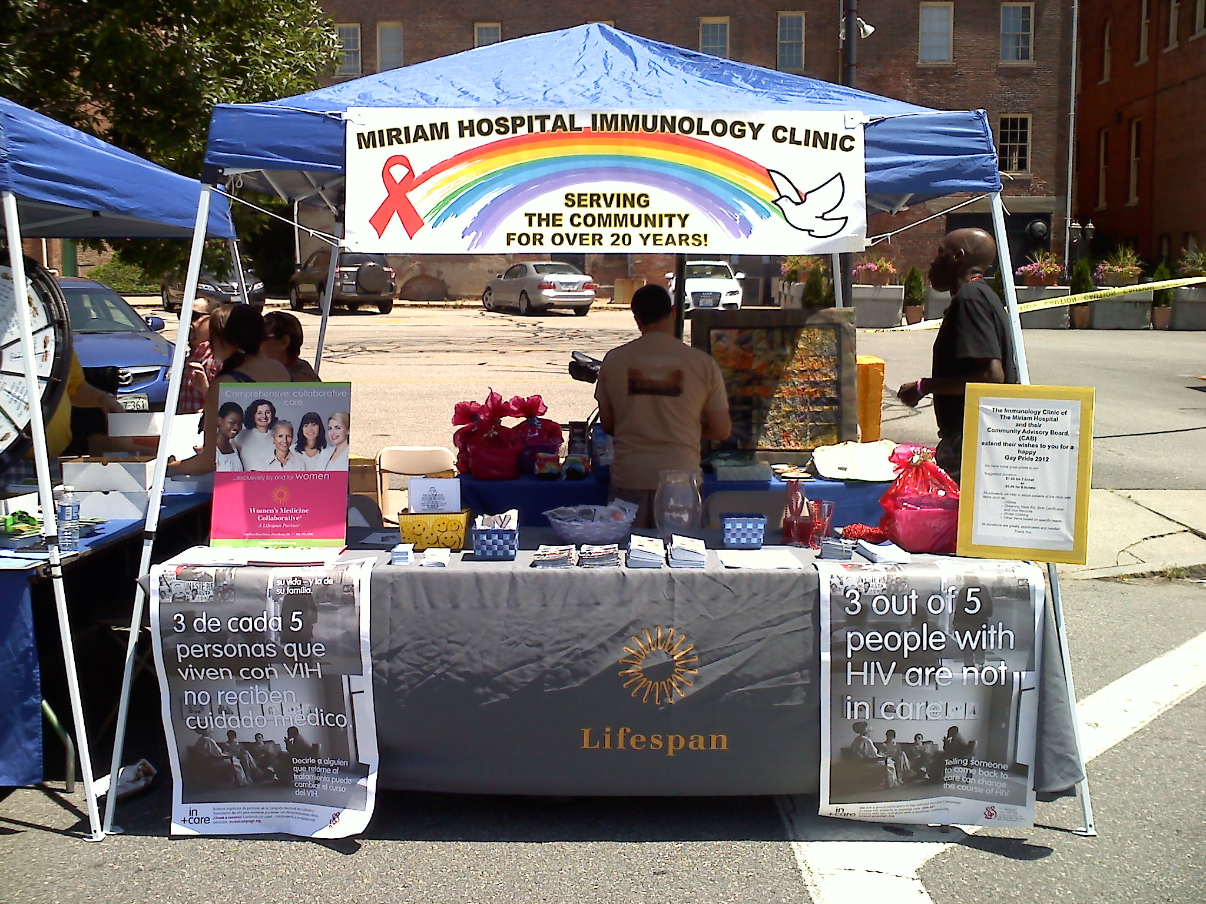

Slide 27
The In Care Campaign Measures
Gaps in care
Persons with visit in first 6m with no visit in last 6m of year
Medical visit frequency
At least one visit in each 6m period over 24 m (at least 60 days apart
Patients newly enrolled in medical care
Newly enrolled patients with visits in each 4m period over 12m
Viral load suppression
Proportion of persons with viral load < 200 (among all persons with at least 1 visit)

Slide 28
Retention Activities in RI
Baseline
Prior to In Care campaign, clinic staff called patients out of care twice a year
In+Care Campaign
Focus on viral load suppression
Lists generated by Ryan White data specialist
New retention team consisting of MD, adherence RN, social workers and case manager addressing lists
Structured process for communicating with Ryan White Part B case managers

Slide 29
Background of Patients Out of Care
In care elsewhere
Socioeconomic barriers
Homeless
Lost insurance/underinsured
Busy with job (s)/working
Mental health, health beliefs
Not ready to deal with diagnosis
Contradicting religious beliefs “God will cure me”
Dual diagnosis of mental health
Substance use
Other barriers
Medication side effects

Slide 30
Establishing Priority Outreach Targets
1 – Viral load not decreasing, no MD appt pending (13)
2 – Unknown viral load, no pending appt (21)
3 – Viral load not decreasing, appt pending (21)
4 – Unknown viral load and pending appt (10)
5 - Viral load decreasing but no MD appt pending (7)
6 – Viral load decreasing and MD appt pending (22)

Slide 31
Strategies
Identification of persons with outside case management support
Monthly review of retention list with part B providers
Case managers asked to make extra effort performing outreach
Effort offset by regularizing communication of clinical data needed for Ryan White part B reporting

Slide 32
Strategies
Outreach made to patients with pending appointments/”hovering” out of care
Contact attempts with remaining patients to coordinate new appointments/assess social or financial barriers to care
Coverage referrals/strategies for lost insurance or underinsured

Slide 33
Community Partners
Ryan White Part B AIDS Service Organizations (ASOS)
Ryan White Part B corrections linkage team “Project Bridge”
Dept of Health outreach
Street worker outreach programs
Mental health agencies
Clinical trials coordinators

Slide 34
Key Interventions
Clinic retention group meets biweekly to discuss complicated cases/issues
Referrals made as needed to AIDS Service organizations
Case managers encouraged to attend MD appointment for support and collaboration
Barriers to care identified on biannual part B case management medical evaluations
Clinic staff presence at part B program staff meetings to review retention list and discuss barriers to care

Slide 35
Consumer Involvement
Clinic Consumer Advisory Board (CAB) -monthly input and feedback
Outreach made at community events by consumers
Clinic CAB newsletter featured resources available to support retention
Exploring potential for development of a peer support/navigator program

Slide 36
Initial Success: Gaps in Care

Slide 37
Lessons Learned/Challenges
Data cleaning is ongoing challenge
Need to identify all available resources at time of new patient intake
Often patients lost to follow up with clinic are also lost to follow up with community partners
Not every patient on list in need of intervention
Ryan White funding mechanism may create disincentives for agencies to take on clients with greatest need

Slide 38
Next Steps
Introduction of acuity scales as means to guide prioritization for outreach and case management
Development of care plan framework for retention activities
Work with the state to address service gaps and disincentives
Continue to develop strategies for consumer input

Slide 39
Questions?
Acknowledgements:
Ryan White Part C: Kimberly R. Hudgens, MSHCA, MBA
RI Department of Health: Bill Lyman, Toshoua Xiong, Paul Loberti
AIDS Care Ocean State
AIDS Project Rhode Island
Agape
National Quality Center In+Care team

