Slide 1
The Elite Society of the Undetectables
Ryan White 2012 Grantee Meeting
Navigating A New Era In CARE
Washington, DC
November 28, 2012

Slide 2
Presenters
Jessica Cole Founder of The Elite Society of the Undetectables
Hermeyone Wilson APRN, BC, AACRN Nurse Practitioner
Necala Penn Chairperson of The Elite Society of the Undetectables

Slide 3
Agenda
History of the program
Jessica Cole
Public & Private Partnership: Clinical Benefits
Hermeyone Wilson
Role of Peer Network
Necala Penn

Slide 4
Who Are We?
The Elite Society of the Undetectables is a Continuous Quality Improvement Program that Celebrates Life & Success through Motivation, Compensation, and Sustainability.

Slide 5
Who Are We?
ELITE: The Best or Most Skilled Member of a Group
E – Eloquent
L – Laureate
I – Intelligent
T – Tribute
E – Embrace

Slide 6
What are our Objectives
1. To provide alternative patient-centered services designed to address and enhance the quality of medical care members receive, the quality of life members live, and the quality of interaction members have with the community at large.
National HIV/AIDS Strategy Reduce HIV Incidence rate

Slide 7
What are Our Objectives?
2. To partner with the public and private sectors to enhance and extend services provided to the members.
National HIV/AIDS Strategy Improve Health Outcomes

Slide 8
What are Our Objectives?
3. To encourage retention and recruitment to medical care through motivational coaching, peer-to-peer networking, and community outreach events.
National HIV/AIDS Strategy Reducing HIV related Health Disparities

Slide 9
The Start of The Elite Society
History
Purpose
Demographics
Undetectable rates

Slide 10
Timeline
August 2009: Georgian Terrance, 85 members – 1st Anniversary
Providers received recognition from patients. First time ever done.
Founded in 2008 by Medical Staff of the Joye Bradley Health Services Clinic at AID Atlanta
December 2008 :
W Hotel, 45 members-
Adherence
April 2009:
Georgian Terrance
75 members – What is
Undetectable?
August 2008: Taurus Restaurant, 25 members – Understanding your labs – Sponsor Gilead

Slide 11
Timeline
December 2009 – Georgian Terrance
95 members –
Celebrate Health
August 2010: Georgian Terrance, 110 members – 2nd Anniversary
April 2010:
Georgian Terrance,
100 members – Overall
Health
December 2010:
Georgian Terrance, 163 members –
Providers Relations
Notes:
Have extra August 2009 bullet. Is on previous slide

Slide 12
Timeline
April 2011 –
Georgian Terrance
115 members –
Celebrate Health
December 2011:
Georgian Terrance,
180 members –
Christmas Celebration
August 2011:
Georgian Terrance,
165 members – Overall
Health
April 2012:
Georgian Terrance,
185 members – Spring Fling

Slide 13
Elite Facts
Currently have 492 enrolled members
354 (72%) are undetectable
30 have decreased viral loads within the last year
April 2011 – Georgian Terrance 143 members –
Now that I’m Undetectable, What next?
August 20, 2011- Providers invited
December 17, 2011- Christmas Celebration

Slide 14
Public & Private Partnership
Private Doctors
Linkage
Community Viral Load
Member Recognized Providers
Community Partners

Slide 15
Sponsors

Slide 16
Role of Peer Network
What Membership Means to Me
Importance of staying connected to ESU
How ESU improved my Adherence and
Retention
Where I am now
Member Board & Fund Raiser

Slide 17
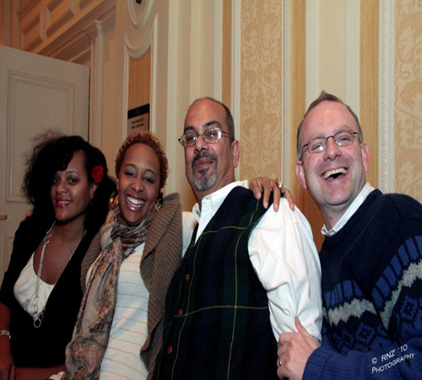
Moving Forward
Challenges
Chapters
Data
Registration

Slide 18
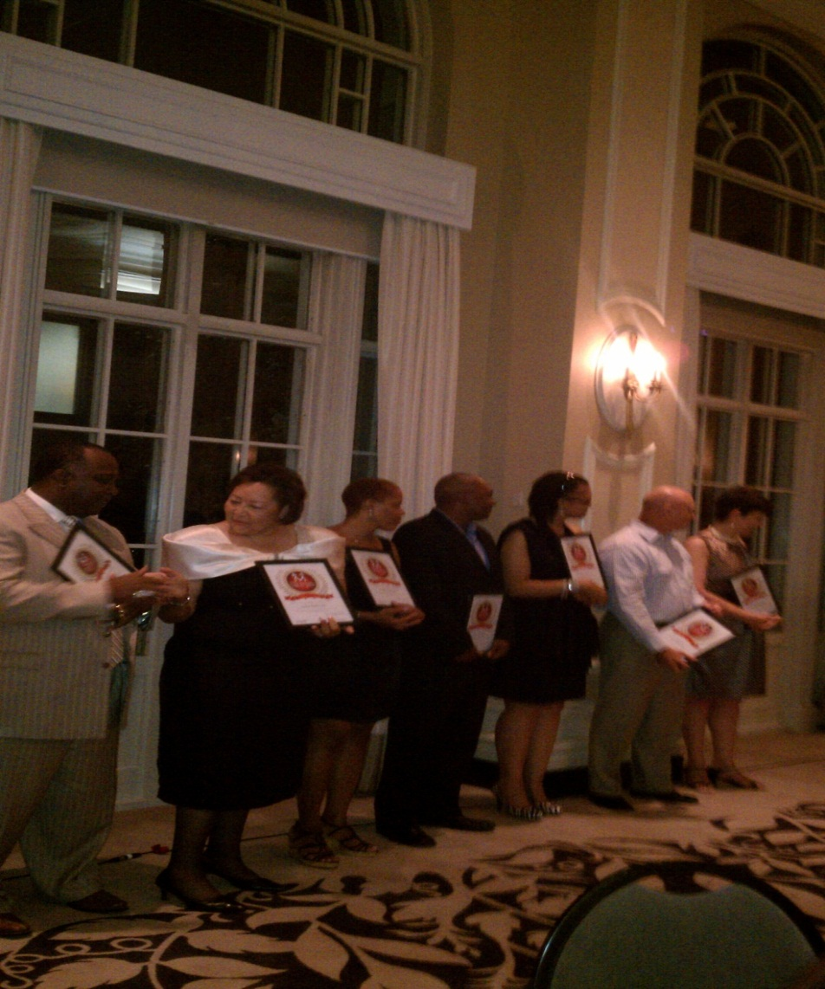
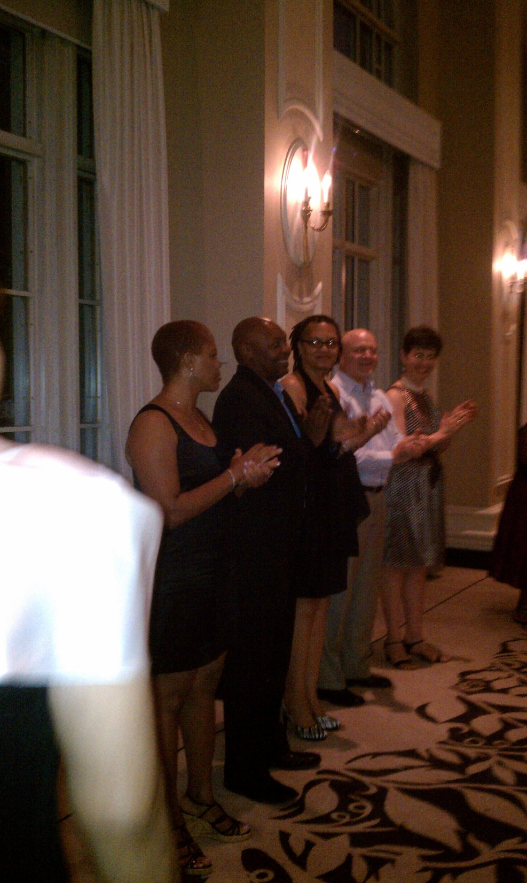

Slide 19
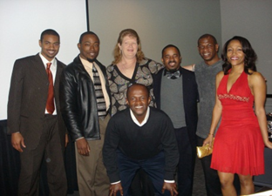
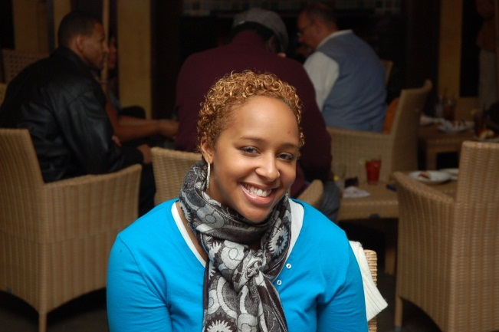
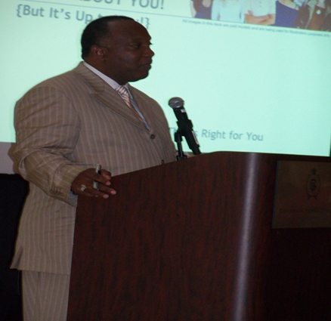
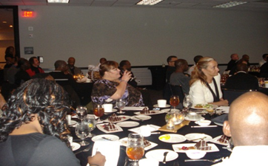
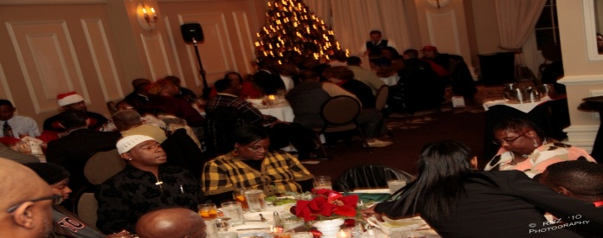
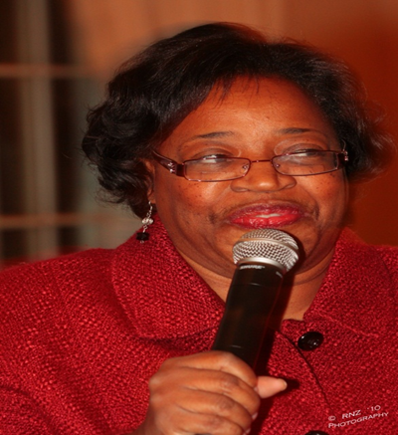
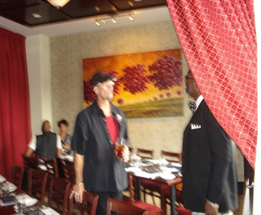

Slide 20
You Make The Difference
Ms. Jessica:
Thanks for the human filled event of the Elite Society of the Undectables on this past Saturday.
The program was wonderful and the speaker was superb in her interacting with the audience.
A new Elite Society Member
Assisting Those Wishing & Wanting to Help Themselves
Subject: THANKS FOR THE SPIRIT, MEDICAL & SOCIAL FILLED EVENT

Slide 21
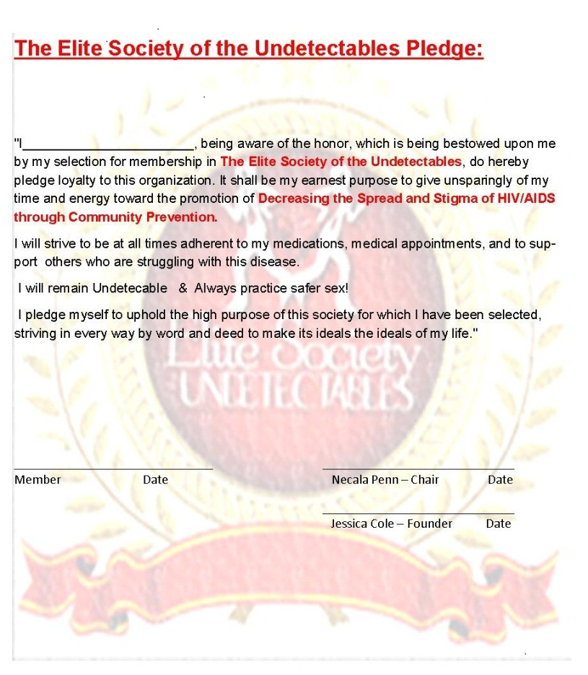
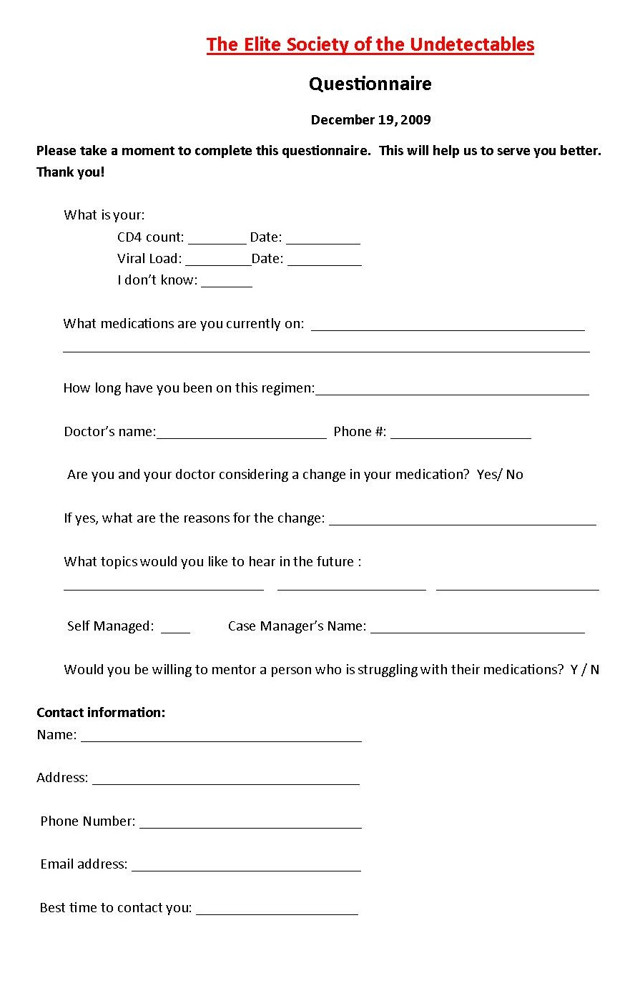
ESU Documents

Slide 24
The Elite Society of the Undetectables
678.637.5832

