Slide 1
Designing robust, capacity-building outreach networks through technology
Christian B. Ramers, MD, MPH – PAETC HIV Learning Network
Kent Unruh, PhD - NW AETC ECHO – University of Washington
Karla Thornton, MD, MPH - Project ECHO – University of New Mexico
Presentation prepared by: Christian Ramers, MD, MPH, Kent Unruh, PhD, and Karla Thornton, MD
Last Updated: October 14, 2012
Notes:
Introduce co-presenters:
Karla Thornton – Professor of Medicine – Associate Director of Project ECHO (experience in ECHO for HIV and HCV)
Kent Unruh – PhD Informatics – Hard to come up with a title…program manger of ECHO at UW in multiple domains, and my right hand when setting up NW AETC ECHO
Implicit in this is the notion of ‘turning outward’ (UW, NWAETC, RW part C clinic) to serve community as center of excellence
- Often hear of Academic Medical Centers as being ‘three legged stool: Research, Education, Service’
“Listen with an active ear, thinking about your own activities and how this model might enhance your trainings”

Slide 2
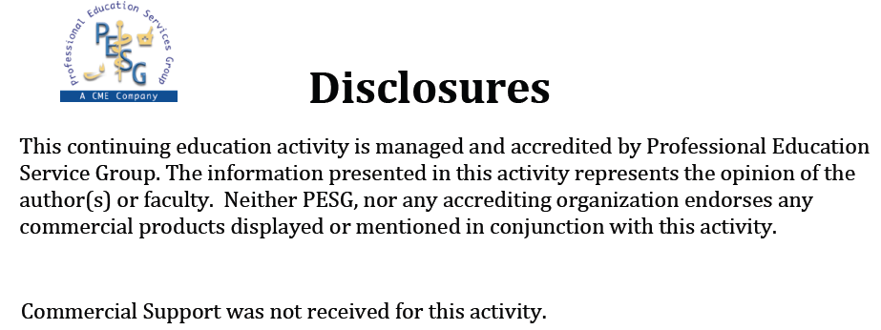
Learning Objectives
NW AETC ECHO Telehealth Program

Slide 3
Disclosures (cont)
NW AETC ECHO Telehealth Program
Kent Unruh, PhD and Karla Thornton, MD, MPH
  Have no financial interest or relationships to disclose
Christian Ramers, MD, MPH
  Consultant/advisory board member: Gilead Sciences
  Speaker’s Bureau: Gilead Sciences
CME Staff Disclosures:
  Professional Education Services Group staff have no financial interest or relationship to disclose.

Slide 4
Learning Objectives
NW AETC ECHO Telehealth Program
At the conclusion of this activity, the participant will be able to:
Distinguish telehealth from telemedicine by efficiency, resource (re)distribution, workforce development and capacity-building
Describe components of the Project ECHO model that utilizes didactics, case consultations and learning loops to build knowledge networks of multi-disciplinary HIV clinicians across geography
Articulate practical steps to plan, implement, and deploy an HIV or HCV-focused telehealth program in one’s local region

Slide 5
Outline
Differentiating ECHO
  Definitions, theoretical framework and justification
The ECHO Model in Depth
  Origins in HCV treatment
Using ECHO to build HIV Capacity
  Illustrative video clips from NW AETC ECHO sessions
Nuts and Bolts
  Planning & Implementation of a Telehealth Program
  Lessons Learned
Notes:
Great Agenda:
Kent Unruh will set the theoretical framework for adult learning and why the ECHO model works so well
Karla Thornton will describe the roots and the history of the ECHO project in New Mexico
Unique opportunity to invite you into an ECHO session – illustrative video clips to show you how it works
Implementation – How to actually make it happen (lessons learned)

Slide 6
Differentiating ECHO
NW AETC ECHO Telehealth Program
Definitions, Theoretical Framework & Justification

Slide 7
Problem
NW AETC ECHO Telehealth Program
Unequal distribution of specialty care
  Concentration of expertise
  Complex diseases that require management over time
  Science is changing
Traditional telemedicine model broken
  Introduces inefficiencies
  Provides de-contextualized expertise
  Lacks capacity building component
Traditional tele-education model broken
  Built on transactional model of learning
  Lacks ‘situated learning’ (biomedically & culturally)

Slide 8
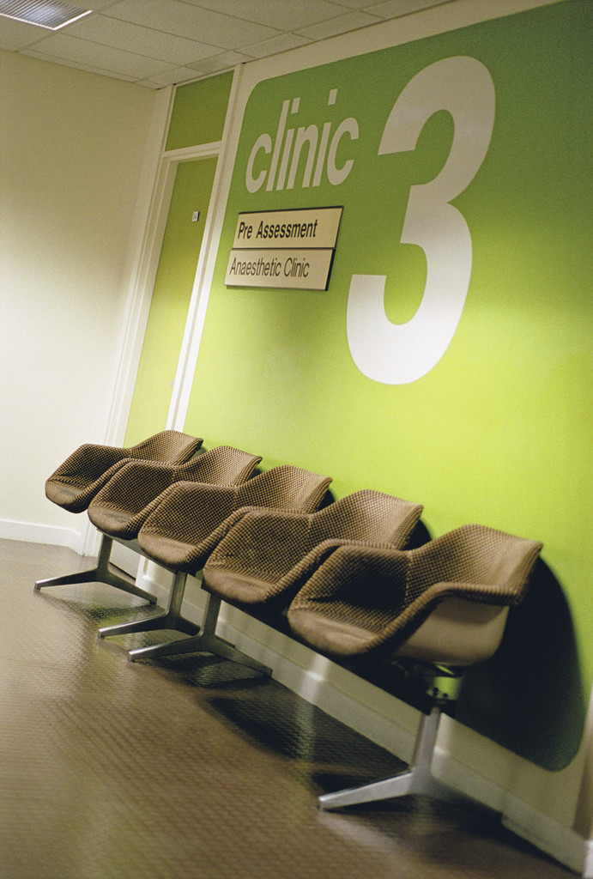

Training is not enough…
Trainings don’t implement in clinic
  Straightforward to take a training
  Challenging to implement
  “Now that I’m back, now what?”
Questions emerge in practice
  Situated support is required
  Collective problem solving is required
Strategy exchange essential
  Clinicians learn over time
…because medicine > protocols
Notes:
If there is time, it’s nice to start with the theoretical basis of why ‘traditional training’ isn’t enough.
Caution with the first point, because it challenges the paradigm that the 2 hour classroom training actually works.

Slide 9
Deployed in Field
Notes:
Very lonely little man meant to depict a newly graduated primary care (FP, IM, etc) provider who is now confronted with high volume and highly complex patients.

Slide 10
Deployed in Field
Notes:
Here come the patients!!! Also notice that this young clinician doesn’t have any colleagues around for bouncing ideas off of, no collegiality, no continuing education except in rare CME opportunities, etc.
In-person training is a start
Webinar is better (easier to attend and overcome distance)
Integrated distance learning is the best

Slide 11
NW AETC ECHO Telehealth Program
Distinguish Telehealth from
Traditional Telemedicine

Slide 12
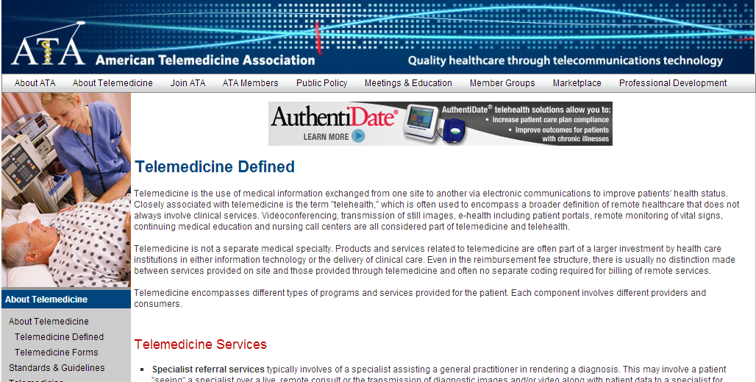
Telehealth & Telemedicine Often Conflated
NW AETC ECHO Telehealth Program
While the term telehealth is sometimes used to refer to a broader definition of remote healthcare that does not always involve clinical services, ATA uses the terms in the same way one would refer to medicine or health in the common vernacular
Telemedicine Defined. American Telemedicine Association. http://www.americantelemed.org/i4a/pages/index.cfm?pageid=3333 [Accessed 9.1.12].

Slide 13
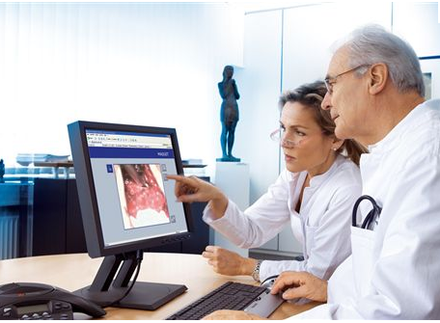
Telemedicine is
NW AETC ECHO Telehealth Program
The use of audio, video and other telecommunications and electronic information processing technologies to provide health services or assist healthcare personnel at a distance.
Committee on Evaluating Clinical Applications of Telemedicine, Institute of Medicine. "FRONT MATTER." Telemedicine: A Guide to Assessing Telecommunications for Health Care. Washington, DC: The National Academies Press, 1996.

Slide 14

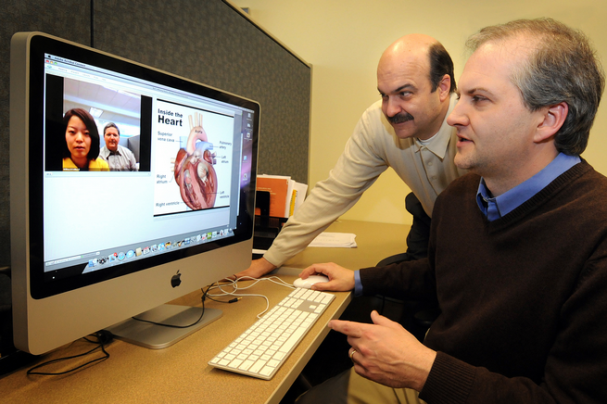
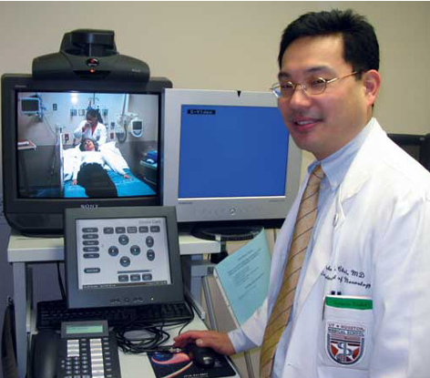
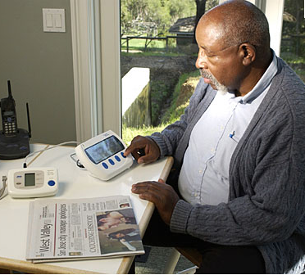
Examples of Telemedicine
NW AETC ECHO Telehealth Program

Slide 15
Telehealth
NW AETC ECHO Telehealth Program
Closely associated with telemedicine is the term "telehealth," which is often used to encompass a broader definition of remote healthcare that does not always involve clinical services.
Case Conferences
Distance Medical Education
Clinician Collaboration & Consultation
Coordinated Care Services
Telemedicine Defined. American Telemedicine Association. http://www.americantelemed.org/i4a/pages/index.cfm?pageid=3333 [Accessed 9.1.12].

Slide 16
NW AETC ECHO Telehealth Program
ECHO as an Efficient Form of Telehealth

Slide 17
Integrated Learning + Clinical Support
Infectious Disease
Theoretical Base
Situated Learning Theory
Structure
1x per week VTC
Clinical update
Case Consultation
Practical Benefits
Just-in-time support
Interdisciplinary
Consultation
Psychiatry
Community
Clinician
Addictions
Hepatology

Slide 18
Integrated Learning + Clinical Support
Infectious Disease
Psychiatry
Community
Clinician
Addictions
Hepatology

Slide 19
Knowledge Network
Interactive learning environment
Infectious Disease
Psychiatry
Hepatology
Addictions

Slide 20
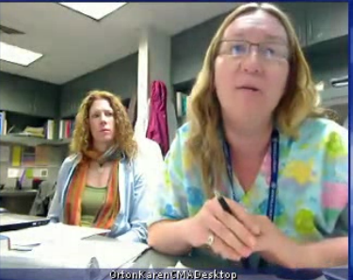
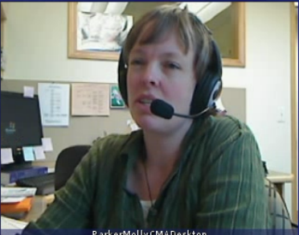
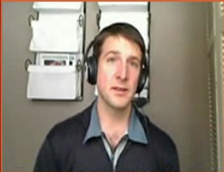
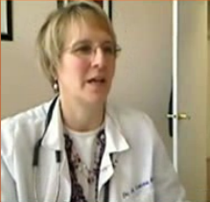
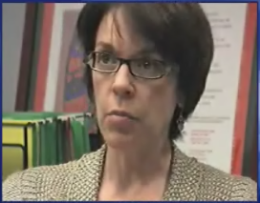
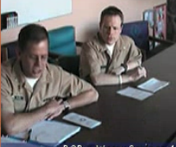
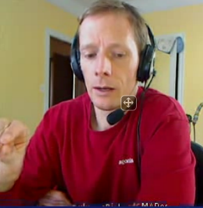
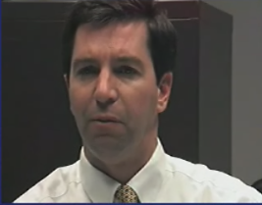
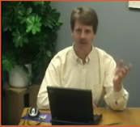
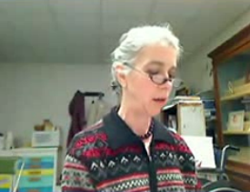
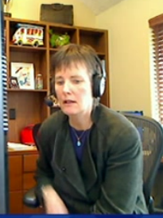
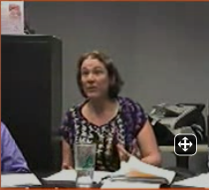
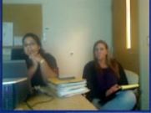
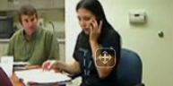
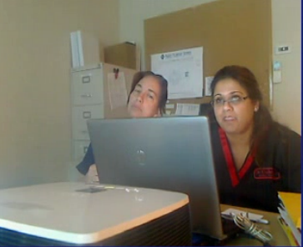
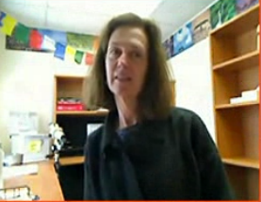
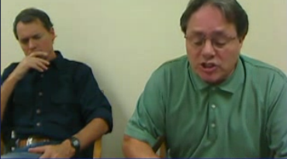
Hepatology
Infectious Dis.
Addictions
Psychiatry

Slide 21
Infectious Dis.
Addictions
Hepatology
Psychiatry

Slide 22
Hepatology
Infectious Dis.
Addictions
Psychiatry

Slide 23
Hepatology
Addictions
Infectious Disease
Psychiatry

Slide 24
Hepatology
Infectious Dis.
Addictions
Psychiatry

Slide 25
Hepatology
Infectious Dis.
Psychiatry
Addictions
Addictions

Slide 26
Psychiatry
Hepatology
Infectious Dis.
Addictions
Addictions

Slide 27
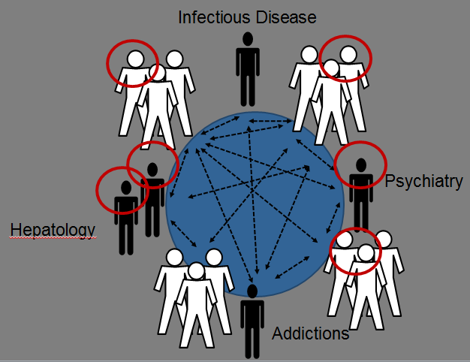
Shift away from
1-1, isolated consultations
Shift towards teams in
interactive learning environment
engaged in collaborative problem solving, over time

Slide 28
Force Multiplier Effect
Patient Cases Presented to ECHO
Additional Patients in Practice Managed
w/o Consultation
Trained Clinician
Trained Clinician
Notes:
Example that bounces around the circle…in the end, what is created is a knowledge network with a fluid exchange of ideas…except

Slide 29
ECHO vs. Telemedicine
Patients Reached with Specialty Knowledge & Expertise
Specialist Supports Community-Based Clinician
Echo
Telehealth
Traditional
Telemedicine
Specialist Manages Patient Remotely

Slide 30

The ECHO Model
Karla Thornton, MD, MPH
Professor of Medicine (Infectious Diseases)
Associate Director of Project ECHO
Department of Medicine
University of New Mexico Health Sciences Center
kthornton@salud.unm.edu

Slide 31

Mission
The mission of Project ECHO™ (Extension for Community Healthcare Outcomes) is to develop the capacity to safely and effectively treat chronic, common and complex diseases in rural and underserved areas and to monitor outcomes.
Supported by New Mexico Dept of Health, New Mexico Medicaid, Agency for Healthcare Research and Quality, New Mexico Legislature, Robert Wood Johnson Foundation

Slide 32
Hepatitis C in New Mexico
Number HCV cases 30,000
In 2004 less than 5% had been treated
2400 prisoners diagnosed in corrections system– none treated before 2004
Highest rate of chronic liver disease/cirrhosis deaths in the nation

Slide 33
Health Care in New Mexico
20% of healthcare providers practice in rural or
frontier areas
New Mexico Physician Survey 2001

Slide 34
Hepatitis C Treatment
Good News:
It is curable in 70-80 % of cases
Bad News:
Severe side effects-
Anemia - 100%
Neutropenia - >35%
Depression - >25%

Slide 35
Goals
Develop capacity to safely and effectively treat HCV in all areas of New Mexico and to monitor outcomes
Develop a model to treat complex diseases in rural and underserved locations and developing countries

Slide 36
Partners
University of New Mexico School of Medicine: Departments of Internal Medicine, Telemedicine and CME
NM Department of Corrections
NM Department of Health
Indian Health Service
Community Clinicians with an interest in HCV
Primary Care Association

Slide 37
Method
Use Technology (multipoint videconferencing and internet) to leverage scarce healthcare resources
Case based learning: Co-management of patients with specialists (Learning by Doing)
Disease Management Model focused on improving outcomes by reducing variation in processes of care and sharing “best practices”
HIPAA compliant centralized database to monitor outcomes
Arora S, Geppert CM, Kalishman S, et al: Acad Med. 2007 Feb;82(2): 154-60.

Slide 38
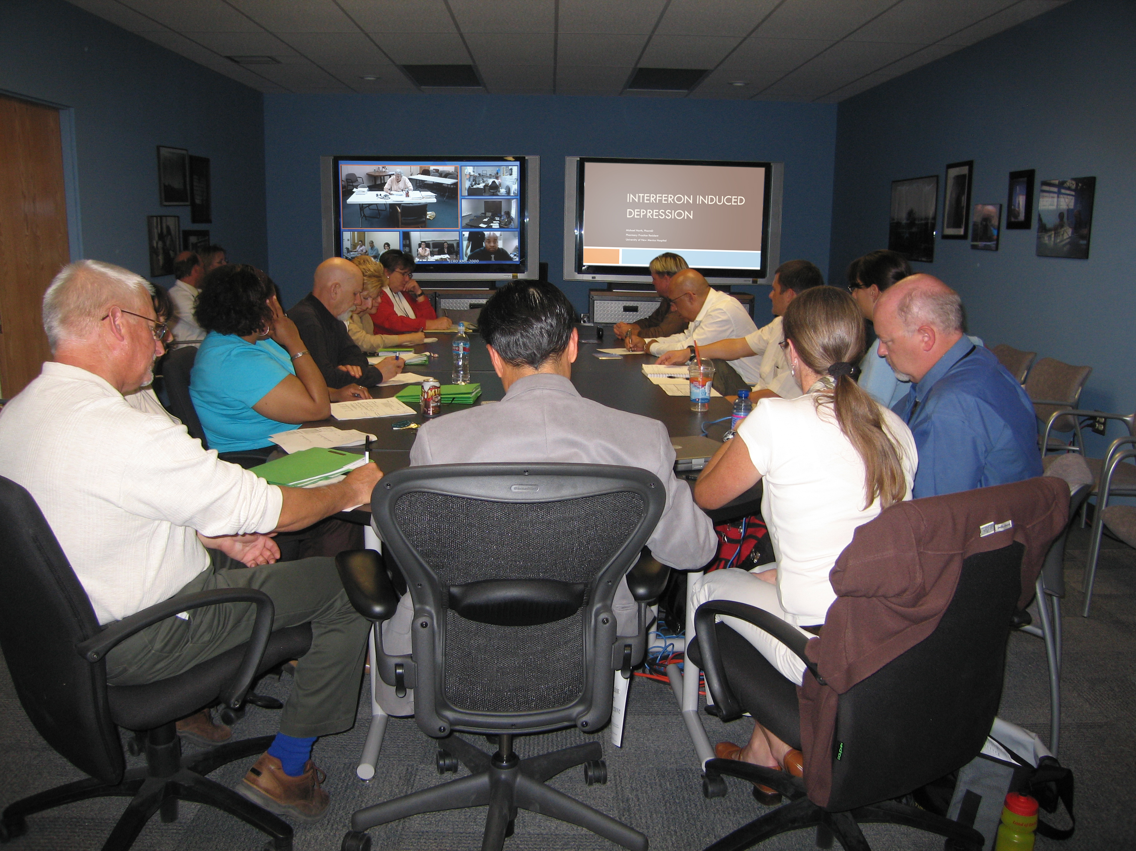

Slide 39
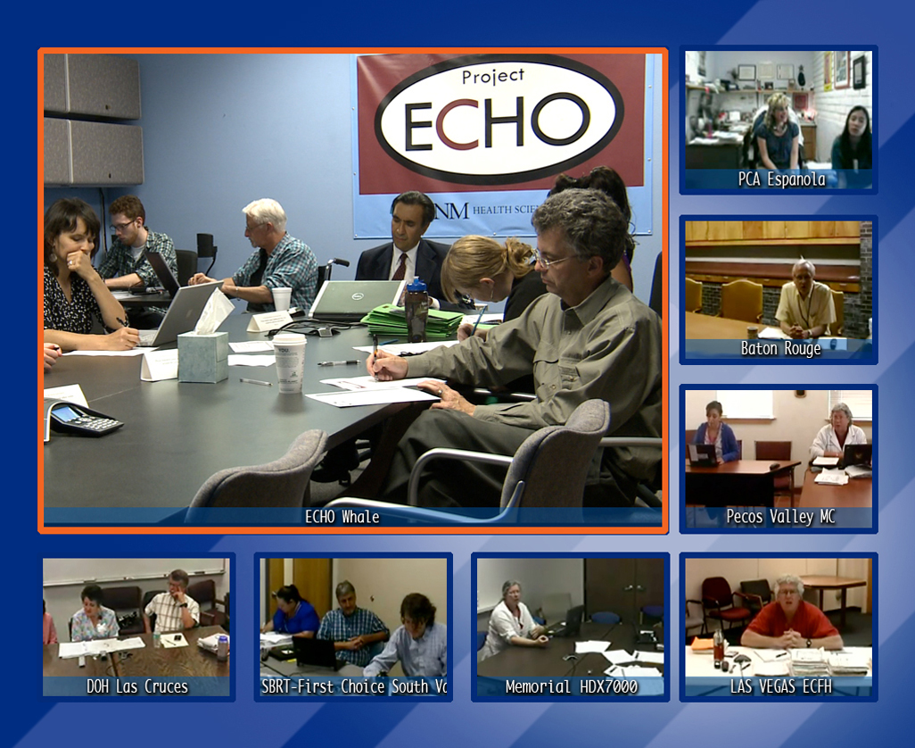

Slide 40
Disease Management Model
Algorithms
Checklists
Process
Wisdom based on experience

Slide 41
Steps
Train physicians, mid-levels, nurses, pharmacists, educators in HCV
Conduct telemedicine clinics – “Knowledge Network”
Initiate co-management – “Learning loops”
Collect data and monitor outcomes centrally

Slide 42
A Knowledge Network is Needed
Increasing Gap
Medical Knowledge
Learning Capacity
Time
“Expanding the Definition of Underserved Population”

Slide 43
How well has the model worked for HCV?
> 500 HCV Telehealth ECHO Clinics conducted
> 5000 patients entered into HCV disease management program
> 300 prisoners treated in the DOC
> 6,000 CME/CE hours issued to clinicians

Slide 44
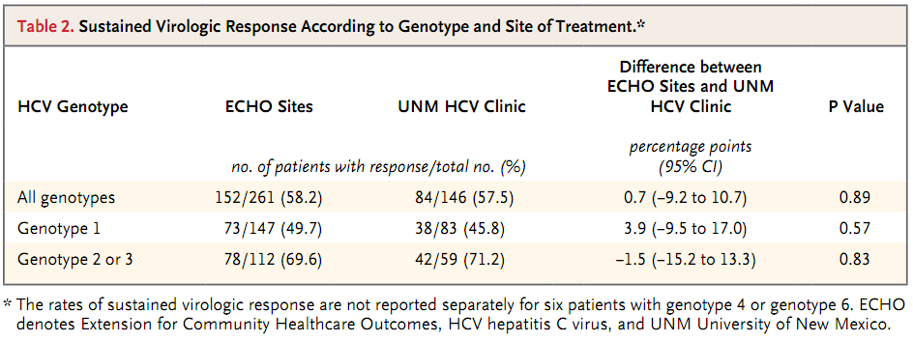
Evidence Supporting Telehealth
* More minorities treated in ECHO group
Arora S, Thornton K et al N Engl J Med 2011; 364:2199-2207

Slide 45
Project ECHO Clinicians HCV Knowledge, Skills and Self-Efficacy
Community Clinicians n=25 | Before Participation Mean (SD) | Today Mean (SD) | Paired Difference Mean (SD) (p-value) | Effect Size for the Change
1. Ability to identify suitable candidates for the treatment of HCV. | 2.8 (1.2) | 5.6 (0.8) | 2.8 (1.2) (<0.0001) | 2.4
2. Ability to assess severity of liver disease in patients with Hepatitis C. | 3.2 (1.2) | 5.5 (0.9) | 2.3 (1.1) (<0.0001) | 2.1
3. Ability to treat HCV patients and manage side effects. | 2.0 (1.1) | 5.2 (0.8) | 3.2 (1.2) (<0.0001) | 2.6
scale: 1 = none or no skill at all 7= expert-can teach others
Arora S, Kalishman S, Thornton K, et al. Hepatology. 2010 Sept; 52(3):1124-33.

Slide 46
Project ECHO Clinicians HCV Knowledge, Skills and Self-Efficacy
Community Clinicians n=25 | Before Participation Mean (SD) | Today Mean (SD) | Paired Difference Mean (SD) (p-value) | Effect Size for the Change
4. Ability to assess and manage psychiatric co-morbidities in patients with Hepatitis C. | 2.6 (1.2) | 5.1 (1.0) | 2.4 (1.3) (<0.0001) | 1.9
5. Serve as local consultant within my clinic and in my area for HCV questions and issues. | 2.4 (1.2) | 5.6 (0.9) | 3.3 (1.2) (<0.0001) | 2.8
6. Ability to educate and motivate HCV patients. | 3.0 (1.1) | 5.7 (0.6) | 2.7 (1.1) (<0.0001) | 2.4
scale: 1 = none or no skill at all 7= expert-can teach others
Arora S, Kalishman S, Thornton K, et al. Hepatology. 2010 Sept; 52(3):1124-33

Slide 47
Benefits to Clinicians
Diminishes professional isolation
Enhances professional satisfaction
No-cost CMEs and Nursing CEUs
A mix of work and learning
Access to specialty consultation with GI, hepatology, psychiatry, infectious diseases, addiction specialist, pharmacist, patient educator
Arora S, Thornton K, et al. Hepatology. 2010 Sept; 52(3):1124-33.

Slide 48
Replication Sites
University of Washington - HCV, Chronic Pain, Substance Use, HIV
University of Chicago - Hypertension
Harvard - Beth Israel Deaconess - HCV
Veterans Administration Hospitals
University of Utah - HCV
Department of Defense - Chronic Pain
India - HIV, HCV, Autism
Brazil -Viral Hepatitis

Slide 49
Use of telemedicine, best practice protocols,
co-management of patients with case based learning (the ECHO model) is a robust method to safely and effectively treat chronic, common and complex diseases in rural and underserved areas and to monitor outcomes.
Supported by NM Dept of Health, Agency for Health Research and Quality HIT grant 1 UC1 HS015135-04, and MRISP, R24HS16510-02 and the New Mexico Legislature, Robert Wood Johnson Foundation

Slide 50
Using ECHO to Build HIV Capacity
Illustrative Video Vignettes

Slide 51
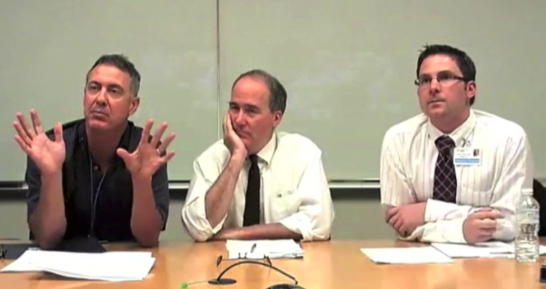
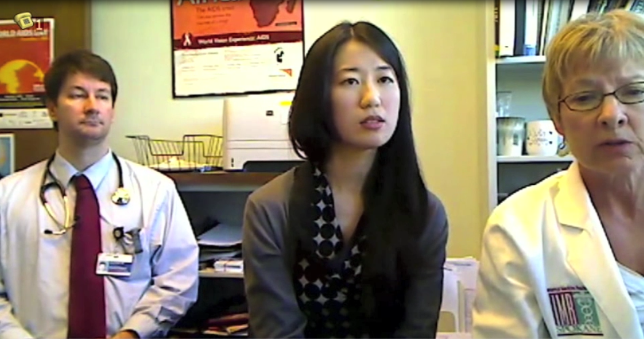
Example 1 - New Diagnosis
Grief Counseling Techniques
Disclosure Counseling
List of Online/Offline Support Groups
Differential Diagnosis Checklist
Treatment Options for Diagnostic Scenarios
Comprehensive
Resource Packet

Slide 52
Example 2 – Knowledge Network
Infectious Disease
Detailed co-management
Proactive
peer learning
Psychiatry
Pharmacy
Case Management

Slide 53
Example 3 – Knowledge Network
Collaborative problem-solving
Patient perspective highlighted
Redundancy:
overlooked
detail identified
Infectious Disease
Psychiatry
Pharmacy
Case Management

Slide 54
Example 4 – Knowledge Network
Collaborative problem-solving
Treatment tied to evidence
Trends in field devices
Infectious Disease
Pharmacy
Psychiatry
Case Management

Slide 55
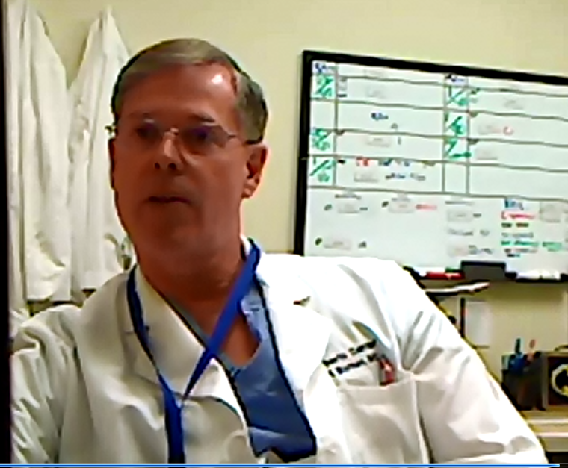
Example 5
Incorporating New Evidence into Decision-Making
Goal:
Prevent virologic breakthrough
Original Decision Inputs:
Maraviroc presumed not viable strategy, go to next best option
Injection of New Information:
New CCR5 test is reliable
New CCR5 test is free
Result:
More clinical options
More precise treatment planning
Notes:
Example that bounces around the circle…in the end, what is created is a knowledge network with a fluid exchange of ideas…except

Slide 56
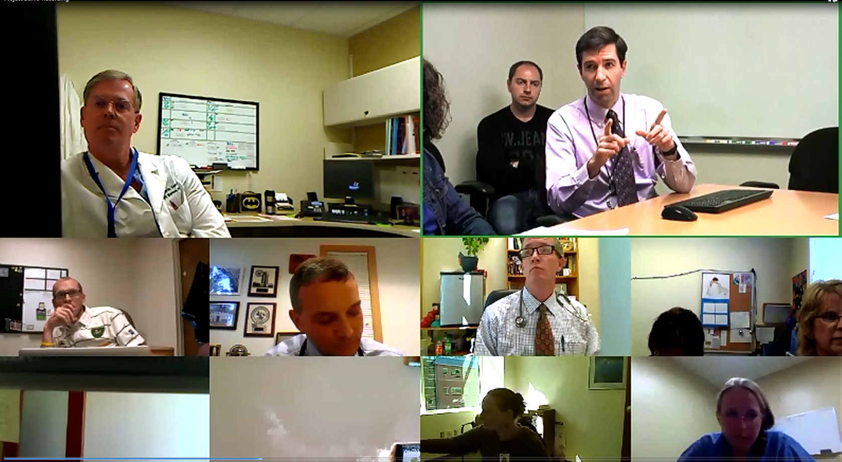
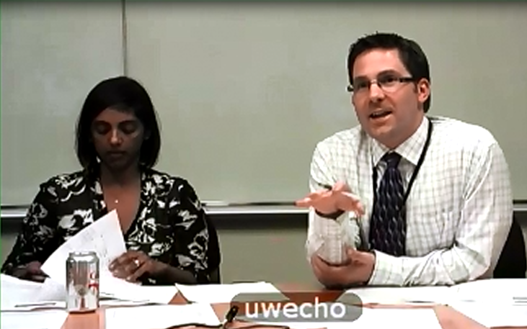
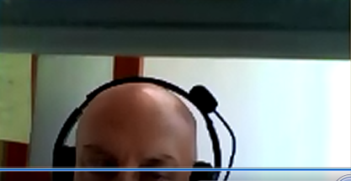
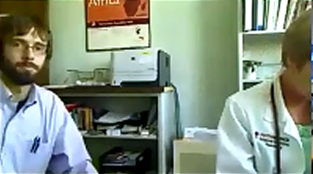
Amplified Dissemination of Knowledge

Slide 57
Example 6 – Knowledge Network
On-demand
resource
generation
Policy
clarification
Strategies identification
Action mobilization
Infectious Disease
Psychiatry
Pharmacy
Case Management

Slide 58
Nuts & Bolts
Implementing a successful Telehealth program

Slide 59

NW AETC ECHO Mission
Catalyze local treatment of most vulnerable and underserved patients (rural sites, CHC’s, FQHC’s)
Catalyze knowledge sharing between clinicians developing treatment expertise across the Pacific Northwest region
Disseminate treatment innovations quickly across a network of clinicians

Slide 60
NW AETC ECHO Timeline
Notice of Grant Award
1st Pilot Session
1st Live Session
2011
2012
Aug
Sept
Oct
Nov
Dec
Jan
Feb
Mar
Apr
May
Jun
Jul
Aug
Sept
Assemble Clinical Team
Develop Tools, Website, Curriculum, & Procedures
Recruit & Visit Sites
Baseline Evaluations
Create Buzz & Publicity
Encourage Case Submission
Semi-Weekly reminder e-mails
Faxed Recommendations within 24 hrs
Ongoing 24/7 Mentoring & Support
Notes:
Identify & Recruit Participants: Utilize AETC and partner networks, press releases, word of mouth, extensive networking & marketing
Prepare tools: modified from other ECHO projects to meet NW AETC program needs
Develop Website & web resources (www.nwaetcecho.org)
Identify & Train NW AETC ECHO multidisciplinary team
Develop curricula blocks for didactic sessions and schedule weekly guest presenters
Conduct site visits with interested sites:
Foster buy-in with clinicians and administrators
Baseline needs assessment
Technology assessment

Slide 61
NW AETC ECHO Groundwork
Identify & Recruit Participants: Utilize AETC and partner networks, press releases, word of mouth, extensive networking & marketing
Prepare tools: modified from other ECHO projects to meet NW AETC program needs
Develop Website & web resources (www.nwaetcecho.org)
Identify & Train NW AETC ECHO multidisciplinary team
Develop curricula blocks for didactic sessions and schedule weekly guest presenters
Conduct site visits with interested sites:
  Foster buy-in with clinicians and administrators
  Baseline needs assessment
  Technology assessment
Notes:
I think this is a meaty slide and would probably be the most useful for those just starting out.
They should look at the first point as if it’s a clinical trial: expect to have to screen 10 sites to find one or two that might be a good fit, use EVERY outlet they have to try and find local primary care clinicians with an interest, acknowledge restrictions of the grant, BE FLEXIBLE with those folks who think they can’t attend every week, but still have some interest, rely on your local LPS people to give you names, utilize primary care listserves, CHC networks, and rural health associations.
Can highlight that we have a growing library of didactics that we are happy to share.
Must have the right personnel to make up the panel. I think there needs to be a strong Medical Director, since the strength of the mentoring relationship depends on this.
Accessibility, non-judgemental approach, interest in the cases from the clinics, and a personal connection (e.g. from site visit) are all key.

Slide 62
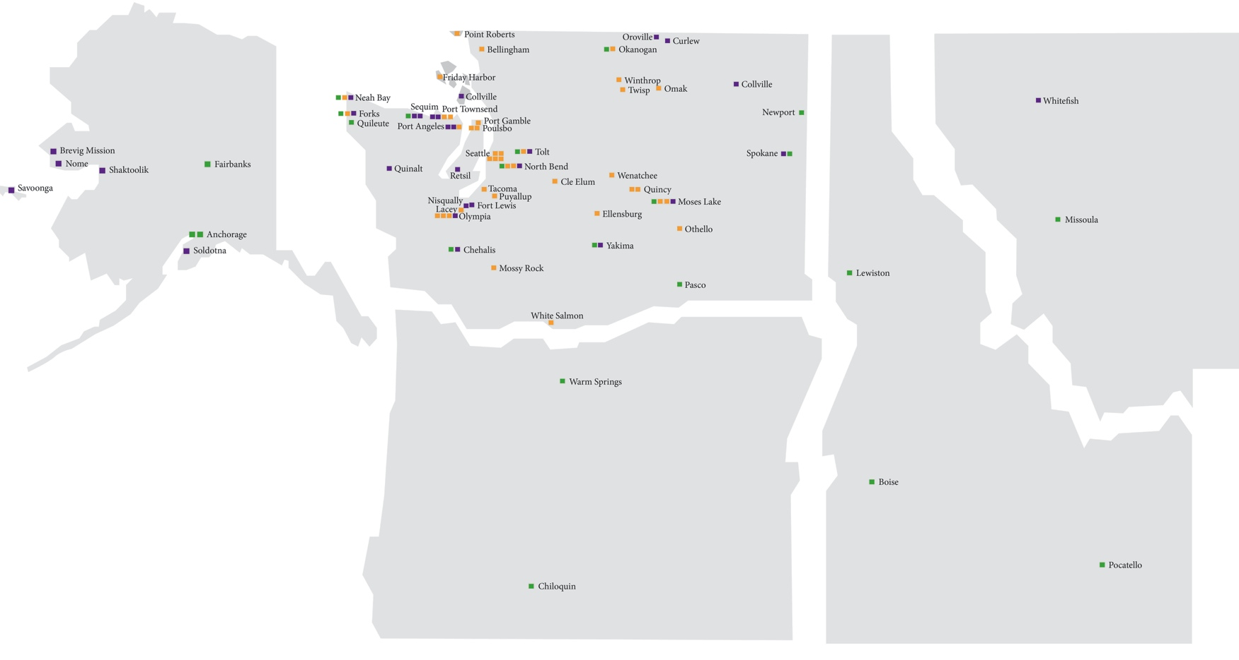
NW AETC ECHO Sites
ALASKA
Bellingham, WA
WASHINGTON
MONTANA
Everett, WA
Bremerton, WA
Spokane, WA
Kalispell, MT
Missoula, MT
Anchorage, AK
Yakima, WA
Butte, MT
Vancouver, WA
Bozeman, MT
Portland, OR
Billings, MT
ECHO - Chronic Pain
27 sites
IDAHO
OREGON
ECHO - Integrated Addiction and Adult Psychiatry, 42 sites
Eugene, OR
Springfield, OR
Boise, ID
ECHO – HCV, 21 sites
Twin Falls, ID
Medford, OR
Pocatello, ID
Notes:
Fortunate to start with much of the groundwork already done by John Scott and Kent Unruh with HCV, Opiate abuse, and Integrated Addiction Psychiatry ECHO already in place.
Spent a lot of time identifying the right clinics and clinicians to participate.
- Visited (nearly) all of our Tier 1 ECHO sites to provide Level IV training, perform workflow analysis and ‘walk a day in their shoes’
- developed a nice partnership with UW Family medicine (and Rural Health associate) to better understand realities of CHC FQHC practice in our region
- Face-to-face interaction via site visit essential to creating a true mentoring relationship

Slide 63
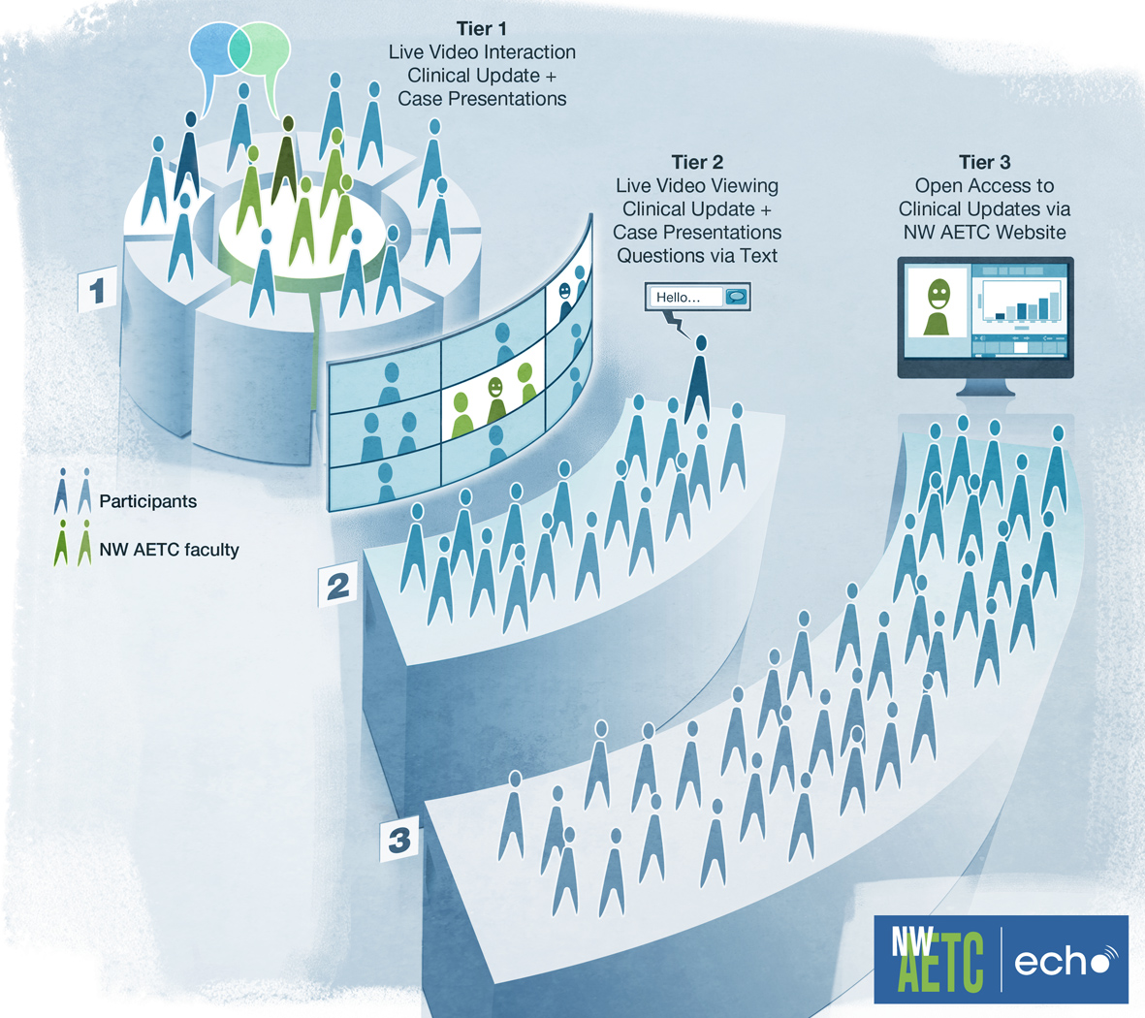
NW AETC ECHO
NW AETC ECHO Telehealth Program

Slide 64
Mechanics of Weekly Telehealth Sessions
Mini-Didactics
Focused clinical topic
First 15 minutes of each session
Additional 5 minutes for discussion
Recorded/archived for future viewing
Case consultations
Remainder of session
Goal 3-4 cases per session
Each site should contribute at least one case per month
12
9
3
6
Notes:
Now let’s get to what the sessions actually look like!!
Cases faxed in beforehand on case report form reviewed the day before by specialty panel.
Meet over lunch hour 12-1 PST. Go to great lengths to start and end on time—often stay on past 1:00 for extra discussion.
Cover three time zones, so usually start with Mountain time zone (Montana, Idaho), finish with Alaska
So that’s essentially ECHO model, Multi-disciplinary case consultations in context of a learning network.

Slide 65
Send Info in Advance
New Pt Form
Thursday
12pm – 1pm
Case
Consultation
Within 24 hours
Follow-up
Pt Form
Receive Tx Recommendations Via Fax from Project ECHO
Fax to
NWAETC-ECHO
Tuesday
Assessment & Diagnostics
Copy of chart notes & Labs
Notes:
consultations in context of a learning network.

Slide 66
Case Discussed
New Pt Form
Thursday
12pm – 1pm
Case
Consultation
Within 24 hours
Follow-up
Pt Form
Receive Tx Recommendations Via Fax from Project ECHO
Fax to
NWAETC-ECHO
Tuesday
Assessment & Diagnostics
Copy of chart notes & Labs

Slide 67
Detailed Recommendations Sent
New Pt Form
Thursday
12pm – 1pm
Case
Consultation
Within 24 hours
Follow-up
Pt Form
Receive Tx Recommendations Via Fax from Project ECHO
Fax to
NWAETC-ECHO
Tuesday
Assessment & Diagnostics
Infectious Disease
Psychiatry
Pharmacy
Case Management
Nursing
Copy of chart notes & Labs

Slide 68
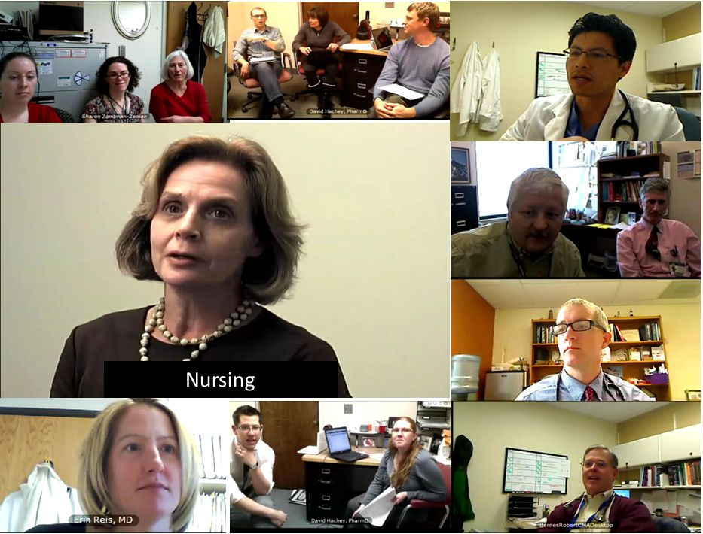
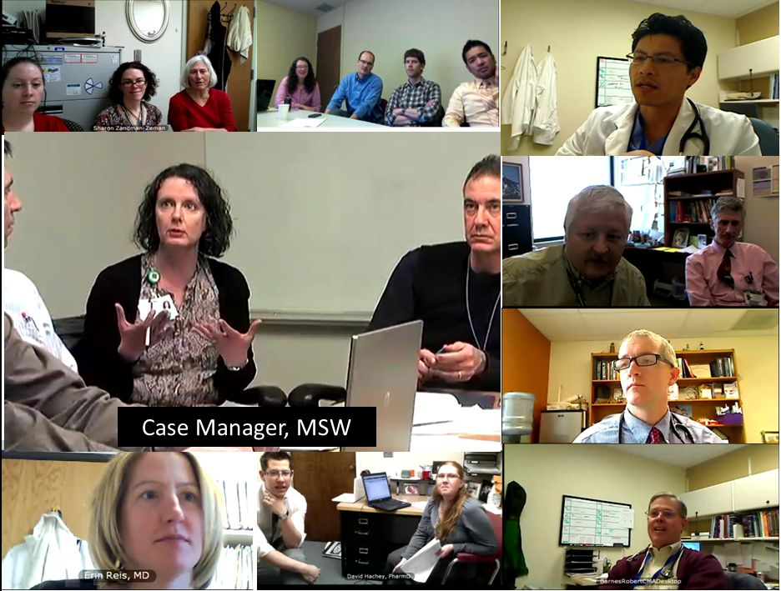
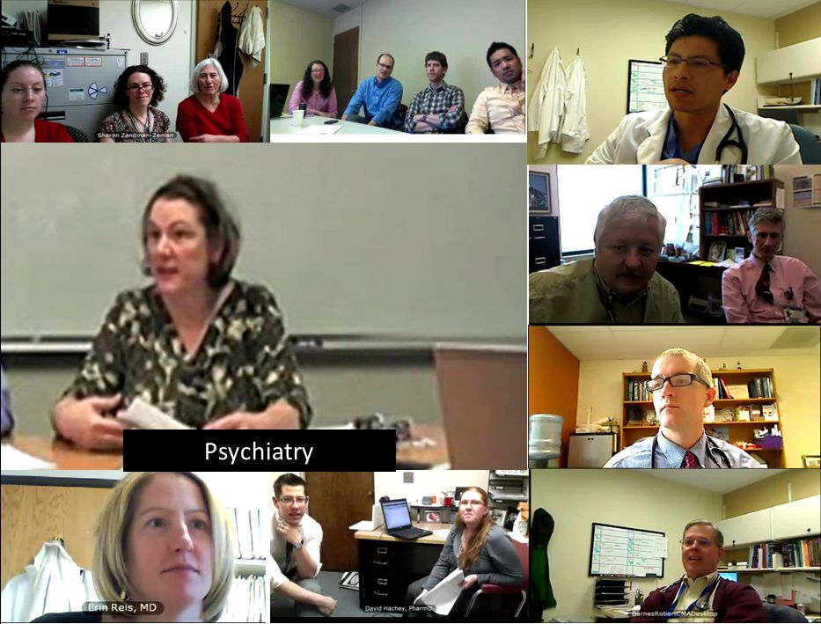
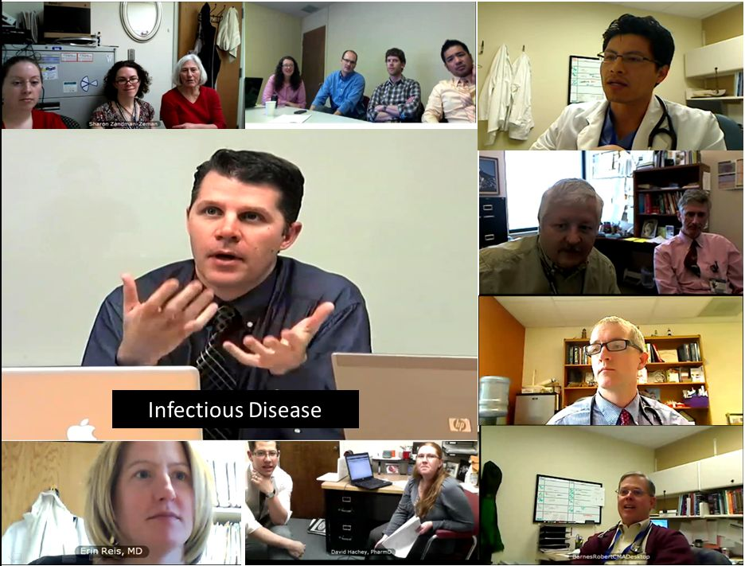
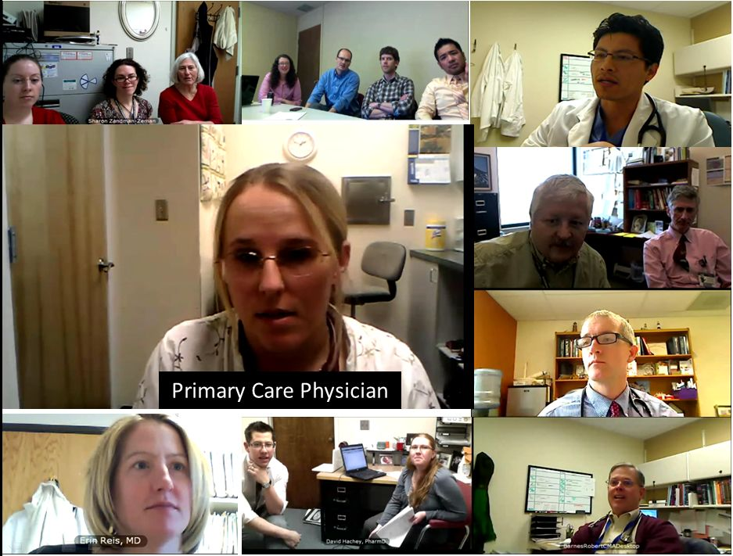
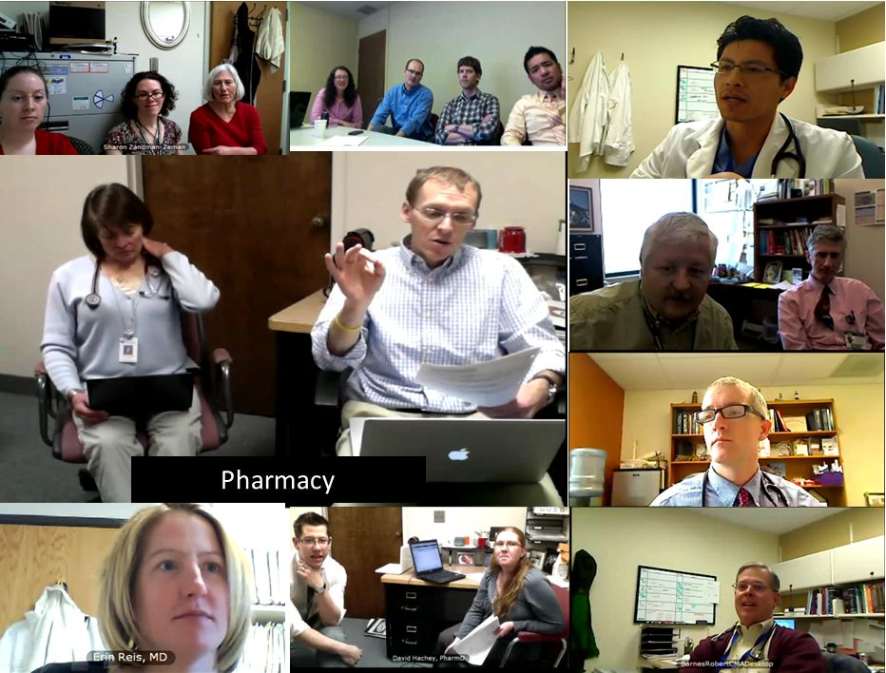
Specialist Panel:
ID – Hep C
PharmD
Case Manager
ID – HIV
Psychiatry
ID – HIV
Family Medicine
Informatics
Nursing
ID - HIV
Notes:
Case submitted by Dr. Marchion – Family Practice doc in rural Idaho (Twin Falls area – 2.5 hrs from Boise)
- Presenting case of a pregnant patient newly diagnosed with HIV, Latent TB, late latent syphilis
significant relationship stressors and social isolation, depression/anxiety
Early on I/specialty panel would directly give recommendations (also didactic component, declarative knowledge). As network matured and participants became more comfortable with each other, my role has shifted to facilitator, summarizing and framing key issues in the case as I would in clinical teaching rounds.
In this case I asked our pharmacist (Pocatello, ID) to summarize choice of ARV’s in pregnancy and FDA classification, Psychiatrist jumped in with strategies to address isolation and screen for depression (eye towards adherence), case manager brought us back to reality offering local/online resources and discussing reporting requirements (disclosure, STI reporting), involving local public health resources.

Slide 69
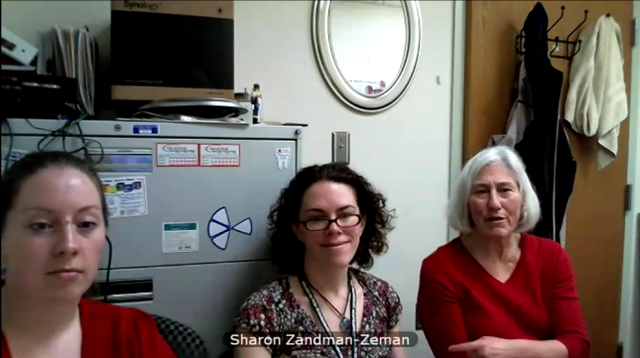
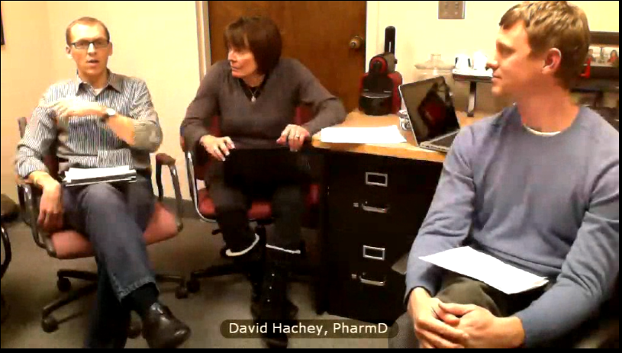
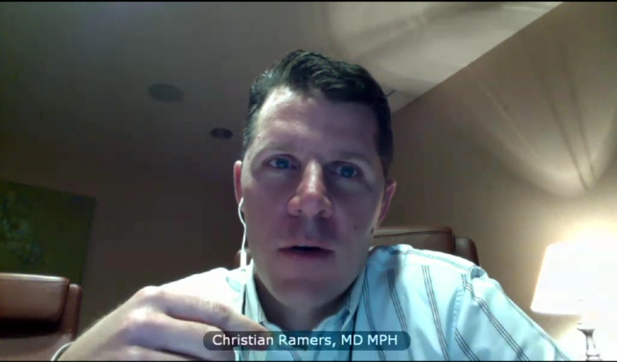
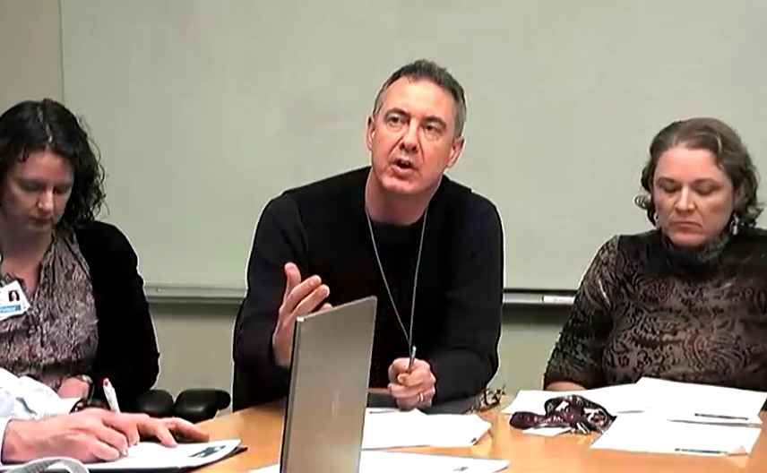
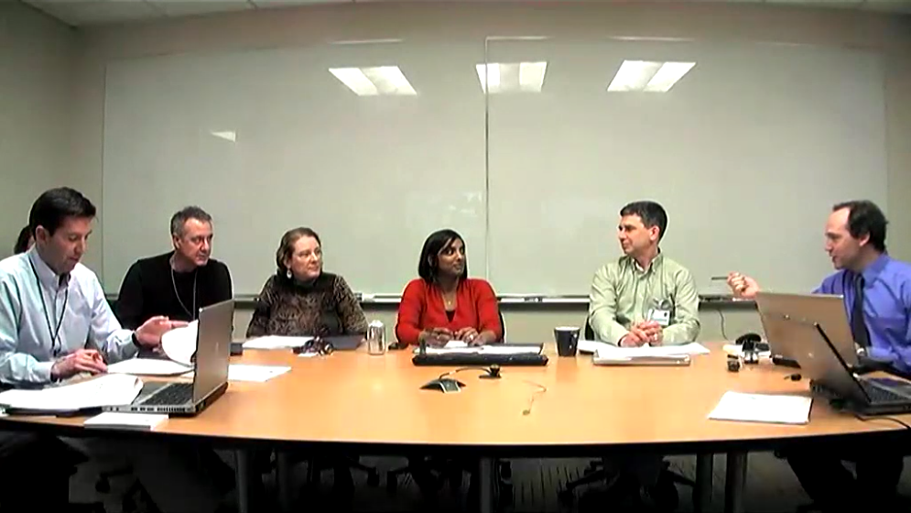
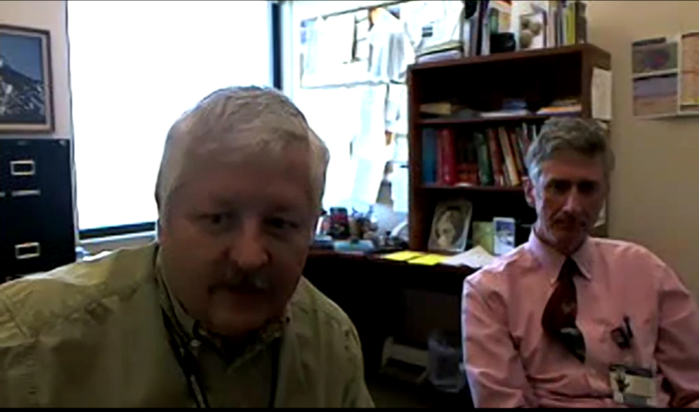
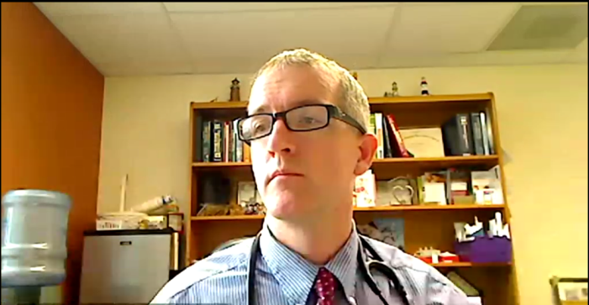



6
Butte, MT
Seattle, WA
Pocatello, ID
Anchorage, AK
Bozeman, MT
Medford, OR
Springfield, OR
Twin Falls, ID
Notes:
In this simulation I’ve shown a bit of what happens. Really a multidisciplinary case consultation (Didactic component, peer-to-peer interaction, resource sharing, also intangible element of professional collegiality and creation of an in-service learning community)
In the space of 15 minutes we’ve worked through a case and in real-time provided coherent interdisciplinary treatment recommendations across 5 state area, which are summarized in a written cover letter faxed back to participant within 24 hours.
In our current rather fractured fee-for service system this type of collaboration rarely exists, and if it does, it would take weeks to months to accomplish. But we must acknowledge that in the busy CHC environment where PRODUCTIVITY is the word of the day, many places are not incentivized to participate in this type of activity.

Slide 70

Motivating your Participants
Real-time multi-disciplinary consultation on their own clinical challenges!!!
Availability of NW AETC ECHO Specialists 24/7
  Long-term mentorship and sense of community (knowledge network)
Additional resources via email
  Hot topics & Articles of interest
Website: www.nwaetcecho.org
  Archived didactics (additional topics!)
CME and CNE for participants
Notes:
Value added resources in the Constant Contact emails, additional PDF’s that are sent as follow-ups to specific clinical issues in the sessions, the website resources, including ‘web only didactics’

Slide 71

Semi-Weekly Email to Participants
Constant Contact mass e-mail service
- Sent Mon & Thurs
- Stores documents
- Saved by Participants
- Preview of upcoming sessions
- Follow-up Articles & Clinical Tools

Slide 72

Notes:
Available for anyone who wants to use them!! Can use example of New Mexico using our Heme-Onc didactic for one of their sessions. Technical issues are easy to overcome, or could just play it right off the player.

Slide 73

Program Evaluation
Clinic Level Assessment
Q12 months
Clinic goals
Standard clinical quality measures
Provider Level Assessment
Q6 months
Individual provider goals
Knowledge
Self-Efficacy
Community of Practice
Within-Session Tracking
Case presentations, participation
Recommendations and peer-to-peer

Slide 74
Lessons Learned
Define and Tailor to Target Audience
  Tiered participation model, recorded mini-didactics
  Ensuring a diversity of content: basic → cutting edge
Obtain Buy-in (from Clinicians and Administrators)
  Provide a valuable service to overcome weekly time commitment
  Understand constraints of local environment (CHC’s, FQHC’s)
  IT barriers: aligning content with clinic workflow constraints
Build Relationships with Participants
  The importance of the face-to-face visit
  Obtain baseline assessment information
  Assess clinic workflow and technology
  Case review (level IV training) in clinician’s own environment
Notes:
To summarize, I’ve outlined the ECHO model and how it has helped to expand our training capacity in a truly unique, real-time, service oriented way.
Hopefully I’ve shown that this is a powerful tool in a larger tool-kit for workforce development and improving underserved access to care.
The future is uncertain (Affordable Care Act) but the model is nimble, capable of adapting to a changing healthcare environment, especially as the role of CHC and FQHC’s expands.

Slide 75
NW AETC ECHO Telehealth Program
Questions / Discussion

Slide 76


