Slide 1
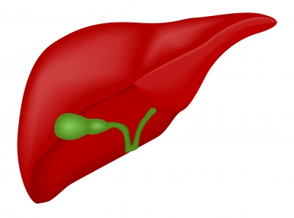
GUIDANCE FOR HCV/HIV Co-infection Programs
AIDS CARE GROUP
Grace Paik, CRNP
Regina Ubaldi-Rosen, CRNP
ELLAH NOTA, CRNP

Slide 2
AIDS CARE GROUP
Is a non-profit organization that provides medical care, dental care, and social services to uninsured and underinsured minority residents of Chester, Delaware County, and many of its surrounding communities in Pennsylvania.
AIDS Care Group incorporated in 1998.
It is the largest and most comprehensive HIV service provider .
Two sites; Chester office & Sharon Hill in Delaware County.

Slide 3
AIDS Care Group: Services and Statistics
Medical staff sees 200 patients per month
Dental staff sees 85 patients per month
Psychiatrist consults with 40 patients each month
Clients are screened for infectious diseases, dermatology diseases, and mental health diseases
Food pantry supplies 30 food baskets to the needy each week.
1,200 meals are served monthly
35 women participate in a women’s
health group

Slide 4
ACG SERVICES
Welfare to work program is supported by teaching vocational skills in construction and gardening.
AIDS Care Group has hired former volunteers to become full and part-time staff members
Housing division is dedicated to providing clean, safe, and affordable housing to clients, their families, and members of the surrounding community
Linked with five county jails to provide discharge planning and reintegration services to prisoners living with HIV/AIDS.

Slide 5
HCV/HIV STATISTICS
Approximately 1/3 of all HIV-infected individuals are co-infected with HCV.
An estimated 10,000 deaths per year are attributed to hepatitis C and its complications.
HCV-related liver failure is the leading reason for liver transplants in the U.S.
An estimated 20% to 40% of individuals with acute HCV infection spontaneously clear the virus without treatment but the rest develop chronic hepatitis C lasting more than six months.
NIH.gov

Slide 6
HIV/HCV Co-infection STATISTICS Cont..,
HCV-related liver disease is a major cause of death for people with HIV.
HIV/HCV co-infected people are more likely to progress to serious liver disease and tend to do so more rapidly.
HIV/HCV co-infected patients have higher baseline viral load, more rapid progression of liver disease/fibrosis, and are at increased risk for cirrhosis, ESLD and hepatocellular carcinoma.
NIH.gov

Slide 7
CURRENT GUIDELINES
The latest U.S. Public Health Service and IDSA guidelines recommend that all HIV positive people be tested for hepatitis B and C, and vaccinated against hepatitis A and B if not already immune.
The HIV primary care guidelines recommends that all HIV-infected patients should be screened for hepatitis C virus (HCV) infection annually.
The CDC also recommends that all “baby boomers” (born during 1945–1965) be screened due to the higher prevalence of chronic hepatitis C in this age cohort.

Slide 8
hiV/HCV treatment guidelines
All patient with HIV/HCV co-infection should be evaluated for HCV therapy.
Strong preference should be given to commence HCV treatment in patient with higher CD4 counts.
For patient with lower CD4 count <200cells/mm, it may be preferable to initiate ART and delay HCV therapy until CD4 count increases as a result of HIV treatment.
Ghany et al, 2011; Soriano, et al, 2007; Tien, 2005; Avidan et al, 2009

Slide 9
BENEFITS OF TREATMENT
Decrease the need for liver transplantation
Lower the risk of liver fibrosis progression
hepatocellular carcinoma
end-stage liver disease
death

Slide 10
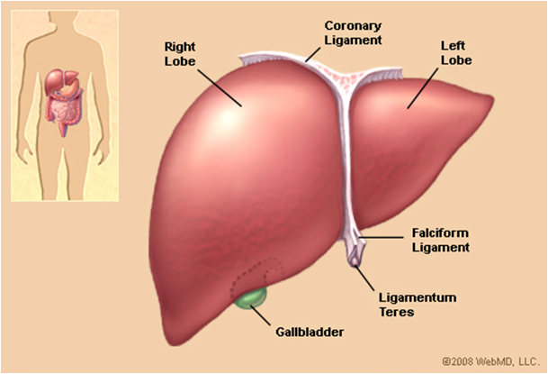
AIDS Care Group: HIV/HCV Co-infection
ACG has over 500 HIV+ patient who are on ARVs
All patient are screening every year for HCV
40% are HCV+ and HCV RNA is checked annually
9% of HCV+ were referred for treatment
2% entered into care within the practice.

Slide 11
Absolute Contraindications to Hiv/hcv TREATMENT
Uncontrolled major psych illness
Hepatic encephalopathy, coagulopathy or ascites
Uncontrolled HIV CD4<100
Allergy or severe adverse rxn to interferon or Ribavirin
Concurrent severe CAD, CHF, COPD, active TB, active cancer, untreated auto immune (hypothyroidism)
Pregnancy, nursing or partners of child bearing potential
Unwilling to use contraceptive during Rx & 6mos after
Active untreated auto-immune Dz (lupus, RA)
Concomitant use of didanosine (ddl).

Slide 12
RELATIVE Contraindications
Hgb <10, neutrophils<1,000 or platelets<50,000
CD4 <200
Pt on hemodialysis or CrCl <50
Uncontrolled DM
Disease; SLR,RA, sickle cell, thalassemia major, Sarcoidosis
Active drug use; Adherence
Untreated mental disorder
Solid organ transplant pt
Concomittant use of AZT

Slide 13
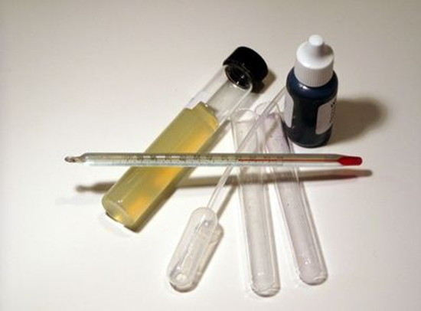
Baseline Laboratory Test
HCV VL
HIV RNA & CD4 Count
AST/ALT
Bilirubin
Creatinine
WBC, Hgb, ANC, Platelets
PT/INR
Albumin
Ferritin
AFP
ANA
TSH
HCG
Vitamin D
BMI
HepaScore
IL28-B
Ultrasound
Liver Biopsy

Slide 14
GUIDANCE FOR HCV/HIV treatment considerations
Identifying suitable candidates.
Commitment to therapy
Med adherence history
Prior HCV treatment history
Effective ART not contraindicated with HCV meds
Comorbid conditions
Patient motivation
Biopsy with chronic hepatitis with significant fibrosis(Portal fibrosis)
Stable HIV disease
Compensated liver disease
Acceptable hematologic parameters
Serum Creatinine <1.5mg/dl
Willingness for regular follow-up for liver clinic every week.
Informed well activated patient
Good rapport

Slide 15
Predictors of a favorable hiv/hcv treatment response
HCV Genotype 2,3
HCV RNA level <400,000 IU/ml
IL-28B Genotype CC
Stable HIV with CD4at least >300
Non-African American Race
Absence of bridging fibrosis or cirrhosis
Body wt. <75kg or BMI <25
Age <40
No insulin resistance
Stable Hgb

Slide 16
facility based CONSIDERATIONS
Committed providers and nursing staff.
Multidisciplinary approach ( Nutritionist, psych, Phlebotomists etc)
Good collaboration, and effective communication among the team
Adequate charting.
Flexible scheduling to allow weekly visit, pill box fill and injection administration.

Slide 17
PRE-Treatment history
HCV Diagnosis
HCV Genotype 1a/1b, 2, 3..)
Previous HCV Treatment
Prior relapser
Prior partial responder
Prior null responder
HIV Status
Other Hepatitis infection A&B
Hepatitis vaccination history
Medication List
Drug and ETOH History/ Last Use

Slide 18
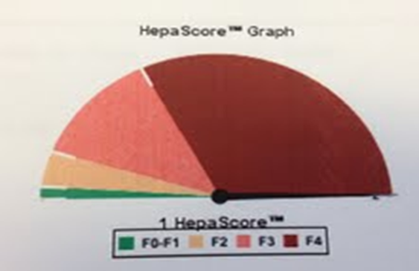
Patient result probability table
F0= Chronic Hepatitis but no fibrosis
F1=Portal Fibrosis without septa
F2= Portal fibrosis and few Septa
F3+ Septal Fibrosis without Cirrhosis
F4=Cirrhosis

Slide 19
Initiating treatment
Thorough screening is crucial in identifying good candidates for treatment;
Patient teaching regarding treatment
Expected side-effects and use of comfort packs
Med adherence counseling
Signing informed consent to avoid pregnancy and using two forms of birth control,
Psychiatric pre-evaluation and treatment,
Reinforcing the importance of regular follow-up every week especially during the first 12 weeks of treatment;

Slide 20
Tools to improve treatment success
Substance abuse counselors
Opioid dependence treatment
Group counseling
Patient education
Peer education counseling
Clinic based injections
Clinic based pill box fill weekly
Nutrition counseling

Slide 21
HCV/HIV REGIMEN
A combination of Peg-inteferon and Ribavirin (PegIFN/RBV) has been the mainstay treatment for HCV in mono-infected pts.
Numerous studies have shown that an addition of HCV NS3/4A protease inhibitor significantly improves a sustained virologic response (SVR) in patients infected with HCV genotype 1.
HCV Genotype 1 is the most predominant type in the US.
Harder to treat than other genotypes.
NIH.gov

Slide 22
Limited research for HCV/HIV treatment REGIMEN
Currently there is limited clinical trials for HIV/HCV co-infection treatments that showed that HCV protease inhibitors in combination with Peg-IFN/RBV will significantly improves a SVR although clinical trials are under way.
Treatment duration for mono-infected patient is 36 weeks.
Treatment recommendations for HIV/HCV co-infection is 48 weeks.
NIH.gov

Slide 23
Advance study influence of patients & virus factors on SVR with Telaprevir +peg-IFN/rbv
SVR %
1b 1a
<800, 000 >800,00
F0-2 F3-4
Marcellin P, et al #451, Dusheiko GM, et al #415 Poster Presented at EASL: The International Liver Congress 2011

Slide 24
HIV/HCV Co-infection
Treatment for both HIV/HCV treatment requires careful consideration due to;
potential drug-drug interactions,
And overlapping toxicities,
Therefore ARV regimen may need to be modified.

Slide 25
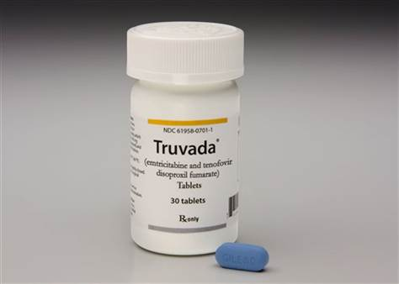
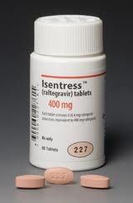
ARV therapy in hiv/hcv co-infection
ACG Preferred regimen;
2NRTI-( Emtricitabine/tenofovir disoproxil)Truvada
Intergrase Inhibitor-Raltegrevir (Isentress).
Based on review of genotype and patient HIV VL to permit use the of Telaprevir or Boceprevir .

Slide 26
OTHER ARV recommendations
Raltegrevir/2-NRTI
Use either boceprevir or Telaprevir
Reyataz/norvir + 2-NRTIs
Use Telaprevir at standard dose. Do not use boceprevir
Sustiva + 2 NRTIs
Use Telaprevir at increased dose of 1125mg every 8hrs.
Do not use Boceprevir

Slide 27
Telaprevir VS boceprevir Hcv ns3 PROTEASE INHIBITORS
TELAPREVIR
High Antiviral activity
Low barrier to resistance
HCV Genotype 1
Given during the 1st 12weeks of therapy in combination with Ribavirin & Peg
6 Pills/day
(ACG Preffered PI)
BOCEPREVIR
High antiviral activity
Low barrier to resistance
HCV Genotype 1
Given on the 24th week into therapy in combination with Ribavirin & Peg
12 pills/day

Slide 28
Telaprevir (incevek) Drug interactions with hiv meds (DHHS: Incevek Product Information)

Slide 29
Telaprevir (incevek)
Lots of drug-drug interactions; subtrate and inhibitor of CYP3A4 and p-gp enzymes
Given during the 1st 12weeks of therapy in combination with Ribavirin & Peg
Requires 20gms of fat with each dose
Dosing is 375mg BID q8hrs
If a dose is missed, follow the 4 hr rule
Store incivek at room temperature.

Slide 30
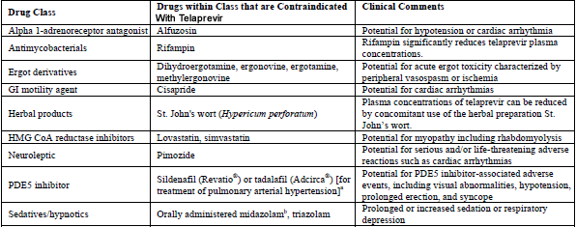
Drugs that are contraindicated with Telaprevir (incevek)

Slide 31
Other Drug interactions
Treatment may need to be modified or close monitoring if you take any of the following medications (250-350 drug interactions);
alprazolam (Xanax); warfarin (Coumadin); itraconazole (Sporanox), ketoconazole (Nizoral), posaconazole (Noxafil), or voriconazole (Vfend); bosentan ( Tracleer); budesonide (Pulmicort, Rhinocort); amlodipine (Norvasc), diltiazem (Cardizem, Dilacor, Tiazac, felodipine (Plendil), nicardipine (Cardene), nifedipine (Adalat, Procardia), nisoldipine (Sular), verapamil (Calan, Isoptin, Verelan); clarithromycin (Biaxin); colchicine (Colcrys); desipramine (Norpramin); digoxin (Lanoxin); efavirenz (Sustiva, in Atripla); escitalopram (Lexapro), fluticasone (Advair, Flonase, Flovent); hormone replacement therapy (HRT); immunosuppressants such as cyclosporine (Gengraf, Neoral, Sandimmune), sirolimus (Rapamune), or tacrolimus (Prograf); sildenafil (Viagra), tadalafil (Cialis), or vardenafil (Levitra, Staxyn); amiodarone (Cordarone, Pacerone), flecainide (Tambocor), lidocaine (Lidoderm, Lidopen, Xylocaine), propafenone (Rhythmol), or quinidine; carbamazepine (Tegretol), phenobarbital, and phenytoin (Dilantin); methadone (Dolophine); midazolam injection , oral birth control pills; dexamethasone (Decadron, Dexpak), methylprednisolone (Medrol), and prednisone (Sterapred); rifabutin (Mycobutin); ritonavir (Norvir) used in combination with other HIV protease inhibitors such as atazanavir (Reyataz), darunavir (Preszista), fosamprenavir (Lexiva), and lopinavir (in Kaletra); salmeterol (Serevent, in Advair); telithromycin (Ketek), PLUS MANY MORE..

Slide 32
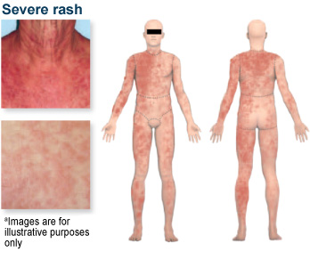
Telaprevir (incevek) Side Effects
Anemia
Anal or rectal problems
Burning around the anus, itching
Anal discomfort& hemorrhoids
Hemorrhoidal cream, cooling wipes
Serious skin reaction
A very small percentage of telaprevir-associated rashes have progressed to serious skin reactions, including drug rash with eosinophilia and systemic symptoms (DRESS) and Stevens-Johnson syndrome (SJS). Stop treatment if Grade 3 develops
Antihistamine, steroid creams to ameliorate symptoms
Severe allergic reactions
rash; hives; itching; difficulty breathing; tightness in the chest; swelling of the mouth, face, lips, or tongue)
dizziness; fever, chills, or sore throat; joint pain unusual tiredness or weakness
NIH.gov

Slide 33
Examples of foods to take with each dose of Telaprevir
20gm of fat with each dose every 8 hrs.
Nutrition consult is necessary with a registered dietician
Examples of foods with 20 grams are;
½ cup nuts
3 tbsp peanut butter
2 ounce American or cheddar cheese
½ cup trail mix
1.5 tbsp oil
3 tbsp blue cheese, ranch or french salad dressing
2 tbsp butter
6 ounce salmon
9 ounces ham
3.5 ounces ground beef
3.5 ounce pork chop

Slide 34
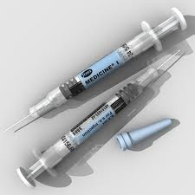
Interferon Side effects
A weight based injection given once sub-Qweekly
Flu-like symptoms
Headache
Fatigue
Myalgias, athralgia
Fever, Chills
Nausea
Diarrhea
Alopecia
Psychiatric
Depression
Insomnia
Injection site reaction
Thyroiditis
Auto-immune
Leukocytopenia
Thrombocytopenia

Slide 35
RIBAVIRIN
Pill form and is weight based and also adjusted in renal impairment.
Ribavirin treatment is primarily associated with anemia.
Dose reduction may be indicated if anemia develops.
Minimal daily dosage is usually not less than 600mg/day
ADVERSE EFFECTS
Hemolytic anemia
Cough & dyspnea
Rash & Pruritus
Insomnia
Anorexia

Slide 36
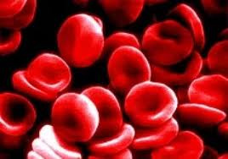
Anemia ribavirin dose reduction
INDICATIONS | BASELINE RIBAVIRIN DOSE | DOSE REDUCTION
Hgb <10 | 800-1200mg/day 1400mg/day | Reduce by 200mg Reduce by 400mg
Hgb <10 unresponsive to initial dose reduction within 2 weeks | Any dosage | Further reduce by 200mg (do not reduce lower than 600mg/day)
Moderate-Severe Acute Hgb drop in the 1st 4 weeks of treatment | Any dosage | Reduce dose to 600mg/day
Use of Epoetin alfa 40,000 -60,000IU SQ weekly may be warranted for severe anemia, and in some cases blood transfusion may be indicated.

Slide 37
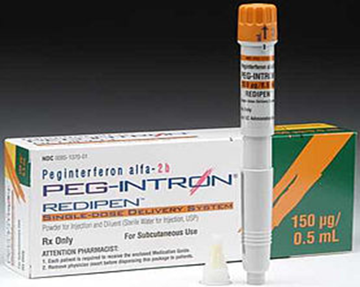
Peg interferon
Peg IFN alfa 2a is approved for use in HIV-infected pts but peg IFN alfa-2b is not.
Once-a-week injection that works to reduce the amount of chronic hepatitis C or hepatitis B virus in the body.
Dosing is based on renal function.
Need to keep the medicine refrigerated (36-46F).
CREATININE CLEARANCE | PEG IFN-2A DOSE
30-50 ML/Min | 180mcg SC weekly
<30mL/min | 135mg SC weekly
Hemodialysis | 135mg SC weekly

Slide 38
Peg-Ifn side effects
flu-like symptoms
tiredness and weakness
stomach problems
loss of appetite
skin reactions
hair thinning
trouble sleeping
Dose adjustment is indicated for;
Severe depression
Thrombocytopenia
Decrease to 90mcg weekly until stabilized.

Slide 39
When do you stop Peg-IFN due to side effects
Active suicide ideations or rapid develop of severe depression
Platelet count <25,000 cells/mm
Neutropenia that does not respond to dose reduction.

Slide 40
MANAGEMENT of depression
Occurs in up to 37% of patients.
Conduct pre-therapy and routine assessment with PHQ-9 scale or other depression scale.
Adjust interferon dose or discontinue therapy according to depression severity.
May warrant use of anti-depressants.
Patients can be treated prophylactically with SSRIs

Slide 41
MONITORING PATIENTS
Anemia
Bone Marrow toxicity
Pulmonary disorders
Pancreatitis
Psychiatric conditions
Acute hypersensitivity reactions
Thyroid abnormalities
Auto-immune disorders
Ophthalmologic disorders
Consent for pregnant prevention while on therapy
Pregnancy test at baseline, during therapy & 6 months post therapy
Sexually active men must sign consent to use 2 forms of protection

Slide 42
Treatment monitoring labs &visits
Week 0
CBC, CMP, TSH, HIV RNA ,CD4, HCV RNA, PHQ-9
Week 2
CBC, CMP
Week 4
HCV RNA, HIV RNA, CBC, TSH,PHQ 9
Week 8
CBC, CMP
Week 12 ( Telaprevir Rx ends 12wks only)
CBC, CMP, TSH, HCV VL, HIV VL, CD4, PH-Q9
**Stop all treatment if HCV is detectable >1,000
Week 18
CBC, CMP
Week 24
CBC, CMP, TSH, HCV RNA, HIV RNA, CD4, PHQ-9
**If HCV RNA not undetectable. Stop all treatment.
Week 30
CBC, CMP
Week 36
CBC, CMP, TSH, HCV RNA, HIV RNA, CD4, PHQ-9
**If HCV RNA not undetectable. Stop all treatment.
Week 42
CBC, CMP
Week 48 (**End of treatment)
CBC, CMP, TSH, HCV RNA, HIV RNA, CD4, PHQ-9

Slide 43
Treatment futility rules
Discontinue treatment
Week 4 if HCV RNA > 1,000
Week 12 if HCV RNA >1,000
(Telaprevir Rx completes @ wk 12)
Week 24 if HCV RNA Detectable
(DC Peg-IFN & Ribavirin)

Slide 44
Case presentations
CASE STUDY 1
67 year old AA male with HIV/HCV Co-infection.
HCV RNA 69,998
HIV CD4 Count 200
Platelet count 60,000
Albumin 2.5mg/dl
Total Bilirubin 2.6mg/dl
Creatinine 1.8
Hgb 11.0 gm
1) What evaluation would you consideration before initiating therapy?
2) What medications would you consider and what are the dose adjustment?
3) How frequent would you monitor him?
4). Hgb drops to 7.7, what are you going to do?

Slide 45
CASE PRESENTATIONS
CASE STUDY 2
24 yr old Latino male with HIV/HCV co-infection
History Heavy alcohol abuse in the past
Abstinent now for 5 months
He is a truck driver
BMI=40
Lives with a 22 year old girlfriend who is also Hep C positive.
PHQ 9=10
CD4 count 956, VL 4600
Not on any ARVs yet.
1)What is your initial evaluation?
2)If you start him on treatment, how would you go about it?
3) Soon after starting treatment he develops a rash, what would you recommend?
4)After treatment, you check a fasting lipid and his tryglycerides are 700, what would you do?

Slide 46
Case presentations
Case study 3
40 year old Caucasian female
Acquired HCV from IV drug use.
HCV RNA 2,560,999
HIV RNA 256
CD4 415
Creatinine 1.1
Hgb 12.0
On Atripla once daily and lisinopril/HCTZ 40/25mg for HTN
What is your initial evaluation prior to treatment?
After you initiate HCV treatment, she reports PHQ 11, what would you do now?
3 weeks into therapy, creatinine is up to 2.0? What should you do?
Later her hemoglobin drops to 7.7, what is your next step?
After adjusting meds, she has no response in 2 weeks and her Hgb is 7.0?

Slide 47
questions
Thank You!!!

Slide 48
references
Avidan et al, (2009). Hepatitis C Viral Kinetics During Treatment with Peg IFN-alpha-2b in HIV/HCV Co-infected patient as a Function of Baseline CD4+ T-Cell Counts.
Centers for Disease Control and Prevention (2006). Guidelines for using antiviral agents in HIV-infected adults: http://AIDSinfo.inh.gov
Ghany M, et al, (2011). An Update on treatment of Genotype 1 chronic Hepatitis C Virus infection: Practice Guidelines by the American Association for the Study of Liver Diseases.
Soriano, V et al, 2007; Tien, 2005; Care of patients with HIV and Hepatitis C virus: Updated recommendations from the HCV-HIV International Panel.

