Slide 1
RWA 0132 Creating a Patient Centered Web-page with Health Literacy and Navigation
Amy Sitapati, M.D.
Interim Director, Owen Clinic
Militza Bonet-Vázquez, MPH
Health Marketing/Communications Manager
Barbara Berkovich, MA
Ambulatory Systems Analyst
Notes:
Still has some work to do with busy workflow slides and ending Nat’l stats

Slide 2

Disclosures
This continuing education activity is managed and accredited by Professional Education Service Group. The information presented in this activity represents the opinion of the author(s) or faculty. Neither PESG, nor any accrediting organization endorses any commercial products displayed or mentioned in conjunction with this activity.
Commercial Support was not received for this activity.

Slide 3
Disclosures
Amy Sitapati, MD
Has no financial interest or relationships to disclose
Militza Bonet-Vazquez, MPH
Has no financial interest or relationships to disclose
Barbara Berkovich, MA
Has no financial interest or relationships to disclose

Slide 4
Learning Objectives
At the conclusion of this activity, the participant will be able to:
Describe unique framing required for PCMH web page development
Explain the challenges of PCHM web page implementation
Describe the different experiences by patients learning to use the site

Slide 5

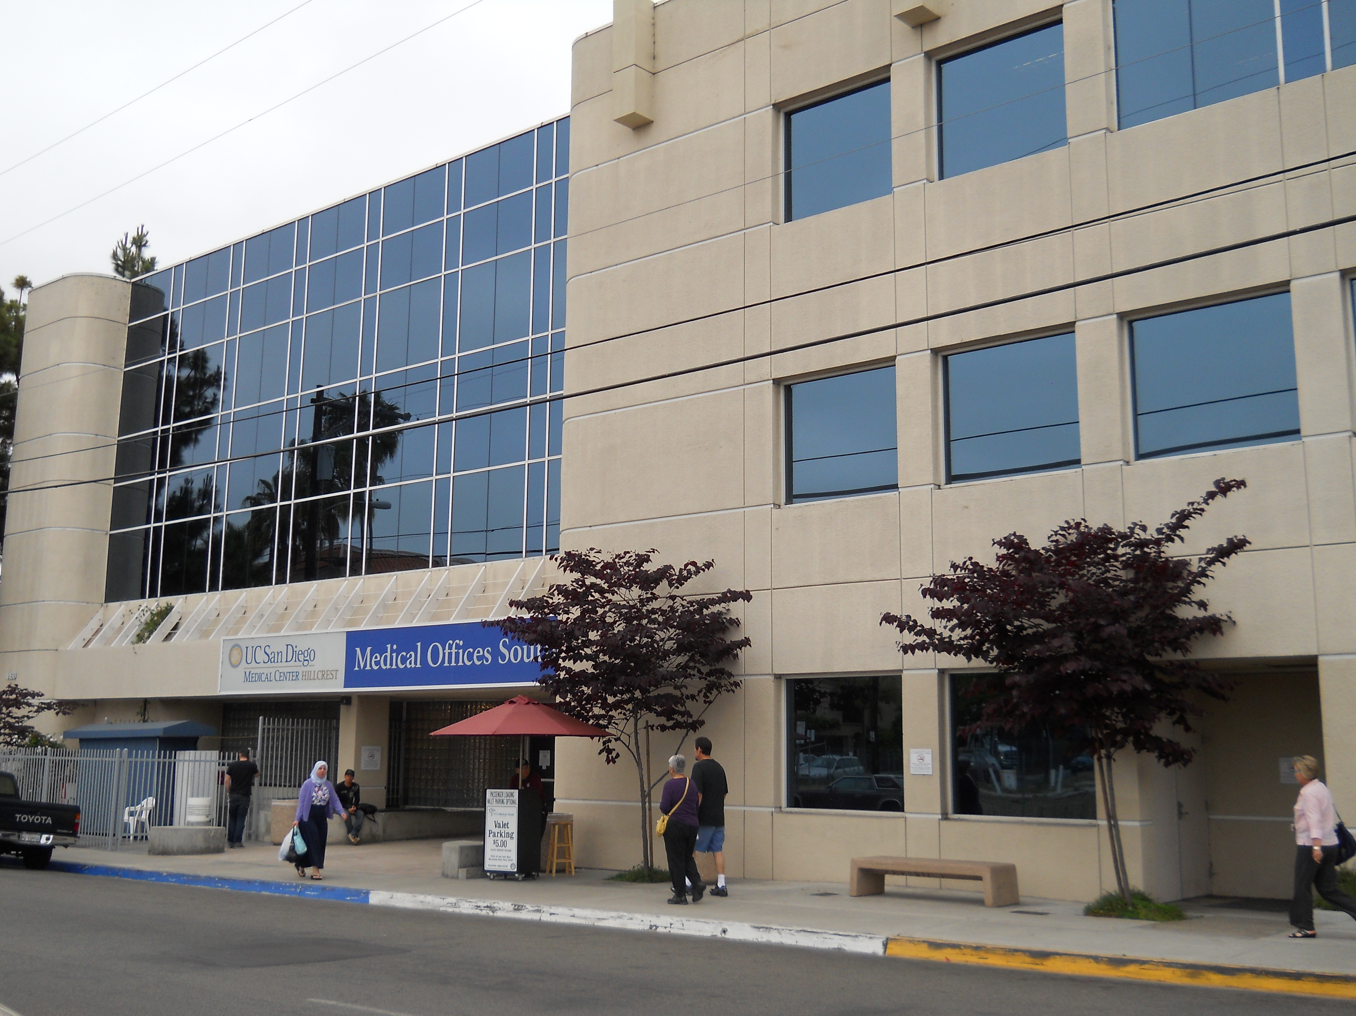


Who are we?
The OWEN CLINIC
University of California, San Diego
20 years of experience
3,000 HIV/AIDS patients
High proportion of Medi-Cal/ Medicare/ RW funding
Funded by California HIV/AIDS Research Program (CHRP) to serve as a pilot center for application of Patient Centered Medical Home in HIV
Site based focus to improve Retention

Slide 6
Who are we?
The OWEN CLINIC
University of California, San Diego
20 years of experience
3,000 HIV/AIDS patients
High proportion of Medi-Cal/ Medicare/ RW funding
Funded by California HIV/AIDS Research Program (CHRP) to serve as a pilot center for application of Patient Centered Medical Home in HIV
Site based focus to improve Retention

Slide 7
CY 2011 OSHPD Patient Discharge Data

Slide 8
San Diego County HIV/AIDS Prevalence
(Living: 12/31/11)
6
Prevalent* AIDS Cases, 2011 Rates per 100,000
 | Male | Female
White | 435.5 | 27.4
Black | 892.2 | 207.1
Hispanic | 421.9 | 53.9
Asian/Other | 97.2 | 17.1
TOTAL | 407.3 | 42.8
Prevalent* HIV (not AIDS) Cases, 2011 Rates per 100,000
 | Male | Female
White | 305.4 | 19.8
Black | 562.5 | 145.6
Hispanic | 245.2 | 32.5
Asian/Other | 76.1 | 8.0
TOTAL | 267.8 | 28.1
*Prevalent Cases: Living at December, 31 2011
Data Source: SD HHSA HIV/AIDS Epidemiology Unit
Epidemiology and Immunization Services Branch

Slide 9
Owen Clinic Patient Demographics
Distribution of Patients by Race/Ethnicity
 | 2011
Race/Ethnicity | # | %
Asian | 69 | 2.2%
Black | 449 | 14.6%
Hispanic | 788 | 25.6%
Native American | 11 | 0.4%
Pacific Islander | 4 | 0.1%
White | 1,572 | 51.2%
Other | 155 | 5.0%
Not Reported | 25 | 0.8%
Total | 3,073 | 100.0%

Slide 10

Learning Objective 1
Describe unique framing required for
Patient Centered Medical Home
web page development
PCMH

Slide 11
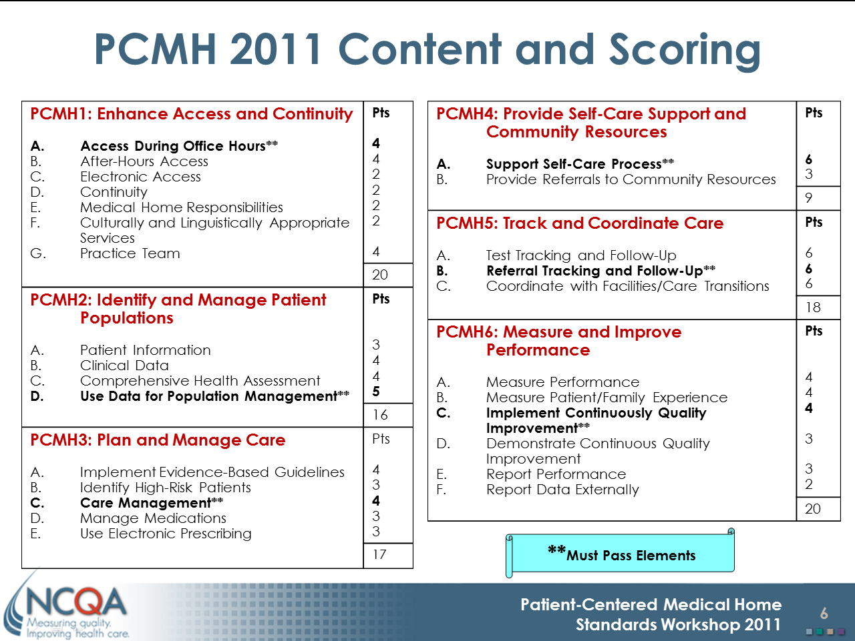
Why a web site?
Source: National Committee for Quality Assurance http://www.ncqa.org

Slide 12
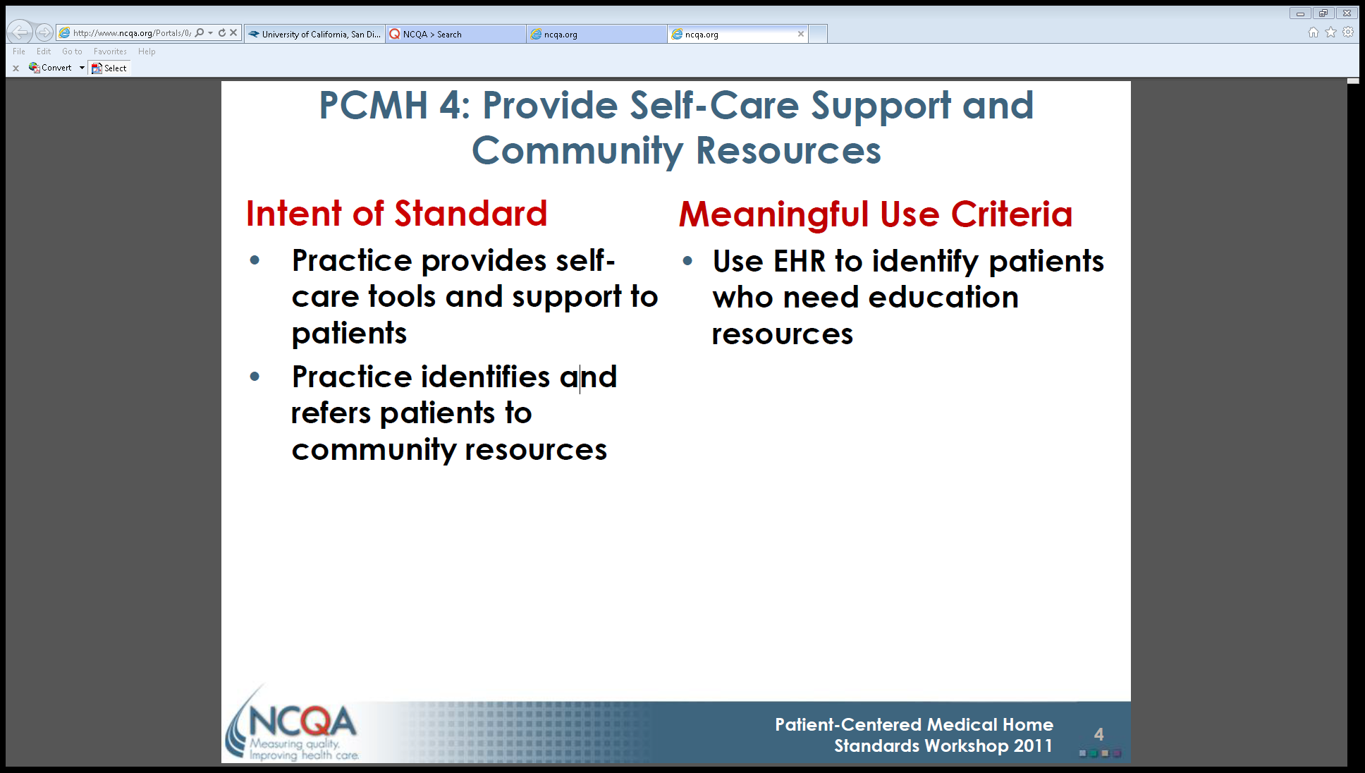

Slide 13
UCSD Owen Clinic ANCHOR Project
A Novel Care Home Optimizing Retention
Demonstrate how to improve the quality of care delivered by constructing a PCMH
Design tools and pilot applications in complicated systems for healthcare delivery using both accepted and novel concepts
Equip patients to drive their healthcare through HEALTH LITERACY strengthening
Measure improved retention and engagement in care
Notes:
How would you prepare patients to drive their health through literacy????

Slide 14
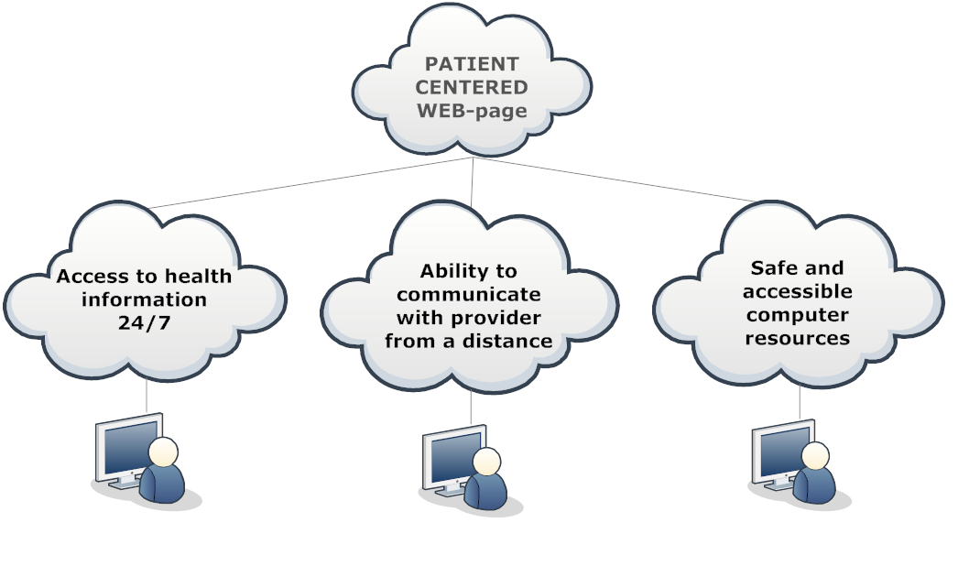
How do you prepare patients to drive their healthcare?
Provide enhanced computer access and training, and an HIV specific online resource within the clinic

Slide 15
With the goal of ….
Increased knowledge about
health conditions
Improved health literacy
and self-efficacy
Improved timeliness
… Through an optimized communication flow

Slide 16
Is the Owen Clinic Web page Patient Centered?
Notes:
Ask

Slide 17

Patient Centered
…relationship-based with an orientation toward the whole person.
…understanding and respecting each patient’s unique needs, culture, values, and preferences.
….supports patients in learning to manage and organize their own care at the levels patient chooses.
…ensure that they [patients and families] are fully informed partners in establishing care plans.
http://he%20PCMH_v2pcmh.ahrq.gov/portal/server.pt/community/pcmh__home/1483/PCMH_Defining%20t

Slide 18
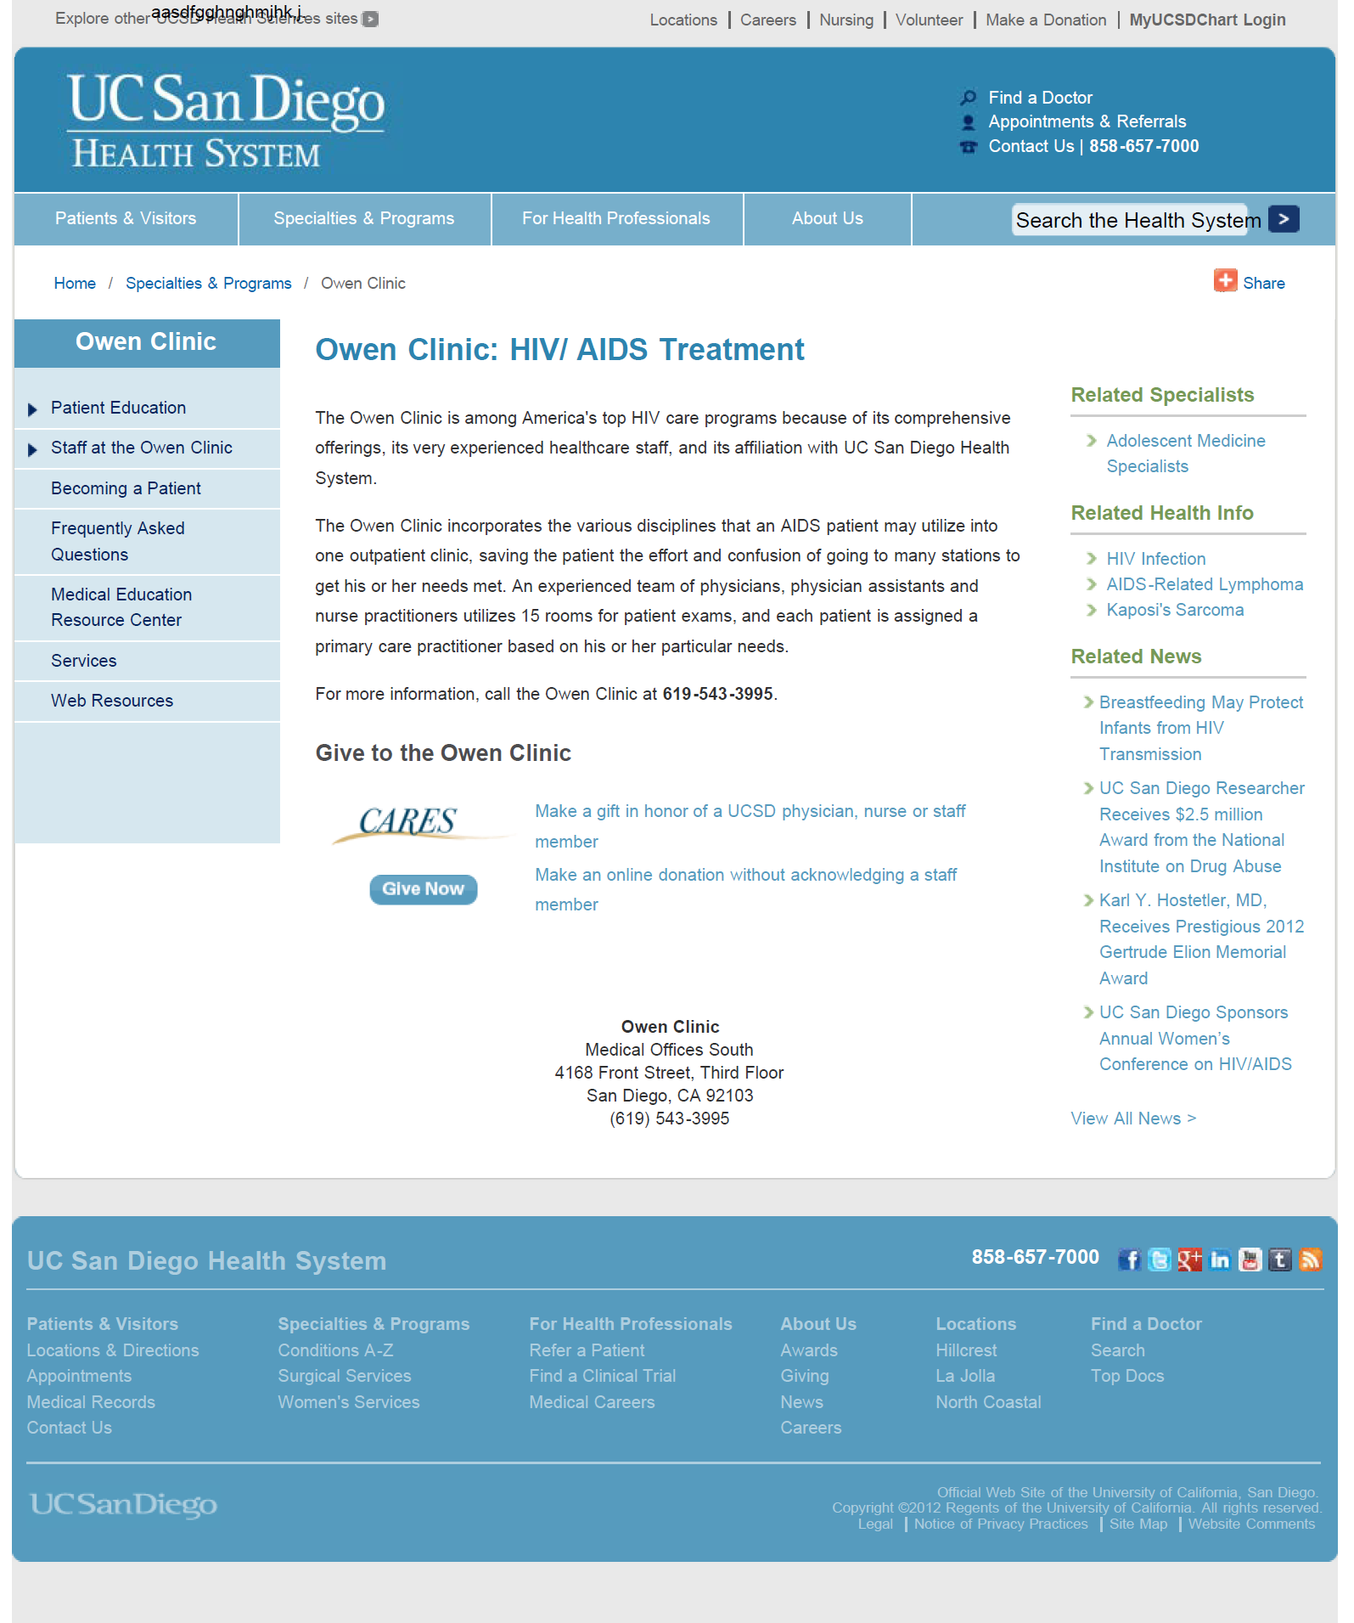
Owen’s Original Web page

Slide 19
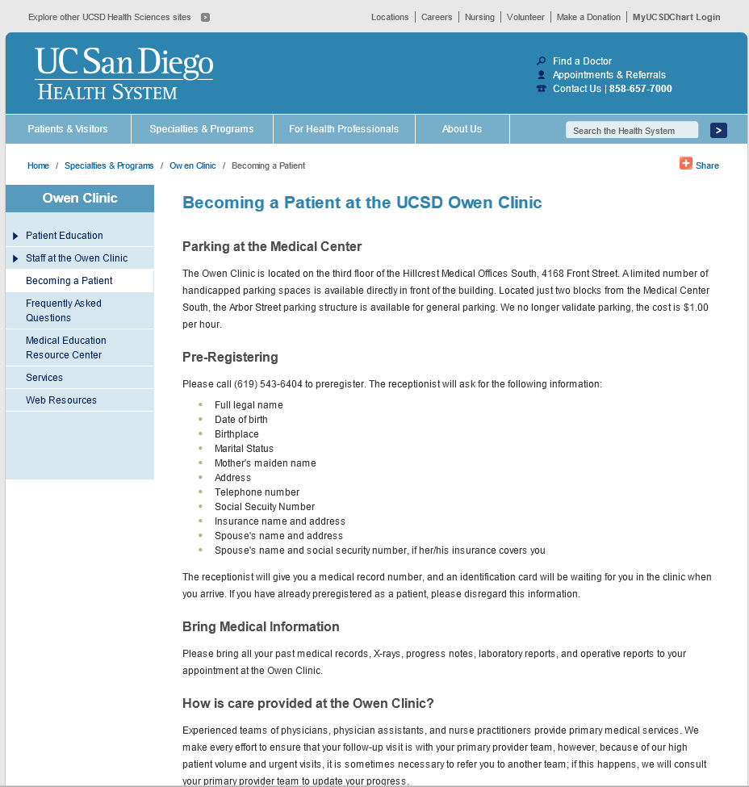

Slide 20
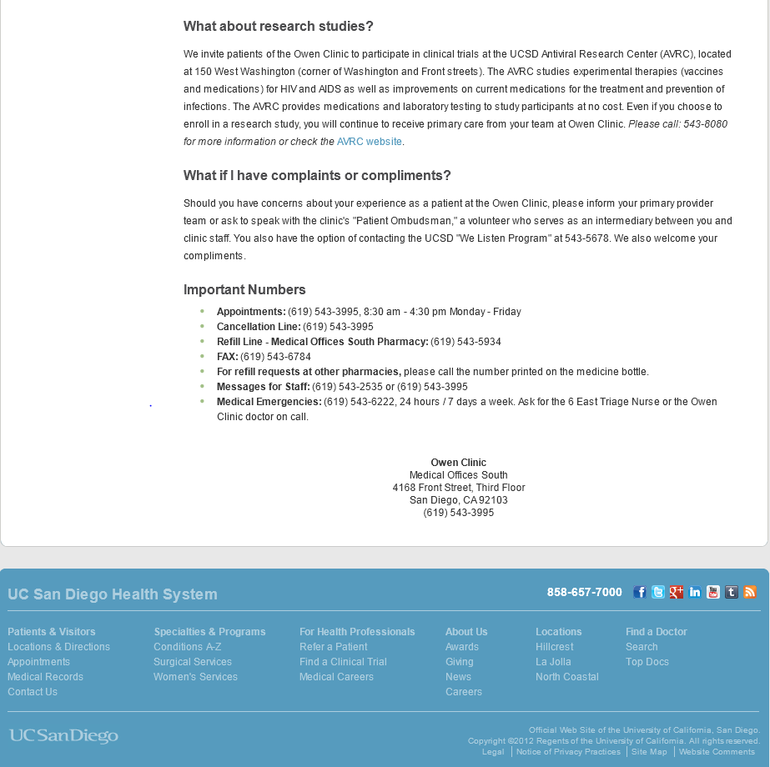

Slide 21
What is a Patient Centered Web-page
CREATE A PATIENT CENTERED WEB-PAGE
  Content development
  Web page design
  Introduction to patients
TOOLS
  Committee Advisory Board/CQI/other stake holders
  Information Technology Team
  3,000 Patients in the Owen clinic

Slide 22
Content Development
To cover patients’ unique needs, we wrote >100 pages
Content was written in a patient centered style
(I am, I have)
Content wording was chosen using CAB advice re:
  unique needs, culture, values and preferences
  translated into Spanish
Handed content to IT to add to our web page
Notes:
Under RW part C we agreed to have 4 CAB during the fiscal year

Slide 23

How do we tailor it to out patients needs???
Committee Advisory Board
    Clean home page
    Less words
    Add visuals
    Be consistent
    Education on related health issues
Notes:
Under RW part C we agreed to have 4 CAB during the fiscal year

Slide 24
Layout Development
Per CAB, patients needed unique layout
The box like navigation structure was not supported
by existing institutional templates
In-house IT recommended contracting out the template build
Negotiation re: CAB design requests
Negotiation re: Contractor price/schedule/design
Negotiation re: IT build within institutional guidelines
Notes:
Under RW part C we agreed to have 4 CAB during the fiscal year

Slide 25
How do you find out what patients want? need?
Ask them!
The Patient Satisfaction Survey for HIV Ambulatory Care, New York State Department of Health AIDS Institute
Administered to 112 patients, with 75 patient responses
Identified access to technology as significant barrier
  72% access to internet at home
  64% internet access from public locations
  39 % cost limit internet access
  33% need more computer training for basic use
Notes:
Make a diagram????
Stake holders: Executives, Compliance , Risk Management, Regulatory
In an effort to gather patient satisfaction and technology use and access data we conducted a patient survey. Between 4/1/2010 and 4/16/2010, the Patient Satisfaction Survey for HIV Ambulatory Care, New York State Department of Health AIDS Institute, was administered to 112 Owen Clinic patients, with 75 patients able to complete the entire survey. Results identified access to technology as significant barriers in our current service delivery model.
72% access to internet at home
64% internet access from public locations
39 % cost limit internet access
33% need more computer training for basic use

Slide 27
HOW DO YOU BUILD PATIENT LITERACY
With access and health information
UCSD Medical Center in Hillcrest, small 750 sq. ft. training computer lab.
Community access terminals
ANCHOR web page

Slide 28
Knowing what our patients need…

Slide 29
We replaced the original Owen Website

Slide 30
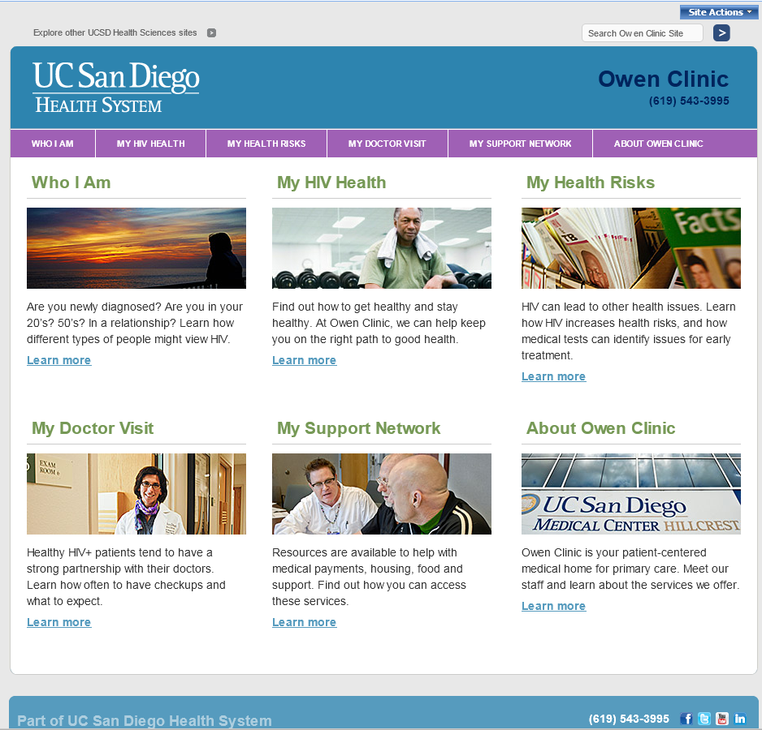
With This!

Slide 31
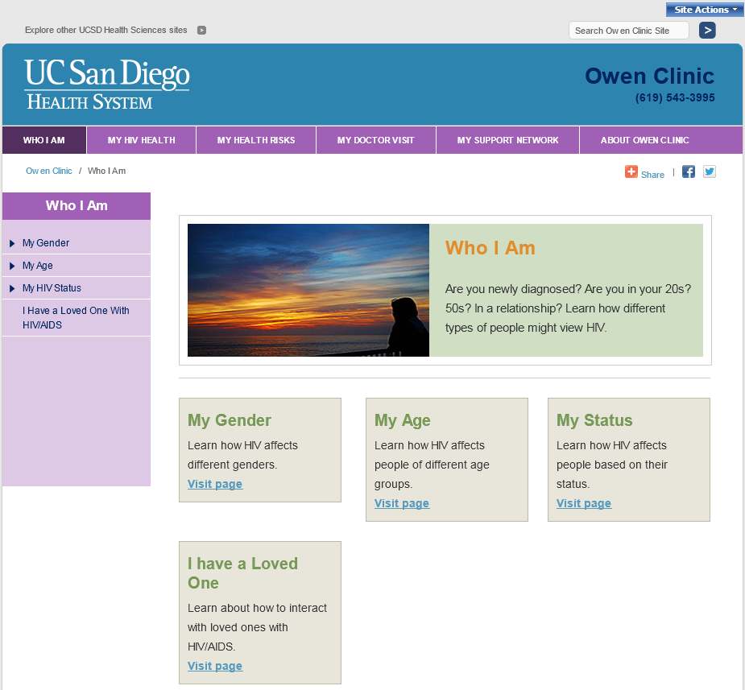

Slide 32
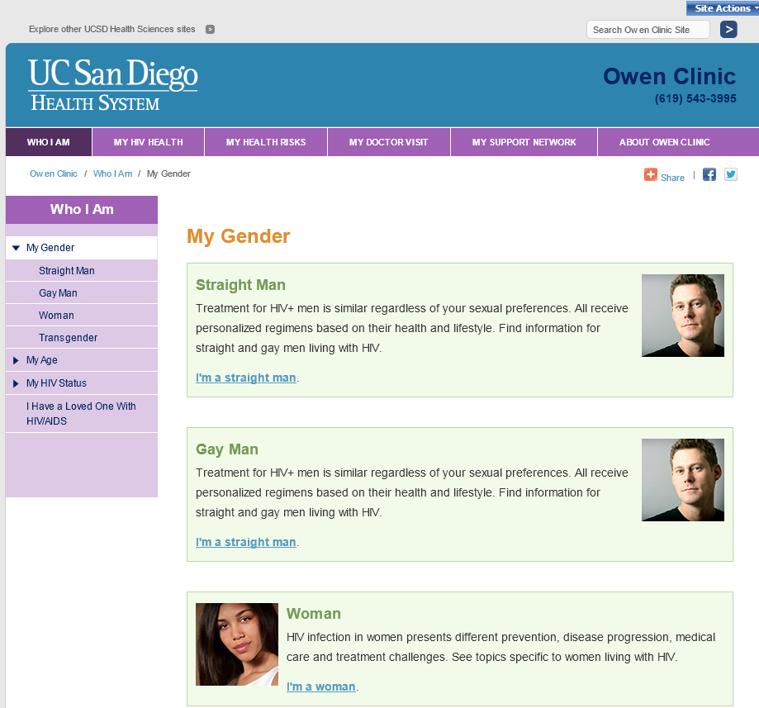
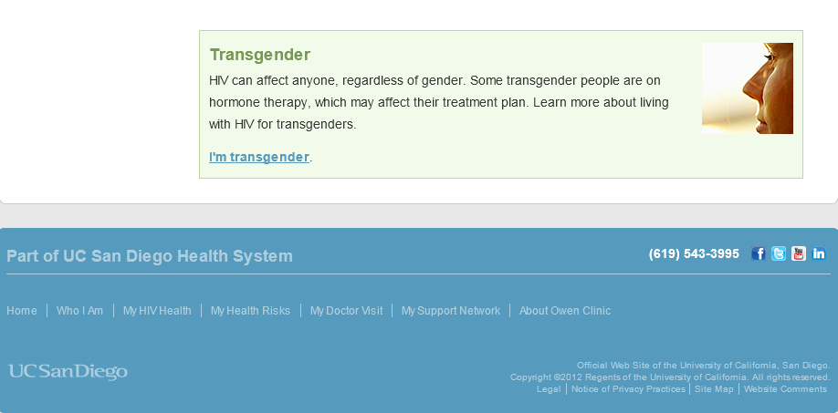

Slide 33
Learning Objective 2
Explain the challenges of PCHM web page implementation

Slide 34


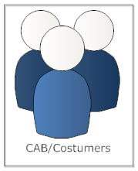



Challenges Part 1

Slide 35

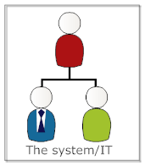



Challenges Part 2

Slide 36
Challenges Part 3, 4, 5, etc.

Slide 37
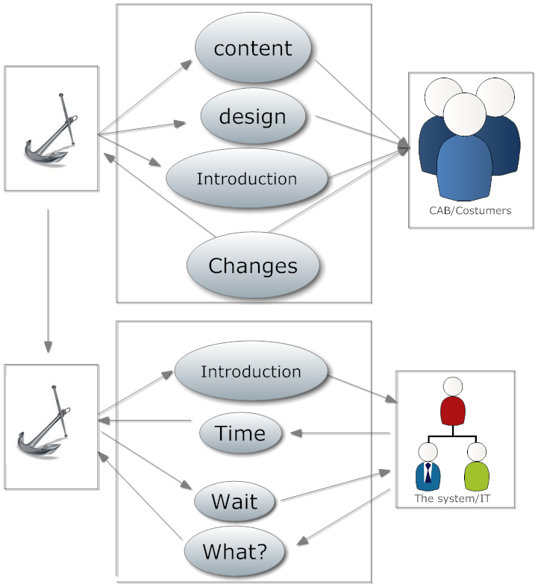
Challenges of PCMH web page implementation

Slide 38


Challenges of PCMH web page implementation
E-Literacy Vision
Experience Level/ Technical Skills/ Bilingual
Content Structure/ Institutional Branding

Slide 39


Technical Considerations
Customization VS Ease of Maintenance

Slide 40
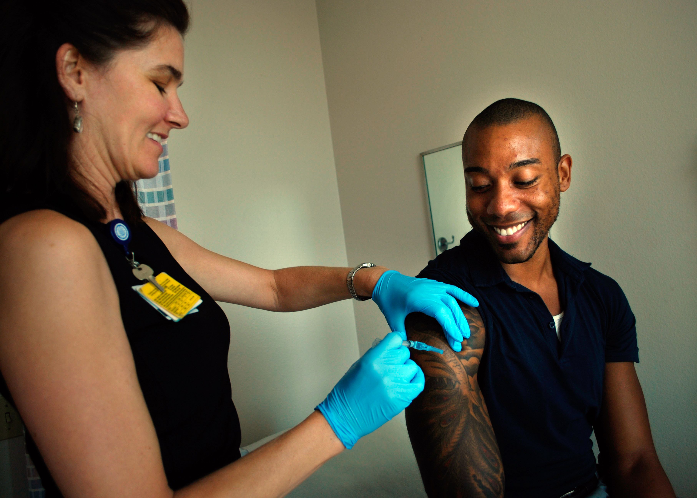

Visuals… make or break your site
Custom
Stock
Custom
You’ll need a lot more than you think. Best to have a mix.
If using custom photography, get consents (specify use)
Many stock photo sites have restrictions on use that would imply model has HIV/AIDS.
Budget and give credit where credit is due

Slide 41
Colors & Fonts
Simple is always better
Use institution style guide (if available)
Start with 1primary color + 1 accent color
Maybe a touch of spice
Clean fonts (sans serif like this Arial)
Not like this Times New Roman
Primary text should be 10-12 pitch

Slide 42
Communicating with Techies
Share samples of websites you like
Create Mock-ups (in Word, PPT, any tool you have)
Phrases we used…..
  Design it like it’s a touch screen interface
  Use color and style to move past the
  “institutional” feeling
During review cycles, use screen capture and PDF markup to communication changes

Slide 43
Learning Objective 3
Describe the process of Patient-Centered Web-page delivery

Slide 44

Notes:
Ask audience how would they do it

Slide 45

Promotion
Create basic, and intermediate computer lessons
Find the right person to conduct the trainings
Provide safe and secure computer access within your facility
Recruit patients and promote computer use
Engage your staff
Spread the word in the community (other clinics)

Slide 46

Lessons learned 1
Listen to your targeted population
Plan at least 6 months to develop the design content
Allow at least 2 months to translate content from one language to another
Plan for future English updates to be translated to Spanish
Make sure your web developer understands your ideas and the target population
Participate in, and closely monitor IT web development
Be ready for negotiation

Slide 47
Lessons learned 2
It is a team effort, and it’s hard make change in the system
It’s also hard change people’s behaviors and beliefs
But… IT IS POSSIBLE

Slide 48

Thanks to the OWEN ANCHOR TEAM:
Moira Mar-Tang
Pavel Tseytlovskiy
Susan Benson
Dorothea Northcutt
Jan Limneos
Dr. Chris Mathews
CQI committee
The California HIV/AIDS Research Program; Award number: MH10-SD-640

Slide 49
Photo credits
The Owen Clinic ©2012 by Moira Mar Tang with Permission
Technical Considerations Slide
Hot Rod by Sids1
http://www.flickr.com/photos/sids1/5338140209/sizes/l/
Reproduced under Creative Commons License
http://creativecommons.org/licenses/by/2.0/
BOSS military spouse’s appreciation day by USAG-Humphreys'
http://www.flickr.com/photos/usaghumphreys/7174846990/sizes/m/in/photostream/
Reproduced under Creative Commons License
http://creativecommons.org/licenses/by/2.0/deed.en
Visuals… make or break your site Slide
NP Giving Shot ©2012 by Moira Mar Tang with Permission
Stock photo :http://office.microsoft.com/en-us/images/results.aspx?qu=doctor&ex=2#ai:MP900422130|

Slide 50
THE END
Thank you

Slide 51
Obtaining CME/CE Credit
If you would like to receive continuing education credit for this activity, please visit:
http://www.pesgce.com/RyanWhite2012

