Slide 1
Planning and Managing a Dental Continuous quality Improvement project Liza Kasmara, Ed.M. Kareem Merrick, DDS Moussa Sanogo, MD, MS, MPH Moderator: Clemens M. Steinböck, MBA

Slide 2
Disclosures
This continuing education activity is managed and accredited by Professional Education Service Group (PESG). The information presented in this activity represents the opinions of the author(s) or faculty. Neither PESG, nor any accrediting organization endorses any commercial products displayed or mentioned in conjunction with this activity
Commercial support was not received for this activity

Slide 3
Disclosures
Liza Kasmara, Ed.M.
Has no financial interest or relationships to disclose
Kareem Merrick, DDS
Has no financial interest or relationships to disclose
Moussa Sanogo, MD, MS, MPH
Has no financial interest or relationships to disclose
Clemens M. Steinböck, MBA
Has no financial interest or relationships to disclose

Slide 4
Learning Objectives
By the end of the workshop, participants will be able to:
Plan and implement a CQI project in their dental clinic
Select and identify performance measures/CQI indicators appropriate for their own dental programs
Identify data collection method and set up data collection procedure
Use performance data to develop and implement CQI activities

Slide 5
Agenda
Agenda Items
Opening Remarks by HAB
Welcome & Introduction
Community-based Partnership Overview
Brainstorming Exercise
Planning and Implementing CQI Project in a Dental Clinic
Facilitated Panel Discussion
Wrap-up and Evaluation
Notes:
Opening Remarks by HAB (5min) - Welcome and Introduction (10min) - Introduction of Speakers - Workshop Expectations/Disclaimers - Ask audience to introduce themselves - Brainstorming Exercise (5min) - what is the most critical barrier to implement effective quality improvement activities in dental programs? - Slide Presentation (30min) - Facilitated Panel Discussion (30min) - Wrap up, Aha Moments and Evaluations (10min

Slide 6
Community-Based Dental Partnership Program (CBDPP)
At Columbia University College of Dental Medicine (CDM) and Harlem United (HU)

Slide 7
CBDPP at CDM & HU
“Dental Care for Hard-to-Reach HIV Populations in New York City”
CBDPP Objectives –
to provide comprehensive dental services for people living with HIV/AIDS (PLWHA) in Harlem and the South Bronx through an integrated and holistic care delivery system
(2) to train community-oriented future dentists in the care of PLWHA
Notes:
Burton

Slide 8
Columbia University College of Dental Medicine (CDM)
Columbia University CBDPP Partner
CDM Section of Social &Behavioral Sciences
Program, research, and teaching intensive interdisciplinary group of 13 non-clinical faculty & staff
CBDPP Team – CDM Members
Public health dentists; Physician/epidemiologist; Dental hygienist/health educator; Dental sociologist
Trainees
AEGD Fellows, DDS-MPH scholars; Dental students
Contributions
CBDPP Program Management; Training, Evaluations/research;
specialty oral health care to HU clients; and
comprehensive oral health care to adolescent patients
Notes:
LK’s suggestion: when we present about trainees (3rd bullet on this slide), we can also talk about involvement of trainees in HU’s CQI program to increase their awareness and capacity in CQI processes;

Slide 9
Columbia University Dental Medicine (CDM)
Clients served –
3500+ PLWHA with multiple complex co-morbidities and high rates of smoking
13 – 24 years olds HIV+ and at-risk youth in “Project STAY (Service To Assist Youth)”
Dental network –
HU offers primary dental treatment for adult clients
CDM offers comprehensive dental treatment for adolescents and dental specialty care on referral from HU
Training program –
Four AEGD Fellows rotate at HU Dental Clinic for 6 months.
DDS-MPH Scholars rotate each semester.
Provider continuity to patients
Train pre-doctoral dental students in basic research methodology and statistical analysis – Involvement in health services evaluations/research activities
Improve trainees’ competency

Slide 10
Harlem United - Overview
Past
Founded at height of first phase of AIDS epidemic: 1988
Specifically to serve people living with HIV/AIDS (PLWH/As) who were homeless and/or suffering from mental illness and/or substance use.
Present
In July 2007, Harlem United received a federally-qualified health center for the homeless (FQHC-H) designation from the Health Resources Services Administration (HRSA)
Agency of last resort for medically-underserved communities of color in Harlem.
Part of community-based movement to care for PLWH/As:
Founded to address lack of response from established providers;
Responding to the unique personal, social, and institutional barriers to care in Harlem
The FQHC-H designation allows HU to expand services to homeless people in Central and East Harlem communities who are predominantly African American and Latino(a) adults, and have histories of substance use and/or mental illness.
In 2012, Harlem United received Patient-Centered Medical Home (PCMH) level 3 accreditation
Notes:
LK
Past:
HU was founded to respond to the AIDS epidemic in the 1980s. Started in the church basement
-Specifically to serve HIV+ because at the time, that was the greatest need for Harlem/Bronx community
Present:
-to respond to the expanding needs in the community & to the healthcare reform, HU expanded services to homeless regardless of HIV status
- PCMH allows HU to provide integrated care, better care coordination for our population with chronic illnesses

Slide 11
Harlem United – Organizational Structure
Community Health Services
Integrated HIV Services
Community Based HIV/STI/HCV Screening
Access to Care
Drug User Health Services (Syringe Access, Harm Reduction, Recovery Readiness)
Black Men’s Initiative – integrated interventions for MSM of color
Adult Day Health Centers
Food & Nutrition
Supportive Housing (Women’s Housing, Transitional Housing, Congregate, etc. )
COBRA Case Management
Family Support
Holistic Provider-Led, Patient-Centered Primary Care and Dental Services
Behavioral Health Services
Patient Navigation/Case Management Support
Notes:
HU’s model of care – Liza
- Harlem United moved from being a three division organization to a two division organization with Primary Care Services and Mental Health Services overlapping both divisions.
The two division model facilitates greater communication and collaboration among programs and individual staff
the model expanded the existing coordination of services, including outreach activities for HIV infected individuals and the homeless.

Slide 12
Harlem United – Dental Clinic
Characteristics of clients served
About 70% are HIV positive
Multiple co-morbidities: asthma, hypertension, diabetes, viral hepatitis, mental illness conditions including depression
About 50% are homeless
Histories of substance abuse & incarceration
Primary dental concerns regarding pain and appearance
Staffing
1 Dental director
1 Part-time dentist
1 Dental Hygienist
4 CDM AEGD Fellows
3 CDM DDS-MPH Scholars
1 Full-time Dental Clinical Coordinator
1 Full-time Dental Receptionist
3 Dental Assistants (2 full-time & 1 part-time)
Notes:
The dental clinic is staffed with the following: 1) Dental Director who oversees the clinic/treats patients a minimum of two full days per week; 2) Part-time dentist who oversees the dental clinic/treats patients a minimum of 3 full days per week; 3) Dental Hygienist who treats patients 3 days; 4) 4 Columbia AEGD Dental Residents who are each in the clinic 2 days each per week; 4) 3 Dental/MPH Columbia Students who are in the Clinic a full day every other week; 5) Full time Dental Clinical Coordinator; 6) Full-time Dental Receptionist; 7) Two full-time Dental Assistants and one part –time Dental Assistant;

Slide 13
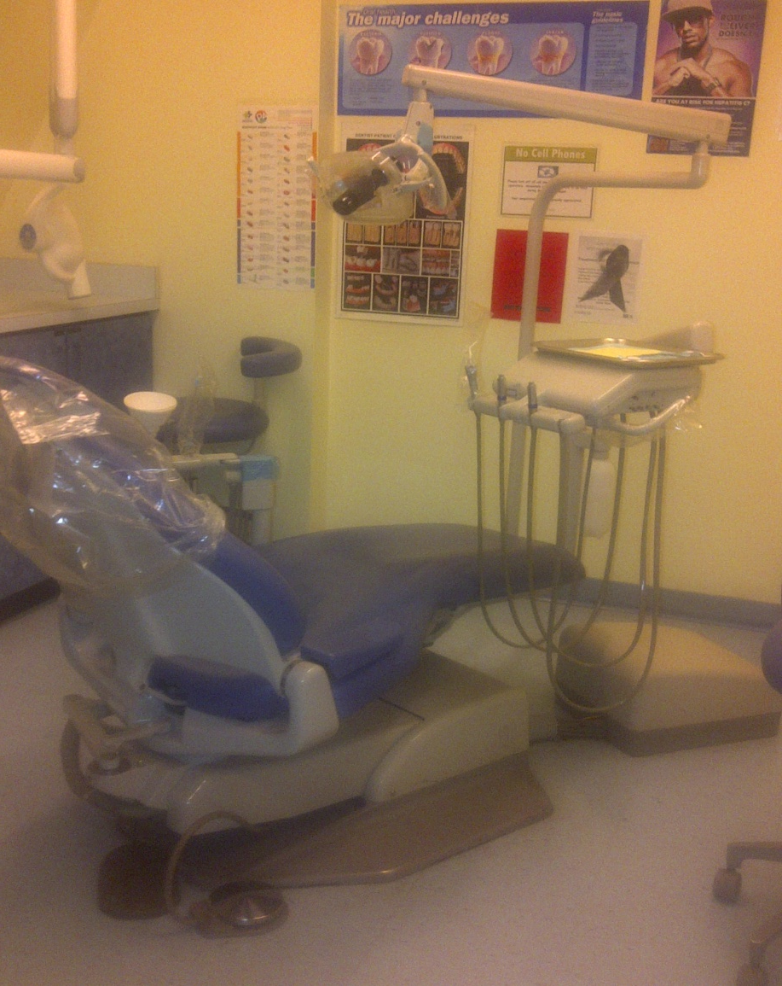
Harlem United – Dental Clinic
Facilities
3 dental operatories
X-ray head in each room
Panorex machine
Modern dental equipment
Services offered
Diagnostic X-rays and Exams
Preventive Care
Emergency Care
Restorations
Endodontics
Prosthodontics
Periodontics
Oral Surgery
Referral to outside specialists for complex Surgical Procedures
Notes:
The Harlem United Dental Clinic houses 3 dental operatories with an x-ray head in each room. In addition, the clinic has a panorex machine. Each operatory is equipped with modern dental equipment which is well-maintained.

Slide 14
Harlem United - Quality Management (QM) Infrastructure
Quality culture
Management Triad
Monthly monitoring of Continuous Quality Improvement (CQI) indicators
Primary Care & Dental QM reporting structure/ leadership
Staff
Data & Evaluation team
Equipment & Technology
Electronic health records
Notes:
LK
PC/Dental QM structure:
Board of Directors
BQMC – meets quarterly, review specific QM issues, evaluate effectiveness of QM efforts
QM Committee –
meets quarterly, responsible for review, administration, implementation and ongoing development of QM plan
annually review the QM plan, the performance measures and outcomes. This document is presented to the BQMC for review and approval.
QMC selects CQI Project Team leaders and members.
CQI project team - meets monthly, responsible for developing a work plan specific to their project.
Assessing resources within Dental clinic
Staff
Data needs
Equipment (computer)
Technology (software, online tool)
Time
Money

Slide 15
Harlem United – Management Triad
Continuous Quality Improvement (CQI): Program-level assessment of service delivery
Administrative Data-driven supervision:
Staff-level assessment (broad) of service delivery
Clinical Supervision:
Staff-level assessment (focused), clinical skills building and trainings
Notes:
Liza
Explain CQI procedure in HU:
-Each program has a list of performance indicators, some funder-driven, some based on best practices/external standard. Agency’s benchmark is 80%
Monthly CQI meetings
Review data
Identify which indicator(s) are bellow benchmark
Select area of focus for CQI – other indicators will be monitored monthly for QA but we won’t develop action plans around it
Brainstorm barriers
Identify possible solutions
Develop action steps – document in CAP
CAP is open for 1 quarter, but if improvement not observed, leave open & monitor & open another CAP
- Pre-CQI (Program Director & Evaluator)

Slide 16
Brainstorming Exercise
What is the most critical barrier to implement effective quality improvement activities in dental programs?

Slide 17
Planning and Implementing CQI project in a Dental Clinic

Slide 18
Getting the project underway
Benefits of having QM infrastructure in place in getting CQI project started
Identifying what need to be done to roll out the project
Data
Defining performance indicators
Determine data collection method/procedure
Staff
Who should be involved
Staff training
Time management
Block staff time for monthly CQI meetings
Block clinic schedule
Allocate staff time for data collection
Notes:
LK, Dr. M
Explain the benefit of having quality culture in getting CQI project started:
We already have the blueprint – easier in implementing QI project since we only need to follow procedures laid out on blueprint
Expertise in house – each program is assigned an evaluator who provides technical assistance (planning/coordinating, consultation on methods/data, assistance with work plans, measuring success, keep meetings on track (give examples in CQI meetings), data analysis)
Leadership is invested in the process
CQI is mandated for all programs at HU
Budget for QI activities
We have technology/software to support QI projects, e.g. SPSS, smart draw, Microsoft office, survey monkey
So, what’s left is planning the details (go back to QI structure, i.e. QMC responsibilities, how CQI project teams are selected)

Slide 19
Challenges in implementing CQI in Dental clinic
Managing staff capacity
Selecting performance indicators that are relevant and meaningful
Database and data reporting limitations
Developing efficient and reliable data collection method/procedure
Notes:
Insert group activity: brainstorm barriers to CQI implementations.

Slide 20
Defining Dental Performance Indicators
Generating a list of indicators to monitor (29 initial indicators):
Selecting indicators to be monitored monthly:
Finalizing indicators to measure performance of Dental clinic:
General indicators (i.e. admin, general health)
Oral Health Quality Indicators recommended by NQC Guideline-based Quality Indicators for HIV Care (http://www.nationalqualitycenter.org/index.cfm/6115/19392)
Defining appropriate denominators for each indicator
16 Oral Health indicators
List of indicators is selected based on a number of factors, e.g. relevance to HU dental population, reporting requirements, internal/external standards, clinic/staff capacity
Notes:
Generating list:
from NQC guidelines
indicators used in the past at HU
Selecting indicators:
Consider: staff capacity/time, relevance to HU dental population
Are old indicators still relevant? Some are not, maybe because: already addressed in other project, too general, not programmatic (in which case, it should be addressed in DDS)
Finalizing indicators:
-Are all indicators relevant for all dental population?

Slide 21
Defining Dental Performance Indicators
 |  | Indicator | Denominator | Data source (Dentrix)
Health history | nqc1a | Is there PCP contact information? | All clients | Document center (Medical hx form) OR Clinical notes
 | nqc1b | Has patient been receiving medical/primary care in the past 6 months? | All clients | Document center (Medical hx form) OR Clinical notes
 | nqc1c | Hep B status documented | All clients | Document center (Medical hx form) OR Clinical notes
 | nqc1d | Hep C status documented | All clients | Document center (Medical hx form) OR Clinical notes
 | nqc1e | If HIV, current HIV medications? | HIV | Clinical notes / Document center (Medical hx form) / Medications
 | nqc1f | If HIV, is there lab data/printout in chart? | HIV | Document Center (scanned labs)
 | nqc1g | CD4 results in the last 6 months | HIV | Document Center (scanned labs)
 | nqc1h | Viral Load results in the last 6 months | HIV | Document Center (scanned labs)
Annual Exam | nqc2 | Documentation of annual intra-oral exam with a dental caries and soft tissue exam | All clients | (1) Go to Progress Note - look at description (periodic oral - 0120, 0160); (2) Go to Clinical Notes
 | nqc3 | Documentation of annual periodontal exam | All clients | (1) Go to Progress Note - look at description (periodic oral - 0120, 0160);(2) Go to Clinical Notes
 | nqc4 | Documentation of annual extra-oral (head and neck) exam | All clients | (1) Go to Progress Note - look at description (periodic oral - 0120, 0160);(2) Go to Clinical Notes
Tx Plan | nqc5 | Written treatment plan that was updated within the past 1 year? | All clients | Progress Notes (status TP) OR Clinical Notes
Oral Health Education | nqc6 | Documentation that client has received education about caries prevention | Clients with teeth | Clinical Notes (initial/hygiene/recall visit, i.e. 0120/0160/1110)
 | nqc7 | Documentation that client has received education about tobacco cessation | Smokers | Clinical Notes (initial/hygiene/recall visit) OR Document center (Medical hx form)
Oral health dx | ai1 | Number of clients who have periodontitis | All clients | Clinical Notes (initial/hygiene/recall visit, i.e. 0120, 0160, 1110)
 | ai2 | Number of clients who wear removable prosthesis | All clients | Teeth chart (blue/green/red color)
Notes:
LK – need to update this table
Denominators for each indicator is specified
The most common place to extract data is noted to make data collection easier

Slide 22
Data Collection Planning
Data collection tool
Hard copy
Sampling method
Random sampling of clients who have dental visit in month of review
Procedure
Data summary
Evaluator provides data summary
50 randomly sampled charts monthly (using randomizer.org)
Distribute list of clients evenly among staff
Staff conducts Dentrix chart review
Data entry specialist enters data into Survey Monkey
Electronic copy (Survey Monkey) for data entry
Developing chart review tool
Staff training on collecting data using chart review tool
Downloads data from Survey Monkey
Summarizes data in CQI table
Notes:
Dr. M will present procedure
Given our resources, how should data collection look like? This is what drives data collection planning
Have to do chart review as data collection method
Staff are all busy on the clinic
Data collection tool:
Based on the fact that we have to do chart review, how should tool look like?
We decided 1 page paper tool since it would be easier for staff to collect data on paper tool
Electronic version was also developed to enter data
Staff was trained on data collection (LK & Sabrina work closely to train staff)
Paper tool was piloted and went through a couple of iterations before finalized (orders was changed around, wordings were adjusted)
Sampling method:
Every month, dental coordinator emails evaluator a list of clients seen in dental clinic within the month of review
Evaluator randomizes the list using randomizer.org
Randomized list is saved in shared drive – evaluator informs coordinator that randomized list is ready
Coordinator work with staff in assigning charts to review
Procedure:
Data entry specialist is not from dental
Data summary:
When data entry done, evaluator downloads data from survey monkey
Check for accuracy & completeness
If not accurate/complete, data collection forms are sent back to staff to fix

Slide 23
Quality Improvement Activities
- Develop problem statement
- Set improvement goal
- Investigate existing process: brainstorm barriers, analyze root cause, identify possible solutions, develop action steps
Evaluate results
Test/Implement Action Steps
Data collection
Random sampling
Chart review
Data entry
- Refine changes as necessary
- Systematize changes
Notes:
LK
Similar as CQI procedure – goes in a cycle, that’s why it’s called Continuous Quality Improvement

Slide 24
Quality Improvement Activities - Example
Collect & review baseline data:
Develop a problem statement:
A large percentage of clients do not have lab documents in their charts, which should be obtained as part of health history assessment. Clients who are medically fragile need to get tests/labs done every 6 months, therefore lab reports in clients’ chart should be updated every 6 months.
Indicator | Oct-11 | Nov-11 | Dec-11
If HIV positive, are there lab reports that are updated within the past 6 months in patient’s chart? | 35% | 48% | 33%
Notes:
Liza:
Dr. M: baseline % is self report.

Slide 25
Quality Improvement Activities - Example
Set a goal for improvement:
The dental clinic will improve care of HIV/AIDS clients by enhancing lab documentation in clients’ charts. In 6 months, 80% of HIV positive clients will have updated lab reports documentation in their charts

Slide 26
Quality Improvement Activities - Example
Investigate the existing process:
Brainstorm barriers:
Clients were not told to bring in their labs
Clients forget to bring their labs
It is challenging to get clients who have outside PCP to bring in their documents
List plans/possible solutions:
Ensure medical clearance forms are completed and scanned into Dentrix
Create an abbreviated form containing list of documents to bring
Conduct reminder call & encourage clients to bring in their labs during the call
Write on clients’ appointment card to bring in their labs
If they are PC clients, front desk staff will print their labs from ECW and scan in Dentrix
Create P&P that clients with no labs can only get certain procedures & mention this P&P to clients during reminder call
Notes:
LK & Dr. M
Dr. M to talk about challenges of having external PCP fax clients’ documents.

Slide 27
Quality Improvement Activities - Example
Develop action plans:
Description of activities to be performed to test solutions, responsible parties, timeframes, and expected results.
Corrective Action Plan (CAP) template
Issues | Plans | Action Steps | Responsible Persons | Target Date | Status Update
Implement action steps outlined in CAP document:
Make sure everyone is aware of which action steps are assigned to them
Identify a champion to make sure that action steps are executed
Notes:
Lk
Action plans should not sit on someone’s desk
Action plans should be distributed to the whole team including to team members who are not directly responsible to execute the action steps
Everyone should be aware of what’s going on
Identify champion to make sure that action steps are executed

Slide 28
Quality Improvement Activities - Example
Evaluate results:
Observe if performance has improved & identify if the target has been met
If necessary, need to slice data to get a more accurate picture of performance and which population to focus on
It might take a while for improvement to be reflected on data
Indicator | Feb-12 | Mar-12 | Apr-12 | May-12 | Jun-12
If HIV positive, are there lab reports that are updated within the past 6 months in patient’s chart? | 57% | 67% | 55% | 74% | 57%
Internal clients | 62% | 67% | 57% | 80% | 62%
External clients | 54% | 67% | 54% | 71% | 54%
Notes:
Update table
- About 60% is external, 40% internal clients

Slide 29
Wrap-up & Evaluation

Slide 30
Data Collection Systems & Challenges
Data collection/chart review
Dentrix issues
Information can be stored in various places making chart review challenging
Dentrix is not report friendly
The version we have is not the most updated version
Data accuracy
Data collection/entry error
Aggregate data may not be accurate – need to slice data to get more accurate performance
It takes time for improvement to be reflected on CQI data
Staff issues
Allocating time for data collection
Limited knowledge
Staff buy-in
Accountability
Notes:
The biggest challenge in data collection is Dentrix
It takes a while for QI to reflect on data
need a lot of digging in to get accurate %
May need to measure shorter term successes
Staff issues
different intellectual level (they don’t look for data at every possible place)
Capacity – staff has to be in the clinic with patients, but have to find time to do chart review
On days with full staff, dental director have some staff rotate out of clinic & do chart review in office
Dental director will probably pull some staff out of chart review

Slide 31
Lessons Learned
Selecting meaningful indicators (NQC, external standards of care, internal needs)
Standardizing documentation
Staff training
Error-proofing data collection process
Consulting with program staff on data interpretation

Slide 32
Summary
Importance of implementing CQI in a Dental Program:
For clients
For providers
For program (ensuring quality of program services)
Significance of community-based partnership
NQC’s role and technical assistance in implementing CQI project

Slide 33
Questions
Notes:
How do you get to your data?
What data collection methods/systems work best for data collection and/or client record system?
How helpful was this presentation?

Slide 34
References
National Quality Center website:
http://www.nationalqualitycenter.org/index.cfm

Slide 35
Obtaining CME/CE credits
If you would like to obtain continuing education credits for this activity, please visit:
http://www.pesgce.com/RyanWhite2012

