Slide 1
Keeping Up With Change: HRSA Technical Assistance & Training
Notes:
HRSA’s Ryan White HIV/AIDS Program provides technical assistance and training to help agencies address the HIV care continuum and adjust to changes in the health care landscape. Learn about available resources from the AIDS Education and Training Centers (AETCs) and others on topics like engaging clients in care, client enrollment in health care coverage, clinician training, fiscal management, and HRSA’s new national projects.

Slide 2
About HRSA/HAB Vision and Mission
Vision
Optimal HIV/AIDS care and treatment for all
Mission
Provide leadership and resources to assure access to and retention in high quality, integrated care and treatment services for vulnerable people living with HIV/AIDS and their families

Slide 3
Purpose of RWHAP
Public health approach to provide a comprehensive system of care
Ensure low-income people living with HIV (PLWH) receive optimal care and treatment
Notes:
Remember why this program exists. It is to provide high-quality HIV care and treatment services to low-income PLWH.
RWHAP has an important role to play in the public health response to HIV. Our clients achieve higher rates of viral suppression than PLWH receiving services elsewhere.
When a person is virally suppressed, they are far less likely to transmit HIV to others.

Slide 4
What Drives Our TA/Training Priorities?
RWHAP Legislation
National HIV/AIDS Strategy
HRSA Priorities
Data: HIV Care Continuum
Notes:
How does HRSA make decisions on what TA and training areas to address?
NHAS outlines the need to focus on given populations, care practices as well as the dispropotionate impact we see geographically.
The National HIV/AIDS Strategy: Updated to 2020 (or NHAS 2020), was released in July 2015.
The vision of the strategy is
“The U.S. will become a place where new HIV infections are rare, and when they do occur, every person, regardless of age, gender, race/ethnicity, sexual orientation, gender identity, or socio-economic circumstance, will have unfettered access to high quality, life-extending care, free from stigma and discrimination.”

Slide 5
HRSA HIV/AIDS Bureau 2016 Priorities
National HIV/AIDS Strategy (NHAS) 2020/President’s Emergency Plan for AIDS Relief (PEPFAR) 3.0 - Maximize HRSA HAB expertise and resources to operationalize NHAS 2020 and PEPFAR 3.0.
Leadership - Enhance and lead national and international HIV care and treatment through evidence-informed innovations, policy development, health workforce development, and program implementation.
Partnerships - Enhance and develop strategic domestic and international partnerships internally and externally.
Integration - Integrate HIV prevention, care, and treatment in an evolving healthcare environment.
Data Utilization - Use data from program reporting systems, surveillance, modeling, and other programs, as well as results from evaluation and special projects efforts to target, prioritize, and improve policies, programs, and service delivery.
Operations - Strengthen HAB administrative and programmatic processes through Bureau-wide knowledge management, innovation, and collaboration.
Notes:
NHAS 2020/PEPFAR 3.0: Maximize HRSA HAB expertise and resources to operationalize NHAS 2020 and PEPFAR 3.0. This includes utilizing our RWHAP and PEPFAR legislations, resources, staff and recipient expertise, national leadership, and partnerships to achieve the goals of NHAS 2020 and PEPAR 3.0.
Examples of focus areas/activities:
• HRSA and HAB level PrEP Workgroups
• RWHAP Part A HIV Continuum of Care Learning Collaborative Initiative
• Global program work in health workforce development and health systems strengthening in the four Fragile States
• Continuous engagement of HAB staff expertise for the development and implementation of NHAS and PEPFAR activities
Leadership: Enhance and lead national and international HIV care and treatment through evidence-informed innovations, policy development, health workforce development, and program implementation.
Examples of focus areas/activities:
• Presenting at the USCA and other high profile meetings to disseminate HRSA policies, HIV care and treatment information and best practices
• Convening the Ryan White HIV/AIDS Program Consultation on Clinical Quality Measurement of Retention in HIV Medical Care
• Staff engagement with opportunities for leadership through workgroups, special projects, Cooperative Agreement and/or contract lead, etc. as well as HRSA leadership training
• Focusing on leadership development by and for people living with HIV
• Development of the National HIV Curriculum with the AETC National Resource and Coordination Center
• Dissemination of best practices through the SPNS Dissemination of Evidence Informed Interventions to Improve Health Outcomes along the HIV Care Continuum Initiative (DEII)
• Developing an HIV health care workforce strategy
• Resilient and Responsive Health Systems in fragile countries
Partnerships: Enhance and develop strategic domestic and international partnerships internally and externally. This includes promoting better collaboration across Divisions, Bureaus/Offices, and HHS OpDivs and other federal agencies in design and implementation of data utilization, programmatic initiatives, communications, and policy development to support service integration and to utilize HRSA, HAB, and partner resources most effectively.
Examples of focus areas/activities:
• Strategic partnerships development work focusing on CDC,SAMSHA, CMS, and HOPWA
• Internal HRSA strategic partnership work with BPHC on service delivery; BHW for workforce development; MCHB for adolescent health and maternal and child health
• Overall Hepatitis C focus and SMAIF Hepatitis C initiative working with BPHC, CDC, and OHAIDP
Integration: Integrate HIV prevention, care, and treatment in an evolving healthcare environment. This includes maximizing opportunities afforded by the healthcare system for preventing infections, increasing access to quality HIV care, and reducing HIV-related health disparities.
Examples of focus areas/activities:
• Quality Management Programs and Quality Measures in the RWHAP and Medicaid
• SPNS Health Information Technology
• Integrated HIV Prevention and Care Plans, including the Statewide Coordinated Statement of Need
• Leveraging opportunities offered by health delivery system reform
Data Utilization: Use data from program reporting systems, surveillance, modeling, and other programs, as well as results from evaluation and special projects efforts to target, prioritize, and improve policies, programs, and service delivery.
Examples of focus areas/activities:
• Continue to document outcomes of the RWHAP and delineate health disparities
• Provide technical assistance to grantees and staff to enhance their capacity
• Focus programmatic, cooperative agreements, and special study investment on specific population focus based on data, e.g. youth, black men who have sex with men, transgender individuals to improve health outcomes
• SPNS Health Information Technology investments
Operations: Strengthen HAB administrative and programmatic processes through Bureau-wide knowledge management, innovation, and collaboration. This includes supporting excellence in HIV care and treatment service delivery and programs by ensuring efficient business and scientific administration, implementing effective communication and policies, and enhancing the skills of current staff.
Examples of focus areas/activities:
• Streamline and improve the site visit, non-site visit, and conference planning processes for travel
• Enhancing communication mechanisms for external and internal stakeholder with an emphasis on staff communications
• Improving SharePoint functionality for workflow processes and information management
• Improving EHB functionality for workflow, dashboard utilization, and reports

Slide 6
Ryan White HIV/AIDS Program Clients (non-ADAP), by Race/Ethnicity, 2014—United States and 3 Territories
* Hispanics/Latinos can be of any race.
Notes:
Nearly three-quarters of RWHAP clients are from racial/ethnic minority populations. In 2014, of the 507,562 clients with reported race/ethnicity information, 47.2% self-identified as black/African American, 22.2% Hispanic/Latino, and less than 2% each American Indian/Alaska Native, Asian, Native Hawaiian/Pacific Islander, and persons of multiple races. Whites accounted for 27.0% of clients. The percentage distribution has remained consistent since 2010.
Hispanics/Latinos can be of any race.
In 2014, 64.2% of the 473,483 RWHAP clients with income information were living at or below 100% of the federal poverty level (FPL), a combined total of 76.3% of clients were living ≤138% FPL (the qualification level for Medicaid eligibility under the Patient Protection and Affordable Care Act).

Slide 7
Viral Suppression, RSR 2010-2014
Viral suppression: ≥ 1 OAMC visit during the calendar year and had ≥1 viral load reported whose last viral load was <200 copies/mL.
Source: HRSA, HIV/AIDS Bureau, Annual Client-Level Data Report, Ryan White Services Report, 2014
Notes:
Rates of viral suppression are going up among clients who receive medical care in the RWHAP. There is still room for improvement but we’re going in the right direction…

Slide 8
Viral Suppression by Race/Ethnicity, RSR 2010-2014
Viral suppression: ≥ 1 OAMC visit during the calendar year and had ≥1 viral load reported whose last viral load was <200 copies/mL.
Source: HRSA, HIV/AIDS Bureau, Annual Client-Level Data Report, Ryan White Services Report, 2014
Notes:
Looking at the rates viral suppression by race/ethnicity…
The scale for viral suppression is from 60% to 90%
Viral suppression lowest in Blacks and Younger people, particularly people of color.

Slide 9
Viral Suppression among Men who have Sex with Men (MSM) Served by the Ryan White HIV/AIDS Program (non-ADAP), 2010‒2014—United States and 3 Territories
Viral suppression: ≥1 OAMC visit during the calendar year and ≥1 viral load reported, with the last viral load result <200 copies/mL.
MSM/IDU: Men who have sex with men who also reported injection drug use as a risk for HIV infection.
Source: HRSA, HIV/AIDS Bureau, Annual Client-Level Data Report, Ryan White Services Report, 2014.
Notes:
Looking at the rates viral suppression by race/ethnicity…
The scale for viral suppression is from 60% to 90%
Viral suppression lowest in Blacks with Asians having the highest rates of suppression.

Slide 10
Viral Suppression among MSM Served by the Ryan White HIV/AIDS Program (non-ADAP), 2014—United States and 3 Territories
Note: N represents the total number of clients in the specific subpopulation.
Viral suppression: ≥ 1 outpatient ambulatory medical care visit during the calendar year and ≥1 viral load reported, with the last viral load result <200 copies/mL.

Slide 11
Viral Suppression Among Women Served by the Ryan White HIV/AIDS Program (non-ADAP), 2014—United States and 3 Territories
Note: N represents the total number of clients in the specific subpopulation.
Viral suppression: ≥ 1 outpatient ambulatory medical care visit during the calendar year and ≥1 viral load reported, with the last viral load result <200 copies/mL.

Slide 12
HRSA/HAB TA and Training Activities

Slide 13
HRSA/HAB TA Resources: Integrating with the Health Care Delivery System
Engaging in Marketplace Insurance Plans Train RWHAP providers of core medical services to contract with qualified health plans
Facilitate client enrollment into health plans as appropriate
Establishing AIDS Service Organization (ASO) Service Models
Train non-medical ASOs to develop business plans to provide services for vulnerable populations
Improve health outcomes across the care continuum
Ryan White HIV/AIDS Program Outcomes within the Context of the Affordable Care Act
Assess effect of services offered post ACA implementation
Develop TA tools to assist recipients navigate insurance marketplace
Notes:
Engaging in Marketplace Insurance Plans
Cooperative agreement; Cicatelli; 7/1/2014 – 6/30/2017
ACE Project
Cooperative Agreement; John Snow Inc (JSI); ends 8/31/2016
Establishing ASO Service Models
Cooperative Agreement; Fenway; 7/1/2014 -6/30/2017
National Center for Innovation in HIV Care

Slide 14
HRSA/HAB TA Resources: Addressing Population Needs
Resource and Technical Assistance Center for HIV Prevention and Care for Black Men Having Sex With Men (MSM-CEBAAC)
Compiling, replicating, and distributing effective models for HIV clinical care & treatment for adult and young (13-24) Black MSM
Building Futures: Supporting Youth Living with HIV
Assessing barriers/gaps in care and current state of HIV infected youth (13-24) receiving RWHAP funded care and treatment
Consultation Meetings & Reports
Completed Consultations 2015 | Planned/Completed Consultations 2016
Women Living with HIV | Leadership of People Living with HIV
Youth Living with HIV | Retention Measure
Trauma and HIV | Pediatric Care Expertise

Slide 15
HRSA/HAB TA Resources: Recap
Current
TARGET Center
ADAP TA
Clinician Training (AETCs)
Data (CAREWare Software, RSR/ADR)
Engaging People in Care
Fiscal Management
Health Care Reform
Health Literacy
National Quality Center
New
Care/Prevention Capacity Building
Community Health Workers and Access to Care
Engaging People in Care & Health Literacy
Hepatitis C
Leadership Training
Integrated Planning
Notes:
TARGET Center Website (UCSF)
National Quality Center (HRI/NYSDOH)
Fiscal Management (HealthHIV)
ADAP TA (NASTAD)
Health Literacy Project (John Snow, Inc.)
HAB Data Support & TA
CAREWare Software
RSR/ADAP Web System Support

Slide 16
HRSA/HAB TA Resources: HRSA
HRSA Project Officers
National TA Contract: TAC
Notes:
HRSA Project Officers: First line of TA for grant recipients.
TA Contract: site visits for grantees

Slide 17
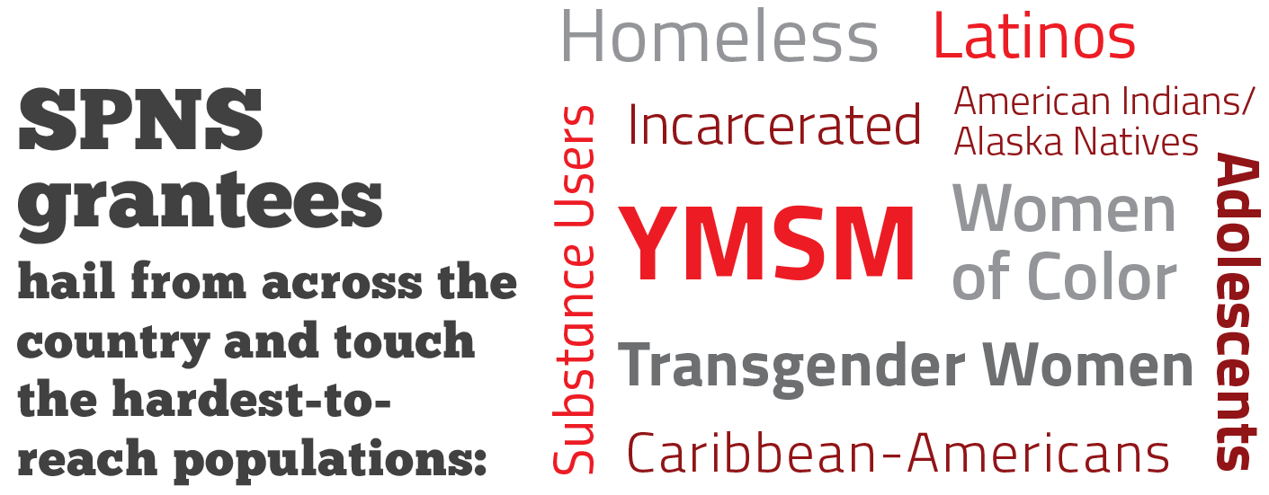
SPNS
Grantees
are located across the country and work with the hardest-to-
-reach populations:
are located across the country and work with the hardest-to-reach populations:
Notes:
And the program focuses on those populations hardest hit by the HIV epidemic.

Slide 18
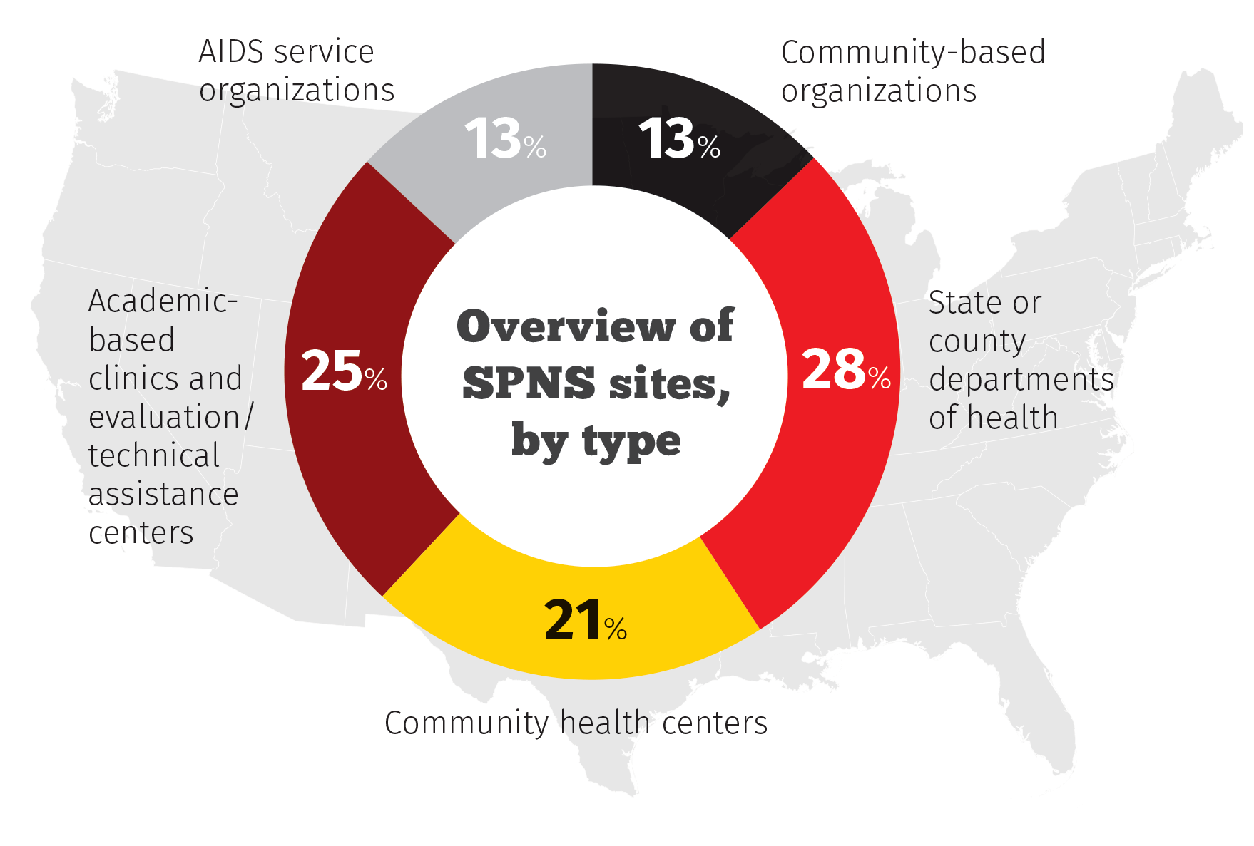
Types of SPNS Recipients 70 Current SPNS Sites
Notes:
SPNS funds a range of grantee types from all across the country.

Slide 19
Disseminating SPNS Best Practices
&

Slide 20
About the AIDS Education and Training Centers (AETC) Program
A national program of leading HIV experts, provides locally based, tailored education and technical assistance to healthcare teams and systems to integrate comprehensive care for those living with or affected by HIV.
Transforms HIV care by building the capacity to provide accessible, high-quality treatment and services throughout the United States and its territories.
Supports the National HIV/AIDS Strategy.

Slide 21
HRSA/HAB TA Resources: AETCs
Regional AETC Training Centers
Three National AETC Centers
AETC National Coordinating Resource Center (NCRC)
AETC National Clinician Consultation Center (NCCC)
AETC National Evaluation Center (NEC)

Slide 22
AETC Programs: Multi-Faceted to Meet Needs at Multiple Levels
National Programs
Provides a National Educational platform with standard Curricula, Resources and Evaluation. RIGHT THING
Regional Programs
Locally based, tailored trainings and educational programs to address immediate training needs. RIGHT PLACE
Training Programs
Training NP/PA practitioners in HIV to care for PLWH in the changing healthcare landscape. RIGHT TIME

Slide 23
AETC Primary Training Focus
HIV care providers:
Physicians, Physician assistants, Nurses, Advanced Practice Nurses, Pharmacists, Dentists/Dental Professionals
Health profession students
Other multidisciplinary HIV care team members

Slide 24
Health Profession Training Programs
Supporting the expansion of accredited graduate nursing and physician assistant programs to include an HIV primary care focus
Physician Assistant Program:
State University of New York Downstate Medical Center
Nurse Practitioner Programs:
Duke University School of Nursing
Johns Hopkins University School of Nursing
University of California San Francisco School of Nursing
Rutgers School of Nursing
Notes:
The NP/PA program trains NP and PAs in HIV/AIDS care and treatment

Slide 25
Connection to HAB Priorities: AETC Program
Regional - Practice Transformation, interprofessional education, collaboration with other RWHAP’s
AETC National Clinician Consultation Center – Substance Abuse Hotline
AETC National Coordinating Resource Center – National HIV Curriculum
National Evaluation Center - Improving use of data to demonstrate impact of training and capacity development activities of the AETC Network of Programs

Slide 26
Mini-Consultation Discussion
How can HRSA/HAB and the RWHAP address the needs of RWHAP recipients and other HIV/AIDS programs?
Within context of the current healthcare landscape
How can HRSA/HAB focus its technical assistance, training, and policy efforts moving forward?
Focus on NHAS 2020 populations
Implementation impact of NHAS on TA, training and policy efforts

Slide 27
Resources
HRSA HIV/AIDS Bureau
http://hab.hrsa.gov
Ryan White TARGET Center
http://targethiv.org

Slide 28
THANK YOU!
April Stubbs-Smith, MPH
Director, Division of Domestic HIV Programs
HRSA/HAB/Office of Training and Capacity Development
301-443-7813
Astubbs-smith@hrsa.gov

