Slide 1
HRSA Innovative Service Models & Best Practices
2017 USCA: HRSA Pathway
Special Projects of National Significance Program
Building a Medical Home for Homeless HIV Positive Populations Initiative
Melinda J. Tinsley, MA
Project Officer
Special Projects of National Significance (SPNS)
HIV/AIDS Bureau (HAB)
Health Resources and Services Administration
Notes:
Introduction Slide
The intersect between HIV health care and housing data utilization and service provision is a truly complicated one, so I appreciate the innovation and dedication you all are doing in your data integration projects to explore ways in which we can increase efficiencies in the service delivery for PLWH in need of housing support to close the gap and improve health outcomes along the HIV care continuum.
Some updates from the HAB, specific to housing and the SPNS Program.
.

Slide 2
Ryan White HIV/AIDS Program Framework
Vision
Optimal HIV/AIDS care and treatment for all.
Mission
Provide leadership and resources to assure access to and retention in high quality, integrated care, and treatment services for vulnerable people living with HIV/AIDS and their families.
Notes:
CLEARED
Several years ago, our leadership examined all of the ways our program works towards achieving our vision and mission and came up with this infographic. The middle of the graphic details our goal of optimal HIV care and treatment for all using a public health approach and a comprehensive care system. The petals represent all of the ways our agency and our local partners work toward achieving these goals They include creating service delivery systems for low-income people living with HIV, implementing and advising on policies related to HIV treatment: assessment of both individuals with HIV and HIV care systems; capacity development; and clinical quality management.
Vision
Optimal HIV/AIDS care and treatment for all.
Mission
Provide leadership and resources to assure access to and retention in high quality, integrated care, and treatment services for vulnerable people living with HIV/AIDS and their families.

Slide 3
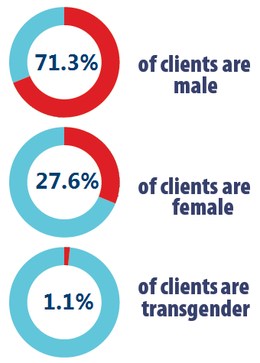
Select Demographic Characteristics of Clients Served by the Ryan White HIV/AIDS Program 2015 —United States and 3 Territoriesª
ª Guam, Puerto Rico, and the U.S. Virgin Islands.
Source: HRSA. Ryan White HIV/AIDS Program Annual Client-Level Data Report 2015. Does not include clients served by the AIDS Drug Assistance Program.
Notes:
CLEARED
WHO IS SERVED BY THE RWHAP?
In 2015, the RWHAP served just over 533,000 clients, 97% of whom were living with HIV. Our client population accounts for more than half of all people living with diagnosed HIV infection in the US, according to HIV Surveillance data.
Nearly three-quarters (73%) of RWHAP clients are from racial/ethnic minority populations, approximately two-thirds (65%) are living at or below the poverty line, and about 80% of clients have some form of health care coverage.
Nearly 80% of RWHAP clients have some form of health care coverage.
Looking at the data by gender, in 2015, 71% of clients were male, 28% were female, and 1% were transgender. Of note, this equates to over 6,000 transgender clients served by the RWHAP.
Male 379,173 71.3
Female 146,623 27.6
Transgender 6,020 1.1
The demographics of the RWHAP clients served are very similar to the demographics of HIV in the United States. That RWHAP clients reflect PLWH in the United States demonstrates the responsiveness of the program to the epidemic.

Slide 4
Viral Suppression among Clients Served by the Ryan White HIV/AIDS Program 2010–2015—United States and 3 Territories ª
It is estimated that 54.7% of people in the U.S. diagnosed with HIV are virally suppressed.
(Source: Centers for Disease Control and Prevention. Monitoring selected national HIV prevention and care objectives by using HIV surveillance data—United States and 6 dependent areas—2014. HIV Surveillance Supplemental)
Viral suppression: ≥1 OAMC visit during the calendar year and ≥1 viral load reported, with the last viral load result <200 copies/mL.
ª Guam, Puerto Rico, and the U.S. Virgin Islands.
Source: HRSA. Ryan White HIV/AIDS Program Annual Client-Level Data Report 2015. Does not include clients served by the AIDS Drug Assistance Program.
Notes:
CLEARED
First, we can take a look at the proportion of clients with viral suppression from 2010 to 2015. Here we can see that overall, viral suppression has increased steadily from 69.5% in 2010 to 83.4% in 2015.
The Centers for Disease Control and Prevention estimates that in the United States, 54.7% of people diagnosed with HIV are virally suppressed.
Viral suppression outcomes lower among:
Younger age groups (13–24 years)
Specific minority populations
Clients with unstable housing

Slide 5
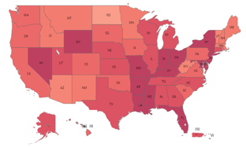
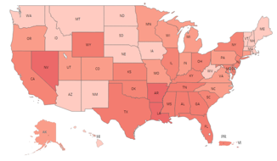
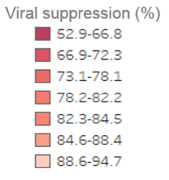
Viral Suppression among Clients Served by the Ryan White HIV/AIDS Program, by State, 2010–2015—United States and 2 Territoriesª
83.4%
IN 2015
VIRALLY SUPPRESSED
69.5%
IN 2010
VIRALLY SUPPRESSED
Viral suppression: ≥1 OAMC visit during the calendar year and ≥1 viral load reported, with the last viral load result <200 copies/mL.
ª Puerto Rico and the U.S. Virgin Islands. Due to low numbers, data for Guam are not presented.
Source: HRSA. Ryan White HIV/AIDS Program Annual Client-Level Data Report 2015. Does not include clients served by the AIDS Drug Assistance Program.
Notes:
CLEARED
Among clients served by the RWHAP, viral suppression has increased steadily over the past six years, from 69.5 in 2010 to 83.4% in 2015. This slide shows the variation in viral suppression by state in 2010 and in 2015, with darker red indicating lower rates of viral suppression – so the lighter the better. The Centers for Disease Control and Prevention estimates that in the United States, 54.7% of people diagnosed with HIV are virally suppressed.
Each year, we can see quite a bit of variation by state; however, we can also note from these slides the great progress that has been made from 2010 to 2015 – across all states.
It is important to note that challenges remain in achieving viral suppression for certain key populations. Most notably, in 2015, the client subpopulations with viral suppression lower than the overall rate of 83.4% were Black/African American clients, transgender women, youth aged 13-24 years, and those who are unstably housed. (BOLD indicates specifically named populations of focus in the TCE FOAs)
We are working to address these disparities. Just as you are here as a part of a program seeking to address the substance use disorder needs of some of the same populations who are at high-risk for HIV infection.
SOURCE: CDC source: Centers for Disease Control and Prevention. Monitoring selected national HIV prevention and care objectives by using HIV surveillance data—United States and 6 dependent areas, 2014. HIV Surveillance Supplemental Report 2016;21(No. 4). http://www.cdc.gov/hiv/library/reports/ surveillance/. Published July 2016.
[Define viral suppression: Viral suppression: ≥1 OAMC visit during the calendar year and ≥1 viral load reported, with the last viral load result <200 copies/mL.]

Slide 6
Ryan White Services Report, 2015 RWHAP Clients by Housing Status
Source: HRSA. Ryan White HIV/AIDS Program Services Report (RSR) 2015) – US and 3 Territories (Guam, PR, USVI). Does not include AIDS Drug Assistance Program data.
Notes:
From HAB cleared slide deck
These graphics show our housing status numbers. You may note that the denominator is slightly lower then our entire Ryan White HIV/AIDs Population. That is because housing status is a required data point only for clients who received outpatient ambulatory medical care, medical case management, non-medical case management, or housing services.
In 2015, of the 509,509 clients with reported housing status, 9.8% had temporary housing and 5.0% had unstable housing.

Slide 7
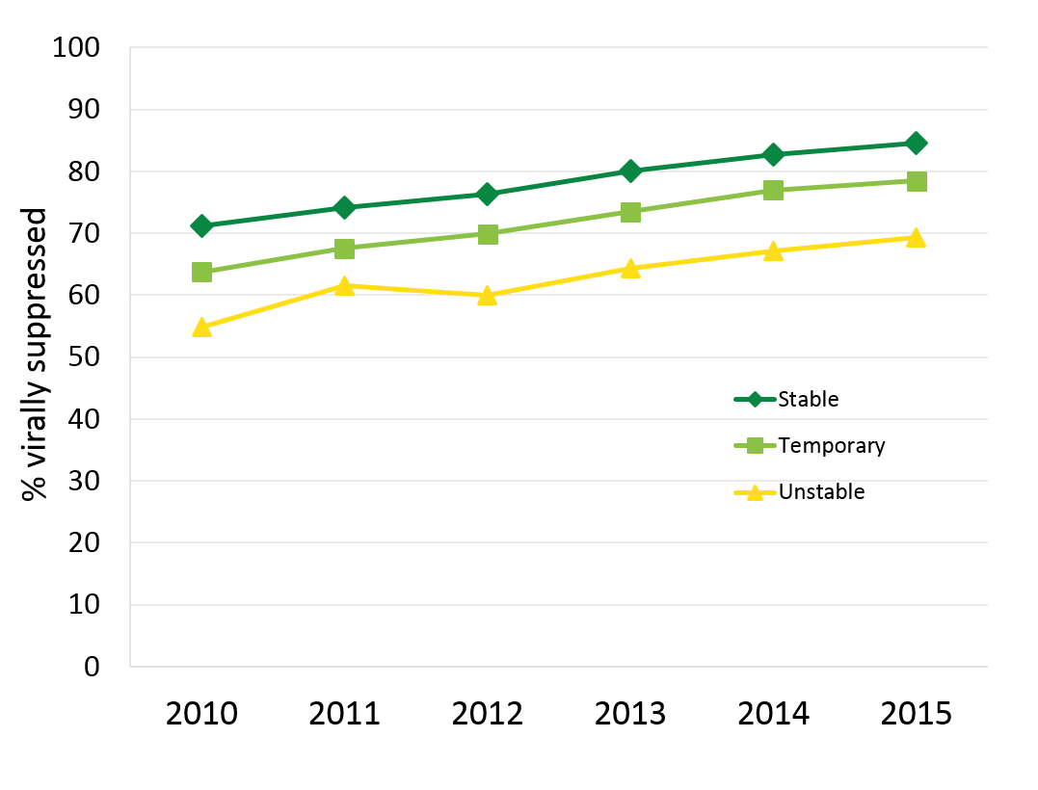
Viral Suppression among Clients Served by the Ryan White HIV/AIDS Program, by Housing Statusª
Viral suppression: ≥1 outpatient/ambulatory medical care visit during the calendar year and ≥1 viral load reported, with the last viral load result <200 copies/mL.ª Guam, Puerto Rico, and the U.S. Virgin Islands.
Source: HRSA. Ryan White HIV/AIDS Program Services Report (RSR) 2015. Does not include AIDS Drug Assistance Program data
Notes:
CLEARED
Closing the gaps…..
See trend over time by housing status....improvement overall, but gaps still persist.
Clients served by the RWHAP with temporary or unstable housing continue to have the lowest percentages of viral suppression, although percentages are steadily increasing. Among temporarily housed clients, viral suppression increased from 63.7% in 2010 to 78.4% in 2015. Among unstably housed clients, viral suppression increased from 54.8% in 2010 to 69.3% in 2015.
Viral suppression is defined as ≥1 outpatient/ambulatory medical care visit during the calendar year and ≥1 viral load reported, with the last viral load result <200 copies/mL.
The three territories include Guam, Puerto Rico, and the U.S. Virgin Islands.

Slide 8
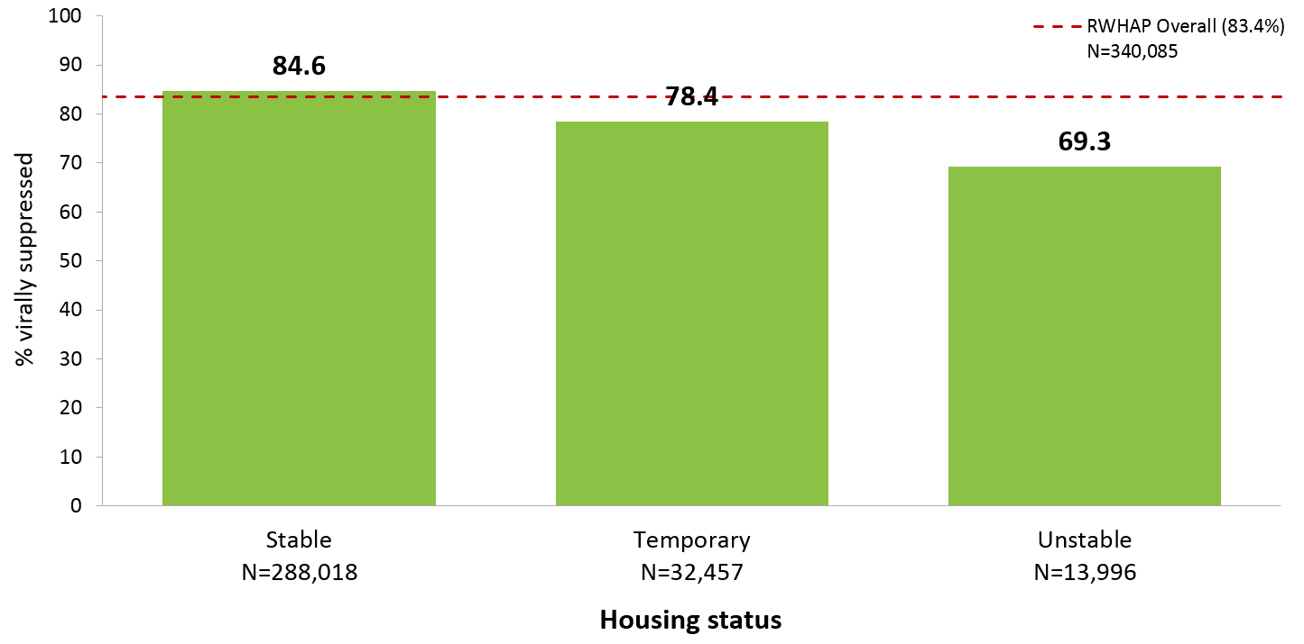
HIV, Homelessness, & Suppression
Ryan White Services Report, 2015 Viral Suppression by Housing Status
N represents the total number of clients in the specific subpopulation.
Viral suppression: ≥1 outpatient/ambulatory medical care visit during the calendar year and ≥1 viral load reported, with the last viral load result <200 copies/mL.
Source: HRSA. Ryan White HIV/AIDS Program Services Report (RSR) 2015) - US and 3 Territories (Guam, PR, USVI). Does not include AIDS Drug Assistance Program data.
Notes:
CLEARED
Viral Suppression among Clients Served by the Ryan White HIV/AIDS Program (non-ADAP), by Housing Status, 2015—United States and 3 Territories
In 2015, viral suppression varied by housing status; 69.3% of clients with unstable housing achieved viral suppression, compared to 78.4% of clients with temporary housing and 84.6% of clients with stable housing.
N represents the total number of clients in the specific subpopulation.
Viral suppression is defined as ≥1 outpatient/ambulatory medical care visit during the calendar year and ≥1 viral load reported, with the last viral load result <200 copies/mL.
The three territories include Guam, Puerto Rico, and the U.S. Virgin Islands.

Slide 9
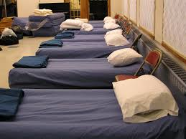
Ryan White HIV/AIDS Program Why Housing Support?
In 2015, 9.8% of RWHAP clients had temporary housing and 5.0% had unstable housing situations
Populations identified as most at-risk for exposure to HIV or poor HIV health care outcomes experience highest rates of unstable housing (youth, people who inject drugs [PWID], transgender persons)
Clients with unstable housing have lower rates of retention in medical care and viral suppression compared to clients with stable or temporary housing
Source: HRSA. Ryan White HIV/AIDS Program Services Report (RSR) 2015).
Notes:
So why do HIV health care providers care about housing services?
In 2015, 9.8% of clients experienced temporary housing and 5% unstable housing which includes homelessness.
Populations identified as most-at risk for poor health outcomes including youth, men who have sex with men, and transgender individuals among others also experienced the highest rates of unstable housing.
And unstable housing was one of the largest predictors of poor medical retention and an unsuppressed viral load.
Under Title XXVI of the Public Health Service Act, recipients receiving Ryan White HIV/AIDS Program Part A, B, and/or C funds are required to spend at least 75% of grant funds on Core Medical Services:
Support services examples include:
Respite care for persons caring for individuals with HIV/AIDS
Outreach services
Medical transportation
Linguistic services
AND Housing Support

Slide 10
The Ryan White HIV/AIDS Program Support Services
Under Title XXVI of the Public Health Service Act, recipients receiving Ryan White HIV/AIDS Program Parts A, B, and/or C funds are required to spend at least 75% of grant funds on Core Medical Services:
In the Ryan White HIV/AIDS Program, up to 25% can be spent on support services defined as services that are needed for individuals with HIV/AIDS to achieve their medical outcomes. Examples include:
Medical transportation
Outreach services
Housing Services
Linguistic services
Referrals for health care and support
Notes:
Previously CLEARED (combined 2 cleared slide decks)
One small change to previously cleared slides- added “up to 25%....” for support services., with Housing Services bolded as a support service

Slide 11
The Ryan White HIV/AIDS Program Housing Support
Housing support services funded under Ryan White HIV/AIDS Program Parts A, B, and D.
Allowable services include (Policy Clarification Notice 11-01):
Housing referral
Short-term or emergency housing
Program Guidelines for Housing Support:
Must be payer of last resort
Must ensure that housing is limited to short-term support
Must develop mechanisms to allow new clients access to housing services
Must develop long-term housing plans for every client in housing
Notes:
In a limited way the Ryan White HIV/AIDS programs funds a number of services under Part A to eligible cities, Part B to state health departments, and Part D to community-based health centers serving families, women, and children. HRSA understand that homelessness and unstable housing affect the ability of persons living with HIV and AIDS to engage in treatment services. From its inception, the Ryan White program has supported not only the provision of housing services, but the importance of collaboration and coordination with housing providers. Because of this the services allowable under the Ryan White Program complement and support those offered by the HUD rather than supplant +them. The overall goal is to minimize housing disruptions for clients, provide recipients flexibility to respond to exceptional situations, and strengthen collaboration both at the Federal and Local level. (source policy notice 11-01)
Specifically HRSA funds the following housing services through the Ryan White HIV/AIDS program (source Policy Notice 11-01):
Housing Referral services defined as assessment, search, placement and advocacy services provided by a case manager
Short-Term or Emergency Housing defined as necessary to gain or maintain access to medical care. Housing must fall into one of two categories:
Residential services that include some type of medical or supportive service such as substance abuse or mental health treatment
Housing services that are essential for an individual or family to maintain or access HIV-related medical care or treatment.
The Ryan White program places parameters around the use of Housing to ensure that Ryan White funds do not supplant but complement those available through HUD. The include:
RWHAP funds can only be used to support other local, state and federal housing programs.
RWHAP programs are encouraged to work through local planning bodies and to set time limits to ensure that services are a stop-gap resource.
Recipients must coordinate with housing to ensure access for newly identified clients.
If the RWHAP program pays for housing services, the client must have a long-term housing plan. HAB reserves the right to review these plans as part of overall program monitoring.
Housing services may be funded under Ryan White Parts A, B, C, and D. The goal of our housing services category is to supplement existing housing services such as the HOPWA program not supplant those services. To do that we fund short term, transitional, or emergency housing services as well as services designed to help people find and access more permanent housing options.
Some program guidelines. Again RWHAP must be the payer of last resort. We cannot fund permanent housing and each client must have a service plan to help them move towards permanent housing.
Using these guidelines our recipients have designed programs that pay for people’s rent or utilities when it is past due, pay for staff to help people find and get to permanent housing appointments, and population specific housing programs that include rental fees, direct observed therapy, and linkages to other services such as employment services.

Slide 12
How Can Ryan White HIV/AIDS Program Recipients Support Housing?
Examples of coordination may include some of the following:
Inclusion of housing services in planning processes and procurement
Focus on housing for needs assessment studies
Co-located housing and care services
Targeted adherence programs for PLWH experiencing unstable housing
Enhanced strategic relationships with housing providers/experts
Inclusion of a housing indicator as a risk for non-adherence and/or medical retention
Assessment of housing status as part of a care plan
Resource commitment as appropriate
Notes:
While some recipients do not directly fund housing many use Ryan White HIV/AIDS Program services to coordinate with other existing housing services. These are some examples of the ways housing is coordinated.

Slide 13
RWHAP Resources
Ryan White HIV/AIDS Program
https://hab.hrsa.gov/about-ryan-white-hivaids-program
Policy Clarification Notice #16-02: Ryan White HIV/AIDS Program Services: Eligible Individuals & Allowable Uses of Funds
https://hab.hrsa.gov/sites/default/files/hab/program-grants-management/ServiceCategoryPCN_16-02Final.pdf
Ryan White HIV/AIDS Program Annual Client Level Data Report, 2015
https://hab.hrsa.gov/sites/default/files/hab/data/datareports/2015rwhapdatareport.pdf

Slide 14
Special Projects of National Significance (SPNS)—Purpose & Mission
SPNS is a component of the Ryan White HIV/AIDS Program, funded under Part F of the Ryan White HIV/AIDS Treatment Extension Act
SPNS Program supports the development of innovative models of HIV care to quickly respond to the emerging needs of clients served by the Ryan White HIV/AIDS Program
SPNS evaluates the effectiveness of these models’ design, implementation, utilization, cost, and health-related outcomes, while promoting dissemination and replication of successful models
Mission
Provide HIV service delivery through demonstration projects and evaluation focused primarily on underserved and uninsured populations
Notes:
CLEARED
SPNS is a component of the Ryan White HIV/AIDS Program, funded under Part F of the Ryan White HIV/AIDS Treatment Extension Act
The SPNS Program supports the development of innovative models of HIV care to quickly respond to the emerging needs of clients served by the Ryan White HIV/AIDS Program
SPNS evaluates the effectiveness of these models’ design, implementation, utilization, cost, and health-related outcomes, while promoting dissemination and replication of successful models
CLEARED
SPNS mission is focused on studying models of care to best identify and meet the needs of primarily underserved and under or uninsured populations.
Indeed SPNS’ mission is focused on studying models of care to best identify and meet the needs of primarily underserved and under or uninsured populations.
SPNS is a component of the Ryan White HIV/AIDS Program, funded under Part F of the Ryan White HIV/AIDS Treatment Extension Act
SPNS Program supports the development of innovative models of HIV care to quickly respond to the emerging needs of clients served by the Ryan White HIV/AIDS Program
SPNS evaluates the effectiveness of these models’ design, implementation, utilization, cost, and health-related outcomes, while promoting dissemination and replication of successful models
A SPNS directive has been to respond to emerging HIV primary care needs of grantees and providers under the Ryan White program.

Slide 15
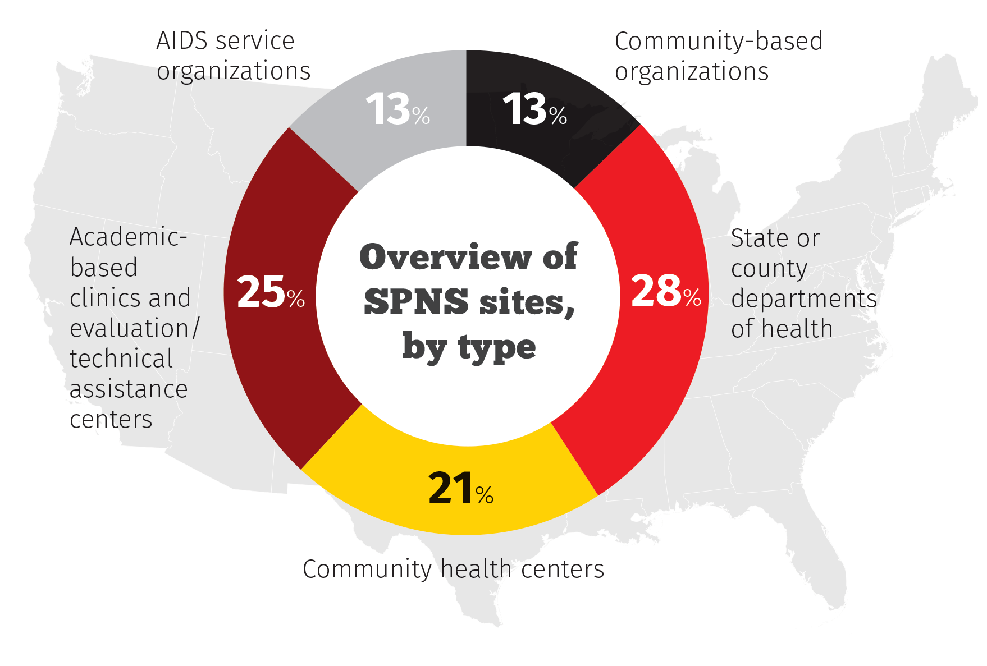
Types of SPNS Grantees 70 Current SPNS Sites
SPNS recipients represent public and private nonprofit organizations that serve people living with HIV/AIDS.
Notes:
CLEARED
SPNS funds a range of grantee types from all across the country.
More often than not, our grantees are your grantees. The SPNS demonstration models are implemented in a variety of settings from CBOs to FQHCs, CHCs and ASOs.
We have grantees who are Part C providers while others are contracted to provide services by their State or EMAs.
Demonstration Projects:
Community-based organizations, hospitals/clinics, Community Health Centers, ASOs, academic-based clinics, FQHCs, faith-based organizations
Commitment to participate in rigorous evaluation, both multi-site and local
Focus on dissemination, replication, and sustainability of proven successful models
6 to 10 projects per initiative
The traditional SPNS Initiative is set up to fund one Evaluation and Technical Center and a cohort of anywhere from 6 – 10 Demonstration sites. The Evaluation and Technical Assistance Center or ETAC is funded as a cooperative agreement to
Provide Technical Assistance to the Demonstration projects over the course of the initiative. TA domains include
Program Development, Implementation and Sustainability
Clinical Consultation.
Multi-site and local evaluation methods
Human Research Subjects Protection and IRB
Intervention Manuals to document the methodology, implementation and outcomes of grantee’s intervention project and guide its potential replication in the future.
2) Serve as a Capacity Building Resource: when necessary, the ETAC may conduct capacity building activities for the demonstration projects as appropriate that relate to the provision of quality clinical and culturally competent HIV primary care
3) Conduct a Rigorous Multi-Site Evaluation
4) Lead and Coordinate Publication and Dissemination of Findings and Lessons Learned

Slide 16
Notes:
CLEARED

Slide 17
Build and maintain sustainable linkages to mental health, substance abuse treatment, and HIV/AIDS primary care services
http://medheart.cahpp.org/
Notes:
CLEARED
Homeless persons living with HIV who also have persistent mental illness and substance use disorders present a formidable challenge for public health authorities seeking to engage and retain them in HIV primary care. Earlier slides highlighted a few key data points as of 2015. When this initiative was originally awarded in 2012, the SPNS program noted some key points:
The prevalence of substance abuse and mental illness among the homeless is much higher than the general population. The 2010 AHAR also reported that 26.2 percent of its sheltered adults had a severe mental illness;
34.7 percent had a substance abuse problem; and
12.3 percent were survivors of domestic violence.
As with HIV, treatment for homeless people with mental health disorders and substance abuse problems poses an enormous challenge.
A Los Angeles study of 1,563 homeless persons found that two-thirds were chemically dependent and 22 percent had mental health disorders, with significant overlap between the two groups.
However, only one-fifth had received mental health or substance abuse treatment in the past 60 days.
Fischer PJ and Breakey WR. The epidemiology of alcohol, drug, and mental disorders among homeless persons. The American Psychologist, 1991 November; 46 (11): 1115-1128.
HUD, 2010 AHAR, p. 18
Koegel P, Sullivan G, Burnam A et al. Utilization of Mental Health and Substance Abuse Services Among Homeless Adults in Los Angeles. Med Care. 1999 Mar;37(3):306-17.
The SPNS program awarded the Building a medical home for HIV positive multiply diagnosed homeless populations with the following primary goals:
Improve timely entry, engagement and retention in HIV care and supportive services
Build and maintain sustainable linkages to mental health, substance use treatment and HIV primary care
Increase access to stable/permanent housing
Create a medical home for HIV positive, multiply-diagnosed homeless/unstably-housed populations
For Persons living with HIV/AIDS who are 18 or older
Persons who are experiencing homelessness
Literally homeless
Unstably housed
Fleeing domestic violence
Persons with one or more co-occurring mental health or substance use disorders

Slide 18
Goal: To engage homeless/unstably housed persons living with HIV who have mental illness and/or substance use disorders in HIV and behavioral health care and obtain stable housing
Notes:
This project is a multisite demonstration and evaluation of HIV/AIDS service delivery interventions for homeless people living with HIV infection. The nine demonstration sites (referenced in map) implemented and evaluated the effectiveness of innovative interventions to improve timely entry, engagement and retention in HIV care and supportive services for HIV positive homeless populations. Boston University School of Public Health is teaming with Boston Health Care for the Homeless Program as MEDHEART, the Medical Home Evaluation And Research Team, which has served as the Evaluation and Technical Assistance Center for this initiative. The MEDHEART team coordinates the multisite evaluation and provides programmatic technical assistance to the nine demonstration sites.

Slide 19
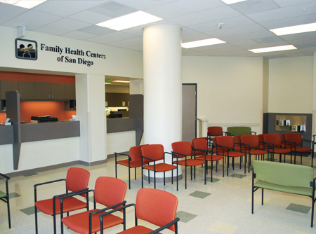
Building Collaborative Partnerships
Co-location of health care in housing/shelter units
Creating special needs units for PLWH in housing programs
Mobile health teams to housing agencies/health centers
Emergency housing programs
Establishing relationships with non traditional landlords
Notes:
Intervention Model components

Slide 20
Building Collaborative Partnerships (cont.)
City/county wide Ryan White HIV/AIDS Program and housing committees- Coordinated Access Initiatives
Greater New Haven Opening Doors Committee Health and Housing Team Meetings
Peer Navigator serves on the Coordinated Access Committee for Pasadena County as the key contact for working with HIV Homeless
UF Cares & River Region in Jacksonville, FL
Harris County, Houston, TX Coordination with Ryan White HIV/AIDS Program Part A for housing support
Notes:
Building a medical home for HIV positive individuals experiencing homelessness as well as co-occurring substance use or mental health issues meant building and maintaining collaborative partnerships with key services. Specifically - Housing partnerships.
Collaborative partnerships with established city and county wide Ryan White and housing committees coordinated access initiatives was one way to maximize existing resources while bringing to the table some innovation that may not otherwise be tested.
In the case of Connecticut for example, Yale University implemented the mHEALTH model – Medical Home Engagement and Aligning Lifestyles and Transition from Homelessness. The Yale AIDS Program, Clinical and Community Research program conducts community-based clinical research at the intersection of HIV, substance abuse, mental illness, and the criminal justice system.

Slide 21
Building Collaborative Partnerships (cont.)
Increased access to behavioral health care
Use of medication assisted therapy (Vivitrol and Suboxone)
Increased internal coordination with behavioral health as part of primary care team
Priority access to residential treatment
Access to Behavior Health Nurse Practitioners & case managers
Notes:
In order to increase access to behavioral health care, sites established key behavioral health partnerships.

Slide 22
Use of Network Navigators/Care Coordinators
Client Tracking and Outreach
Find those who have fallen out of care
Connect with people coming out of prison
Supporting Retention in Care
Accompaniment to appointments
Transportation
Appointment reminders
Help with getting/scheduling appointments
Bridging communication with providers
Notes:
Once those partnerships were created, it was even more important to ensure the clients can access and navigate the care system and ensure they could maintain Systems integration.
In the case of this initiative, sites employed network navigators to achieve care coordination for clients.

Slide 23
Use of Network Navigators/Care Coordinators (cont.)
Providing Emotional Support
Relationship building/trust
Encourage clients to keep going to their appointments
Coaching and support
Reducing stigma
Systems navigation & service coordination
Educating on how systems work
Brainstorming on how to get resources
Notes:
Each site provided valuable services in order to ensure access to and retention in care for this population. I will now turn it over to Verna Gant from Family Health Centers of San Diego who will provide more detailed information on their collaborative peer navigator model for serving HIV positive individuals in San Diego experiencing homelessness. FHCSD and People Assisting The Homeless or PATH have an integrated coordination model through Connections Housing(link is external), a “one-stop” shopping resource for social services and FHCSD clinic co-located under one roof. Peer Navigators at both organizations worked to braid services together to best meet the needs of identified San Diegans.

Slide 24
Further Information on SPNS
List of SPNS Initiatives
https://hab.hrsa.gov/about-ryan-white-hivaids-program/part-f-special-projects-national-significance-spns-program
Target Center
www.careacttarget.org/category/topics/spns
SPNS Products
https://hab.hrsa.gov/about-ryan-white-hivaids-program/special-projects-national-significance-spns-program-initiative-products
Notes:
CLEARED
For more information, check out our webpage ! Each current or previous SPNS initiative is described on the HAB website, listing our grantees and a description of their demonstration project, related products and links to journal article abstracts.
The TARGET Center houses the monographs, tools, toolkits and other various product mentioned in this presentation and more.

Slide 25
Contacts
 | Email | Phone
Adan Cajina, Chief, Demonstration and Evaluation Branch (SPNS Program), HAB | Acajina@hrsa.gov | (301) 443-3180
Melinda Tinsley, HAB/SPNS Lead Public Health Analyst | MTinsley1@hrsa.gov | (301) 443-3496
Pamela Belton, Public Health Analyst | PBelton@hrsa.gov | (301) 443-4461
John Hannay, Public Health Analyst | Jhannay@hrsa.gov | (301) 443-0678
Corliss Heath, Health Scientist | Cheath@hrsa.gov | (301) 443-0973
Thelma Iheanyichukwu, Public Health Analyst | TIheanyichukwu@hrsa.gov | (301) 945-3959
Chau Nguyen, Public Health Analyst | CNguyen1@hrsa.gov | (301) 443-5785

