Slide 1
Using Data to Improve HIV Care and Treatment
Data Quality and Data Dashboards
2017 U.S. Conference on AIDS
HRSA Pathway
Saturday, September 9, 2017
9:00 – 11:00 AM

Slide 2
Session Objectives
To discuss the importance of using data for improving retention in care and HIV-related health outcomes for people living with HIV (PLWH)
To describe successful strategies to improve data quality and examples/best practices of how to use high quality data to enhance the care and health outcomes for PLWH
To hear from RWHAP recipients, through an interactive session, about how they use their data, challenges to using data, and technical assistance needs around data utilization

Slide 3
Today’s Session
Using National-Level RWHAP Data to Inform Program Decision-Making and Priorities
  HRSA HIV/AIDS Bureau – Stacy Cohen
Data Disconnect
  Elmhurst Hospital Center, Ryan White HIV/AIDS Program (Part C) – Carlos Salama, MD
Data to Care
  McAuley Clinic, Mercy Health Saint Mary’s, Ryan White HIV/AIDS Program (Part C) – C. Ryan Tomlin, Pharm.D., BCPS, AAHIVP
Using Data to Inform Decisions and Drive Performance
  Nashville/Davidson County TGA, Ryan White HIV/AIDS Program (Part A) – Pam Sylakowski
Interactive feedback session: How do you use your data?
  All participants

Slide 4
Using National-Level Ryan White HIV/AIDS Program Data to Inform Program Decision-Making and Priorities
Stacy Cohen
Branch Chief, Evaluation, Analysis, and Dissemination Branch
Division of Policy and Data
HIV/AIDS Bureau
Health Resources and Services Administration

Slide 5
Outline
Overview
  HRSA HIV/AIDS Bureau
  Ryan White HIV/AIDS Program (RWHAP)
Demonstrating Effectiveness of Program Investments
National-level data
  RWHAP client demographic data
  RWHAP viral suppression
Using data to address gaps and disparities
  Implementing Solutions
  Identifying New Approaches to Improve Health Outcomes

Slide 6
Overview
The Ryan White HIV/AIDS Program

Slide 7
HRSA HIV/AIDS Bureau
Vision
Optimal HIV/AIDS care and treatment for all.
Mission
Provide leadership and resources to assure access to and retention in high quality, integrated care, and treatment services for vulnerable people living with HIV/AIDS and their families.
Notes:
The HIV/AIDS Bureau (HAB) is located within HRSA (Health Resources Services Administration), which is the primary Federal agency for improving health care to people who are geographically isolated, economically or medically vulnerable. HRSA’s mission is to improve health and achieve health equity through access to quality services, a skilled health workforce, and innovative programs.
Our work in HAB focuses specifically on providing leadership and resources to assure access to and retention in high quality, integrated care, and treatment services for uninsured and underserved people living with HIV and their families.

Slide 8
Overview: Ryan White HIV/AIDS Program
Provides comprehensive system of HIV primary medical care, medications, and essential support services for low-income people living with HIV
    More than half of people living with diagnosed HIV in the United States – over 500,000 people – receive care and support services through the Ryan White HIV/AIDS Program
  Funds grants to states, cities/counties, and local community based organizations
    $2.32 Billion annual investment (fiscal year 2016)
    Recipients determine service delivery and funding priorities based on their local needs and planning process
Payor of last resort statutory provision: RWHAP funds may not be used for services if another state or federal payor is available
Notes:
The RWHAP is administered by HRSA HAB.
The Ryan White HIV/AIDS Program provides a comprehensive system of care that includes primary medical care and essential support services for low-income people living with HIV who are uninsured or underserved.
The Program works with cities, states, and local community-based organizations to provide HIV care and treatment services to more than half of all people diagnosed with HIV in the United States – more than 500k people each year.
First authorized in 1990, the Program is funded at $2.32 billion in fiscal year 2016.
An important provision in the RWHAP statute is the payor of last resort – RWHAP funds may not be used for services if another payor is available. This prevents duplication and maximizes all available resources for service delivery.

Slide 9
Overview: Ryan White HIV/AIDS Program
Parts A (cities), B (states), C (clinics and community based organizations), and D (community based organizations for women, infants, children, and youth) services to people living with HIV:
  Medical care, medications, and laboratory services
  Clinical quality management and improvement
  Support services including case management, medical transportation, and other services
Part F Services include:
  Clinician training, dental services, and dental provider training
  Development of innovative models of care to improve health outcomes and reduce HIV transmission among hard to reach populations
Notes:
The Ryan White HIV/AIDS Program is divided into five Parts, following from the authorizing legislation…
The majority of Ryan White HIV/AIDS Program funds through Parts A – D support primary medical care and essential support services as well as focusing on clinical quality management.
Part F: A smaller but equally critical portion is used to fund technical assistance, clinical training, and the development of innovative models of care. The Program serves as an important source of ongoing access to HIV medication that can enable people living with HIV to live close to normal lifespans.

Slide 10
Demonstrating Effectiveness of Program Investments
Parts A, B, C, & D represent the majority of RWHAP resources
  Program data needed to measure program effectiveness
Ryan White Services Report (RSR):
  Annual data on clients served by RWHAP Parts A-D
  Services funded and provided
  Client characteristics and health outcomes (i.e., viral suppression)
RSR data link improved health outcomes to RWHAP services
  Viral suppression is a primary outcome that demonstrates RWHAP effectiveness
  Also identifies health disparities and areas for improvement
Notes:
We demonstrate the effectiveness of the RWHAP investments by looking at the clients, services, and outcomes as reported by the primary investments in Parts A, B, C, and D.
We specifically collect information on (list in bullet 2) in the RSR. This data set allows us to link the RWHAP investment to the outcomes of the program. Viral suppression is essential for preventing HIV transmission and improving the overall health and lifespan of a person living with HIV – for these reasons, we use VS as a key outcome to demonstrate effectiveness. The data also provide us with the ability to identify and address health disparities. I will talk more about that in a few slides.

Slide 11
National-Level Ryan White HIV/AIDS Program Data
RWHAP client demographic and viral suppression data
Notes:
So lets take a look at the overall characteristics of the clients served by RWHAP

Slide 12
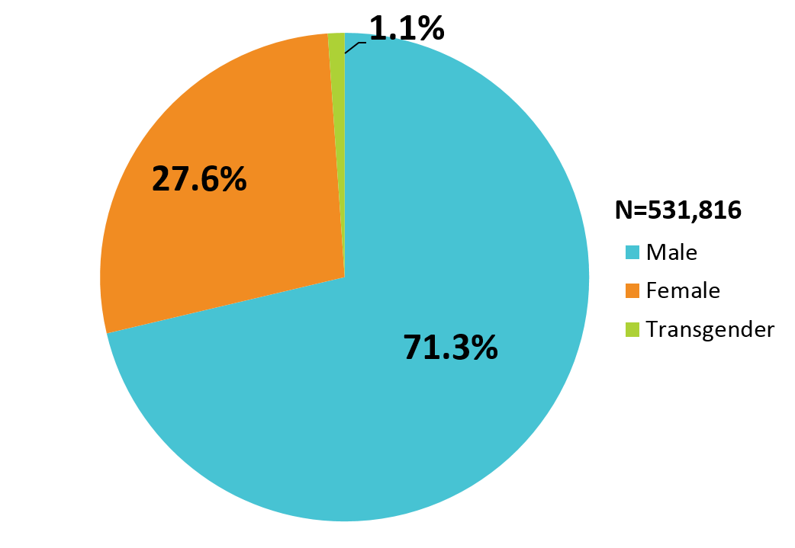
Clients Served by the Ryan White HIV/AIDS Program by Gender, 2015—United States and 3 Territoriesª
ª Guam, Puerto Rico, and the U.S. Virgin Islands.
Source: HRSA. Ryan White HIV/AIDS Program Services Report (RSR) 2015. Does not include AIDS Drug Assistance Program data.
Notes:
The RWHAP serves over half a million people each year. In 2015, of the 531,816 clients with a reported gender, 71.3% were male, 27.6% were female, and 1.1% were transgender.

Slide 13
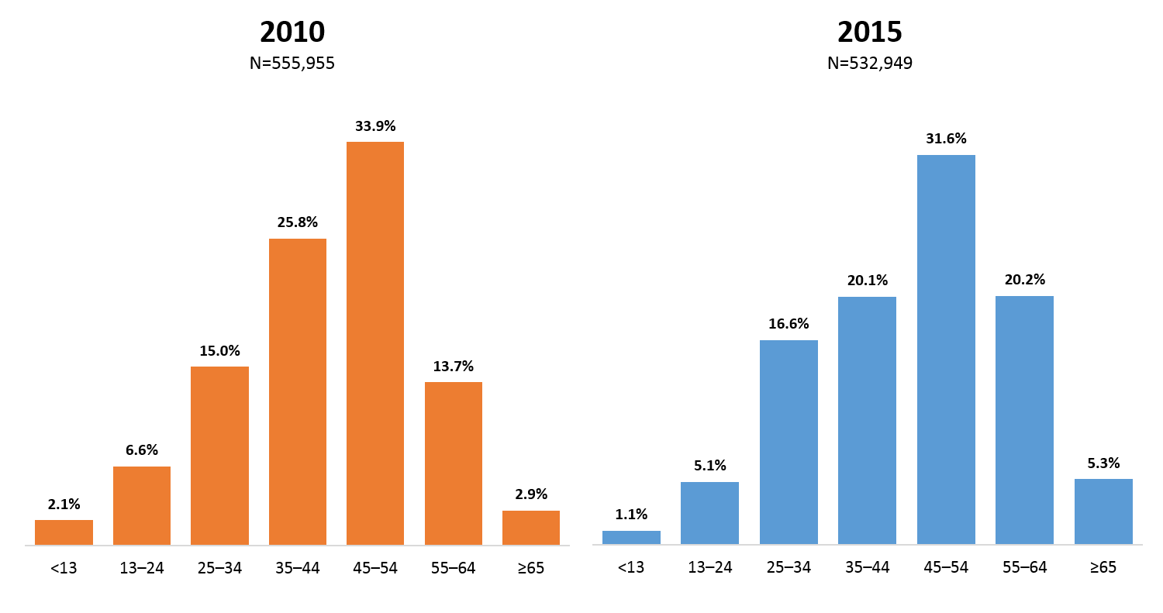
Clients Served by the Ryan White HIV/AIDS Program by Age Group, 2010 and 2015—United States and 3 Territoriesª
ª Guam, Puerto Rico, and the U.S. Virgin Islands.
Source: HRSA. Ryan White HIV/AIDS Program Services Report (RSR) 2015. Does not include AIDS Drug Assistance Program data.
Notes:
Here you can see that the RWHAP client population is aging. In 2015, clients aged 55 and older accounted for 27.5% of all clients, an increase from 16.6% in 2010. In addition, more than 30% of clients in both 2010 and 2015 were aged 45-54.

Slide 14
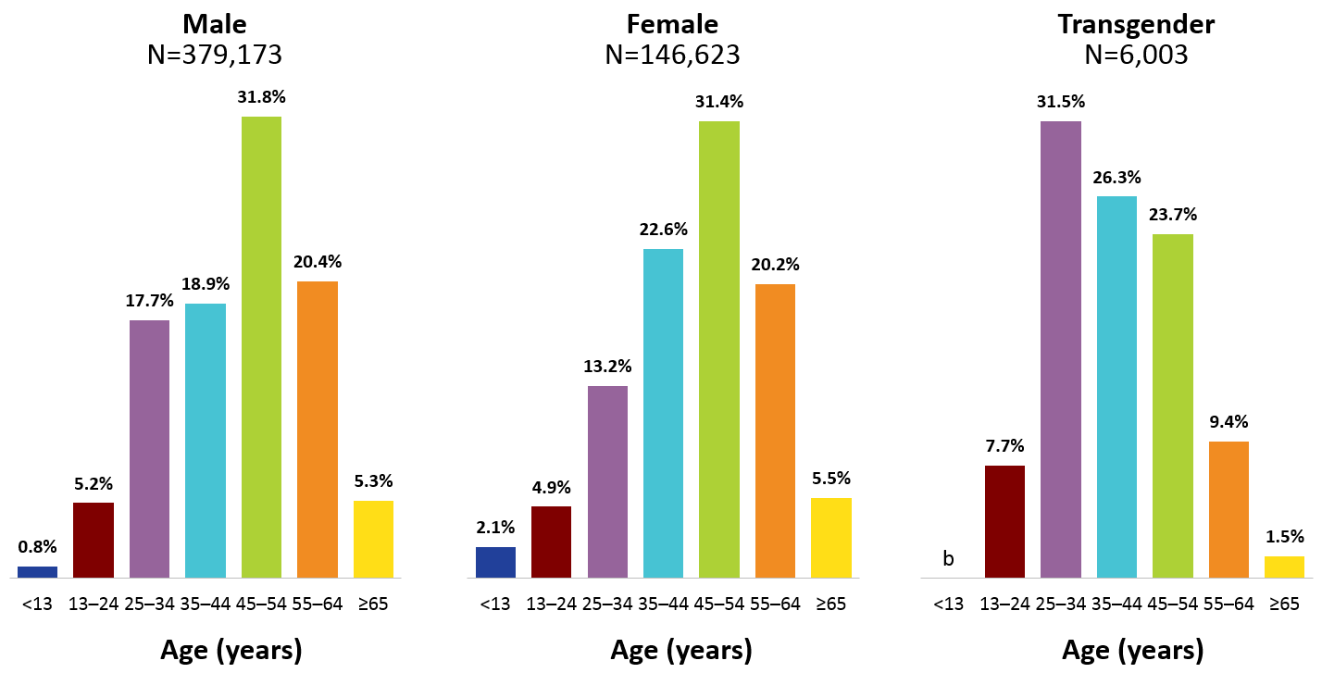
Clients Served by the Ryan White HIV/AIDS Program by Gender and Age Group, 2015—United States and 3 Territoriesª
ª Guam, Puerto Rico, and the U.S. Virgin Islands.
^{b} To ensure confidentiality, data have been suppressed.
Source: HRSA. Ryan White HIV/AIDS Program Services Report (RSR) 2015. Does not include AIDS Drug Assistance Program data.
Notes:
Here we have stratified the age data for 2015 by gender. And you can clearly see that among male clients, 50.7% were aged 35-54 years, and among female clients, 54.0% were aged 35-54 years. Transgender clients, however, were a little younger, with 57.8% aged 25-44 years in 2015.

Slide 15
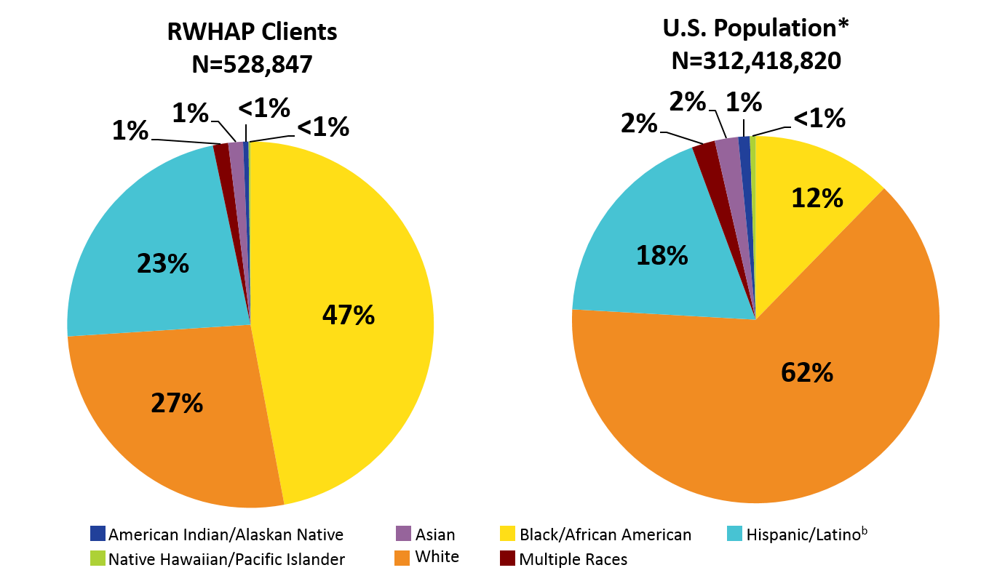
Clients Served by the Ryan White HIV/AIDS Program and U.S. Population, by Race/Ethnicity, 2015—United States and 3 Territoriesª
Hispanics/Latinos can be of any race.
ª Guam, Puerto Rico, and the U.S. Virgin Islands.
* Does not include U.S. territories
Source: HRSA. Ryan White HIV/AIDS Program Services Report (RSR) 2015. Does not include AIDS Drug Assistance Program data.
Notes:
The majority of our clients are racial/ethnic minorities - 68.7% of males, 83.8% of females, and 87.3% of transgender clients were racial/ethnic minorities. For reference, white clients appear in each pie chart in orange shading.

Slide 16
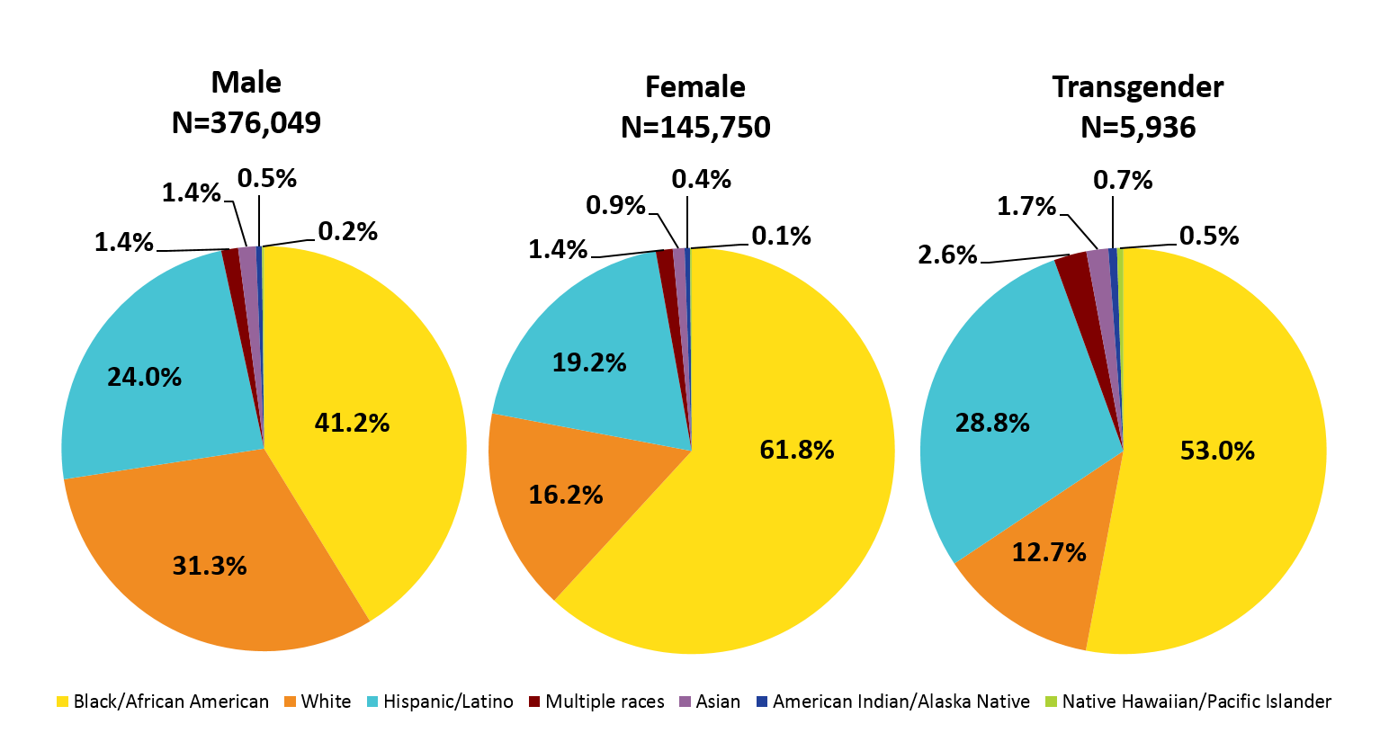
Clients Served by the Ryan White HIV/AIDS Program by Gender and Race/Ethnicity, 2015—United States and 3 Territoriesª
Hispanics/Latinos can be of any race.
ª Guam, Puerto Rico, and the U.S. Virgin Islands.
Source: HRSA. Ryan White HIV/AIDS Program Services Report (RSR) 2015. Does not include AIDS Drug Assistance Program data.
Notes:
And this distinction is even more apparent when we stratify by gender with 68.7% racial/ethnic minorities among males, 83.8% among females, and 87.3% among transgender clients.

Slide 17
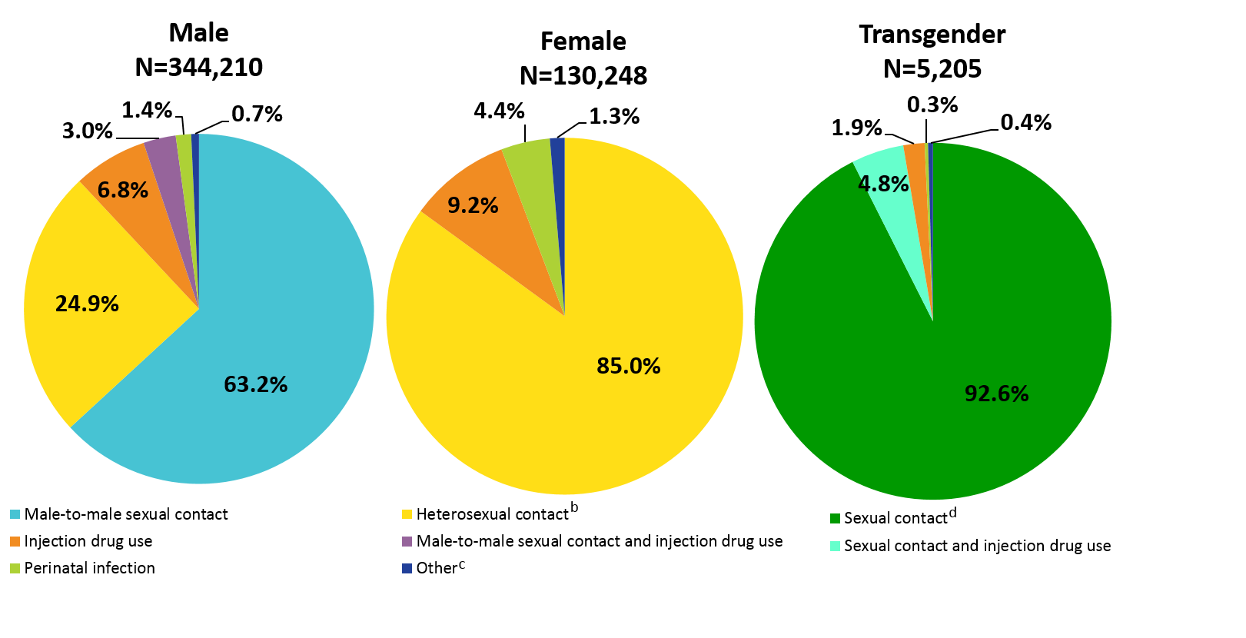
Clients Served by the Ryan White HIV/AIDS Program by Gender and Transmission Risk Category, 2015—United States and 3 Territoriesª
ª Guam, Puerto Rico, and the U.S. Virgin Islands.
^{b} Heterosexual contact with a person known to have, or to be at high risk for, HIV infection.
^{c} Includes hemophilia and blood transfusion.
^{d} Includes any reported sexual transmission category.
Source: HRSA. Ryan White HIV/AIDS Program Services Report (RSR) 2015. Does not include AIDS Drug Assistance Program data.
Notes:
By gender and transmission risk category, among male clients, 63.2% had HIV infection attributed to male-to-male sexual contact; among female clients, 85.0% had infection attributed to heterosexual contact; and among transgender clients, 92.6% had infection attributed to some form of sexual contact.

Slide 18
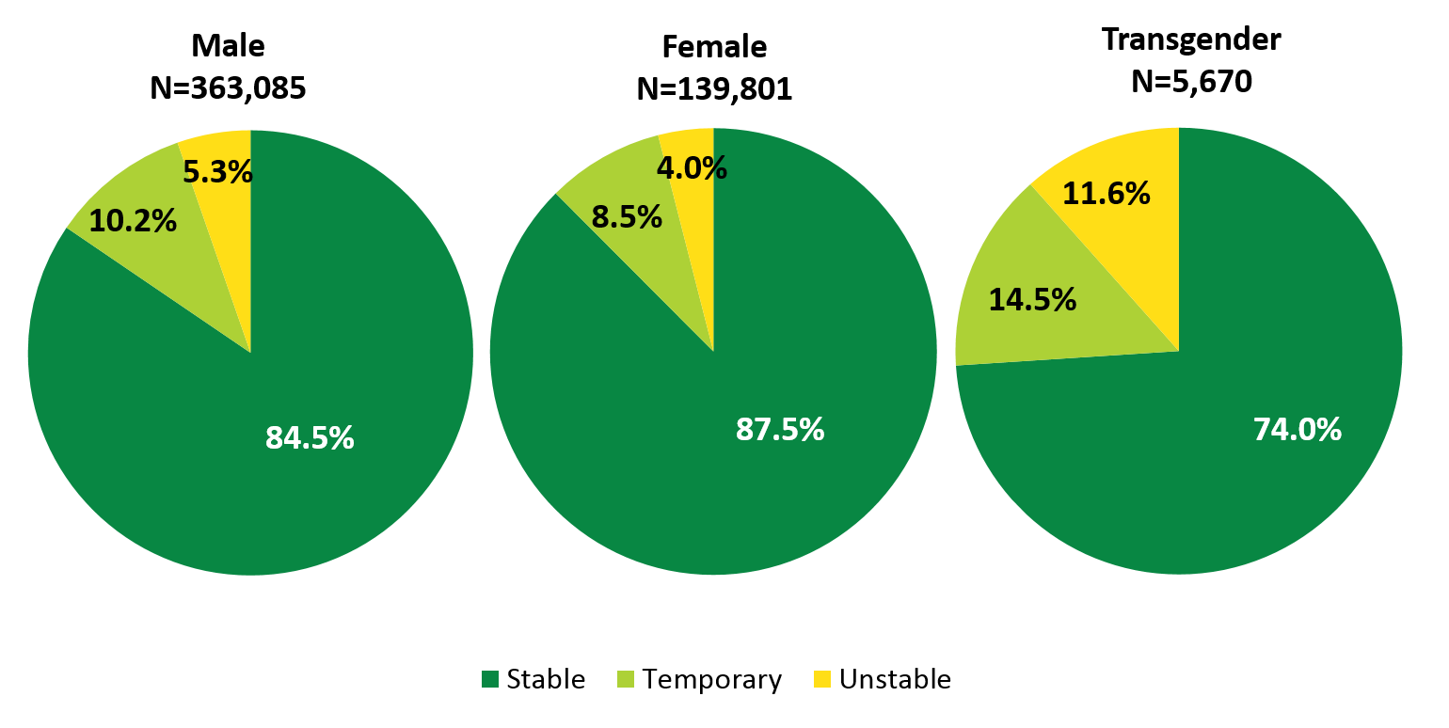
Clients Served by the Ryan White HIV/AIDS Program by Gender and Housing Status, 2015—United States and 3 Territoriesª
ª Guam, Puerto Rico, and the U.S. Virgin Islands.
Source: HRSA. Ryan White HIV/AIDS Program Services Report (RSR) 2015. Does not include AIDS Drug Assistance Program data.
Notes:
Housing stability is another place where we see differences by gender - A greater proportion of female RWHAP clients had stable housing in 2015, compared with male and transgender clients.

Slide 19
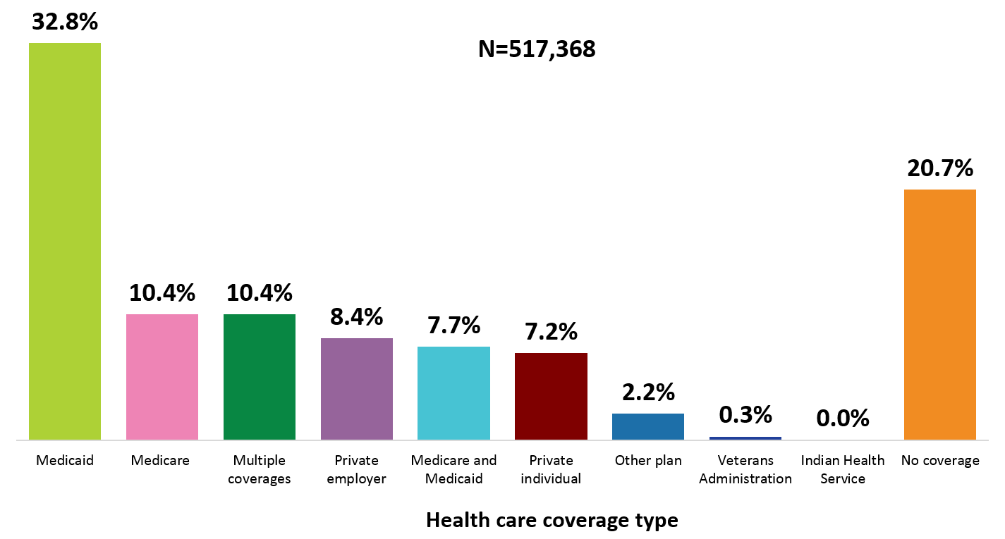
Clients Served by the Ryan White HIV/AIDS Program by Health Care Coverage, 2015—United States and 3 Territoriesª
ª Guam, Puerto Rico, and the U.S. Virgin Islands.
Source: HRSA. Ryan White HIV/AIDS Program Services Report (RSR) 2015. Does not include AIDS Drug Assistance Program data.
Notes:
In 2015, nearly 80% of RWHAP clients were covered by some form of health care coverage. One-fifth (20.7%) of RWHAP clients had no health care coverage in 2015.

Slide 20
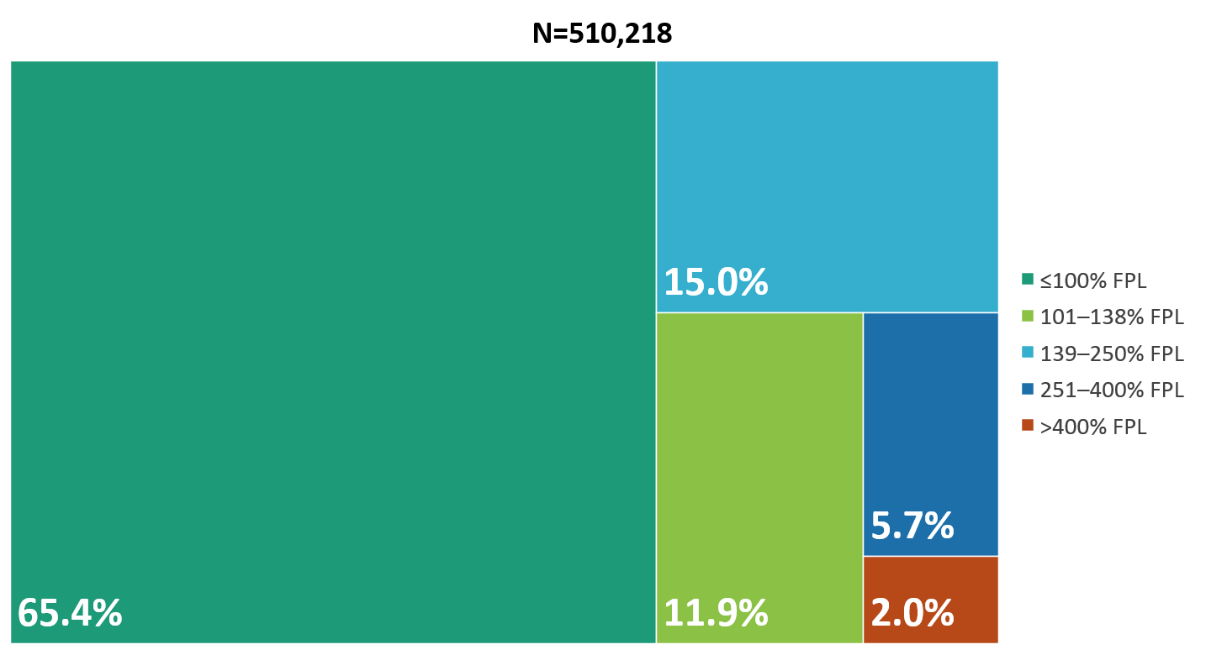
Clients Served by the Ryan White HIV/AIDS Program by Poverty Level, 2015—United States and 3 Territoriesª
FPL, federal poverty level.
ª Guam, Puerto Rico, and the U.S. Virgin Islands.
Source: HRSA. Ryan White HIV/AIDS Program Services Report (RSR) 2015. Does not include AIDS Drug Assistance Program data.
Notes:
In 2015, 65.4% of the 510,218 clients with income information were living at or below 100% of the federal poverty level (FPL).
The three territories include Guam, Puerto Rico, and the U.S. Virgin Islands.

Slide 21
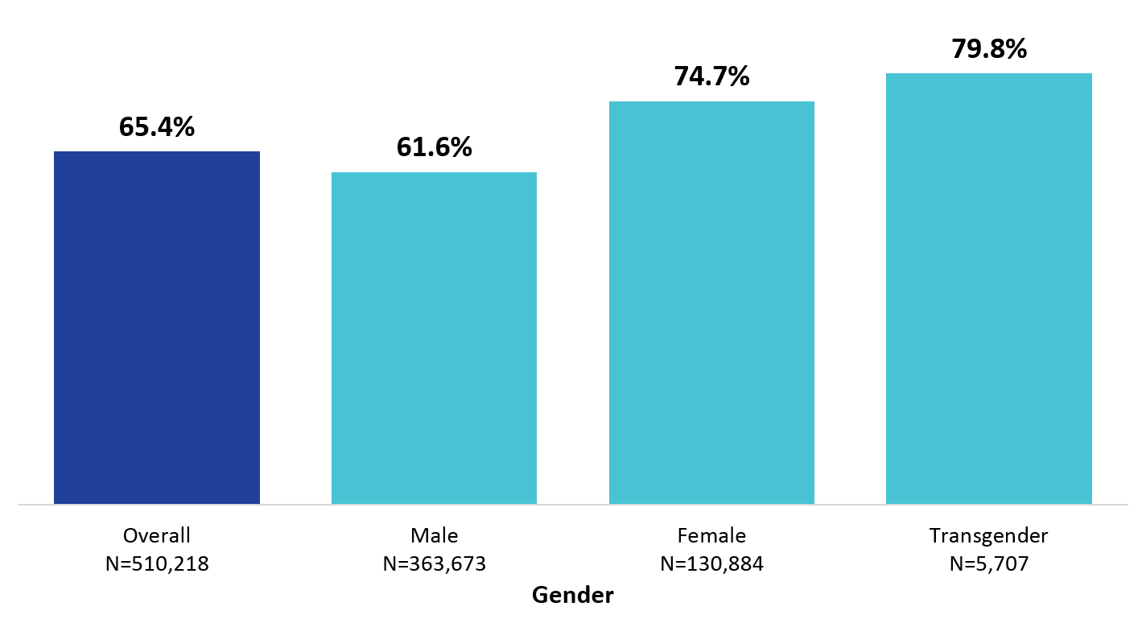
Clients Served by the Ryan White HIV/AIDS Program Living ≤100% of the Federal Poverty Level, by Gender, 2015—United States and 3 Territoriesª
ª Guam, Puerto Rico, and the U.S. Virgin Islands.
Source: HRSA. Ryan White HIV/AIDS Program Services Report (RSR) 2015. Does not include AIDS Drug Assistance Program data.
Notes:
Here we can see the percent of clients living below 100% FPL by gender. Female and transgender clients had lower incomes than male clients.

Slide 22
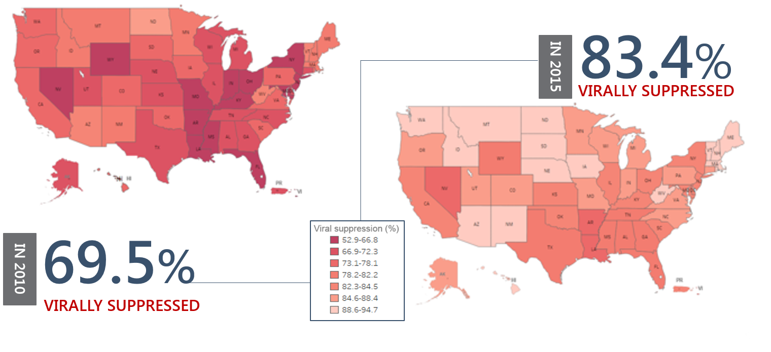
Viral Suppression among Clients Served by the Ryan White HIV/AIDS Program, by State, 2010–2015—United States and 2 Territoriesª
Viral suppression: ≥1 OAMC visit during the calendar year and ≥1 viral load reported, with the last viral load result <200 copies/mL.
ª Puerto Rico and the U.S. Virgin Islands. Due to low numbers, data for Guam are not presented.
Source: HRSA. Ryan White HIV/AIDS Program Services Report (RSR) 2015. Does not include AIDS Drug Assistance Program Data.
Source: HRSA. Ryan White HIV/AIDS Program Services Report (RSR) 2015. Does not include AIDS Drug Assistance Program data.
Notes:
[Define viral suppression: Viral suppression: ≥1 OAMC visit during the calendar year and ≥1 viral load reported, with the last viral load result <200 copies/mL. ]
Among clients served by the RWHAP, viral suppression has increased steadily over the past six years, from 69.5 in 2010 (on the left) to 83.4% in 2015 (on the right). Improvements in viral suppression are indicated by the lighter color red for each state.
We can see from this slide, the great progress that has been made from 2010 to 2015 – across all states.

Slide 23
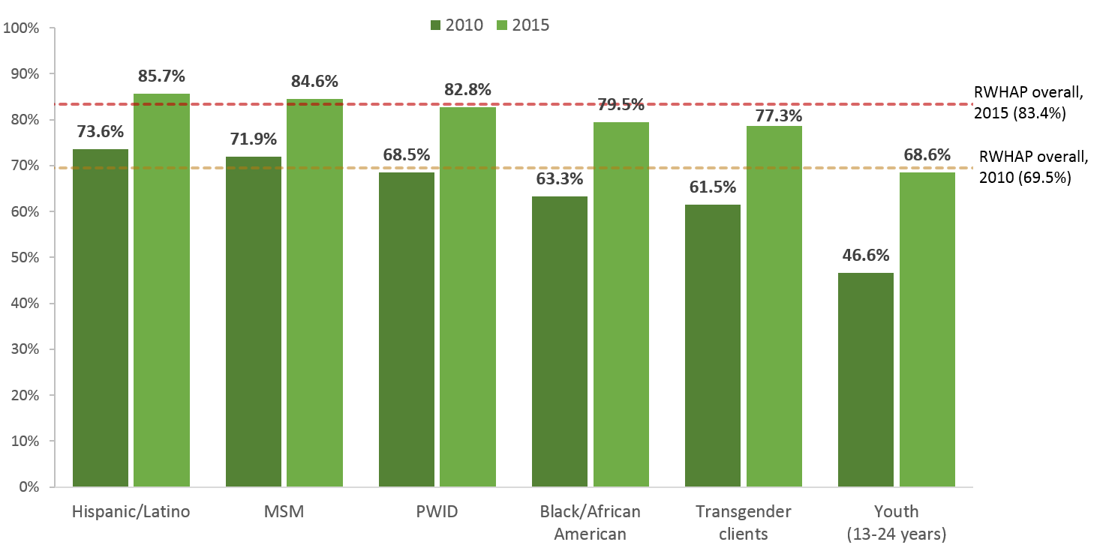
Viral Suppression among Key Populations Served by the Ryan White HIV/AIDS Program, 2010–2015—United States and 3 Territoriesª
Hispanics/Latinos can be of any race.
Viral suppression: ≥1 OAMC visit during the calendar year and ≥1 viral load reported, with the last viral load result <200 copies/mL.
ª Guam, Puerto Rico, and the U.S. Virgin Islands.
Source: HRSA. Ryan White HIV/AIDS Program Services Report (RSR) 2015. Does not include AIDS Drug Assistance Program data.
Notes:
Viral suppression among key populations. Here we can see increases for all key populations, but there are still several disparate groups.

Slide 24
Using data to address gaps and disparities
Implementing Solutions
Identifying New Approaches to Improve Health Outcomes

Slide 25
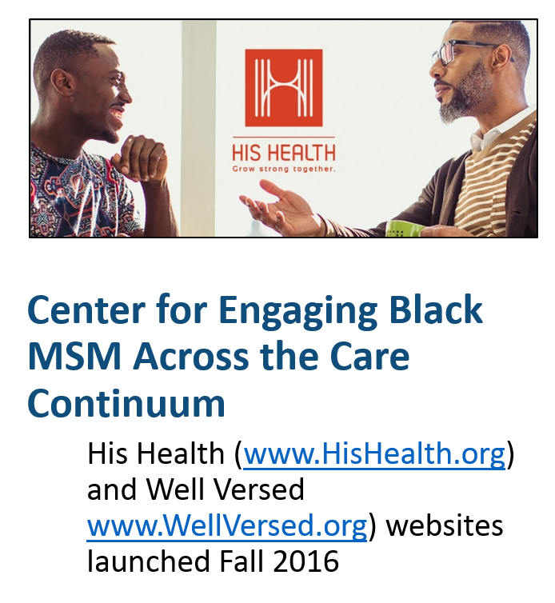
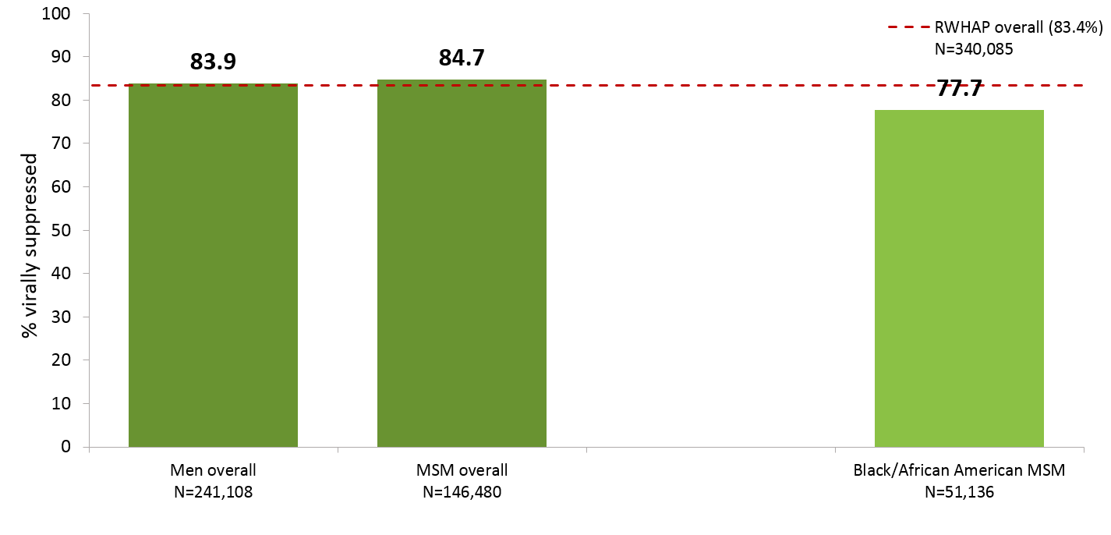
Implementing Solutions:
Improving Health Outcomes Among Black MSM
Viral Suppression among Men who have Sex with Men (MSM) Served by the Ryan White HIV/AIDS Program, 2015—United States and 3 Territoriesª
N represents the total number of clients in the specific subpopulation.
Viral suppression: ≥1 outpatient/ambulatory medical care visit during the calendar year and ≥1 viral load reported, with the last viral load result <200 copies/mL.
ª Guam, Puerto Rico, and the U.S. Virgin Islands.
Source: HRSA. Ryan White HIV/AIDS Program Services Report (RSR) 2015. Does not include AIDS Drug Assistance Program data.
Notes:
To continue focusing on improving health outcomes in the RWHAP, we are implementing some key initiatives that I will spend a few slides talking about.
Based on the significant impact of HIV on black men who have sex with men, we have invested in addressing health disparities among Black MSM (in addition to the core work in the RWHAP Parts A-D).
If you look at the chart on the right – the bars on the left show viral suppression among males overall and among MSM overall which were both consistent with the national RWHAP average (83.4%) – indicated by the dashed red line – BUT the bar on the right side shows the viral suppression percentage for BMSM which is lower than all of the comparison groups (77.7%).
One example of a specific initiative, is the Center for Engaging Black MSM Across the Care Continuum (CEBACC), which is an online resource providing effective tools, models of care, resources, and trainings to advance the healthcare for young and adult BMSM by increasing health literacy of BOTH health care providers and BMSM. It also has a directory of culturally competent healthcare providers for Black men.

Slide 26
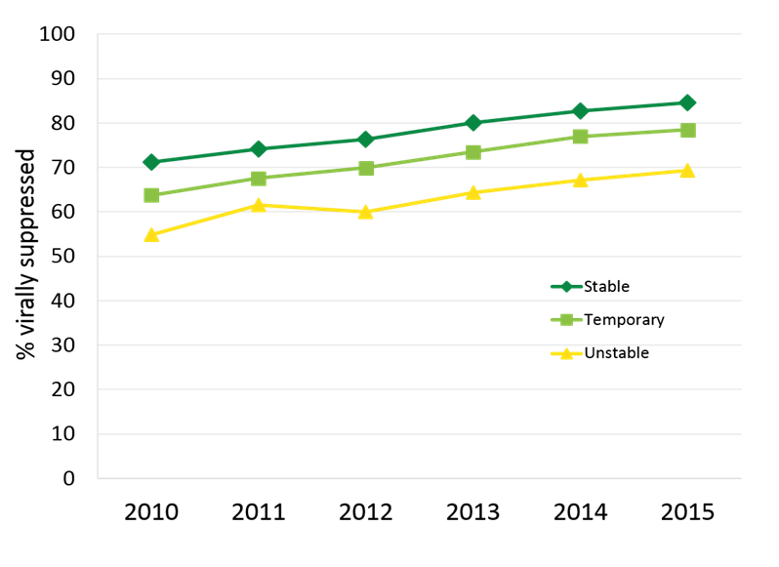
Implementing Solutions:
Focusing on Housing and Employment
Viral Suppression among Clients Served by the Ryan White HIV/AIDS Program, by Housing Status, 2010‒2015—United States and 3 Territoriesª
HIV Care & Housing – Using Data Integration to improve Health Outcomes along HIV Care Continuum
Improving HIV Health Outcomes through the Coordination of Supportive Employment and Housing Services
Viral suppression: ≥1 outpatient/ambulatory medical care visit during the calendar year and ≥1 viral load reported, with the last viral load result <200 copies/mL.
ª Guam, Puerto Rico, and the U.S. Virgin Islands.
Source: HRSA. Ryan White HIV/AIDS Program Services Report (RSR) 2015. Does not include AIDS Drug Assistance Program data.
Notes:
We know that social determinants of health significantly impact the health outcomes of PLWH and our RWHAP data on the right hand side of the slide show the that clients with unstable housing status have lower levels of viral suppression compared to those with stable or temporary housing. Based on this information, we have focused some investments on some structural level interventions such as housing and employment.
One example is a partnership with the U.S. Department of Housing and Urban Development (HUD) Housing Opportunities for PwAIDS (HOPWA). This project works to integrate and coordinate HIV and housing services using information technology to Improve entry, engagement, retention in care for HIV positive homeless & unstably housed PLWH to improve patient health outcomes.
Another example is a recently released funding opportunity announcement which focuses on the coordination of employment and housing services and clinical services in order to improve patient health outcomes.
---------don’t read below-----
HIV Care & Housing – Using Data Integration to Improve Health Outcomes along HIV Care Continuum
Promotes integration and coordination of HIV and housing services using information technology to Improve entry, engagement, retention in care for HIV positive homeless & unstably housed PLWH with mental illness and substance abuse disorders.
Improving HIV Health Outcomes through the Coordination of Supportive Employment and Housing Services-
Supports the design, implementation, and evaluation of innovative interventions that coordinate HIV care and treatment, housing and employment services to improve HIV health outcomes for low-income, uninsured, and underinsured PLWH in racial and ethnic minority communities

Slide 27
Identifying New Approaches to Improve Health Outcomes
Building Futures for Youth Living with HIV (evaluation study)
  Use data to assess the current state of youth living with HIV aged 13-24 receiving RWHAP-funded care.
  Identify best practices to improve care and treatment for youth living with HIV
    Overcome barriers to care, fill gaps in care, optimize health outcomes
  Develop and provide technical assistance for youth-serving RWHAP providers
Notes:
In addition to implementing solutions, we also focus on identifying new approaches to improve health outcomes…
We are currently conducting an evaluation study that is helping us develop and provide technical assistance for youth-serving RWHAP providers to overcome barriers to care, fill in gaps in care, and optimize health outcomes for this special population.
For this project we used the RWHAP RSR data on viral suppression to identify high performing and low performing sites, and we used other variables such as populations, race/ethnicity, risk, gender, etc.
This project is conducting 24 sites visits to gather best practices for improving HIV care and treatment outcomes for youth living with HIV. The information gathered will inform TA webinars geared towards youth-serving RWHAP providers.

Slide 28
Identifying New Approaches to Improve Health Outcomes
Implementation Center for HIV Clinical Quality Improvement
  Provide training and technical assistance to recipients aimed at improving patient health outcomes
Assessing client factors with detectable viral load (evaluation study)
  Identify differences between PLWH who are virally suppressed and those who are not
  Identify new strategies to achieve improved viral suppression
Notes:
Another new project is the Implementation center for HIV clinical quality improvement
- As many of you know, clinical quality management, including quality improvement, is a legislative requirement for RWHAP Parts A-D grant recipients as it is a key approach and process that leads to improved patient health outcomes. HIV/AIDS Bureau continues to provide training and technical assistance to grant recipients through the implementation center for HIV clinical quality improvement.
We also have an evaluation study that is helping us assess client characteristics and service delivery barriers that contribute to a lack of viral suppression.
- ? When the study concludes, we will share this information with grant recipients in order to continue to achieve higher rates of viral suppression and improved patient health outcomes.

Slide 29
Identifying New Approaches to Improve Health Outcomes
Dissemination of Evidence-Informed Interventions to Improve Health Outcomes Along the HIV Care Continuum
  Four evidence-informed care and treatment interventions for linkage and retention
  Based on evidence informed interventions: Jail, Outreach, Buprenorphine, and Re-Engagement and Retention initiatives
Using Evidence Informed Interventions to Improve Health Outcomes among People Living with HIV
  Improving HIV health outcomes for transgender women and black men who have sex with men
  Integrating behavioral health with primary medical care for people living with HIV
  Identifying and addressing trauma among people living with HIV
Notes:
The last two examples of identifying new approaches to improve health outcomes…are our work to implement and disseminate evidence informed interventions.
In our dissemination effort, we are pushing out four interventions for linkage and retention for PLWH (ADD THE SPNS IF THEY ARE DIFFERENT).
Enhancing Linkages for Those Newly Released from Jails
Innovative Methods for Integrating Buprenorphine Opioid Abuse Treatment in HIV Primary Care
Targeted Outreach and Intervention Model Development for Underserved HIV-Positive Populations Not in Care
The SMAIF Retention and Re-engagement Project
In our effort to keep moving forward with implementation of evidence informed interventions for either specific PLWH populations or key SDH that impact the health outcomes of PLWH, we have a recent cooperative agreement that focus on transgender women and black men who have sex with men; and on the integration of BH w medical care; and on addressing trauma.

Slide 30
Summary
The Ryan White HIV/AIDS Program (RWHAP) provides HIV care, treatment, and support service to over 500,000 people living with diagnosed HIV in the U.S.
People living with HIV (PLWH) receiving RWHAP services have better viral suppression outcomes than the national average
  Lowers HIV transmission
  Improves the lifespan of the PLWH
RWHAP utilizes data to develop innovative HIV care and treatment service delivery approaches in the U.S.
CDC. HIV Surveillance Report Supplemental Report Volume 21, Number 4. Monitoring Selected National HIV Prevention and Care Objectives by Using HIV Surveillance Data, United States and 6 Dependent Areas, 2014.
HRSA. Ryan White HIV/AIDS Program Annual Client-Level Data Report 2015. Does not include clients served by the AIDS Drug Assistance Program.

Slide 31


Thank you!
Thank you!
Stacy Cohen
Email: sgagne@hrsa.gov
Web: www.hab.hrsa.gov
Twitter: twitter.com/HRSAgov
Facebook: facebook.com/HHS.HRSA
Notes:
Thank you…

Slide 32

Data Disconnect
Carlos Salama, M.D.
Ryan White HIV/AIDS Program Parts C, D
Elmhurst Hospital Center
Elmhurst (Borough of Queens), N.Y.

Slide 33
Our Problem
Disconnect between:
    Data collected for grants
    Ability to use this data to enhance care for our patients
Extensive resources needed to collect data and send to city, state, and federal authorities
    Each grant / agency has different reporting mechanisms, making it difficult and time consuming to synthesize data for decision making
Format of the data
    Not optimal to help guide our program in decision making for future goals

Slide 34
Our Experience
AIRS and E-share: two programs that are used to report Ryan White HIV/AIDS Program (RWHAP) data
    RWHAP Parts C/D are reported on AIRS
    RWHAP Part A is reported to Public Health Solutions on E-share
Other grants (MCM, PEP, HDR) are also reported on E-share
Separate reporting to the NY AIDS Institute (HIVQual) requires uploading to their website.

Slide 35
Our Experience
Three separate databases that we must use to report similar data to different agencies
No communication with our previous EHR (quadramed) or current EHR (EPIC)
Database manager must find data on EPIC and manually enter into the programs in order to report
Significantly reduced ability of data manager to run reports and supply the data needed to help us improve patient care

Slide 36
Our Strategy
Direct monthly reports from EPIC (EHR)
Reports provide physician-oriented data, including:
    Demographics, risk factors, therapy, viral suppression, etc.
    % virologic suppression; broken down by provider and other parameters
    List of patients that are not suppressed to monitor provider success
    Date of last appointment – sorting to over 6 months and then reaching out to those patients using a multidisciplinary approach of providers, nurses, adherence counselors, social workers and care-coordination navigators.
These data do not directly communicate with e-share or AIRS

Slide 37
Our Data
Focus on two patient groups (over 8 months):
Patients that are not virologically suppressed
    Every two months we run a report on VL suppression
    Report is sorted by name and number of all patients with VL >200 copies
    These charts are reviewed and patients are called in as needed to address elevated VL
Patients not seen / without VL in over 8 months
    Pre-emptively identify patients before they are lost to follow up (defined at our clinic as not seen in >1 year)

Slide 38
Our Data – no VL over 8 months
125 patients identified (out of 1305 patients, 9.6%)
    Put into place a multidisciplinary team (MD, RN, SW, MCM, Adherence/PharmD) to aggressively pursue patients and get back into care
19 patients (15%) were not able to be found
    Ultimately lost to follow up at 12 months
106 patients (85%) were contacted
    3 patients were deceased
    7 patients had moved out of state or country
    10 patients were transferred to other institutions in NYC
    86 patients (81%) were successfully seen and re-integrated in our clinic
      88% of these patients were still virologically suppressed at time of return to clinic

Slide 39
Our Lessons Learned
Direct EHR data reports can have an immediate effect on patient retention
    Systematic ability to track patients to ensure they are making appointments
    Ability to target specific patients to pursue for follow-up
Multi-disciplinary team needed to make use of these data

Slide 40
Our Need
To ensure data hospitals are required to report is useful for improving patient care, different data systems must communicate
    Software should be able to communicate with the large EMR programs, such as EPIC, Allscripts, etc.
More data support is needed
    Many HIV programs are public hospitals with limited resources, making the hiring of many tech savvy computer specialists to upkeep reporting capabilities difficult
Grantors at the city, state, and federal level should work to standardize data reporting
    Public hospitals receive funding from multiple entities which support operations of their clinics
    For the data reported to each of these entities to be useful, standardization is needed

Slide 41
Our Need
Data reported should be readily available to programs
Programs could then rapidly disseminate information to providers and administrators to guide decision making
Providers should be able to independently look up data that is currently inaccessible to them
NYC provides clinics with HIV suppression dashboard that helps us compare ourselves to other programs

Slide 42
Our Need – A dashboard sounds good!
A data dashboard from HRSA would be useful if it could answer the following questions:
    How are we doing as a clinic? As a provider?
    What is our/my suppression rates? How do we/I compare to other institutions with similar demographics?
    Are there specific groups that are struggling? Risk factor group, racial group, etc.
    What are my patients’ vaccination rates?

Slide 43
Thank you!
Carlos Salama, M.D.
salamac@nychhc.org
718-334-2283

Slide 44
Mercy Health Saint Mary’s
Data To Care
C. Ryan Tomlin, Pharm.D., BCPS, AAHIVP
Ryan White HIV/AIDS Program Parts B, C, D
Grand Rapids, Michigan

Slide 45
Where Our Data Originates
Outpatient Clinic EHR
Inpatient Hospital EHR
Careware
Insurance / PBM Data
Pharmacy Refill Information
Michigan Care Improvement Registry
EHR – Electronic Health Record
PBM – Pharmacy Benefits Manager

Slide 46
How We Use Our Data
Implement Quality Improvement Projects
Careware
Identify Disparities
Routine Patient Care

Slide 47
Example 1: HPV Immunizations
Careware
Clinic medical assistants collect immunization history from MCIR
Reports generated from Careware of all patients eligible for HPV vaccination
Report provided to all clinic nurses
Nurses order and schedule vaccination series at patients’ next clinic visit
Michigan Care Improvement Registry
Patient Immunization Reports
MCIR – Michigan Care Improvement Registry
HPV – Human Papilloma Virus

Slide 48
Results: HPV Immunizations
Challenges
  Getting staff members access to the state database
  Getting the initial immunization orders from the patients' provider
Successes
  Baseline: Jan 2017 – 28% completed series
  Current: Aug 2017 – 49% completed series
    75% on schedule to complete by the end of the year

Slide 49
Example 2: Pharmacy Refill Histories
Careware
VLS Data
Pharmacy Refill Information
Once weekly reports generated from our retail pharmacies of all patients on ART and >5 days overdue for a refill
Reports cross referenced with patients who have detectable viral loads in Careware
Follow-up calls made by nurses and case managers to check-in or reengage patients in care
Improved Viral Load Suppression

Slide 50
Challenges: Pharmacy Refill Histories
Reports less accurate in patients who recently changed antiretroviral medications
Not every patient uses our health system’s retail pharmacies
  Some refill info gained from PBM claims data
  Manual calls made to pharmacies as needed for patients with detectable viral loads
Some gaps in refills are for legitimate reasons (example: short inpatient stay)

Slide 51
Successes: Pharmacy Refill Histories
Viral Load Suppression Rates
Adherence phone calls have developed into other clinic processes
  Pharmacist-led adherence visits
  Clinic wide case conferences
 | Numerator | Denominator | Percentage
Dec 2015 | 856 | 968 | 88.43%
Dec 2016 | 917 | 1014 | 90.43%
July 2017 | 954 | 1033 | 92.35%

Slide 52
Thank you!
C. Ryan Tomlin, Pharm.D., BCPS, AAHIVP
Charles.Tomlin@mercyhealth.com

Slide 53

Using Data to
Inform Decisions &
Drive Performance
Pam Sylakowski
Director
Nashville TGA
Ryan White HIV/AIDS Program
Part A

Slide 54
What gets measured, gets managed. Peter Drucker
Errors in using inadequate data are much less than using no data at all.
Charles Babbage
The goal is to turn data into information, and information into insight. Carly Fiorina
If you can’t explain it simply, you don’t understand it well enough. Albert Einstein

Slide 55
……While nonprofits engage heavily in collecting data, there’s room for improvement when it comes to using it to make decisions about programs, services, operations………….
✓
✓
Source:How Non-Profits Can Use Data to Inform Decisions and Drive Performance, First Republic Bank, 12/9/16
https://www.firstrepublic.com/~/media/frb/documents/pdfs/content/how-nonprofits-can-use-data-to-inform-decisions.ashx

Slide 56
SUCCESSES
As a local health department having direct access to eHARS
  Timely
  Report Continuum of Care/Cascade measures (CDC as well as HRSA)
  Quality check on viral load lab data between CAREWare & eHARS
Collaboration with TN Medicaid
  Indirect access to information we do not have (e.g., other health conditions persons with HIV disease have, information on retention to care and ART Rx for Medicaid enrollees)
  State health department working with Medicaid to import viral load data into Medicaid data base
  Episodes to Care Project – influence beyond Ryan White program, including private insurance https://www.tn.gov/tenncare/topic/episodes-of-care
Implemented “data monitoring” process to improve data quality
  Developed a monitoring tool with key data quality items (how client names are entered, service naming, timeliness of entry)
  Creates a formal conversation for importance of data quality & helps identify provider needs related to data collection (large & small providers)

Slide 59
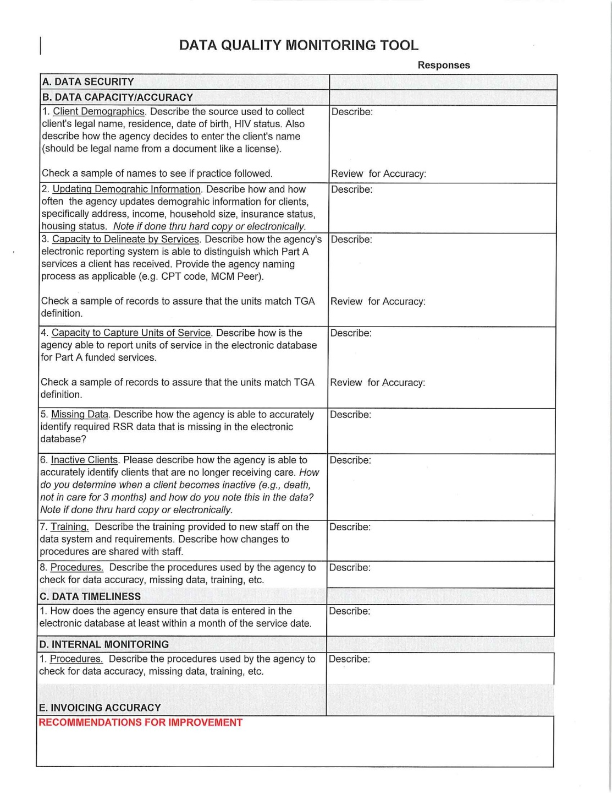

Slide 60
CHALLENGES
Create reports that are simple, usable & meaningful for the Recipient staff, Planning Council, providers, stakeholders, public
  Use for decision making & to drive action
Obtain more client level social indicator data (e.g., employment)
  Use to end the epidemic
Strengthen QI activities
  Use to respond to changing needs & issues and drive improvement
Improve mechanisms for setting new local targets, with a focus on DOCUMENTING DISPARITIES and measuring change over time.
  Use to monitor and drive improvement

Slide 61
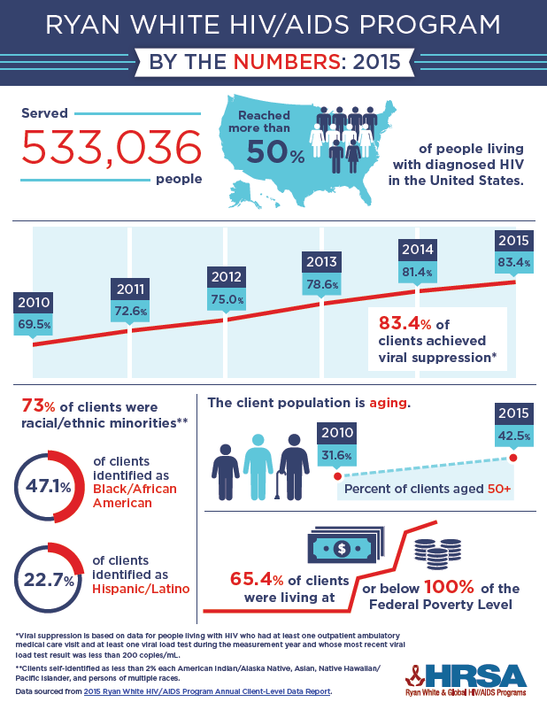
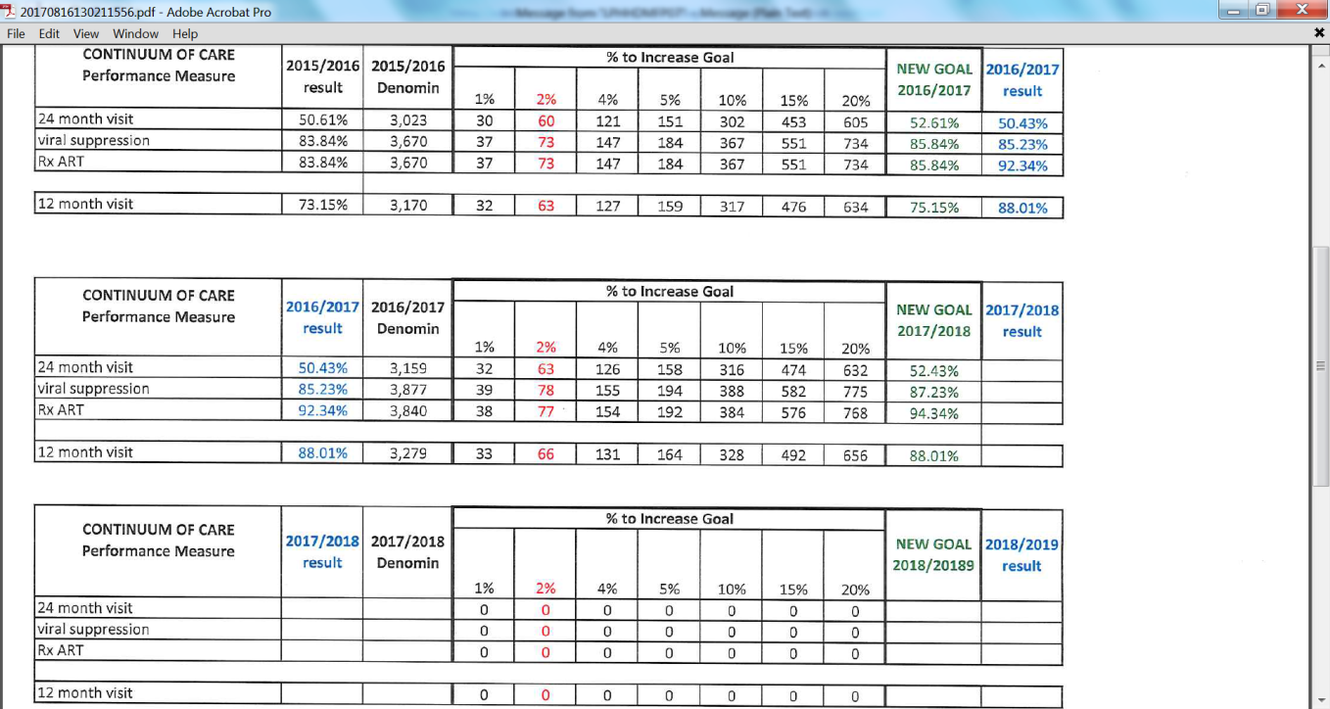

Slide 62
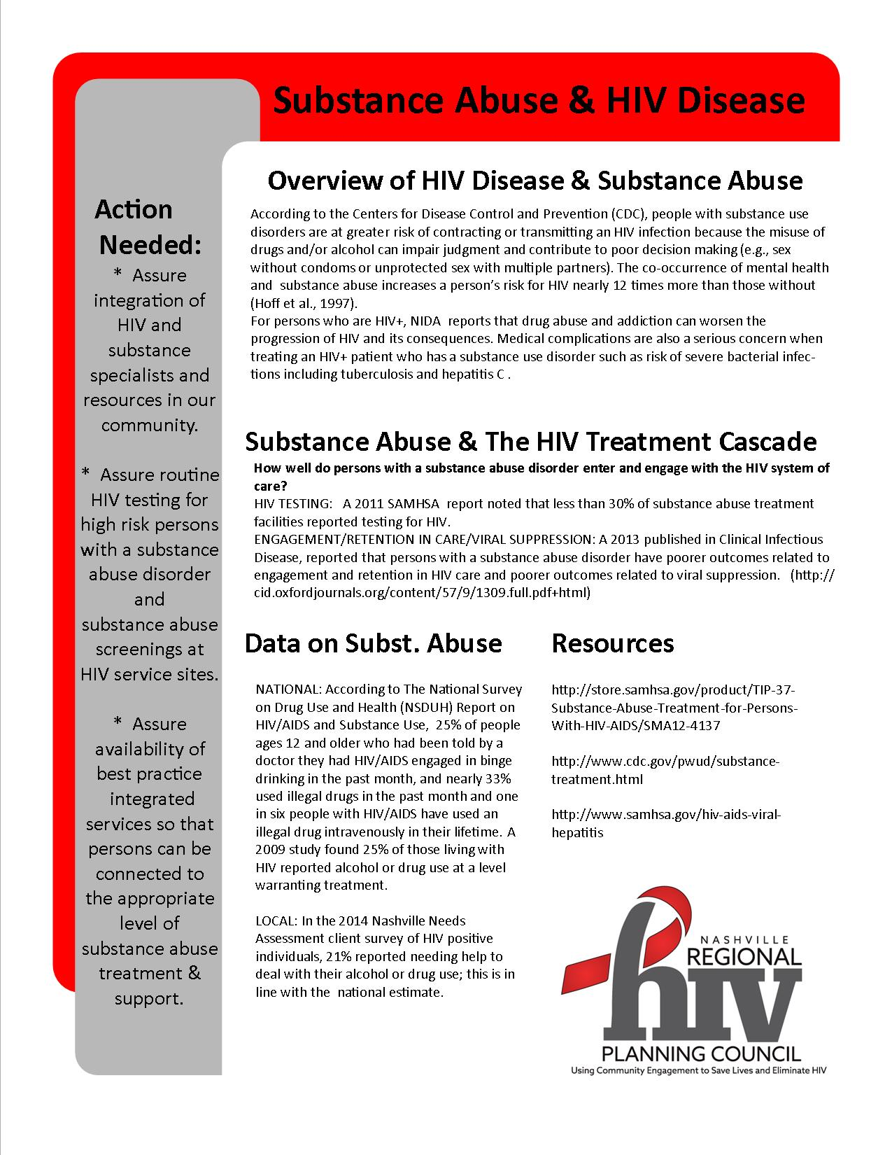

Slide 63


Slide 64



Numbers have an important story to tell. They rely on you to give them a clear and convincing voice.
Stephen Few
Things get done only if the data we gather can inform and inspire those in a position to make [a] difference. Mike Schmoker
Patients are empowered by having access to their own health information, and then by owning their own data.
Elizabeth Holmes

Slide 65
Interactive Session:
How do you use your data?
HIV/AIDS Bureau
Health Resources and Services Administration

Slide 66
Concept
To provide HAB Project Officers and Grant Recipients with a user-friendly interactive data tool
What can data dashboards help recipients and POs to do?
Data quality
  Review data quality
  Identify and address issues with data quality
Using data to improve care and treatment services
  Identify gaps in care in the jurisdiction
  Identify disparities
  Data-driven decision-making for policies and programs

Slide 67
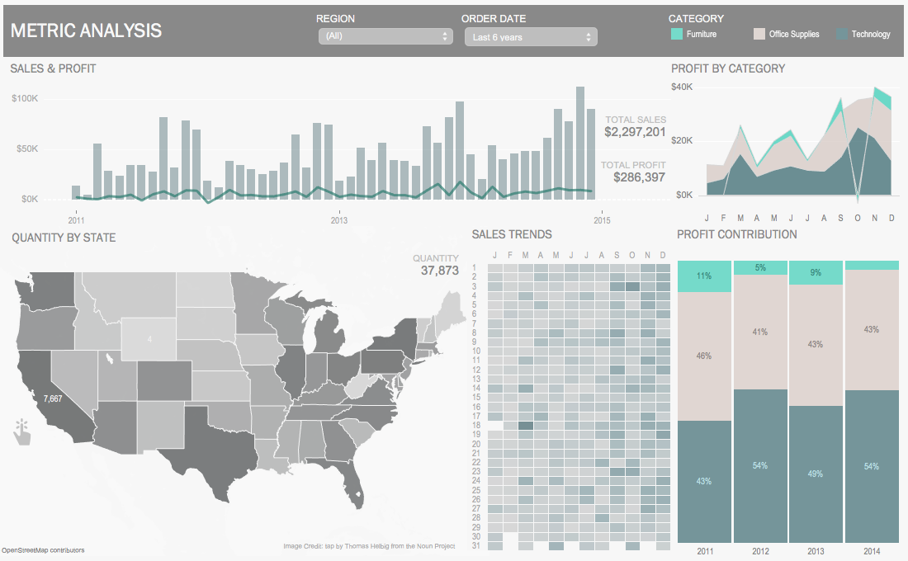
Dashboard Example 1

Slide 68
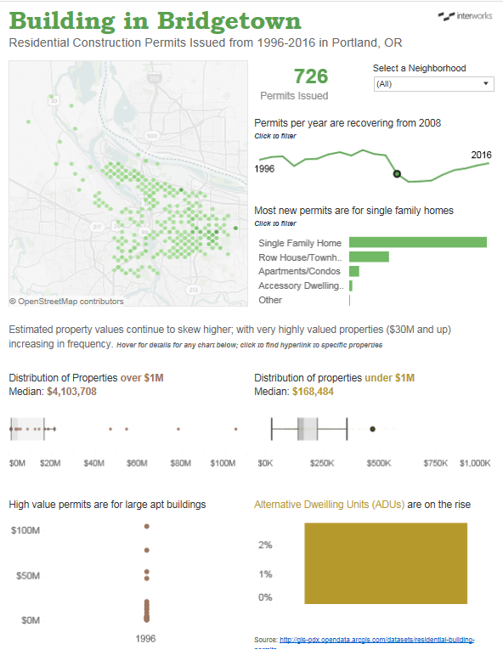
Dashboard Example 2

Slide 69
Feedback Session: Key Questions
How do you use data in your work? What data elements are most useful?
What do you feel you need to make data more accessible and easier to use in your setting?
How, if at all, does the format affect the level of comfort you have with using the data?
In what ways would you like to be able to manipulate data to better meet your needs?
What kinds of support can be provided to you in terms of data utilization?

