Slide 1
Habilidades interculturales
Notes:
Welcome participants.

Slide 2
Objetivos
Al final de esta sesión, las participantes podrán hacer lo siguiente:
Proporcionar y utilizar una definición amplia de cultura que vaya más allá de la raza o etnia;
Identificar varios grupos culturales de los que son miembros;
Explicar cómo el poder y el privilegio influyen en las interacciones entre los grupos culturales en los Estados Unidos;
Practicar la humildad cultural en su trabajo.
Notes:
Review the slide.

Slide 3
Programa
Introducción y una definición amplia de cultura
Exploración de las identidades múltiples
El efecto del poder y los privilegios en los grupos culturales en los Estados Unidos
El modo de practicar la humildad cultural en el trabajo
Revisión de la sesión
Notes:
Review the slide.
Mention that the ability to work effectively cross-culturally is a very important skill for CHWs. This skill can be applied in all settings (with communities, our co-workers, and our institutions).
Ask, “Does anyone have questions before we proceed?”

Slide 4
Pregunta para lluvia de ideas
¿Qué les viene a la mente cuando
escuchan la palabra “cultura”?
Notes:
Explain that in order to talk about working cross-culturally, it is important that we have a shared definition of culture.
Play the hot potato game. Ask participants to toss a ball around the circle. When the music stops, whomever is holding the ball will be asked this question: What comes to your mind when you hear the word “culture”?
Write responses on the flip chart page. Play the game long enough so that most of the participants get a chance to participate.
After finishing the game, review what was written and ask participants if anyone would like to add anything else.
Reflect as a large group: What catches your attention about the words we associate with the word “culture”?

Slide 5
La cultura es:
“...el conjunto de actitudes, valores, creencias y comportamientos compartido por un grupo de personas, pero diferente para cada individuo, comunicado de una generación a la siguiente” (Matsumoto, 1996).
Notes:
Ask for a volunteer to read the definition.
Ask, “What catches your attention about this definition? Is it consistent with the words that come to our mind when we think about culture? If it is different, how is it different?”
When we think about cultures, we often think about racial/ethnic culture. However, it’s important to recognize that, as the definition states, any social group in society can and does have a culture. So there are class cultures, religious cultures, sexual orientation cultures, etc.

Slide 6
ACTIVIDAD: EXPLORACIÓN DE LAS IDENTIDADES
Notes:
Explain that in order to be able to work cross-culturally, we first need to develop an awareness of our own cultures and
how they affect us. The next activity will help us become more aware of the cultures of which we are all members.
Sometimes we think of ourselves in terms of one part of our identity. For example, on one day, I might be really aware that
I am _______ (insert examples of your identity). In reality, all of us have multiple identities that make us who we are. This is
called intersectionality.

Slide 7
Definición de interseccionalidad
Interseccionalidad: un enfoque ampliamente impulsado por las mujeres de color, que argumenta que las clasificaciones como el género, la raza, la clase y otras no se pueden examinar de forma aislada; interactúan y se entrecruzan en la vida de los individuos, en la sociedad, en los sistemas sociales y son mutuamente constitutivos. (http://www.racialequitytools.org/glossary)
Kimberle Crenshaw, J. D. acuñó el término por primera vez en 1989.
Notes:
Ask for a volunteer to read the slide.

Slide 8
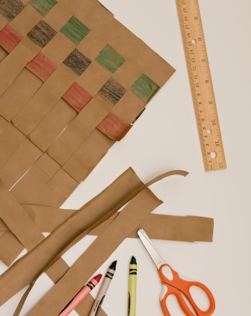
Mkeka de identidad
Hagan una lista de las comunidades y los grupos principales a los que pertenecen (es decir, raza/etnia, identidad de género, estado socioeconómico, orientación sexual, idioma, religión, capacidad/discapacidad, educación, estado civil, entre otros). Estas son las piezas de su identidad.
Entrelacen las piezas de su identidad para hacer la alfombra (mkeka).
Sean tan creativas como quieran.
Notes:
To demonstrate our multiple identities, we can use the woven mat or “mkeka” in Swahili. Here is my mkeka (facilitator shows their example).
Facilitator discusses the strands that make up their mkeka, and how they are woven together.
These strands intersect and cross each other in order to form our identity. This is a concept known as intersectionality.
Explain that participants will now have about 10 minutes to make their own mkeka. Distribute strips of colored paper, tape or glue, and markers.
Say, “Here’s how to do it.” (read instructions on PowerPoint).
After everyone has finished, ask that participants attach their mats to the wall, do a silent “gallery walk” and note to themselves anything that catches their attention or raises questions.
Reflect by asking: What caught your attention about our mats of intersectionality? Did anything surprise you?

Slide 9
Introducción al poder, el privilegio y la opresión en la sociedad estadounidense
Notes:
In order to work effectively across cultures, it is also necessary to understand how power and privilege influence interactions among and between cultural groups in the U.S.
Think for a moment about how you interact with your supervisor at the clinic. Now think for a minute about how you interact with children in your life. Do you relate the same way to both of these people?
Power relations strongly affect how we interact with the people around us in society.

Slide 10
Cultura estadounidense dominante
Arriba
hombre
blanco
sin discapacidad
heterosexual
educado formalmente
clase media o alta
angloparlante (primer idioma inglés)
habitante de la ciudad/urbano
empleado
sobrio/sin trastorno de consumo de sustancias
VIH negativo
sin antecedentes de trauma
con vivienda estable
cisgénero
con buena salud general
Abajo
mujer
persona de color
discapacitada
LGBTQ
sin educación formal
pobre o de clase trabajadora
segundo idioma inglés o no angloparlante
de zona rural
desempleada
con trastorno por consumo de sustancias
VIH positivo
sobreviviente de un trauma
con vivienda inestable/sin hogar
transgénero
con salud general deficiente
Notes:
To explore this idea, we are going to use the “One Up-One Down Model.” We borrowed this model from Guadalupe Guajardo at the Non-Profit Association of Oregon.
In dominant U.S. society, some characteristics tend to give us power or put us “up.” These include being: male, white, able-bodied, straight/heterosexual, formally educated, middle class or wealthy, first language English speaker, city dweller, employed, sober/no substance abuse, HIV negative, no trauma history, stable housing, cisgender, and having good overall health.
Some characteristics tend to deprive us of power or put us “down” in dominant culture in the U.S. These include being: female, person of color, disabled, LGBTQ, lacking in formal education, poor or working class, second language English or non-English-speaker, rural, unemployed, having substance use issues, HIV positive, trauma survivor, unstable housing/homeless, transgender, or having poor overall health.
Let’s brainstorm on the flip chart: What are some other things that put us up that we have not listed yet? What are some things that put us in the down position?
Write responses on corresponding columns on the flipchart.

Slide 11
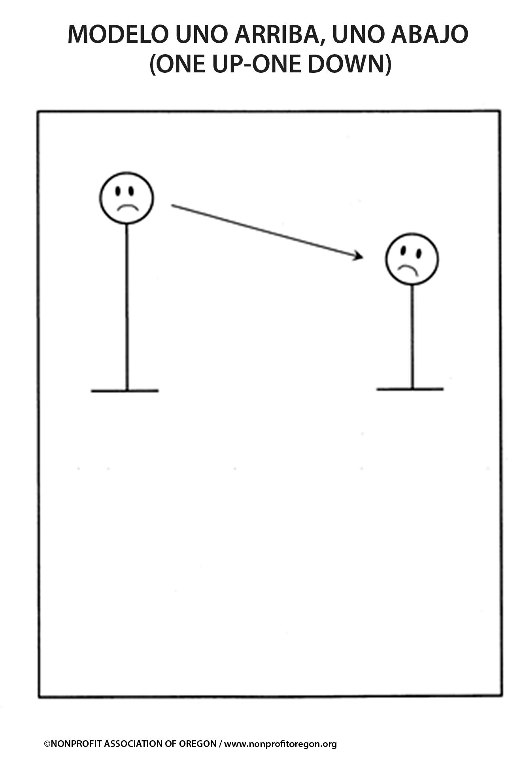
Notes:
Pass out copies of the “One Up-One Down Model.” Ask participants to take a moment to write which characteristics give them power and which take away their power within the context of dominant U.S. culture.
Explain that now we will use a technique called Image Theater to explore power differences. In a moment, I will break you into groups of three. Two people will be the “clay” and will be sculpted by the third person into a still image that represents how the power imbalances might look or feel like. Each person will get a chance to be the sculptor and the clay. After each round, ask the group to stop and look at the other images.
Break participants into groups of 3 and ask them to create their images.
Ask: “What did you notice or feel during that exercise?”
Our place in society is sometimes referred to as our “positionality.” Just as we all have multiple identities, our positionality changes depending on who we are with. Sometimes we are up, sometimes we are down, and sometimes we are both at the same time. Keep this in mind as we view the video in the next segment.

Slide 12
Humildad cultural
Concepto creado por dos médicos, las Dras. Melanie Tervalon y Jann Murray-Garcia
Propuesto como alternativa al concepto de “competencia cultural”.
Es imposible para los médicos (o las promotoras de salud) ser “competentes” en todas las culturas de sus pacientes.
Es posible practicar la humildad cultural.
Notes:
In our work as CHWs, we encounter people from a variety of class, racial/ethnic, and other types of cultures. It is impossible for us to be “competent” in all the cultures we encounter. But it is possible to practice cultural humility in all our interactions.

Slide 13
Video de humildad cultural
Video:
“Cultural Humility: People, Principles, and Practices”
Notes:
Watch the video.
Cultural Humility: People, Principles and Practices: https://www.youtube.com/watch?v=_Mbu8bvKb_U

Slide 14
Tres aspectos de la humildad cultural
Autorreflexión crítica y aprendizaje continuo
Reconocer y desafiar las desigualdades de poder
Responsabilidad institucional
Notes:
The authors identified 3 aspects of cultural humility. Read the slide.

Slide 15
Lluvia de ideas en grupos pequeños
Como promotoras de salud, ¿cómo pueden practicar la humildad cultural mediante la autorreflexión crítica y el aprendizaje permanente?
Notes:
Explain that in a moment we will break into small groups so that you can reflect together on how you can practice cultural humility through critical self-reflection and lifelong learning in your work as a CHW.
Each group will be given a flip chart sheet with the words “cultural humility” in a mindmap format.
Please use the flipchart page to capture your thoughts. For the brainstorm, please draw from your experiences, the CHW roles, and the handout on Building Cross-Cultural Skills Awareness.
Ask each group to share back 3 ideas from their discussion. Post flipchart pages around the room for participants to look at throughout the day.
Summarize: No matter our background or our position in society, there are ways we can interact with others from different backgrounds that increase the effectiveness of the interaction. Remind people that we also have further resources if anyone wants to dig into these topics more deeply.

Slide 16
Revisión de las habilidades interculturales
Nuestra experiencia en la vida está determinada por nuestra identidad. A menudo nos cuesta comprender la experiencia de personas con una identidad diferente.
La cultura va más allá de la raza o etnia e incluye clase, geografía, orientación sexual y otras características que nos hacen diferentes de los demás.
Notes:
Ask for a volunteer to read the slide.

Slide 17
Revisión de las habilidades interculturales
Todos tenemos múltiples identidades. Ciertas identidades nos dan poder y privilegios, mientras que otras identidades nos privan de poder y privilegios.
La humildad cultural es una alternativa efectiva a la competencia cultural como un objetivo para luchar en nuestras interacciones con los demás. La humildad cultural incluye la autorreflexión crítica, aborda las desigualdades de poder y la responsabilidad institucional.
Notes:
Ask for a volunteer to read the slide.

Slide 18
Si quieren investigar más en profundidad
Video clip sobre la interseccionalidad
Notes:
If time permits, show the video Kimberle Williams Crenshaw: Intersectionality: https://www.youtube.com/watch?v=9yKX_MH2bHs

