Slide 1
Proceso continuo de la atención del VIH

Slide 2
Objetivos
Proceso continuo de la atención del VIH
Al final de esta unidad las participantes podrán hacer lo siguiente:
Describir cómo las promotoras de salud (CHW) trabajan para lograr los Objetivos nacionales para poner fin a la epidemia del VIH, que incluyen involucrar a las personas en la atención médica y la retención.
Describir el proceso continuo de la atención del VIH con más detalle.
Identificar los factores que afectan la capacidad de una persona para seguir los pasos en el proceso continuo de la atención del VIH.
Notes:
Review objectives.

Slide 3
Los objetivos nacionales para poner fin a la epidemia de VIH
Proceso continuo de la atención del VIH
https://www.hiv.gov/federal-response/national-hiv-aids-strategy/nhas-update
Reducir las nuevas infecciones por VIH;
Aumentar el acceso a la atención y optimizar los resultados de salud para las personas con VIH;
Reducir las disparidades y las desigualdades sanitarias relacionadas con el VIH;
Lograr una respuesta nacional más coordinada a la epidemia del VIH.
Notes:
Review the National Goals to End the HIV Epidemic. Ask participants if they have heard of this national plan. If respondents have heard of the plan, where did they learn about it?
The National Plan to End the Epidemic is the federal government’s national strategy to address the HIV/AIDS epidemic in the United States.
Ask participants to read each goal.
Ask participants for examples of how a Community Health Worker (CHW) might play a role in achieving these goals.
Sample answers to share:
Reduce new infections: CHWs can help screen and test people at risk for HIV infection; help educate partners of people with HIV (PLWH) to take medications, called PreP, that can reduce HIV transmission; educate the community about risk reduction techniques including safer sex practices such as condom use and not sharing needles with IV drug use to prevent HIV transmission.
Increase access to care: Help PLWH find a HIV care provider or clinic; provide support and education about antiretroviral treatment; support clients with transportation assistance to appointments and other basic needs, like food, so they can get the medical care they need.
Reduce disparities: Educate members of their community about how HIV affects them; provide information about where to access treatment, especially for people who may be at risk.

Slide 4
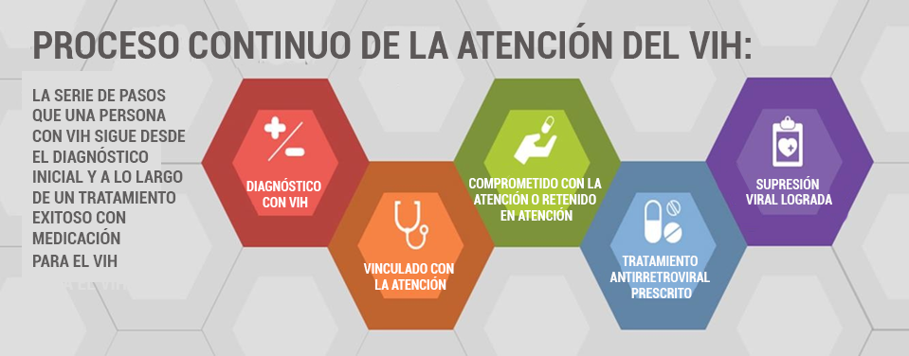
Proceso continuo de la atención del VIH
Notes:
Review the HIV care continuum model. The care continuum outlines the sequential steps or stages of HIV medical care that people with HIV go through from initial diagnosis to achieving the goal of viral suppression (a very low level of HIV in the body).

Slide 5
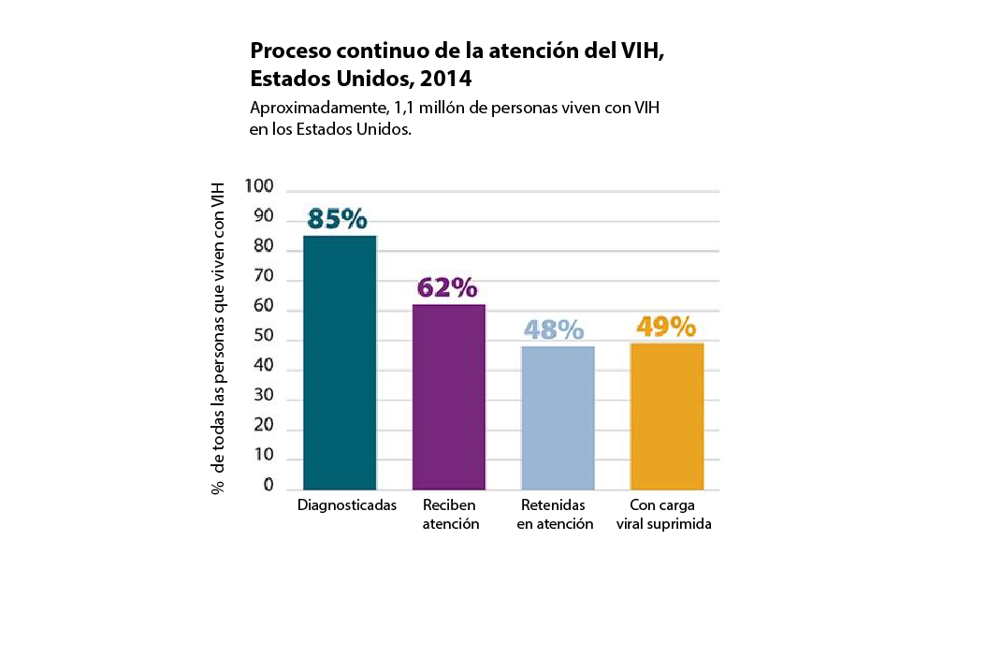
Proceso continuo de la atención del VIH
Centers for Disease Control November 2014 HIV in the United States: “Stages of Care”, noviembre de 2014. Disponible en https://www.cdc.gov/nchhstp/newsroom/2017/HIV-Continuum-of-Care.html
Notes:
The care continuum also shows the proportion of individuals living with HIV who are engaged at each stage. It is the framework for which HRSA/HAB measures Ryan White HIV/AIDS programs’ success.
Describe Health Resources and Services Administration's (HRSA) specific definitions for each stage:
Linkage to care: within 90 days of diagnosis
Retained in care: 2 appointments at least 90 days apart in a 12-month period, or no gaps in care of 6 months or greater in a 24-month period
Prescribed antiretroviral treatment
Viral suppression: < 200ml/copies
The Centers for Disease Control (CDC) has found that there are many gaps in our health care system that make it challenging for a person to achieve this continuum of care. This is what the current HIV care continuum looks like across the United States (review the data on the slide).
Think-pair-share activity. Ask participants to discuss in pairs:
What are some of the reasons for these gaps in care for people with HIV?
What are some of the factors that impact whether someone is diagnosed?
What impacts linkage to care?
What impacts engagement/retention in care?
What impacts whether someone is prescribed medications?
What impacts whether someone can achieve viral suppression?
Ask participants to share responses; record on flip chart sheets.
To close, ask, “How is your work as a CHW unique in impacting the HIV care continuum?”

