Slide 1
Medications and Drug Interactions

Slide 2
Objectives
Medication and Drug Interactions
Supporting Clients with Disclosure
At the end of this unit, participants will be able to:
Understand drug-drug, drug-condition, drug-food, and drug-alcohol interactions
Explain polypharmacy and related issues
Discuss how the body process drugs
Discuss drugs that may interact with HIV drugs
Discuss how to avoid drug interactions
Use online resources to check for drug interactions

Slide 3
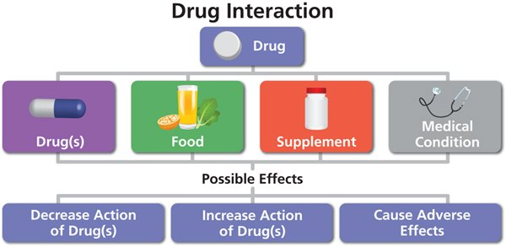
What is a Drug Interaction?
Medication and Drug Interactions
A reaction between two (or more) drugs, a food or beverage, or a medical condition.
There are 3 types of drug interactions:
Drug-drug interaction – a reaction between two (or more) drugs
Drug-food interaction – a reaction between a drug and a food or beverage
Drug-condition interaction – a reaction that occurs when taking a drug while having an existing medical condition
Photo: https://aidsinfo.nih.gov/understanding-hiv-aids/fact-sheets/21/95/what-is-a-drug-interaction-

Slide 4
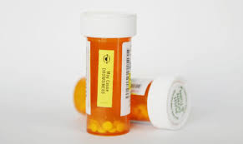
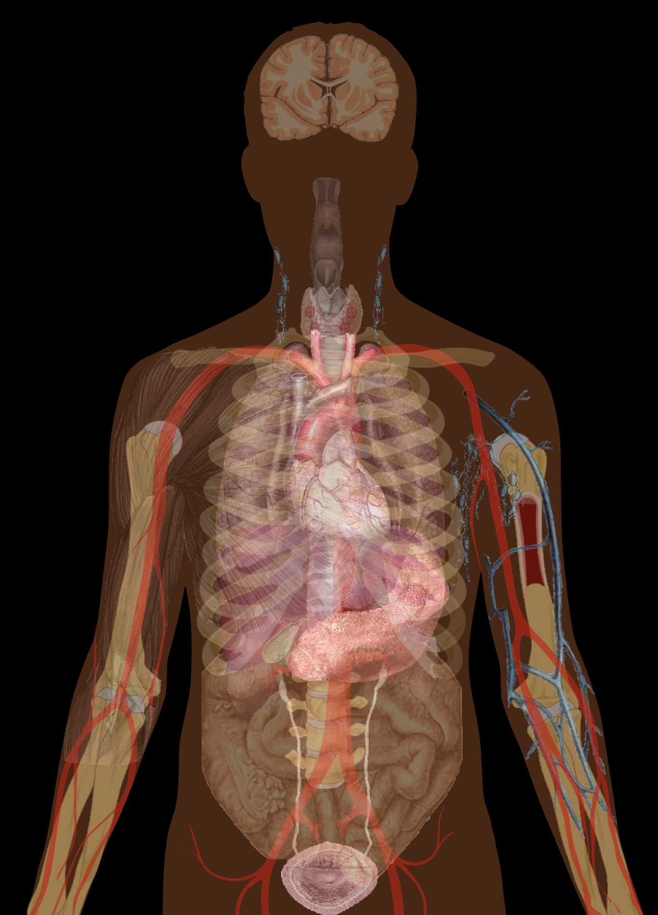
Medication and Drug Interactions
Drug-Drug and Drug-Condition Interactions
Drug-Drug Interactions
Occur when one medication affects the level of another medication.
For example: the herbal medicine St. John’s Wort may decrease the levels of some HIV medicines. As a result, the HIV medicine may not work as well and the virus could multiply.
Drug-Condition Interactions
Occur when a health condition you have makes a medicine potentially harmful.
For example: certain medicines that treat high blood pressure can make asthma worse.

Slide 5
Medication and Drug Interactions
Drug-Food and Drug-Alcohol Interactions
Drug-Food/Beverage Interactions
Occur when a food or beverage affects how a medicine gets into the blood. A medicine can also change how the body uses a food/beverage.
For example: certain drugs that treat osteoporosis (thinning of the bones) are not properly absorbed unless they are taken on an empty stomach.
On the other hand, some drugs need to be taken with food so they break down more slowly or to reduce their side effects.
It’s important to follow food instructions carefully.
Drug-Alcohol Interactions
Occur when alcohol affects the level of a medicine or increases its side effects.
For example, people who take certain antidepressants should avoid alcohol because they can make side effects worse.
Notes:
Medication and Drug Interactions

Slide 6
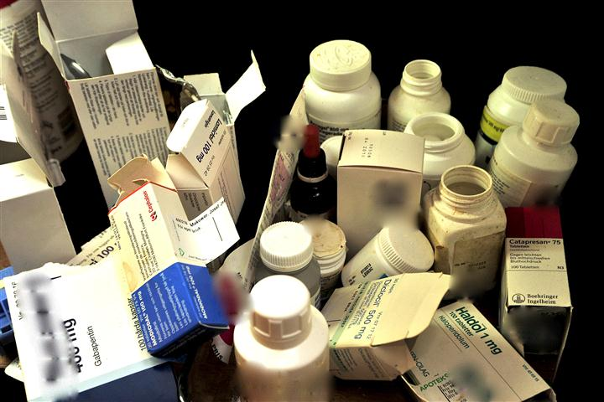
What is Polypharmacy?
Medication and Drug Interactions
Polypharmacy is when people take several medications.
The practice of administering many different medicines, especially concurrently for the treatment of a single disease; also
The concurrent use of multiple medications by people to treat usually coexisting conditions, which may result in adverse drug interactions.
Notes:
Review the slide.
A drug interaction is a reaction between two (or more) drugs, a reaction between a drug and a food or beverage, or a reaction between a drug and an existing medical condition.
Medications make us feel better and stay healthy, but sometimes drug interactions can cause problems. Drug interactions can reduce or increase the action of a medicine or cause adverse (unwanted) side effects. For example, taking a nasal decongestant if you have high blood pressure may cause an unwanted reaction.
Medication and Drug Interactions

Slide 7
Issues Related to Polypharmacy
Medication and Drug Interactions
Healthcare providers are concerned about Polypharmacy because more medications can mean:
More side effects
A higher likelihood of different medications
interacting with each other (drug interactions)
Notes:
Polypharmacy is when people take several medications concurrently.
The practice of administering many different medications at the same time—the use of five or more medications, especially for the treatment of a single disease.
The concurrent use of multiple medications to treat coexisting conditions, which may result in adverse drug interactions.
For example, people with diabetes can have several health conditions such as heart problems, high blood pressure, and kidney damage. These conditions could cause a person to take additional medications.
This also includes herbs, supplements, and over-the-counter medicine, all of which we’ll discuss in more detail.
The likelihood of polypharmacy increases with age.
People with hypertension, diabetes, and hyperlipidemia have increases risks of adverse drug events.
The number of drugs prescribed predicts the number of drug interactions.
Medication and Drug Interactions

Slide 8
HIV Medicines Can Cause Drug Interactions
Medication and Drug Interactions
Treatment for HIV requires a combination of HIV medications to be taken to keep HIV under control; this combination can be a single-tablet-regimen (STR) or multiple pills.
Drug-drug interactions between HIV medications, and between HIV medications and other medications are common; drug interaction can complicate HIV treatment.
Prescription drug dosages need to be high enough to fight a specific disease but not so high that it causes a lot of side effects.
Possible results of drug interactions include:
Medicine levels go down, so the medicine may not work as well.
Medicine levels go up, which may lead to worse or new side effects.
Individuals should discuss drug interactions with providers when choosing new HIV drug combinations, adding, or removing any drug from a regimen.
Notes:
Ask, “Has anyone has experience caring for an adult with health concerns that involved polypharmacy?”
Take responses then review slide.
Healthcare providers are concerned about polypharmacy because more medications can mean:
More side effects
A higher likelihood of different medications interacting with each other (drug interactions)
Ask, “What do we know about people who have side effects from medication?”
Take responses.
Ask, “Are they more inclined to continue taking the medication?”
No, many will discontinue.
Medication and Drug Interactions

Slide 9
How Does the Body Process Drugs?
Medication and Drug Interactions
The main ways the human body handles drugs are:
Step 1. Drug absorption
Step 2. Drug distribution
Step 3. Drug metabolism
Step 4: Drug elimination
Anderson, P.L. (2005). The ABC’s of Pharmacokinetics: What’s PK got to do with it? Positively Aware.
Notes:
All people with HIV who are on treatment take more than one HIV drug, even if they only take one pill. Some pills contain more than one drug; for example, Truvada is a pill that contains the HIV drugs Emtriva (emtricitabine) and Viread (tenofovir). Many people with HIV take other types of medications as well.
Interactions between medicines can reduce or increase the concentration of a medicine in the blood. The change in concentration can make a medicine less effective, more effective, or so strong that it causes dangerous side effects.
For example: A person may take Triumeq, an HIV drug known to have very few side effects. However, if the person adds calcium or calcium and magnesium supplements to their daily regimen, those minerals could lower the level of Triumeq, making the HIV medicine less effective.
In order for a drug to work properly, a person must take the correct dose at the correct time so that the right amount of drug enters the bloodstream. Before an HIV drug is approved, researchers study different doses and choose one that is both safe and effective. The dose has to be high enough to stop HIV from making copies of itself, but not so high that it causes a lot of side effects.
Tell clients that it is important to discuss the possibility of drug interactions with their health care provider when choosing a new HIV drug combination, or when adding or removing any drug or supplement from their regimen.
Medication and Drug Interactions

Slide 10
How the Body Metabolizes Drugs
Medication and Drug Interactions
This process involves the liver and kidneys:
Liver makes chemicals called enzymes to break drugs down
Kidneys filter drugs out of bloodstream and into urine
Drug is removed from the body in urine or feces
Sometimes, one drug affects the way another drug is metabolized
Speeds up or slows down action of liver enzymes
Can cause changes in blood levels of other drugs that are broken down by the same enzyme
Notes:
Distribute the handout “What's PK (Pharmacokinetics) Got to Do with It?”.
Tell participants “When you swallow a pill, the drug goes from the stomach to the intestine and then into the liver before circulating to the rest of the body. “ There are several steps on how the body processes drugs. Ask for a volunteer to read each step.
Step 1. Drug absorption:
How the drug enters the blood, usually through tablets or capsules in the stomach and intestines. This where food requirements come in, and why some drugs have warnings not to take antacids.
Step 2. Drug distribution:
How the drug travels in the blood-stream and how it goes into and comes out of other areas of the body. Some areas of the body like the brain and reproductive organs are protected from chemicals; it’s difficult to measure drug levels in those areas.
Step 3. Drug metabolism:
How the body chemically changes a drug, usually in the intestines and liver. Metabolism involves breaking a drug down or adding a chemical that makes it easier to pass it into urine.
Step 4: Drug elimination:
How the body gets the drug out, usually by passing the drug into the urine (via the kidneys) or stool via the liver. Some people have kidney or liver illness. In these cases, the blood level of some drugs may build to very high levels if the drug dose is not reduced.
Medication and Drug Interactions

Slide 11
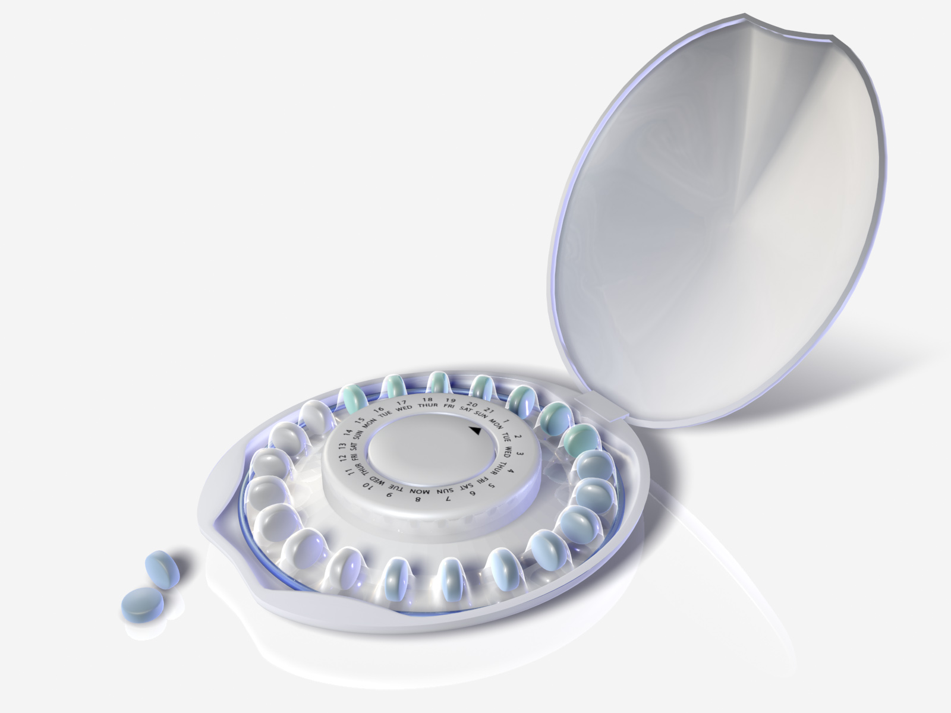
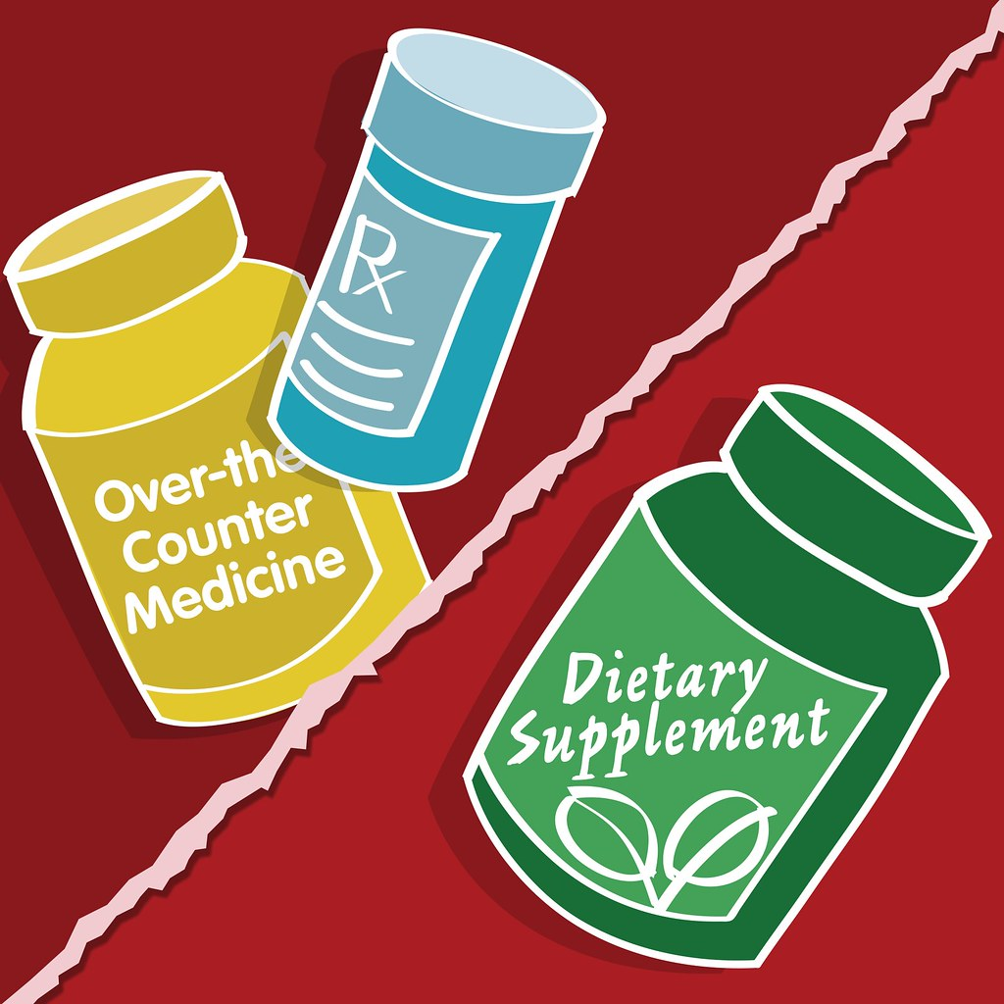
Drugs That May Interact with HIV Drugs
Medication and Drug Interactions
Prescription, over-the-counter and complementary therapies may have major interactions with HIV drugs:
Birth control pills with ethinyl estradiol (form of estrogen) can interact with HIV meds, making birth control pills less effective, increasing chance of pregnancy
Complementary therapies
Most vitamins and herbs have not been studied with HIV drugs
St. John's Wort (herbal anti-depressant) and garlic supplements should NOT be taken with any PIs or NNRTIs
Notes:
The body metabolizes (breaks down) the drugs you take. This process involves the liver and kidneys. Review slides.
Drugs that slow down metabolism inhibit the metabolism of drugs. This causes other drugs to be metabolized and removed from the system more slowly, which:
Increases the amount of other drugs in the body
Increases how long other drugs stay in bloodstream
Individuals taking drugs that slow down liver enzymes should talk to their providers about adjusting doses of other medications.
Drugs that speed up metabolism get rid of drugs faster. This can be useful in HIV treatment, for example, Norvir (ritonavir), a PI, makes liver enzymes work more slowly. It boosts levels of other PIs like Reyataz (atazanavir); the amount of Reyataz in the blood becomes higher than it would be without Norvir. This reduces the chance of developing resistance. However, Norvir can cause other types of drugs to have higher levels in the blood. These increased blood levels of drugs can cause overdoses or increase side effects including:
Enducer = causes or induces breakdown/reduces concentration
Inhibitor = stops/slows down a drug from breaking down so drug concentration builds up
Medication and Drug Interactions

Slide 12
Other Drugs That May Interact with HIV Drugs
Medication and Drug Interactions
Classes of drugs that are more likely to interact with HIV drugs (not a complete list):
Drugs to control heart rhythm
Opium-based pain killers (narcotics)
Drugs that increase bowel activity
Sedatives (medications to calm your nerves)
Blood thinners
Drugs to treat erectile dysfunction
Drugs to treat tuberculosis
Drugs to treat hepatitis C
Antifungal drugs
Antibiotics
Antacids
Drugs that prevent seizures
Drugs to treat high cholesterol
Drugs to treat depression
Antihistamines (allergy medications)
Notes:
There is a long list of prescription, over-the-counter, complementary, and recreational drugs that may have major interactions with HIV medications. Food and beverages can also change the way HIV drugs are broken down in the body. Here are a few examples:
Birth control pills containing ethinyl estradiol (a form of estrogen) can interact with HIV drugs. This can make the birth control pills less effective and increase the chances of pregnancy. Clients may need to talk with their provider about switching to or adding another form of birth control.
Many people with HIV use complementary therapies such as vitamins or herbs. While most of these have not been studied with HIV drugs, St. John's Wort (an herbal anti-depressant) and garlic supplements have been shown to affect the levels of some HIV drugs. St. John's Wort and garlic supplements should not be taken with any PIs or NNRTIs. Clients should discuss any vitamins, herbs, or supplements they take with their health care provider.
Medication and Drug Interactions

Slide 13
Substances That May Interact with HIV Drugs
Medication and Drug Interactions
Recreational drugs and alcohol
Reports of overdoses caused by taking recreational drugs and HIV drugs
Interactions between ecstasy or amphetamines (crystal meth, speed) and PIs are particularly dangerous
Alcohol affects body processes, can cause drug interactions
Combining alcohol and some HIV drugs (e.g., Videx) can increase risk for developing pancreatitis
Methadone and buprenorphine
Can interact with many HIV drugs
Notes:
Review the slide. There are certain classes of drugs used to treat some medical conditions that are more likely to interact with HIV drugs. Not all drugs in these classes will cause problems. Note: this is not a complete list; other classes of drugs may also cause interactions.
There is no way that the average person can keep up with all of these possible medication interactions.
Ask, “What should a client do?”
They should always talk to their doctor and pharmacist to discuss any potential interactions.
Medication and Drug Interactions

Slide 14
Medication and Drug Interactions
Things You Can Do to Avoid Drug Interactions:
Keeping a current list of all your medications and taking it to every healthcare visit. Include all prescription and over-the-counter medicines, vitamins, herbs, and supplements. It’s important for health care providers and patients to review medications together.
Use the same pharmacy for all your prescription medications.
The pharmacist can have access to all medications you are taking and can check for possible drug interactions.
Asking questions when you receive a new medicine.
Should I take the new medication in the morning/evening or at bedtime?
Should I take the new medication with food or on an empty stomach?
Does this medication have any interactions with alcohol, food, or other drugs that I should know about?
Ask if you need all the medications you are taking?
Ask if there are ways to simplify your treatment regimen?
Providers may need to adjust doses or change drugs based on possible interactions.
Other tips:
Know which medications you take and what they do.
Take each of your medications as directed by your healthcare provider.
Refill prescriptions on time so you never run out of medication.
Notes:
Review the slide.
There have been reports of overdoses, some fatal, caused by taking recreational drugs (street drugs) and HIV drugs. Interactions between ecstasy or amphetamines (crystal meth, speed) and PIs are particularly dangerous.
Alcohol affects body processes and is often responsible for drug interactions. Combining alcohol and certain HIV drugs like Videx can increase the risk of developing pancreatitis (inflammation of the pancreas).
Methadone and buprenorphine can interact with many HIV drugs. It is important that the opioid treatment program and the HIV health care provider know what medications a patient is taking. This way necessary adjustments can be made to ensure the person receives enough methadone or buprenorphine to prevent withdrawal symptoms, and enough HIV drugs to fight the virus effectively.
People are not always ready to get treatment for their substance use. Ask, “What can we tell them, or how can we encourage them?”
Use harm reduction principles
Encourage them to be honest with their doctor so they can be placed on the right regimen
Offer to assist them with resources (connecting them to in-patient services, support groups, etc.)
Ask, “What are some ways to avoid drug interactions?”
Take answers, then review the next slide.
Medication and Drug Interactions

Slide 15
Medication and Drug Interactions
Which kind of drug interaction concerns you the most?
Notes:
Review the slide.
Medication and Drug Interactions

Slide 16
Examples of Online Interaction Practice
Medication and Drug Interactions
The HIV Drug Interaction Checker by the University of Liverpool is an online resource that allows you to check drug-drug interactions between an HIV drug and any other prescription or over-the-counter medication.
There is also a mobile app, the HIV iChart (Note: for the app you’ll need to use the generic, or scientific name, not the brand name).
https://www.hiv-druginteractions.org/checker
MedScape’s Drug Interaction Checker is another resource.
https://reference.medscape.com/drug-interactionchecker
Notes:
Review the slide.
Medication and Drug Interactions

Slide 17
QUIZ
Notes:
Review the slide.
Medication and Drug Interactions

Slide 18
Medication and Drug Interactions
A drug interaction is:
A reaction between 2 or more drugs
When one drug affects the level of another drug
A chemical reaction that keeps HIV medications from working
The 3 types of drug interactions are:
Drug to _______ interaction
Drug to _______ interaction
Drug to _______ interaction
3. Polypharmacy is taking several different medications.
(True or False)
4. Possible results of drug interactions are when (choose up or down)
Medicine levels go _______, so the medicine may not work as well.
Medicine levels go _______, which may lead to worse or new side effects.
Notes:
Ask, “Which kind of drug interaction concerns you the most?”
Take responses and discuss. Address any questions participants have about drug interactions.
Medication and Drug Interactions

Slide 19
Medication and Drug Interactions
5. Which classes of HIV medications cause many drug side effects
Protease inhibitors and nukes
Protease inhibitors and non-nukes
6. Drugs like antacids, complementary therapies, antidepressants and Viagra could likely cause drug interactions. (True or False)
7. What are some things to do to avoid drug interactions? List
Notes:
The HIV Drug Interaction Checker by the University of Liverpool is an online resource that allows you to check drug-drug interactions between an HIV drug and any other prescription or over the counter medication.
MedScape’s Drug Interaction Checker is another resource. Use this website to demonstrate with a couple of examples using an HIV drug along with an over-the-counter drug:
Triumeq + St. John’s Wort
Triumeq + Calcium Magnesium
Medication and Drug Interactions

Slide 20
References
Medication and Drug Interactions
Positively Aware. 2019 HIV Drug Guide. https://www.positivelyaware.com/issues/march-april-2019-2019-hiv-drug-guide
Anderson, P.L. (2005). The ABC’s of Pharmacokinetics: What’s PK got to do with it? Positively Aware.
Positively Aware - http://www.thebody.com/content/80958/uderstanding-drug-interactions.html
The Well Project - http://www.thebody.com/content/58994/drug-interactions-and-hivaids.html
AIDSinfo - http://www.thebody.com/content/79250/what-is-a-drug-interaction.html

