Slide 1
Introduction to Communication Skills

Slide 2
ACTIVITY: SOCIODRAMA
Notes:
Introduce session and share objectives
Communication is defined as the imparting or exchanging of information or news. This definition is accurate and simplistic; however, the process of communicating is far more dynamic and complex.
Ask, “What factors affect our ability to communicate effectively?” Write a list of the potential factors, such as identity, power, race/ethnicity, etc. Affirm participants’ responses.
Summarize participants’ responses and conclude that communication is a multifaceted and complex process. Communication involves a process where communicators convert their thoughts into messages that are conveyed through content and symbols (e.g. verbal messages, emails, emojis, sign language, etc..) Processing the sent messages includes decoding and interpreting them through the receiving communicator’s values, attitudes, beliefs and life’s experience. Effective communication is essential to the work of CHWs and is worthy of exploration. To demonstrate this complexity, we will now enact a sociodrama.
Invite two volunteers to enact a sociodrama in which a CHW and a client of different positionality in terms of social identity, power, race/ethnicity, age, socio-economic status, and/or other factors have a conversation (volunteers can choose the characteristics of their social identities from the generated list). One person will portray a CHW and the other the client.
Speak privately with the volunteers and share the following information prior to their enactment:
At the beginning of their interaction, there should be no conflict, but because of different communication styles, the messages that are being sent are not the messages that are being received. In the sociodrama, the CHW will demonstrate different ways of addressing the issue. For example: Aggression-standing over the client or speaking loudly with terse language.
Review the sociodrama scenario below with the volunteers. They will have 3-5 minutes to enact the scenario in front of the larger group. Sociodrama Scenario:
The CHW is meeting with a client for a regularly scheduled appointment. They have been working together for one year. The CHW inquires about the client’s adherence. The client is hesitant to respond, but says they have been taking their medications as prescribed. The CHW is aware that the client’s lab results reflect differently. The lab results suggest that the client has not been taking their medications as prescribed.

Slide 3
Reflection on Sociodrama
What did you see in the sociodrama?
What are some of the various reasons we may choose to communicate with another person?
What factors influenced the effectiveness of the CHW’s and client’s communication?
Notes:
Upon completion of the scene, ask participants the questions on the slide (10 minutes).
Facilitator’s note: It may be helpful to remind participants that a person’s intention does not override the impact of their communication. Sometimes it’s helpful to reflect on the question, “Is my intent to be right, or to build and maintain relationship?”

Slide 4
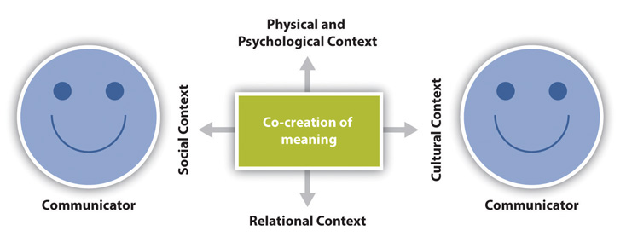
The Communicator's Context
Notes:
Communication is essentially about the sending and receiving of messages. The communicators, often referred to as the sender and listener, use verbal (words), vocal (tone, intonation, volume, etc.) and visual (body language) cues to both send and receive messages. In addition, the speaker and listener come to the conversation with their own personal background, culture, values, positionality and other factors we call context. Context impacts how messages are sent and received.
Context – The transactional model of communication views communication as inclusive of all of the previous elements and adds a layer of context. As we just stated, each communicator has their own sphere of context through which they interpret and evaluate exchanged messages. The inclusion of a communicator’s context is an important distinction for this model of communication. A person’s context is made up of several factors:
Physical context includes the environmental factors in a communication encounter. The size, layout, temperature, and lighting of a space influence our communication. Ask participants for examples from their experience of a “good physical context” for communication. Ask for examples of where the physical context could be challenging and what makes it challenging.
Psychological context includes the mental and emotional factors in a communication encounter. Stress, anxiety, and emotions are just some examples of psychological influences that can affect our communication.
Social context refers to the stated rules or unstated norms that guide communication. As we are socialized into our various communities, we learn rules and implicitly pick up on norms for communicating.
Relational context includes the previous interpersonal history and type of relationship we have with a person. We communicate differently with someone we just met versus someone we’ve known for a long time.
Cultural context includes various aspects of identities such as race, gender, nationality, ethnicity, sexual orientation, class, and ability.
Ask:
What value does this information provide for the CHW?
How will you use this information in your role as a CHW?
Summarize and close. The co-creative process of developing understanding between communicators is influenced by the amount of commonalities and differences between their two spheres of context. For example, If communicators share similar cultural contexts (e.g. race, sexuality), the shared experiences can help facilitate more effective communication. In contrast, the fewer commonalities in context communicators share, the more challenging it will be to facilitate shared understanding. The CHW should be aware of the many facets that impact effective communication. This understanding will help CHWs employ effective communication skills to facilitate a shared understanding with others.

