Slide 1
Navegación de pacientes
Notes:
Welcome participants.

Slide 2
Objetivos
Navegación de pacientes
Al final de esta unidad las participantes podrán hacer lo siguiente:
Describir el propósito y los elementos de las reuniones de navegación de pacientes.
Compartir cómo los navegadores de pacientes pueden ayudar a los clientes a acceder a los servicios necesarios.
Saber qué formularios son necesarios para registrar las actividades de navegación de pacientes.
Notes:
Review the objectives.

Slide 3
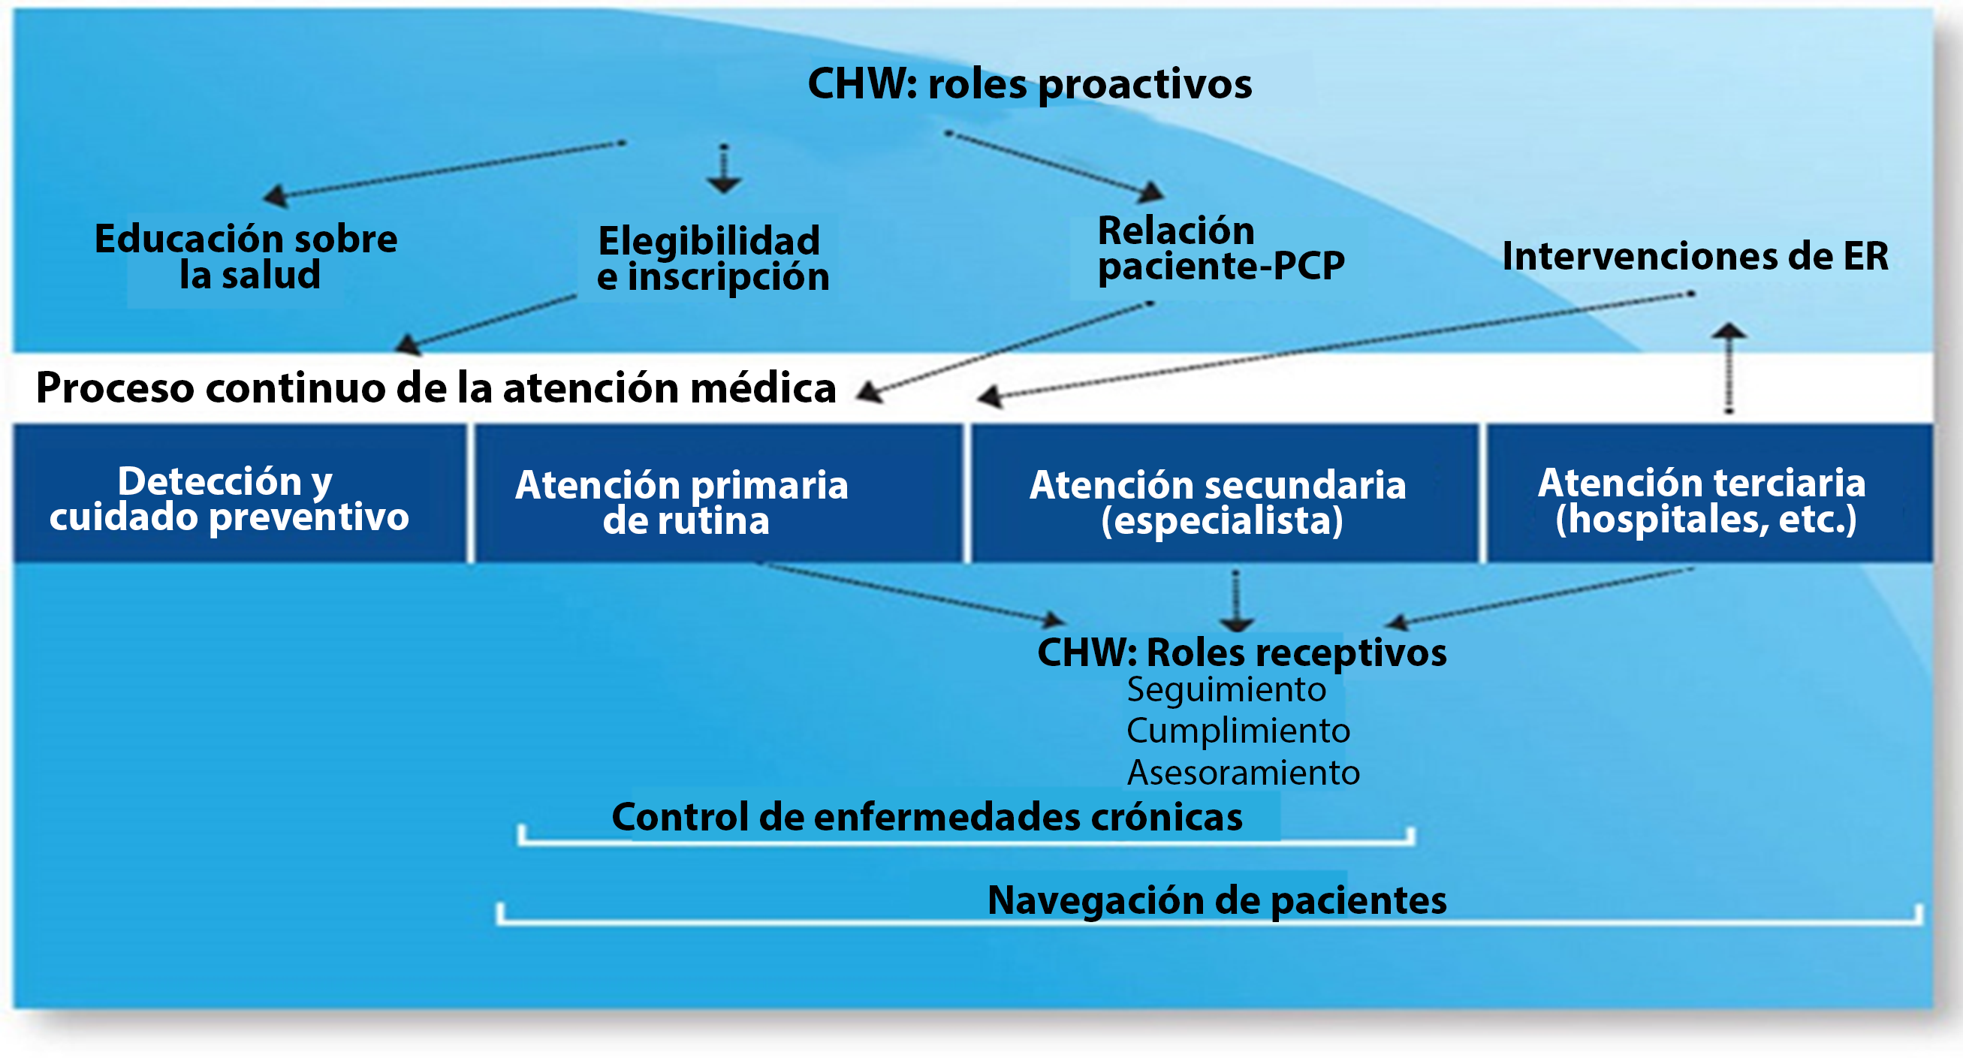
Navegación de pacientes
Notes:
Let's take a look at the care continuum and what areas patient navigation influences.
This diagram reflects the key components of care: Screening and preventive care, routine primary care, secondary care (specialist), and tertiary care (hospitals).The CHW roles are separated into two categories:
Proactive roles
Health education
Eligibility and enrollment
Patient and PCP engagement
Emergency room interventions
Responsive roles
Follow-up, Adherence, and Coaching
Routine primary care
Specialty care
Tertiary care (e.g., hospitals)
The two areas that chronic disease management falls under are:
Routine primary care: working with clients on adherence, making appointments, and reaching their health care goals on their care plan.
Tertiary care: supporting clients in hospice situations, end stage liver disease and hospitalization transitions.
Patient navigation encompasses both of these, plus secondary care which might entail escorting a client to specialty appointments and understanding instructions from the PCP, or helping form questions they can ask the PCP. These roles are responding to the needs and goals of the client. Proactive roles are those supportive roles that help the client gain access to and navigate the health systems.
Ask, “Considering this diagram what roles are you playing at your organization?”

Slide 4
Navegación de pacientes
Reuniones con navegadores de pacientes
Para comunicarse con un cliente:
Respondan cualquier pregunta que el cliente pueda tener.
Ofrezcan sesiones de autogestión del VIH.
Brinden atención y apoyo individualizado.
Notes:
Tell participants: These meetings are where you bond and gain trust with the client as you support them in identifying and developing health-related goals, as well as answer their questions and clear up myths that they may have using your communication skills such as motivational interviewing.
Ask Participants, “Do you perform these tasks at your organization, or does someone else?” “How do you perform these activities?” “How do you document and track your meetings with a client?”
4

Slide 5
Coordinación y seguimiento de servicios
Navegación de pacientes
Atención médica
Transferencia cálida
Programas de vivienda/beneficios/asistencia social
Programas de asistencia financiera
Asistencia alimentaria
Transporte
Notes:
Tell participants: These are some of the services that you as a CHW may perform and help a client navigate the service system in addition to linking and staying in medical care. You may work closely with the care team and other community partners to communicate client needs that may arise out of these meetings in order to support them in reaching their goals and increasing their investment in their health outcomes.
Ask Participants, “Do you perform these tasks at your organization, or does someone else?” “How do you perform these activities?” “Who do you contact?” “How do you document and track your work with clients on obtaining services?”
Write participant responses on a flip chart and note similarities and differences.
5

Slide 6
Apoyo en la atención y las consultas médicas
Navegación de pacientes
Asistencia
Acompañamiento físico
Ayuda con la programación
Recordatorios
Documentación
Revisión del plan de atención
Materiales educativos para el paciente
Video: “HRSA Dissemination of Evidence Informed Interventions/AIDS United Treatment Tips”
Notes:
Tell participants: The need for assistance will vary from client to client. Some will require more support than others, especially in the beginning. You may have to physically escort or accompany them to appointments at first; that might be a good opportunity to educate a client about scheduling, identifying types of reminders that work best, and assisting them in setting up appointments. Remember, always make time for documentation as soon as possible after the visit and review the care plan and update what was and wasn’t accomplished.
Ask participants, “Do you perform these tasks at your organization, or does someone else?” “How do you perform these activities?” “Who do you contact?” “How do you document and track your work with clients on obtaining services?”
Ask participants, “Do you perform patient education?” If yes how for volunteers to share how they educate materials on what topics and what materials they use.
Share with participants: the video clips from AIDS United HRSA DEII initiative that can be used to educate clients.
Write participant responses on a flip chart and note similarities and differences.

Slide 7
Por su parte...
Navegación de pacientes
¿Los roles en la agencia son más proactivos que receptivos o una combinación de ambos?
¿Cuál de estos roles no forma parte de su rol actual?
¿Existe algún rol que no están cumpliendo que les gustaría incorporar a su rol para mejorar la prestación del servicio?
Esta fotoEsta foto de un autor desconocido tiene licencia bajo CC BY-NC-ND
Notes:
Review the slide.
Break participants in to groups of 3-4 persons. Ask them to discuss the 3 questions on the slide for about 15 minutes.
Bring participants back and ask them to share what they learned from each other.

Slide 8
Formularios útiles para la navegación
Navegación de pacientes
Herramienta de agudeza para la evaluación de riesgos del cliente
Plan de atención para trabajar con el cliente en sus objetivos
Notes:
In the HRSA Dissemination of Evidence Informed Interventions: Enhanced Patient Navigation for Women of Color with HIV tool kit you will find useful forms to help track client progress and health outcomes.
Ask participants if their agencies has forms they need to complete and how they document their services. Ask if they have access to the patients electronic medical record or paper chart. Note responses on a flip chart .
Tell participants: Whether your work is proactive or responsive, remember to schedule regular meetings with the client, take care to communicate changes and progress to your team, and document all the work you do concerning the client.
8

Slide 9
Recursos
Navegación de pacientes
Video: “HRSA Dissemination of Evidence Informed Interventions/AIDS United Treatment Tips”.
https://www.youtube.com/playlist?list=PLmeLn9qRyk-hdU_ueS_QQCY8wHkKLqN0g
“HRSA’s Dissemination of Evidence Informed Interventions: Enhanced Patient Navigation for Women of Color with HIV: Modules 1, 2, 4”. Disponible en
https://targethiv.org/library/dissemination-evidence-informed-interventions-2017
“A Guide to Implementing a Community Health Worker (CHW) Program in the Context of HIV Care”. Disponible en
https://targethiv.org/library/hiv-chw-program-guide
Notes:
Share the resources with participants and wrap up the session.
9

