Slide 1
El VIH y el estigma

Slide 2
Objetivos
El VIH y el estigma
Al final de esta unidad las participantes podrán hacer lo siguiente:
Comprender cómo el lenguaje da forma a nuestro mundo.
Comprender la historia del lenguaje en relación con el VIH y otras enfermedades crónicas.
Definir estigma
Definir el estigma relacionado con el VIH y su efecto en la prevención de, el tratamiento contra y la atención del VIH.
Explicar las diferencias entre el lenguaje estigmatizante y el lenguaje de empoderamiento cuando hablamos o escribimos sobre nosotras mismas y los demás.
Identificar el lenguaje para poner a la persona primero y su importancia.
Explorar el uso del lenguaje de empoderamiento al hablar o escribir sobre uno mismo y los demás.
Notes:
Review the objectives.

Slide 3
El lenguaje es nuestra base
El VIH y el estigma
Uno de los fundamentos de la comunidad es el lenguaje.
El lenguaje influye en cómo nos sentimos y en cómo reaccionamos a las cosas.
El lenguaje sesgado se refiere a palabras y frases que se consideran prejuiciosas, ofensivas e hirientes.
Notes:
Review the slide.

Slide 4
Lenguaje
El VIH y el estigma
Centrarse en el uso del lenguaje puede ser el primer paso para abordar el estigma, la exclusión social y la discriminación contra las personas con VIH.
Lenguaje:
Ayuda a dar forma a nuestro mundo
Describe y da sentido a nuestras vidas
Persuade y cambia de opinión
Puede destruir o empoderar
Notes:
Review the slide.

Slide 5
Definir estigma
Notes:
Ask, “What is stigma? Can someone define stigma, not related to HIV? Who has experienced stigma? How?”

Slide 6
Estigma relacionado con el VIH y el SIDA
El VIH y el estigma
El estigma relacionado con el VIH/SIDA se refiere al prejuicio, el descarte, el descrédito y la discriminación dirigida a las personas que se perciben como portadoras de SIDA o VIH, así como a sus parejas, amigos, familias y comunidades.
Notes:
Review the slide and make the following points.
Stigma is borne out of fear and it represents one of the most complex and pervasive barriers to health care for people with HIV/AIDS.
HIV/AIDS-related stigma often builds upon and reinforces other existing prejudices, such as those related to gender, sexuality, and race. For example, stigma associated with HIV is often based upon the association of HIV and AIDS with already marginalized and stigmatized behaviors, such as drug use and same-sex and transgender sexual practices.
Share the two major causes of stigma: Fear and ignorance.
People often do not know how HIV is or is not transmitted, so, fearing they might get infected through contact with a person with HIV, they isolate them.
Moral judgments: People know that HIV is transmitted mainly through sex or injecting drugs, so they assume that people with HIV get HIV through these activities. Therefore, they condemn people with HIV for “immoral” behavior. They don’t consider people born with HIV.
From the beginning, the Ryan White HIV/AIDS Program has fought against discrimination and the isolation that stigma creates. Ask participants how many people have heard of the Ryan White program? Explain that the Ryan White program is a federally funded program to help people with HIV to get care and treatment. The Ryan White Program made a commitment to help more people engage and remain in care.

Slide 7
Definir estigma
El VIH y el estigma
“Sentimientos, creencias y comportamientos negativos dirigidos hacia un individuo o grupo debido a una etiqueta o característica particular”.
“Inhabilitación para una plena aceptación social”
“Creemos, por definición, desde luego, que la persona que tiene un estigma no es totalmente humana. Valiéndonos de este supuesto practicamos diversos tipos de discriminación, mediante los que reducimos en la práctica, aunque a menudo sin pensarlo, sus posibilidades de vida”.
Goffman, E. (1963). “Stigma: Notes on the management of spoiled identity”. Englewood Cliffs, N.J: Prentice-Hall.
Notes:
Review the slide.
Stigma is a process where we (society) create a “spoiled identity” of an individual or a group of individuals. We identify a difference in a person or group, such as a physical difference (e.g., physical disfiguration), or a behavioral difference (e.g., people having lots of sex) and then mark that difference as a sign of disgrace. This allows us to stigmatize the person or group (i.e., they have already made up their mind about you).

Slide 8
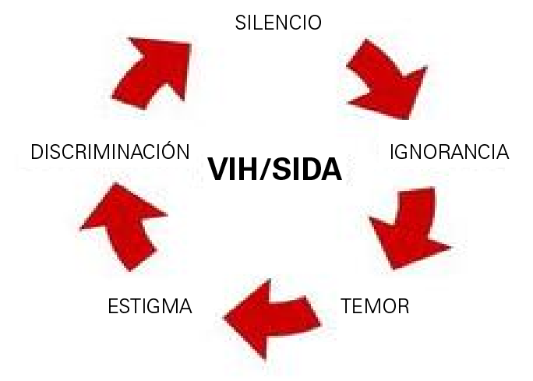
Definir el estigma relacionado con el VIH
El VIH y el estigma
Estigma social se refiere a la desaprobación extrema (o el descontento con) una persona o grupo por motivos socialmente característicos que se perciben y sirven para distinguirlos de otros miembros de una sociedad.
El estigma relacionado con el VIH se refiere a:
Prejuicio,
Descarte, descrédito y discriminación
Dirigido a personas que se perciben como portadoras de SIDA o VIH, así como a sus parejas, amigos, familias y comunidades.
Notes:
There are different types of stigma – social stigma is the exclusion of a person or group because of who and what they are perceived to be.
HIV/AIDS- related stigma refers to prejudice, discounting, discrediting, and discrimination directed at people perceived to have AIDS or HIV, as well as their partners, friends, families and communities. (Source: Herek, G. M. (1999). AIDS and stigma. American behavioral scientist, 42(7), 1106-1116.) So now it gets more expansive…it’s not only people with HIV, but people that do the work to help them.
Ask if participants have any questions. HIV can be the elephant in the room in so many households, relationships, and organizations. It can be contentious, especially after a person shares their diagnosis with family or friends because of fear and lack of knowledge about HIV.

Slide 9
Definir lenguaje estigmatizante
El VIH y el estigma
El lenguaje estigmatizante se define como un lenguaje que:
Perpetúa mitos y estereotipos
Utiliza sustantivos (etiquetas) para describir personas (p. ej., mujeres infectadas por el VIH)
Utiliza palabras o frases degradantes u obsoletas
Notes:
Review the slide.
Source: Patterson, J. B., and Witten, B. J. (1987). Disabling language and attitudes toward persons with disabilities. Rehabilitation Psychology, 32(4), 245.

Slide 10
Por qué el lenguaje es importante
El VIH y el estigma
Las personas experimentan múltiples formas de opresión, estigma y discriminación basadas en:
Sexo
Raza
Identidad sexual
Condición socioeconómica
Agregar un diagnóstico de VIH puede aumentar esto, afectando la autoestima, la confianza y la identidad propia.
Notes:
Review the slide.

Slide 11
Dos tipos de estigma
El VIH y el estigma
Interno
Externo
Proviene del juicio propio y del diálogo interno negativo que escuchamos en nuestras cabezas.
Se desarrolla por nuestras experiencias de vida y puede ser difícil de cambiar.
VERGÜENZA = Soy malo
No soy digno
Silencio
Secreto
Juicio
Proviene de lo que escuchamos de los demás.
Amigos de la familia
Proveedores de servicios de salud
Medios de comunicación
Imagen de http://www.revelandriot.com
Notes:
Review the slide.
There are two types of stigma, internal and external.
Internal comes from self-judgement while external comes from what we hear from others. The results from both types can include ignorance, discrimination, violence just to name a few.
Internal stigma can be difficult to change because it can be rooted in our life experiences. Some people who receive an HIV diagnosis have already experienced multiple forms of oppression and discrimination based on gender, race, or sexual identity.
External stigma can cause us to internalize the messages we get from others. For example, are you “clean” or “dirty” or “damaged”?

Slide 12
El estigma relacionado con el VIH se experimenta a diferentes niveles.
El VIH y el estigma
Nivel individual
Ostracismo, rechazo, evitación
Prejuicio
Pruebas obligatorias de VIH sin consentimiento informado previo o protecciones de confidencialidad
Cuarentena de personas infectadas
Violencia
Nivel social
Leyes, políticas o regulaciones
Condiciones sociales de las personas que viven con VIH/SIDA
Discriminación en empleo, vivienda, servicio militar, acceso a servicios de salud, programas sociales y comunitarios
Nivel de organización/institución
Nombre u organización
Tarjetas de negocios
Lenguaje del proveedor
Ambiente
Revistas POZ
Materiales educativos
Fuente: Tomaszewski, E. P. (2012). “Understanding HIV and AIDS stigma, and discrimination, Human Rights Update”. Washington, DC: NASW National Association of Social Workers.
Notes:
HIV and AIDS do not discriminate; people do. Let’s briefly examine 3 different levels of stigma.
Individual level
A person may experience: Ostracism, rejection, avoidance, and prejudice.
Mandatory HIV testing of individuals without prior informed consent or confidentiality protections may occur.
Violence can be a reality especially for the transgender community and other “high risk groups.”
Organization/institutional level
Organizations also bear responsibility. If a clinic has the name “AIDS” or “HIV Clinic Services,” people may choose to not visit it. If a CHW’s business card says HIV/AIDS case manager, or the clinic’s educational materials display sad photos, this may turn people away. Try to provide comfort in clinic rooms, making them warm and inviting.
Societal level
Stigma on a societal level seeks punishment by enacting laws and policies against people with HIV and AIDS, while other diseases are rarely mentioned. People with HIV face discrimination in employment, military service, housing, access to health services, and basic civil and human rights. For example, the criminalization of HIV transmission and forcible segregation of HIV positive prisoners. Organizations such as the Association of Nurse in AIDS Care (ANAC ), the American Medical Association, the U.S. Conference of Mayors and many more support the modernization of state HIV-specific laws and prosecutions.

Slide 13
El VIH y el estigma
Efecto del estigma en la atención y el tratamiento
Personas con estado de VIH conocido
Revelación y calidad de vida
Infecciones nuevas
Estigma
Pruebas
Personas con estado de VIH conocido
Revelación y calidad de vida
Infecciones nuevas
Estigma
Pruebas
Notes:
Review the slide.
Source: Herek, G. M. (1999). AIDS and stigma. American behavioral scientist, 42(7), 1106-1116.
When stigma is high, testing is low, fewer people know their status, fewer people disclose, and new infections rise. When stigma is low, testing increases, more people learn their status, more people disclose, and new infections drop. Unfortunately, people are sometimes stigmatized even in places they go for medical care and other services.
While access to appropriate treatment and care for individuals with HIV is generally recognized as a fundamental human right, discrimination can prevent people from getting tested and seeking or adhering to treatment and care due to the stigma associated with being HIV positive. For example in the United States, it is estimated that one in five persons with HIV is unaware of their HIV status. HIV stigma intensifies feelings of fear and isolation for people with HIV, which can compromise engagement in care.
Think about:
Counseling and Testing
A person is less likely to seek HIV testing in environments where they perceive workers to be judgmental about sexual activity and drug use. The use of less stigmatizing language is important in reducing stigma and empowering people with HIV and reflect the current science and the ways that people with HIV feel about themselves. Reducing stigma can help reduce HIV transmission by increasing disclosure and encouraging HIV testing.
Access to Care
People who exhibit concerns about stigma are more likely to delay care and/or not adhere to care.
Disclosure of Status
The decision to reveal one’s HIV status is associated with a person’s level of comfort. The more accepting, caring, and nonjudgmental a social network is toward HIV, the more likely the individual is to disclose.
Health Disparities
Consider stigma as it relates to racial/ethnic health disparities among communities of color when accessing HIV/AIDS services.
Isolates Families
Stigma can discourage households from registering affected children in national support programs and further limits access to information, prevention, care, and treatment.
13

Slide 14
Diálogo interno
El VIH y el estigma
Infectado
Notes:
HIV infection is medically correct; however we don’t have to refer to people with HIV as “infected”.
When you think about someone being infected, what do you envision?
Instead, say “people with HIV.”

Slide 15
Microagresiones
El VIH y el estigma
Los desprecios, las ofensas o los insultos verbales, no verbales y ambientales cotidianos, ya sean intencionales o no, que comunican mensajes hostiles, despectivos o negativos a personas objetivo basados únicamente en su pertenencia a grupos marginados.
“Diversity in the Classroom”, UCLA Diversity & Faculty Development, 2014.
Notes:
Review the slide.
Ask, “What microaggressions have you heard?”
Ask, “What is the connection between stigma and microaggressions?”
Encourage participants to discuss in dyads or small groups. Then elicit responses.

Slide 16
Microagresiones
El VIH y el estigma
Ejemplos
Mensaje (intencionado o no)
No eres un verdadero estadounidense.
Eres extranjero en tu propio país.
Las personas de color por lo general no son tan inteligentes como las blancas.
Negar la importancia de la experiencia e historia racial/étnica de una persona de color
¿De dónde eres?
Hablas inglés muy bien.
Eres un honor para tu raza.
Cuando te miro no veo color.
Notes:
Review the slide for additional examples of microaggressions.

Slide 17
Ejemplos de microagresiones
El VIH y el estigma
“¡Realmente te ves genial! Apenas noto que eras transgénero”.
“¡No parece que tengas VIH en absoluto!”
“Olvidé que eras gay. Actúas tan hétero”.
Notes:
Review the slide for additional examples of microaggressions, and allow participants to respond.
Both stigma and microaggressions share similarities because they both stem from people's fears, ignorance, and judgments.
Microaggressions may be conscious or unconscious, and evoke shame in people. People are not aware of how stigma and microaggressions affect people with HIV. HIV stigma is wrong and unacceptable—it hurts people with HIV and affects their willingness to disclose and engage in care and other health enhancing practices.

Slide 18
Historia del lenguaje relacionado con el VIH

Slide 19
Terminología
El VIH y el estigma
GRID (deficiencia inmunitaria relacionada con la homosexualidad)
SIDA (síndrome de inmunodeficiencia adquirida)
ARC (complejo relacionado con el SIDA)
SIDA en estado más avanzado
VIH (virus de inmunodeficiencia humana)
VIH en etapa tardía, VIH en etapa final o etapa 3 (EE. UU.) o etapa 4 (Organización mundial de la salud [OMS])
Notes:
HIV terminology and stigma
To understand the present, we must look at the past.
GRID – Gay Related Immune Deficiency – was the original name for AIDS in 1982.
AIDS - Acquired Immunodeficiency Deficiency Syndrome – changed from GRID to AIDS. GRID did not fully encompass the changing demographics of the disease. The first recognized cases were restricted to gay men.
ARC - AIDS-related complex
Full-blown AIDS
HIV - Human Immunodeficiency Virus
Late-stage HIV or end-stage HIV
All of these terms shaped how communities thought about this disease.

Slide 20
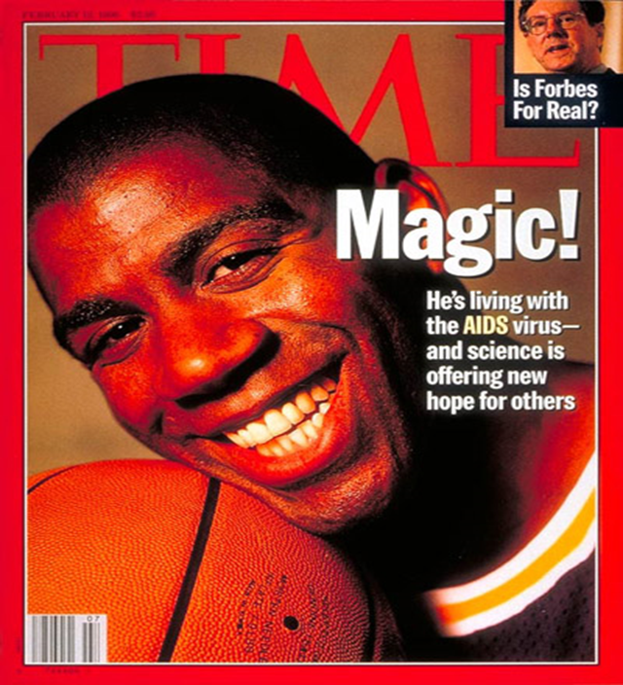
Medios de comunicación
El VIH y el estigma
Algo no está bien en la portada de esta revista.
¿Qué es?
Notes:
The media can have a big effect on changing the tide on stigmatizing language. However, the media has a lot of responsibility. Mainstream media reporting on HIV often sensationalize stories about people with HIV. Media coverage often includes disclosure of the person’s identity, disclosing the person’s HIV status not only to the individual’s community but also, with the internet, to the world.
Media messaging can either support HIV prevention, care, and treatment efforts or hinder them.
Ultimately, the outcome of HIV messaging depends upon three things: The clarity of the message; the precision of the message; and the sensitivity of the message
Ask, “How did Time Magazine get this wrong?”
Take responses from participants.
Answer: AIDS is not a virus, AIDS is a syndrome. AIDS, which stands for acquired immunodeficiency syndrome, is a condition characterized by progressive failure of the immune system.

Slide 21
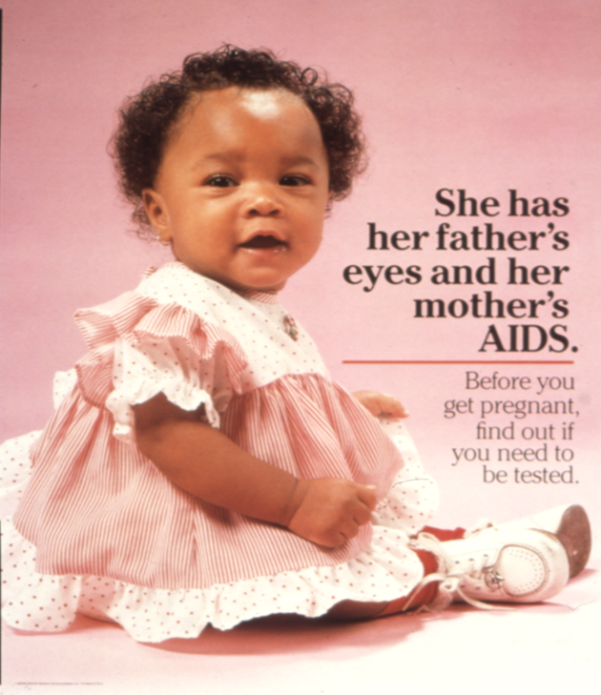
Medios de comunicación
El VIH y el estigma
Notes:
This poster is one of a series produced by Clement Communications, a public relations company that researches, creates, publishes, and distributes programs and materials to help organizations communicate with their intended audience. Designed to appeal to specific racial groups, each poster in the series features a different child. Although the child in the photograph appears to be happy and healthy, we learn from the message that her mother has given her AIDS. We see an emotional appeal to women—African-American women in this case—which along with the text suggests they have a responsibility beyond themselves to be tested for AIDS.
This ad shows a healthy baby but what is the message in the caption? Does the mother have a greater responsibility to be tested? What is the coded language from the media? Maybe the message is mothers with HIV should not have children?

Slide 22
Vocabulario callejero en la comunidad del VIH
El VIH y el estigma
Sucio
El bicho
Cazadores del bicho
Monstruo
Ninja
El germen
Enfermo
¿Estás limpio?
Notes:
These are examples of how language has been used in the HIV community in a negative way. How many of these have you heard?

Slide 23
Diálogo interno estigmatizante frente a diálogo interno de empoderamiento
El VIH y el estigma
Diálogo interno estigmatizante | Diálogo interno de empoderamiento
Estoy infectado con el VIH. | Soy una persona con VIH.
Es mi culpa que me haya infectado; drogas inyectables | Nadie merece el VIH; el VIH no es un castigo.
Murió de SIDA, morir de SIDA | Murió de una enfermedad relacionada con el SIDA o una complicación relacionada con el SIDA, o de VIH en etapa terminal
Gente de color “gay” | Personas que aman al mismo género
Notes:
Stigmatizing self-talk is “I’m infected with HIV.” Empowering self-talk is “I am a person with HIV.”
No one deserves HIV; HIV is not a punishment. HIV is a human disease that can affect anyone.
Incarcerated does not equal criminal. Being incarcerated does not define you as a person nor brand you as a criminal.
“Gay” people of color. Many people of color identify as same-gender loving rather than gay.
Transgender or gender-diverse people may use a pronoun that is different from what you might assume, so asking everyone what pronouns they use to show trans people they are welcome in your organization. Respecting people’s core identify and the words they use to describe themselves is at the heart of putting people first.

Slide 24
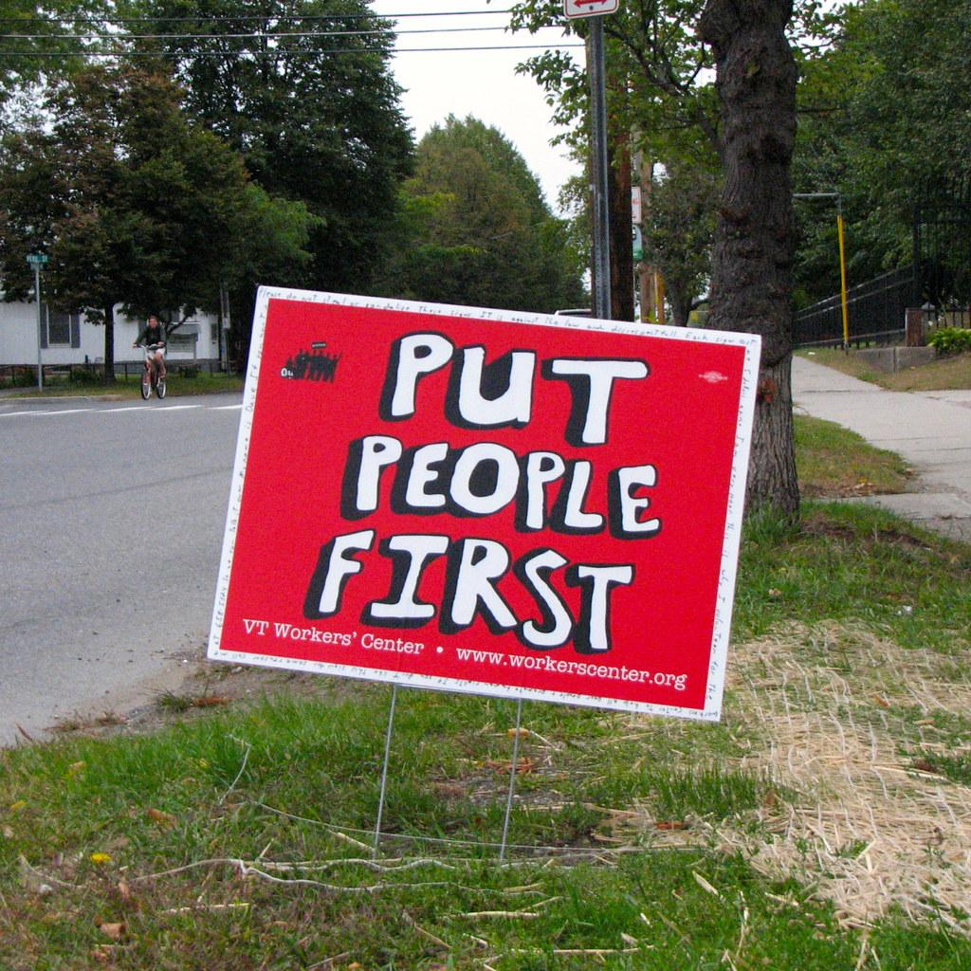
El VIH y el estigma
Notes:
Ask, “Who has heard the term “People First Language?”
People First Language is an alternative way to talk about people with disabilities. It’s putting people before the disability. To use People First Language, simply say the person’s name or use a pronoun first, follow it with a verb, than state the name of the disability.
Using People First Language is not an attack nor does it call the disease to attention front and center. It puts the person first. We’ll look at a few examples later.

Slide 25
¿Por qué usar el lenguaje para poner a la persona primero?
El VIH y el estigma
Elimina el lenguaje estigmatizante
Reforma la conversación
Se centra en lo que realmente importa: la persona
Empodera a las personas
Notes:
Review the slide.

Slide 26
Lenguaje para poner a la persona primero
El VIH y el estigma
En lugar de usar etiquetas para definir individuos con un problema de salud, es más apropiado usar terminología que describe a los individuos como diagnosticados con un trastorno.
Usen frases como “personas con una enfermedad mental” en lugar de “enfermos mentales”. Usen “personas con VIH” en lugar de “infectados por el VIH”.
Esta terminología enfatiza el tratamiento de una persona con una enfermedad en lugar de simplemente tratar una enfermedad.
Notes:
Review the slide.
People First Language puts the person before the disability, illness or medical condition. A person is more than their medical diagnosis. People First Language helps to eliminate prejudice and it removes value judgements about the person. When we describe people by labels or medical diagnoses, we devalue and disrespect them as individuals.

Slide 27
Ejemplos de lenguaje para poner a la persona primero
El VIH y el estigma
Es más probable que las mujeres se infecten con VIH mediante el contacto heterosexual.
Es más probable que las mujeres contraigan o adquieran el VIH mediante el contacto heterosexual.
La enfermedad cardiovascular se ha convertido en una preocupación importante entre las personas infectadas por el VIH.
La enfermedad cardiovascular se ha convertido en una preocupación importante entre las personas con VIH.
Las personas con enfermedades mentales a menudo son diagnosticadas con el virus del SIDA* cuando se ignora la atención médica adecuada.
Las personas con problemas de salud mental a menudo son diagnosticadas con SIDA cuando no se brinda o se ignora la atención adecuada.
*El SIDA no es un virus; es un síndrome y el resultado de una atención o un tratamiento inadecuado. El VIH es el virus.
Notes:
We will look at a few examples that will help us distinguish between stigmatizing, incorrect, and insensitive language vs. what is preferred by communities.
Compare the first examples for each sentence (stigmatizing language) to the second example (People First Language).

Slide 28
ACTIVIDAD: DIÁLOGO INTERNO ESTIGMATIZANTE FRENTE A DIÁLOGO INTERNO DE EMPODERAMIENTO
Notes:
Activity: Discuss stigmatizing language and its impact on people with HIV
Distribute Using Language that Empowers worksheet.
Divide participants into small groups.
Participants will brainstorm empowering statements that will convert or reframe stigmatizing language and microaggressions.
Review responses as a large group.
Ask, “What can you do to help reduce stigmatizing language?”
Discuss and make distinctions between external and internal stigma.
External stigma (enacted stigma, discrimination) refers to the experience of unfair treatment by others.
Internal stigma (felt stigma or self-stigmatization) refers to the shame and expectation of discrimination that prevents people from talking about their experiences and stops them from seeking help.
If any participants have disclosed that they are living with HIV, ask if they would be willing to briefly share their experiences by answering the following questions (3 minutes or less).
What was a stigmatizing situation you have experienced since your diagnosis?
How did it make you feel and what did you do?
If the person has been living with HIV for several years (5 or more) would they feel any different if the situation were to occur today?

Slide 29
Todos tenemos un papel que desempeñar para eliminar el estigma y ayudar a las personas a recibir y mantener la atención.
Notes:
Review the slide.

Slide 30
¿Qué puedo hacer para ayudar a reducir el lenguaje estigmatizante?
El VIH y el estigma
Use el lenguaje para poner a la persona primero cuando se refiera a personas con una afección médica.
Hable con colegas y amigos y eduque a otros.
Fomente el uso del lenguaje para poner a la persona primero.
Cambie los documentos de la organización y los materiales educativos para reflejar el lenguaje preferido cuando sea posible.
Incluya a personas con diversos antecedentes afectados desproporcionadamente por el VIH, como HSH de color, personas transgénero, mujeres y jóvenes, en la creación de documentos y materiales de la organización.
Notes:
What can we all do to reduce stigma?
Use People First language when referring to people with a medical condition.
Talk with colleagues and friends and educate others. Encourage use of People First Language.
Change organizational documents and educational materials to reflect preferred language when possible.
Include people with diverse backgrounds disproportionately impacted by HIV, such as MSM of color, transgender people, women, and youth in the creation of organizational documents and materials. This will help ensure that language is culturally appropriate beyond the issue of HIV.
Optional activity
In small groups, have participants develop situations that are examples of external stigma and internal stigma.
Example external stigma: A client has been expelled from their home due to their HIV status and sexuality.
Example internal Stigma: A client believes they deserved HIV because of their behaviors.
Ask probing questions to help participants understand the impact stigma plays in providing services as a CHW.
Example questions:
What impact can internalized stigma have on a person’s motivation or willingness to work with a CHW?
In what ways can stigma impact a CHW’s role effectiveness if they experience externalized or internalized stigma?
Emphasize that stigma separates and is counterproductive to building supportive, honest, and authentic working relationships with clients.
Summarize: Stigma can be a difficult topic because it often brings up hurt feelings, past aggressions, and negative experiences for people in general, not just people with HIV. Take some time for self-care if this lesson has triggered feelings for you.

