Slide 1
Clinical Aspects of Buprenorphine Therapy

Slide 2
Opioids and HIV
You may know that…
Injection drug use (IDU), either directly or via sexual contact with an IDU partner, accounts for one-third of the cumulative estimated AIDS cases in the U.S.

Slide 3
Opioids: Shocking Facts
Dependence/abuse of pain relievers ranked second (after marijuana) among illicit drug use in the U.S.
Prescription opioid abuse may be proportional to the number of opioid prescriptions written.¹
“[B]etween 2004 and 2008, emergency department visits involving oxycodone, hydrocodone, and methadone increased 152%, 123%, and 73%, respectively.”²
Mortality among illicit opioid users has been estimated at 13 times that of general population.
1. Lum P, Little S, Botsko M, et al. Opioid-prescribing practices and provider confidence recognizing opioid analgesic abuse in HIV primary care settings. JAIDS. 2011; 56(Suppl 4): S91-7.
2. Lum P, Tulsky JP. The medical management of opioid dependence in HIV primary care settings. Current HIV/AIDS Reports. 2006; 3(4): 185-94.

Slide 4
SPNS Buprenorphine Initiative
Funded between 2004-2009
Key findings from initiative:
Providers and patients were overwhelmingly satisfied with results
Improved HIV medication adherence and viral load.
Reduced risk behaviors.
Improved overall health outcomes.
Patients felt incredibly lucid and stated improved quality of life and social functioning.
To share training materials and best practices SPNS has launched the “Integrating HIV Innovative Practices” (IHIP) project.

Slide 5
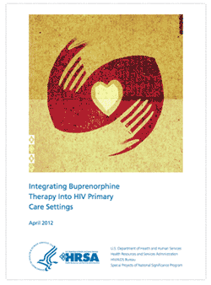
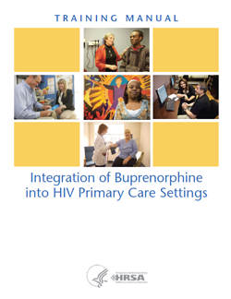
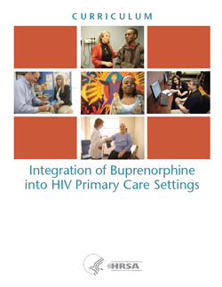
To access training resources, visit: www.careacttarget.org/library/integrating-hiv-innovative-practices-ihip

Slide 6
Today’s Agenda
Dr. Vergara-Rodriguez, CORE Center in Chicago
Dr. Tulsky, San Francisco General Hospital
Discussing clinical aspects to care
Sarah Cook-Raymond
Discussing qualifications to get started
Q & A

Slide 7
Clinical aspects of integrating buprenorphine into the HIV primary care setting
Pamela Vergara-Rodriguez
The Ruth M Rothstein CORE Center
HRSA HIV/AIDS Bureau: SPNS

Slide 8
Opium is an extract derived from the seedpods of poppies
OPIOIDS
Opioids stimulate the release of dopamine and produce pleasurable feelings
Natural | Semi-synthetic | Synthetic
Morphine Heroin Codeine | Oxycodone Hydrocodone Buprenorphine | Methadone Fentanyl Propoxyphene Diphenoxylate Hydromorphone

Slide 9
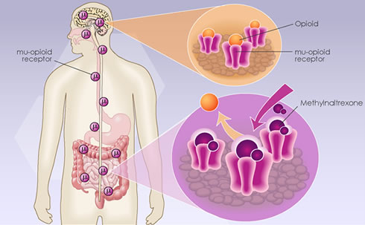
What are opioids?
OPIOID Receptors
Mu
Kappa
Delta
OPIOID
MU-opioid Receptor
MU-opioid Receptor
(+) Activity at BRAIN MU Receptors leads to
Euphoria
Sedation
↓ BP
↓RR
Constricted Pupils
Itching
ANALGESIA
BUPRENORPHINE
(+) Activity MU Receptors in the intestinal tract leads to nausea and constipation
Notes:
Opioids Attach to Opioid Receptor
Activation of the μ receptor by an agonist such as morphine causes analgesia, sedation, slightly reduced blood pressure, itching, nausea, euphoria, decreased respiration, miosis (constricted pupils) and decreased bowel motility often leading to constipation. Some of these side effects, such as sedation, euphoria and decreased respiration, tend to lessen with continued use as tolerance develops. Analgesia, miosis and reduced bowel motility tend to persist; little tolerance develops to these effects.

Slide 10
ADDICTION
PORN
Sex
Pharmacologically Active Substances
“DRUGS”
Internet
Video
Food
Addiction is a behavioral syndrome where drug procurement and use dominate the individual’s motivation and where the normal constraints on behavior are largely ineffective……
……may or may not be accompanied by physical dependence on the drug.
TV
Gamble
Shop
Exercise
Notes:
ASAM
Addiction is a primary, chronic disease of brain reward, motivation, memory and related circuitry. Dysfunction in these circuits leads to characteristic biological, psychological, social and spiritual manifestations. This is reflected in the individual pursuing reward and/or relief by substance use and other behaviors. The addiction is characterized by impairment in behavioral control, craving, inability to consistently abstain, and diminished recognition of significant problems with one’s behaviors and interpersonal relationships. Like other chronic diseases, addiction can involve cycles of relapse and remission. Without treatment or engagement in recovery activities, addiction is progressive and can result in disability or premature death.
Addiction is defined as a behavioral syndrome characterized by the repeated, compulsive seeking (psychological dependence) or use of a substance despite adverse social, psychological, and/or physical consequences, along with the physical need for an increased amount of a substance as time goes on to achieve the same desired effect. Addiction is often (but not always, as with an addiction to gambling) accompanied by tolerance, physical dependence, and withdrawal syndrome.
The American Academy of Pain Medicine, American Pain Society, and American Society of Addiction Medicine, recognizes these definitions below as the current accepted definitions.
Addiction: Addiction is a primary, chronic, neurobiologic disease, with genetic, psychosocial, and environmental factors influencing its development and manifestations.
It is characterized by behaviors that include one or more of the following: impaired control over drug use, compulsive use, continued use despite harm, and craving.
II. Physical Dependence: Physical dependence is a state of adaptation that is manifested by a drug class specific withdrawal syndrome that can be produced by abrupt cessation, rapid dose reduction, decreasing blood level of the drug, and/or administration of an antagonist.
III. Tolerance: Tolerance is a state of adaptation in which exposure to a drug induces changes that result in a diminution of one or more of the drug’s effects over time.
Summary: Addiction is uncontrollable compulsive behavior caused by alterations of parts of the brain from repeated exposure to high euphoric responses.
Many of you ust of gotten very excited when I metnioned the word sex thinking I would be talk about sex addiction today but in fact I want to clarify that I am acutally talking about drug addiction

Slide 11
why are opioids they so addictive?
Opioid Addiction
Opioid Physiologic Dependence
Opioids attach to opioid receptors in the brain
High (Intoxication)
Dependence
Analgesia
Tolerance
Opioids stimulate the release abnormal amounts of dopamine and produce pleasurable feelings beyond what is normal
Normal pleasures become non-pleasurable (anhedonia)
Produces Tolerance
Tachyphylaxis
Need more drug to prevent withdrawal
Need more drug to get euphoria
Produces Withdrawal
severe dysphoria, depression
sweating, rhinorrhea
nausea, vomiting loose stools
severe fatigue,
pain
Opioid Antagonists/Partial Agonists can also produce withdrawal when given to an opioid intoxicated patient (naltrexone, naloxone, buprenorphine)
Notes:
Long-term or high dose use of opioids may also lead to additional mechanisms of tolerance becoming involved. This includes downregulation of mu opioid receptor gene expression, so the number of receptors presented on the cell surface is actually reduced, as opposed to the more short-term desensitisation induced by β-arrestins or RGS proteins.^{[15][16][17]} Another long-term adaptation to opioid use can be upregulation of glutamate and other pathways in the brain which can exert an opioid-opposing effect and so reduce the effects of opioid drugs by altering downstream pathways, regardless of mu opioid receptor activation.^{[18][19]}

Slide 12
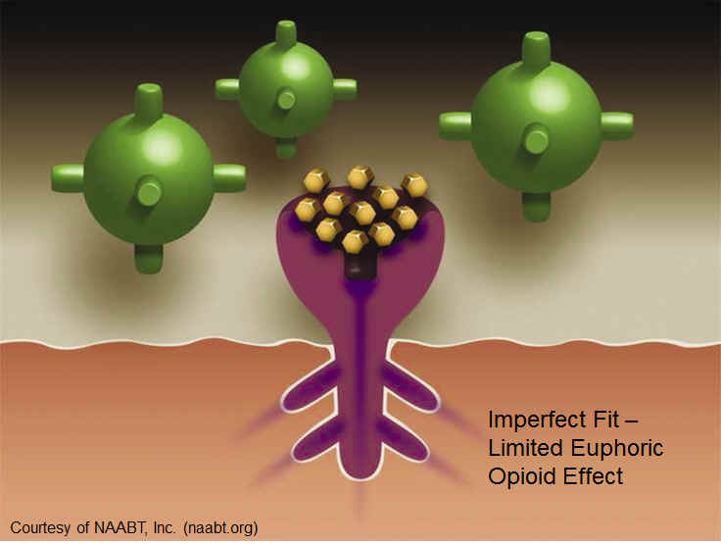
What is buprenorphine? How does it work? What's the safety profile?
agonist/antagonist (partial agonist) at the Mu Receptor
attaches to the receptor very strongly
pushes off other opioids
less respiratory depression
little Euphoric Effect
limited maximal positive effect on the receptor (ceiling effect)

Slide 13
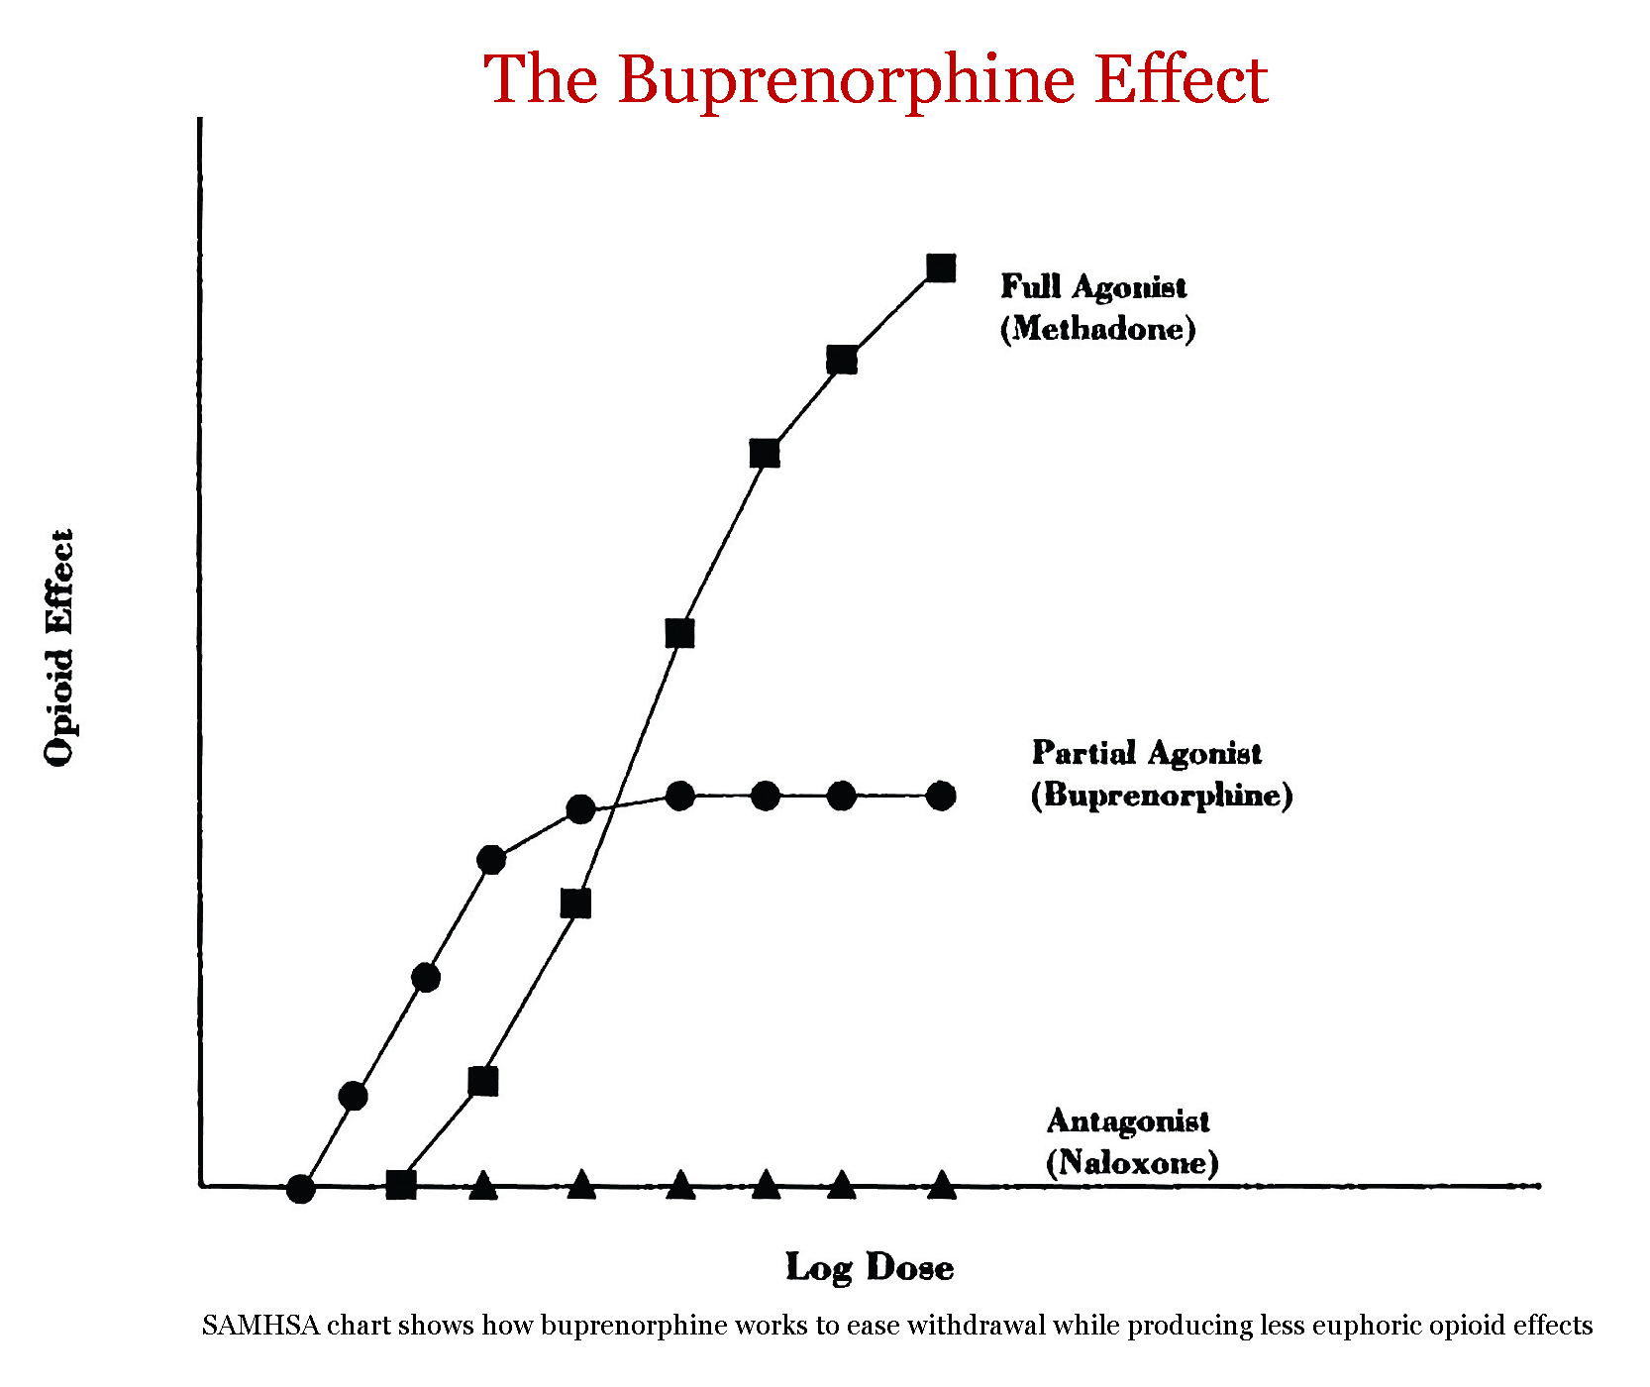
How does buprenorphine differ from methadone?
Buprenorphine
Schedule 3:
low likelihood to induce tolerance or addiction
Increased safety because of ceiling effect on respiratory depression
Naloxone reverses the effect of buprenorphine slowly
Graph
Methadone
Schedule 3:

Slide 14
How do you identify which patients have opioid abuse issues?
Universal Screening
(patient reports misuse, abuse, dependence)
Patient presents intoxicated
Patient presents in Withdrawal
Provider becomes aware thru a third party
Pharmacist, another provider, prescription monitoring
Patient presents with drug seeking behavior

Slide 15
How did you identify which patients may be a good candidate for buprenorphine?
Good candidate
Opioid Dependent. Actively using
Recent Opioid Dependence with cravings
Good Engagement/ Good Attachment
Less favorable candidate
On Methadone over 40mg
Known Diversion
Misuse/Abuse/Dependence of CNS depressants: Alcohol/Benzodiazepines/ Other tranquilizers
Unable to use sublingual formulations
Cognitive Deficits
Active Psychiatric Illness
???Poor Compliance???

Slide 16
What is the process for buprenorphine administration: induction,
PRE-INDUCTION | INDUCTION | STABILIZATION | STABILIZATION
Day-2 | Day 1 | Day 2 | DAY 3
Alcohol and Drug Screening and Assessment | Withdrawal Assessment | Assessment for Dose increase
Medical History Medications LABS Pregnancy Test UDS | Observe sublingual administration 1 tablet | Observe sublingual administration 1 tablet | Observe sublingual administration 1 tablet
Education Withdrawal Specifics | RX: 1 tab home | RX: 1 tab home | RX: 1 week supply
 | Daily Counseling | Daily Counseling | Daily Counseling

Slide 17
Buprenorphine Induction
COWS – Clinical Opioid Withdrawal Scale to assess severity of withdrawal
(score: 5-12=mild; 13-24=moderate; 25-36=moderately severe; more than 36 = severe withdrawal)
Administer 4mg (1/2 tablet)
Observed for 30 minutes, administer COWS again
Administer 4 mg
Usually relief of withdrawal should begin within 30-45 minutes
Take home medication with instructions

Slide 18
What is the process for buprenorphine, and maintenance?
STABILIZATION | MAINTENANCE
Week 2-4 | Month 2-12
Assessment for symptoms of under-dosing | Q month Assessment Check Clinical Stability, dose
UDS: Weekly | UDS: Every 2-4 weeks
RX: weekly supply | RX: 2-4 week supply
Counseling Week 2: 1-2 days/week Week 3 &4 : Once weekly | Counseling Once Every 2-4 weeks
Symptoms of Under-dosing: Significant Craving, Pain issues, withdrawal symptoms, positive opioid toxicology

Slide 19
What was your experience with buprenorphine?
What you Need:
Staff with right Attitude
Cohesive Treatment Team
CLEAR RULES
Ongoing Patient Education
Reinforcement of Good Behavior
Ongoing Provider Education/Communication
What you don’t need
Judgment
Splitting
Patient RULES
One Time explanation
Punishment
Isolation of Treatment Team

Slide 20
Staff
Providers | Service | Description
Provider /Prescriber (MD) | Buprenorphine Induction | Opiate withdrawal evaluation and Buprenorphine induction
Administrator | Office Management | Correspondence, ordering supplies, budget oversight, documentation review
Clinical Coordinator | Social Services | Referrals for housing, legal services, food pantry, clothing, ID cards
 | Substance Abuse Screening and Referral | Refer to BUP Program or other outside agencies
 | Substance Abuse Group | Individual counseling and once weekly BUP group : 1 hour
 | Buprenorphine Induction | Manage follow-up induction protocol

Slide 21
What information do you wish you knew at the onset?
It’s not Magic
Antidepressant effect: Buprenorphine has kappa opioid-receptors antagonist action, counteracting dysphoria, negativism and anxiety
Predictors of drop-out: Separation from spouse, poor family/social functioning, less education, female, psychiatric dysfunction
Patient Education is KEY

Slide 22
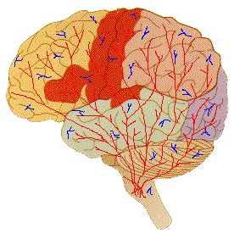
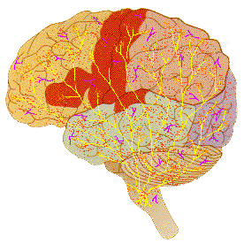
Neurobiology of Withdrawal and Induction
As opioids detach from the receptors, people experience withdrawal and CRAVING
Brain without Opioids
Opioid receptors must be empty i.e., patient must present in withdrawal for induction
Brain After BUP Induction
Buprenorphine will occupy the empty opioid receptors

Slide 23
Other clinical issues
Behavioral Treatment must remain the focus of treatment
Other drug dependences must be addressed
Contracts: Agreement
Addressing slips/relapses
Addressing Diversion
Easier to Hold Bup or split Bup and treat acute Pain as opposed to adding short acting opioids for pain

Slide 24
SPNS Buprenorphine Training
Jacqueline Tulsky, MD
UCSF Professor of Medicine
SFGH Positive Health Program
Opioid Treatment Outpatient Programs

Slide 25
OA’s story
39-yr-old w/ HIV and Hep C suppressed on ART, fairly adherent and is bonded to his primary care provider
In and out of jail and prison directly/indirectly related to heroin addiction
Multiple methadone detox episodes, struggles with getting in to dose and craving and rarely finishes detox
In jail heard about a “new” drug your own doctor could prescribe for opioid dependence
Notes:
Medical home may be very helpful in encouraging a more complete integration in total care.,

Slide 26
OA’s story continues
Screens eligible for buprenorphine/naltrexone (bup/nx) at new program in HIV clinic
Rocky induction, but quickly settles into weekly, then monthly refills with counseling sessions
Overall benefits
Out of jail for 5 years, works some, family connected
Struggles with depression
Very engaged in HIV care
Notes:
Medical home may be very helpful in encouraging a more complete integration in total care.,

Slide 27
Background
Moving Mountains:
Integrating HIV care and Addiction treatment
Part of HRSA-funded Buprenorphine Initiative at 10 sites from 2004-2009

Slide 28
Injecting Drugs & HIV/AIDS
Over 1.15 million HIV cases in the US through end 2009
Cases attributed to Injection Drug Users (IDU):
All reported cases through 2008 = 17%
New cases in 2009 = 9%
Overall trend toward decrease in IDU-related cases because of effective interventions to stop transmissions
CDCP, Atlanta; HIV/AIDS Surveillance Report, 2012 (22)
Notes:
Injection drug use is a common exposure category among persons with HIV/AIDS
Of the more than 1.148 million cases of HIV reported through 2009 in the U.S
And 40% were associated with injection drug use – either directly or by having an IDU sex partner.
ORT to be effective on decreased transmission and sexual risk behavior, hospitalization, and increase engagement in care.

Slide 29
Notes:
In 2010, among adult and adolescent males diagnosed with HIV infection MSM is the largest risk category, but 7% were attributed to injection drug use.and 4% attributed to male-to-male sexual contact and injection drug use.
In women and 14% were attributed to injection drug use.

Slide 30
Q. Why bup/nx? A. The opioid treatment gap
In 2006 NSDUH estimated 323,000 heroin dependent persons in the US
In 2009 the gap between those needing opioid treatment and those getting treatment was over 600,000 persons*
5 states with no methadone programs
*Buprenorphine Q&A :NIDA/NIH May, 2009
http://archives.drugabuse.gov/bupupdate.html
Notes:
National Survey on Drug Use and Health NSDUH.
Historically, methadone has been the drug of choice for providing ORT.
Methadone, however, is so highly regulated by federal and state laws, that there are not enough treatment slots for those who desire treatment
In 2011
San Francisco has less than 3000 maintenance slots for the more than estimated 17,000 active heroin users in SF. And there are 300-400 individuals on a waiting list at any one time.
*********************************
Reliable estimates place the number of active heroin users in San Francisco between 15,000 and 17,000 [6]. However, the City and County of San Francisco has a capacity of only 2695 methadone maintenance slots and 815 methadone detoxification slots funded through public, federal, and private sources [7].
Opioid treatment for 200,000 persons in 1000 narcotic treatment programs (NTPs)
14% of opioid dependent persons receive treatment through NTPs
Arch Intern Med. 2004;164:277-288
For over 10 years, San Francisco has consistently ranked among the top four cities in heroin-related hospital admissions relative to other U.S. metropolitan areas [2]. In addition, San Francisco has led the state in the number of heroin-related problem indices, consistently possessing three times the number of heroin-related hospital admissions and heroin-related deaths relative to the California average [3]. Substance abuse is the leading cause of death among San Francisco’s homeless population, where heroin is specifically related to 87% of these deaths [4]. However, approximately half of the individuals who die from drug-related causes (i.e., non-alcohol) in San Francisco never receive drug treatment services from the public health system [5]. The treatment gap is wide. Reliable estimates place the number of active heroin users in San Francisco between 15,000 and 17,000 [6]. However, the City and County of San Francisco has a capacity of only 2695 methadone maintenance slots and 815 methadone detoxification slots funded through public, federal, and private sources [7].

Slide 31
Q. Why bup/nx? A. Patient safety and preference
Less arrhythmia risks through QTc prolongation with bup/nx compared to methadone
Trend of interactions are to lower bup/nx which can be addressed with dose adjustment.
Less sedation, less restrictions than methadone
Comprehensive care from primary provider
AIDS Monograph, 2012 BHIVEs Investigators
Notes:
National Survey on Drug Use and Health NSDUH.
Historically, methadone has been the drug of choice for providing ORT.
Methadone, however, is so highly regulated by federal and state laws, that there are not enough treatment slots for those who desire treatment
In 2011
San Francisco has less than 3000 maintenance slots for the more than estimated 17,000 active heroin users in SF. And there are 300-400 individuals on a waiting list at any one time.
*********************************
Reliable estimates place the number of active heroin users in San Francisco between 15,000 and 17,000 [6]. However, the City and County of San Francisco has a capacity of only 2695 methadone maintenance slots and 815 methadone detoxification slots funded through public, federal, and private sources [7].
Opioid treatment for 200,000 persons in 1000 narcotic treatment programs (NTPs)
14% of opioid dependent persons receive treatment through NTPs
Arch Intern Med. 2004;164:277-288
For over 10 years, San Francisco has consistently ranked among the top four cities in heroin-related hospital admissions relative to other U.S. metropolitan areas [2]. In addition, San Francisco has led the state in the number of heroin-related problem indices, consistently possessing three times the number of heroin-related hospital admissions and heroin-related deaths relative to the California average [3]. Substance abuse is the leading cause of death among San Francisco’s homeless population, where heroin is specifically related to 87% of these deaths [4]. However, approximately half of the individuals who die from drug-related causes (i.e., non-alcohol) in San Francisco never receive drug treatment services from the public health system [5]. The treatment gap is wide. Reliable estimates place the number of active heroin users in San Francisco between 15,000 and 17,000 [6]. However, the City and County of San Francisco has a capacity of only 2695 methadone maintenance slots and 815 methadone detoxification slots funded through public, federal, and private sources [7].

Slide 32
Q. Why bup/nx? A. Provider perspective
Wanted to address important factor in HIV care
Monitor drug use
Address barrier to adherence
Take advantage of good patient-provider relationship
Exciting/challenging new skill/service for providers and the health care system
AIDS Monograph, 2012 BHIVEs Investigators
Notes:
National Survey on Drug Use and Health NSDUH.
Historically, methadone has been the drug of choice for providing ORT.
Methadone, however, is so highly regulated by federal and state laws, that there are not enough treatment slots for those who desire treatment
In 2011
San Francisco has less than 3000 maintenance slots for the more than estimated 17,000 active heroin users in SF. And there are 300-400 individuals on a waiting list at any one time.
*********************************
Reliable estimates place the number of active heroin users in San Francisco between 15,000 and 17,000 [6]. However, the City and County of San Francisco has a capacity of only 2695 methadone maintenance slots and 815 methadone detoxification slots funded through public, federal, and private sources [7].
Opioid treatment for 200,000 persons in 1000 narcotic treatment programs (NTPs)
14% of opioid dependent persons receive treatment through NTPs
Arch Intern Med. 2004;164:277-288
For over 10 years, San Francisco has consistently ranked among the top four cities in heroin-related hospital admissions relative to other U.S. metropolitan areas [2]. In addition, San Francisco has led the state in the number of heroin-related problem indices, consistently possessing three times the number of heroin-related hospital admissions and heroin-related deaths relative to the California average [3]. Substance abuse is the leading cause of death among San Francisco’s homeless population, where heroin is specifically related to 87% of these deaths [4]. However, approximately half of the individuals who die from drug-related causes (i.e., non-alcohol) in San Francisco never receive drug treatment services from the public health system [5]. The treatment gap is wide. Reliable estimates place the number of active heroin users in San Francisco between 15,000 and 17,000 [6]. However, the City and County of San Francisco has a capacity of only 2695 methadone maintenance slots and 815 methadone detoxification slots funded through public, federal, and private sources [7].

Slide 33
How to determine who is eligible? “OA screens eligible for bup/nx”
Known opioid addicted patients approached by providers. Soon some self referral.
Social workers/nurse with addiction background screened patients with a protocol for:
Polysubstance use with benzos and ETOH
Chronic opioid pain meds
Need for more structure in drug treatment

Slide 34
Drug-Drug Interactions? CYP3A4 Effects
Not a significant issue except for CNS active meds/drug used w/o close monitoring
Many drugs decrease the drug concentration of bup/nx,
On initial induction not really an issue
Monitor for withdrawal with protease inhibitor drugs, some antibiotics (ex: rifampin, ciprofloxacin)
(Also see the IHIP training manual’s drug-drug interaction chart: www.careacttarget.org/library/chapter-4-prescribing-buprenorphine#drugdrug.)

Slide 35
Challenge of Induction
OA has a “rocky induction” because of initial precipitated withdrawal. Was afraid of full withdrawal and didn’t completely believe bup/nx would help.
Had used the day before, but only a” small amount”, not in full withdrawal. Asked to come back later in the day, but with test dose had
Had vomiting/diarrhea/cramps and “fluid bath” after initial test dose. Additional dose an hour later and felt better
Given dose to take that night and came back next day.
Precipitated withdrawal a risk due to the partial agonist/antagonist properties of buprenorphine
How to prevent: SOAP note format w/ COWS

Slide 36
Classic Precipitated Withdrawal
A risk due to the partial agonist/antagonist properties of buprenorphine
“Narcan effect”
How to prevent: SOAP note format w/ COWS

Slide 37
Induction SOAP Note
Subjective Data
Elicit symptoms of opioid withdrawal
Include pt’s rating of sx (mild/moderate/severe).
Objective Data
Document signs of opioid withdrawal (COWS)
Signs of intoxication?
Assessment
In opioid withdrawal? YES or NO.
Include severity (mild, moderate, severe) based on COWS score. Must have at least mild signs of withdrawal and COWS >5 before test or first dose.

Slide 38
Induction SOAP Note (cont.)
Plan
NO:
Pt appears intoxicated or no signs of withdrawal. Reschedule for a later date or time.
Counsel on the importance of presenting in some withdrawal for a more comfortable overall induction.
Address fears
YES:
Begin bup/nx dosing
Titrate to target dose per clinical guidelines protocol.

Slide 39
Models of Bup/n Rx Integration
Covering screening, counseling, education, monitoring induction & stabilization, ongoing contact role
Sound like like HIV or diabetes care?
Primary Care: BUP/nx prescribed by the HIV PCP
Relay: Off or On Site by Addiction Specialist
May be opportune to do induction outside of regular PCP clinc.
Notes:
Physician acceptance of buprenorphine
Lack of familiarity with new medication
Discomfort talking about drug use or dealing with drug users
Discomfort with induction procedures
Limited time: how to preserve continuity of clinical care when prescribers are part-time clinicians (E.g., academic centers, multiple site practices)

Slide 40
Consideration for Providers
New training and skills
Your colleagues are not trained for addiction
Some eagerly seek out, others avoidant
Finding the Champion in your group
New patients
May bring drug users to primary HIV care
Comfort level working with drug users
Insurance and med coverage issues
Notes:
Physician Acceptance of Buprenorphine
One challenge to integrating buprenorphine into primary care settings is physician’s lack of familiarity with a new medication and discomfort with induction procedures. In an informal survey of HIV primary care physicians at the PHP, barriers that providers cited were perceived lack of skill or knowledge about induction; lack of clinic infrastructure; and chronic pain management.

Slide 41
Unexpected Outcomes? Double or Nothing phenomenon
The patient benefits by both better HIV and substance use outcomes
or
The patient disengages from both drug treatment and HIV care, when one becomes difficult
Notes:
One phenomenon that can occur in both the multidisciplinary and primary care models…

Slide 42
Has integration worked? YES
For some patients stabilized an aspect of his health care within the PCP relationship
PCPs can really addresses drug use barriers to HIV care
Much more interest by junior faculty than more senior
Notes:
One phenomenon that can occur in both the multidisciplinary and primary care models…

Slide 43
Has integration worked? YES, but….
Patients still have multiple physical, mental health and sometimes ongoing addiction issues
Bup/nx has added a important tool, but does not directly address other drugs of abuse i.e stimulants
One or two “practice partners” plus an engaged nurse and pharmacy group have been enough to support about 25 patients
Notes:
One phenomenon that can occur in both the multidisciplinary and primary care models…

Slide 44
Conclusion
Bup/nx allows for integrated care to patients with HIV and opioid dependence
The model is similar to other chronic diseases for induction and maintenance
Word of mouth among the patients is good, and should be encouraged.

Slide 45
Notes:
Hearts in San Francisco was a Bay Area-wide “heart installation” that debuted in the spring of 2004. While similar to Chicago’s “Cows on Parade,” the San Francisco version used a heart icon, appropriate for a city that is recognized for its acceptance and tolerance, as well as being perennially open-hearted. The goal of this project was to become a unique hybrid of fund-raising, compassionate community involvement, and a positive nurturing of artistic expression at a time when it is sorely needed. The financial beneficiary of Hearts in San Francisco is the San Francisco General Hospital Foundation, whose sole purpose is to fund projects that will enhance patient care and comfort at San Francisco General Hospital Medical Center (SFGHMC).
Over 130 recognized and emerging artists transformed heart sculptures into unique works of art. These hearts were installed on sidewalks, plazas, parks, and street corners throughout the San Francisco Bay Area.

Slide 46
How Do I Get Started?

Slide 47
Prescribing Buprenorphine
Who can prescribe buprenorphine?
Qualifying physicians
What training is necessary?
Required board specialty, or
8 hours of approved training
To access qualifying physician trainings, visit: http://buprenorphine.samhsa.gov/training.html, www2.aaap.org/buprenorphine, www.docoptin.com/physician/calendar.aspx, or www.buppractice.com.)
Notify SAMHSA for Waiver to treat
See diagram on next slide
If approved, receive notice and DEA registration number
1st year=maximum treatment of 30 patients per authorized physician. After 1st year, may apply for additional waiver to treat up to 100 patients.

Slide 48
Treating Patients: Online Request Forms
To access and email notifications, visit: http://buprenorphine.samhsa.gov/pls/bwns/additional_notification_form?prefilled_or_online=ONLINE.
To access an online form to fax or mail in, visit: http://buprenorphine.samhsa.gov/pls/bwns/additional_notification_form?prefilled_or_online=PREFILLED OR http://buprenorphine.samhsa.gov/SMA-167_Increase_Patients.pdf and send to the contact information below:
Substance Abuse and Mental Health Services Administration Division of Pharmacologic Therapies Attention: Opioid Treatment Waiver Program One Choke Cherry Road, Rm 2-1063 Rockville, MD 20857 Fax 240-276-1630 Phone 1-866-287-2728 (1-866-BUP-CSAT)
(To learn more about increasing patient limits, visit: http://buprenorphine.samhsa.gov/federal.html.)
SAMHSA. Buprenorphine: how to obtain a waiver. n.d. Available at: http://buprenorphine.samhsa.gov/howto.html. Accessed December 9, 2011.

Slide 49
Diagram of Waiver Process
(To learn more about waiver qualifications, visit http://buprenorphine.samhsa.gov/waiver_qualifications.html.)

Slide 50
Counseling Services
Physicians either need to offer counseling services or have formal referral systems in place to link patients undergoing opioid treatment to counseling.
To view a grantee example of referral procedures, visit www.careacttarget.org/library/bup/UCSF_Buprenorphine_ProgramProtocols.pdf.

Slide 51
Other Considerations
Confidentiality:
Records for substance abuse treatment have stricter standards than traditional medical records.
^{Safety:}
Buprenorphine must be stored in securly locked cabinet. Any theft must be reported to DEA.

Slide 52
IHIP Resources
All of this information is available in detail on the IHIP site: www.careacttarget.org/library/integrating-hiv-innovative-practices-ihip

Slide 53
Q & A

