Slide 1
HIV and Stigma

Slide 2
Objectives
HIV and Stigma
At the end of this unit participants will be able to:
Understand how language shapes our world
Understand the history of language in relation to HIV and other chronic illnesses
Define stigma
Define HIV-related stigma and its impact on HIV prevention, treatment, and care
Explain the differences between stigmatizing and empowering language when we talk or write about ourselves and others
Identify “People First Language” and its importance
Explore the use of empowering language when talking or writing about oneself and others
Notes:
Review the objectives.

Slide 3
Language is our Foundation
HIV and Stigma
One of the foundations of community is language.
Language influences how we feel and how we react to things.
Biased language refers to words and phrases that are considered prejudiced, offensive, and hurtful.
Notes:
Review the slide.

Slide 4
Language
HIV and Stigma
Focusing on the use of language may be the first place to start in order to address stigma, social exclusion, and discrimination against people with HIV.
Language:
Helps to shape our world
Describes and gives meaning to our lives
Persuades and changes minds
Can destroy or empower
Notes:
Review the slide.

Slide 5
Defining Stigma
Notes:
Ask, “What is stigma? Can someone define stigma, not related to HIV? Who has experienced stigma? How?”

Slide 6
HIV and AIDS-related Stigma
HIV and Stigma
HIV/AIDS-related stigma refers to prejudice, discounting, discrediting, and discrimination directed at people perceived to have AIDS or HIV, as well as their partners, friends, families, and communities.
Notes:
Review the slide and make the following points.
Stigma is borne out of fear and it represents one of the most complex and pervasive barriers to health care for people with HIV/AIDS.
HIV/AIDS-related stigma often builds upon and reinforces other existing prejudices, such as those related to gender, sexuality, and race. For example, stigma associated with HIV is often based upon the association of HIV and AIDS with already marginalized and stigmatized behaviors, such as drug use and same-sex and transgender sexual practices.
Share the two major causes of stigma: Fear and ignorance.
People often do not know how HIV is or is not transmitted, so, fearing they might get infected through contact with a person with HIV, they isolate them.
Moral judgments: People know that HIV is transmitted mainly through sex or injecting drugs, so they assume that people with HIV get HIV through these activities. Therefore, they condemn people with HIV for “immoral” behavior. They don’t consider people born with HIV.
From the beginning, the Ryan White HIV/AIDS Program has fought against discrimination and the isolation that stigma creates. Ask participants how many people have heard of the Ryan White program? Explain that the Ryan White program is a federally funded program to help people with HIV to get care and treatment. The Ryan White Program made a commitment to help more people engage and remain in care.

Slide 7
Define Stigma
HIV and Stigma
“Negative feelings, beliefs and behaviors directed toward an individual or group due to a particular label or characteristic.”
“Disqualification from full social acceptance”
“By definition, or course, we believe the person with a stigma is not quite human. On this assumption, we exercise varieties of discrimination, through which we effectively, if often unthinkingly, reduce his life chances”.
Goffman, E. (1963). Stigma: Notes on the management of spoiled identity. Englewood Cliffs, N.J: Prentice-Hall.
Notes:
Review the slide.
Stigma is a process where we (society) create a “spoiled identity” of an individual or a group of individuals. We identify a difference in a person or group, such as a physical difference (e.g., physical disfiguration), or a behavioral difference (e.g., people having lots of sex) and then mark that difference as a sign of disgrace. This allows us to stigmatize the person or group (i.e., they have already made up their mind about you).

Slide 8
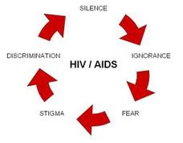
Define HIV Related Stigma
HIV and Stigma
Social stigma refers to extreme disapproval of (or discontent with) a person or group on socially characteristic grounds that are perceived, and serve to distinguish them, from other members of a society.
HIV Related Stigma refers to:
Prejudice,
Discounting, discrediting and discrimination
Directed at people perceived to be living with AIDS or HIV, as well as their partners, friends, families and communities.
Notes:
There are different types of stigma – social stigma is the exclusion of a person or group because of who and what they are perceived to be.
HIV/AIDS- related stigma refers to prejudice, discounting, discrediting, and discrimination directed at people perceived to have AIDS or HIV, as well as their partners, friends, families and communities. (Source: Herek, G. M. (1999). AIDS and stigma. American behavioral scientist, 42(7), 1106-1116.) So now it gets more expansive…it’s not only people with HIV, but people that do the work to help them.
Ask if participants have any questions. HIV can be the elephant in the room in so many households, relationships, and organizations. It can be contentious, especially after a person shares their diagnosis with family or friends because of fear and lack of knowledge about HIV.

Slide 9
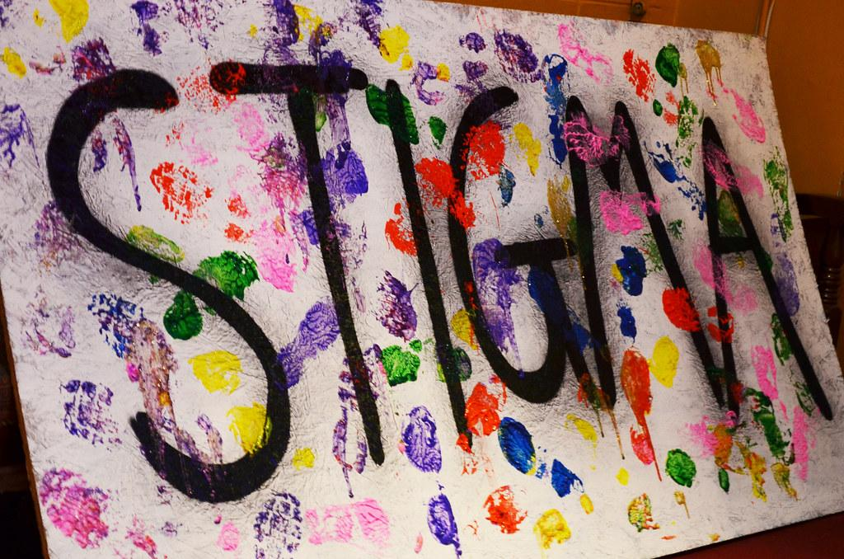
Defining Stigmatizing Language
HIV and Stigma
Stigmatizing language is defined as language that:
Perpetuates myths and stereotypes
Uses nouns (labels) to describe people (e.g. HIV-infected woman)
Uses demeaning or outdated words or phrases
Notes:
Review the slide.
Source: Patterson, J. B., and Witten, B. J. (1987). Disabling language and attitudes toward persons with disabilities. Rehabilitation Psychology, 32(4), 245.

Slide 10
Why Language Matters
HIV and Stigma
People experience multiple forms of oppression, stigma, and discrimination based on:
Gender
Race
Sexual identity
Socioeconomic status
Adding an HIV diagnosis can magnify this, affecting self-worth, confidence, and self identity
Notes:
Review the slide.

Slide 11
Two Types of Stigma
HIV and Stigma
Internal
External
Comes from self-judgement and negative self-talk we hear in our heads.
It is developed by our life experiences and can be difficult to change.
SHAME = I am bad
I am not worthy
Silence
Secrecy
Judgment
Comes from what we hear from others.
Family friends
Healthcare providers
Media
Image from: http://www.revelandriot.com
Notes:
Review the slide.
There are two types of stigma, internal and external.
Internal comes from self-judgement while external comes from what we hear from others. The results from both types can include ignorance, discrimination, violence just to name a few.
Internal stigma can be difficult to change because it can be rooted in our life experiences. Some people who receive an HIV diagnosis have already experienced multiple forms of oppression and discrimination based on gender, race, or sexual identity.
External stigma can cause us to internalize the messages we get from others. For example, are you “clean” or “dirty” or “damaged”?

Slide 12
HIV-Related Stigma is Experienced at Different Levels
HIV and Stigma
Individual Level
Ostracism, rejection, avoidance
Prejudice
Mandatory HIV testing without prior informed consent or confidentiality protections
Quarantine of persons who are infected
Violence
Societal Level
Laws, policies, and/or regulations
Social conditions of persons living with HIV/AIDS
Discrimination in employment, housing, military service, access to health services, social and community programs
Organization/Institutional Level
Name or organization
Business cards
Provider language
Environment
POZ magazines
Educational materials
Source: Tomaszewski, E. P. (2012). Understanding HIV and AIDS stigma, and discrimination, Human Rights Update. Washington, DC: NASW National Association of Social Workers.
Notes:
HIV and AIDS do not discriminate; people do. Let’s briefly examine 3 different levels of stigma.
Individual level
A person may experience: Ostracism, rejection, avoidance, and prejudice.
Mandatory HIV testing of individuals without prior informed consent or confidentiality protections may occur.
Violence can be a reality especially for the transgender community and other “high risk groups.”
Organization/institutional level
Organizations also bear responsibility. If a clinic has the name “AIDS” or “HIV Clinic Services,” people may choose to not visit it. If a CHW’s business card says HIV/AIDS case manager, or the clinic’s educational materials display sad photos, this may turn people away. Try to provide comfort in clinic rooms, making them warm and inviting.
Societal level
Stigma on a societal level seeks punishment by enacting laws and policies against people with HIV and AIDS, while other diseases are rarely mentioned. People with HIV face discrimination in employment, military service, housing, access to health services, and basic civil and human rights. For example, the criminalization of HIV transmission and forcible segregation of HIV positive prisoners. Organizations such as the Association of Nurse in AIDS Care (ANAC ), the American Medical Association, the U.S. Conference of Mayors and many more support the modernization of state HIV-specific laws and prosecutions.

Slide 13
HIV and Stigma
Impact of Stigma on Care and Treatment
People With HIV know status
Disclosure & Quality of Life
New Infections
Stigma
Testing
People With HIV know status
Disclosure & Quality of Life
New Infections
Stigma
Testing
Notes:
Review the slide.
Source: Herek, G. M. (1999). AIDS and stigma. American behavioral scientist, 42(7), 1106-1116.
When stigma is high, testing is low, fewer people know their status, fewer people disclose, and new infections rise. When stigma is low, testing increases, more people learn their status, more people disclose, and new infections drop. Unfortunately, people are sometimes stigmatized even in places they go for medical care and other services.
While access to appropriate treatment and care for individuals with HIV is generally recognized as a fundamental human right, discrimination can prevent people from getting tested and seeking or adhering to treatment and care due to the stigma associated with being HIV positive. For example in the United States, it is estimated that one in five persons with HIV is unaware of their HIV status. HIV stigma intensifies feelings of fear and isolation for people with HIV, which can compromise engagement in care.
Think about:
Counseling and Testing
A person is less likely to seek HIV testing in environments where they perceive workers to be judgmental about sexual activity and drug use. The use of less stigmatizing language is important in reducing stigma and empowering people with HIV and reflect the current science and the ways that people with HIV feel about themselves. Reducing stigma can help reduce HIV transmission by increasing disclosure and encouraging HIV testing.
Access to Care
People who exhibit concerns about stigma are more likely to delay care and/or not adhere to care.
Disclosure of Status
The decision to reveal one’s HIV status is associated with a person’s level of comfort. The more accepting, caring, and nonjudgmental a social network is toward HIV, the more likely the individual is to disclose.
Health Disparities
Consider stigma as it relates to racial/ethnic health disparities among communities of color when accessing HIV/AIDS services.
Isolates Families
Stigma can discourage households from registering affected children in national support programs and further limits access to information, prevention, care, and treatment.
13

Slide 14
Self Talk
HIV and Stigma
Infected
Notes:
HIV infection is medically correct; however we don’t have to refer to people with HIV as “infected”.
When you think about someone being infected, what do you envision?
Instead, say “people with HIV.”

Slide 15
Microaggressions
HIV and Stigma
The everyday verbal, nonverbal, and environmental slights, snubs, or insults, whether intentional or unintentional, that communicate hostile, derogatory, or negative messages to target persons based solely upon their marginalized group membership.
Diversity in the Classroom, UCLA Diversity & Faculty Development, 2014.
Notes:
Review the slide.
Ask, “What microaggressions have you heard?”
Ask, “What is the connection between stigma and microaggressions?”
Encourage participants to discuss in dyads or small groups. Then elicit responses.

Slide 16
Microaggressions
HIV and Stigma
Examples
Message (intended or not)
You are not a true American
You are a foreigner in your own country
People of color are generally not as intelligent as whites
Denying the significance of a person of color’s racial/ethnic experience and history
Where are you from?
You speak English very well.
You are a credit to your race.
When I look at you I don’t see color
Notes:
Review the slide for additional examples of microaggressions.

Slide 17
Examples of Microaggressions
HIV and Stigma
“You really look great! I could barely tell you were transgender.”
“You don't look like you have HIV at all!”
“I forgot you were gay. You act so straight.”
Notes:
Review the slide for additional examples of microaggressions, and allow participants to respond.
Both stigma and microaggressions share similarities because they both stem from people's fears, ignorance, and judgments.
Microaggressions may be conscious or unconscious, and evoke shame in people. People are not aware of how stigma and microaggressions affect people with HIV. HIV stigma is wrong and unacceptable—it hurts people with HIV and affects their willingness to disclose and engage in care and other health enhancing practices.

Slide 18
History of HIV-Related Language

Slide 19
Terminology
HIV and Stigma
GRID (Gay Related Immune Deficiency)
AIDS (Acquired Immunodeficiency Syndrome)
ARC (AIDS-Related Complex)
Full-Blown AIDS
HIV (Human Immunodeficiency Virus)
Late Stage HIV, End Stage HIV, or Stage 3 (US) or Stage 4 (World Health Organization (WHO))
Notes:
HIV terminology and stigma
To understand the present, we must look at the past.
GRID – Gay Related Immune Deficiency – was the original name for AIDS in 1982.
AIDS - Acquired Immunodeficiency Deficiency Syndrome – changed from GRID to AIDS. GRID did not fully encompass the changing demographics of the disease. The first recognized cases were restricted to gay men.
ARC - AIDS-related complex
Full-blown AIDS
HIV - Human Immunodeficiency Virus
Late-stage HIV or end-stage HIV
All of these terms shaped how communities thought about this disease.

Slide 20
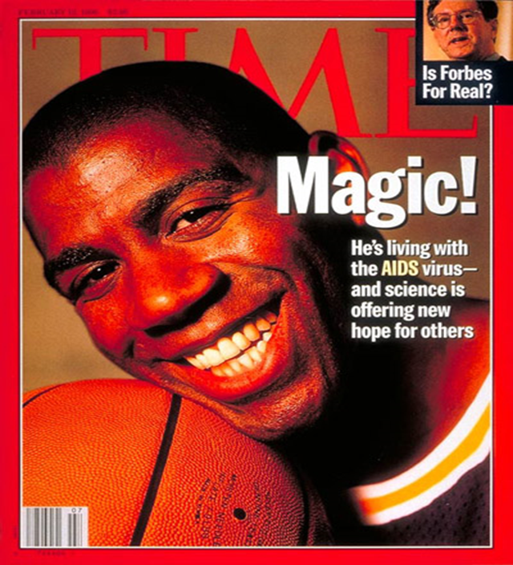
Media
HIV and Stigma
Something is not correct on this magazine cover.
What is it?
Notes:
The media can have a big effect on changing the tide on stigmatizing language. However, the media has a lot of responsibility. Mainstream media reporting on HIV often sensationalize stories about people with HIV. Media coverage often includes disclosure of the person’s identity, disclosing the person’s HIV status not only to the individual’s community but also, with the internet, to the world.
Media messaging can either support HIV prevention, care, and treatment efforts or hinder them.
Ultimately, the outcome of HIV messaging depends upon three things: The clarity of the message; the precision of the message; and the sensitivity of the message
Ask, “How did Time Magazine get this wrong?”
Take responses from participants.
Answer: AIDS is not a virus, AIDS is a syndrome. AIDS, which stands for acquired immunodeficiency syndrome, is a condition characterized by progressive failure of the immune system.

Slide 21
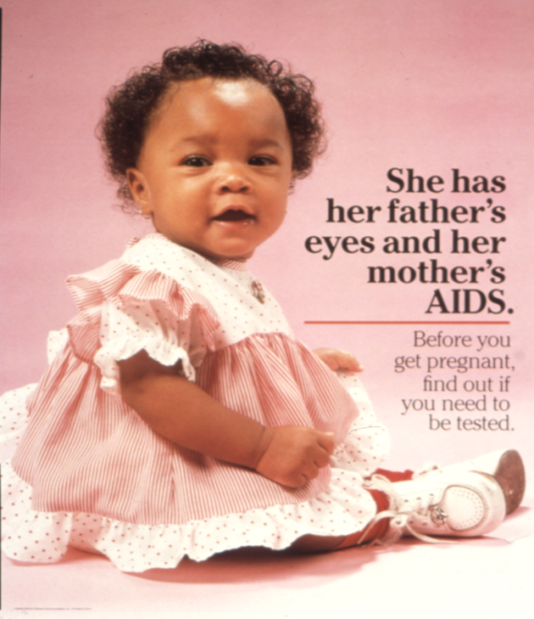
Media
HIV and Stigma
Notes:
This poster is one of a series produced by Clement Communications, a public relations company that researches, creates, publishes, and distributes programs and materials to help organizations communicate with their intended audience. Designed to appeal to specific racial groups, each poster in the series features a different child. Although the child in the photograph appears to be happy and healthy, we learn from the message that her mother has given her AIDS. We see an emotional appeal to women—African-American women in this case—which along with the text suggests they have a responsibility beyond themselves to be tested for AIDS.
This ad shows a healthy baby but what is the message in the caption? Does the mother have a greater responsibility to be tested? What is the coded language from the media? Maybe the message is mothers with HIV should not have children?

Slide 22
Street Slang in the HIV Community
HIV and Stigma
Dirty
The bug
Bug catchers
Monster
Ninja
The germ
Diseased
Are you clean?
Notes:
These are examples of how language has been used in the HIV community in a negative way. How many of these have you heard?

Slide 23
Stigmatizing Self-talk vs. Empowering Self-talk
HIV and Stigma
Stigmatizing Self-Talk | Empowering Self-Talk
I’m infected with HIV. | I am a person with HIV.
It’s my fault I got infected; injecting drugs | No one deserves HIV; HIV is not a punishment.
Died of AIDS, to die of AIDS | Died of AIDS-related illness or AIDS-related complication, or end stage HIV
“Gay” people of color | Same gender loving
Notes:
Stigmatizing self-talk is “I’m infected with HIV.” Empowering self-talk is “I am a person with HIV.”
No one deserves HIV; HIV is not a punishment. HIV is a human disease that can affect anyone.
Incarcerated does not equal criminal. Being incarcerated does not define you as a person nor brand you as a criminal.
“Gay” people of color. Many people of color identify as same-gender loving rather than gay.
Transgender or gender-diverse people may use a pronoun that is different from what you might assume, so asking everyone what pronouns they use to show trans people they are welcome in your organization. Respecting people’s core identify and the words they use to describe themselves is at the heart of putting people first.

Slide 24
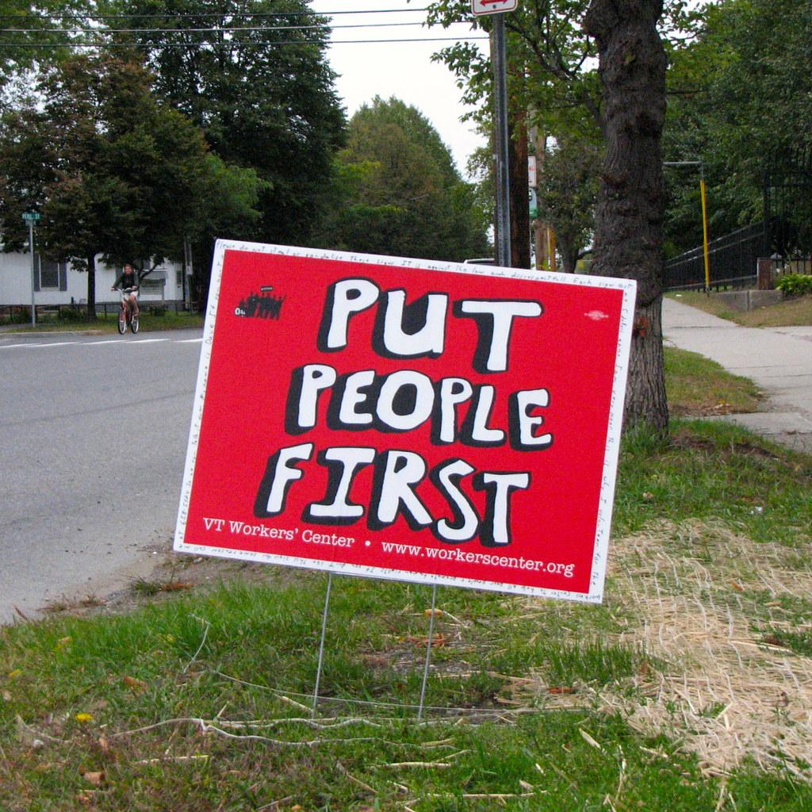
HIV and Stigma
Notes:
Ask, “Who has heard the term “People First Language?”
People First Language is an alternative way to talk about people with disabilities. It’s putting people before the disability. To use People First Language, simply say the person’s name or use a pronoun first, follow it with a verb, than state the name of the disability.
Using People First Language is not an attack nor does it call the disease to attention front and center. It puts the person first. We’ll look at a few examples later.

Slide 25
Why Use People First Language?
HIV and Stigma
Removes stigmatizing language
Reshapes the conversation
Focuses on what really matters—the person
Empowers people
Notes:
Review the slide.

Slide 26
People First Language
HIV and Stigma
Rather than using labels to define individuals with a health issue, it is more appropriate to use terminology which describes individuals as being diagnosed with a disorder.
Use phrases such as “individuals with a mental illness,” rather than, “the mentally ill.” Use “people with HIV,” rather than, “HIV infected.”
This terminology emphasizes the treatment of a person with a disease rather than simply treating a disease.
Notes:
Review the slide.
People First Language puts the person before the disability, illness or medical condition. A person is more than their medical diagnosis. People First Language helps to eliminate prejudice and it removes value judgements about the person. When we describe people by labels or medical diagnoses, we devalue and disrespect them as individuals.

Slide 27
Examples of People First Language
HIV and Stigma
Women are most likely to be infected with HIV through heterosexual contact.
Women are most likely to contract or acquire HIV through heterosexual contact.
Cardiovascular disease has become a major concern among HIV-infected individuals.
Cardiovascular disease has become a major concern among people with HIV.
Mentally ill people are often diagnosed with AIDS virus* when proper medical care is ignored.
People with mental health challenges are often diagnosed with AIDS when proper care is not provided or ignored.
*AIDS is not a virus; it’s a syndrome and a result of inadequate care or treatment. HIV is the virus.
Notes:
We will look at a few examples that will help us distinguish between stigmatizing, incorrect, and insensitive language vs. what is preferred by communities.
Compare the first examples for each sentence (stigmatizing language) to the second example (People First Language).

Slide 28
ACTIVITY: STIGMATIZING SELF-TALK VS. EMPOWERING SELF-TALK
Notes:
Activity: Discuss stigmatizing language and its impact on people with HIV
Distribute Using Language that Empowers worksheet.
Divide participants into small groups.
Participants will brainstorm empowering statements that will convert or reframe stigmatizing language and microaggressions.
Review responses as a large group.
Ask, “What can you do to help reduce stigmatizing language?”
Discuss and make distinctions between external and internal stigma.
External stigma (enacted stigma, discrimination) refers to the experience of unfair treatment by others.
Internal stigma (felt stigma or self-stigmatization) refers to the shame and expectation of discrimination that prevents people from talking about their experiences and stops them from seeking help.
If any participants have disclosed that they are living with HIV, ask if they would be willing to briefly share their experiences by answering the following questions (3 minutes or less).
What was a stigmatizing situation you have experienced since your diagnosis?
How did it make you feel and what did you do?
If the person has been living with HIV for several years (5 or more) would they feel any different if the situation were to occur today?

Slide 29
All of us have a role to play in eliminating stigma and helping people get in and stay in care.
Notes:
Review the slide.

Slide 30
What Can I Do to Help Reduce Stigmatizing Language?
HIV and Stigma
Use People First Language when referring to people with a medical condition.
Talk with colleagues and friends and educate others.
Encourage the use of People First Language.
Change organizational documents and educational materials to reflect preferred language when possible.
Include people with diverse backgrounds disproportionately impacted by HIV, such as MSM of color, transgender people, women, and youth, in the creation of organizational documents and materials.
Notes:
What can we all do to reduce stigma?
Use People First language when referring to people with a medical condition.
Talk with colleagues and friends and educate others. Encourage use of People First Language.
Change organizational documents and educational materials to reflect preferred language when possible.
Include people with diverse backgrounds disproportionately impacted by HIV, such as MSM of color, transgender people, women, and youth in the creation of organizational documents and materials. This will help ensure that language is culturally appropriate beyond the issue of HIV.
Optional activity
In small groups, have participants develop situations that are examples of external stigma and internal stigma.
Example external stigma: A client has been expelled from their home due to their HIV status and sexuality.
Example internal Stigma: A client believes they deserved HIV because of their behaviors.
Ask probing questions to help participants understand the impact stigma plays in providing services as a CHW.
Example questions:
What impact can internalized stigma have on a person’s motivation or willingness to work with a CHW?
In what ways can stigma impact a CHW’s role effectiveness if they experience externalized or internalized stigma?
Emphasize that stigma separates and is counterproductive to building supportive, honest, and authentic working relationships with clients.
Summarize: Stigma can be a difficult topic because it often brings up hurt feelings, past aggressions, and negative experiences for people in general, not just people with HIV. Take some time for self-care if this lesson has triggered feelings for you.

