Slide 1
El VIH y el consumo de sustancias

Slide 2
Objetivos
El VIH y el consumo de sustancias
Al final de esta unidad las participantes harán lo siguiente:
Tener conocimiento de los datos epidemiológicos sobre las personas con VIH que se enfrentan al consumo de sustancias.
Comprender la interacción entre el VIH y el consumo de sustancias.
Comprender las estrategias para apoyar a las personas con VIH y el manejo del consumo de sustancias.
Notes:
Review the objectives.

Slide 3
Primero, algunas preguntas...
El VIH y el consumo de sustancias
Notes:
Guide participants through the series of questions on the following slides.
Say, “First let’s take a poll to determine what you currently know about HIV and substance use.”

Slide 4
¿Cuántas personas son VIH positivo en los Estados Unidos?
El VIH y el consumo de sustancias
3,0 millones
1,2 millones
1,9 millones
36,9 millones
Notes:
Read the question and potential answers. Ask for a show of hands.
Provide the correct answer: B. 1.2 million

Slide 5
¿Qué porcentaje de personas con VIH están luchando con trastornos por el consumo de sustancias (SUD) y necesitan tratamiento?
El VIH y el consumo de sustancias
24 %
7 %
44 %
52 %
Notes:
Read the question and potential answers. Ask for a show of hands.
Provide the correct answer: A. 24%
5

Slide 6
¿Cuáles de los siguientes son desafíos para las personas con VIH y diagnosticadas con SUD?
El VIH y el consumo de sustancias
Incumplimiento del tratamiento
Omisión de citas médicas
Resistencia a los medicamentos contra el VIH
Todas las anteriores
Notes:
Read the question and potential answers. Ask for a show of hands.
Provide the correct answer: D. All of the above
6

Slide 7
¿Los opiáceos y los opioides son iguales?
El VIH y el consumo de sustancias
Sí
No
Notes:
Read the question and potential answers. Ask for a show of hands.
Provide the correct answer: B. No
7

Slide 8
¿Los programas de asistencia para medicamentos contra el SIDA (ADAP) pagan el tratamiento de asistencia con medicamentos contra la adicción a los opioides?
El VIH y el consumo de sustancias
Sí
No
A veces
Notes:
Read the question and potential answers. Ask for a show of hands.
Provide the correct answer: C. Sometimes
8

Slide 9
¿Cuál de las siguientes es una estrategia para ayudar a los clientes con VIH y SUD?
El VIH y el consumo de sustancias
Reducción del estigma
Uso del lenguaje
Plan de reducción de daños
Intervenciones efectivas para promover el cambio
Todas las anteriores
Notes:
Read the question and potential answers. Ask for a show of hands.
Provide the correct answer: E. All of the above
Thanks for answering these questions. As we go through the slides the answers will be explained.
9

Slide 10
Definiciones
El VIH y el consumo de sustancias
Consumo de sustancias: tomar o consumir dosis bajas de una sustancia, como alcohol o medicamentos recetados, por lo que los efectos negativos son poco frecuentes o menores.
Uso indebido/abuso de sustancias: el consumo excesivo de una sustancia, como drogas o alcohol, que da lugar a alteraciones clínicas y funcionales.
Trastorno por el consumo de sustancias (SUD): un término de diagnóstico que se refiere al consumo recurrente de alcohol u otras drogas (AOD) que causa una discapacidad de “importancia clínica y funcional” (p. ej., en el trabajo, la escuela, el hogar, la salud).
Notes:
Lets begin by first defining terms that may frequently be used interchangeably. Review the definitions.
10

Slide 11
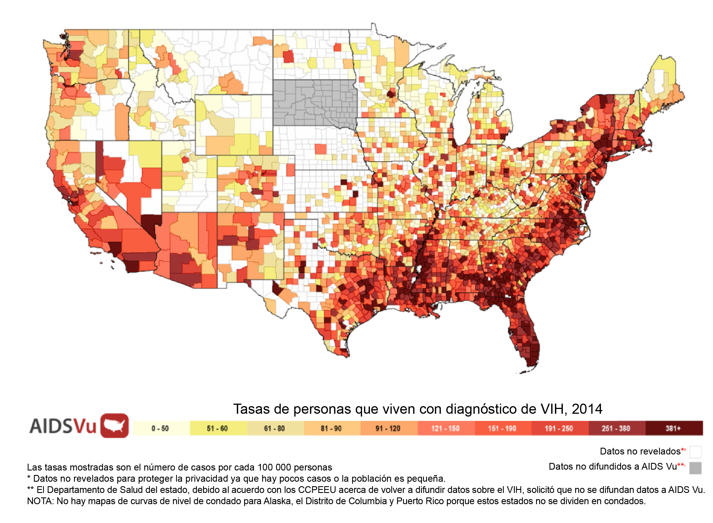
Datos epidemiológicos 1,2 millones de personas con VIH en los Estados Unidos
El VIH y el consumo de sustancias
Notes:
One of our polling questions asked about the number of people with HIV in the US. There are 1.2 million as documented by
the Centers for Disease Control. The darker colors indicate areas with the highest HIV incidence, which are in the East, South, and
Western states of the United States.
11

Slide 12
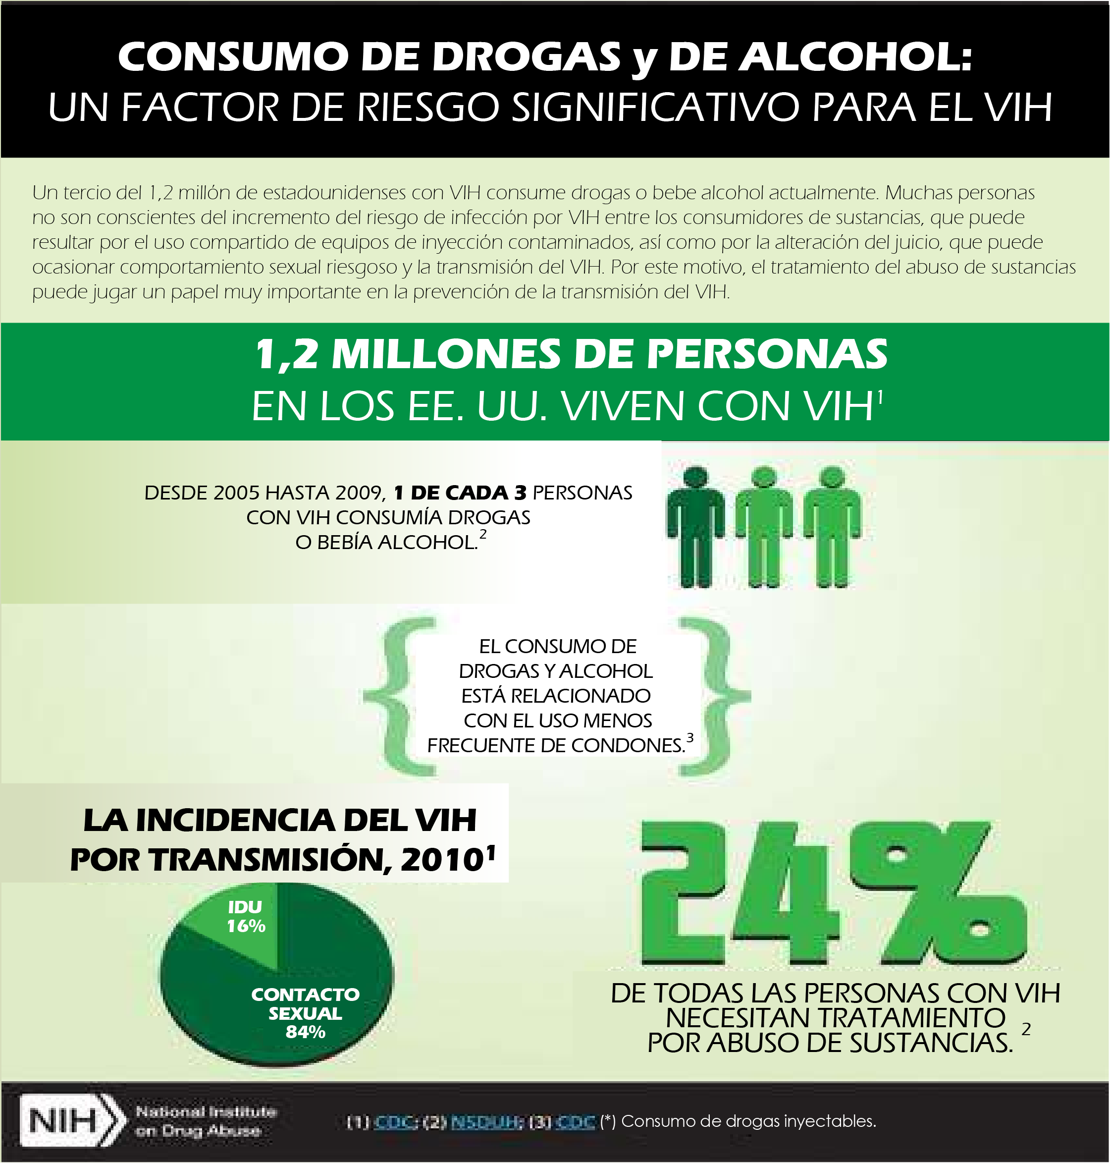
El VIH y el consumo de sustancias
Notes:
While this data is from 2009, the National Institutes of Health state that 1 in 3 people with HIV are using drugs or alcohol.
24% of people with this dual diagnosis could benefit from substance use treatment and more current data suggests that 16% of
HIV transmission was from injection drug use.
12

Slide 13
Sustancias
El VIH y el consumo de sustancias
Alcohol
Tabaquismo
Drogas ilícitas
Opioides y opiáceos
Notes:
For this purpose of this unit, we will focus on the following substances.
13

Slide 14
El alcohol y el VIH
El VIH y el consumo de sustancias
Debilita el sistema inmunitario
Beber en exceso puede perjudicar el juicio y conducir a un mayor comportamiento de riesgo sexual
Disminuye la efectividad de la terapia antirretroviral
Oportunidad para que ocurra la replicación viral
Incumplimiento del tratamiento
Aumento del virus
Omisión de citas médicas
Daño hepático
Hepatitis C
Determina si tratar el VIH o tratar el hígado
Notes:
The combination of alcohol and HIV:
Weakens the immune system.
Excessive drinking can impair judgement and lead to increased sexual risk behavior.
Diminishes how effective antiretroviral therapy can be in managing viral suppression.
When our immune system is weakened, there is opportunity for viral replication to occur.
Research indicates that excessing drinking can lead to poor adherence to medications, leading to increased virus and liver damage.
We know that alcohol affects judgement and potential for missed medical appointments.
A diagnosis of Hepatitis C is dependent on lab results of how functional a client’s kidneys are. With alcohol, it complicates the picture—need to determine whether to treat HIV or treat the liver.

Slide 15
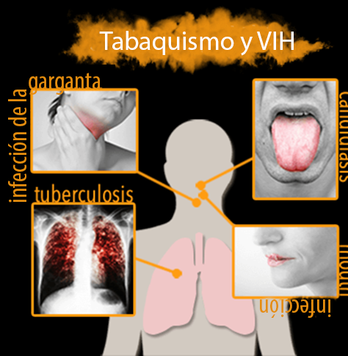
El tabaquismo y el VIH
El VIH y el consumo de sustancias
La tasa de tabaquismo es entre dos y tres veces mayor en una persona con VIH.
Enfermedad cardíaca
Osteoporosis
Derrame cerebral
Cáncer
Dejar de fumar puede salvar la vida de una persona con VIH.
Fuente: americanaddictionscenter.org
Notes:
Research conducted by the American Addictions Center indicates that the rate of smoking is 2 to 3 times greater in a person
with HIV. This combination can lead to heart disease, osteoporosis, stroke, and cancer, as well as throat, mouth and lung infections,
pneumonia, and COPD. One major change that can improve a person’s health is if they stop smoking.
15

Slide 16
Las drogas ilícitas y el VIH
El VIH y el consumo de sustancias
Metanfetaminas
Cocaína
Marihuana (en algunos estados)
Efectos negativos
Incumplimiento del tratamiento y de las citas médicas
Resultados virales deficientes
Falta de apoyos sociales
Elecciones de comportamiento arriesgado
Posibles efectos secundarios de los medicamentos
Las drogas ilícitas permanecen más tiempo en la sangre y son más tóxicas
Notes:
Next, we will look at illicit or illegal Drugs and HIV.
Methamphetamines or meth are a stimulant drug that is a white powder or pill.
Crystal meth is also known as chalk, crank, crystal, ice, meth, and speed. The drug looks like glass fragments or shiny, bluish-white rocks. It is chemically similar to amphetamine [a drug used to treat attention-deficit hyperactivity disorder (ADHD) and narcolepsy, a sleep disorder.
Cocaine, also known as coke, is a strong stimulant, mostly used as a recreational drug. It is commonly snorted, inhaled as smoke, or dissolved and injected into a vein. Mental effects may include loss of contact with reality, an intense feeling of happiness, or agitation. Crack cocaine, also known simply as crack, is a free base form of cocaine that can be smoked. Crack offers a short but intense high to smokers.
Cannabis, also known as marijuana, among other names, is a psychoactive drug from the cannabis plant used for medical or recreational purposes. From this map you can see there are many states that have legalized marijuana for medicinal purposes and recreational use.
16

Slide 17
¿Qué son los opioides?
El VIH y el consumo de sustancias
Opiáceo: derivado de la amapola
Morfina
Codeína
Opioide: cualquier compuesto que se une a los receptores opioides
Semisintético (es decir, hidrocodona, oxicodona, heroína, buprenorfina)
Sintético (es decir, fentanilo [de 30 a 50 veces la potencia de la heroína], metadona)
Formulaciones orales, transdérmicas e intravenosas
Narcótico: designación legal
Notes:
Opiates are direct derivatives of the opium poppy plant. Examples of opiates are opium itself, morphine, and codeine.
Opioids are any compound that binds to opioid receptors in the brain and body. There are semi-synthetic compounds-hydrocodone, oxycodone, heroin, and buprenorphine. We know that many times people are prescribed these pain medications which become addictive. There also are synthetic opioids such as fentanyl and methadone which are prescribed for pain management and are addictive. Many deaths are caused by fentanyl overdose as well as fentanyl being mixed with other drugs that unfortunately can lead to death. The term “narcotic” is more of a legal designation for drugs that is used less and less in drug treatment settings because of its negative connotation.
Reference: Galanter, M., Kleber, H.D., & Brady, K.T. (2015). Textbook of Substance Abuse Treatment, 5th Ed. Arlington, VA: American Psychiatric Publishing.
17

Slide 18
Efectos de los opioides
El VIH y el consumo de sustancias
Los opioides son altamente adictivos.
Las células cerebrales pueden volverse dependientes en la medida en que los usuarios lo necesiten para funcionar en su rutina diaria (sin necesariamente “drogarse”).
Los opioides inicialmente causan una oleada de placer.
Los opioides reducen el procesamiento cognitivo,desaceleran el tiempo de reacción y deterioran la memoria, lo que afecta el comportamiento y las capacidades para tomar decisiones.
Notes:
Make the point that opioids are highly addictive and people can become physiologically dependent on them very quickly. It is important to understand that individuals who are physiologically dependent on opioids can need drugs just to be able to function normally, without even necessarily getting high.
There are Medically Assisted Treatment programs that we will discuss next that are given to people who are dependent on opioids, with the support of a treatment team.
REFERENCE: Galanter, M., Kleber, H.D., & Brady, K.T. (2015). Textbook of Substance Abuse Treatment, 5th Ed. Arlington, VA: American Psychiatric Publishing.

Slide 19
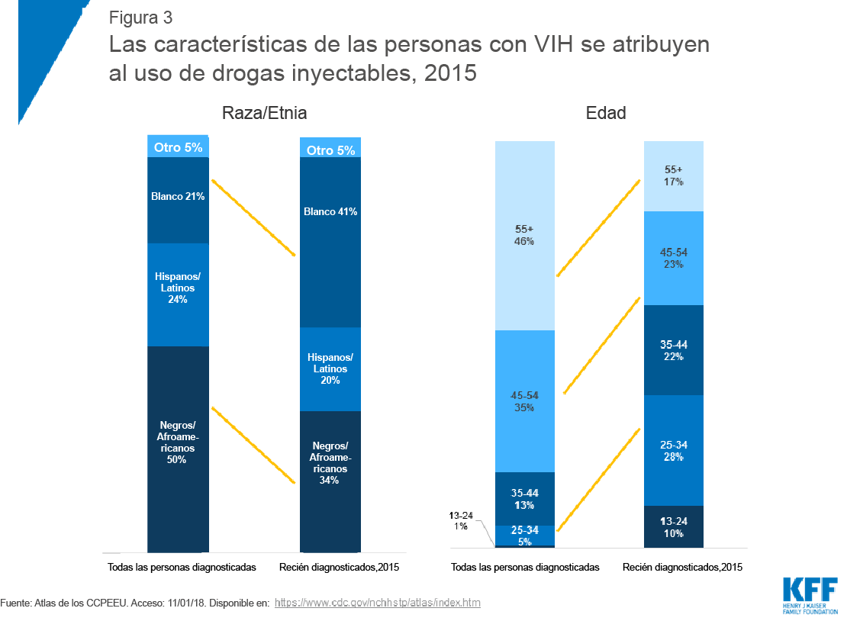
El VIH y el consumo de sustancias
69
Notes:
As the graph shows, in 2015, fewer of the new injection drug use (IDU) related HIV diagnoses were among African-Americans and more were among Whites. This likely reflects the movement of the opioid epidemic into largely white, poor, rural areas. Additionally, new diagnoses in 2015 tended to be much younger than the overall population of IDU-related HIV cases (60% were under the age of 45 vs. 80% 45 and older in the broader population). The increase was especially large among ages 13-24 and ages 25-34.
Reference: Kaiser Family Foundation (2018). Characteristics of people with HIV attributed to injection drug use, 2015. Retrieved from: https://www.kff.org/hivaids/issue-brief/hiv-and-the-opioid-epidemic-5-key-points/.
19

Slide 20
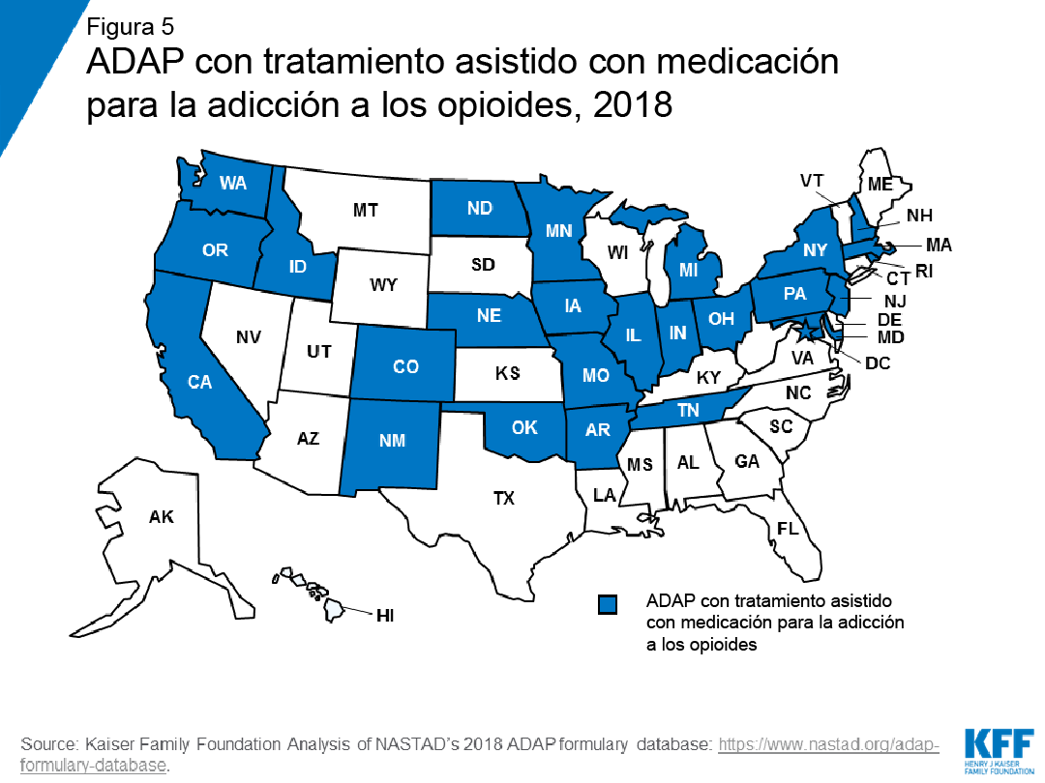
El VIH y el consumo de sustancias
70
Notes:
This is a map showing AIDS Drug Assistance Programs (ADAP) in states that include medication-assisted treatment (MAT) for
opioid addiction in their formulary. HIV care recipients on ADAP who have an opioid addiction have access to MAT if they live in
one of the highlighted states.
Reference: Kaiser Family Foundation (2018). Analysis of NASTAD’s 2018 ADAP formulary database. Retrieved from: https://www.kff.org/hivaids/issue-brief/hiv-and-the-opioid-epidemic-5-key-points/.
20

Slide 21
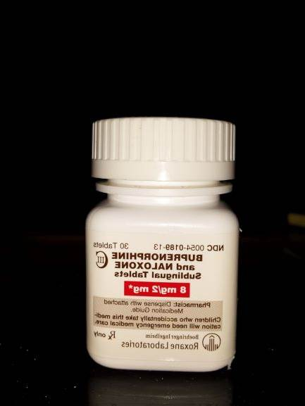
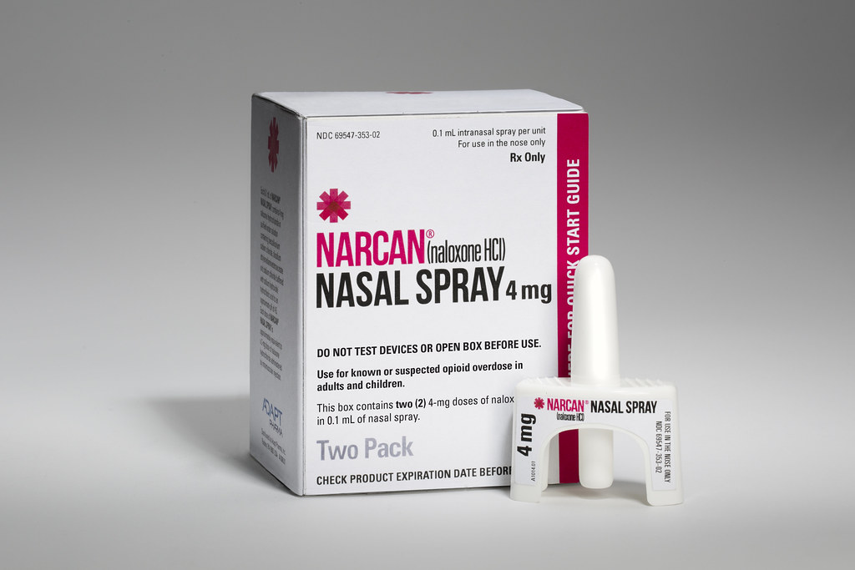
Tratamiento asistido con medicamentos (MAT) para el tratamiento con opioides
El VIH y el consumo de sustancias
Metadona
Tratamiento con buprenorfina (buprenorfina [Subutex], naloxona, suboxona)
Parche transdérmico
Tableta o película sublingual
Inyección mensual de liberación prolongada (naltrexona/Vivitrol)
Naloxona (Narcan)
Fuente: SAMSHA
Notes:
A common misconception associated with MAT is that it substitutes one drug for another. Instead, MAT helps withdrawal
symptoms and psychological cravings that cause chemical imbalances in the body. MAT programs provide a safe and controlled
level of medication to overcome the use of an abused opioid.
Methadone, buprenorphine, and naltrexone are used to treat opioid dependence and addiction to short-acting opioids such as heroin, morphine, and codeine, as well as semi-synthetic opioids like oxycodone and hydrocodone. People may safely take medications used in MAT for months, years, several years, or even a lifetime. Plans to stop a medication must always be discussed with a doctor.
Like methadone, buprenorphine suppresses and reduces cravings for the abused drug. It can come in a pill form or sublingual tablet that is placed under the tongue (Suboxone) or as an injection (Sublocade).
Naltrexone works differently than methadone and buprenorphine in the treatment of opioid dependency. If a person using naltrexone relapses and uses the abused drug, naltrexone blocks the euphoric and sedative effects of the abused drug and prevents feelings of euphoria.
Opioid overdose prevention medication-FDA approved naloxone, or Narcan, an injectable drug used to prevent an opioid overdose. There is also a mist form which can be easier to administer. You can be trained to carry Narcan an use as needed.
21

Slide 22
Estrategias para considerar
El VIH y el consumo de sustancias
Reducción del estigma
Uso del lenguaje
Plan de reducción de daños
Intervenciones efectivas para promover el cambio
SBIRT (detección, intervención breve, derivación al tratamiento)
Terapia cognitivo conductual (CBT)
Programas de 12 pasos
Para las personas que pueden estar sufriendo una adicción, infórmense sobre los programas de terapia asistida con medicamentos y alienten a las personas a hablar con los médicos.
Notes:
22
Next we will review strategies to consider as a CHW.

Slide 23
El VIH y el consumo de sustancias
Notes:
We know that stigma has many negative impacts, from discouraging people from getting tested for HIV and engaging in
healthcare to making people feel judged. While it is makes sense that providers should use person-centered language in talking
with individuals, research has actually demonstrated the negative impact of not using person-centered language.
In a study, one individual was referred to as a “substance abuser” while the other was referred to as “having a substance use
disorder.” In gathering feedback about the two individuals, participants demonstrated biases based on these descriptors alone. The
“substance abuser” was viewed as being less likely to benefit from treatment, more likely to benefit from punishment, more likely
to be threatening, more likely to be blamed for substance-related difficulties, and more able to control their substance use without
help. If each of these biases were held (consciously or unconsciously by a provider), they could impact treatment and engagement
in significant ways.
Source: Facing Addiction with the National Council on Alcoholism and Drug Dependence, 2018.
23

Slide 24
Cómo corregir el lenguaje para que sea menos estigmatizante
El VIH y el consumo de sustancias
Cambiar de términos estigmatizados a correctos y menos críticos es beneficioso para el compromiso.
Fuente: Centers for Disease Control and Prevention. (n.d.) “A Guide to Talking About HIV”. Extraído de https://www.cdc.gov/actagainstaids/pdf/campaigns/lsht/cdc‐hiv‐together‐stigma‐talking‐guide.pdf. 8. Centers for Disease Control and Prevention
ESTIGMATIZANTE | CORRECTO
Drogadicto, adicto, alcohólico | Una persona con un trastorno de consumo de sustancias
Sobrio | Una persona en recuperación
Abuso de sustancias | Trastorno por el consumo de sustancias
Recaída | Una recurrencia de los síntomas
Sucio | Una persona que aún no se está recuperando, prueba de orina positiva
Notes:
Using people first language is less stigmatizing. Let’s look at some examples of how we can make an intentional shift to use less
judgmental language when talking with and about our clients.
24

Slide 25
Ejemplos de un plan de reducción de daños
El VIH y el consumo de sustancias
Las personas que consumen drogas pueden dar pequeños pasos para reducir el daño a sí mismas y a otros:
Conocer el origen de las drogas puede aumentar su conocimiento de la potencia y toxicidad de la droga.
Reducir la cantidad de drogas consumidas
Evitar el consumo de drogas solamente
Asistir a programas de intercambio de agujas
Obtener apoyo para problemas de salud física y mental, vivienda o necesidades
Notes:
Let’s look an example of a harm reduction strategies we could talk about with our clients.
25

Slide 26
Intervenciones efectivas para promover el cambio
El VIH y el consumo de sustancias
SBIRT (detección, intervención breve, derivación al tratamiento)
SBIRT se enfoca en la gran cantidad de personas que consumen alcohol o drogas de manera poco saludable, pero que no tienen un trastorno de consumo de sustancias (es decir, abuso, dependencia). La investigación muestra que pueden y logran cambiar con éxito su consumo con devoluciones e intervención temprana. SBIRT también brinda devoluciones positivas a quienes toman decisiones saludables.
10 preguntas
https://www.integration.samhsa.gov/clinical-practice/sbirt
Terapia cognitivo conductual (CBT)
Terapia de conversación
Grupo de 12 pasos
Notes:
There are many effective interventions that have been proven to promote change in clients who have a SUD.
SBIRT is one such intervention. It stands for Screen, Brief Intervention, Referral, and Treatment. Based on the results of the
assessment, a client would receive a brief intervention and be referred to treatment. If you click on the link, it would take you to a
toolkit and places to receive training.
Cognitive behavioral therapy is talk therapy, provided by a therapist, substance abuse counselor, or clinical social worker.
12 Step groups or programs include Alcoholics Anonymous (AA) and Narcotics Anonymous (NA).
26

Slide 27
El VIH y el consumo de sustancias
Oportunidades del sistema
Disparidades en la atención médica del cliente
Entrada y retención reducidas en la atención del VIH
Inicio tardío de ART
Resultados inferiores del tratamiento del VIH
Baja alfabetización en salud
Condición socioeconómica
Falta de seguro médico
Vivienda inestable
Sistemas de salud desarticulados
Servicios clínicos, farmacológicos, conductuales y sociales
Servicios rentables y convenientes
Detección y tratamiento de SUD subyacentes
Tratar los SUD subyacentes podría tener un efecto positivo en el cumplimiento del tratamiento contra el VIH
Servicios secundarios de prevención del VIH para reducir la transmisión del VIH
Cambio de la economía de la guerra contra las drogas a la guerra para brindar servicios contra el consumo de sustancias a las personas
Notes:
We have an opportunity to form relationships with our clients that can ultimately support the choices they make, which we hope
can include accessing substance use treatment.
Let’s take a moment to empathize with some of our clients, who may struggle with substance use.
Review disparities and opportunities on the slide.

Slide 28
Respondamos esas preguntas otra vez para saber cuánto hemos aprendido...
El VIH y el consumo de sustancias
Notes:
Read the slide.
28

Slide 29
¿Cuántas personas son VIH positivo en los Estados Unidos?
El VIH y el consumo de sustancias
3,0 millones
1,2 millones
1,9 millones
36,9 millones
Notes:
Read the question and potential answers. Ask for a show of hands.
Provide the correct answer: B. 1.2 million

Slide 30
¿Qué porcentaje de personas con VIH están luchando con trastornos por el consumo de sustancias (SUD) y necesitan tratamiento?
El VIH y el consumo de sustancias
24 %
7 %
44 %
52 %
Notes:
Read the question and potential answers. Ask for a show of hands.
Provide the correct answer: A. 24%
30

Slide 31
¿Cuáles de los siguientes son desafíos para las personas con VIH y diagnosticadas con SUD?
El VIH y el consumo de sustancias
Incumplimiento del tratamiento
Omisión de citas médicas
Resistencia a los medicamentos contra el VIH
Todas las anteriores
Notes:
Read the question and potential answers. Ask for a show of hands.
Provide the correct answer: D. All of the above
31

Slide 32
¿Los opiáceos y los opioides son iguales?
El VIH y el consumo de sustancias
Sí
No
Notes:
Read the question and potential answers. Ask for a show of hands.
Provide the correct answer: B. No
32

Slide 33
¿Los programas de asistencia para medicamentos contra el SIDA (ADAP) pagan el tratamiento de asistencia con medicamentos contra la adicción a los opioides?
El VIH y el consumo de sustancias
Sí
No
A veces
Notes:
Read the question and potential answers. Ask for a show of hands.
Provide the correct answer: C. Sometimes
33

Slide 34
¿Cuál de las siguientes es una estrategia para ayudar a los clientes con VIH y SUD?
El VIH y el consumo de sustancias
Reducción del estigma
Uso del lenguaje
Plan de reducción de daños
Intervenciones efectivas para promover el cambio
Todas las anteriores
Notes:
Read the question and potential answers. Ask for a show of hands.
Provide the correct answer: E. All of the above
Thanks for answering these questions!
Next, ask participants to briefly discuss their experiences with linking clients to care.
34

Slide 35
Recursos
El VIH y el consumo de sustancias
“Recreational Drugs and HIV”: http://www.aidsinfonet.org/fact_sheets/view/494#DRUG_INTERACTIONS
“Substance Abuse and HIV/AIDS”: https://americanaddictioncenters.org/health-complications-addiction/substance-abuse-hiv-aids
Jaimie P. Meyer, Amy L. Althoff, and Frederick L. Altice. “Optimizing Care for HIV-Infected People Who Use Drugs: Evidence-Based Approaches to Overcoming Healthcare Disparities”. Clinical Infectious Diseases, volumen 57, edición 9, 1 de noviembre de 2013, páginas 1309-1317, https://doi.org/10.1093/cid/cit427
Notes:
Here are some additional resources.
35

