Slide 1

end+disparities ECHO Collaborative
Kick-Off Session
Monday March 26th, 2018
12:00-1:00 pm ET

Slide 2

Before we start…
Please type your name, organization, city and state in the chat room

Slide 3
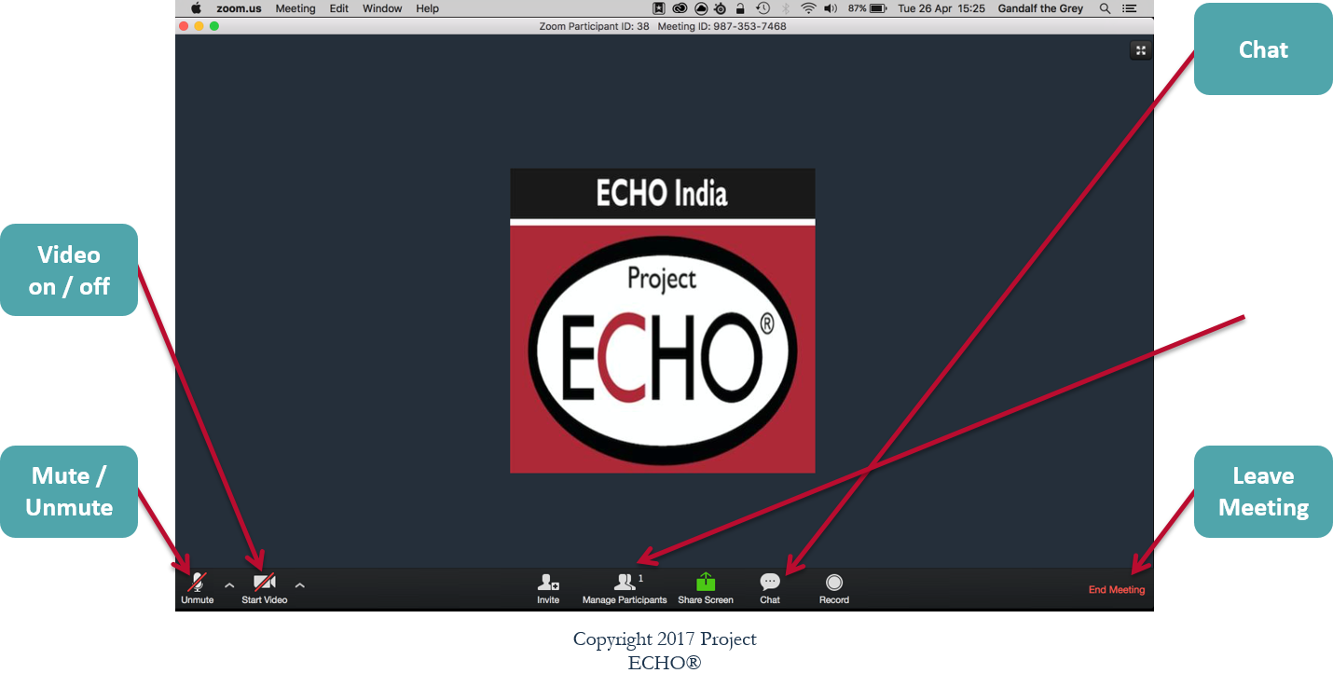
Features as Computer Participant
Copyright 2017 Project ECHO®

Slide 4
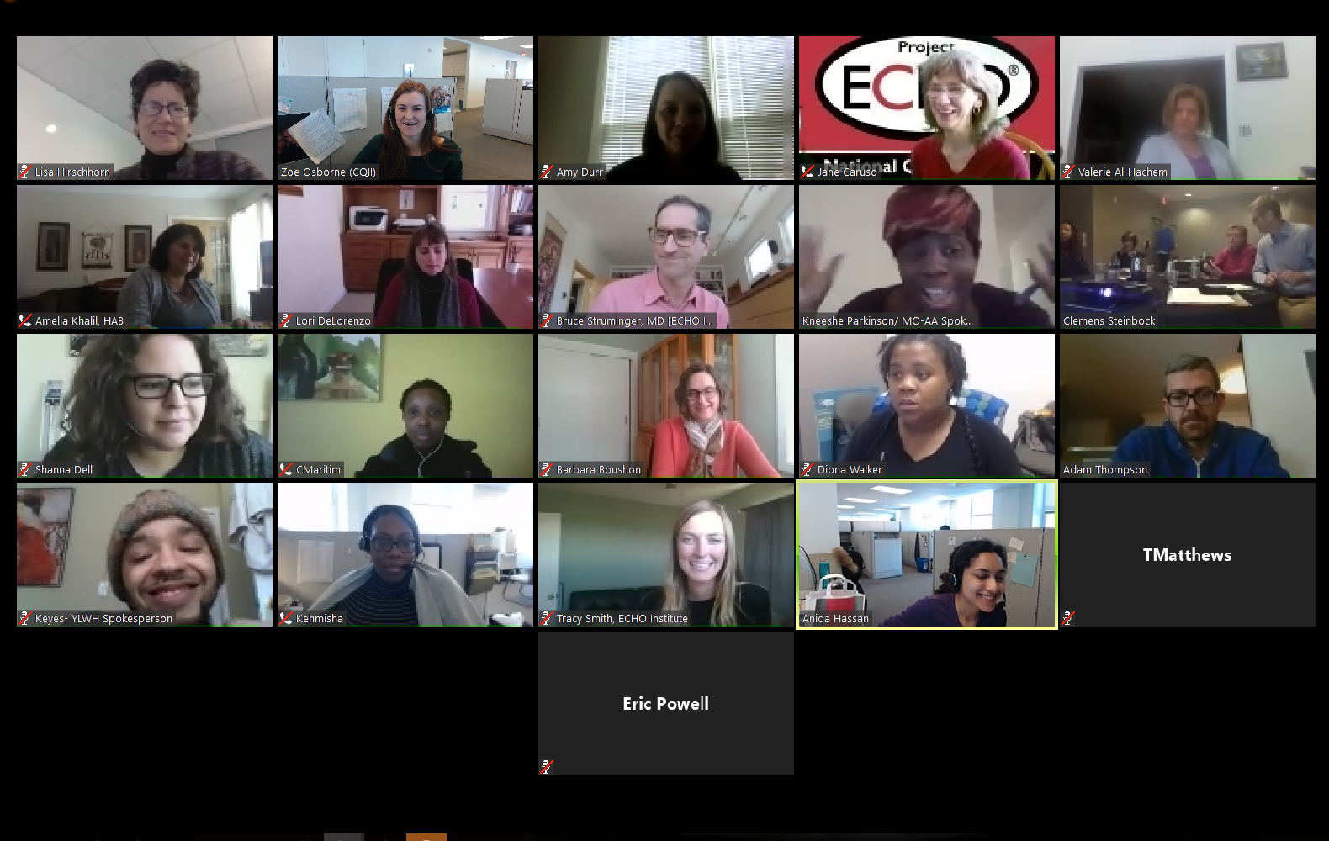
Please use your camera to help us create a community of learning!

Slide 5

Ground Rules for Zoom Participation
Actively participate and write your
questions into the chat area during
the presentation
Do not put us on hold
Mute your line by pressing the
microphone button in the bottom left
This call is recorded for replay for those who missed the session
For technology-related questions please directly chat with Aniqa Hassan

Slide 6
Opening Remarks

Slide 7
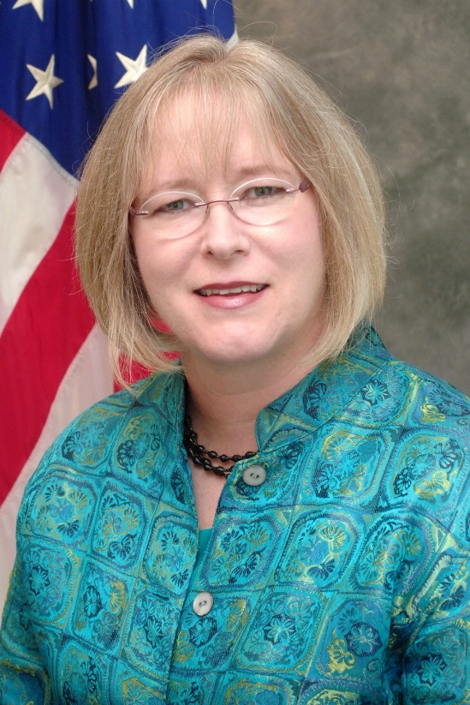
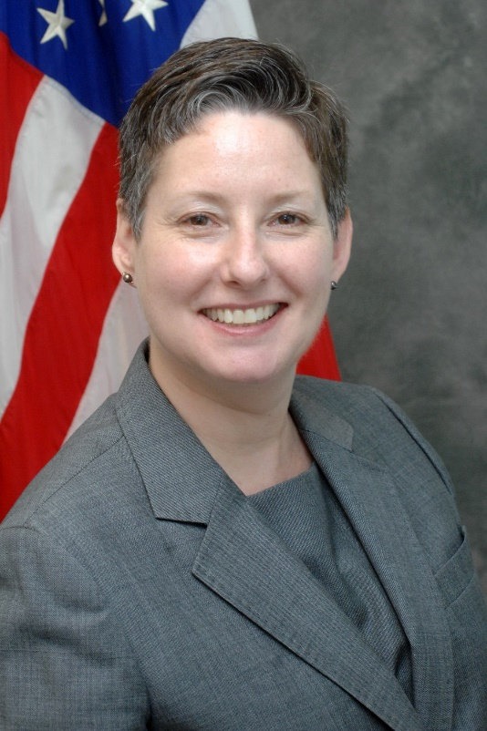
Laura W. Cheever, MD, ScM
HAB Associate Administrator
Heather Hauck, MSW LICSW
Deputy Associate Administrator

Slide 8

Agenda
Welcome
Overview of HIV Disparity Literature Review
Collaborative Overview, Framework and Timeline
Introduction to Tools & Resources
Q&A Session

Slide 9
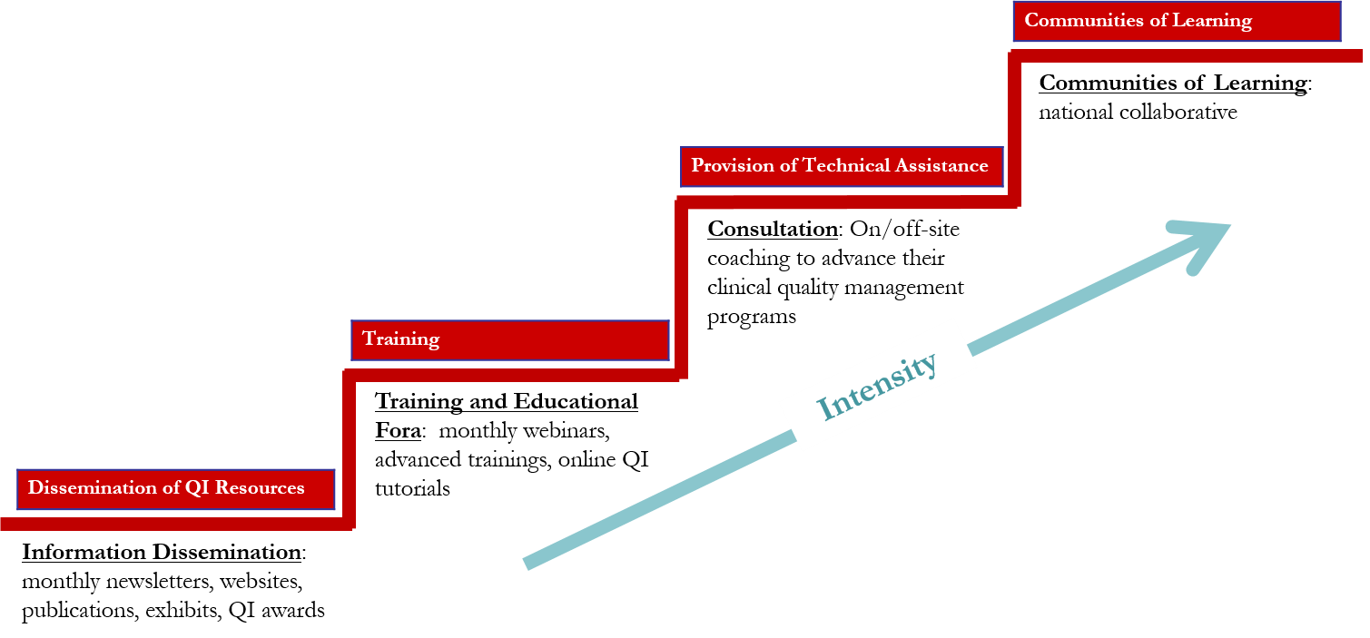

HRSA Ryan White HIV/AIDS Program
Center for Quality Improvement & Innovation
  “Together, we continue to improve the lives of people living with HIV. The HRSA Ryan White HIV/AIDS Program Center for Quality Improvement and Innovation (CQII) provides state-of-the-art technical assistance to Ryan White HIV/AIDS Program-funded recipients and subrecipients to measurably strengthen local clinical quality management programs in order to impact HIV health outcomes.”

Slide 10
Literature Review – Key Findings

Slide 11
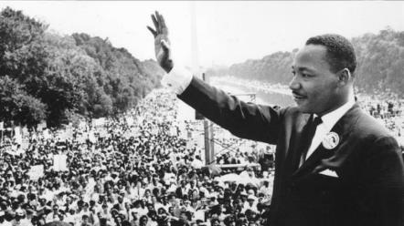
“Of all the forms of inequality, injustice in health care is the most shocking and inhumane.”
- Martin Luther King
CDC MMWR Supplement / Vol. 62 / No. 3 November 22, 2013: CDC Health Disparities and Inequalities Report — United States, 2013

Slide 12
What is a Health Disparity?
“A population is a health disparity population if there is a significant disparity in the overall rate of disease incidence, prevalence, morbidity, mortality, or survival rates in the population as compared to the health status of the general population.”
– Minority Health and Health Disparities Research and Education Act, United States Public Law 106-525 (2000)

Slide 13
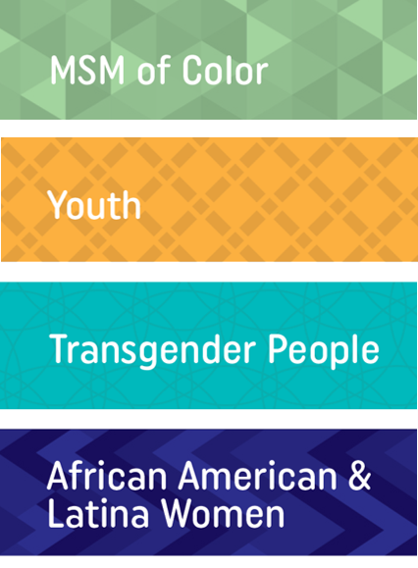
Did you know?
Men who have sex with men are 46 times more likely to have HIV than other men
Youth (ages 13-24) are 5 times more likely to have HIV than people older than 25
Transgender women are 50 times more likely to have HIV than other adults
African American women are 20 times more likely to have HIV than white women
http://www.unaids.org/sites/default/files/media_asset/08_Transgenderpeople.pdf
http://www.cdc.gov/hiv/pdf/statistics_hssr_vol_17_no_4.pdf
http://www.aidsmap.com/HIV-positive-youth-are-less-likely-than-adults-to-achieve-viral-suppression-on-antiretroviral-treatment/page/2994025/
http://www.cdc.gov/mmwr/preview/mmwrhtml/su6203a19.htm?s_cid=su6203a19_w

Slide 14

Disparities among MSM of Color

Slide 15


MSM of Color
1 in 11 White MSM will be diagnosed with HIV in his lifetime
1 in 4 Hispanic MSM will be diagnosed with HIV in his lifetime
1 in 2 African American MSM will be diagnosed with HIV in his lifetime
CDC/NCHHSTP. 2016 conference on retroviruses and opportunistic infections--CROI graphics: lifetime risk of HIV diagnosis in the United States. Updated 2016 Feb 24. Available from http://www.cdc.gov/nchhstp/newsroom/2016/croi-2016.html

Slide 16
HIV Care Continuum (African American MSM vs. White MSM)
African American MSM are 47% less likely than White MSM to achieve viral suppression (16% vs 34%).
Rosenberg ES, Millett GA, Sullivan PS, del Rio C, and Curran JW. Understanding the HIV disparities between Black and White men who have sex with men in the USA using the HIV Care Continuum: a modelling study. Lancet HIV. 2014;1(3):e112-e118.

Slide 17

Disparities among African American and Latina Women

Slide 18


African American and Latina Women
13% of the U.S. female population are African American women
62% of new HIV infections among women occur among African American women
CDC. HIV/AIDS Resource Library Slide Sets: HIV surveillance in women (through 2014). Updated 2016 Feb 26. Available from http://www.cdc.gov/hiv/pdf/library/slidesets/cdc-hiv-surveillance-women-2014.pdf

Slide 19

African American and Latina Women
1 in 227 Latina women will be diagnosed with HIV in her lifetime
African American women are 18 times more likely to be diagnosed with HIV than white women
Latina women are 4 times more likely to be diagnosed with HIV than white women
CDC/NCHHSTP. 2016 conference on retroviruses and opportunistic infections--CROI graphics: lifetime risk of HIV diagnosis in the United States. Updated 2016 Feb 24. Available from http://www.cdc.gov/nchhstp/newsroom/2016/croi-2016.html

Slide 20

Disparities among Youth (13-24)

Slide 21

In the U.S., what percentage of youth aged 13 to 24 with HIV are unaware of their infection?
32 percent
42 percent
52 percent
CDC. HIV/AIDS: HIV among youth. Updated 2016 Apr 27. Available from http://www.cdc.gov/hiv/group/age/youth/

Slide 22
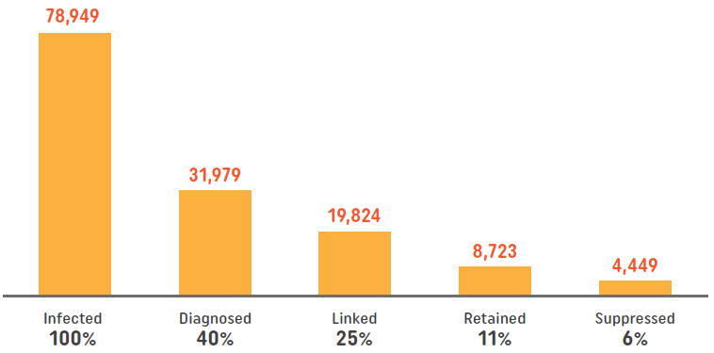
Youth (13-24)
HIV Care Continuum in HIV-infected Youth in the United States
Only 6% of youth are estimated to be virally suppressed, compared to an average rate of 30% across all age groups.
Zanoni BC and Mayer KH. The adolescent and young adult HIV cascade of care in the United States: exaggerated health disparities. AIDS Patient Care STDS. 2014;28(3):128-35. CDC, http://www.cdc.gov/hiv/pdf/library/factsheets/understanding-hiv-care-continnum.pdf

Slide 23

Disparities among Transgender People

Slide 24


Transgender People
1 in 250 odds of having HIV as an adult of reproductive age
1 in 5 odds of having HIV as a transgender woman
Transgender People are 49 times more likely to acquire HIV than all adults
UNAIDS. Countries: United States of America—HIV and AIDS estimates (2012); CDC. HIV/AIDS: HIV among transgender people. Updated 2016 Apr 18.
Baral SD et al. Worldwide burden of HIV in transgender women: a systematic review and metaanalysis. Lancet Infect Dis. 2013;13(3):214–222.

Slide 25
Transgender People
Percent of Transgender Women on ART
Transgender women are less likely to receive ART treatment (59% are on ART vs 82%)
Melendez RM, Exner TA, Ehrhardt AA, Dodge B, Remien RH, Rotheram-Borus MJ, et al. Health and health care among male-to-female transgender persons who are HIV positive. Am J Public Health. 2006;96(6):1034-37

Slide 26
More Information Available
Review our detailed literature review on disparities in HIV care for each subpopulation
Download a more detailed slide set with findings from the literature review
Join upcoming sessions when we present our detailed findings for each subpopulation
To access the Literature Review and the associated slides |
end+disparities ECHO Collaborative tools
Notes:
26

Slide 27
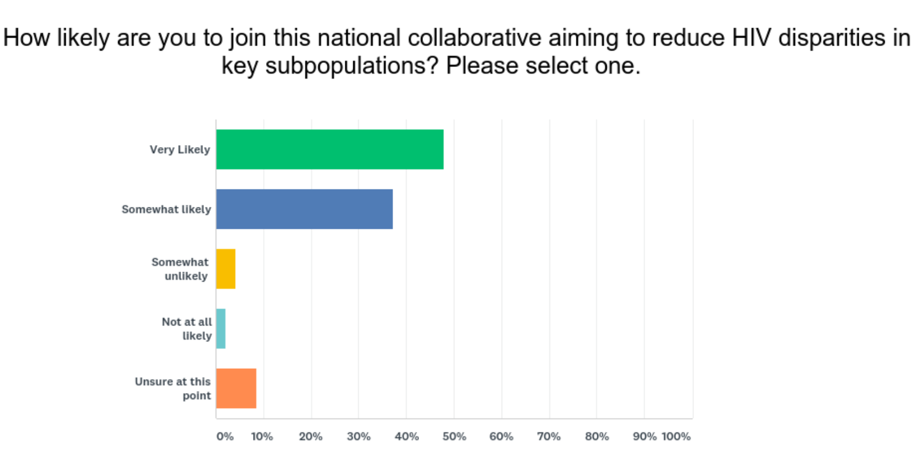
CQII Online Survey – Nov 2017
259 individual responses
[as of December 4, 2017]
97% of respondents stated that the focus of the Collaborative is in line with priorities of HIV providers (n=256)
85% of respondents reported that they were “Very Likely” (48%) or “Somewhat Likely” (37%) to join the initiative (n=163)
Online Needs Assessment Report, December 4, 2017

Slide 28
Disparities affect us all.
Health equity benefits everyone.

Slide 29
Collaborative Overview

Slide 30
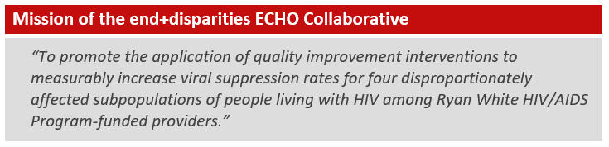
Mission

Slide 31
Big Picture
The end+disparities ECHO Collaborative promotes the application of quality improvement interventions to measurably increase viral suppression rates for four disproportionately affected subpopulations of people living with HIV among Ryan White HIV/AIDS Program recipients and subrecipients
The 18-month Collaborative (starting June 2018) combines the IHI Breakthrough Series model with elements of virtual case presentations and discussions developed by the Project ECHO at the University of New Mexico

Slide 32
Collaborative Overview
Each Collaborative participant is asked to focus their improvement efforts on one identified subpopulation
Participants join virtual special interest groups based on shared interests, such as subpopulations (Affinity ECHO Session)
Recipients and subrecipients partner with other local HIV providers to form regionally-based improvement groups (Regional Group)
Learning sessions with all participants are held every four months, starting Jun 2018 and ending Sep 2019
A faculty of experts is available for assistance
Key resources and tools are shared to maximize local use, i.e., disparities calculator, intervention grid

Slide 33
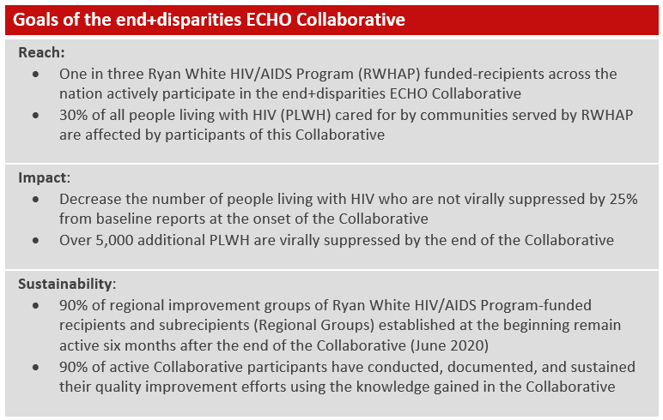
Collaborative Goals

Slide 34
Pre-Work Expectations for Participants
Join other regional HIV providers to form a local improvement group (Regional Group)
Select one subpopulation to focus your improvement efforts on, using the provided Disparity Calculator
Create an agency-specific aim statement with measurable improvement goals related to reducing disparities for their selected subpopulation
Completion of all pre-work assignments (submission of key agency QI contacts, information on current data system(s), technology assessment, patient caseload information, etc.)

Slide 35
Collaborative Expectations for Participants
Attend the monthly meetings with other providers in your Regional Group
Attend of Affinity ECHO Session twice a month with other participants focusing on same subpopulation
Present at least one case study during these Affinity ECHO Session using the provided template
Participation in the Collaborative-wide Learning Sessions
Routine submission of viral suppression performance data every other month
Routine submission of QI intervention updates quarterly

Slide 36

Benefits of Participation
Improve viral suppression rates, not only for your selected subpopulation but for your entire HIV caseload
Strengthen clinical quality management capacity to meet RWHAP expectations
Foster partnerships with other RWHAP recipients and subrecipients locally and across the country
Increase the quality improvement capacity of HIV providers and consumers
Routine access to feedback by nationally recognized quality experts to advance local improvement efforts
Enhance learning opportunities for networking with fellow participants with similar challenges

Slide 37
Collaborative Framework

Slide 38
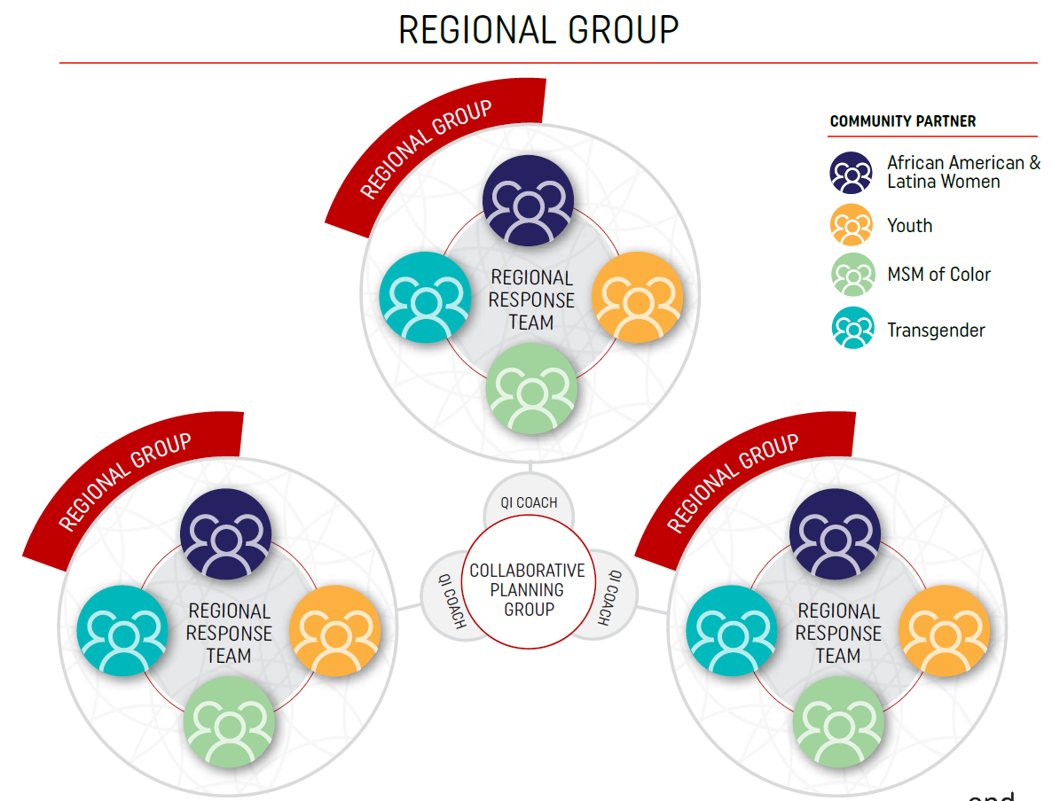
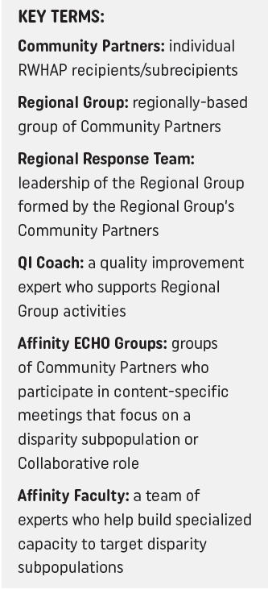

Slide 39
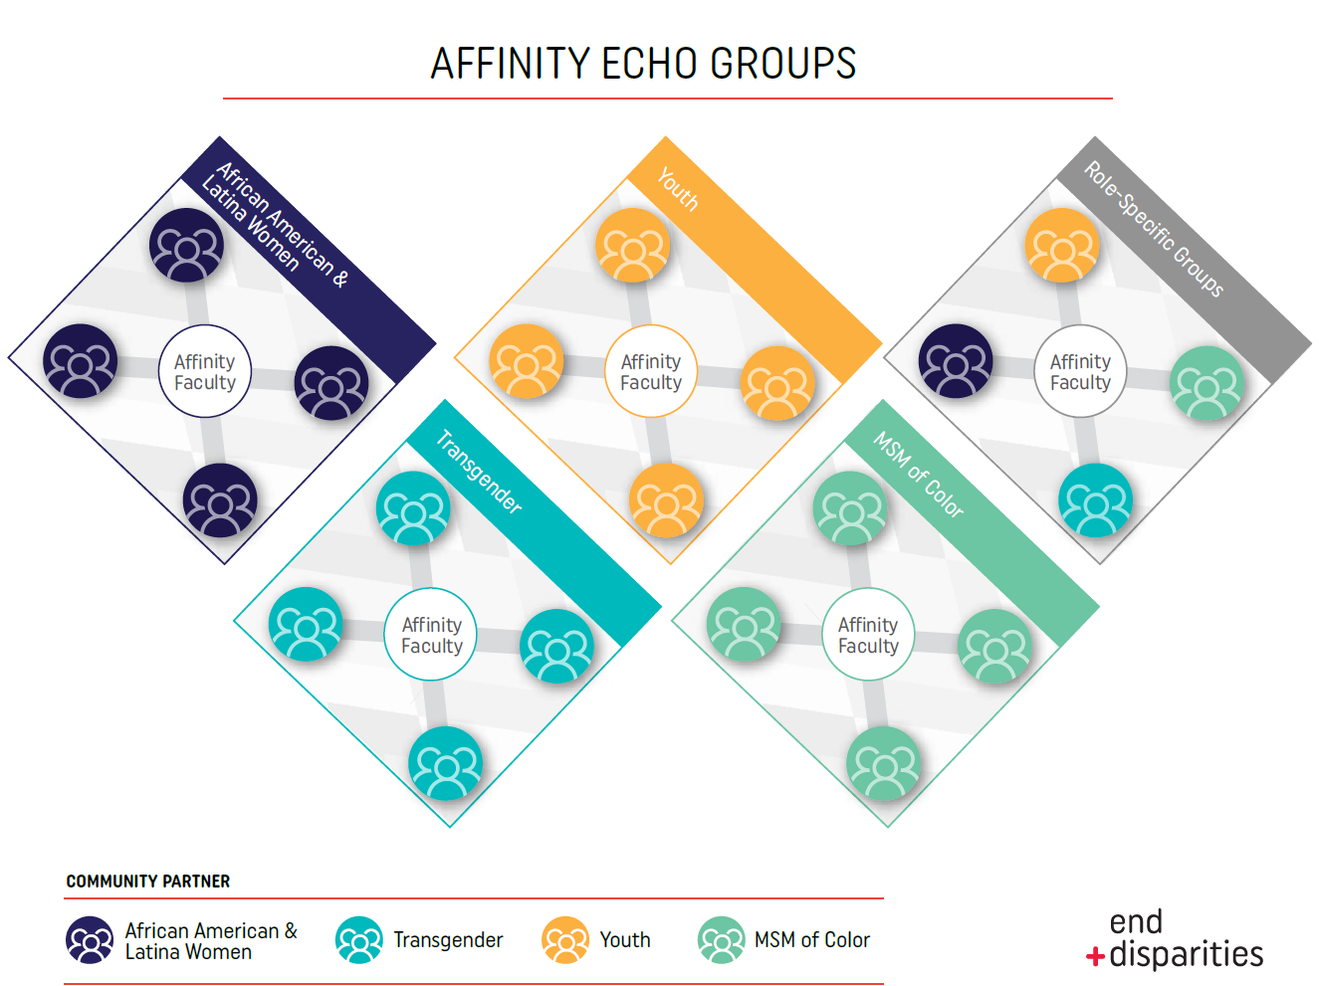

Slide 40
Spokespersons
Individuals living with HIV who represent a subpopulation of focus for this Collaborative and actively participates in the Planning Group and Affinity Group Faculty
Two to three spokespersons will be identified for each disparity subpopulation
Spokespersons have the important role of bringing the consumer voice into the discussion as well as providing a client perspective for providers during the Affinity ECHO Sessions

Slide 41
Reporting Elements

Slide 42
Performance Measurement Overview
Submission of viral suppression data every other month throughout the Collaborative
Data points for viral suppression measure include
  Numerator and Denominator for entire HIV caseload
  Numerator and Denominator for identified subpopulation
Adoption of HAB Viral Suppression Measure definition (National Quality Forum #: 2082)
The submission will be done online using our reporting database

Slide 43
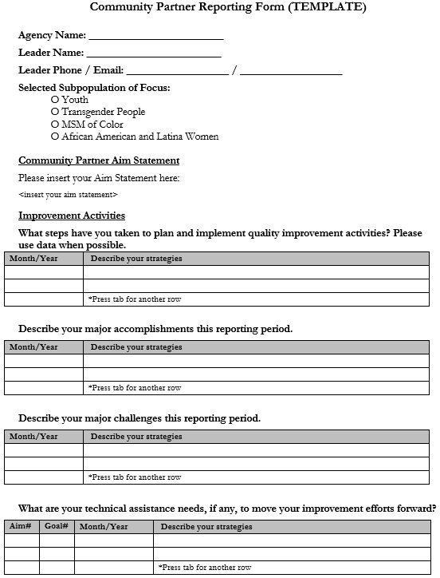
QI Interventions
All participants are asked to report their improvement interventions on a quarterly basis, starting Sep 2018
A reporting template is provided to chronicle the individual improvement journeys; only activities/findings related to that reporting period are reported
Submitters are encouraged to share the information within their organizations and or educating the community

Slide 44
Enrollment and Registration Process

Slide 45
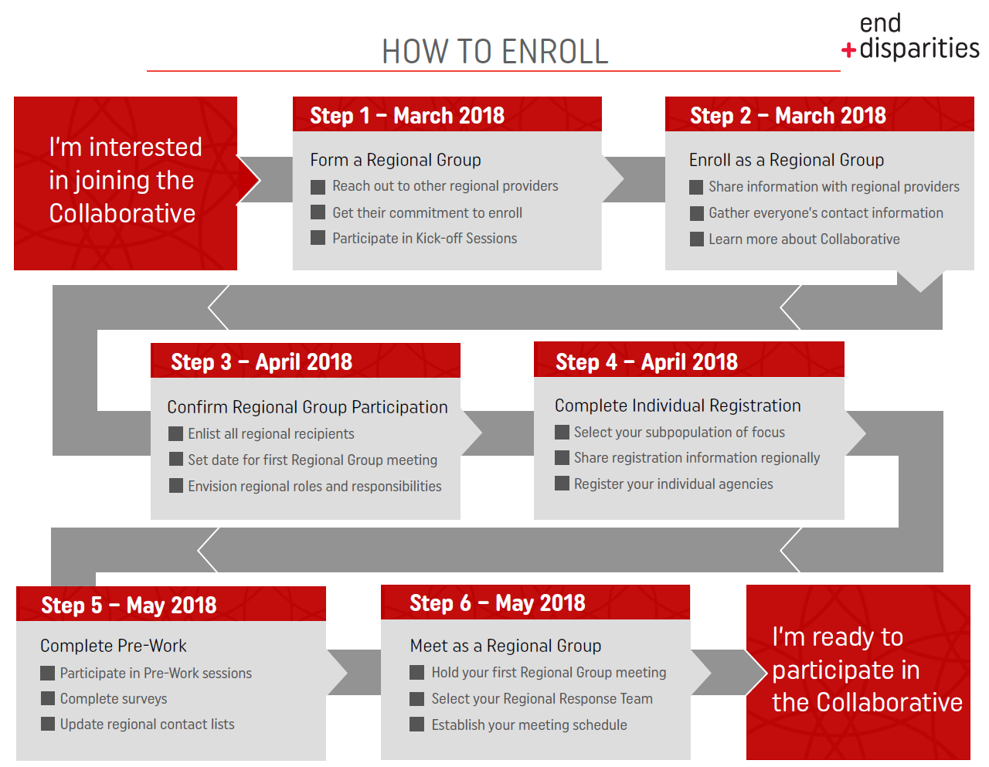

Slide 46
Tools and Resources

Slide 47
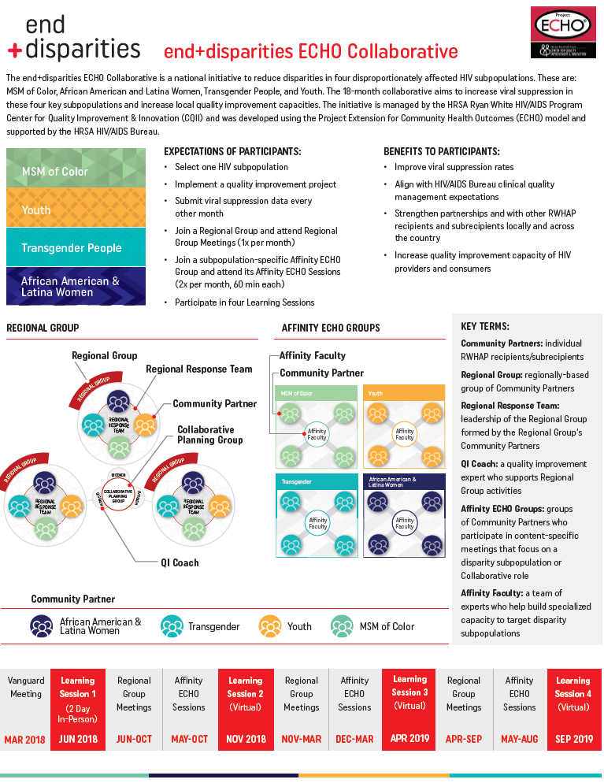
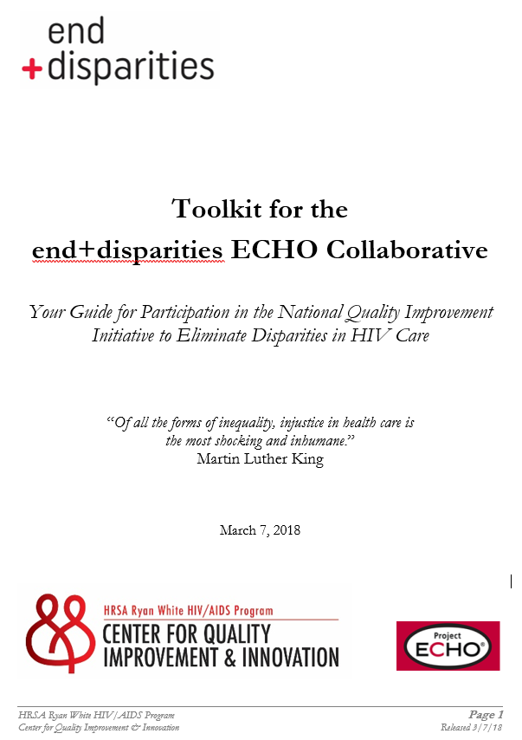
To access the Collaborative Flyer | end+disparities ECHO Collaborative tools
Notes:
47

Slide 48
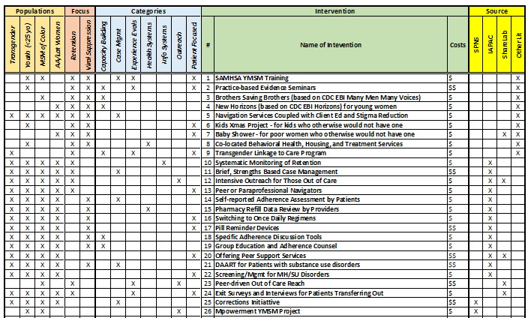
Intervention Grid
The Intervention Grid outlines evidence-based interventions that have been implemented to address disparities in HIV care

Slide 49
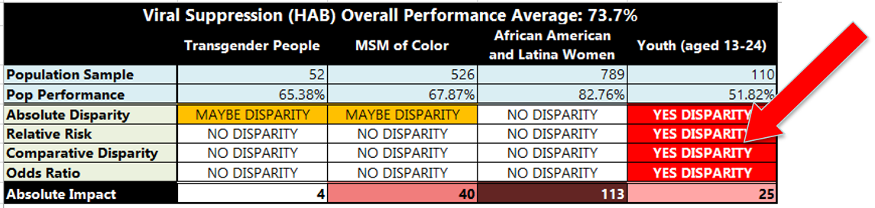
Disparities Calculator
The Calculator automatically calculates HIV performance data and highlights the presence and severity of disparities
Viral Suppression

Slide 50

Mobile App for Collaborative
  Allows participants to communicate directly with other participants
  Learn more about the Collaborative and access documents
  See upcoming events and access directly thru the phone
  Push notifications to alert participants of any changes or send reminders

Slide 51

end+disparities Video
Notes:
51

Slide 52
Timeline and Next Steps

Slide 53
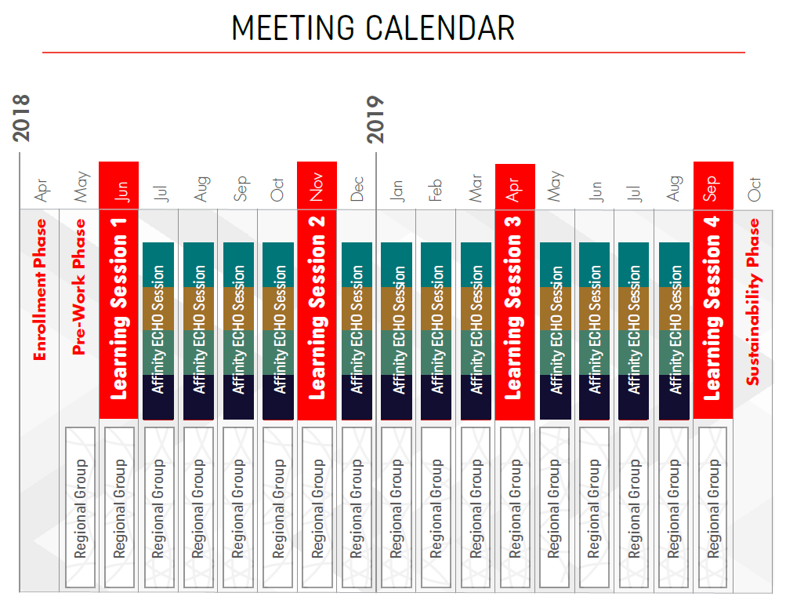

Slide 54
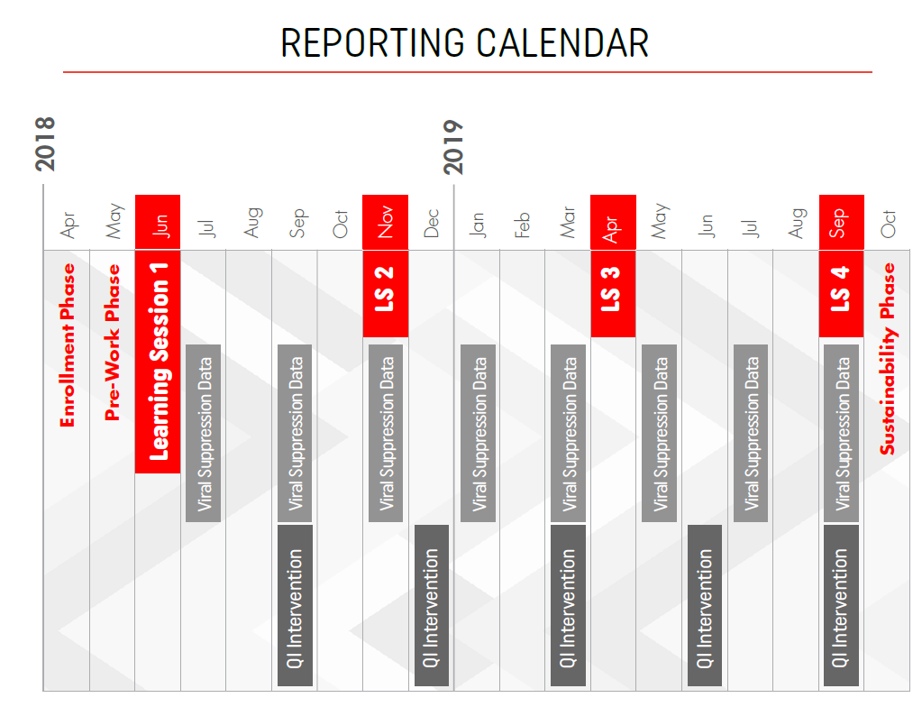

Slide 55
Next Steps
Sign-up - Group Enrollment Deadline: Apr 2018
Register - Individual Agency Registration Deadline: May 2018
Get Ready - Participate in introductory webinars, see announcements
Meet Locally – Conduct your first Regional Group meeting: prior to Jun 2018
Join the Community of Learners - Learning Session 1: Jun 2018
Learn From Each Other – Attend the first Affinity ECHO Sessions: Jul 2018
To Enroll as a Group| https://www.surveymonkey.com/r/groupenrollment

Slide 56
Ending disparities will end the HIV epidemic.

Slide 57
Special Thanks to…
HAB: Chep Maritim, Marlene Matosky, Dr. Laura Cheever, Heather Hauck
CQII: Johanne Morne, Aniqa Hassan, Zoe Osborne, Kehmisha Reid, Kevin Garrett, Taina Sampeur
Our Consultants: Lori DeLorenzo, Jane Caruso, Nanette Brey-Magnani
Spokespersons
University of New Mexico – ECHO Institute: Bruce Struminger, Tracy Smith, Michelle Iandiorio, Elizabeth Clewett
University of Washington: Brian Wood
Impact: Sarah Cook-Raymond, Darrell Walker

Slide 58
Q&A Session

Slide 59


Learn More:
212-417-4730 (phone)
212-417-4684 (fax)
Info@CQII.org

