Slide 1
Strategic Planning in an Era of Change
Bill Tiedemann, MSW
Executive Director

Slide 2
Objectives
Participants will gain an understanding of…
The history of AIDS Service Organizations (ASOs) and how to use our history to make sense of our world. All of this change is not new!!
The components of a comprehensive strategic planning process.
The emerging business models ASOs are now embracing.
A year in review including successes and lessons learned from an organization in transition.

Slide 3
Six Crises of ASOs Our History
Services (Palliative Care) vs. Advocacy (1981)
Volunteer run
Professionalizing the work force (1987)
Emergence of Ryan White Funding (1990)
Splintering/Separatist movement
HAART (1996-97)
ACA/NHAS (2010)
Post implementation (2013)
Hybrid- Medical, Social Service, and Public Health

Slide 4
Current Trends and Struggles
Uncertain federal funding
Shrinking public support
Foundation support shrinking and/or shifting to other social concerns
AIDS funding competing with Marriage for All
Relevance
Changing health care environment
HIV Prognosis: Now a 50-year plan although with complications (15-20% reduction in life expectancy)

Slide 5
Reasons for Strategic Planning in Passion-Driven Organizations
The obvious… Ending HIV
Understand the needs of the community. So the board and staff can develop a clear direction with goals. Remember why we are here!
Assess internal strengths and limitations. Knowing these will allow us as leaders to expand programs areas and focus on what makes us great, including what we need to improve on.
Create a road map for change. Your organization can not stagnate at this time. If you achieve your plan, congrats, restate or refresh it until you work yourself out of a job.

Slide 6
Reasons Not…
Too busy
The environment is moving too fast
Not enough resources
We are in crisis
Too small
We are not a expansion state
Ryan White will be here for many more years
No money to do a extensive strategic plan
**These are all reasons to do a strategic plan.

Slide 7
What Is and What Is Not a Strategic Plan
Simply put, a strategic plan is the formalized road map that describes how your company executes the chosen strategy. A plan spells out where an organization is going over the next year or more and how it’s going to get there. Typically, the plan is organization-wide or focused on a major function, such as a division or a department.

Slide 8
What Is and What Is Not a Strategic Plan
A strategic plan is a management tool that serves the purpose of helping an organization do a better job, because a plan focuses the energy, resources, and time of everyone in the organization in the same direction.
A strategic plan also:
Helps build your competitive advantage
Communicates your strategy to staff
Prioritizes your financial needs
Provides focus and direction to move from plan to action

Slide 9
What Is and What Is Not a Strategic Plan
If you’re thinking, “Hey, I’ve got this great book on business plans, so I’ll just use that to form my strategic plan,” be aware that strategic plans and business plans aren’t the same concepts.
A business plan, on the other hand, is a planning tool for new businesses, projects, or entrepreneurs who are serious about starting a business. Business planning:
Helps define the purpose of your business
Helps plan human resources and operational needs
Is critical if you’re seeking funding
Assesses business opportunities
Provides structure to ideas

Slide 10
Who We Are…
31 Years Young
$4.9 Million Revenue
85% Grant Funded
62 FTEs
Served over 39,000 Minnesotans at risk for, impacted by, and infected with HIV in 2013

Slide 11
Mission:
To lead Minnesota’s fight to end HIV through prevention, advocacy, awareness, and services.
Vision:
A Minnesota where new HIV infections are eliminated and individuals with HIV live long and healthy lives.

Slide 12
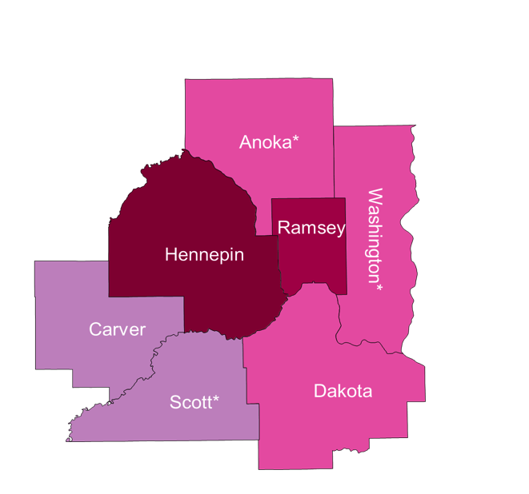
Service Area
7 Counties Plus Duluth
Number Living with HIV/AIDS
None
1-20
21-100
101-500
501-1000
1000-2000
2001-4190
City of Minneapolis – 2,943
City of St. Paul – 1,025
Suburban# – 2,393
Total number (Metro only) = 6,361
* Counties in which a state correctional facility is located.
# 7-county metro area, excluding the cities of Minneapolis and St. Paul
Notes:
Data Source: Minnesota HIV/AIDS Surveillance System HIV/AIDS in Minnesota: Annual Review
Statewide: 15% greater MN; 39% Minneapolis; 14% St. Paul; 32% suburban. Suburban = Seven-county metro area including Anoka, Carver, Dakota, Hennepin (except Minneapolis), Ramsey (except St. Paul), Scott, and Washington counties. Greater MN = All other Minnesota counties, outside the seven-county metro area.

Slide 13
Program Pillars
Prevention
Advocacy
Local, State, and National Issues
Positive Leaders Program
HIV/AIDS Action Network
Awareness
50/5 Hotline
Community Capacity-Building Services
Services
Prevention for Positives
Outreach to at-risk populations of all races, sexual orientation and ethnicities
Testing and Linkage to Care Services
Syringe Services
Case Management and Medical Transportation
Temporary Housing, Emergency Financial Services
Benefits Counseling, Legal Services, Behavioral Health Services

Slide 14
Threats:
ACA-Uncertain and Fast changing environment
Prevention funding decreasing
Shrinking public/private support
Opportunities:
ACA-Increase numbers of insured
Receptive Health Department and Governor’s office to increase state funding support
Involved and interested public policy constituent base
Environment
Strengths:
Comprehensive Strategic Plan
Entrepreneurial Board and Senior Staff
Reputation
Passionate and committed staff
Weaknesses:
Brand recognition
Relevance in the community
Decreasing revenue from sole event (AIDS WALK)

Slide 15
The Process
RFP construction and release
Proposal review and contract negotiation
Create Design Team (critical decision point, Board/Staff participation, bottom-up/top-down)
State of the Sector Assessment—National/Regional/Local
First Design Team Meeting—Identify DT charge, leadership, create timeline, agenda for first retreat, final expectations of team and consultant, charge staff with creating strategic scenarios to be tested. …oh MAP you could…, create communication plan for staff. Phase 1 begins

Slide 16
The Process
First Retreat: (Four hours with staff, board, key stakeholders)
Both large and small group work lead by consultant
Review Sector Assessment (outsource)
Review staff-created strategic scenarios and messages, charge small groups to refine a strategic scenarios
Prepare strategic scenarios for interviews/focus groups with key informants, funders, and partners
Review Mission/Vision/Values to determine further refinement
Post-meeting debrief with Design Team (2nd of 4)
Create time line and delegation of duties for Phase 2 interviews/focus groups

Slide 17
The Process
Complete Phase 2 interviews/focus groups—2 months
Design Team meeting #3—Review outcomes of interviews/focus groups. Create agenda for Retreat #2
Retreat #2:
Review data
Refine scenarios (share)
Discuss how scenarios move into goals
Next steps for approval: board vote
Finalize products and roll out (phased approach)

Slide 18
The Process
Create Products (consultant and senior staff)
Strategic Plan
Prepare document for approval by board of directors
Begin to prepare work plan for staff and E.D. monitoring
Dashboard for Board Monitoring (2X2)
Public Strategic Plan Document
“Roll out” Communications Plan—internal and external
Revisit communication plan for staff engagement

Slide 19
GOAL 1 GOAL 2 GOAL 3 GOAL 4 GOAL 5 The Minnesota AIDS Project will shift from being solely social service focus to a hybrid to include public health
Mission
Vision
Core Values
Strategic Activities
Strategic Activities
Strategic Activities
Strategic Activities
Strategic Activities

Slide 20
5-6 Business models emerged- Utilizing core competencies of an ASO as the focus.
HIV Specific Primary Care and Pharmacy Services
LGBTQ +HIV Primary Care and Pharmacy Services
Chronic Disease Model – Expansion beyond HIV
Single entity – Marketing Agency Core Competencies and contracting with Health Care Organizations to meet outcomes to reduce high cost care and sharing in cost savings.
Community Collaborative Model- Marketing Sector Core Competencies and contracting with Health Care Organizations to meet outcomes to reduce high cost care and sharing in cost savings.
Hybrid- Pharmacies Services only plus marketing sector or single entity core competencies and contracting with Health Care Organizations to meet outcomes to reduce high cost care and sharing in cost savings.

Slide 21
Launched September 2013

Slide 22
One Year Out!
Successful Launch—30th Anniversary
Implemented Mental Health Services
Expanded TEACH and Legal Services
Pharmacy Services
Implemented Women’s Services

Slide 23
Lessons Learned
Take the temp of your staff—regularly
Communication is key
Decision memos critical
Pace

