Slide 1



Literature Review Findings: Social Determinants of Health in HIV Care
Last Updated: Oct 17, 2020

Slide 2
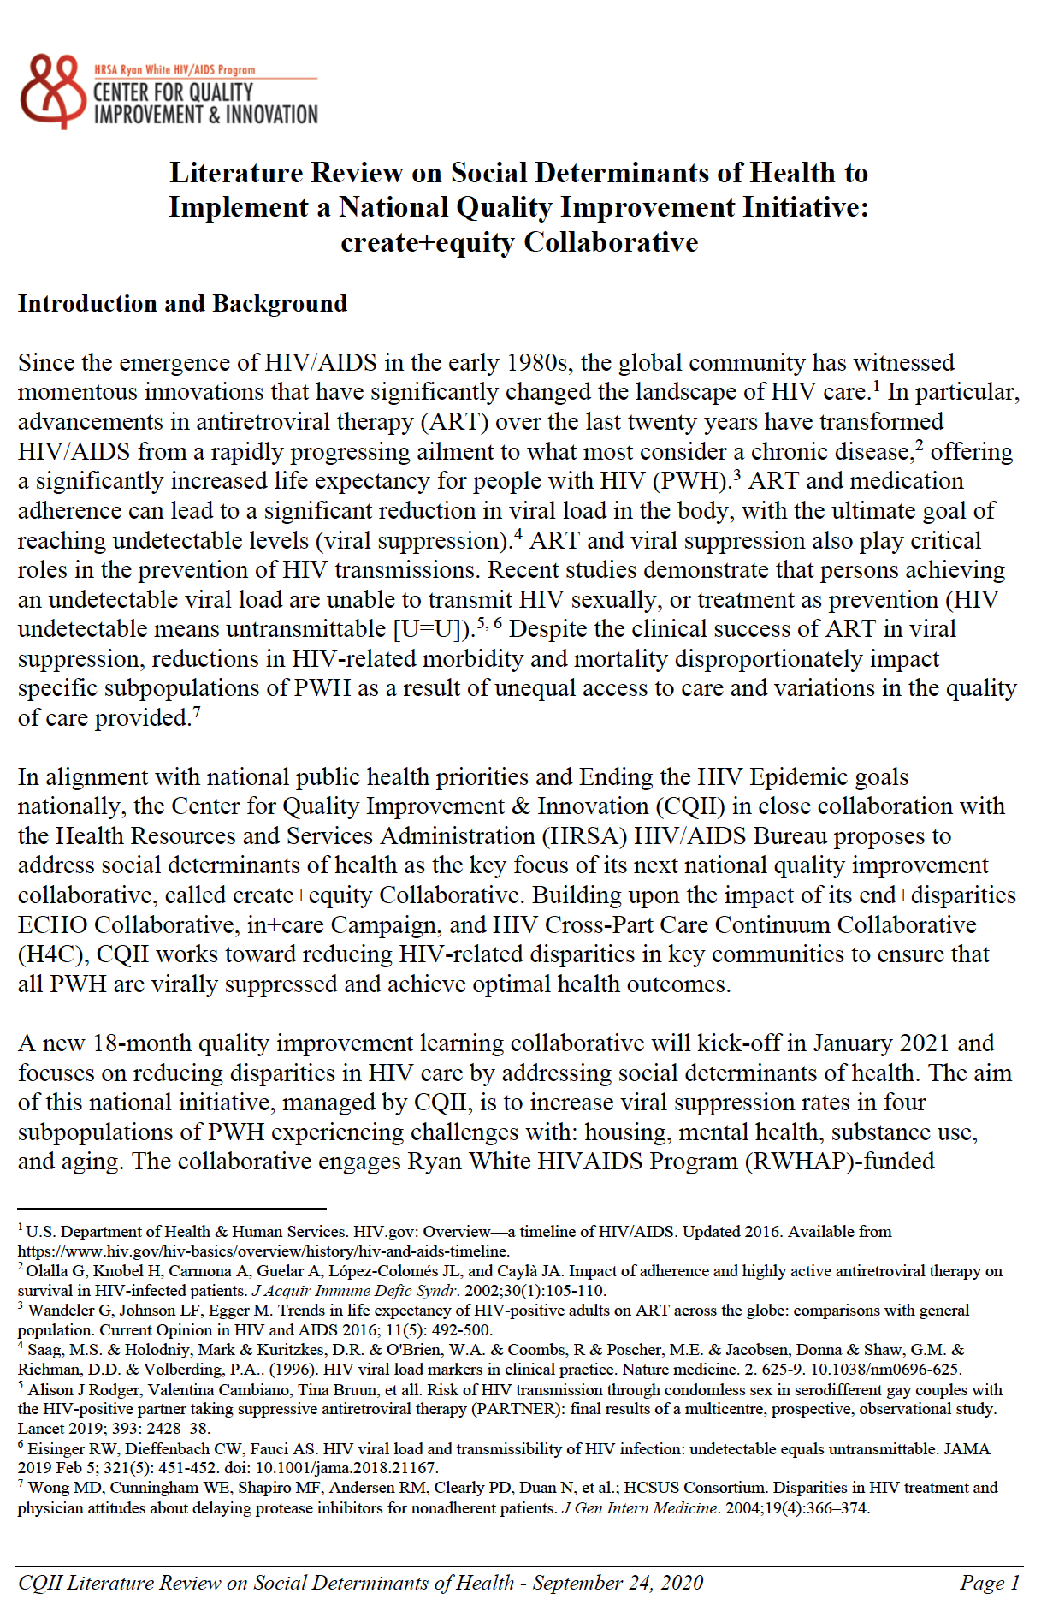


Literature Review
A detailed Literature Review has been developed to make a case about the importance of addressing social determinants of health to end the HIV epidemic in the United States
A corresponding PowerPoint slide set with information related to the four priority areas of the Collaborative is available
Literature Review
Link
Notes:
A thorough and detailed Literature Review has been comprised to highlight the need to focus on the social determinates of health, but more specifically on housing, mental health, substance use, and age across the lifespan.
The full Literature Review and accompanying slides can be found on our site CQII.org.

Slide 3
Introduction

Slide 4

create+equity Video
Notes:
You might be familiar with the end disparities video we developed in 2019.
Another informational tool that we have developed is a short animated video about social determinants of health in HIV care and outcomes. Please take a look and feel free to share with others. The video can be access at CQII.org.
Demonstrate the video.
4

Slide 5

“Of all the forms of inequality, injustice in health care is the most shocking and inhumane.”
- Martin Luther King
CDC MMWR Supplement / Vol. 62 / No. 3 November 22, 2013: CDC Health Disparities and Inequalities Report — United States, 2013

Slide 6

“I diagnosed ‘abdominal pain’ when the real problem was hunger.
I mislabeled the hopelessness of long-term unemployment as depression.
I misdiagnosed poverty that causes patients to miss pills or appointments as noncompliance.
I mistook the inability of one older patient to read for dementia.”
- Dr. Laura Gottlieb, Professor and Author
Notes:
Dr.Laura Gottlieb, MD, MPH, is a Professor of Family and Community Medicine at UCSF. A former National Health Services Scholar and safety-net family physician with fellowship training in social determinants of health, Dr. Gottlieb now serves as Principal Investigator on multiple quantitative and qualitative projects examining the integration of social and medical care services.
Dr. Laura Gottlieb will be the keynote speaker of our first Learning Session.

Slide 7
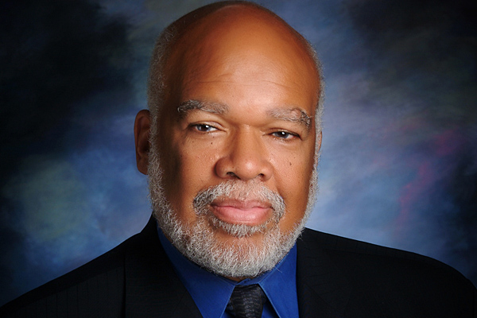
“Achieving health equity requires valuing all individuals and populations equally, and entails focused and ongoing societal efforts to address avoidable inequalities by assuring the conditions for optimal health for all groups, particularly those who have experiences historical or contemporary injustices or socioeconomic disadvantage.”
- Dr. Adewale Troutman, President of the American Public Health Association
Notes:
Adewale Troutman, M.D., M.P.H., M.A., president of the American Public Health Association (APHA), is the nation’s leading authority on public health and the voice of APHA, the oldest and most diverse organization of public health professionals in the world.
Widely considered a Public Health Hero and Icon, Dr.Troutman has an accomplished career in public health and leadership, and his numerous achievements established policies and initiatives for better health and health equity.
https://www.researchamerica.org/advocacy-action/public-health-thank-you-day/public-health-heroes/public-health-hero-adewale-troutman

Slide 8

What is a Social Determinant of Health?
“Social determinants of health are conditions in the places where people live, learn, work, and play that affect a wide range of health and quality-of-life-risks and outcomes.”
– Centers for Disease Control (CDC)
https://www.cdc.gov/socialdeterminants/index.htm

Slide 9
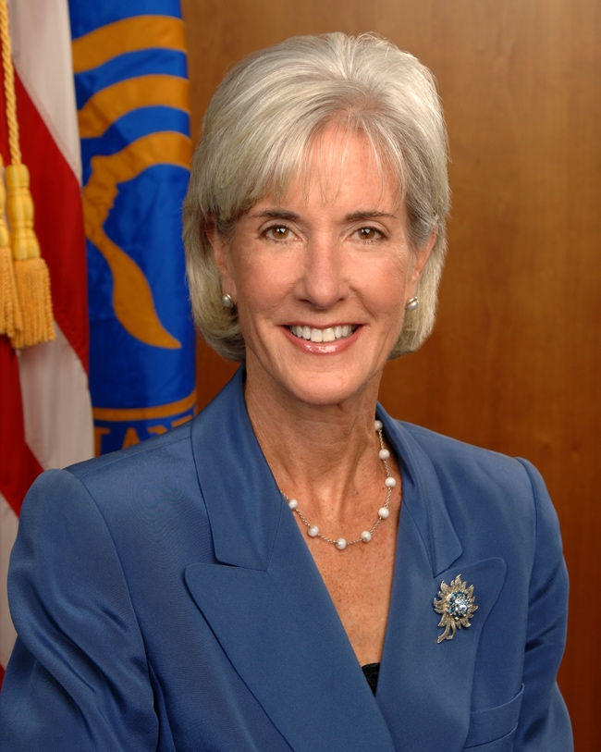
“It is time to refocus, reinforce, and repeat the message that health disparities exist and that health equity benefits everyone.”
- Former U.S. Secretary of Health and Human Services Kathleen Sebelius

Slide 10

“Health inequalities and social determinants of health are not a footnote to the determinants of health. They are the main issue.”
- World Health Organization (WHO) Chair of the
Commission on Social Determinants of Health,
Sir Michael Marmot

Slide 11
Did You Know?
People with unstable housing have a 16% lower viral suppression rate compared to those with stable housing
People with mental illness have a lower viral suppression rate, on average by 8.5%
People who inject drugs make up of 1 in 10 new HIV diagnoses
People ages 13 to 24 make up 21% of new HIV diagnoses, while people ages 50 and older make up 17% of new HIV diagnoses in the United States
Health Resources and Services Administration. Ryan White HIV/AIDS Program Annual Client-Level Data Report 2018. http://hab.hrsa.gov/data/data-reports
https://www.cdc.gov/hiv/group/age/olderamericans/index.html
https://www.cdc.gov/hiv/group/hiv-idu.html
https://www.cdc.gov/hiv/group/age/youth/index.html

Slide 12
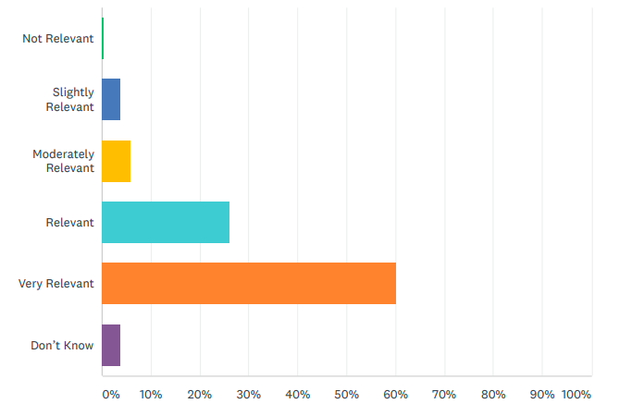
2019 CQII Online Survey (n=241)
How do you assess the relevance of the following topic for your future quality improvement work: Social Determinants of Health?
86% viewed the topic of social determinants of health as relevant/very relevant
96% were interested/very interested in creating QI projects that address social determinants of health
94% indicated that they would participate in a social determinants of health collaborative
Retrieved from 2019 CQII National QI Survey and Results
Notes:
The 2019 CQII National QI Survey and Results clearly demonstrates the majority of agencies hold a strong interest in being apart of a collaborative focused on social determinants of health in HIV care and want to join a national QI initiative.

Slide 13
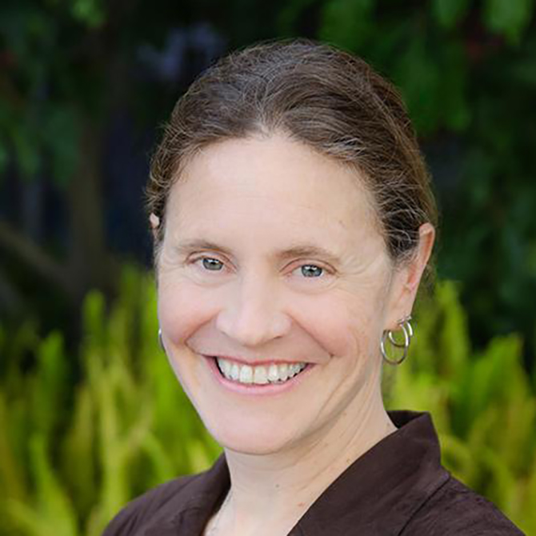
“My medical training had not prepared me for this ambush of social circumstance. I had neither the skills nor the resources for treating them, I ignored the social context of disease altogether.”
- Dr. Laura Gottlieb
Notes:
Dr.Laura Gottlieb, MD, MPH, is a Professor of Family and Community Medicine at UCSF. A former National Health Services Scholar and safety-net family physician with fellowship training in social determinants of health, Dr. Gottlieb now serves as Principal Investigator on multiple quantitative and qualitative projects examining the integration of social and medical care services.
Dr. Laura Gottlieb will be the keynote speaker of our first Learning Session.

Slide 14

“The welfare of each is bound up in the welfare of all.”
- Helen Keller
Notes:
Helen Adams Keller was a famous American author, political activist, and lecturer. She was the first deaf-blind person to earn a Bachelor of Arts degree.

Slide 15
Creating equity will end the HIV epidemic.

Slide 16
Literature Review by Affinity Group

Slide 17
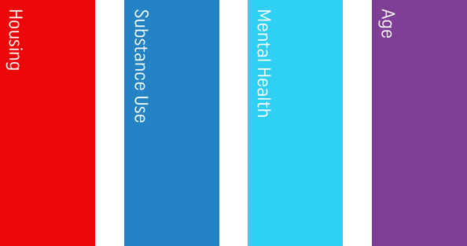




Affinity Groups
housing
mental health
substance use
Notes:
The four affinity groups were chosen because of a demonstrated need.
We understand the overlapping nature of these groups. We also recognize that there are more barriers facing people with HIV that are not covered by this Collaborative. However, we can start with these groups.

Slide 18


Disparities in Housing
“ It is hard to argue that housing is not a fundamental human need. Decent, affordable housing should be a basic right for everybody in this country. The reason is simple: without stable shelter, everything falls apart.”
- Matthew Desmond, Sociologist and Author at Princeton University

Slide 19

What is the difference in viral suppression rate for those who are unstably housed compared to those who are stably housed?
~5% less
~20% less
~16% less
Health Resources and Services Administration. Ryan White HIV/AIDS Program Annual Client-Level Data Report 2018. http://hab.hrsa.gov/data/data-reports. Published December 2019. Accessed June 2020
Notes:
Answer: C, ~16% less

Slide 20
In 2018, how many RWHAP clients faced temporary or unstable housing?
~ under 25,000
~ 50,000
~ 65,000
Health Resources and Services Administration. Ryan White HIV/AIDS Program Annual Client-Level Data Report 2018. http://hab.hrsa.gov/data/data-reports. Published December 2019. Accessed June 2020
Notes:
Answer: C, ~ 65,000

Slide 21
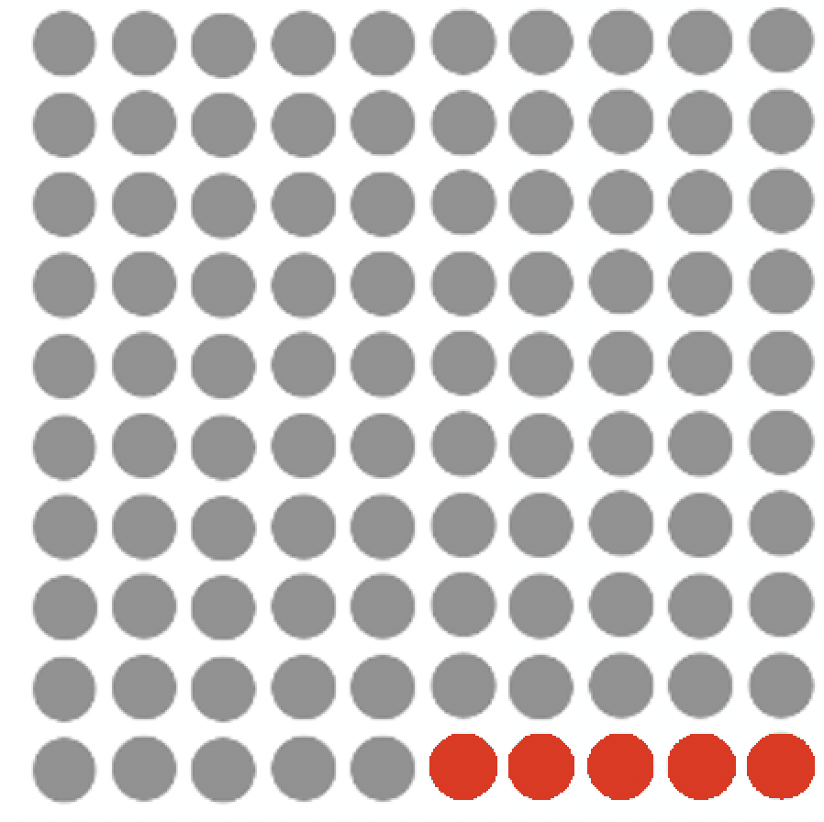

Disparities in Housing
5.3% of RWHAP clients are unstably housed
7.7% of RWHAP clients are temporarily housed
Of the 501,000 RWHAP clients, 65,000 (13%) are unstably housed (26,815) and temporarily housed (38,436).
Unstably Housed
Temporarily Housed
Health Resources and Services Administration. Ryan White HIV/AIDS Program Annual Client-Level Data Report 2018. http://hab.hrsa.gov/data/data-reports.
Notes:
Out of 501,000, approximately 65,251 Ryan White clients were unstably or temporarily housed in the year 2018.

Slide 22



Disparities in Housing
11.6% of stably housed clients have not reached viral suppression
19.3% of temporarily housed clients have not reached viral suppression
27.6% of unstably housed clients have not reached viral suppression
Not Virally Suppressed
Not Virally Suppressed
Not Virally Suppressed
Health Resources and Services Administration. Ryan White HIV/AIDS Program Annual Client-Level Data Report 2018. http://hab.hrsa.gov/data/data-reports.
Notes:
RWHAP clients who are temporarily or unstably housed have a significantly higher rate of not reaching viral suppression (an average of ~11.85% higher), compared to those who live in stable housing.
Unstably housed RWHAP clients have the highest rate at 27.6%, which is 8.3% higher than the rate for temporary housing

Slide 23
Viral Suppression and Retention in HIV Care by Housing Status
Those experiencing unstable housing face the lowest rates of retention in care (75% vs. 82%), as well as viral suppression (72% vs. 88%) rates, compared to those with stable housing.
Health Resources and Services Administration. Ryan White HIV/AIDS Program Annual Client-Level Data Report 2018. http://hab.hrsa.gov/data/data-reports.
Notes:
Its clear that a RWHAP client’s housing status affects their likelihood of being retained in care and virally suppressed.
Those experiencing stable housing face the highest rates in both RIC and viral suppression (82.1%, 88.4%).
The overall average RWHAP rate of viral suppression which is 87.1% (provided for comparison)

Slide 24
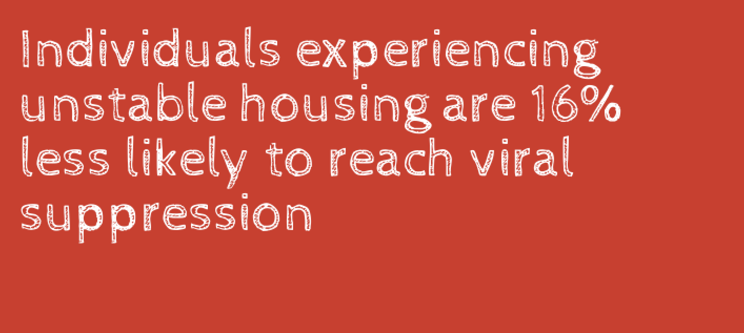
Disparities in Housing
Health Resources and Services Administration. Ryan White HIV/AIDS Program Annual Client-Level Data Report 2018. http://hab.hrsa.gov/data/data-reports.

Slide 25

“The essence of global health equity is the idea that something so precious as health might be viewed as right.”
- Dr.Paul Farmer
Notes:
Dr. Paul Farmer is an American medical anthropologist, a global health icon, and a physician

Slide 26


Disparities in Mental Health
“There is no health without mental health.”
- Former United States Surgeon General, Dr. David Satcher

Slide 27
People with HIV are how many times more likely to have depression compared to those who
do not have HIV?
Similar rate
Twice as likely
Ten times more likely
https://www.nimh.nih.gov/health/topics/hiv-aids/index.shtml#:~:text=If%20you%20are%20living%20with,These%20conditions%20may%20be%20treatable
Notes:
Answer: B, Twice as likely

Slide 28
What percent of people with mental illness are less likely to be prescribed antiretroviral therapy?
Prescribed at the same rate
5.5% less likely
2% less likely
Health Resources and Services Administration. Ryan White HIV/AIDS Program Annual Client-Level Data Report 2018. http://hab.hrsa.gov/data/data-reports. Published December 2019. Accessed June 2020
Notes:
Answer: B, 5.5% less likely

Slide 29
Health Outcomes of People with HIV and Mental Illness
The viral suppression rate for individuals living with mental diagnoses is 8.5% lower than those without a mental health diagnosis.
Health Resources and Services Administration. Ryan White HIV/AIDS Program Annual Client-Level Data Report 2018. http://hab.hrsa.gov/data/data-reports.
Notes:
A 2015 study at the University of Pennsylvania analyzed the health outcomes of PWH with mental illness and reported that individuals with mental illness were 5.5% less likely to be prescribed antiretroviral therapy, compared to those who do not have a mental health diagnosis. No significant difference was seen in retention in care.

Slide 30
Disparities in Mental Health
One in five people diagnosed with HIV in the U.S. live with depression
Two in nine people diagnosed with HIV in the U.S. live with anxiety
Health Resources and Services Administration. Ryan White HIV/AIDS Program Annual Client-Level Data Report 2018. http://hab.hrsa.gov/data/data-reports.
Notes:
18% of people diagnosed with HIV in the United States live with depression and 22% live with anxiety.
Exploring the association between increased chronicity of depression and its impact on affected HIV care continuum indicators a study concluded that if someone was affected with depression for a longer period of time, they were more likely to miss HIV primary care appointments, lack viral suppression, and have increased mortality rate.

Slide 31
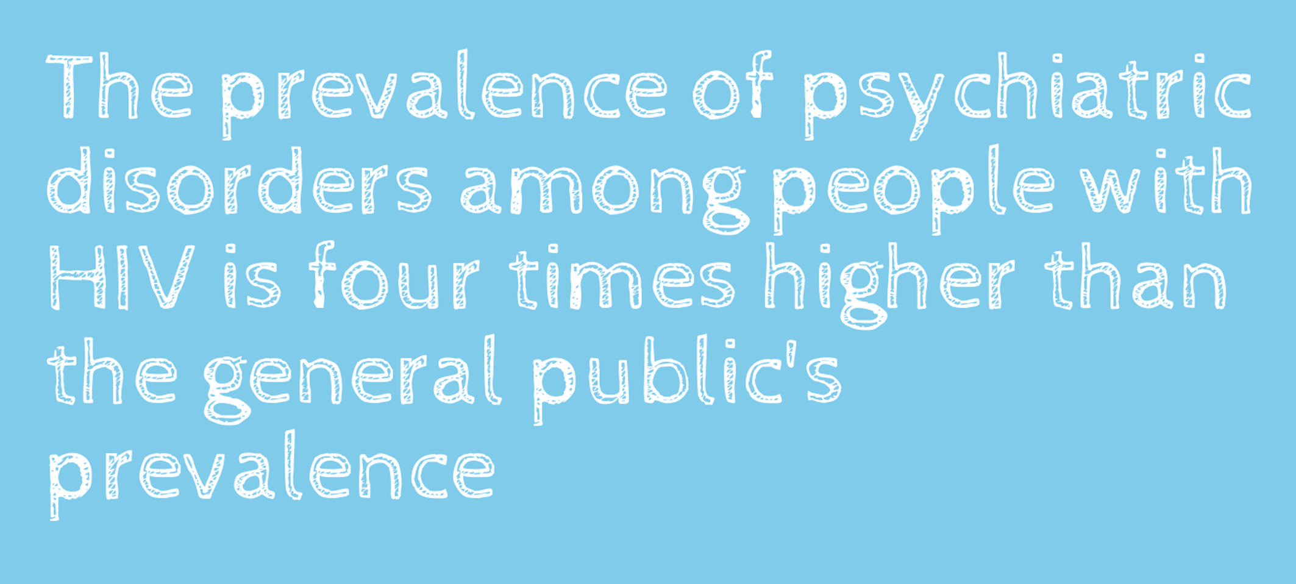
Disparities in Mental Health
Coviello DM, et al. Prevalence of HIV Viral Load Suppression Among Psychiatric Inpatients with Comorbid Substance Use Disorders. Community Ment Health J. 2018;54(8):1146-1153.

Slide 32


Disparities in Substance Use
“The mentality and behavior of people who use substances is wholly irrational until you understand that they are completely powerless over their addiction and unless they have structured help, they have no hope.”
- Russell Brand, Actor & Author

Slide 33
Out of 1.2 million Americans with HIV, how many individuals currently use drugs or binge drink alcohol?
1 in 3
1 in 50
1 in 10
https://archives.drugabuse.gov/trends-statistics/drug-alcohol-use-significant-risk-factor-hiv
Notes:
Answer: A, 1 in 3

Slide 34
What percent of all persons with HIV in the United States are in need of substance use treatment?
4%
24%
54%
https://archives.drugabuse.gov/trends-statistics/drug-alcohol-use-significant-risk-factor-hiv
Notes:
Answer: B, 24%

Slide 35
Disparities in Substance Use
42.8% of PWH who inject drugs are virally suppressed
60% of PWH who engage in binge drinking are virally suppressed
13% of PWH active cocaine users are virally suppressed
Suppressed
Suppressed
Suppressed
Unsuppressed
Unsuppressed
Unsuppressed
Karch DL. HIV Infection Care and Viral Suppression Among People Who Inject Drugs, 28 U.S. Jurisdictions, 2012-2013. Open AIDS J. 2016;10:127-135.
Notes:
The majority of PWH who inject drugs or are active cocaine users are not virally suppressed (57.2%; 87%). 40% of PWH who engage in binge drinking are not virally suppressed

Slide 36
Viral Suppression Rates among HIV Patients who Use Substances
The viral suppression rate of non-substance users is significantly higher, with an average rate of 18% more across all substances.
Yehia BR, et al. Health Outcomes of HIV-Infected People with Mental Illness. AIDS Behav. 2015;19(8):1491-1500
Notes:
Active cocaine use exhibits the lowest rates of viral suppression (13%), but on the other hand non-active cocaine use displays the highest rate of viral suppression in all three categories (46%).
Active heroin use has a viral suppression rate of 29% and Alcohol use 21%

Slide 37
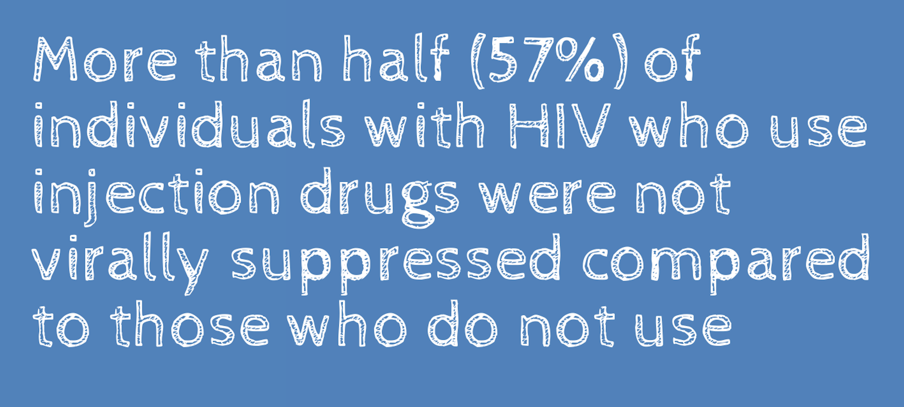
Disparities in Substance Use
Karch DL. HIV Infection Care and Viral Suppression Among People Who Inject Drugs, 28 U.S. Jurisdictions, 2012-2013. Open AIDS J. 2016;10:127-135.
Notes:
A meta-analysis of data reported by 28 U.S. jurisdictions discovered that, among 80,958 PWH who inject drugs, only 49.7% were retained in care and 42.8% had achieved viral suppression.

Slide 38


Disparities Across the Lifespan
“It’s not the years in your life that count. It’s the life in your years.”
- Abraham Lincoln

Slide 39
In the United States, how many individuals with HIV are 50 years and older?
1 in 6
1 in 3
1 in 2
  https://www.cdc.gov/hiv/group/age/olderamericans/index.html
Notes:
Answer: C, 1 in 2

Slide 40
In the United States, what percent of new HIV diagnoses occur in individuals ages 50 and older?
1 in 6
1 in 4
1 in 50
  https://www.cdc.gov/hiv/group/age/olderamericans/index.html
Notes:
Answer: A, 1 in 6

Slide 41
Of the new HIV diagnoses in the United States, what percent of new HIV diagnoses occur
in youth (ages 13-24)?
~21%
~42%
~17%
  https://www.cdc.gov/hiv/group/age/olderamericans/index.html
Notes:
Answer: A, ~21%

Slide 42
Disparities Across the Lifespan
Children & Youth
(24 and younger)
Adults
(ages 40-64)
Young Adults
(ages 25-39)
Older Adults
(65 and older)
Notes:
These are the four age groups used in the Collaborative to represent a spectrum of critical ages for PWH.
According to the 2018 Ryan White HIV/AIDS Program Service Report (RSR), approximately 4.1% of RWHAP clients with HIV fall under ‘Children and Youth’, 27.7% are ‘Young Adults’, 60.7% are ‘Adults’, and 7.5% are classified as ‘Older Adults’.

Slide 43
Disparities Across the Lifespan
The younger the individual, the less likely they are to be retained in care or virally suppressed
The older the individual, the more likely they are to be virally suppressed and face co-morbidities
Health Resources and Services Administration. Ryan White HIV/AIDS Program Annual Client-Level Data Report 2018. http://hab.hrsa.gov/data/data-reports.
Notes:
Overall, viral suppression has improved for RWHAP clients of all age groups, but young adults and children/youth face much lower levels of viral suppression in comparison to adults and older adults

Slide 44
Disparities Across the Lifespan
While the overall viral suppression rate is 87%, the rate for individuals under the age of 39 is 82% and for individuals above the age of 65 is 95%.
Health Resources and Services Administration. Ryan White HIV/AIDS Program Annual Client-Level Data Report 2018. http://hab.hrsa.gov/data/data-reports.
Notes:
Approximately, 83.5% of children/youth and 75.83% of young adults were successfully retained in care, compared to 83.1% of adults and 86.9% of older adults (2018). Older adults exhibited the best rates of retention in HIV care, maintaining 85.6% to 86.9% from 2014 to 2018. The RWHAP client age group with the lowest rate of retention continues to be young adults (76.17%, 75.83% respectively), while children/youth and adults remain stable around 83% (83.4%-83.5%, 82.52%-83.12%). Children and youth is the only age group where retention in HIV care has decreased over time.

Slide 45
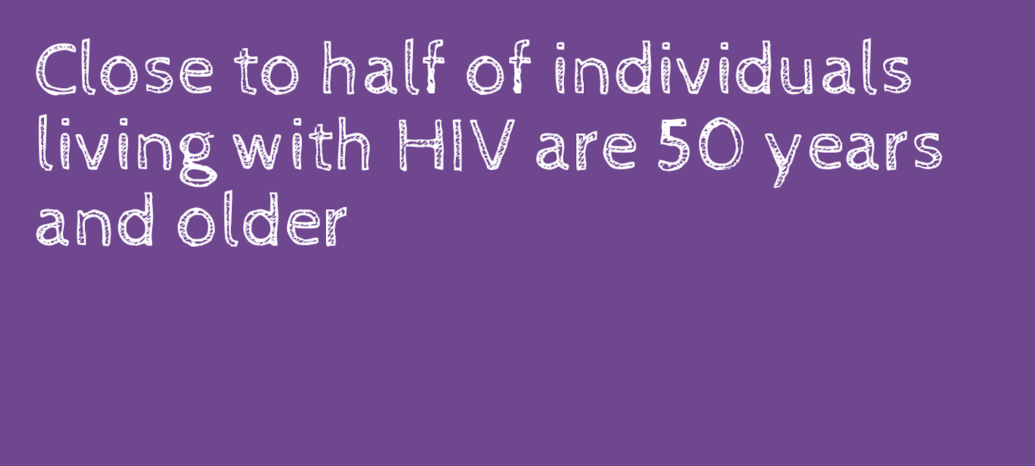
Disparities Across the Lifespan
Health Resources and Services Administration. Ryan White HIV/AIDS Program Annual Client-Level Data Report 2018. http://hab.hrsa.gov/data/data-reports.
Notes:
RSR Year 2018:
RWHAP clients with HIV who are 50 and older = 241,949
Total RWHAP clients with HIV= 518,703 (46%)

Slide 46
Health equity benefits everyone.
Notes:
Health equity benefits everyone
Kathleen Sebelius, who served as the 21st United States Secretary of Health and Human Services from 2009 until 2014.

Slide 47
create+equity Collaborative

Slide 48
create+equity Collaborative: Big Picture
Each Community Partner is asked to focus their improvement efforts on one population of focus: housing, substance use, mental health, or age across the lifespan
Community Partner join virtual special interest groups based on their population of focus twice a month (Affinity Group)
Learning Sessions with all Community Partners are held every five months, starting Feb 2021 and ending May 2022
Online reporting of population-specific measures (every 2 months) and QI intervention updates (every 3 months)
A faculty of experts and QI coaches are available for assistance
Key resources and tools are shared to maximize local use, i.e., driver diagrams, listing of evidence informed- interventions
Notes:
Community Partners will select one area of interest and will attend special interest groups based on population of focus twice a month.
In addition to these affinity group sessions, will also participate in learning session with all other Community Partners every 5 months.
It is expected that Community Partners utilize our online reporting site to report population specific measures and QI interventions.

Slide 49


Collaborative Tools
One-Page Flyer
Collaborative Toolkit
To access all Collaborative tools and resources | CQII.org
Notes:
For more information, please be sure to check out our website, which has information about upcoming events, contains an interactive page on interventions, and provides resources for you to use.
49

Slide 50
Next Steps
Apply to Participate: Application Deadline: Mon, Nov 30, 2020
Get Ready: Community Partners are selected, join introductory webinars, and connect with assigned QI Coach [Dec-Jan 2021]
Prepare for Learning Session 1: Participate in our first Learning Session [Feb 2021]
Learn From Each Other: Attend the first Affinity Sessions [Mar 2021] and start submitting your performance data [Mar 2021]
Apply Here
Submit your application for review by CQII
and the HIV/AIDS Bureau:
www.surveymonkey.com/r/collaborativeapplication
Notes:
Key Dates: Nov 30th is the deadline to apply to participate in our Collaborative
Community partners selected will conduct pre-work and join introductory webinars during Dec. and Jan.
First Learning Session: Feb 2021
First Affinity Session: Mar 2021
First Submission of Performance Data also in Mar. 2021

Slide 51

Contact Information
Clemens M. Steinböck, MBA
Director
New York State Department of Health
AIDS Institute
90 Church Street, 13th floor
New York, NY 10007-2919
212.417.4730
Clemens.Steinbock@health.ny.gov
This project is supported by the Health Resources and Services Administration (HRSA) of the U.S. Department of Health and Human Services (HHS) as part of an award totaling $1.5M. The contents are those of the author(s) and do not necessarily represent the official views of, nor an endorsement, by HRSA, HHS or the U.S. Government.
Notes:
Now we have some time to discuss your questions that have not yet been answered in the chat. We will attempt to answer these in the time remaining. However, after we formally close the meeting at the top of the hour, we invite anybody who can stay on the line to do so, as we will be available for this for the next 30 minutes to answer any remaining questions.
Let’s start with the questions already in the chat that have not yet been addressed? Please feel free to chat in additional questions.

