Slide 1



create+equity Collaborative:
Kick-Off Webinar
Mon, November 9, 2020
1:00 pm ET
Notes:
[Rotate slides 1-3]
Good day everyone. My name is […]. On behalf of the HRSA Ryan White HIV/AIDS Program Center for Quality Improvement & Innovation (CQII), we would like to welcome you to the kick-off session for the create+equity Collaborative.

Slide 2

Before we start…
Please type your name, organization, city and state in the chat room
Notes:
Before we start our webinar, I’d like to take a moment and ask our participants to introduce themselves via our chat room, which can be found on the right-hand side of your screen. There is a box labelled Chat.
When introducing yourself please enter your name, organization, city, and state so others can see who we have on the call today.
If you are still having trouble finding the Chat room, in a few slides we will go over Zoom instructions.

Slide 3
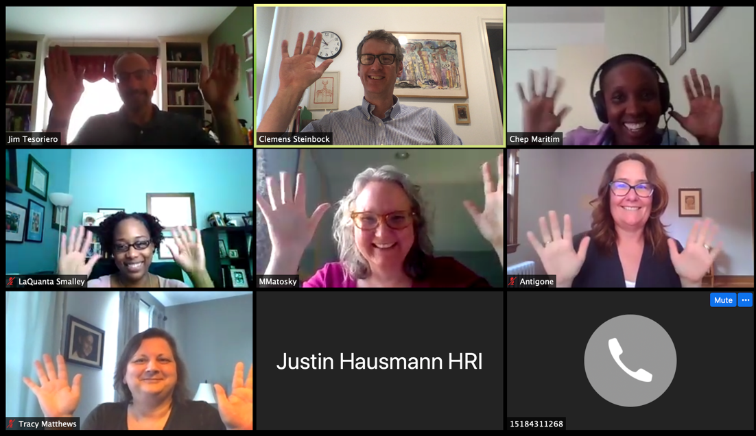
Picture Consent
You allow CQII to take pictures from our training events and post them on our websites, social media platforms, and other marketing materials for an undetermined period of time
You have the right to revoke your consent for pictures that are publicly posted
At no time, individual names will be used to identify you, unless you sign the appropriate release form
Notes:
Please note that CQII will take screenshots from our Zoom sessions and you allow us to use them on our websites and social media postings.
You individual names will NOT be used to identify you, unless you sign the appropriate release form.

Slide 4
Zoom Introduction

Slide 5
Zoom Functionalities
Notes:
Here are several functions of Zoom, the chat box can be found in the bottom center of your screen as shown here. And the mute button can be found in the bottom left corner of your screen.

Slide 6
Our Zoom Hand Gestures
Notes:
In order help facilitate our webinar and to create a participatory environment we at CQII like to use the some of these hand gestures while using zoom.
NOTE: Demonstrate one or two of the hand gestures

Slide 7


Good Practices for Zoom Participation
Include name and location on Zoom label
Keep video on and mute your line when needed
Use our hand signals
Use the chat room to ask for clarifications, post questions, or share your wisdom
Eliminate personal/private health information
Create a “brave space of learning” - don’t assume or be silent
We will record the Zoom sessions to allow others to learn
Please be reminded that we will record our session for later replay!
Notes:
Keep the following best practices in mind for todays webinar:
7

Slide 8
Opening Remarks

Slide 9
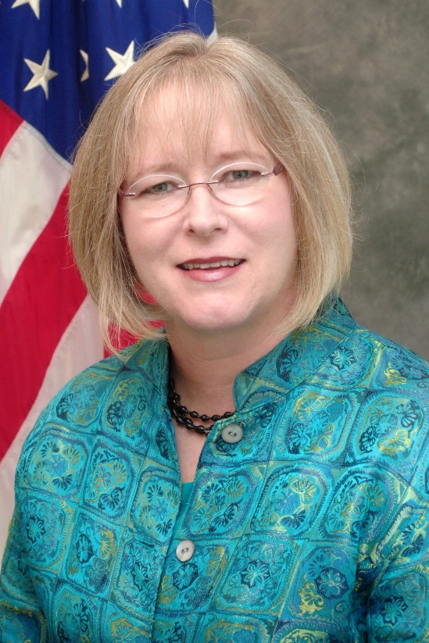
Introductions
Laura W. Cheever, MD, ScM
HAB Associate Administrator
Notes:
It is our great pleasure and honor to introduce the Associate Administrator of the HIV/AIDS Bureau, our persistent and tenacious leader of the Ryan White Program, Dr. Laura Cheever and Heather Hauck, Director of the Division of Policy & Data. Both have been strong supporters over the last decade to continuously improve HIV care and we are honored to ask both leaders for their opening remarks on behalf of the HIV/AIDS Bureau.
Dr. Cheever and Heather, thank you for being on the call today with us.
Our thanks for being on the call and your support over the years.

Slide 10

Agenda
Welcome
Opening Remarks by HRSA HIV/AIDS Bureau
Overview of Literature Review (10min)
Collaborative Overview, Framework, and Timeline (30min)
Introduction to Tools & Resources (5min)
Q&A Session (10min)
Notes:
Our webinar today is broken down into two sections, the first 50 minutes we will learn more about the initiative, its goals, available tools and resources to address HIV disparities. Afterwards, we will open up the webinar for your questions in our Q&A session.
So, the webinar goals are to
Review the findings of our literature review on disparities in HIV care
Learn more about the create+equity Collaborative, its framework and timeline
Overview of the available tools and resources

Slide 11

HRSA Ryan White HIV/AIDS Program
Center for Quality Improvement & Innovation (CQII)
Communities of Learning
National QI collaboratives with engagement of RWHAP recipients
Annual Quality Award Program
  “Together, we continue to improve the lives of people with HIV. CQII provides state-of-the-art technical assistance and training to RWHAP recipients and subrecipients to measurably strengthen local clinical quality management programs and improve patient care, health outcomes, and patient satisfaction.”
Technical Assistance
Provision of on/off-site technical assistance by QI experts
Request for technical assistance via HIV/AIDS Bureau TA request form
Communities of Learning
QI Trainings
Online tutorials for providers and consumers – Quality Academy
Face-to-face/virtual training sessions to build QI capacity of providers and consumers
TA Calls to showcase recipients and QI content
Consultation/Coaching
Dissemination of QI Resources
Online presence on TargetHIV to highlight events and QI resources
Presence at national conferences to disseminate and present
Development of new QI resources
Intensity
Training/Educational Fora
Information Dissemination
CQII.org | 212-417-4730
Notes:
Before we dive into our create+equity Collaborative, I would like to provide a quick overview of CQII, and some of resources and services we provide.
Dissemination of QI Resources, this is mainly our TargetHIV site, presenting at national conferences
QI Trainings: Online tutorials, provided through our Quality Academy, and coming soon our Learning Labs, exclusively offered to Ryan White providers. As well as monthly TA Calls
Technical Assistance: Provision of no/off site technical assistance by QI experts
Communities of Learning: Which consist of national collaboratives such as the create+equity Collaborative

Slide 12
Creating equity will end the HIV epidemic.

Slide 13

create+equity Video
Notes:
Another informational tool that we have developed is a short animated video about the social determinates of health and how they have an impact on HIV care and outcomes. Please take a look and feel free to share with others.
Demonstrate the video.
13

Slide 14
Literature Review – Key Findings

Slide 15
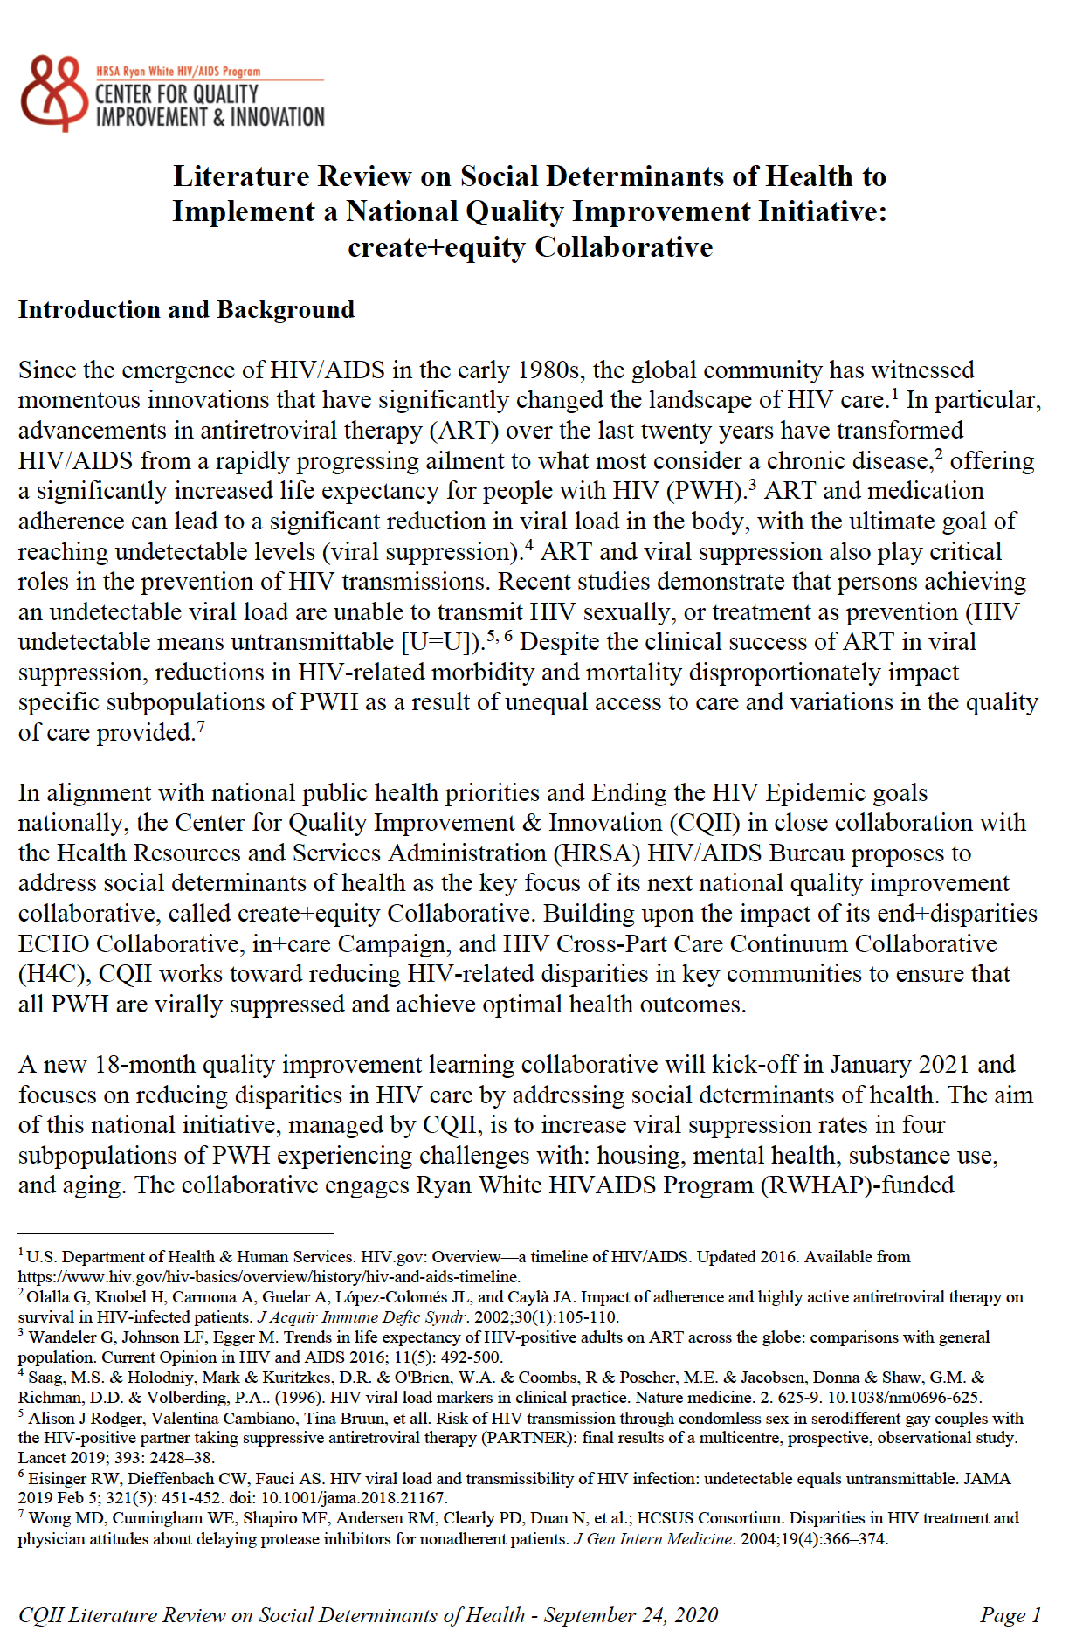

Literature Review
A detailed Literature Review has been developed to make a case about the importance of addressing social determinants of health to end the HIV epidemic in the United States
A corresponding PowerPoint slide set with information related to the four priority areas of the Collaborative is available
Literature Review
Link
Notes:
A thorough and detailed Literature Review has been comprised to highlight the need to focus on the social determinates of health, but more specifically on housing, mental health, substance use, and age across the lifespan.
The full Literature Review and accompanying slides can be found on our site CQII.org.

Slide 16

What is a Social Determinant of Health?
“Social determinants of health are conditions in the places where people live, learn, work, and play that affect a wide range of health and quality-of-life-risks and outcomes.”
– Centers for Disease Control (CDC)
https://www.cdc.gov/socialdeterminants/index.htm

Slide 17

“I diagnosed ‘abdominal pain’ when the real problem was hunger.
I mislabeled the hopelessness of long-term unemployment as depression.
I misdiagnosed poverty that causes patients to miss pills or appointments as noncompliance.
I mistook the inability of one older patient to read for dementia.”
- Dr. Laura Gottlieb, Professor and Author
Notes:
Dr.Laura Gottlieb, MD, MPH, is a Professor of Family and Community Medicine at UCSF. A former National Health Services Scholar and safety-net family physician with fellowship training in social determinants of health, Dr. Gottlieb now serves as Principal Investigator on multiple quantitative and qualitative projects examining the integration of social and medical care services.
Dr. Laura Gottlieb will be the keynote speaker of our first Learning Session.

Slide 18
Did You Know?
People with unstable housing have a 16% lower viral suppression rate compared to those with stable housing
People with mental illness have a lower viral suppression rate, on average by 8.5%
People who inject drugs make up of 1 in 10 new HIV diagnoses
People ages 13 to 24 make up 21% of new HIV diagnoses, while people ages 50 and older make up 17% of new HIV diagnoses in the United States
Health Resources and Services Administration. Ryan White HIV/AIDS Program Annual Client-Level Data Report 2018. http://hab.hrsa.gov/data/data-reports
https://www.cdc.gov/hiv/group/age/olderamericans/index.html
https://www.cdc.gov/hiv/group/hiv-idu.html
https://www.cdc.gov/hiv/group/age/youth/index.html

Slide 19


Disparities in Housing
“ It is hard to argue that housing is not a fundamental human need. Decent, affordable housing should be a basic right for everybody in this country. The reason is simple: without stable shelter, everything falls apart.”
- Matthew Desmond, Sociologist and Author at Princeton University

Slide 20



Disparities in Housing
12% of stably housed clients have not reached viral suppression
19% of temporarily housed clients have not reached viral suppression
28% of unstably housed clients have not reached viral suppression
Not Virally Suppressed
Not Virally Suppressed
Not Virally Suppressed
Health Resources and Services Administration. Ryan White HIV/AIDS Program Annual Client-Level Data Report 2018. http://hab.hrsa.gov/data/data-reports.
Notes:
RWHAP clients who are temporarily or unstably housed have a significantly higher rate of not reaching viral suppression (an average of ~11.85% higher), compared to those who live in stable housing.
Unstably housed RWHAP clients have the highest rate at 27.6%, which is 8.3% higher than the rate for temporary housing

Slide 21
Viral Suppression and Retention in HIV Care by Housing Status
Those experiencing unstable housing face the lowest rates of retention in care (75% vs. 82%), as well as viral suppression (72% vs. 88%) rates, compared to those with stable housing.
Health Resources and Services Administration. Ryan White HIV/AIDS Program Annual Client-Level Data Report 2018. http://hab.hrsa.gov/data/data-reports.
Notes:
Its clear that a RWHAP client’s housing status affects their likelihood of being retained in care and virally suppressed.
Those experiencing stable housing face the highest rates in both RIC and viral suppression (82.1%, 88.4%).
The overall average RWHAP rate of viral suppression which is 87.1% (provided for comparison)

Slide 22


Disparities in Mental Health
“There is no health without mental health.”
- Former United States Surgeon General, Dr. David Satcher

Slide 23
Health Outcomes of People with HIV and Mental Illness
The viral suppression rate for individuals living with mental health diagnoses is 8.5% lower than those without a mental health diagnosis.
Yehia BR, Stephens-Shield AJ, Momplaisir F, et al. Health Outcomes of HIV-Infected People with Mental Illness. AIDS Behav. 2015;19(8):1491-1500. doi:10.1007/s10461-015-1080-4.
Notes:
A 2015 study at the University of Pennsylvania analyzed the health outcomes of PWH with mental illness and reported that individuals with mental illness were 5.5% less likely to be prescribed antiretroviral therapy, compared to those who do not have a mental health diagnosis. No significant difference was seen in retention in care.

Slide 24
Disparities in Mental Health
One in five people diagnosed with HIV in the U.S. live with depression
Two in nine people diagnosed with HIV in the U.S. live with anxiety
CDC. Behavioral and Clinical Characteristics of Persons with Diagnosed HIV Infection, United States, 2018 Cycle (June 2018–May 2019). HIV Surveillance Special Report 25.
Notes:
18% of people diagnosed with HIV in the United States live with depression and 22% live with anxiety.
Exploring the association between increased chronicity of depression and its impact on affected HIV care continuum indicators a study concluded that if someone was affected with depression for a longer period of time, they were more likely to miss HIV primary care appointments, lack viral suppression, and have increased mortality rate.

Slide 25


Disparities in Substance Use
“The mentality and behavior of people who use substances is wholly irrational until you understand that they are completely powerless over their addiction and unless they have structured help, they have no hope.”
- Russell Brand, Actor & Author

Slide 26
Disparities in Substance Use
43% of PWH who inject drugs are virally suppressed
60% of PWH who engage in binge drinking are virally suppressed
13% of PWH active cocaine users are virally suppressed
Suppressed
Suppressed
Suppressed
Unsuppressed
Unsuppressed
Unsuppressed
Karch DL. HIV Infection Care and Viral Suppression Among People Who Inject Drugs, 28 U.S. Jurisdictions, 2012-2013. Open AIDS J. 2016;10:127-135.
Notes:
The majority of PWH who inject drugs or are active cocaine users are not virally suppressed (57.2%; 87%). 40% of PWH who engage in binge drinking are not virally suppressed

Slide 27
Viral Suppression Rates among HIV Patients who Use Substances
The viral suppression rate of non-substance users is significantly higher, with an average rate of 18% more across all substances.
Yehia BR, et al. Health Outcomes of HIV-Infected People with Mental Illness. AIDS Behav. 2015;19(8):1491-1500
Notes:
Active cocaine use exhibits the lowest rates of viral suppression (13%), but on the other hand non-active cocaine use displays the highest rate of viral suppression in all three categories (46%).
Active heroin use has a viral suppression rate of 29% and Alcohol use 21%

Slide 28


Disparities Across the Lifespan
“It’s not the years in your life that count. It’s the life in your years.”
- Abraham Lincoln

Slide 29
Disparities Across the Lifespan
The younger the individual, the less likely they are to be retained in care or virally suppressed
The older the individual, the more likely they are to be virally suppressed and face co-morbidities
Health Resources and Services Administration. Ryan White HIV/AIDS Program Annual Client-Level Data Report 2018. http://hab.hrsa.gov/data/data-reports.
Notes:
Overall, viral suppression has improved for RWHAP clients of all age groups, but young adults and children/youth face much lower levels of viral suppression in comparison to adults and older adults

Slide 30
Disparities Across the Lifespan
While the overall viral suppression rate is 87%, the rate for individuals under the age of 39 is 82% and for individuals above the age of 65 is 95%.
Health Resources and Services Administration. Ryan White HIV/AIDS Program Annual Client-Level Data Report 2018. http://hab.hrsa.gov/data/data-reports.
Notes:
Approximately, 83.5% of children/youth and 75.83% of young adults were successfully retained in care, compared to 83.1% of adults and 86.9% of older adults (2018). Older adults exhibited the best rates of retention in HIV care, maintaining 85.6% to 86.9% from 2014 to 2018. The RWHAP client age group with the lowest rate of retention continues to be young adults (76.17%, 75.83% respectively), while children/youth and adults remain stable around 83% (83.4%-83.5%, 82.52%-83.12%). Children and youth is the only age group where retention in HIV care has decreased over time.

Slide 31
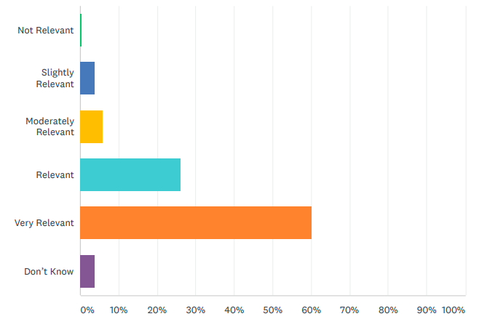
2019 CQII Online Survey (n=241)
How do you assess the relevance of the following topic for your future quality improvement work: Social Determinants of Health?
86% viewed the topic of social determinants of health as relevant/very relevant
96% were interested/very interested in creating QI projects that address social determinants of health
94% indicated that they would participate in a social determinants of health collaborative
Retrieved from 2019 CQII National QI Survey and Results
Notes:
The 2019 CQII National QI Survey and Results clearly demonstrates the majority of agencies hold a strong interest in being apart of a collaborative focused on social determinants of health in HIV care and want to join a national QI initiative.

Slide 32
create+equity Collaborative Overview
Notes:
Now onto a better understanding of the create+equity Collaborative; the big picture mission and goals, and the give and the get, meaning what participants will be expected to do, and what benefits they will gain from participation.

Slide 33
Mission of the create+equity Collaborative
“To promote the application of quality improvement interventions to measurably increase viral suppression rates for people with HIV experiencing the impact of social determinants of health related to housing instabilities, substance use, mental health, and age across Ryan White HIV/AIDS Program-funded recipients and subrecipients.”
Notes:
Couple of notes here
- We recognize that there are more disparities than the four identified HIV subpopulations but it is a starting point
- This initiative is about improvement, increasing viral suppressions rates, and not one that focuses on performance measurement alone
- We invite recipients and subrecipients to join us

Slide 34
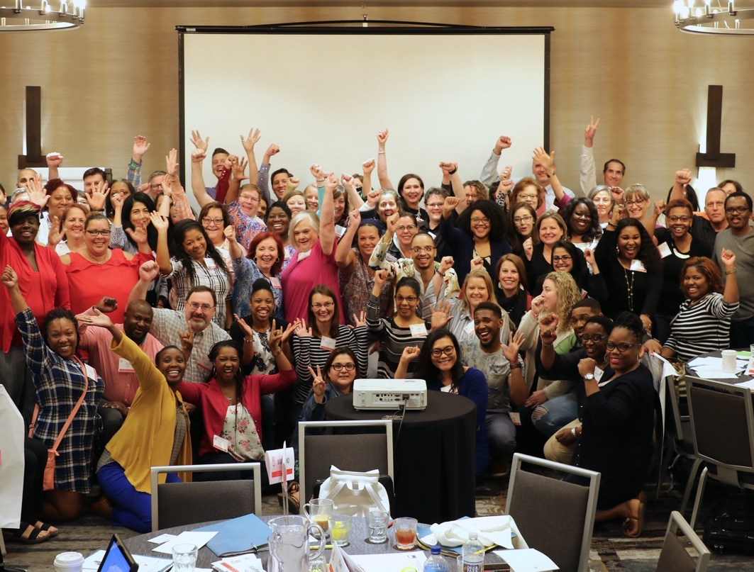

create+equity Collaborative: Big Picture
This national QI initiative promotes the application of evidence-informed interventions and emerging practices to measurably increase viral suppression rates for people with HIV experiencing social determinants of health related to
  Housing Substance Use
  Mental Health Age Across the Lifespan
The 18-month Collaborative (starting Jan 2021) combines the IHI Breakthrough Series model with the Project ECHO at the University of New Mexico
2018: end+disparities ECHO Collaborative
Notes:
In this Collaborative we use evidence-informed interventions and emerging practices to measurably increase viral suppression rates in our four domain areas: Housing, Mental Health, Substance Use, and Age Across the Lifespan.
We recognize the overlap of the four affinity groups

Slide 35
create+equity Collaborative: Big Picture
Each Community Partner is asked to focus their improvement efforts on one population of focus: housing, substance use, mental health, or age across the lifespan
Community Partner join virtual special interest groups based on their population of focus twice a month (Affinity Group)
Learning Sessions with all Community Partners are held every five months, starting Feb 2021 and ending May 2022
Online reporting of population-specific measures (every 2 months) and QI intervention updates (every 3 months)
A faculty of experts and QI coaches are available for assistance
Key resources and tools are shared to maximize local use, i.e., driver diagrams, listing of evidence informed- interventions
Notes:
Community Partners will select one area of interest and will attend special interest groups based on population of focus twice a month.
In addition to these affinity group sessions, will also participate in learning session with all other Community Partners every 5 months.
It is expected that Community Partners utilize our online reporting site to report population specific measures and QI interventions.

Slide 36
Goals of the create+equity Collaborative
Reach: One in six Ryan White HIV/AIDS Program-funded recipients across the United States actively participate in the create+equity Collaborative
Impact: Reduce the viral suppression gap between the entire caseload and the selected subpopulations of focus by 20%
Sustainability: 90% of active Community Partners have conducted, documented, and sustained their quality improvement efforts using the knowledge gained in the Collaborative and remain active six months after the formal end of the Collaborative (June 2022)
Notes:
Our 3 big Goals for our create+equity Collaborative are: Reach, Impact, and Sustainability

Slide 37

Pre-Work Expectations for Community Partner
Select one population focus for your improvement efforts using the provided Disparity Calculator
Connect with your assigned QI Coach
Create an aim statement with measurable improvement goals for your selected population of focus
Set up your local QI team with multidisciplinary membership
Complete other pre-work assignments (submit key staff contacts, information on current data systems, patient caseload, etc.)
Notes:
When establishing your local QI team it is an opportunity to expand the current membership by including external providers of key services (such as housing, mental health) and individuals with lived experiences

Slide 38

Collaborative Expectations for Community Partners
Attend Affinity Sessions twice a month (60min) with other Community Partners focusing on same subpopulation
Present at least one Case Presentation during these Affinity Sessions using the provided template and a Report Back
Conduct local improvement efforts to mitigate the impact of social determinants of health
Participate in the Collaborative-wide Learning Sessions
Routinely submit performance data (every other month) and QI intervention updates (quarterly)
Create a Storyboard to capture your improvement efforts
Notes:
One of our key expectations for Community Partners is the completion/presentation of Case presentations as well as a 6-month report back. To provide an opportunity for Community Partners to present any challenges they faced, as well as a look into sustainability of QI projects after the end of the Collaborative.

Slide 39
Benefits of Participation for Community Partners
Increased capacity to conduct effective QI projects that address the impact of social determinants of health
Improved viral suppression rates for the selected population of focus
Increased access to QI Coaches, content experts, and other Community Partners to advance local improvement efforts
Access to evidence-informed and emerging practices for each Affinity Group population of focus
Strengthened partnerships with internal/external providers focusing on key services related to social determinants of health
Increased performance measurement capacity to routinely detect and track disparate HIV-related health outcomes for HIV subpopulations
Join Us
Notes:
The benefits to participation are many. You will be part of a learning community that will foster partnerships with other recipients and sub-recipients locally and across the country, and allow you to network with people with similar challenges and learn from them. In addition, you will have routine access to nationally recognized quality experts. They will help you increase the clinical quality management capacity of your program, and the quality improvement capacity of HIV providers and consumers, in order to meet the Ryan White HIV/AIDS Program expectations. And more importantly, you will have the opportunity to improve viral suppression rates not only for you selected subpopulation, but for your entire HIV caseload.

Slide 40
Collaborative Framework
Notes:
Now that we know a bit about the Collaborative’s goals, expectations, and benefits.

Slide 41
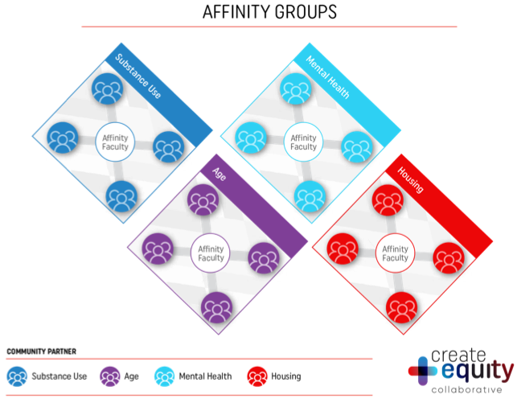
Affinity Sessions
Bi-weekly virtual Affinity Sessions for each Affinity Group: housing, mental health, substance use, and age across the lifespan
  Enable teams to create a community of learning while eliminating barriers to meeting in-person
  Each participating agency present at least one Case Presentation and one Report-Back 6 months afterwards
Each Affinity Group is supported by a dedicated faculty, which includes content experts, including individuals with lived experiences, to provide ongoing expertise and facilitate support by peer providers
Notes:
Affinity Sessions are topic specific, housing, mental health…. where you meet with all other Community Partners who have chosen the Affinity Group.

Slide 42
Affinity Groups Focus
Housing | Substance Use
Assist HIV clients who are temporarily or unstably housed to reach viral suppression Increase access to the appropriate and ongoing (internal or external) housing services Increase the annual housing status screening rates for all HIV clients served by the agency | Assist active or recent substance users to reach viral suppression Increase annual substance use screening rates for all HIV clients served by the agency Affinity Faculty will focus on specific substance use disorders, such as opioids, methamphetamine, stimulants, or alcohol, , while each Community Partner can determine their own mental health improvement focus
Mental Health | Age Across the Lifespan
Help HIV clients who have a documented mental health diagnosis/es to reach viral suppression Increase annual mental health screening rates for all HIV clients Affinity Faculty will focus on specific mental health diagnoses, such as depression, anxiety, psychotic disorders, and post-traumatic stress disorder, while each Community Partner can determine their own mental health improvement focus | Community Partners select one of following age groups based on their local performance data and interest: children/youth (24 and younger); young adults (25-39); adults (40-64); and older adults (65 and older) Improve the viral suppression rate for the selected age group

Slide 43
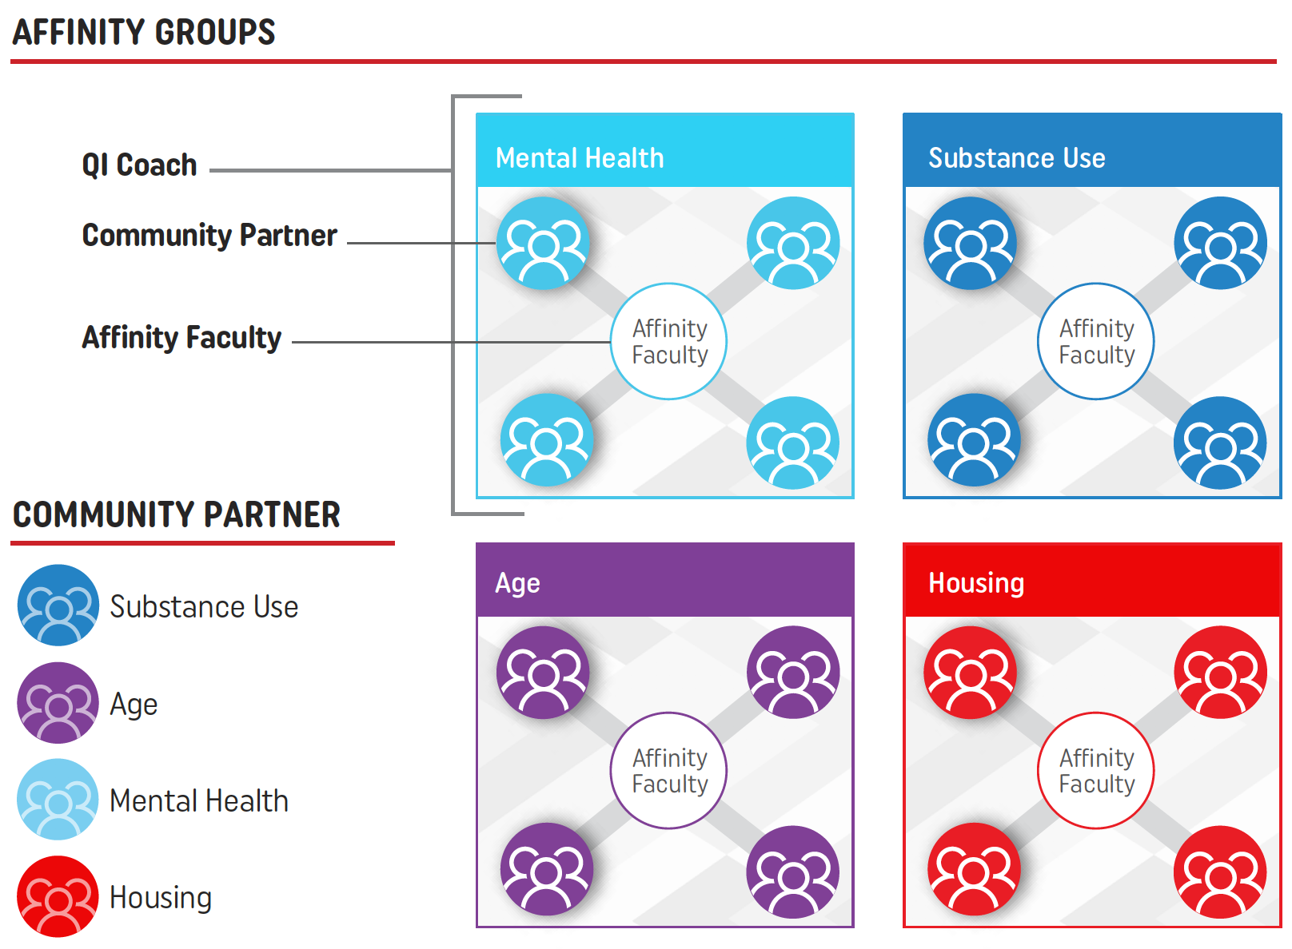
QI Coach Support
Two nationally recognized quality improvement experts – CQII QI Coaches – are assigned to each Affinity Group to support participants to meet the collaborative milestones and expectations
QI Coaches provide support via monthly QI Group sessions and individualized coaching sessions to provide additional support
QI Coaches focus on guiding Community Partners through each step of their QI project, prepare for their Case Presentations, and provide feedback after reporting cycles, and the preparation of your Storyboard
Notes:
Two nationally recognized QI coaches are assigned to each affinity groups, working closely with community partners via monthly QI sessions as well as individualized coaching sessions
Providing support through each step of their QI projects, and helping to prepare for their case presentations.

Slide 44
Case Presentations
Case Presentations are designed to promote peer sharing, build capacity, learn from real-life situations, and allow participants to improve their work
Community Partners focus on one of the following areas related to their selected Affinity Group
  One system-wide challenge or barrier
  A current or planned quality improvement intervention
  Best practices or lessons learned based on current or recent QI efforts
  Single patient experience (no patient identifiers) to illustrate the effects of a system issue
Notes:
A key aspect of the create+equity Collaborative is the Case Presentation which allows community partners to learn from real-life situations. And will focus on one 4 topic areas: one system-wide challenges, a current or planned QI intervention, Best practices or lessons learned, single patient experience

Slide 45
Reporting Elements
Notes:
Next, let’s better understand the type of information that participants in this Collaborative will need to report.

Slide 46

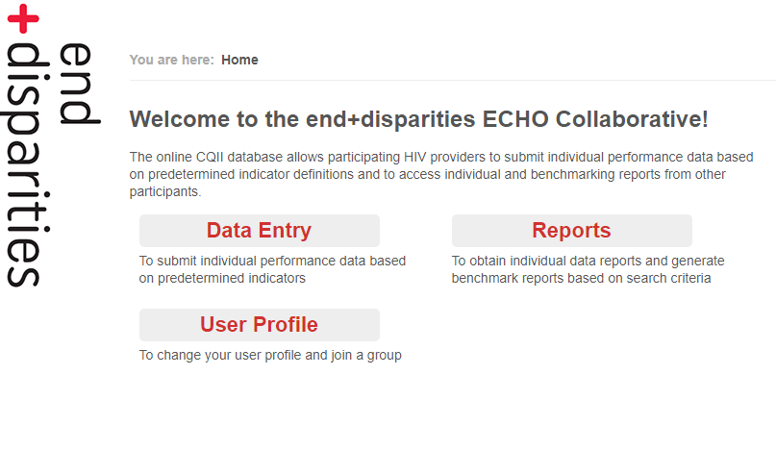
Reporting of Performance Data and QI Interventions
All Community Partners report on the HAB Viral Suppression Measure definition for all patients and their Affinity Group-specific measures
Community Partners enter their aggregated data (no individual patient data) every 2 months allowing them to benchmark their progress with their peers
Participants enter their QI interventions every 3 months to share and inspire other participants to improve their quality of care
Previously used online database is being re-programmed to allow for routine reporting
2018: end+disparities Database
Notes:
Similar to the last collaborative Community Partners utilize an online reporting site unique to the create+equity Collaborative.

Slide 47
Affinity Groups Measures
Housing | Substance Use
Housing Stability : % of HIV pts who are temporarily or unstably housed with a viral load less than 200 copies/mL at last viral load test during the measurement year Housing Screening : % of HIV pts with a housing status screening during the measurement year Housing Intervention: % of HIV pts who are temporarily or unstably housed at the most recent housing screening with at least one relevant housing intervention | Substance Use: % of HIV pts who have a documented substance use disorder or a substance use service with a viral load less than 200 copies/mL at last viral load test during the measurement year Substance Use Screening: % of HIV pts with a substance use screening during the measurement year
Mental Health | Age Across the Lifespan
Mental Health: % of HIV pts who have received one or more of the mental health diagnoses OR received one or more mental health services during the same measurement period with a viral load less than 200 copies/mL at last viral load test during the measurement year Mental Health Screening: % of HIV pts with a mental health status screening during the measurement year | Age Across the Lifespan: % of HIV pts with the site-selected age group [children/youth (24 and younger); young adults (25-39); adults (40-64); or older adults (65 and older)] with a viral load less than 200 copies/mL at last viral load test during the measurement year [Other measures for each age group to be developed]

Slide 48
Tools and Resources
Notes:
There are many tools and resources available now and being built to assist you on the journey.

Slide 49


Collaborative Tools
One-Page Flyer
Collaborative Toolkit
To access all Collaborative tools and resources | CQII.org
Notes:
For more information, please be sure to check out our website, which has information about upcoming events, contains an interactive page on interventions, and provides resources for you to use.
49

Slide 50

Change Packages: Listing of Key Interventions
A Change Package is a set of evidence-informed interventions and emerging practices that are critical to the improvement of an identified process and generate ideas for tests of change
An extensive Change Package are available for : housing, mental health, substance use, and age across the lifespan
Each Community Partner should review the appropriate Change Package and the related interventions, and prioritize those that are most relevant for their organization
CQII partnered with IHI to develop Change Packages for each Affinity Group with content experts and stakeholders
Link
Notes:
As part of our create+equity Collaborative we have partnered with the Institute for Healthcare Improvement they have identified interventions for each of our collaborative focus areas, using evidence-informed interventions as well as emerging practices identified through the literature as well as interview with key stakeholder including consumers.

Slide 51
Driver Diagrams
Driver Diagrams present a graphical representation of drivers (factors) that have an impact on achieving the preferred outcomes
  Primary Drivers are the major factors driving the outcomes
  Secondary Drivers are the detailed activates and structures that make up the primary divers
CQII partnered with IHI to develop Driver Diagrams for each Affinity Group with content experts and stakeholders
Link
Notes:
To supplement intervention packages Driver Diagrams were also developed with help from IHI, that present graphically the key drivers or factors that have an impact on the referred outcomes.

Slide 52
Application Process
Notes:
Next steps in how Community Partners can apply to be part of our Collaborative.

Slide 53
Application Process
Kick-Off Webinars
Individual Application
[Nov 2020] Individual recipients/subrecipients
apply online as Community Partners and indicate
their Affinity Group of choice
Selection Process
[Dec 2020] CQII and HIV/AIDS Bureau review all applications and select the Community Partners; final announcements are made and Pre-Work activities start
[Nov 2020] Zoom sessions to introduce RWHAP recipients/subrecipients to the Collaborative,
purpose, and benefits of participation
Notes:
Some important dates: Application period is though Nov and the deadline is Nov. 30 and the Selection process will take place in Dec and selected Community partners will be notified.

Slide 54

Selection Criteria
A max of 100 Community Partners - 25 per Affinity Group - can join the Collaborative; CQII and HAB will assess all applications using the following selection criteria:
Geographic representation vs prevalence
RWHAP Part funding diversity
QI competency level
New recipients vs those who have participated in a prior CQII collaborative
Ability to draw performance data from EMR
Performance gap between overall vs subpopulation
Number of patients reported to increase Collaborative impact
Notes:
Here are some of the selection criteria that CQII and HAB assess when a Community Partners applies to be part of the Collaborative. A more extensive list of selection criteria can be found on our create+equity Collaborative Toolkit

Slide 55
Timeline and Next Steps
Notes:
So by now, you have an idea about what the Create+Equity Collaborative is all about, let’s finish with the timeline and next steps to give you an even clearer picture.

Slide 56
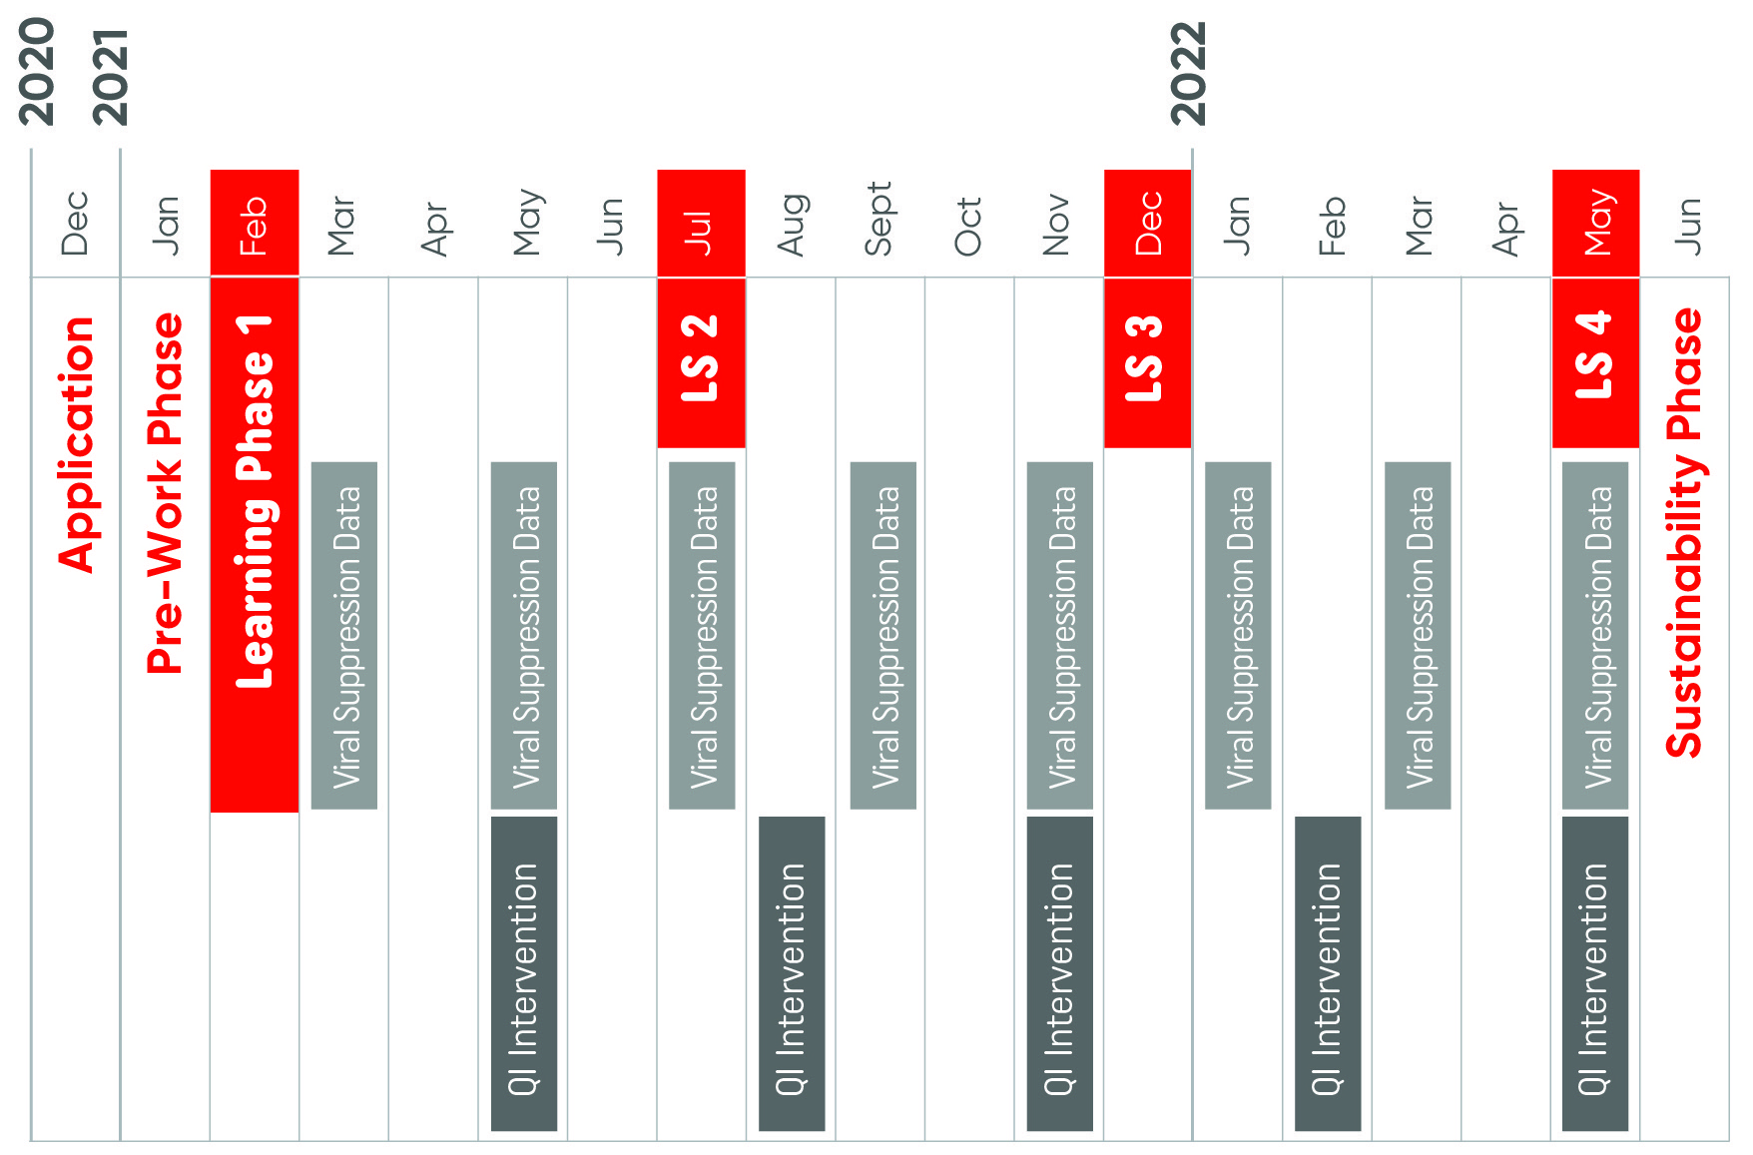
Reporting Calendar
Notes:
Note: walk very quickly through the diagram and reiterate a more detailed timeline for reporting can be found in the toolkit doc.

Slide 57
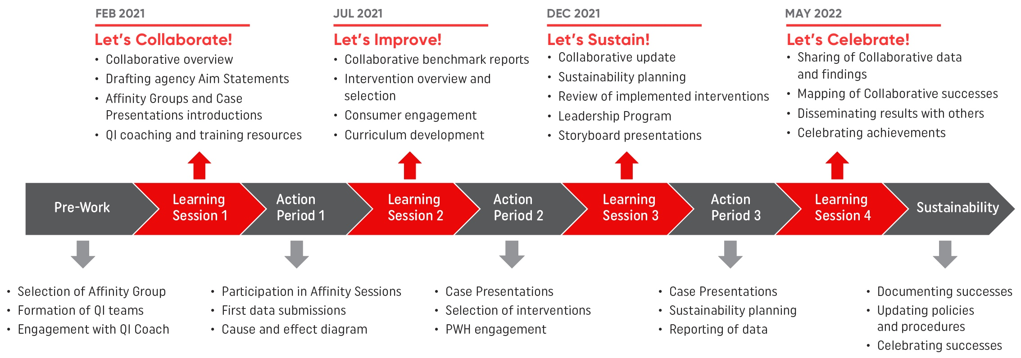
Collaborative Timeline
Notes:
A broad overview of key points in our upcoming Collaborative, again a more detailed timeline can be found in our Toolkit

Slide 58
Next Steps
Apply to Participate: Application Deadline: Mon, Nov 30, 2020
Get Ready: Community Partners are selected, join introductory webinars, and connect with assigned QI Coach [Dec-Jan 2021]
Prepare for Learning Session 1: Participate in our first Learning Session [Feb 2021]
Learn From Each Other: Attend the first Affinity Sessions [Mar 2021] and start submitting your performance data [Mar 2021]
Apply Here
Submit your application for review by CQII
and the HIV/AIDS Bureau:
www.surveymonkey.com/r/collaborativeapplication
Notes:
Key Dates: Nov 30th is the deadline to apply to participate in our Collaborative
Community partners selected will conduct pre-work and join introductory webinars during Dec. and Jan.
First Learning Session: Feb 2021
First Affinity Session: Mar 2021
First Submission of Performance Data also in Mar. 2021

Slide 59
Health equity benefits everyone.
Notes:
Health equity benefits everyone
Kathleen Sebelius, who served as the 21st United States Secretary of Health and Human Services from 2009 until 2014.

Slide 60

Q &A
To learn more about the create+equity Collaborative | CQII.org
Notes:
Now we have some time to discuss your questions that have not yet been answered in the chat. We will attempt to answer these in the time remaining. However, after we formally close the meeting at the top of the hour, we invite anybody who can stay on the line to do so, as we will be available for this for the next 10 minutes to answer any remaining questions.
Let’s start with the questions already in the chat that have not yet been addressed? Please feel free to add any additional questions to the chat box.

Slide 61
FAQs
Where can you find the literature review slides and more resources?
  To find our literature review slides and many other resources please visit the create+equity Collaborative Recourses page (CQII.org).
Will the create+equity Collaborative involve Regional Groups?
  No. The create+equity Collaborative will not support Regional Groups, but we encourage members from previous collaborative Regional Groups to apply.
When is the application deadline?
  The deadline for the create+equity Collaborative is November 30th, 2020, we encourage you to apply before the deadline. You can apply using the following application link. Application Site
What Ryan White Funding recipients are you targeting?
  We are recruiting from Parts A, B, C, D.

Slide 62
FAQs
Does a Part A or B recipient have to apply or does each subrecipient have to submit an application?
  You have two options to choose your level of participation.
  Option A: The Part A or Part B network recipient can be the lead agency and conduct QI efforts across your network of subrecipients. In this scenario, all participating subrecipients focus on the same Affinity Group (Housing, Mental Health, Substance Use, or Age Across the Lifespan), lead all improvement activities across all participating subrecipients, and submit their data. We encourage that as many subrecipients as possible join.
  Option B: The Part A or Part B network recipient supports the subrecipient and the subrecipient improvement project as a local QI team member. In this scenario, the subrecipient enrolls in the Collaborative, is the team lead, and submits all data and QI updates.
Is the application for an individual person or per agency/Community Partner?
  Each Community Partner/agency will fill out one application for participating in the create+equity Collaborative. Individual Community Partner staff who wish to participate may do so as part of the agencies’ QI team.
Will agencies receive guidance and assistance when pulling their data?
  Yes, agencies/Community Partners will receive guidance throughout the Collaborative from other collaborative participants as well as QI Coaches and Faculty members.

Slide 63
Special Thanks to…
HAB: Laura Cheever, Antigone Dempsey, Tracy Matthews, Marlene Matosky, Chep Maritim
CQII Staff: Jim Tesoriero, Chuck Kolesar, Jennifer Lee, Zainab Khan, Alejo Carbajal, Kevin Garrett, Kehmisha Reid, Shaymey Gonzalez
CQII Consultants: Adam Thompson, Allan Clear, Barbara Boushon, Chinnie Ukachukwu, D'Angelo Keyes, David Moody, Dawn Trotter, Dottie Dowdell, Alex Keuroghlian, Brian Wood, Cole Stanely, Kathleen Clanon, Jamie Shank, Jane Caruso, Julia Schlueter, Justin Britanik, Jeremy Hyvarinen, Kneeshe Parkinson, Lori DeLorenzo, Mulamba Lunda, Nanette Brey Magnani, Rose Conner, Tania Chatterjee, Susan Weigl
University of California San Francisco: Wayne Steward, Shannon Fuller
University of New Mexico: Sanjeev Aurora, Bruce Struminger
Institute for Healthcare Improvement: Paul Howard, Robert Lloyd, Angelo Lima
Impact Marketing: Sarah Cook-Raymond, Cortney Kreer, Darrel Walker, Terry Plater

Slide 64

Contact Information
Clemens M. Steinböck, MBA
Director
New York State Department of Health
AIDS Institute
90 Church Street, 13th floor
New York, NY 10007-2919
212.417.4730
Clemens.Steinbock@health.ny.gov
This project is supported by the Health Resources and Services Administration (HRSA) of the U.S. Department of Health and Human Services (HHS) as part of an award totaling $1.5M. The contents are those of the author(s) and do not necessarily represent the official views of, nor an endorsement, by HRSA, HHS or the U.S. Government.
Notes:
Now we have some time to discuss your questions that have not yet been answered in the chat. We will attempt to answer these in the time remaining. However, after we formally close the meeting at the top of the hour, we invite anybody who can stay on the line to do so, as we will be available for this for the next 30 minutes to answer any remaining questions.
Let’s start with the questions already in the chat that have not yet been addressed? Please feel free to chat in additional questions.

