Slide 1
Spreading Good Ideas for Change
The Quality Academy
1
Notes:
The Center for Quality Improvement & Innovation (CQII) is pleased to bring you the Quality Academy, an online learning opportunity on key quality management concepts. CQII provides no-cost, state-of the-art technical assistance for all Ryan White HIV/AIDS Program grant recipients and subrecipients to improve the quality of HIV care nationwide. CQII is funded through a cooperative agreement with the HRSA HIV/AIDS Bureau
.
This Tutorial is titled: Spreading Good Ideas for Change

Slide 2
Learning Objectives: You Will Learn About…
How innovations work
The theory behind innovation and the spread of innovation
How to support openness to innovation in your HIV program
2
Notes:
In this Tutorial, we will discuss the concept of innovation and the spread of innovation. As we have explored in other Tutorials, improving quality involves making change, and change is often difficult. But
when a good idea for change is developed, tested, and proves effective, the next steps are applying the idea throughout your HIV program and sharing the idea with other HIV and health care programs.
Through research, we have learned a great deal about innovation. In this Tutorial, we will examine how innovation works and how an innovation can radiate outward from its source.
We will close by discussing strategies to help support openness to innovation in your HIV program.

Slide 3
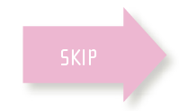
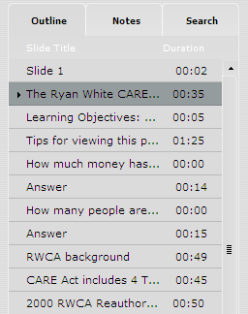
Tips for Viewing This Presentation
Read along with the narrator
Skip to other slides in the presentation
Search for keywords in the presentation
Review current slide
Play, rewind and fast forward
View full screen
3
Notes:
Before we begin today, please take a moment to familiarize yourself with the available tools that will help you navigate, participate and review the information outlined in this training module. Off to the right of the presentation window you will notice 3 tabs. The outline tab presents you with a complete outline and slide count for this module. You can use this outline to navigate to any specific slide you wish to view again. Adjacent to that is a tab called notes. If you do not have speakers or are in any way hearing impaired, you may select this tab so that you can read along with our narrators. Finally, the search tab is just that. You may search for any keywords in the presentation which will allow you to come back multiple times and easily find specific data that you are looking for. Below the presentation window you will find the player controls for this presentation. If you would like to pause, rewind or fast forward the presentation, you can use the controls located to the left of the player. To rewind or fast forward on a specific slide, just click and grab the scrubber icon that you see sliding across the timeline of the slide. If you would like to remove the tabs on the right and watch the presentation in full screen mode, just click this icon on the right side of the player bar. Now sit back, relax, and enjoy today’s training session.

Slide 4
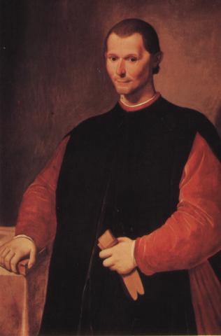
Creating a New Order
“There is nothing more difficult to plan,
more doubtful of success, nor more dangerous to manage than the creation of a new order of things….”
Nicolo Machiavelli, The Prince
4
Notes:
Perhaps you are familiar with the writing of the Renaissance political theorist Machiavelli. He has some not-very-inspiring words for people who would “create a new order of things.” Luckily, we now know more about what is involved in creating a new order than Machiavelli did, and this information can reduce some of the “danger” involved. This Tutorial will explore some of that knowledge.

Slide 5

Key Question
How can my HIV care program become more open to innovative ideas?
5
Notes:
The key question we are seeking to answer in this Tutorial is, “how can my HIV care program become more open to innovative ideas?”

Slide 6

OK, my improvement works, now what?
Now What?
6
Notes:
Let’s go back a few steps. You have gone through an improvement effort, you’ve used the 3-question Model for Improvement, applied change concepts and run PDSA Cycles. You’ve got something good results; you’re ready to implement it fully.
So, what’s next? How can you ensure that your improvements will sustain and spread within your organization, and beyond?

Slide 7
What’s the Sequence?
Improvement
Hold Gains
Spread
??? more like …
Improvement
Hold Gains
Spread
Source: Institute for Healthcare Improvement
7
Notes:
What is the right sequence for moving from a tested, implemented improvement to an improved system, where process changes that result in improvement are implemented throughout?
Often, we think of improvement work as linear as in this top diagram.
First, we do improvement: testing changes, identifying those that will result in improvement and then implementation in the population with which they have been tested.
Then we work on holding the gains or making sure the changes we have implemented “have legs”.
Once that is complete, we begin to tackle the challenge of spread.
In fact, while there is some sequential nature to this continuum of improvement, more often we find that these steps overlap as in the second diagram.

Slide 8



Three Prerequisites for Spreading Changes
Improved HIV care is a strategic initiative within the organization
An executive is responsible for spread
An improvement team has been successful
8
Notes:
1
While spreading successful changes is the ultimate goals of many improvement teams, it’s important to make sure that you are in the right position to do so effectively.
Here are some specific prerequisites that you may want to consider:
First, the topic should be a strategic initiative within the organization: the senior leadership must recognize and communicate to others that this issue is a top priority for the organization. This will help staff realize that the status quo is no longer acceptable, and that the expectation is for the organization to change.
It’s important to have a quality champion designated by the senior leader to be responsible for spread. This means developing a plan for spread and monitoring progress.
Also, the success of the improvement team is an essential component of spread since it provides evidence that the changes can be made and tips on how to make the improvements.
Let’s take a moment to think about how you can make sure that your changes will be sustained over time.

Slide 9
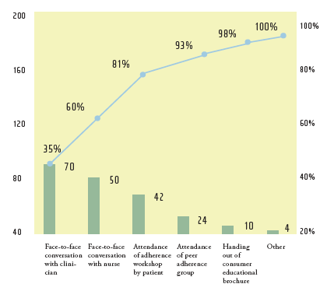
Getting Improvements to “Stick”
Document processes
Continue to measure
Write new job descriptions
Train staff
Assign ownership
9
Notes:
How can you make sure that your improvement effort, in “show business” terms, “has legs?”
Essentially, the improvements have to be institutionalized in order to “stick.” They have to be written down, tracked and integrated into standard policies and procedures.
Here are some ideas to help you facilitate institutionalization of your improvements:
• Establish and document the new processes. Staff can change, people can forget; make sure the new process can survive a staff turnover
• Continue to measure performance indicators. You may be able to collect less data, or collect it less frequently, but develop a way to keep track of whether the improvement you’ve made continues to have the result you want
• Revise job descriptions so they reflect the new ways of doing work you have developed
• Make sure to train, train, train. It’s critical that staff know what to do
• Have someone be appointed to direct the “holding the gains” phase and oversee all these steps; the organization’s leadership should assign the responsibility

Slide 10
Getting Improvement to “Spread”
Initial test site
The rest of the system:
- Other clinicians
- Other units - Other clinics
- Other hospitals
10
Notes:
Once you’ve tackled the challenges of sustaining an improvement, it’s time to start thinking about how to approach the larger task of taking a proven change and spreading it to the other parts of the HIV care program, that is, the other parts of your system.
These are some important things to keep in mind about “spread.”
• Spread can be challenging because the “rest of the system” doesn’t have the knowledge or background that the initial test site has about why and how the change was developed
• An organization’s senior leadership has the responsibility for spread, as they are the part of the organization that can manage the relation of the parts of the organization to the whole of the organization
• We know a lot about how people react to innovation, and senior leaders need to learn this information to be able to guide the spread of improvements successfully

Slide 11
Do you think the improvements from this project will "stick"?
Test Question
Here’s a description of a quality improvement effort:
Physicians inconsistent in their prescription refill practices, sometimes giving up to 6 refills for the convenience of the patient.
Patients then put off their medical exams until they need a new prescription.
Team created a “Safe Ordering Practice” policy, with guidelines for refill frequency, medical visits and lab monitoring frequency.
Guidelines published in patient education brochures; patients also told about the change in process when they called in for refills.
Staff educated, new process monitored.
Physician and pharmacist are designated as “gatekeeper.”
A) Yes
11
Notes:
Let’s pause and do an assessment of one organization’s quality improvement work.
Here is a description of an actual improvement project in an HIV care program. Review the description and then indicate whether you think the gains of this project will be likely to stick by answering the question “yes” or “no.”

Slide 12

The Tipping Point
‘The Tipping Point: How Little Things Can Make a Big Difference’
by Malcolm Gladwell
12
Notes:
Malcolm Gladwell’s The Tipping Point has stayed on best-seller lists for years. In this highly readable book, Gladwell examines several cases where a new idea or approach has seemingly “caught fire” overnight, and explores the specific conditions and actions behind each case. We highly recommend reading this valuable resource if you would like to gain even further knowledge on this topic.

Slide 13
The “Diffusion Curve”:
Reaching the Tipping Point
Tipping Point
13
Notes:
In The Tipping Point, Gladwell describes how the process of the diffusion of a new idea or the creation of a new “order of things” follows a natural progression, building slowly and then accelerating. The point where the acceleration of the adoption of the change occurs is called the Tipping Point. This point occurs when approximately 20% of the target population has adopted the change.
This is an important message for us as we try to “spread” an improvement throughout our organization. You should have a strong plan to get the new idea to that 20%, to the “tipping point.”

Slide 14

Diffusion of Innovations
‘Diffusion of Innovations’
Everett M. Rogers
The Free Press, New York
14
Notes:
Gladwell’s work builds on, and popularizes, the theoretical work of Everett Rogers, probably the leading thinker in the field of innovation. Roger’s book, Diffusion of Innovations, is a thought-provoking resource about how new ideas get adopted and used. We will refer to Roger’s work throughout this Tutorial.

Slide 15
Critical Mass and Momentum
“The part of the diffusion curve from about 10 percent to 20 percent adoption is the heart of the diffusion process. After that point, it is often impossible to stop the further diffusion of a new idea, even if one wished to do so.”
E.M. Rogers, Diffusion of Innovations
15
Notes:
Here is a quote from Roger’s work that further explains Gladwell’s tipping point. Rogers talks about the importance of the “10 percent to 20 percent” part of the diffusion curve, that most of the work involved in spreading an innovation comes at this point. Getting to or past this point on the diffusion curve is, however, more complicated than that small percentage would suggest.

Slide 16
“Diffusion Curve” in Health Care
“tipping point”
“tipping point”
Source: Institute for Healthcare Improvement
16
Notes:
Here’s some evidence that this theory applies in health care, not just in fashion or in agriculture.
This graph shows the actual spread of the Chronic Care Model across 80 clinics. It was slow in the beginning, then it seemed that critical mass was achieved in the 10-20% range, and the spread accelerated. You can also see on both this and the seed corn chart on the following slide, that the rate of spread slowed down near the end. That is because the last people to adopt the best idea are often traditionalists, and by definition are slow to adopt, or may never adopt the change.

Slide 17
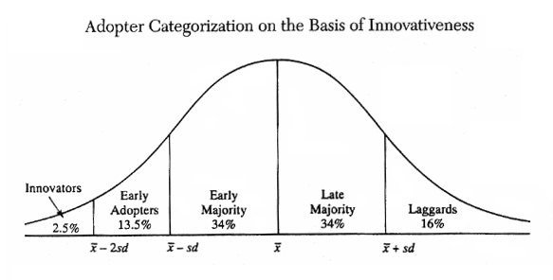

‘Diffusion of Innovation’
Source: Ryan and Gross, “Hybrid Seed Among Iowa Farmers,” 1940
17
Notes:
Why can diffusion be difficult? Because of the different ways people in the population feel about new ideas.
Think about the people you know: probably someone was the first person you knew who used online streaming services to listen to music, and probably someone else is still listening to cassette tapes – or even record albums!
This graph is from a study in 1940 that measured how quickly farmers in Iowa accepted a new kind of corn seed. Rogers’ work has shown that this graph applies pretty much no matter what the specific innovation is: corn seed or new processes in health care. It’s basically a bell curve, with a small number of people who will take up a new idea quickly, most people in the middle, and a few people who lag behind.
Take a minute and see where the 20% tipping point lies on this graph, and then we’ll talk more about each of these categories.

Slide 18

Types of Innovators
Innovators - Venturesome
Early Adopters - Respected
Early Majority - Deliberate
Late Majority - Skeptical
Laggards - Traditional
18
Notes:
Let’s examine the five ways that people respond to innovation.
• First, we have the Innovators, the venturesome among us. These are the people who bring new ideas into the system, those who tolerate risk and are willing to accept the possibility of losses in seeking potential gain. Sometimes their very innovativeness causes them to be viewed as “outsiders” by the rest of the system in which they live or work.
• Next along the curve come the Early Adopters. Less “cosmopolitan” than innovators, their dominant characteristic is that they are respected by others in their system. They are well integrated into the local social system, are seen as opinion leaders and advisors of others. Because they serve as role models, their adoption of an innovation decreases uncertainty about the innovation for others, making it more likely that others will try it out.
• The next group is the Early Majority, deliberate in their decision making, relying on, but also trusting, the early adopters. They can be convinced by the logic of the benefit of the change.
• The Late Majority then follows. This group is, in general, skeptical about the innovation (and also is less able to handle a financial risk). They tend to adopt the innovation only in the face of economic necessity or when they face intense peer pressure, and they need to know they will be in the majority if they adopt the innovation.
• Finally, there are the Laggards, tied to tradition, connected with the past. They will learn about innovation later than others, and their peer group will be those with similar traditional ideas.

Slide 19

Rogers’s Five Attributes of Change
Relative advantage
Compatibility
Complexity
Trialability
Observability
-- E.M. Rogers, Diffusion of Innovations
19
Notes:
Rogers also identified five attributes of change:
Relative Advantage: how much better is the new compared to the old?
Compatibility: how consistent is the new idea with values, experiences, and needs?
Complexity: how difficult is the new idea to understand and use?
Trialability: how easy is it to test the new idea?
Observability: how visible are the results of the new idea?
Each attribute is on a continuum, and the more of the attribute the change has, the easier it will be to spread. For example, a change with a high degree of compatibility will be easier to spread than one without. A change with visible results will be easier to disseminate that one where the results are subtle.

Slide 20
Rules of Diffusion (by Donald Berwick)
Identify changes that are ready to spread
Find innovators and support them
Invest in early adopters and allow communication with innovators
Make early adopters observable
Allow re-invent innovation
Trust and enable innovation
20
Notes:
What does this knowledge about how people react to innovation allow us to do? Donald M. Berwick, of the Institute for Healthcare Improvement, gives us these helpful rules:
• Identify changes that are ready to be spread. As we said earlier, ideas that are ready to be spread are those that link to the organization’s strategy, have leadership support and a successful improvement team’s work.
• Find innovators and support them. Figure out who’s going to be first to jump on and give them resources, encouragement, and a chance to try out the innovation. But also realize they’re not going to be enough.
• Invest in early adopters and allow communication with innovators. The early adopters are those who have respect within your organization and who will help bring in the early majority, to get you to your 20% “tipping point.” They need to learn from, and be inspired by, the innovators – and you need to link them together.
• Make early adopters observable. Again, the early adopters are respected in your organization. They will convince others. Make their work visible: presentations, posters, discussions – whatever it takes.
• Allow re-invent innovation. Innovators and early adopters will further refine the innovation through their own implementation work. This is OK. Don’t be too rigid in the definition of the innovation that you accept.
• Trust and enable innovation. Be honest with yourself, how do you really feel about innovation? The leadership of an organization has to be willing to support the changes that are taking place. If they are not, the diffusion becomes almost impossible.

Slide 21
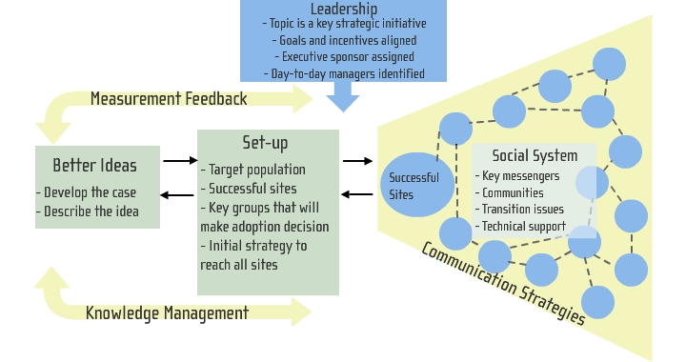
IHI’s Framework for Spread
© Institute for Healthcare Improvement
21
Notes:
This diagram depicts a very robust framework for spread, that is, the diffusion of innovation in an organization. The diagram was developed by the Institute for Healthcare Improvement to support spread of the improvements identified in its health care improvement collaboratives.
The framework shows the interaction of the key elements we’ve been discussing:
• Leadership creating the alignment of improvements and strategy
• Better ideas
• A plan, or set-up, for the innovation
• Methods for building off the success of key sites
• And some attention being paid to the social system, the role of who sends the message about the change, its importance and its value
• Finally, the framework also includes a feedback loop of measures and knowledge management between the better ideas and the social system to which they are spread

Slide 22
What Improvement Teams Can Do to Help
Help to make the case for change
Make it easier for others to do the work
Identify the messengers
22
Notes:
Now let’s talk about some very specific things that improvement teams, those who developed the original change for improvement, can do to help spread the improvement through your HIV care program.
Here are three concrete tips:
• Help make the case for change. Remember how important this is to convince the early majority – and you need their help to get to the “tipping point.”
• Make the change easy, and make “making the change” easy too. Remember the importance of “complexity” and “trialability.” People will be more willing to accept a change if they understand it and can easily try it out.
• Identify who the messengers will be. Don’t rely on innovators for this; they don’t command the attention of the organization. You need the trusted early adopters as your messengers.
The following slides will detail these 3 points.

Slide 23
Make the Case for Change
Clarify the benefits
Demonstrate that your changes provide these benefits
  Evidence supporting the changes (literature and experience)
  Data – especially annotated run charts
Promote your work
23
Notes:
When making the case, do the following:
• Explain the benefits of the improved system: why it is better for patients, providers and other members of the care team. It is especially important to address the concerns and questions of providers. Answer the questions “What’s in it for me? What’s in it for my patients?” Having providers and other front-line staff able to explain through their own experience what the changes have meant to them and their patients is a powerful message that helps to attract others to the changes.
• Through your improvement work, you have the evidence to demonstrate how the new way of doing work is better. The best evidence are run charts from the team that demonstrate that the changes can result in measurable improvement.
• Be prepared to share your work with others. Consider creating a “storyboard” that shows what the improvement team did and what the results were. Post it in an obvious place (employee cafeterias and waiting rooms are nice). Build a presentation that you can use to explain what you did, how you did it, and the results that you got. Take every opportunity to talk with others about your team and what it did.

Slide 24
Make it Easier for Others to Do the Work
Describe the change
Coach how to start doing improvement work
Highlight where management needs to help
24
Notes:
As you work on diffusing your innovations, you will need to help others in two areas;
One, they need to understand what’s involved in the change you are proposing. Second, they need to know how to use the tools of improvement, especially PDSA cycles, to adapt this change to their own clinic, or program, or site.
Specific things that improvement teams can do include:
• Making sure that the improvement is well described and documented, so providers being asked to adopt this innovation are clear on what they should do. Examples, flowcharts, before-and-after data; all are helpful.
- Give tips on how to begin; what are the first tests in applying the new system that you would recommend to a new team?
- From your experience, inform where the new site may need help, especially if planned changes will involve
• Changes to the budget
• Acquisition of technology
• Staffing issues - be ready to support both teams and management in identifying and meeting these needs.

Slide 25
Identify the Messengers
Choose the right messengers
  Opinion leaders
  Connectors
Educate the messengers to deliver the message
Include peer-to-peer communication
25
Notes:
In addition to helping to make the case for the new system and making it easier to do the work, the improvement team can also help to identify and support those who will serve as “messengers” about how the new system works.
The most effective messengers are those that are well respected by their peers (opinion leaders) and those that have a lot of natural connections with others.
If such a messenger is a member of the improvement team, then that person may take on the role of helping to spread the word about the new system to others. Often, however, additional messengers will be needed to spread the new system more rapidly and more widely throughout the organization.
The improvement team can play an important role in working with the messengers, in explaining how to make the changes, and also in how to then share their new knowledge and experience with others. Having peers talk with peers is vital.

Slide 26
Channels of Communication Are Important
SHARE
INFORMATION
SHAPE
BEHAVIOR
General
Publications
flyers
newsletters
videos
articles
posters
Personal
Touch
letters
cards
postcards
Interactive
Activities
telephone
email
visits
seminars
learning sets
modeling
Public
Events
Road shows
Fairs
Conferences
Exhibitions
Mass mtgs
Face-to-face
one-to-one
mentoring
shadowing
2002, Sarah W. Fraser
26
Notes:
Sarah Fraser also has researched the effective diffusion of innovation. In this diagram she shows the many different ways we communicate. As you can see, some work better to simply share information, while others are targeted at shaping behavior. Be sure to use many of these communication methods in your plan for spread—possibly even choose a few from each category to make sure many modes are covered. Take some time to review this chart and then click continue to proceed.

Slide 27
Key Points
A successful improvement project is the basis for spreading a new idea
Organization-wide dissemination of new ideas requires strong and consistent support from leadership
Innovation theory helps explain how to go about spreading change
Pay attention to the messengers: choose the right people and methods
27
Notes:
To summarize this Tutorial:
• We begin with a successful improvement project. You have something that works, and this gives you good information to spread to others
•Leadership makes dissemination of this innovation, the spread of this idea, happen. Direction from leadership is critical
• Innovation theory tells us how change happens, and helps us understand how people are likely to react to new ideas
• Messengers are important; choose the right methods and people, the ones whom others will respect

Slide 28
Resources
Rogers, Everett M., Diffusion of Innovation, New York: Free Press.
Gladwell, Malcolm, The Tipping Point, Boston and New York: Little, Brown, 2002.
For more information about the IHI’s Framework for Spread, see www.ihi.org/IHI/Topics/Improvement/SpreadingChanges/Changes/ or download their white paper on this topic at www.ihi.org/IHI/Results/WhitePapers/AFrameworkforSpreadWhitePaper.htm
The IHI’s: Improving HIV Care: A Modular Quality Improvement Curriculum, available on the National Quality Center’s website at http://www.nationalqualitycenter.org/index.cfm/5659
28
Notes:
Many sources of information contributed to the creation of this Tutorial. If you would like to learn more, you can check out these valuable resources and don’t forget, you can also contact the Center for Quality Improvement and Innovation for more help via email at Info@cqii.org.
Explore us further at TargetHIV.org/cqii and browse or publication and TA webinar sections.

Slide 29
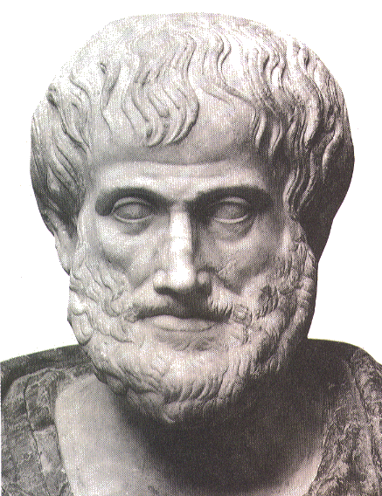
Closing Thoughts
“We are what we repeatedly do; excellence is not an act, but a habit.”
–Aristotle
29
Notes:
We hope that what you have learned in these Tutorials will help your HIV care program in its pursuit of excellence.
As Aristotle reminds us, excellence comes from habit. Make quality a habit in the HIV care and services that you provide.

Slide 30

The Quality Academy
For further information, contact:
Center for Quality Improvement & Innovation
90 Church Street, 13th floor
New York, NY 10007-2919
Email: Info@cqii.org
Or visit us online at TaregtHIV.org/cqii
30
Notes:
This concludes this tutorial. As you can see, there is a lot to learn about improving quality. If you have not done so yet, please check out the other training resources we have available for you. Each Tutorial is just a piece of a larger puzzle. You will need all of the information to truly understand how your organization can create a successful quality management program. You can also contact via email if you need more information. Thank you for your time today and we look forward to hearing from you soon.

