Slide 1
FY 2020 & FY 2021 Reporting Requirements Overview Ryan White HIV/AIDS Program Part A April 22, 2021
Division of Metropolitan HIV/AIDS Programs
HIV/AIDS Bureau (HAB)
Notes:
Jon
Good afternoon, I am LCDR Jonathon Fenner, thank you for attending the RWHAP Part A FY 2020 and 2021 Reporting Requirements Overview Webinar.
First, I would like to introduce today’s presenters.
Chrissy Abrahms Woodland, DMHAP Director
Deborah Medina, DMHAP Project Officer
Kristin Athey, DMHAP Project Officer
Now, I will turn the presentation over to Chrissy for introductory remarks.

Slide 2
HRSA’s HIV/AIDS Bureau (HRSA HAB) Vision and Mission
Vision
Optimal HIV/AIDS care and treatment for all.
Mission
Provide leadership and resources to assure access to and retention in high quality, integrated care, and treatment services for vulnerable people with HIV and their families.
Notes:
Chrissy
HAB Vision and Mission
Welcome and announcements

Slide 3
Waiving Penalties and Administrative Requirements for Ryan White HIV/AIDS Program Recipients
HRSA HAB released a letter outlining statutory penalties and administrative requirements that will be waived for RWHAP recipients for FY 2020 and FY 2021 RWHAP funding.
Automatic Waivers
Unobligated Balances Penalty —Part A, Part B
Expedited Distribution and Penalty—Part B
Non-Automatic Waivers
Core Medical Services Requirement—Part A, Part B, Part C
50 percent EIS—Part C
Matching Requirement—Part B, ADAP Supplemental
Maintenance of Effort—Part A, Part B, Part C,
Part F Dental Programs
Consolidated
Appropriations Act of 2021
(P.L. 116-260; Signed into Law: 12/27/2020)
Notes:
Chrissy
The Coronavirus Disease 2019 (COVID-19) public health emergency has posed significant challenges for Ryan White HIV/AIDS Program recipients, providers, and clients to provide and access care.
On January 27, 2021 you’ll recall that HRSA HAB released a letter indicating that we were carefully reviewing RWHAP penalties and requirements to see which may be waived based on provisions in the Consolidated Appropriations Act of 2021.
HRSA HAB has carefully reviewed and considered RWHAP provisions in order to identify opportunities that allow greater flexibility or administrative relief from penalties that would be otherwise applicable.
This week, HAB released a final letter outlining the specific RWHAP requirements and penalties that are waived for FY2020 and FY2021. You can access the letter by clicking on the hyperlink on the slide.
There are two ‘buckets’ of waivers: automatic and non-automatic. A summary of the penalties that are waived under those buckets are listed on this slide.
The automatic waivers apply to penalties that will be waived for all applicable recipients for FY 2020 and FY 2021 RWHAP funding as it pertains to RWHAP provisions and funding limitations.
The non-automatic waivers apply to penalties that may be waived, if specifically requested.
Additional guidance detailing how to request an automatic waiver through EHB and when to submit a waiver request is forthcoming.
Recipients will be notified via the issuance of a Notice of Award that the penalties associated with the requirement(s) are waived for the applicable fiscal year in which the waiver would be imposed, as applicable.
We appreciate your dedication and remain committed to working with you to reduce burden in accordance with applicable laws and regulations.

Slide 4
Housekeeping Rules
The font size on template screenshots is small; however, each template is available for download in the File Share pod on your screen
Please type your questions in the Q & A pod
Notes:
Jon
The font size on template screenshots is small; however, each template is available for download in the File Share pod on your screen
There will not be a real-time question and answer session. Please type your questions in the Q & A pod. We will follow-up via e-mail in the next few days with answers.

Slide 5
FY 20-21 Reporting Requirements Overview
FY 2020 Annual Progress Report
FY 2021 Program Terms Report
Consolidated List of Contracts (CLC)
Allocations Report
FY 2021 Program Submission
FY 2020 Expenditure Report
Notes:
This slide represents a brief outline of our agenda today. First, We will be discussing the FY 2020 Annual Progress Report, the FY2021 Program Terms Report and finally the FY 2021 Program Submissions process.
At the end of our presentation there will be a brief training on the expenditure report provided by the WRMA contractors.
Now, Deborah Medina will begin walking us through the FY 20 reporting deliverables.

Slide 6
FY 20 Reporting Requirements
Annual Progress Report
Final fiscal year (FY) 2020 Service Category and HIV Care Continuum Tables & Narrative
Planning Council/Body Activities
Early Identification of Individuals with HIV/AIDS (EIIHA) Update
Minority AIDS Initiative (MAI) Report Narrative
Certification of Aggregate Administrative Expenditures
FY 2020 Women, Infant, Children, and Youth (WICY) Expenditures Report
Local Pharmacy Assistance Program (LPAP) Summary
Expenditure Report
Notes:
Deborah
Now we will go over the Fiscal Year 2020 reporting requirements. This year, we have a change in the Annual Progress Report. FY2020 report consists only of the Annual Progress Report with its seven (or six depending on the recipient having to report on LPAP or not).
Final FY 2020 Service Category and Care Continuum Tables & Narrative
Planning Council/Body Activities
Early Identification of Individuals with HIV/AIDS (EIIHA) Update
MAI Report Narrative
Certification of Aggregate Administrative Expenditures
FY 2020 WICY Expenditures Report
And Local Pharmacy Assistance Program (LPAP) Summary
Next, we will review each component of the Annual Progress Report.

Slide 7
Annual Progress Report Final FY 2020 Service Category Plan Table
Submit an updated Ryan White HIV/AIDS Program (RWHAP) Part A and MAI Service Category Plan Table, based on the one submitted in your FY 2020 application
Report actual spending, service utilization, and outcomes data
Provide an explanation of variance(s) exceeding 20%, including how variances impacted:
Expenditures
Unduplicated clients
Service units
Notes:
Deborah
For the updated service category table, you must use the table submitted with your FY 2020 application, and update with the following elements: (a) actual spending, (b) service utilization, and (c) outcomes data.
It is important to stress here that any variations reported exceeding 20% over or under the projected numbers, must include an explanation for the variance. The narrative should include how expenditures, service units and number of unduplicated clients were affected by these variations IF over 20%.

Slide 8
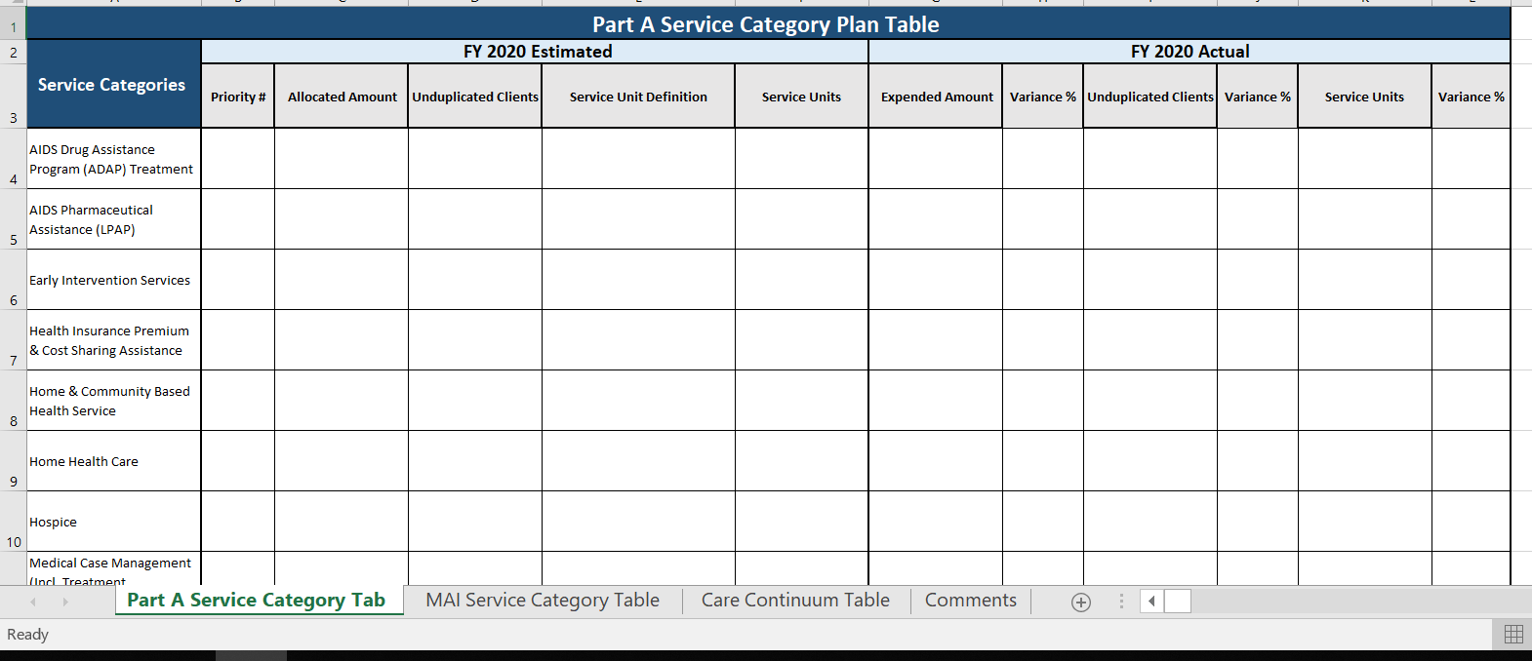
Annual Progress Report Final FY 2020 Service Category Plan Table
Notes:
Deborah
For the purpose of the presentation, this is an abbreviated table. Please note that the table has separate tabs at the bottom – one each, for MAI and non-MAI funding – highlighted in the red circle.
In addition, note that variances within the table will auto populate as data is entered.

Slide 9
Annual Progress Report Final FY 2020 HIV Care Continuum Table
Submit an updated HIV Care Continuum Table showing actual outcomes, including FY 2020 baseline and target data
Service categories related to each stage of the continuum must be included in the service category column of the table
Please explain any factors contributing to meeting or not meeting targets in the comments section
Information on the steps of the HIV care continuum (diagnosis- and prevalence-based) using the HHS indicators is available on the CDC website
Notes:
Deborah
You must submit a final/updated FY 2020 HIV Care Continuum Table that shows the actual outcomes, including the FY 2020 baseline and target data.
This section has to include an explanation of any factors that particularly contributed to meeting or not meeting the target in the comments section. Information on the steps of the HIV care continuum (diagnosis- and prevalence-based) using the HHS indicators is available on the CDC website, the link is included in the slide.

Slide 10
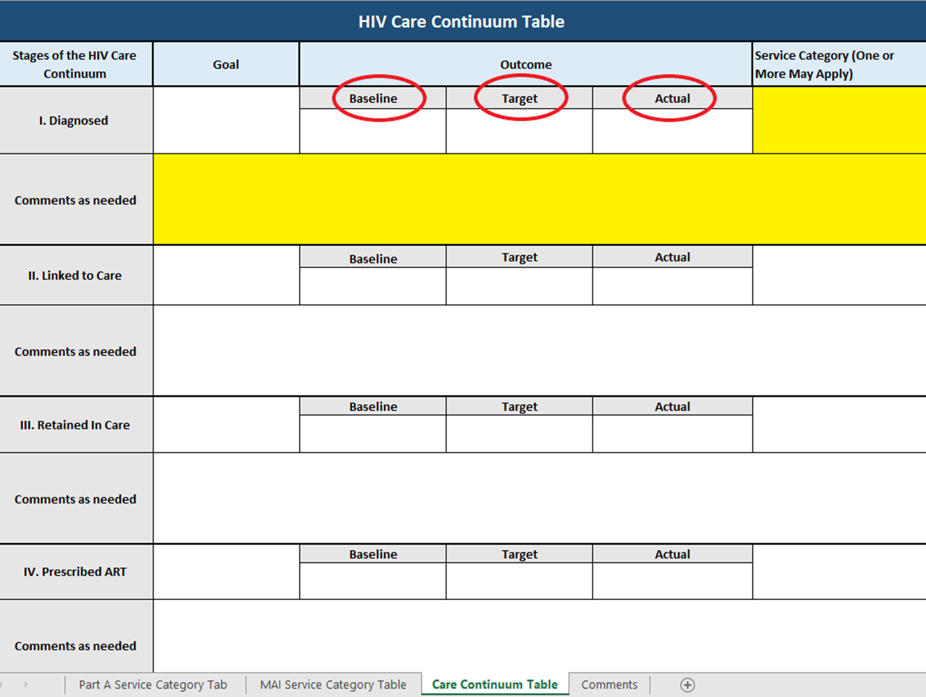
HIV Care Continuum Sample Table
Notes:
Deborah
On this slide, we can see the HIV Care Continuum Table. At the top of the table under your Outcomes, you can see the three specific classification categories: baseline, your original target, and in the far right your actual outcome. Please provide comments as needed on the highlighted section of the table.

Slide 11
Annual Progress Report Final FY 2020 Narrative
Discuss up to five program accomplishments and up to five program challenges
Addressing the National Goals to End the HIV Epidemic and HIV care continuum outcomes
Explain how the following factors have impacted the HIV care continuum outcomes
Expanded/reduced resources
Unmet need
Evolving healthcare landscape (e.g., changes in health care coverage options, COVID-19)
Describe how you share HIV care continuum outcome information with community stakeholders
Notes:
Deborah
The final FY2020 narrative requires addressing three major issues:
Program accomplishments and challenges in addressing the national goals to end the HIV epidemic and the HIV care continuum outcomes.
The impact of expanded or reduced resources, unmet need and the evolving healthcare landscape in the HIV care continuum outcomes
How you share your HIV care continuum outcomes with community stakeholders
This does not have to be a lengthy narrative. Include up to five program accomplishments and up to five challenges with a brief narrative for each.

Slide 12
Annual Progress Report Planning Council/Body (PC/PB) Activities & EIIHA
Describe PC/PB accomplishments and challenges – up to five for each
Discuss challenges related to legislative compliance
Describe EIIHA activities, addressing:
Activities specific to the target populations (successes and challenges)
Contributions to the National HIV/AIDS Strategy goals
Legal barriers
Sharing outcomes
Notes:
Deborah
Now, changing gears I would like to address the Planning Council or Planning Body activities and Early Intervention of Individuals living with HIV, better known as EIIHA.
First, for the planning council or planning body section,
You must describe up to five challenges encountered and up to five accomplishments by your respective Planning Council or Planning Body, and
- Discuss any challenges related to legislative compliance, for example membership.
Next, for EIIHA activities, you should address: (1) activities specific to the target populations, (2) the contributions to achieve the National HIV/AIDS Strategy goals, (3) legal barriers, and (4) how you share your EIIHA outcomes with community stakeholders.

Slide 13
Annual Progress Report MAI Annual Report Narrative
For each of the targeted MAI populations, provide an update on the following:
Viral suppression rates
Subrecipient performance and/or changes in programming or interventions and how these factors have impacted health outcomes
Jurisdictional changes that may have contributed to the lack of improvement in health outcomes
Interventions that had the greatest impact on improved outcomes
Notes:
Deborah
For each of your selected MAI target populations, please provide updates for the following criteria:
Viral suppression rates
Sub recipient performance, and/or changes in programming or interventions that have impacted health outcomes
Jurisdictional changes that may have contributed to the lack of improvement in health outcomes.
Interventions that had the greatest impact on improved outcomes.

Slide 14
Annual Progress Report Certification of Aggregate Administrative Expenditures & WICY Report
Certification of Aggregate Administrative Expenditures
Certifies that the actual amount of funds expended on administrative costs by sub-recipients does not exceed 10% of the aggregate total of all HIV service dollars expended
WICY Report
Template provided
The 2019 WICY data is included as a separate tab on the WICY template
For further guidance on preparing the WICY report, refer to the instructions tab
Notes:
Deborah
On this slide we have two elements: the Certification of Aggregate Administrative Expenditures, which certifies that:
The actual amount of funds expended on administrative costs by Sub-recipients does not exceed 10% of the aggregate total of all HIV service dollars expended
The second element is:
The Women, Infants, Children, and Youth, better known as WICY, Report, which includes:
The 2019 WICY data as a separate tab on the respective WICY template
For further guidance on preparing the WICY report, please refer to the instructions tab.

Slide 15
Annual Progress Report Local Pharmacy Assistance Program (LPAP) Summary
Eligible Metropolitan Areas (EMAs)/Transitional Grant Areas (TGAs) that allocated FY 2020 funds for medications as part of an LPAP must provide an update on the provided template
Notes:
Deborah
Please keep in mind that the Local Pharmacy Assistance Program or better known as LPAP does not apply to everyone. It applies to recipients that allocated funding for LPAP during the application process or the 2020 Program Submission.

Slide 16
Knowledge Check 1
Notes:
Deborah
True/False: For the Part A and MAI Service Category Plan Table, all variances between the estimated and actual figures must to be explained in the comments section.
A: False. Only variances exceeding 20% need to be addressed (slide #5).
Next, I will turn it over to Kristin Athey, who will discuss the Program Terms Report.

Slide 17
2021 Program Terms Report & Program Submission
Program Terms Report (PTR)
The PTR will be submitted in the PTR Web System, and is comprised of:
Consolidated List of Contracts (CLC)
Allocations Report (Table)
Program Submission
The Program Submission will be submitted in EHB, and is comprised of:
PC/PB Chair(s) signed letter
PC/PB Membership Roster and Reflectiveness
Local Pharmacy Assistance Program (LPAP) Profile (if applicable)
Notes:
Kristin
Thank you, Deborah. Next, we will transition to the 2021 reporting requirements. More specifically, I will be going through with you the components of the 2021 Program Terms Report before I turn it over to LCDR Fenner who will walk you through the Program Submission. As many of you may remember, the Program Terms Report (PTR) is submitted separately from the Program Submission, in the Grant Contract Management System (GCMS), which is located within the Electronic Handbooks (also known as the EHB).
The Program Terms Report is comprised of the Consolidated List of Contracts (CLC) and the Allocations Table, both of which will be generated in the Program Terms Report Web System (also known as the PTR Web System) similar to the process last year.
The Program Submission will be submitted in the EHB and will contain the remaining components (e.g., PC/PB letter of concurrence, LPAP profile, if applicable, and PC/PB roster). LCDR Fenner will go into further detail once we get to the Program Submission section of the webinar.

Slide 18
Program Terms Report Web System Guidance
PTR submission process is two-fold:
Entry of contract information into the Grantee Contract Management System (GCMS)
Subsequent generation of the CLC and Allocations Report in the PTR Web System
If there are any questions or issues with the PTR submission process, contact the data support team at
888-640-9356 or ryanwhitedatasupport@wrma.com
Notes:
Kristin
The process of submitting the PTR is two-fold. Recipients must first enter Ryan White Part A Program contracts with HIV service and non-HIV service entities into the GCMS. Following this, recipients can generate the Allocations Table and CLC in the PTR Web System. You will note that the PTR Web System pulls information from GCMS to generate the CLC and Allocations Table.
The GCMS and PTR Web System manuals are available on the Target HIV website, and provide additional information on how to generate the CLC and Allocations Table.
If there are any questions or issues with the Program Terms Submission process, please follow up with the data support team by phone at 1-888-640-9356 or by e-mail at ryanwhitedatasupport@wrma.com. You can also reach out to your Project Officer.

Slide 19
Program Terms Report Consolidated List of Contracts
Purpose: Identifies all service and non-service contracts being funded for the current grant year
All contracts that have been executed or planned to be executed should be entered into GCMS and will be reflected in the CLC
Notes:
Kristin
The first of the two PTR components is the Consolidated List of Contracts (CLC). The CLC is a reporting tool used to report all Part A and MAI service providers and non-service contracts receiving funds for the current grant year. As previously mentioned, the information displayed on the CLC is auto-populated based on information entered in the GCMS. Therefore, it is important to ensure that the contract information in GCMS is updated for the current grant budget year before you submit the CLC.
All contracts that have been executed or you plan to execute should be reflected in the CLC and you must also use placeholders for unexecuted contract amounts where a subrecipient or contractor has not yet been identified at the time of the CLC submission—these contracts are entered as “unidentified subrecipient providers”.

Slide 20
Program Terms Report Consolidated List of Contracts
Before submitting your CLC, be sure to:
Address any validation issues (i.e., errors, warnings, and/or alerts)
Clearly identify executed and unexecuted contracts
Identify placeholder contracts (i.e., unidentified subrecipient provider)
Include all contracts (e.g., HIV service, administrative, CQM contracts, etc.)
Cross reference the CLC with the Allocations Table
Notes:
Kristin
Let’s look at some tips for submission of the CLC. Before submitting the CLC, you should ensure that you:
Address any validation issues (warnings and/or errors)
Identify all executed and unexecuted contracts
Identify any placeholder contracts (unidentified subrecipient providers)
Include all contracts, not just the HIV-service contracts
Cross-reference with the Allocations Table

Slide 21
Program Terms Report RWHAP Part A & MAI Allocations Report
Purpose: Reports Planning Council or Planning Body allocations of RWHAP funds in accordance with Notice of Award (NoA) reporting requirements
Identifies funded service categories
Reports the percentage of allocations for core medical and support services
Ensure the 75/25 requirement is met (unless waiver is approved)
Reports the Administrative and Clinical Quality Management (CQM) percentages
Ensure the 10% Administrative and the 5% or $3 million (whichever is less) CQM caps are not exceeded
Notes:
Kristin
The second component of the Program Terms Report is the Part A and MAI Allocations Table. As many of you may know Ryan White legislation requires Planning Councils establish service priorities and the allocation of funds within the eligible area.
The Allocations Table is a reporting tool used by recipients to report their allocation of Ryan White funds in accordance with the conditions of the award. It outlines the anticipated administrative and service delivery costs for the current fiscal year, identifies the funded service categories, and ensures the 75/25 core medical and support services rules are met.
Should there be a greater need for support services (i.e., your support service aggregate allocation is greater than 25 percent), you can submit a core medical services waiver for approval. If you have been approved for a Core Medical Service Waiver, please remember to check the box indicating so. The Table also ensures that the administrative and CQM caps are met.

Slide 22
Program Terms Report RWHAP Part A & MAI Allocations Report
The Allocations Report is generated in the PTR Web System after all contract information has been entered into the GCMS
The Allocations Report will auto-populate using contract amounts in GCMS
To change HIV service allocations, contract information in GCMS must first be updated
Amounts for Administration and CQM are entered manually
Perform validation checks
Notes:
Kristin
You will be able to generate the Allocations Table in the PTR Web System after all contracts have been entered into the GCMS. Any changes to HIV service category allocations will need to be made to the applicable contracts in GCMS for the changes to be reflected in the Allocations Table.
Non-HIV service allocations (e.g., Administrative and Clinical Quality Management (CQM) costs) will need to be entered manually in the Allocations Table. This includes potential non-HIV service contracts (e.g., a contract for Planning Council Support) that were entered in GCMS.
The PTR Web System will allow recipients to perform a validation check on the amounts in the Allocations Table. Errors and/or warnings (e.g., caps on Administrative and CQM allocations, core medical and support service percentage requirements, etc.) must be addressed prior to submission of the Allocations Table.
Contact Ryan White Data support should you encounter an error or warning that you cannot resolve.
Next, we’re going to take a look at an example of a Part A & MAI Allocations Table.

Slide 23
Program Terms Report RWHAP Part A & MAI Allocations Report
Notes:
Kristin
The Allocations Table is broken out into two segments for the purpose of this webinar. The first portion illustrates the award information as well as a summary of the allocation categories. More specifically this section presents:
The service dollar amounts allocated for the current fiscal year broken down into Part A Base plus Supplemental and the MAI amounts, as well as non-service dollar amounts allocated to Administration and CQM.
Please be aware that the core medical services and support services percentages in this section of the Allocations Table are displayed as a proportion of the entire award, not as a proportion of the dollars allocated to HIV services.

Slide 24
Program Terms Report RWHAP Part A & MAI Allocations Report
Notes:
Kristin
The second section of the Allocations Table focuses on the service categories. As you can see, the core medical services and support services percentages are correctly shown as a proportion of the dollars allocated to HIV services.
Prior to submitting the Allocations Table, please ensure that your allocations comply with the 75/25 percentage requirements unless you have an approved core medical services waiver.

Slide 25
Program Terms Report RWHAP Part A & MAI Allocations Report
Before submitting your Allocations Report:
Ensure the Allocations Report service category amounts match the list of allocations included with the PC or PB letter
Ensure that errors, warnings, and/or alerts encountered during validation are addressed, for example:
75/25 core medical and support service requirement is not met (unless waiver is approved)
Caps on Administrative and CQM expenses are not met
Cross-reference the Allocations Report with the final NoA
Notes:
Kristin
Here are some helpful tips to reference for the Allocations Table.
Ensure the Allocations Table service category amounts match the list of allocations included with the PC/PB letter submitted with the Program Submission. POs will cross-reference the PC/PB letter and list of allocations to verify that the Allocations Table matches.
You want to ensure that errors and warnings encountered during the validation checks are addressed; including:
Caps on Administrative and CQM requirements are complied with
Ensuring that the 75/25 core medical and support service requirement is met unless you have a waiver based on the standard Core Medical Services (CMS) waiver process. Please note for the purposes of this presentation we are not addressing the specifics of the recently released waivers as it relates to the COVID-19 pandemic, if you have any questions about the COVID related waivers please contact your Project Officer.
You also want to make sure that you cross-reference the Allocations Table totals with the Final NoA
Over the last couple of years we realized some recipients entered dollar amounts in the MAI education and MAI outreach sections. Please do not enter dollar amounts for these service categories, as well as, the Pediatric Development Assessment category. These fields are specific to other RWHAP parts. Recipients may allocate dollars to MAI outreach by populating the Outreach Services field in the MAI award column.

Slide 26
Program Terms Report RWHAP Part A & MAI Allocations Report
Do not populate the “MAI Education,” “MAI Outreach,” or “Pediatric Development Assessment” fields as they are specific to other RWHAP Parts.
Recipients may allocate MAI funding to outreach by populating the Outreach Services field in the MAI Award column.
Notes:
Kristin
Note the circled services categories where no data should be entered: Pediatric Development Assessment, MAI Education, and MAI Outreach.

Slide 27
Knowledge Check 2
Notes:
Kristin
True/False: Non-HIV service allocations (e.g., Administrative and Clinical Quality Management (CQM) costs) will need to be entered manually in the Allocations Table.
A: True. (slide 22)
Next, we will hear from LCDR Fenner about the Program Submission.

Slide 28
Program Submission
A signed letter from PC/PB chair(s) endorsing FY 2021 priorities and allocations
Including a copy of the RWHAP Part A and MAI Allocations Table signed by the PC or PB chair(s)
PC/PB Membership Roster and Reflectiveness Report
Local Pharmacy Assistance Program (LPAP) Profile
Notes:
LCDR Fenner
Thanks Kristin, and good afternoon everybody. I will be reviewing the Program Submission. As you may recall from last year, the Program Submission is submitted in EHB, and is comprised of the following components:
A signed letter from Planning Council or Planning Body Chair(s) endorsing priorities and allocations, in addition to a list of the service category allocations approved by the Planning Council or Planning Body. Electronic signatures are acceptable.
The Planning Council and Planning Body Membership Roster and Reflectiveness table, and
The Local Pharmacy Assistance Program (LPAP) Profile

Slide 29
Program Submission Signed letter from PC/PB Chair(s)
The letter must indicate that the PC/PB concurs with the funded service categories and the dollar amounts reflected on the FY 2021 RWHAP Part A and MAI Allocations Table
Include a list of the FY 2021 RWHAP Part A & MAI service category allocations approved by the PC or PB
Notes:
LCDR Fenner
The first component of the Program Submission is a signed letter from the Planning Council or Planning Body chair or chairs. This letter must indicate that the Planning Council or Planning Body concurs with the funded service categories and the dollar amount reflected on the FY 2021 Part A and MAI Allocations Table submitted with the Program Terms Report.
Along with this letter, please be sure to include a copy of the document containing the service category allocations approved by the Planning Council or Planning Body during the PSRA process leading into the 2021 program year. This document must also be signed by the Planning Council or Planning Body Chair.

Slide 30
Program Submission PC/PB Membership Roster and Reflectiveness Report
Purpose: Illustrates whether the PC/PB membership is in compliance with legislative reflectiveness and representation requirements.
Notes:
LCDR Fenner
The second component of the Program Submission is the Planning Council and Planning Body membership roster and reflectiveness table.
This table is a reporting tool used to demonstrate the recipient’s compliance with the legislative requirements for Planning Council membership. The purpose of this roster is to identify the planning council’s or planning body’s membership and to ensure that it is representative and reflective of the HIV epidemic in the EMA/TGA jurisdiction.

Slide 31
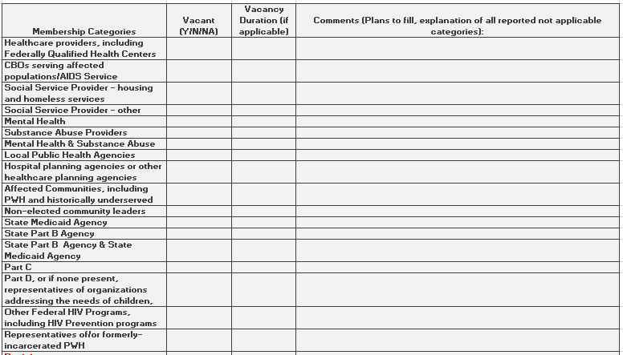
Program Submission PC/PB Membership Roster and Reflectiveness Report
Notes:
LCDR Fenner
This slide provides a screenshot of the Planning Council and Planning Body roster and reflectiveness table – note that it is an abbreviated version of the table. There are four worksheets in the Excel workbook. The current slide is a screenshot of the PC/PB Membership Category tool. There is also a worksheet for the membership roster table, the reflectiveness table, and a worksheet for instructions to correctly complete the tables.
The PC/PB Membership Category tool is a new worksheet that was added this year to help planning councils/planning bodies identify vacant legislatively required membership representatives and develop a plan to address the deficiency.
That said, the PC/PB Membership Category Tool is broken down into four columns:
Membership Categories (which are pre-populated)
Vacancy status (Y/N/NA)
Duration of vacancy (if applicable), and
Comments.
For each of the listed Membership Categories fill in the corresponding Vacant, Vacancy duration, and comments columns.
1) In the Vacancy column use the drop down menu to select yes, no, or not applicable.
2) In the Vacancy Duration column, indicate the duration of vacancy for any membership categories marked “Yes” for Vacant.
3) In the comments column, provide your plan to correct the deficiency in all legislatively mandated membership categories that are marked as vacant as well as any challenges associated with filling the position.
Please note: There are three exceptions to the rule on separate representation for membership categories listed in the instructions worksheet. For the purposes of this tool please indicate exceptions to the separate representation rule by using the “not applicable” option in the “Vacant” column drop down menu and include an explanation in the comments section.
Again, specific examples of these exceptions are provided in the instructions worksheet of the PC/PB Membership Roster and Reflectiveness Report.

Slide 32
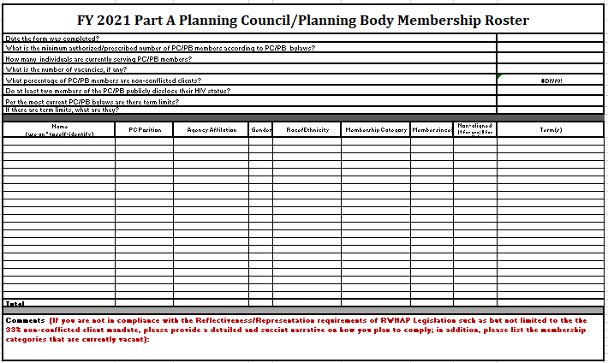
Program Submission PC/PB Membership Roster and Reflectiveness Report
Notes:
LCDR Fenner
This slide provides a screenshot of the Planning Council and Planning Body roster and reflectiveness table.
That said, the Membership Roster table is broken down into three sections: The first section includes the following information:
The date the form was completed
The total authorized or prescribed number of members according to the By-laws (i.e., the minimum number);
The number of individuals that are currently serving members;
The number of vacancies, if any;
The percentage of members that are non-conflicted clients;
An indication that at least two members of the PC/PB publicly disclose their HIV status, and;
Whether there are term limits in the current By-laws.
The Second section lists the:
Members (remember to use an asterisk for self-disclosure)
Position in Planning Council or Planning Body
Agency Affiliation
Gender
Race/Ethnicity
Membership Category
Length of membership
Non-conflicted status, and
Terms served
The third section is used for comments. The expectation is that rationale must be provided in this section for non-compliance with the reflectiveness and representation requirement, in addition to a plan to regain compliance. Furthermore, include rationale and remedy steps for membership categories that are currently vacant. HRSA/HAB recommends recipients utilize the provided “PC/PB Membership Category Tool” worksheet to assist them with identification of mandated representation categories and the development of a plan to resolve vacancies.

Slide 33
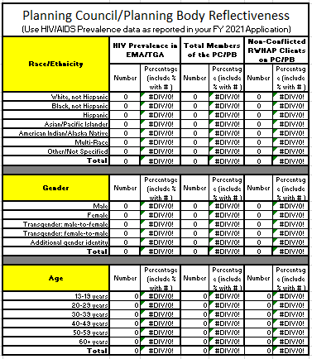
Program Submission PC/PB Membership Roster and Reflectiveness Report
Notes:
LCDR Fenner
This slide provides a screenshot of the Planning Council and Planning Body reflectiveness table, which, as the title indicates, demonstrates how the Planning Council or Planning Body membership is reflective of the epidemic in the jurisdiction. To complete this table accurately, please use the most recent prevalence data or data used for your FY 21 application.
Taking a closer look at the reflectiveness table, you will see that it reports on race/ethnicity, gender, and age. For each demographic, please provide data on:
the number of living HIV cases in EMA/TGA
the number of Members of the PC/PB under each category, and
the number of non-conflicted Clients under each category
Please note that the reflectiveness table has formulas embedded in certain cells to aid with the conversion of numbers entered to percentages.

Slide 34
Program Submission PC/PB Membership Roster and Reflectiveness Report
The PC/PB Membership Roster and Reflectiveness Report demonstrates compliance with the following legislative requirements:
Membership complies with membership categories (i.e., the legislative representation requirement)
33 percent of voting members must be receiving RWHAP Part A services and be “unaligned”
They are not staff, paid consultants, or Board members of RWHAP Part A-funded agencies
Overall PC/PB membership, and the 33% of people with HIV unaligned clients, must both reflect HIV/AIDS demographics
Notes:
LCDR Fenner
Here are some tips and guidelines to follow prior to submitting your Planning Council and Planning Body membership roster and reflectiveness table. You will want to ensure that:
membership complies with mandated membership categories (i.e., the legislative representation requirement);
Planning Council and Planning Body membership and the 33% PWH non-conflicted/unaligned clients must both reflect HIV demographics, and;
at least 33% of members are clients that are currently accessing Part A Services and are unaligned/non-conflicted. For clarification:
non-conflicted or unaligned means that there is no benefitting party affiliation with the clients (i.e. They are not staff, paid consultants, or Board members of RWHAP Part A-funded agencies) and
Conflict of interest requirements apply to the Planning Council or Planning Body.
It is highly recommended to use the “PC Membership Category Tool Worksheet” to assist with the Roster Reflectiveness table.

Slide 35
LPAP Profile
An LPAP is not a substitute for the RWHAP AIDS Drug Assistance Program (ADAP). It provides medications when the ADAP is not meeting the needs of the clients
Note: LPAP cannot be used for medications provided on an emergency or short-term basis. (See Emergency Financial Assistance)
The LPAP is developed based on need and complies with the National Monitoring Standards (NMS)
See the LPAP Clarification Program Letter for reference
Notes:
LCDR Fenner
The final component of the Program Submission is the Local Pharmacy Assistance Program profile, also known as the LPAP profile. As a reminder, the purpose of an LPAP is “…means of providing ongoing medication assistance when an HRSA RWHAP ADAP has a restricted formulary, waiting list and/or restricted financial eligibility criteria.”
LPAP is not a substitute for the AIDS Drug Assistance Program (ADAP); instead, it is intended to provide medications when the ADAP does not meet the needs of the clients of the EMA/TGA.
Additionally, LPAP is not to be used for short-term or emergency medication needs. And lastly, the LPAP should be developed based on need and must comply with the National Monitoring Standards.
Please refer to the LPAP Clarification Program Letter for additional detail on LPAP—a link is included in this slide.

Slide 36
LPAP Profile
Components:
Statement of Need – Supports and justifies LPAP funding and, at a minimum, describes the inability of ADAP to meet medication needs of clients. It also describes process for ensuring LPAP is payer of last resort.
Structure of the LPAP – Describes compliance with the National Monitoring Standards, including a description of: advisory board, formulary, eligibility, coordination with other payers, cost savings strategies, and distribution/record keeping.
Note: 1) LPAP Profile is not required if previously submitted in the FY 21 application, 2) limit LPAP Profile to 3 pages or less, and 3) provide a brief description of any changes in the previously submitted LPAP Profile and the impact on clients
Notes:
LCDR Fenner
Not all recipients may be required to submit the LPAP profile. The LPAP Profile is applicable only to recipients that are allocating funds to the LPAP service category if funds were not allocated in the previous year. Also, the LPAP Profile is not required if the information was previously submitted in the FY 21 application. Based on this, if you are required to submit an LPAP profile, there are two sections which include:
A Statement of Need, which supports and justifies the prioritization and allocation of funds to the LPAP service category in the jurisdiction, and
2. Structure of the LPAP Profile, which addresses compliance with the National Monitoring Standards, indicates the presence of an advisory board, describes LPAP and ADAP formularies, the eligibility and enrollment process, and cost savings strategies. More information can be found in the program submission instructions.
Please keep your LPAP profile to three pages or less.
Lastly, as alluded to on the previous slide, LPAP dollars are not to be used for short-term or emergency medication needs (for example, paying for medications for clients who are in the process of applying to the state ADAP program, also known as “bridging clients”).

Slide 37
FY 2020 Expenditure Report
Please note the FY 20 Expenditure Report will be submitted through the PTR system.
A new expenditure report manual will be available with instructions on the submission process.
Notes:
And now I would like to hand off the presentation to our fellow presenter Brian from WRMA who will be providing updates on the new Expenditure report process…..

Slide 38
Questions
Notes:
LCDR Fenner
Thank you Brian Mcbee.
Again, we will not be conducting a real-time question and answer session today. If you have a question, please type it into the Q&A pod, and we will follow-up via e-mail. Alternately, you may direct your question to your project officer.

Slide 39
Presenter Information
Chrissy Abrahms Woodland, LCDR Jon Fenner, Deborah Medina, Kristin Athey
Reporting Requirements Workgroup
HIV/AIDS Bureau (HAB)
Health Resources and Services Administration (HRSA)
Web: hab.hrsa.gov
Notes:
LCDR Fenner
Thank you for participating in this webinar. A special thank you to the reporting requirements work group for their hard work pulling together the webinar and guidance documents.
You may download all documents discussed during the webinar from the chat section on your screen. The documents are available in the EHB, as well as on the calendar invite for today’s webinar.
Please keep in mind Project Officers have a different version of EHB than recipients, for EHB navigation assistance contact the EHB helpdesk at 877-464-4722.
For programmatic assistance, please contact your Project Officer.

Slide 40
Connect with HRSA
Learn more about our agency at:
www.HRSA.gov
Sign up for the HRSA eNews
FOLLOW US:
Notes:
HRSA is on four social media platforms. We encourage you to follow along and share our content on Twitter, Facebook, LinkedIn and Instagram to stay up-to-date on the latest HRSA news. Our account/handle on each platform is @HRSAgov.
Additionally, we also encourage you to sign up for HRSA’s e-News, a biweekly email of comprehensive HRSA news, and to sign up for HRSA press releases. You can also visit our website www.HRSA.gov for more detailed information about all of our programs.

