Slide 1
The National HIV/AIDS Strategy and Quality Improvement
Adam Thompson & Deloris Dockrey
June 25, 2019
4:00PM – 5:00PM EST

Slide 2
Learning Objectives
Introduce the National HIV/AIDS Strategy (NHAS) and the United States HIV Care Continuum
Review the NHAS Goals and Progress Indicators
Introduce and Define Clinical Quality Management (CQM)
Explore the use of quality improvement to address HIV-related health disparities
Discuss ways Persons Living with HIV can be involved in implementing the NHAS through CQM

Slide 3
United States HIV Care Continuum
The National HIV/AIDS Strategy: Updated to 2020 Indicator Supplement December 2016
Notes:
Introduce the HIV Care Continuum and highlight that improvements are needed to diagnose Persons Living with HIV who are unaware of their status and improvements in retention and linkage through care and supportive services to ensure that all persons are virally suppressed

Slide 4
Vision of the National HIV/AIDS Strategy
The United States will become a place where new HIV infections are rare, and when they do occur, every person, regardless of age, gender, race/ethnicity, sexual orientation, gender identity, or socio-economic circumstance, will have unfettered access to high quality, life-extending care, free from stigma and discrimination.
Office of National AIDS Policy . National HIV/AIDS Strategy for the United States: Updated to 2020. White House; Washington, DC: 2015.
Notes:
In July of 2010 the United States Office of National AIDS Policy in collaboration with communities and stakeholders issued the first set of national goals. In 2009 through a series of community town halls and technical expert panels, the HIV community sought to collect the needs of Persons Living with HIV across the nation.
Our national goals were informed by the voices of over 4200 people attending 14 different community meetings. Over 800 public comments were submitted and special meetings were held to discuss the epidemic in relationship to Women, Youth, and Housing.
The measurable goals use evidence-based indicators which aligned national efforts in the hope that through coordination and collaboration communities might continue to bend the curve and reduce the number of people acquiring HIV and the number of people dying HIV-associated morbidity.
In 2015 our national goals were evaluated and updated based on changes in communities and in the science of HIV disease. The new goals recommitted the community to continued integration with a focus on measurable outcomes.

Slide 5
National HIV/AIDS Strategy
There is still an HIV epidemic and it remains a major health issue for the United States.
Most people can live long, healthy lives with HIV if they are diagnosed and get treatment.
For a variety of reasons, certain populations bear a disproportionate burden of HIV.
People across the nation deserve access to tools and education to prevent HIV transmission.
Every person diagnosed with HIV deserves immediate access to treatment and care that is non-stigmatizing, competent, and responsive to the needs of the diverse populations impacted by HIV
Office of National AIDS Policy . National HIV/AIDS Strategy for the United States: Updated to 2020. White House; Washington, DC: 2015.

Slide 6
Goals of the Strategy

Slide 7
Goals of the National HIV/AIDS Strategy
Reduce New Infections
Increase Access to Care and Improve Health Outcomes for People Living with HIV
Reduce HIV-Related Health Disparities and Health Inequities
Achieve a More Coordinated National Response to the HIV Epidemic

Slide 8
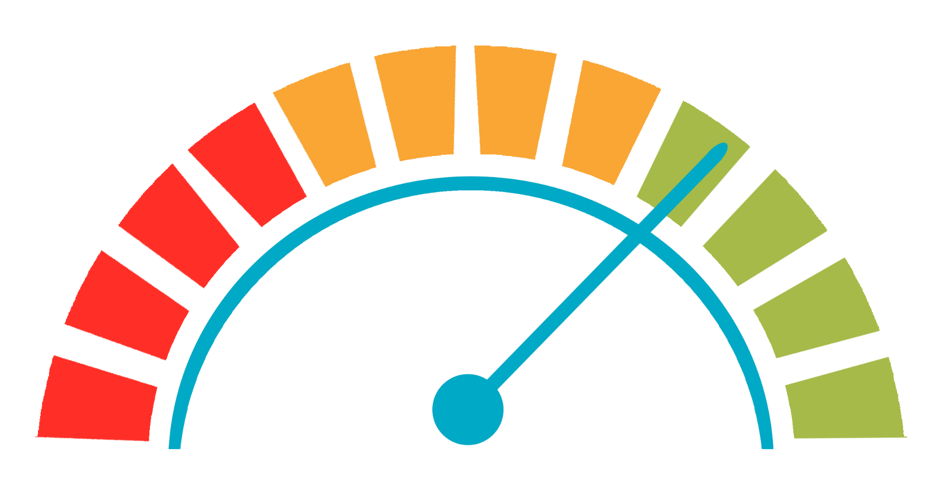
Indicators of progress

Slide 9
Indicators of Progress
Increase the percentage of people living with HIV who know their serostatus to at least 90 percent.
Reduce the number of new diagnoses by at least 25 percent.
Reduce the percentage of young gay and bisexual men who have engaged in HIV-risk behaviors by at least 10 percent.
Increase the percentage of newly diagnosed persons linked to HIV medical care within one month of their HIV diagnosis to at least 85 percent.

Slide 10
Indicators of Progress
Increase the percentage of persons with diagnosed HIV infection who are retained in HIV medical care to at least 90 percent.
Increase the percentage of persons with diagnosed HIV infection who are virally suppressed to at least 80 percent.
Reduce the percentage of persons in HIV medical care who are homeless to no more than 5 percent.
Reduce the death rate among persons with diagnosed HIV infection by at least 33 percent.

Slide 11
Indicators of Progress
Reduce disparities in the rate of new diagnoses by at least 15 percent in the following groups: gay and bisexual men, young Black gay and bisexual men, Black females, and persons living in the Southern United States.
Increase the percentage of youth and persons who inject drugs with diagnosed HIV infection who are virally suppressed to at least 80 percent

Slide 12
Developmental Indicators
Increase the percentage of transgender women in HIV medical care who are virally suppressed to at least 90 percent.
Increase the number of adults prescribed PrEP by at least 200 percent.
Decrease stigma among persons with diagnosed HIV infection by at least 25 percent.

Slide 13
Questions or Comments

Slide 14
Quality Improvement

Slide 15
Policy Clarification Notice 15-02
The purpose of this policy clarification notice (PCN) is to clarify the Health Resources and Services Administration (HRSA) Ryan White HIV/AIDS Program (RWHAP) expectations for clinical quality management (CQM) programs.

Slide 16
Components of a CQM Program
CQM program is the coordination of activities aimed at improving patient care, health outcomes, and patient satisfaction.
CQM activities should be continuous and fit within and support the framework of grant administration functions.
Components of a CQM program
Infrastructure
Performance measurement
Quality improvement

Slide 17
Quality Improvement
Quality improvement entails the development and implementation of activities to make changes to the program in response to the performance data results.
Recipients are required to implement quality improvement activities aimed at improving patient care, health outcomes, and patient satisfaction.
Recipients are expected to implement quality improvement activities using a defined approach or methodology.

Slide 18
A National HIV Quality Improvement Project
Notes:
Discuss how NHAS is a giant QI project aimed at aligning efforts across the country to measurably improve outcomes – these outcomes are more efficiently attained when using a QI lens to directly affect specific services and processes.

Slide 19
Service Improvement Along the Continuum
Notes:
Discuss the role of RWHAP services in making improvements in the HIV Care Continuum – with projects aimed at each of the service and implemented effectively, agencies can expect to see improvements at all stages of the continuum.

Slide 20
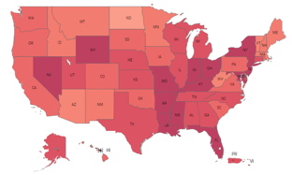
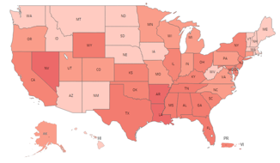
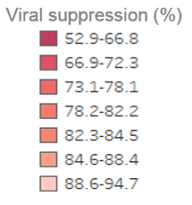
Viral Suppression among Clients Served by the Ryan White HIV/AIDS Program (non-ADAP), by State, 2010–2015—United States and 3 Territories*
83.4%
IN 2015
VIRALLY SUPPRESSED
69.5%
IN 2010
VIRALLY SUPPRESSED
* Health Resources and Services Administration, HIV/AIDS Bureau. Ryan White HIV/AIDS Program Services Report 2014. Rockville, MD, 2015.
Viral suppression: ≥1 OAMC visit during the calendar year and ≥1 viral load reported, with the last viral load result <200 copies/mL
Notes:
Highlight the importance of QI in improvements in Viral Load Suppression – this is an achievable goal with people who are diagnosed, in care, and supported. Briefly mention that while this national view shows great improvements, when we look at particular communities and jurisdictions there are still great disparities at the individual and community level – to achieve health equity, we will need to focus our efforts and ensure our care is culturally responsive and tailored to the those communities experiencing health disparities.

Slide 21
Quality and the National Strategy
Notes:
Introduce an example of how RWHAP programs are addressing NHAS priorities – i.e. health disparities – through quality improvement projects as an example of how QI aligns with the strategy implementation

Slide 22
Disparity and Equity
Health Disparity – systematic difference in health between social groups
Health Equity - the absence of disparities or avoidable differences among social groups
Adapted from: HEALTH RESOURCES AND SERVICES ADMINISTRATION, OFFICE OF HEALTH EQUITY. HEALTH EQUITY REPORT 2017. ROCKVILLE, MARYLAND: U.S. DEPARTMENT OF HEALTH AND HUMAN SERVICES; 2018.
Notes:
Review the definitions of Health Disparity and Health Equity – highlight the CQII ECHO Collaborative as one mechanism being used to address HIV-related Health Disparities in communities experiencing these disparities

Slide 23
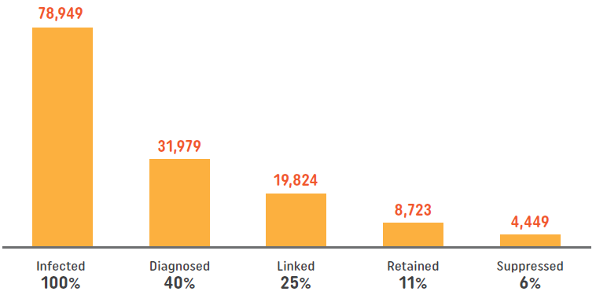
Youth Aged 13-24
HIV Care Continuum in HIV-infected Youth in the United States
Only 6% of youth are estimated to be virally suppressed, compared to an average rate of 30% across all age groups.
Zanoni BC and Mayer KH. The adolescent and young adult HIV cascade of care in the United States: exaggerated health disparities. AIDS Patient Care STDS. 2014;28(3):128-35. CDC, http://www.cdc.gov/hiv/pdf/library/factsheets/understanding-hiv-care-continnum.pdf
Notes:
Explore the challenges faced when looking at communities and sub-populations – while we have achieved a lot towards our NHAS goals, further analysis shows we have a lot of work to do still.

Slide 24
CQII end+disparities ECHO Collaborative
The end+disparities ECHO Collaborative, a national quality improvement initiative with participation by Ryan White HIV/AIDS Program (RWHAP) Recipients and Sub-Recipients across all Parts.
The Collaborative focuses on reducing disparities by increasing viral suppression rates in four disproportionately affected subpopulations of people living with HIV (PLWH):
MSM of Color, Black/African American and Latina Women, Transgender People, and Youth.

Slide 25
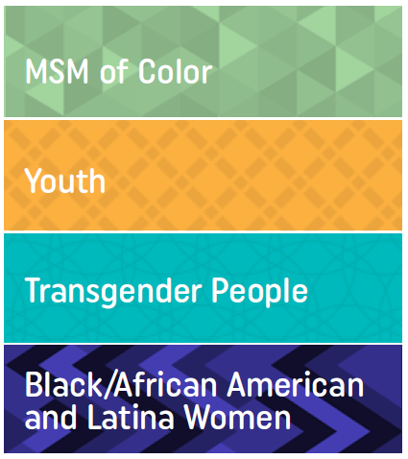
Collaborative Overview
Each Collaborative participant is asked to focus their improvement efforts on one identified subpopulation
Participants join virtual special-interest groups based on shared interests, such as subpopulations (Affinity ECHO Session)
Recipients and subrecipients partner with other local HIV providers to form regionally-based improvement groups (Regional Group)
Learning sessions with all participants are held every five months, starting Jun 2018 and ending Sep 2019

Slide 26
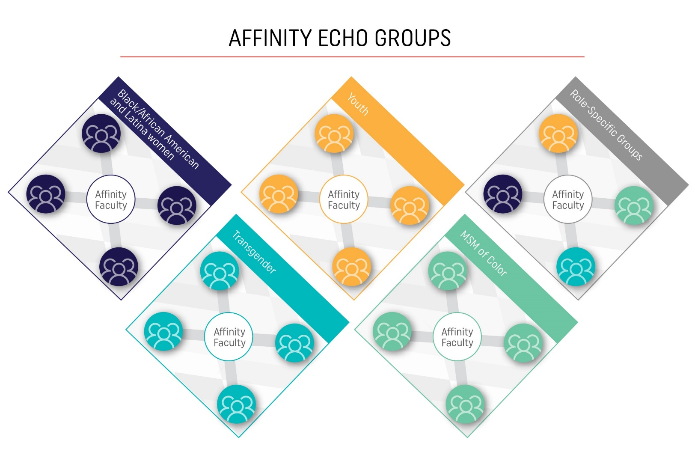
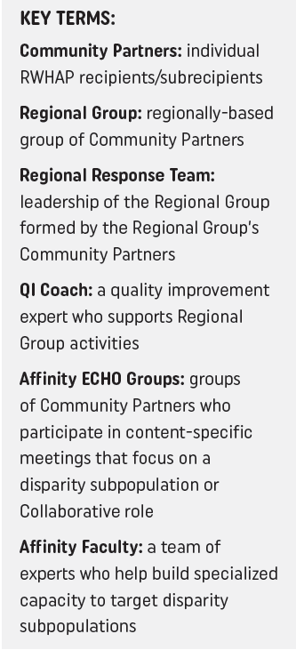

Slide 27
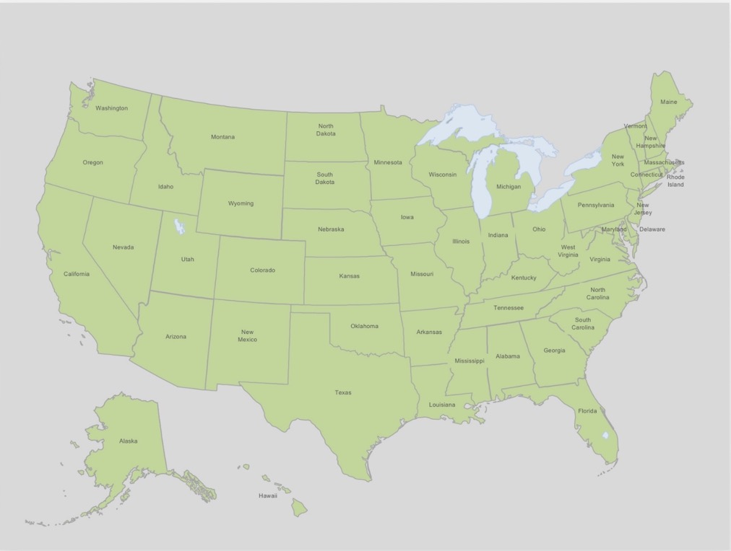
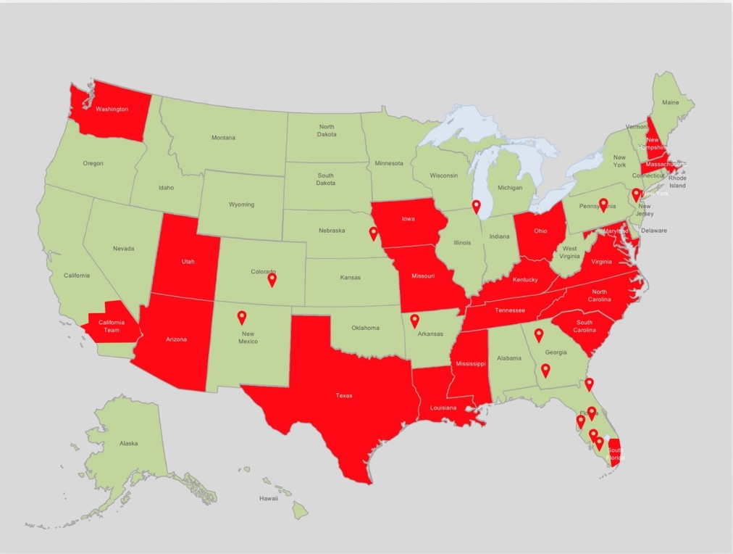
end+disparities ECHO Collaborative Teams
Arizona
California Regional Group
Mavericks Regional Group
Louisiana
Maryland
Massachusetts / New Hampshire
Mississippi
Missouri
New York Regional Group
North Carolina
Ohio
South Carolina
South Florida
Tennessee / Kentucky
Texas
Washington State
Washington, DC / Virginia
end+disparities ECHO Collaborative Enrollment Data: May 25, 2018
Notes:
27

Slide 28
Collaborative Milestones
17 Collaborative Teams = largest HIV Collaborative!
31/50 States/Territories are represented in the Collaborative
38% (214 out of 567) of all federally funded Ryan White recipients are participating in the Collaborative
Collaborative has the potential to reach an estimated 145,000 or 43% of all Ryan White patients (RSR 2017 Data) – 1 in every 2.3 RWHAP patients!
8 out of 15 State Health Departments with the lowest viral suppression rates participate, as well as 9 out of 15 City Health Departments with the highest number of RWHAP clients
end+disparities ECHO Collaborative Data Feb 2019
Notes:
Low Incidence Collaborative – 17 States/Territories (2007)
Part B Collaborative: Alabama, Georgia, Florida,
Michigan, Missouri, Ohio, Oregon, and Washington, DC – reaching 79,000 1 in every 4.3 RW patients
9/16 with lowest VL rates 8/16 with highest # of RW pts 10/16 w highest # of RW pts
28

Slide 29
Viral Suppression (Jul 2018 – Apr 2019)
What Are the Data Telling Us? Cross-Sectional Data Submissions (Preliminary Results)
Overall Viral Suppression Rates
‘Based on the initial data cycle (Jul 2018 – 83.3%), the overall aim is to reach a 87.5% viral suppression rate by the end of the Collaborative to decrease the number of people living with HIV who are not virally suppressed by 25%.’
Data Cycle | Denominator | Numerator | VS %
Mar 2019 | 119,403 | 102,328 | 85.7%
Jan 2019 | 124,197 | 105,940 | 85.3%
Nov 2018 | 120,041 | 100,234 | 83.5%
Sep 2018 | 132,633 | 109,953 | 82.9%
Jul 2018 | 140,328 | 116,893 | 83.3%
Subpopulation Viral Suppression Rates
 | AA Latina Women | MSM of Color | Transgender | Youth
Mar 19 | 85.1% | 84.0% | 80.3% | 76.0%
Jan 19 | 84.1% | 81.7% | 80.5% | 75.0%
Nov 18 | 82.6% | 82.2% | 78.9% | 72.6%
Sep 18 | 81.8% | 81.9% | 76.2% | 72.3%
Jul 18 | 81.7% | 80.9% | 77.2% | 72.2%
Viral Suppression Rate
Notes:
Notes:
Routine performance measurement reporting focuses on one standardized measure of viral suppression for two groups. Data are submitted every other month and each Community Partner is asked to report viral suppression data for:
a) all HIV patients receiving HIV outpatient ambulatory health services in a 12-month measurement period (entire HIV caseload)
b) all HIV patients identified in the participant-selected disparity subpopulation who receive HIV outpatient ambulatory health services in a 12-month measurement period (HIV subpopulation)
The Collaborative utilizes the HAB viral suppression measure definition (National Quality Forum #: 2082): percentage of patients, regardless of age, with a diagnosis of HIV with an HIV viral load less than 200 copies/ml at last HIV viral load test during the measurement year
Key Messages (as of Apr 17, 2019):
So far, 5 bi-monthly data submissions occurred, starting in July 2018; the last submission occurred in March 2019
Approximately 100 RWHAPs have submitted data and the total patients entered ranged from 119,000 to 140,000 HIV-infected individuals served by Collaborative participants per reporting cycle
Overall, average VLS for entire HIV caseload and HIV subpopulations have increased from July 2018 to March 2019.
The overall average VLS rate increased from 83.3% (Jul 2018) to 85.7% (Mar 2019)
During the same time period, the subpopulation VLS rates increased for Black/AA Latina Women from 81.7% to 85.1%; MSM of Color from 80.9% to 84.0%; Transgender from 77.2% to 80.3%; and Youth from 72.0% to 76.0%
The Collaborative aim is to reach VLS rate of 87.5% by the end of the Collaborative – we are getting closer to achieving this goal!

Slide 30
Viral Suppression (Jul 2018 – Apr 2019)
Are We Improving? Difference between First and Last Submission for Each HIV Subpopulation (Preliminary Results)
‘Modest gains in viral suppression were found across all HIV sub-populations (on average 3.6%) when comparing the first and last agency subpopulation data submissions.’
Differences in Viral Suppression Rates between First and Last Submission by Participating Agencies
# of Months Difference | # of Sites | %
2 | 20 | 14%
4 | 16 | 11%
6 | 17 | 11%
8 | 95 | 64%
 | 148
 | # of Clinics | # of Patients | First Data | Last Data
African American and Latina Women | 35 | 9,998 | 83.3% | 86.2%
MSM of Color | 52 | 14,542 | 80.5% | 83.9%
Transgender | 18 | 577 | 79.9% | 82.7%
Youth | 43 | 2,902 | 72.9% | 78.0%
Grand Total | 148 | 28,039 | 79.1% | 82.7%
Notes:
Methodology:
Inclusion: Collaborative participants that submitted at least two data submissions for the same HIV subpopulation between July 2018 and March 2019
The average differences were calculated when comparing the first and last agency data submissions for each HIV subpopulation
Over 145 providers with over 28,000 patients across all HIV subpopulations were included in these results
Key Messages (as of Apr 17, 2019):
An increase of viral suppression rates was found across all HIV subpopulations when comparing the first and last agency subpopulation data submissions
As of April 2019, the average VLS rate for HIV subpopulations increased by 3.6%; African American and Latina Women 2.9%; MSM of Color 3.4%; Transgender 2.8%; and Youth 5.1%
64% (95 out of 148) of agencies submitted viral suppression data in two cross-sectional data points (1) in July 2018 and (2) March 2019 (8 months apart)

Slide 31
Viral Suppression (Jul 2018 – Apr 2019)
Are We Closing the Gap? Changes in Agency Subpopulation vs Overall Agency VS Rates: (n=148) (Preliminary Results)
No Disparity between
Agency Subpopulation and Overall Agency Averages
‘A reduction in the difference between each HIV subpopulation and the overall viral suppression rates between Jul 2018 and Mar 2019 was found comparing the first and last viral suppression rates of each agency-identified HIV subpopulation against the overall agency viral suppression rates during the same time period.’
Notes:
Methodology:
Inclusion: Collaborative participants that submitted data at least twice for the same HIV subpopulation between July 2018 and March 2019 and corresponding entire caseload viral suppression rates
The average differences were calculated when comparing the first and last agency data submissions for each HIV subpopulation and the overall agency viral suppression rates during the same reporting cycle
Over 145 providers with over 28,000 patients across all HIV subpopulations were included in these results
Key Messages (as of Apr 17, 2019):
A reduction in the gap between HIV subpopulations and the overall viral suppression rates between July 2018 and March 2019
This reflects progress toward mitigating HIV disparities seen between subpopulations and overall populations of people living with HIV
As of April 2019, the average agency VLS rate difference between HIV subpopulation(s) and the entire caseload was reduced from -5.1% to -3.7%; African American and Latina Women from -0.4% to -0.3%; MSM of Color from -3.6% to -2.5%; Transgender from -5.7 to -4.3%; Youth from -10.5 to -7.8%

Slide 32
Vancouver Consensus Statement
“Knowing medicine cannot work in isolation and ARVs alone cannot end AIDS, a comprehensive, community-driven response attentive to underserved groups is urgent.”
Notes:
In the summer of 2015, key leaders of the HIV community gathered in Vancouver at the International AIDS Society Conference on HIV Pathogenesis and Treatment. They issued a consensus statement highlighting some of the continued challenges to ending the epidemic: “Knowing medicine cannot work in isolation and ARVs [antiretrovirals] alone cannot end AIDS, a comprehensive, community driven response attentive to underserved groups is urgent”
Discuss with participants the importance of community involvement in fighting HIV, ask for one or two examples.

Slide 33
Breaking Down Silos
Notes:
NHAS calls on efforts to be aligned – to ensure we are leveraging all resources in appropriate ways to address not only the clinical care of our patients but to ensure access to supportive services both inside and outside of the RWHAP. This alignment should also happen between us as Persons Living with HIV and our systems of care to ensure that our experience is leveraged and informs efforts and systems redesign

Slide 34
The Role of Persons Living with HIV

Slide 35
Discussion
How can Persons Living with HIV engage with and support efforts aimed at ending the HIV epidemic?
How can Persons Living with HIV be involved in local clinical quality management activities and quality improvement projects to support improved testing and viral load suppression?
What challenges do we face as Persons Living with HIV in attaining and sustaining meaningful involvement in clinical quality management and quality improvement projects?

Slide 36
Questions or Comments

Slide 37
End the Epidemic Plans (EtE)
Source: https://www.nastad.org/maps/ending-hiv-epidemic-jurisdictional-plans
Notes:
In our next webinar, we will look more closely at a sample of EtE plans from across the country to see how localities are implementing NHAS tailored to their communities and explore how PLWH can involved at the local level to support EtE efforts in their backyards.

