Slide 1

Training-of-Trainers (TOT) Program

Slide 2

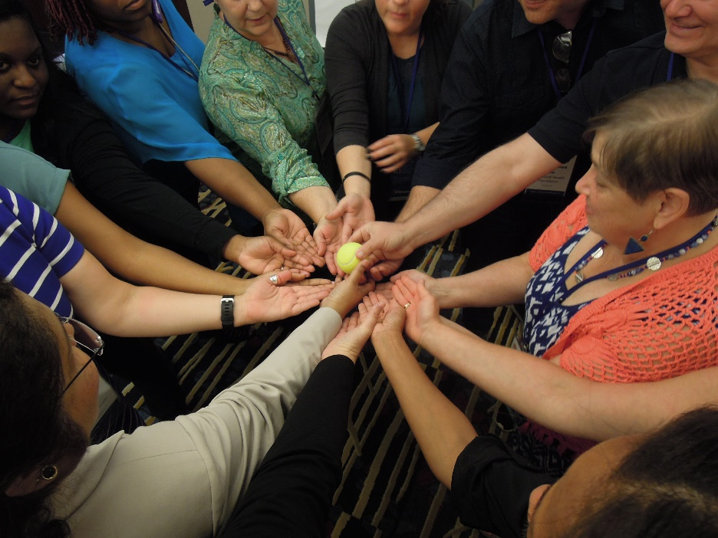
Module 1 – Day 1
8:00am – 9:00am (60 min)
TOT Handout-of-Handouts: Module 1
Welcome to the TOT Program
Day 1

Slide 3
How Important is Training?
Six volunteers needed
Three quick role plays (scripts provided)

Slide 4


HRSA Ryan White HIV/AIDS Center for Quality Improvement & Innovation
Communities of Learning
One national QI collaborative with engagement of RWHAP recipients
Annual Quality Award Program to highlight QI leaders
  “Together, we continue to improve the lives of people living with HIV. The HRSA Ryan White HIV/AIDS Program Center for Quality Improvement and Innovation (CQII) provides state-of-the-art technical assistance to Ryan White HIV/AIDS Program-funded recipients and subrecipients to measurably strengthen local clinical quality management programs in order to impact HIV health outcomes.”
Provision of Technical Assistance
Provision of on/off-site technical assistance by QI experts
Functional PMD to track all relevant ongoing TA activities
TA case conferences to learn from past TA activities
Communities of Learning
Training
Face-to-face training sessions to build capacity among providers and consumers
Online presence of the new Center on the TARGET Center website
TA Calls to showcase recipients and QI content
Online tutorials for providers and consumers
Consultation
Dissemination of QI Resources
Marketing strategies to increase awareness of the new Center, including an informational brochure
Presence at national conferences, including the 2018 National Ryan White Conference
e-Newsletters to highlight upcoming events and QI resources
Training and Educational Fora
Intensity
Information Dissemination

Slide 5
TOT Learning Objectives
Understand quality improvement principles and their application to HIV care
Design appropriate and helpful adult learning experiences that measurably advance quality improvement practice
Improve your confidence facilitating quality improvement-related training opportunities, from QI principles to rapid cycle PDSA

Slide 6
TOT Learning Objectives (cont.)
Effectively plan meeting logistics for workshops
Application of sustainability plans to your trainings
Understand how to routinely report to CQII your training activities
Access resources dedicated to successful TOT participants

Slide 7
Expectations of TOT Participants
Learn about quality improvement
  Expand knowledge of QI models and applications
  Expand knowledge of available QI resources
  Become aware of novel approaches to facilitating quality management to an array of HIV providers
  Share the QI principles with local HIV service providers across other Ryan White HIV/AIDS Program Parts

Slide 8
Expectations of TOT Participants (cont.)
Post-TOT work
  Provide three (3) QI trainings within 120 days of completion of the TOT session and report these trainings to CQII
  Meet with assigned TOT Study Groups at least twice within 120 days of the TOT
  Participate in post-TOT webinars with CQII staff and TOT faculty

Slide 9
TOT Agenda Overview
Day 1: “The What”
  Learning the quality content
Day 2: “The How”
  Designing a quality training for your audience(s)
Day 3: “Delivery”
  Nailing down the where, who, and when, technique, and practice

Slide 10
TOT Agenda Overview
Day 1
The What
Learning the quality content
Day 3
Delivery
Nailing down the where, who, and when, technique, and practice
Day 2
The How
Designing a quality training for your audience(s)

Slide 11
Agenda – Day 1
8:00 Welcome
9:00 PCN #15-02
9:40 Satisfaction Continuum
10:00 Break
10:30 QI Principles
11:45 Lunch (“Some One New & Video”)
12:45 Model For Improvement and PDSA Cycle
2:00 Marshmallow Game and Interactive Games
3:00 Break
3:30 Learner-Centered Training
4:15 Mini-Presentations
5:40 Aha! Moments & Evaluation
6:00 Adjourn

Slide 12
Agenda Highlights – Day 2 and Day 3
Day 2: 8:00am – 6:00pm
Using Organizational Assessment Findings
Five-Step Model for Creating Effective Training
Performance Measurement: Collecting and Using Data to Improve Quality
Quality Resources Safari
Design Your Training Module…plus Practice and Feedback
‘Paper Puppets’ - Game
Day 3: 8:00am – 3:00pm
Practice and Role Play
Evaluate Training Effectiveness
Quality Management Plans
Nightmares, Mishaps, and Messes
Game Plan Going Forward: Your Personal Plan

Slide 13
Details…
Ground Rules
Garden
TOT Guide
Red Book
Handout-of-Handouts
Contact List

Slide 14

Picture Consent
You allow CQII to take pictures from our training events and to post them on our websites, social media platforms, and other marketing materials for an undetermined period of time
You have the right to revoke your consent for pictures that are publicly posted
At no time, individual names will be used to identify you, unless you sign the appropriate release form

Slide 15

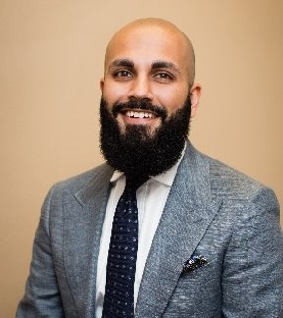
Faculty Introductions
Justin Britanik | CQII Coach, justin@cqii.org
Khalil Hassam | CQII Coach, khassam@gmail.com

Slide 16
Participant Introductions
  Step 1: Take a moment and identify individually one hope and one concern for participating in the TOT
  use Handouts-of-Handouts: Module 1 Tool
  Step 2: Introduce yourself to others by stating
    Name and agency
    One hope and one concern for participating in the TOT

Slide 17
Participant Poll

Slide 18
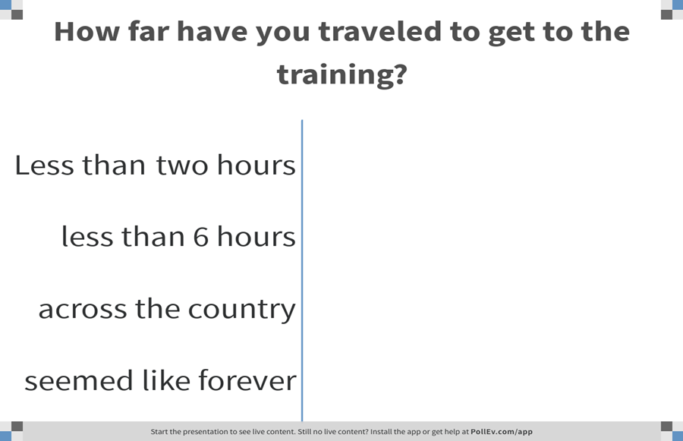
Notes:
Poll Title: How far have you traveled to get to the training?
https://www.polleverywhere.com/multiple_choice_polls/Y5anucInqRi6Shv3YOmnH

Slide 19
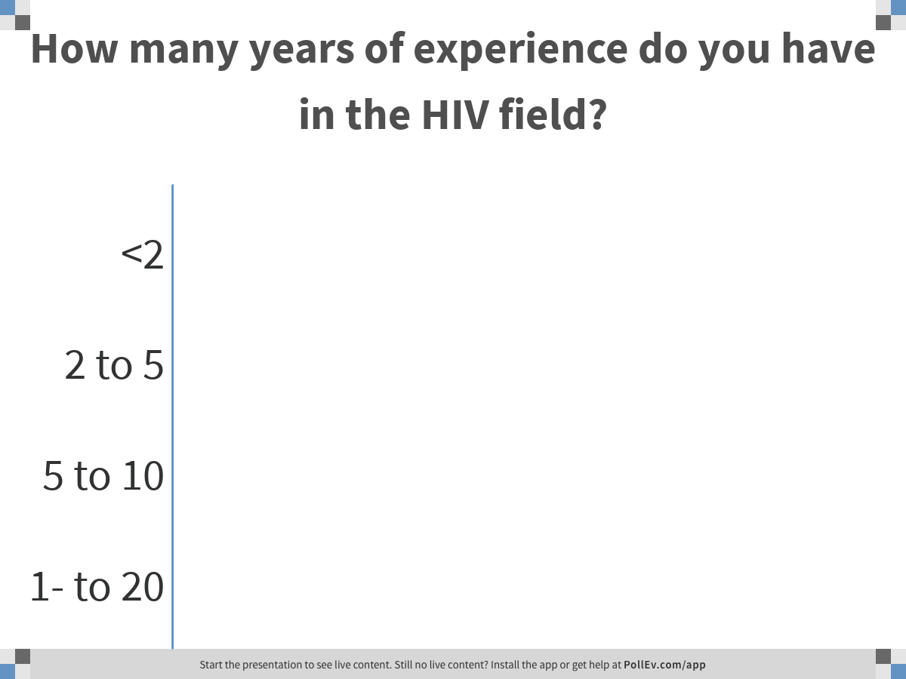
Notes:
Poll Title: How many years of experience do you have in the HIV field?
https://www.polleverywhere.com/multiple_choice_polls/llSiii9nbqImkQ1PwYIzT

Slide 20
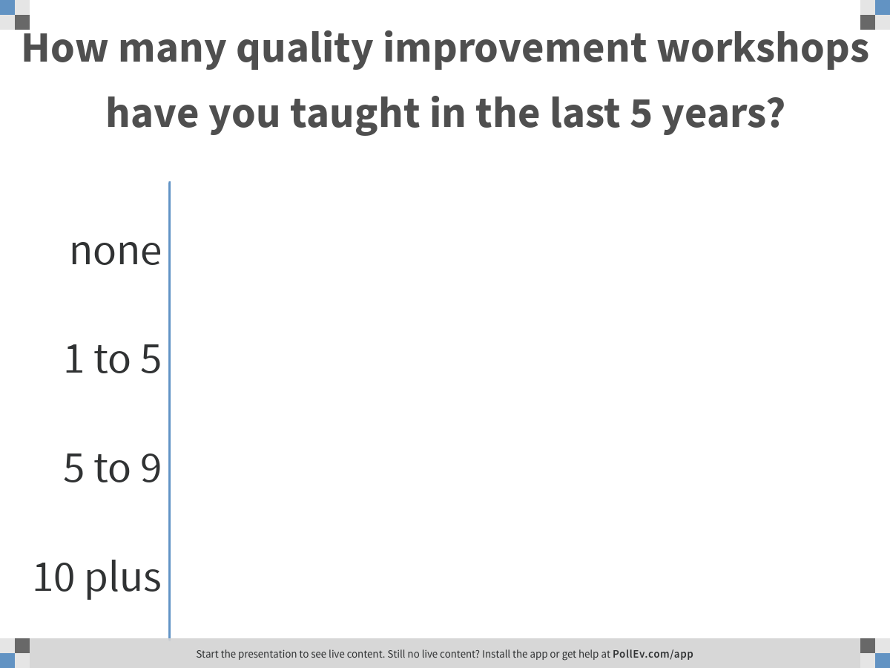
Notes:
Poll Title: How many quality improvement workshops have you taught in the last 5 years?
https://www.polleverywhere.com/multiple_choice_polls/m9KC9iPYwA9VRCPUB0ATZ

Slide 21
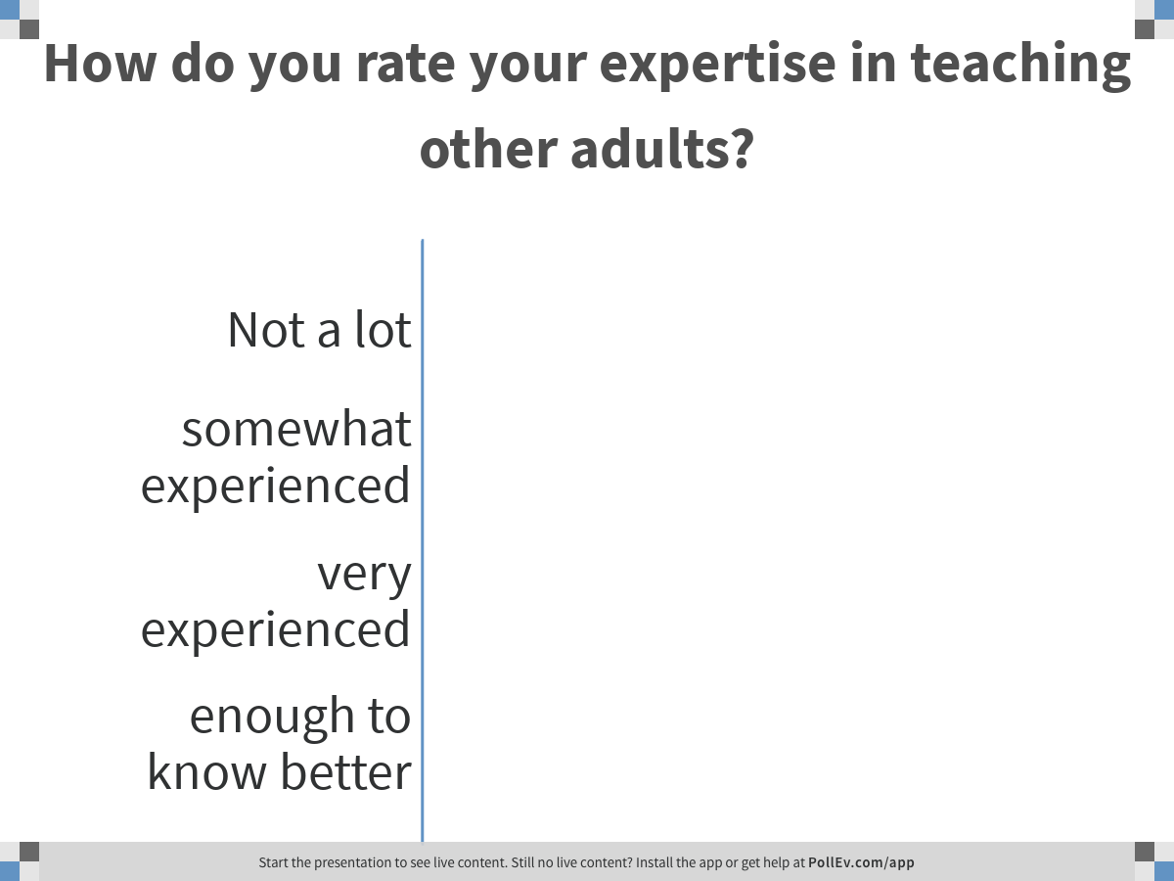
Notes:
Poll Title: How do you rate your expertise in teaching other adults?
https://www.polleverywhere.com/multiple_choice_polls/5lcyct60T6227V7Lv7agm

Slide 22
What are Study Groups?
Groups of 5-7 of your peers working together for the next 3 months past this TOT session
Groups connect at least monthly to provide peer support and reflect on individual post-TOT QI trainings
Study Groups provide
  Support and feedback for QI training skills
  Offer wisdom based on your experiences and successes
  Keep commitments to each other and to the TOT session
Find TOT colleagues you want to work with

Slide 23

Four Corners Exercise

Slide 24
Four Corners Questions
1. What region do you live in?
West/Southwest, Midwest, Northeast, South
2. Within what kind of system are you training?
Community clinic, academic practice, public hospital/free clinic, other
3. What is your current training experience?
Beginner vs Intermediate vs Advanced vs Highly Proficient

Slide 25
Module 2 – Day 1
9:00am – 9:40am (40 min)
Policy Clarification Notice #15-02:
Framing the Clinical Quality Management Program

Slide 26
PCN #15-02 Quiz

Slide 27
Clinical Quality Management (CQM)
CQM is:
  Building quality management and improvement specific infrastructure
    Includes that subrecipients provide services that have the:
      Capacity to contribute to the recipient’s CQM program
      Resources to conduct CQM activities in their organizations
      Implement a CQM program in their organizations
  Performance measurement for QI
  Quality improvement projects
CQM is not:
  Grant administration
  Quality assurance
  Monitoring and evaluation of subrecipients programmatic and fiscal performance
  Data reporting and integration

Slide 28
CQM Network Essential Infrastructure
Dedicated Resources
QM Plan
People with HIV
Involvement
Dedicated Staffing
Committee
Stakeholder Involvement
Network
CQM
Program
Leadership Involvement
Evaluation
Notes:
Playbook: J

Slide 29
Performance Measurement Requirements
Frequency: Regularly collect and analyze data at least quarterly
Analysis: Collect and study stratified data that allows for inspection and improvement of services and outcomes for key populations.
Select measures based on service category utilization and feedback from key stakeholders
Stratify at least one measure and look
for health disparities
Notes:
I

Slide 30
Performance Measures
Which service categories need measures, and how many?
Percent of RWHAP eligible clients (by Part) receiving at least one unit of service for a RWHAP-funded service category | Minimum number of performance measures
>=50% | 2
>15% to <50% | 1
<=15% | 0
Measures are based on utilization by Ryan White Part
At least one measure should be stratified to analyze key populations

Slide 31


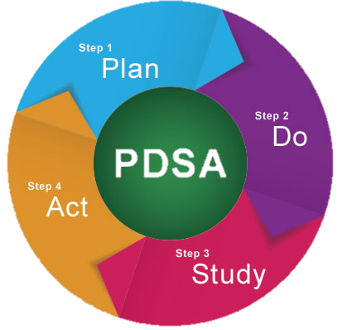

QI Activities
Projects to improve patient health outcomes, patient care and service delivery, and patient satisfaction

Slide 32
Quality Improvement Activities
Quality Improvement is the implementation of activities to impact outcomes, services, and satisfaction in response to data.
Projects should be documented using a defined approach or methodology
Model for Improvement, Lean, etc.
At least one project should be active at any given time
Quality improvement activities may span multiple service categories
Don’t limit the projects to just outcome measures – some service categories are better served by measures and projects that address a service delivery process, or client satisfaction
Notes:
More than a PDSA worksheet, a cohesive demonstration of infrastructure, measurement, QI tools, and change ideas being implemented.

Slide 33
Applicability to Subrecipients
Recipient has the specified CQM program activities for the service area:
  CQM activities could include: QM plan, performance measure portfolio, collaborative community learning, joint QI projects, quarterly data analysis submission, CQM minute submission, and identification of quality improvement activities with a coach
It is up to recipient to ensure that subrecipients provide services that have the:
  Capacity to contribute to the recipient’s CQM program
  Resources to conduct CQM activities in their organizations
  Implement a CQM program in their organizations

Slide 34
Group Competition: PCN #15-02 Quiz
Step 1: Form teams of 5 to 8 participants at your table
Step 2: Identify one facilitator and one reporter (who will officially report the team’s response)
Step 3: Each team is given 30 seconds to find consensus in the group and to report their answer; each team with the correct answer will get one point
Step 3: The team with the highest score wins!
Notes:
Provide handout to participants in the group
Provide solution sheet to coach (instruct them not to provide answers)
Emphasize team competition and to produce quickly results

Slide 35
All recipients and subrecipients - Parts A thru F - are required to have a CQM program.
True
False
False. According to the Title XXVI of the Public Health Service (PHS) Act, Ryan White HIV/AIDS Program (RWHAP) Parts A – D are required to establish a CQM program that includes activities at the recipient agency and at all funded subrecipient organizations. Not Part F.
Notes:
Flase. According to the Title XXVI of the Public Health Service (PHS) Act, Ryan White HIV/AIDS Program (RWHAP) Parts A – D are required to establish a CQM program that includes activities at the recipient agency and at all funded subrecipient organizations.

Slide 36
A recipient or subrecipient program is doing really well with health outcomes, like viral suppression. Is CQM program still needed?
True
False
True. A CQM program is still required. According to the Title XXVI of the PHS Act, RWHAP Parts A – D are required to establish a CQM program that includes activities at the recipient agency and at all funded subrecipient organizations.
Notes:
True. A CQM program is still required. According to the Title XXVI of the PHS Act, RWHAP Parts A – D are required to establish a CQM program that includes activities at the recipient agency and at all funded subrecipient organizations.

Slide 37
Are QI projects required for each funded RWHAP service?
Yes
No
No, but all funded services should be assessed through performance measurement to evaluate the effectiveness of the service. If the performance measurement is not meeting expectations, then a QI project to address the service should be implemented.
Notes:
No, but all funded services should be assessed through performance measurement to evaluate the effectiveness of the service. If the performance measurement is not meeting expectations, then a QI project to address the service should be implemented.

Slide 38
Should all performance measurement data be collected quarterly?
Yes
No
No. In order to adequately assess for change and to support quality improvement projects, HAB recommends at least quarterly data collection. However, some measures may be collected annually or semiannually to meet the organization’s performance goal.
Notes:
B – No. In order to adequately assess for change and to support quality improvement projects, HAB recommends at least quarterly data collection. However, some measures may be collected annually or semiannually to meet the organization’s performance goal.

Slide 39
Does the quality management plan only cover clinical services?
Yes
No
No, the quality management plan should include all aspects of the CQM program and thus all funded core medical and support services.
Notes:
No, the quality management plan should include all aspects of the CQM program and thus all funded core medical and support services.

Slide 40
A recipient organization does not fund outpatient ambulatory health services. What performance measures should that organization use?
Viral suppression
The frequency of updating the client case management plan
Ones that reflect the Ryan White HIV/AIDS Program services provided
Only retention in care
All of the above
C. An organization should collect performance measures that are reflective of their RWHAP funded services. For example, if an organization primarily funds medical case management then retention in care (i.e., gap in medical visits and/or medical visit frequency) would be an important measure to include in a performance portfolio.
Notes:
C An organization should collect performance measures that are reflective of their RWHAP funded services. For example, if an organization primarily funds medical case management then retention in care (i.e., gap in medical visits and/or medical visit frequency) would be an important measure to include in a performance portfolio.

Slide 41
Which of the following is NOT a statement by HAB about clinical quality programs?
CQM programs need to look beyond clinical services to consider both supportive services and outcomes
CQM programs assess the extent to which HIV health services are consistent with the most recent Public Health Service guidelines
The primary focus of the CQM program is on performance measurement to assess clinical and non-clinical services
Develop strategies for ensuring that such services are consistent with the guidelines for improvement in the access to and quality of HIV services
Both 2 and 4
Correct Answer - 5
Notes:
5

Slide 42
Are recipients required to use HAB-defined performance measures?
Yes
No
No. Recipients are able to select any performance measures for their portfolio. Recipients should select measures reflective of RWHAP funded services, local HIV epidemiology, and identified needs of PLWH.
Notes:
No, recipients are able to select any performance measures for their portfolio. Recipients should select measures reflective of RWHAP funded services, local HIV epidemiology, and identified needs of PLWH.

Slide 43
Module 3 – Day 1
9:40am – 10:00am (20 min)
TOT Handout-of-Handouts: Module 3
Satisfaction Continuum

Slide 44
Satisfaction Continuum Exercise
Step 1: Reflect back on your most recent healthcare experience
Step 2: Rate this experience on a scale from 1 (best care ever) to 10 (worst care possible)
Step 3: Come and align yourself on the Satisfaction Continuum score you have; 1 (best care ever) to 10 (worst care possible)
Step 4: Turn to your neighbor and share why you have scored the experience that way
Step 5: Let’s reflect on assessing the quality of care and services

Slide 45

10:00am to 10:30am

Slide 46
Module 4 – Day 1
10:30am – 11:45am (75 min)
TOT Handout of Handouts: Module 4
QI Principles

Slide 47
Learning Objectives
Be able to recognize underlying key quality improvement principles in day-to-day activities
Practice identifying strengths and weaknesses of programs in using these QI principles
Provide an opportunity to strengthen the participants’ ability to work in teams

Slide 48
Module Agenda
Quiz
Quality Improvement Principles Presentation

Slide 49
Quiz

Slide 50
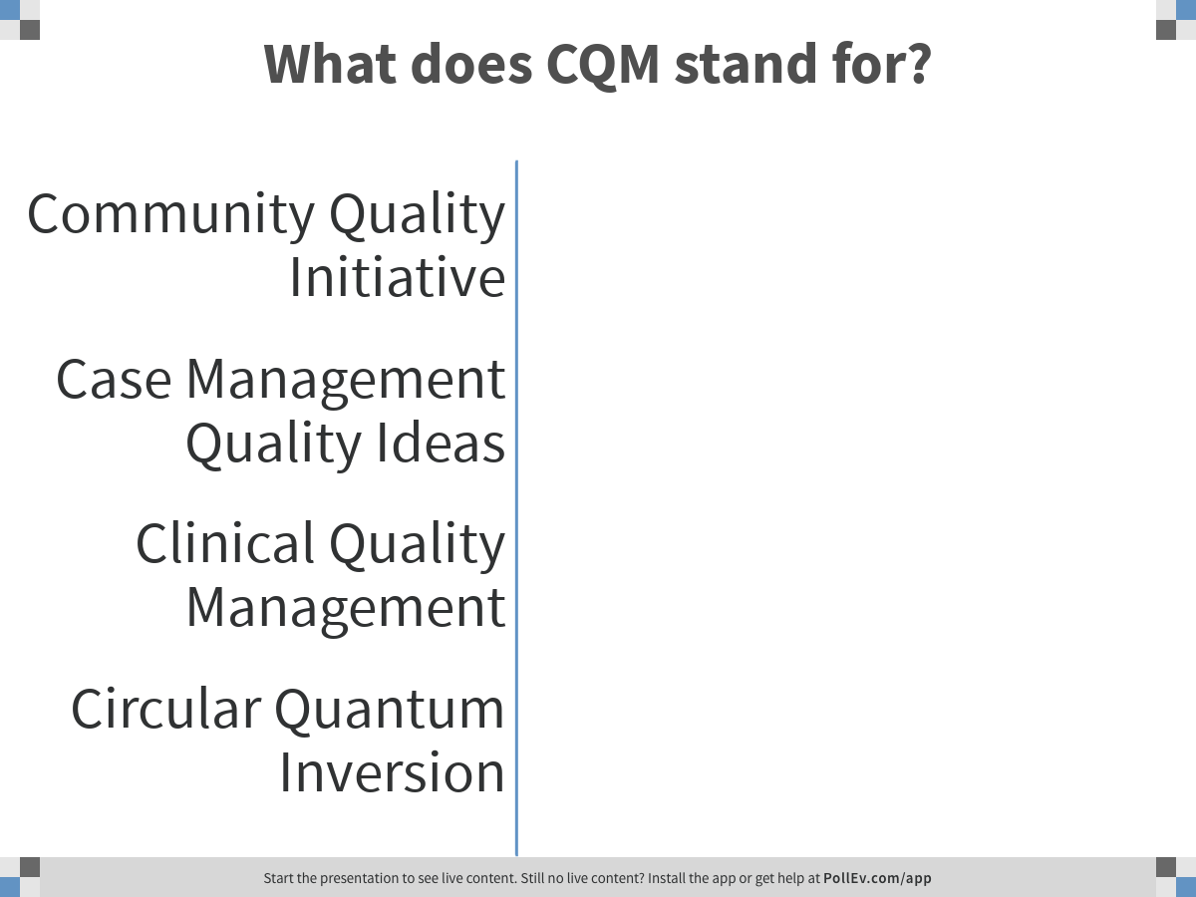
Notes:
Poll Title: What does CQM stand for?
https://www.polleverywhere.com/multiple_choice_polls/kzx3ZlxvLWWyHOqDhojWH

Slide 51
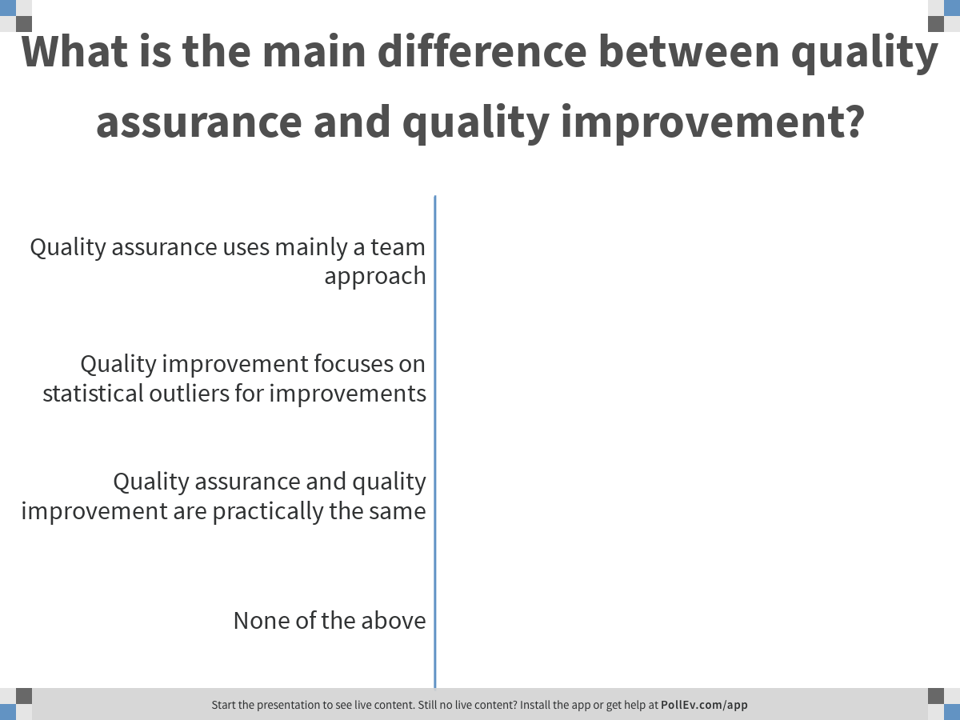
Notes:
Poll Title: What is the main difference between quality assurance and quality improvement?
https://www.polleverywhere.com/multiple_choice_polls/e0iXuakvNPsNKKtetfCAq

Slide 52
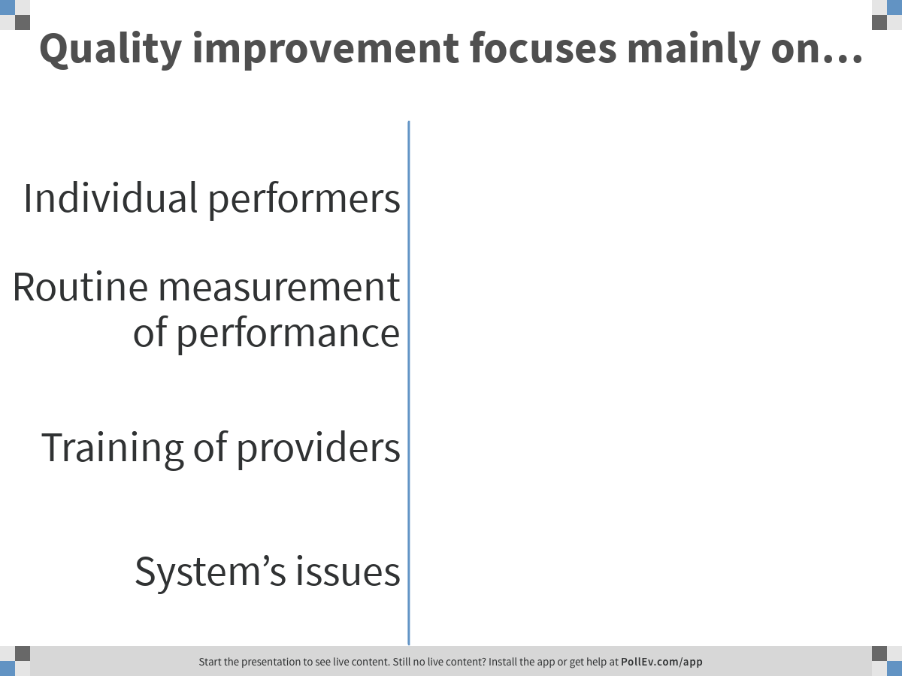
Notes:
Poll Title: Quality improvement focuses mainly on…
https://www.polleverywhere.com/multiple_choice_polls/aHQZJR7rFIBaV8XzgpbJ7

Slide 53
QI Principles

Slide 54


Success is achieved through meeting the needs of those who are served
Why does a restaurant known for standardization sell these items unfamiliar to us?

Slide 55
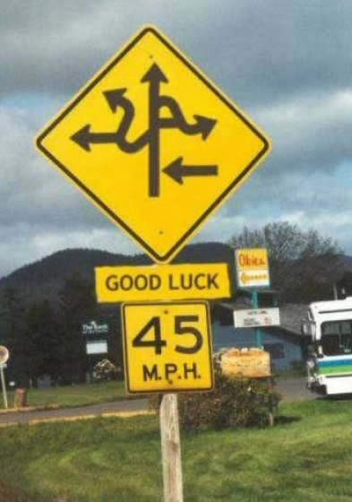
Most problems are found in processes, not in people
What is wrong with this picture?

Slide 56
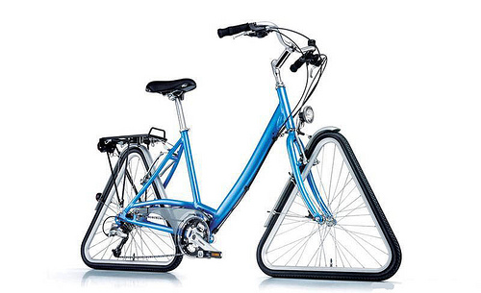
Do not reinvent the wheel. Learn from best practices.
This is new and different – but will it do the job?

Slide 57


I Can’t Even!
I Want to…
How Can I?
I’ll Try
I Think I can
I Will
I Did!
Achieve continuous improvement through small, incremental changes
Notes:
K. Rome wasn’t built in a day – we need to break problems down into manageable chunks – why QI fails: it’s implemented as extra work for a few people to take on problems that are too big

Slide 58

Actions are based upon accurate and measured data
Notes:
K. Rome wasn’t built in a day – we need to break problems down into manageable chunks – why QI fails: it’s implemented as extra work for a few people to take on problems that are too big

Slide 59
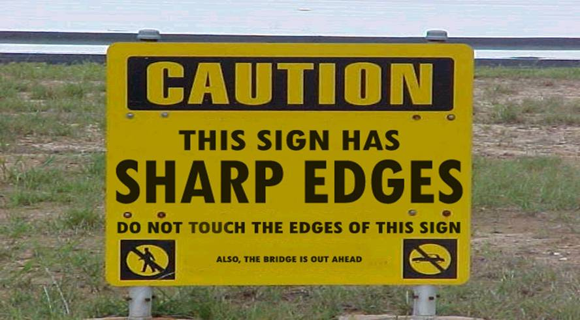
Set priorities and communicate clearly
Notes:
K. Rome wasn’t built in a day – we need to break problems down into manageable chunks – why QI fails: it’s implemented as extra work for a few people to take on problems that are too big

Slide 60
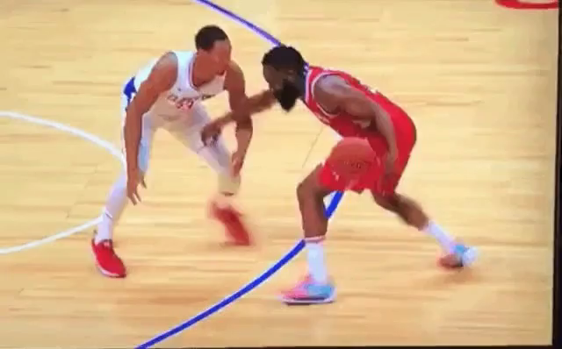
A Step Backward Is Not a Mistake
Notes:
J. Let’s be real – we have all done things that we thought were a good idea at the time and then we learned (sometimes rather harshly) that in fact that was not a good idea. And we go back and make a different choice (hopefully). But that step back taught us something – and sometimes it’s those little steps back that teach us a lot. So instead of viewing those steps back as a bad thing think of them as part of larger process – think of them as a step back three-pointer, we’re getting further from the basket – but in the future we’re going to make a big measurable impact instead of rushing in and turning the ball over.

Slide 61

Quality Work is Done by Teams!

Slide 62

Teams Outperform Individuals When…
The task is complex
Creativity is needed
The path forward is unclear
More efficient use of resources is required
Fast learning is necessary
High commitment is desirable
The implementation of a plan requires the commitment of others
The task or process is cross-functional
WITH OUR POWERS COMBINED!

Slide 63
Components for Success
Improvement is about learning
    trial and error learning method
    share findings with staff to create staff ownership into improvement efforts
    learn from others, power of peer learning
Focus on systems of care
    not on individual providers
    systematize improvements
Leadership
    establish organizational commitment
    resource commitment
    support staff and activities

Slide 64
Components for Success (cont.)
Infrastructure
    quality is achieved through people working in teams
    create infrastructure to support quality efforts
    resources available to provide staff development
Improvement activities
    action-oriented approach (rapid tests of change)
    test on small scale before full-scale implementation
    improvements through continuous cycles of changes

Slide 65
‘QI is not QA’
 | Quality Assurance | Quality Improvement
Motivation | Measuring compliance with standards | Continuously improving processes to meet standards
Means | Inspection | Prevention
Focus | Individuals, “bad apples” | Processes and Systems
Responsibility | Few | All
ADAPTED: Solberg “The Three Faces of Performance Measurement: Improvement, Accountability and Research.”
Journal on Quality Improvement. V 23 1997.

Slide 66
Working Definition of Quality
“Quality of care is the degree to which health services for individuals and populations increase the likelihood of desired health outcomes and are consistent with current professional knowledge.”
Institute of Medicine. Medicare: A Strategy for Quality Assurance. Vol. 1. (1990)

Slide 67
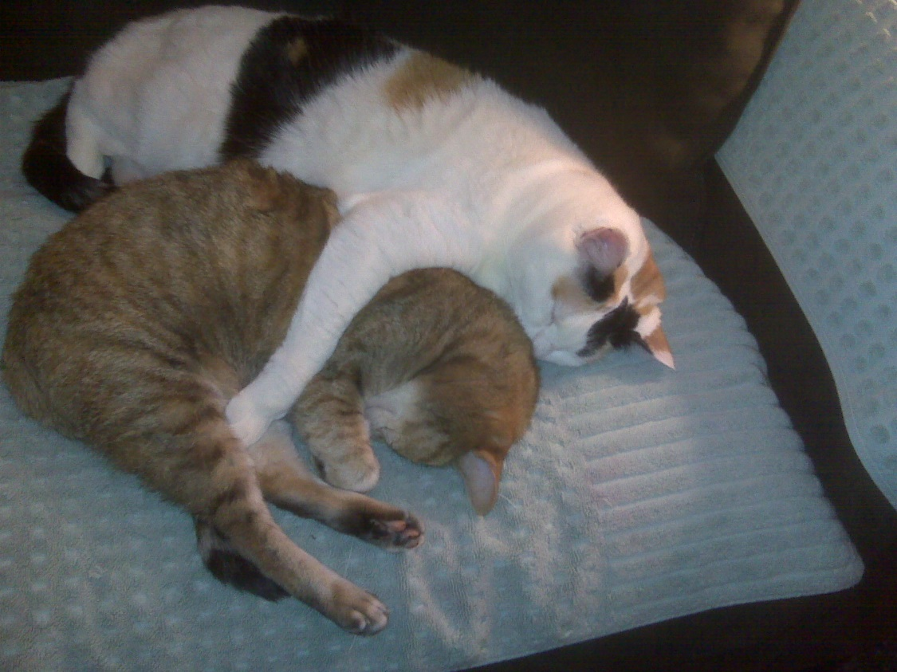
Lunch with a New Friend!
11:45am to 12:45pm
Schedule:
  45 min Lunch - Meet someone new!
  12:30 PM - Watch a video
Reminder:
  Bring your Organizational Assessment for the afternoon session

Slide 68
Model for Improvement, PDSA Cycle, Change Hats
Module 5 – Day 1
12:45pm – 2:00pm (75 min)
TOT Handout-of-Handouts: Module 5

Slide 69
Learning Objectives
Familiarize participants with the Model for Improvement
Discuss application of Model for Improvement in HIV care
Practice use of the PDSA Cycle in real life scenarios
Strengthen the participants’ ability to problem solve using this quality concept
Understand different change management roles that further improvements

Slide 70
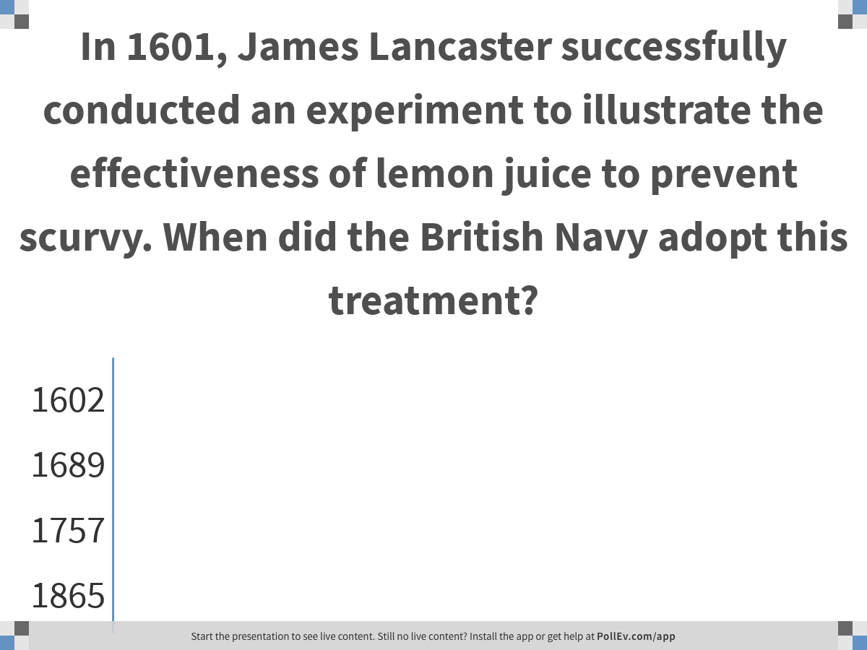
Notes:
Poll Title: In 1601, James Lancaster successfully conducted an experiment to illustrate the effectiveness of lemon juice to prevent scurvy. When did the British Navy adopt this treatment?
https://www.polleverywhere.com/multiple_choice_polls/HiLVVHUgPE4hfQa4L2uqF

Slide 71

Treatment of Scurvy
Stephen J. Bown - Scurvy: How a Surgeon, a Mariner, and a Gentleman Solved the Greatest Medical Mystery of the Age of Sail; St. Martin's Press, 2004
In 1601 lemon juice, as a protective against scurvy, is recorded by James Lancaster.
In 1612, Woodall recommended citrus fruit for protection against scurvy on sea voyages.
In 1753 James Lind published A Treatise on the Scurvy which portrays his experiment on-board the ship Salisbury in 1747.
From 1772 to 1775 sailors on historic voyages with Captain James Cook remained free from scurvy.
In 1796 lemon juice was officially introduced in the British Navy as a prophylactic against scurvy.
In 1865 British Board of Trade adopted the policy for the merchant marine.
Notes:
1865 British Board of Trade adopted the policy for all ships in the merchant marine – 264 Years later

Slide 72
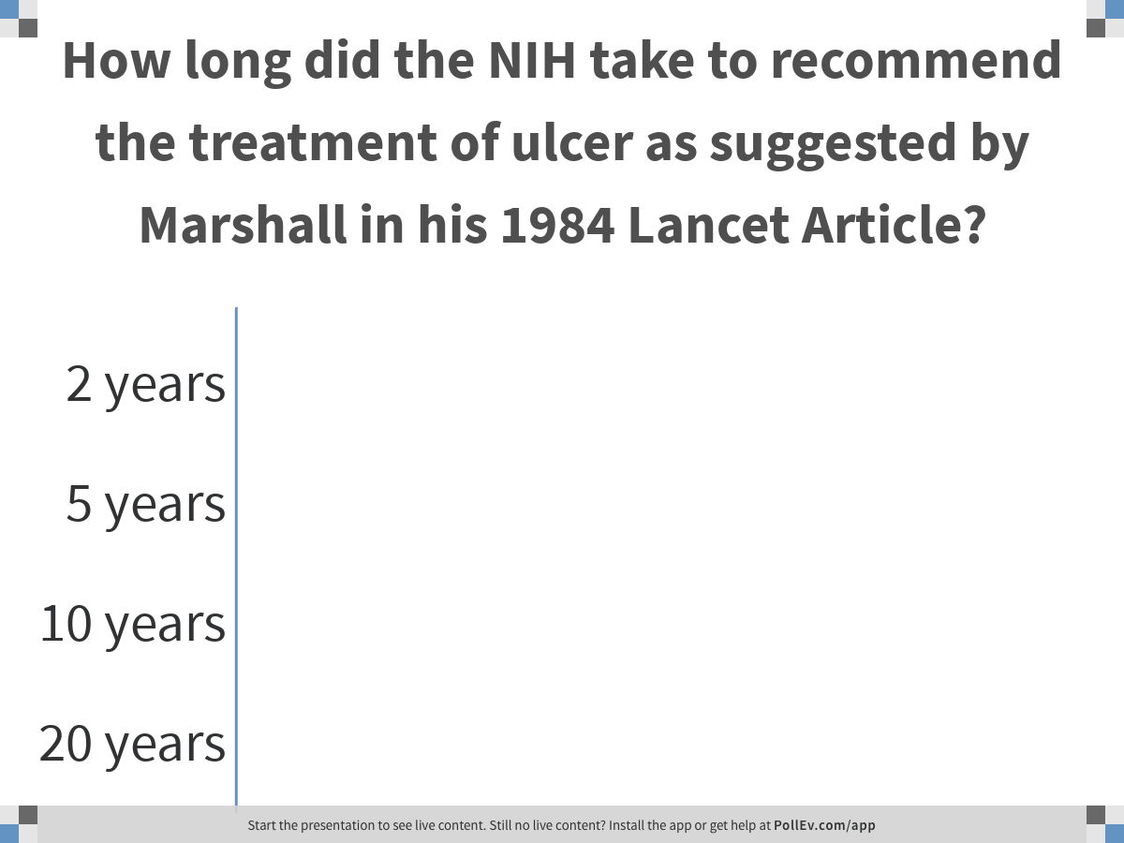
Notes:
Poll Title: How long did the NIH take to recommend the treatment of ulcer as suggested by Marshall in his 1984 Lancet Article?
https://www.polleverywhere.com/multiple_choice_polls/HPFMBGM5SGAdddaX7JIiB

Slide 73
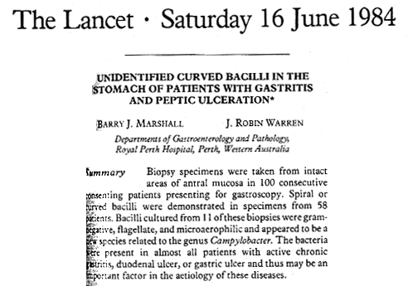
Treatment of Ulcer – Marshall
Timeline:
1979: Dr. Robin Warren, pathologist at Royal Perth Hospital, Australia found bacteria in stomach of patients
1981: Dr. Barry Marshall starts residency
1982: Marshall cultivates bacteria: Helicobacter pylori, 100% in Duodenal Ulcer and 77% in Gastric Ulcer
1984: first publication in Lancet; presents treatment of ulcer with common antibioticum
1994: National Institute of Health recommends treatment of ulcer as suggested by Dr. Marshall
Notes:
Conclusio:
Too long to adapt proven concept - how can we adapt existing knowledge faster in daily actvities
New ideas come from outsiders
‘Early Adopter’ Diffusion of Innovation Everett Rogers
B) Neugeborenenstation in Honulu, Hawaii hat jährlich $120,000 Dollar für Schutzmasken, Plastik Handschuhe usw. ausgegeben. Nach 13 Studien wurde dort eine 14. Studie durchgeführt mit dem selben Ergebnis: es gibt keinen messbaren Unterschied der Ansteckungsrate zwischen der Vergabe von Schutzkleidern an Besuchern und der Nichtvergabe.
C) CQI Team: billinf Team, six months still trying to find causes, did not start to change things around.
HAND OUTS

Slide 74
How can we accelerate change and improvements in HIV programs?

Slide 75
Many Models for Change
There are advantages and disadvantages
What we look for: simple and robust
Model for Improvement
  3 Questions & PDSA Cycle
  Non-linear - do what makes sense ☺
  Action-oriented
  Multiple levels - very small to large
  Based in inquiry, which
    Fosters creativity
    Reduces shackle effect

Slide 76
Model for Improvement:
A method to help accelerate change… and increase the odds that the changes we make are improvements
Notes:
Second method

Slide 77
Model for Improvement
Improvement is trial and error (scientific method)
  Improvements require change, however not all changes are an improvement
Measure your progress
  Only data can tell you whether improvements are made
  Integrate measurement into the daily routine
Improvements thru continuous cycles of changes
  Plan-Do-Study-Act (PDSA) approach
  Changes are initiated on a small scale to test them before systemwide implementation

Slide 78
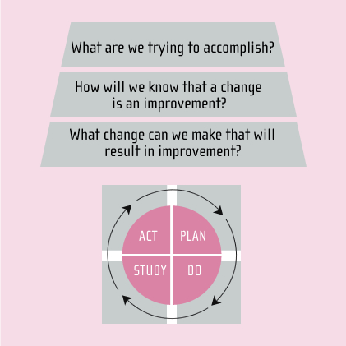
Model for Improvement
*Developed by the Associates in Process Improvement. Building on the work of W.E.Deming and Walter Shewhart
Notes:
…

Slide 79
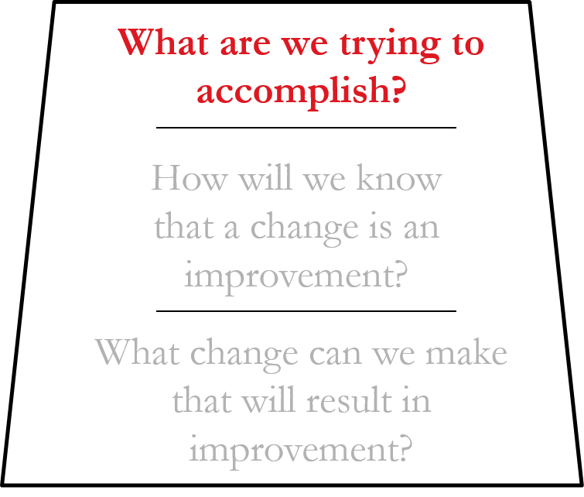
Model for Improvement
Notes:
..

Slide 80
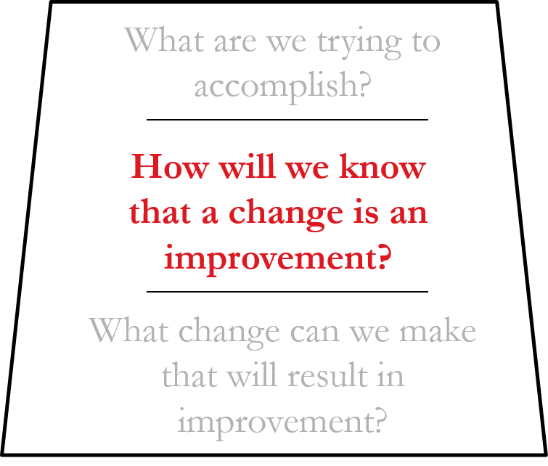
Model for Improvement
Notes:
What is the second question … how will we know?
Why is this important ….

Slide 81
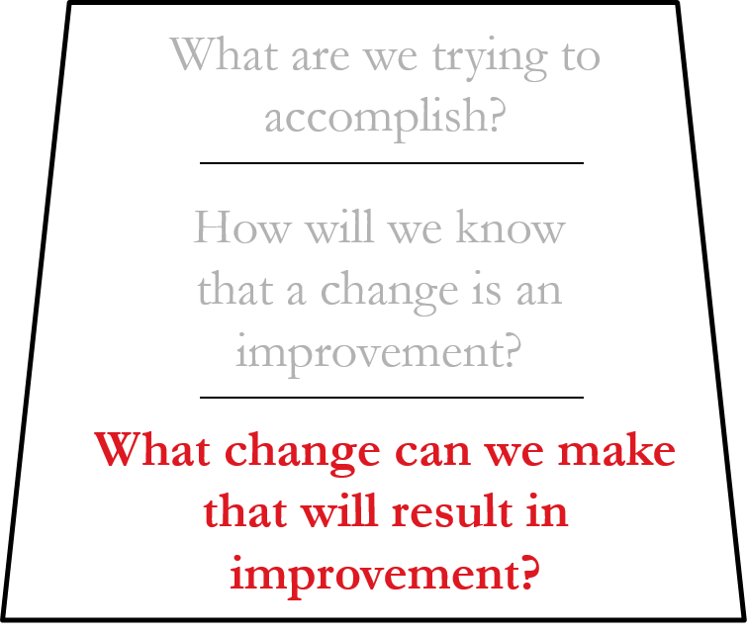
Model for Improvement
Notes:
So what is the third question?
The changes that you make should align with your aim and measures…
Where do they come from ? IHI change packages… chanes with a pedigree… have a high degree of belief they willwork .. Have worked .. Ideas in the op doc.. Op Doc.. Each other..

Slide 82
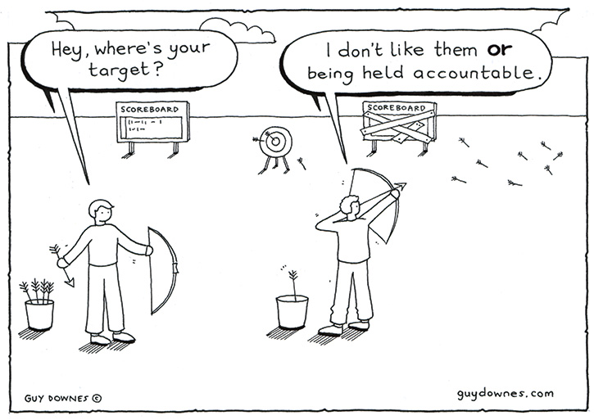
Change
Improvement
usually requires change…
However not all
changes are an
improvement!

Slide 83
Change Ideas
HRSA Ryan White HIV/AIDS Program Center for Quality Improvement & Innovation:
  Quality Academy
  Quality Resources
  Self-Management/Consumer Involvement
  Interventions from past Collaboratives
  Quality Award Winners
Best Practice Compilations
https://targethiv.org/bestpractices
IHI Change Packages at http://www.ihi.org:
  Search Changes (12 pages of packages)
  Chronic Care Model
  Access and Efficiency
Other Change Packages:
  Improvement Guide by Langley et all

Slide 84
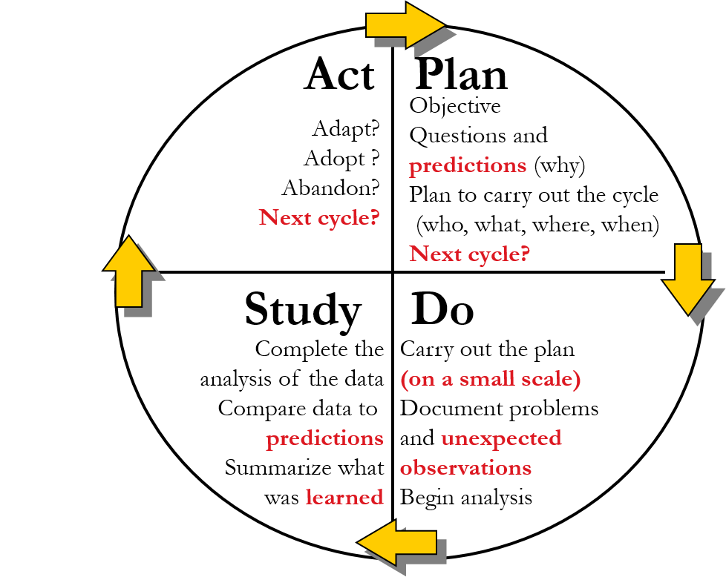
The PDSA Cycle for Learning and Improvement

Slide 85
PDSA (test) Cycles …
Have Been Going on for Years

Slide 86
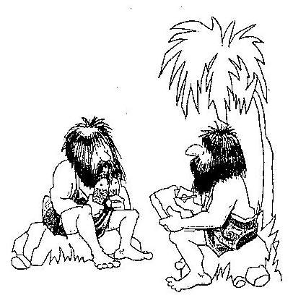
“Negative results on the fish…
Let’s try rubbing two sticks together.”

Slide 87
Why Test?
Increase your confidence that the change will result in improvement in your organization
Learn to adapt the change to conditions in the local environment
Minimize resistance when you move to implementation

Slide 88
The PDSA Cycle Requires Iterative Tests to Solve Problems
Test ALL
Data Collection
Test n=20
This initial cycle requires the most planning
Test n=5
Test n=1
IMPACT ON AIMS
Quantitative
Change
Anecdotal
Change
Qualitative
Change

Slide 89
PDSA Cycle Example
Aim: Improve no-show rate
Test ALL
Change: day-prior reminder call from
trusted member of team
Test n=20
Test n=5
Test n=1
Cycle 1d: test script across all patients for one week
Adapt?
Adopt?
Cycle 1c: Developed alternate script and trying across two care teams
Cycle 1a: Arthur tried with one of his patients
Cycle 1b: Revise call message based on learning and test again with Laura’s patients on Friday

Slide 90


Slide 91
PDSA Exercise

Slide 92
How Tests Lead to Improvements
You learn something from each test
That knowledge gets incorporated into the next test
Over time, as you build knowledge and expertise, you design a change that will more likely result in improvement in your environment
Notes:
The answer lies in the repetitive nature of the tests. You run one PDSA cycle, and then another that is a little more complex (based on what you learned from the first), and then another that is still more complex.

Slide 93
Tips for PDSA Cycles
Clinic
One Provider
Define your target state (system level) and then work backwards (to the ground)
Identify the smallest place to test your intervention
Patients seen next week
Patients seen next Tuesday
One patient in key population seen next Tuesday
1
Notes:
By far, the biggest mistake we see people making.

Slide 94
Tips for PDSA Cycles (cont.)
Learn from others (‘Steal shamelessly, Share senselessly’)
Just do it – get started with Rule of 1
Volunteers at first; move to others
Useful, not perfect, data
Use “huddles” to report
Design toward sustainability
Notes:
Here are three more important pointers for success:
Start out with your friends. Don’t try to convince the skeptics until you have proof. To get the proof, use volunteers – people who are interested in doing things differently.
This isn’t a randomized clinical trial. It’s a test. You don’t need double-blind data, you need information about how to make things work. Whether Dr. Smith’s test took 34.3 minutes or 36.72 minutes doesn’t matter. The point is that it took about 35 minutes, and that was way too long.
Scheduling a formal meeting will take at least a week – pretty silly to do that to discuss the results of a one-day test. Grab people when you can, share information as it comes up. Dr. Smith could find Sally after the patient visit on Thursday morning and say, “Sally, that tool took 35 minutes, this will never work.” Sally might say, “Wow, you’re right. Joan and I found other tools, let me get her and we’ll come up with some others that might be better to try next.”
The important thing is to keep moving forward, because…

Slide 95

What Questions Do You Have?
I have one for you:
Do you have any ideas for a next cycle.. ?

Slide 96
The Need for Both
Good changes and a robust Model for
Improvement (one that incorporates learning and action) are both needed to help accelerate change and increase the odds that the changes we make are improvements.
Notes:
Second method

Slide 97

Change Hats

Slide 98






Designer
Project Manager
Champion
Sponsor
Training
What else?

Slide 99

Designer
Designing the actual change
  Documenting and updating a process
  Adapting another jurisdiction’s best practice screening form

Slide 100

Project Manager
Manage the process
  Using the project charter / aim statement
  Monitoring progress of implementation
  Communicating updates to stakeholders

Slide 101

Champion
Champion the change
  Serve as a point of contact between stakeholders and people experiencing change
  Advocate openness and positivity to the change
  Receive and share feedback from people
  Influence

Slide 102

Sponsor
Sponsor/endorse the change
  Actively and regularly participate in the process
  Use influence/authority to endorse the change
  Build support for the change
  Communicate to the team

Slide 103

Trainer
Develop the team to make improvements
  Assess trainee needs
  Prepare learning materials
  Evaluate training effectiveness

Slide 104
You Tell Us!
What is another ‘change hat’ that you have seen employed successfully, or is missing at your work?
What are the key responsibilities for that role?

Slide 105
References and Resources
Langley, Gerald, Kevin Nolan, Thomas Nolan, Cliff Norman, and Lloyd Provost; “The Improvement Guide” San Francisco, CA; Jossey-Bass, 1996
HIVQUAL Workbook: Guide for Quality Improvement in HIV Care. New York State Department of Health AIDS Institute and the Health Resources and Services Administration HIV/AIDS Bureau. 2006
Quality Academy - New York State Department of Health AIDS Institute and the Health Resources and Services Administration HIV/AIDS Bureau

Slide 106
Module 6 – Day 1
2:00pm – 3:00pm (60 min)
Experiential Learning and
Interactive Games

Slide 107

Marshmallow Game
Source: The Marshmallow Challenge by Peter Skillman; website by Tom Wujec - http://marshmallowchallenge.com

Slide 108
Group Competition: The Marshmallow Challenge
Step 1: Form teams of 5 to 8 participants
Step 2: Each team is given a Marshmallow Challenge tool set
Step 3: Build the largest free-standing tower within 18 minutes
Step 4: Debrief with large group
Notes:
Provide handout to participants in the group
Provide solution sheet to coach (instruct them not to provide answers)
Emphasize team competition and to produce quickly results

Slide 109
Rules for The Marshmallow Challenge
Build the Tallest Freestanding Structure (measured from the table top surface to the top of the marshmallow)
The Entire Marshmallow Must be on Top
Use as Much or as Little of the Kit (no other items are allowed)
The Challenge Lasts 18 minutes (touching or supporting the structure at the end will lead to disqualification)
Notes:
Provide handout to participants in the group
Provide solution sheet to coach (instruct them not to provide answers)
Emphasize team competition and to produce quickly results
109

Slide 110
Group Competition: The Marshmallow Challenge
Video
Notes:
Provide handout to participants in the group
Provide solution sheet to coach (instruct them not to provide answers)
Emphasize team competition and to produce quickly results
110

Slide 111

Debriefing Your Experience

Slide 112

3 Steps of Improvement
Steps of Improvement:
  Standardization
  Incremental improvement
  Innovation

Slide 113
PDSA Tip: “Oneness”
1
Notes:
Objective: Test of 1.
Explanation: Conduct the test in 1 facility or 1 office in the organization or 1 doc or with 1 patient. The test is to see what you can learn and can often save many an error.
Bridge to next slide: Typically, teams test more than one change at a time.

Slide 114
PDSA Tip
PDSA Tip: Track your PDSA Cycles
PDSA Worksheet
Fill out one PDSA Worksheet for each test conducted
Keep a file (either electronic or hard copy) of all PDSA Worksheets for all changes tested
http://www.ihi.org/IHI/Topics/HIVAIDS/HIVDiseaseGeneral/Tools/
Notes:
Objective: Structure to support documentation, learning, reflection and keeping one foot ahead of the other (Form can be found at http://www.ihi.org/IHI/Topics/HIVAIDS/HIVDiseaseGeneral/Tools/ click on Plan-Do-Study-Act (PDSA) Worksheet (IHI Tool) at which point you will be asked to log onto the site before you can download this form).
Explanation: Use of the Plan-Do-Study-Act (PDSA) Worksheets will help your team document the many tests they conduct. Fill out one PDSA Worksheet for each test you conduct. Your team will test several different changes, and each change will go through several PDSA cycles. Keep a file (either electronic or hard copy) of all PDSA Worksheets for all changes your team tests for documentation and knowledge management.
Although the form is valuable for documentation and knowledge management it is also a structure that supports learning and movement. First, the form asks you to predict the outcome of the test, comparing the outcome of the test to your prediction is where learning takes place. Second, the form asks the team to plan the next test based on their prediction. Although this test is often changed by what the team learns from the test, the plan supports movement and next steps.
Bridge to next slide: The last tip is really a matrix of tips.

Slide 115
Uh Oh
Uh Oh…….
Your process when “X” is on vacation involves coverage from another building –will your process work?
Notes:
Need to build process that are robust ..work under many circumstances.. Or at least know when to change them – i.e. like subway – or disaster plan in an emergency department.. Or hospital ..

Slide 116
Repeated Use of the PDSA Cycle
4. Full, sustained implementation
3. Later tests are designed to predict and prevent failures
2. Test over a variety of conditions to identify weaknesses
Changes that result in Improvement
1. Early tests are simple and designed to succeed (larger and more)
Hunches Theories Ideas

Slide 117
Interactive Games and Improvement

Slide 118

Game Guide
20 interactive exercises for trainers to teach quality improvement in HIV care
Covers all key quality improvement concepts: Data and Measurement, Systems, Developing Changes, Testing and Making Changes, and Cooperation
Includes rationale for game, target audience, key concepts, materials needed, instructions, background information, and discussion points

Slide 119

Virtual Game Guide
25 interactive exercises for trainers to virtually teach quality improvement in HIV care
Covers all key quality improvement concepts: Data and Measurement, Systems, Developing Changes, Testing and Making Changes, and Cooperation
Includes rationale for game, target audience, key concepts, materials needed, instructions, background information, and discussion points

Slide 120

Cross-Part Quality Management Guide
Changes in the health care system require more cooperating than ever to deliver maximum benefit to patients
When RWHAP recipients work together they can accelerate the pace of improvements
Collaboratives have successfully changed the delivery of care and improved viral load outcomes within their respective jurisdictions

Slide 121

Partnering with Subcontractors to Improve HIV Care
This Guide facilitates effective partnerships between Ryan White recipients and subrecipients. Learn how to:
Build a quality management infrastructure to enhance QI activities with subrecipients
Increase capacity among subrecipients for QI activities
Establish system-wide data systems for QI

Slide 122
Options for Interactive Activities
Interactive games (individual or group)
Case studies or scenarios
Quiz
Role play
Icebreakers
What else?

Slide 123
Time to Share
What interactive exercises around quality improvement do you suggest to your fellow TOT participants?
How can you use interactive activities most effectively, and what are some rules to engage participants in these activities?

Slide 124

3:00pm to 3:30pm

Slide 125
Learner-Centered Training
Module 7 – Day 1
3:30pm – 4:15pm (45 min)
TOT Handout-of-Handouts: Module 7

Slide 126

Group Competition
Step 1: Form teams of 5 to 8 participants at your table
Step 2: Identify one facilitator and one reporter (who will officially report the team’s response)
Step 3: Each team is given 15 seconds to find consensus in the group and to report their answer; each team with the correct answer will get one point
Step 3: The team with the highest score wins!
Notes:
Provide handout to participants in the group
Provide solution sheet to coach (instruct them not to provide answers)
Emphasize team competition and to produce quickly results

Slide 127
Quiz Question:
Subject Matter Experts Typically Are:
Consciously competent
Consciously incompetent
Unconsciously incompetent
Unconsciously competent

Slide 128
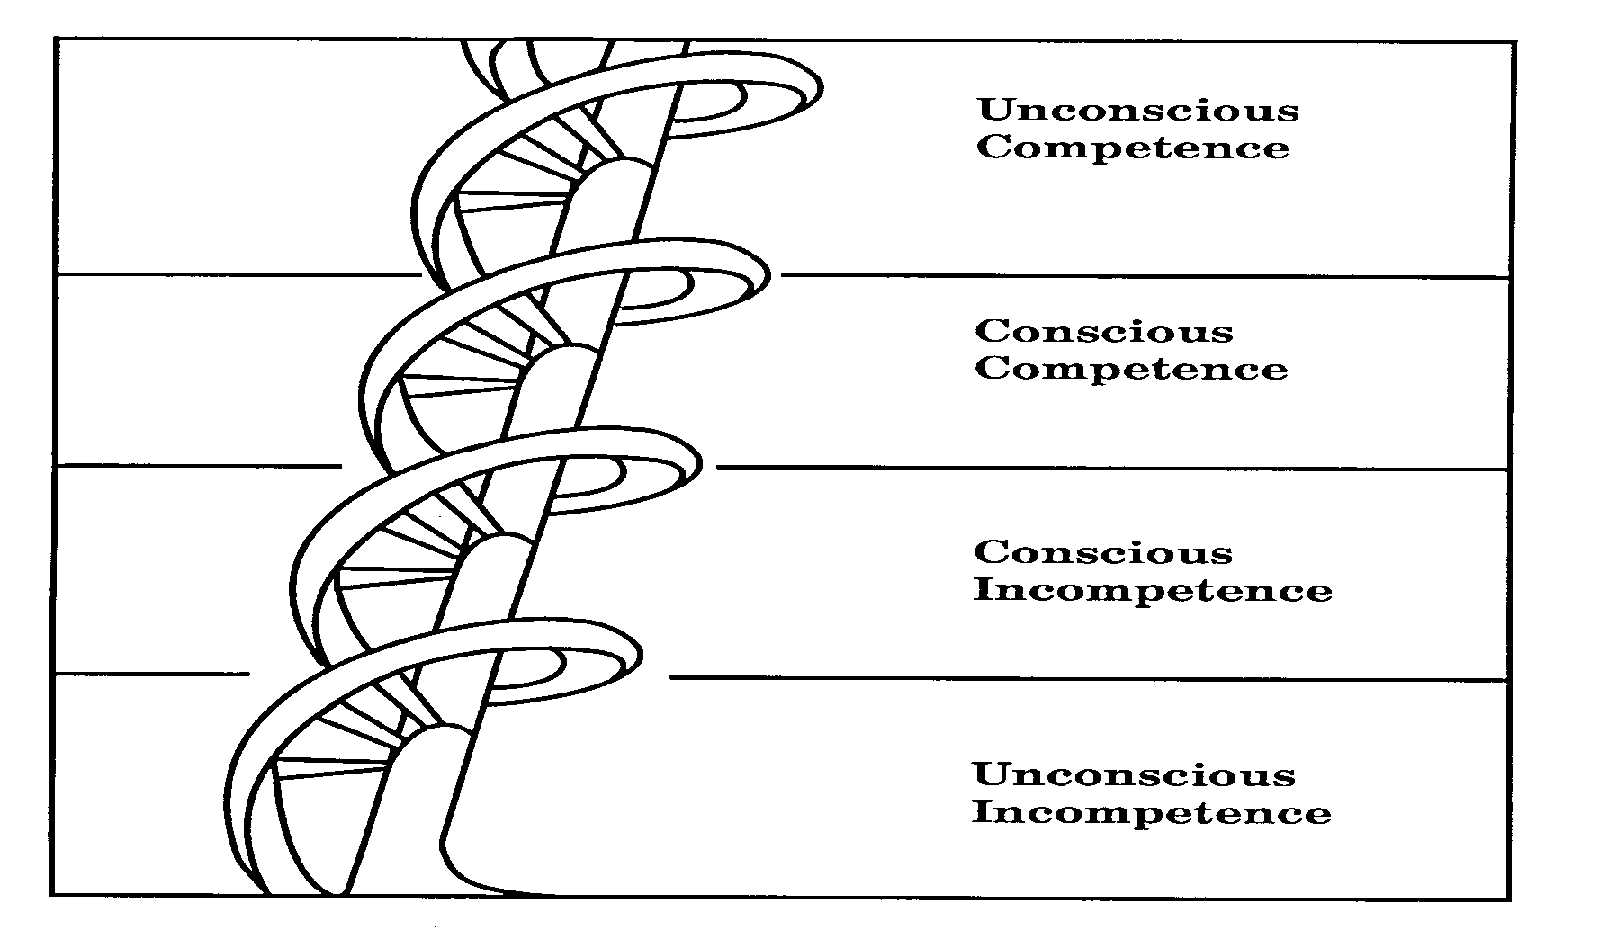
Stages of Knowledge
1. You do not know what you do not know.
(unconscious incompetent)
2. You know what you do not know.
(conscious incompetent)
3. You know what you know.
(conscious competent)
4. You do not know what you know.
(unconscious competent)
Mr. House - Hewlett Packard© 1993 Total Quality Learning, Inc.
Notes:
Refer to slide 1-25 for notes.

Slide 129
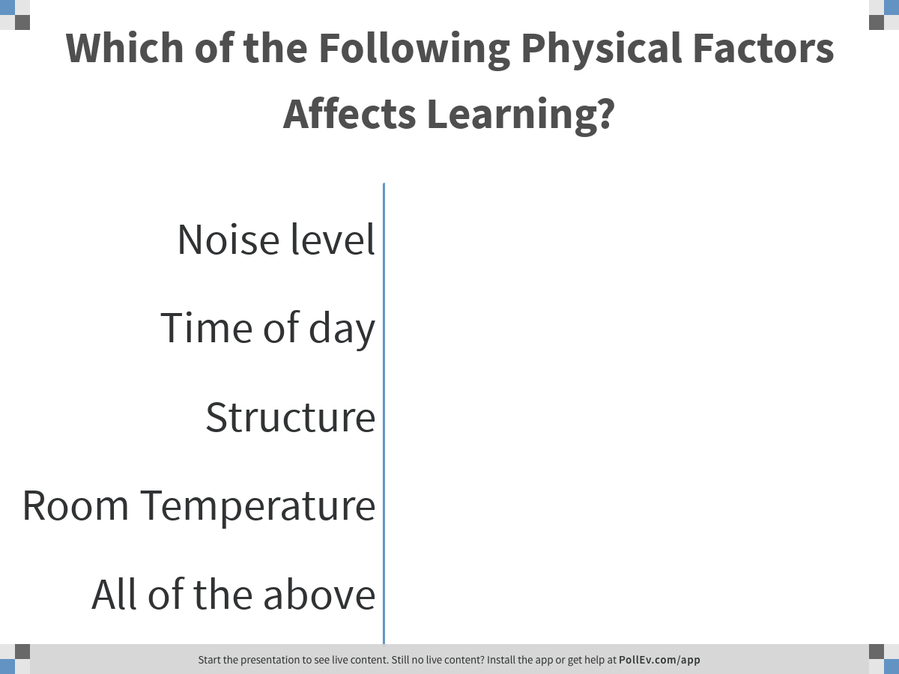
Notes:
Poll Title: Which of the Following Physical Factors Affects Learning?
https://www.polleverywhere.com/multiple_choice_polls/xyzIXProYwLKp8AZ2sijj

Slide 130
Adult Preferences Regarding a Learning Environment
PHYSICAL FACTORS
Learning Setting:
Noise Level
Lighting
Temperature
Time of Day
Structure
EMOTIONAL FACTORS
Social Needs:
Learn Alone
Learn With Others
Motivation:
Extrinsic
Intrinsic
LEARNING FACTORS
Learning Styles:
Auditory
Visual
Kinesthetic
Notes:
Materials page 1-17.
INSTRUCTOR NOTES:
Begin by saying, “There are a number of things which can affect learning. These include physical factors, emotional factors and learning factors, Since we’ve discussed learning styles earlier, let’s briefly discuss physical factors and the issue of motivation.”
Key points:
Physical factors – people must be comfortable or these issues will become major distractions
Motivation – the highest form of motivation occurs when learner are intrinsically motivated to learn.
Ask the question, “How can you help the learners get in touch with intrinsic aspects of motivation?”
Questions like:
What’s in it for you to become an expert in QI methods?
How about your patients? How will they benefit from your work?
What types of things are you especially proud of at work? Least proud of?

Slide 131
Quiz Question:
A Standard Way to Keep People Engaged in Learning Is To:
Summarize key points frequently
Use dramatic gestures to make points more forcefully
Ask good questions and allow people time to think and respond
Repeat key points numerous times to support short term memory

Slide 132
Questioning Strategies: A Method to Keep Learners Involved
Which questions best reinforce your instructional goals?
Develop them in advance
Open or closed ended?
Notes:
Materials page 1-16
INSTRUCTOR NOTES:
Have participants read individually to themselves page 1-16.
Then say, “The key is to determine which questions will best reinforce your instructional goals. We recommend you develop them in advance, carefully. Have participants work in groups to answer a good probing question.”
Then ask, “Generally, should questions be open or close ended?”
Then say, “Remember the power of silence. Become comfortable with the deafening silence which follows a question poised to the group. Remember, participants need time to process the question, don’t rush in and spoil the moment”
Offer this observation, “New trainers are especially troubled with moments of silence because they feel they may be losing the group”

Slide 133
Questioning Samples
What are all the ways you could incorporate this material into your workshop design?
Which aspects of this training are most and least compelling for you?
Does this segment on questioning help you? (how?)
Why is it important to create questions in advance?
What will be the difficulty in translating this material to your actual use?
On a scale of 1-5, with one as low and 5 being high, how confident are you that you can incorporate these principles into your planning activities?
Notes:
Still on materials page 1-16.
INSTRUCTOR NOTES:
Say, “Here are a few samples of questions on questions.”
Read through the list. Move to next slide and page 1-17.

Slide 134
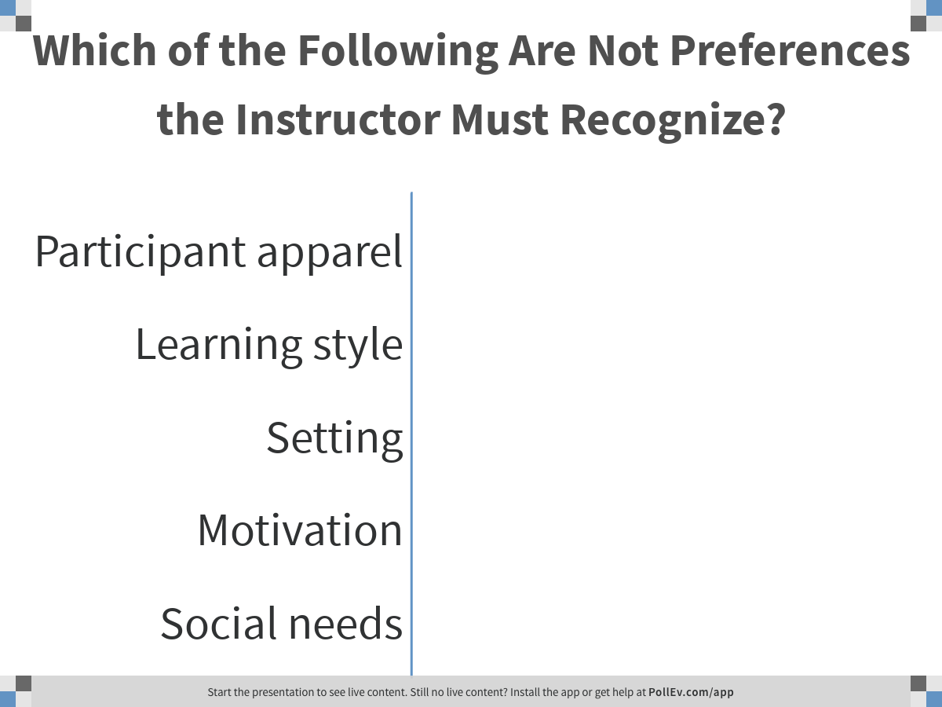
Notes:
Poll Title: Which of the Following Are Not Preferences the Instructor Must Recognize?
https://www.polleverywhere.com/multiple_choice_polls/iOHSKcrDcuTnrEhbPeOH0

Slide 135
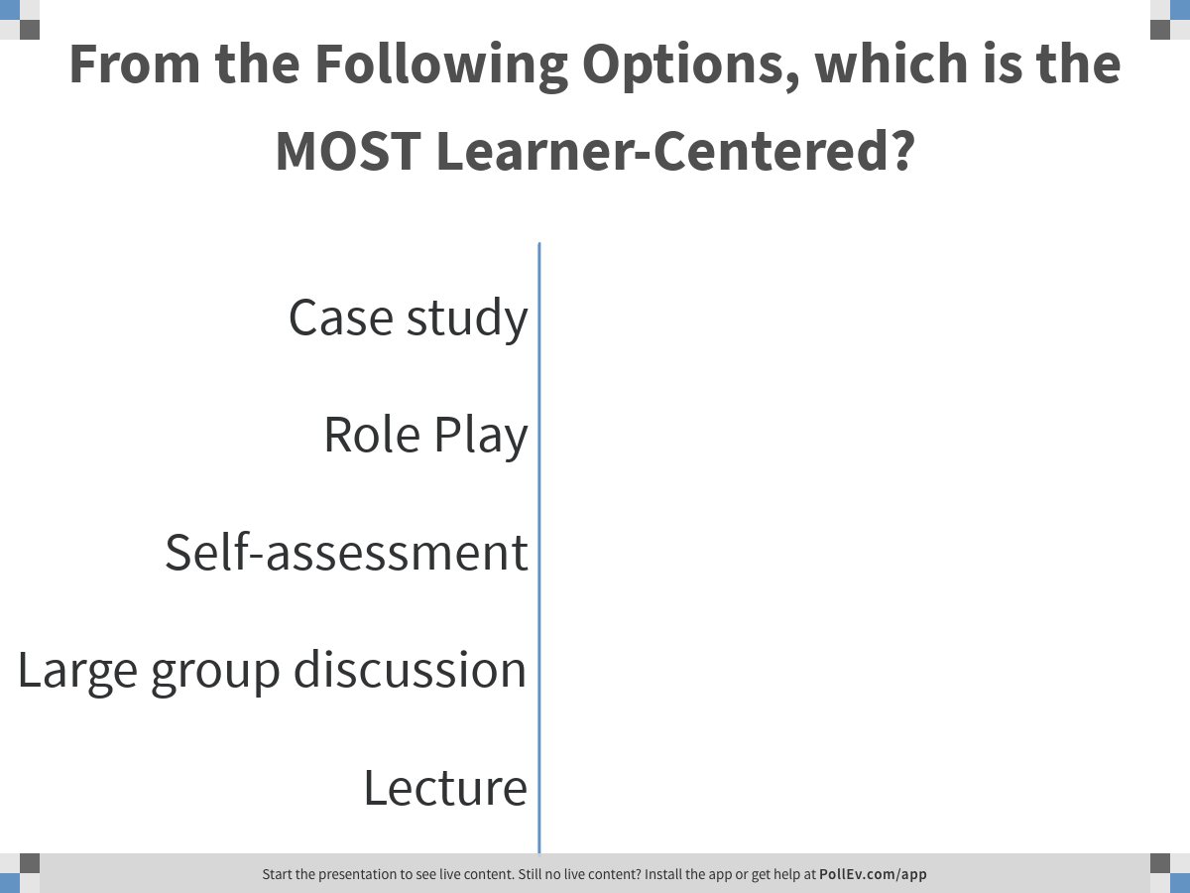
Notes:
Poll Title: From the Following Options, which is the MOST Learner-Centered?
https://www.polleverywhere.com/multiple_choice_polls/cIsambFvboWGcp5Z6282j

Slide 136
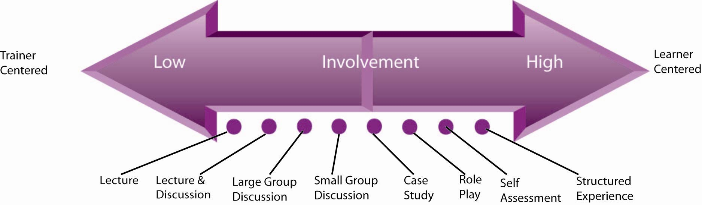
A Key Ingredient: The Level of Involvement
Source: Telling Ain’t Training, ASTD, Harold Stolovitch, Erica Keeps, 2006
Notes:
Materials page 1-15
INSTRUCTOR NOTES:
In another format on page 1-15, we discuss trainer centered approaches versus learner centered approaches. Ask, “Where do lectures fall on the continuum?”
Ask participants to reflect on the 2 questions on page 1-15 of the materials.
After 2 minutes, conduct a short debrief, especially on the implications for teaching adults.
Then ask, “Where are newly minted trainers most comfortable? Why?
What can be done to promote a more learner centered approach, especially with new trainers, possibly like some of you in this session today?
Talk about the new trainer with 140 pages of materials vs. the accomplished trainer with a few handouts and with a better grasp of involvement techniques.
Ask, “Which will help their learners the most with learning the ideas or concepts ?”

Slide 137
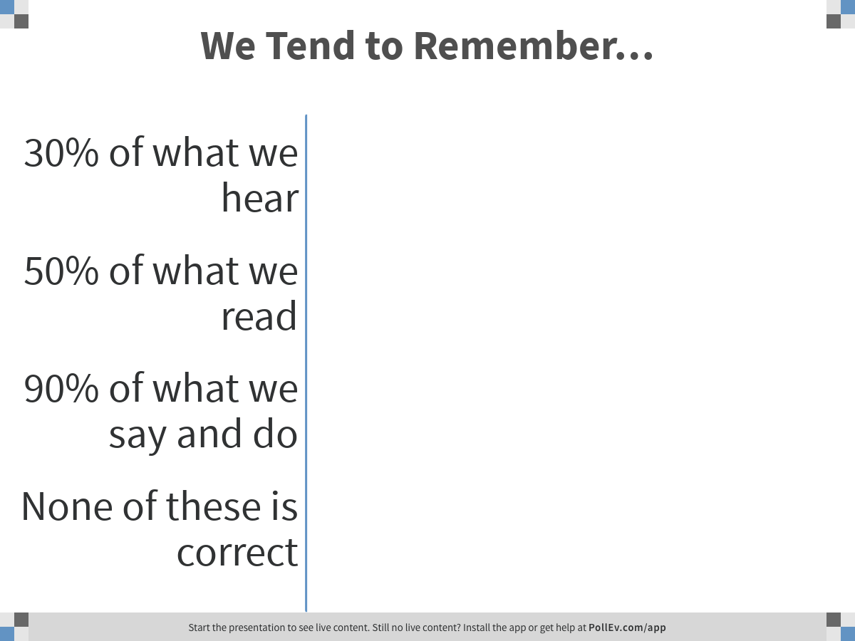
Notes:
Poll Title: We Tend to Remember…
https://www.polleverywhere.com/multiple_choice_polls/T0aLmSyGKGU18ODjZkIpq

Slide 138
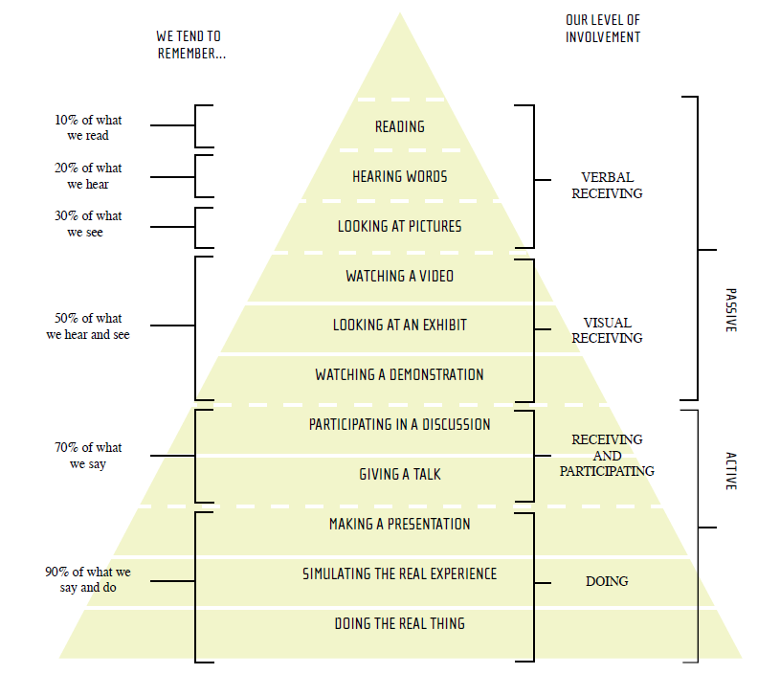
Experience and Learning
NQC Training-of-Trainer Guide. New York State Department of Health AIDS Institute and the Health Resources and Services Administration HIV/AIDS Bureau. 2007.
Notes:
Materials page 1-14
INSTRUCTOR NOTES:
Transition to this slide by saying, “Another way to think about learning relates to the types of things we have people do in the session.”
Then say, “Let’s study for a few minutes the pyramid on page 1-14 in your materials.”
Let participants look at the materials for 3-4 minutes.
Then say, “What’s it telling us. Who would like to help?”
Listen to the ideas presented.
Ensure participants understand the relationship between what learners remember and their level of involvement. The less passive methods with higher levels of involvement encourage significantly higher levels of retention.
Use a story such as Red Bead Experiment or Win As Much As you Can as examples….

Slide 139
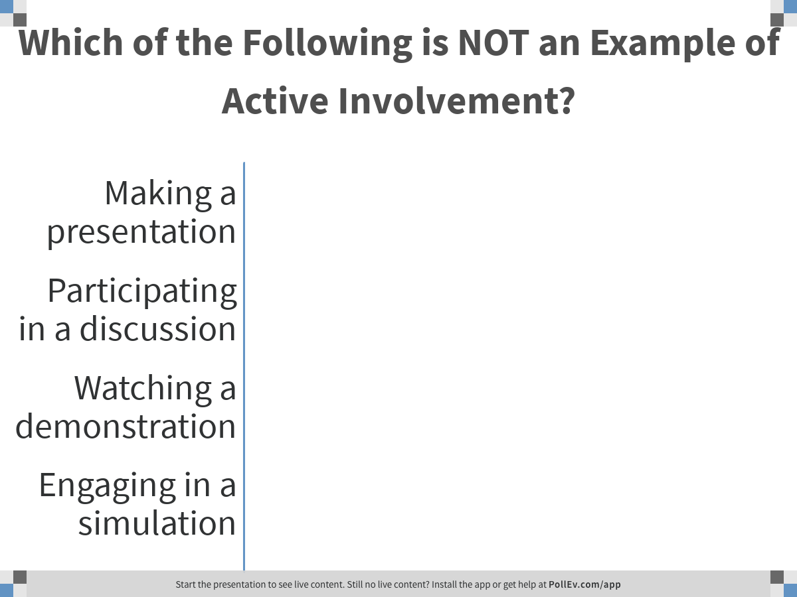
Notes:
Poll Title: Which of the Following is NOT an Example of Active Involvement?
https://www.polleverywhere.com/multiple_choice_polls/k9jg0UZ1LUK8EiPms61A0

Slide 140
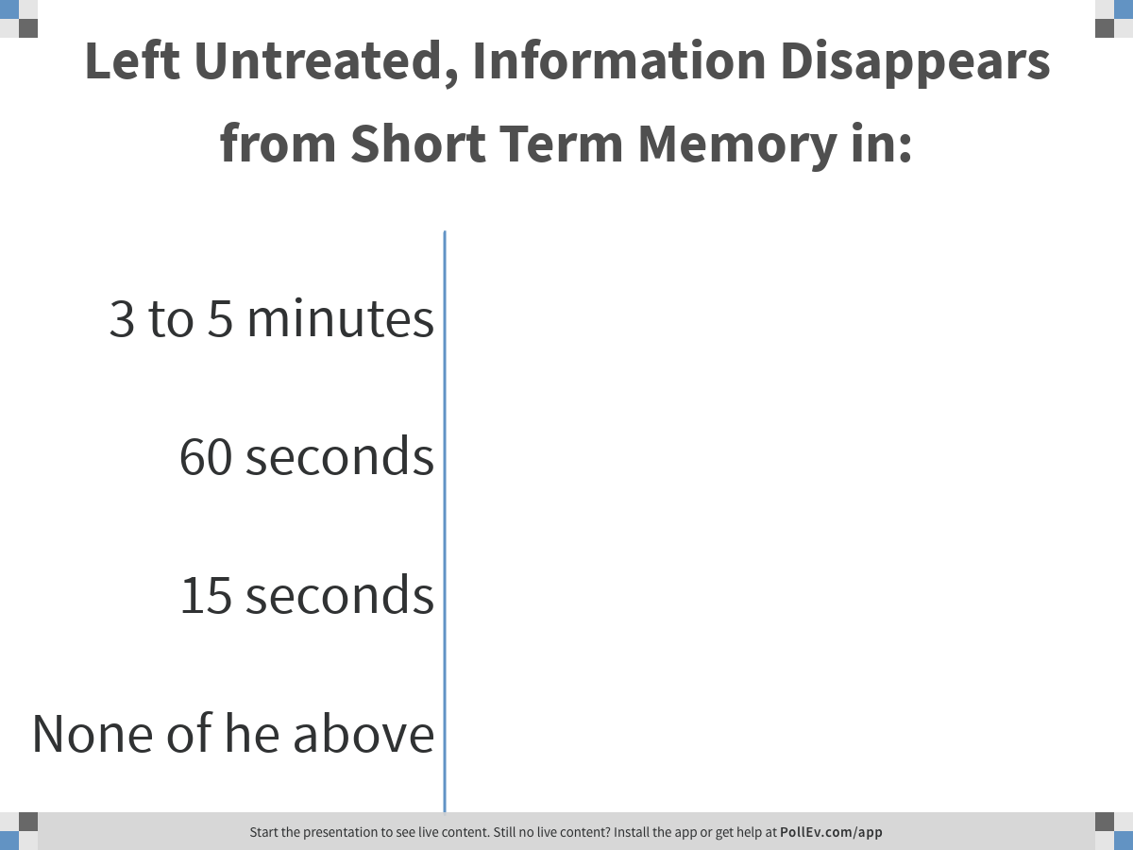
Notes:
Poll Title: Left Untreated, Information Disappears from Short Term Memory in:
https://www.polleverywhere.com/multiple_choice_polls/L9agAIvWYyj8K6tXb0P91

Slide 141
Short-Term Memory
Information that passes our filters needs to be stored and organized
Left untreated, information disappears in 15 seconds or less
Research suggest 5-9 “chunks” of information can be stored in short term memory
Chunking information
Source: Telling Ain’t Training, ASTD, Harold Stolovitch, Erica Keeps, 2006
Notes:
Materials page 1-11.
Transition to the slide on Short Term Memory by saying, “One consideration when training is how people can retain information in their short term memory.”
Then say, “Let’s look at a few points on short term memory from the book Telling Ain’t Training.” Explain the first 3 bullets. Then explain bullet 4 by saying, “We can help people retain ideas if we help them organize the ideas more easily. An example is PDCA, which stands for….?”
Then ask, “Are there other examples where we help people organize ideas more easily?” Listen to other examples.
Examples include:
Forming, Storming, Norming, Performing – stages of team development

Slide 142
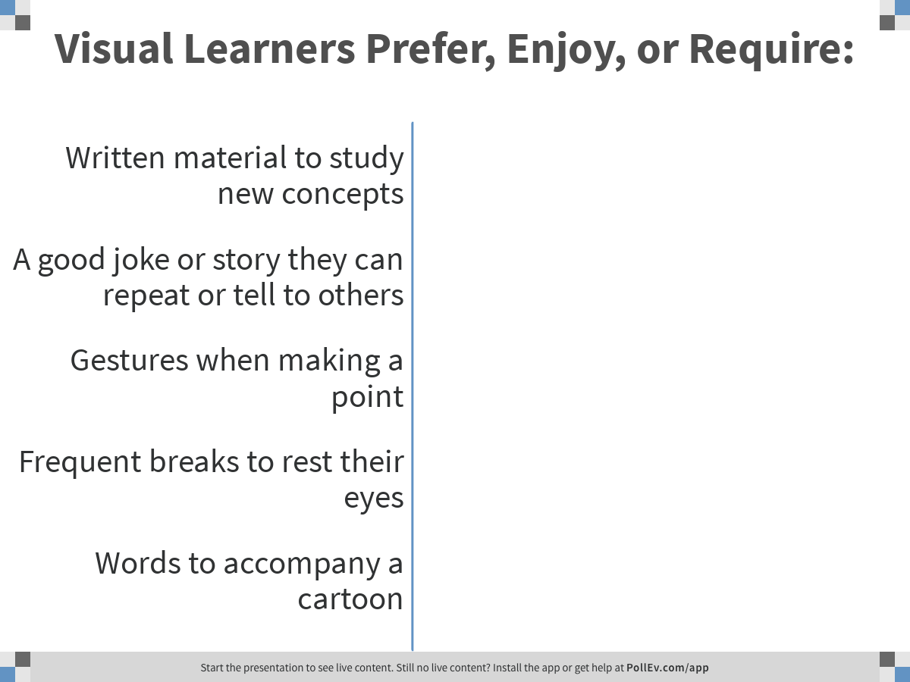
Notes:
Poll Title: Visual Learners Prefer, Enjoy, or Require:
https://www.polleverywhere.com/multiple_choice_polls/yfdaLZ4So4g5gBPvXi1cy

Slide 143
Adult Learning Styles
Visual Learners
Auditory Learners
Kinesthetic Learners
Presentations that are multi-sensory will increase learning and retention for most adults
Notes:
Material page 1-9
INSTRUCTOR NOTES:
Transition to page 1-9 by saying, “Spend 2-3 minutes and read the material on page 1-9 on Adult Learning Styles”
Use slide 14 to reinforce the 3 types of Styles.
Then say, “Presentations that are multi-sensory will increase learning and retention for most adults.”
Then ask, “What are other things you can do to appeal to diverse learner groups?”
Listen to the conversation and contribute your own ideas if time permits.

Slide 144
Training Development Guide
    Step 1 – Topic and Rationale
    Step 2 – Performance Objectives
    Step 3 – Activities
    Step 4 – Evaluation
    Step 5 – Feedback
“A Universal 5-Step Model That Gets Great Results”
Source: Telling Ain’t Training, ASTD, Harold Stolovitch, Erica Keeps, 2006
Notes:
Transition to page1-21 in the participants materials.
INSTRUCTOR NOTE:
Begin by taking participants through the diagram on page 1-21.
Then say, “We’d like to think of an upcoming training experience you will be responsible for in the near future. Use pages 1-22 through 1-24, jot down a few words or ideas for each of the 5 steps as directed. Spend about 5 minutes and be prepared to discuss the 5 step approach.”
After 5 minutes, ask the question, “Which of the 5 steps were easy for you to complete? Which were difficult?”
Listen to the answers and in your mind identify patterns, if any. Thank people for their effort.
Conclude by saying we’ll spend more time discussing and using the 5 step process in the upcoming TOT training session.

Slide 145
Quiz Question:
Research Suggests People Learn Best When:
There is a lot of detailed content
They are shown how things are done
They see what’s in it for the organization
They get to try things for themselves
They are told how things work

Slide 146
I Learn Best When…
Column A | Column B
someone who knows something I don’t explains an describes it to me I observe a demonstration I attend lectures in which an instructor presents information to me I see what’s in it for the organization there is a lot of detailed content what is presented to me is organized according to the logic of the content I am shown how things are done I attend long learning sessions I am in a formal instructional setting I am told how things work | I dialogue and discuss with someone who knows something I don’t I get involved and try things out during a demonstration I attend sessions in which an instructor engages me in a two-way interaction I see what’s in it for me there is minimal and meaningful content what is presented to me is organized according to the logic of how I learn I get to try things for myself I attend short learning sessions I am in an informal work and learning setting I experience how things work
Source: Telling Ain’t Training, ASTD, Harold Stolovitch, Erica Keeps, 2006
Notes:
Set up this slide by saying, “Review columns A and B and determine which column best answers for you the question, I Learn Best When….”
INSTRUCTOR NOTES:
Materials page 1-7.
Give people about 1 minute to select a column. Invite people to share which column they selected. Most will say B.
Then make the following observation, “Research suggests that in fact most people select B for themselves, but when placed into the role of teacher or trainer, they many times behave in a manner that demonstrates their belief that participants in their session prefer column A.”
Then say, “If you believe that’s true, would anyone be willing to offer an explanation on why this occurs.”
Let the discussion run for 4-5 minutes.
Then conclude the discussion by saying, “Who would like to write the headline on this last discussion? What’s the key learning or takeaway?”

Slide 147
Contemporary Historical Roots
Adults prefer self direction
Adults learn more easily when they can relate the learning to their past experiences
Real life events dictate adult’s specific learning needs and interests
Adults are pragmatic in their learning – they seek an impact on life or work-related situations
Andragogy = Unified Theory of Adult Learning (Malcolm S. Knowles, 1973)

Slide 148
Quiz Question:
Learning is Defined as. . .
Retaining facts accurately in long term memory
A change in behavior due to experience or continued practice
Successfully driving knowledge from core skills sets
Correctly replicating in a work environment techniques discussed in a training

Slide 149
Learning, Defined…
“A Change in Behavior Due to Experience or Continued Practice.”
Learning = Change
Learning is adaptation to the environment, allowing survival
Humans have a huge capacity for learning
The ability to learn varies by individual
Your job is to facilitate change through learning for individuals
Source: Telling Ain’t Training, ASTD, Harold Stolovitch, Erica Keeps, 2006
Notes:
Read aloud the operational definition for learning…
“A Change in Behavior Due to Experience or Continued Practice”
INSTRUCTOR NOTES:
Materials page 1-4.
After saying, “ Learning = Change ” slowly read the bullet items for participants to reflect on…
Say aloud, “In training sessions we don’t teach skills, we convey techniques or concepts.”
Present the following concept. “In training, we teach various ideas, techniques, concepts or approaches over a short period of time. People leave the training environment armed with ideas and begin to interact with their environment. By practicing concepts presented in the training in their work environment, they begin to learn, through trial and error, what works and what doesn’t.
Eventually, through trial and error, they refine the techniques and concepts until they become skillful in the use of the techniques or concepts. ”

Slide 150
Quiz Question:
Which of These Learning Conclusions Is False?
Adults resist situations where they are not treated with respect
Adults will strive to do their best when they are physically comfortable
Adults prefer a serious, no-nonsense tone to maximize learning
Adults prefer practical results from learning
Teachable moments are determined by that adult’s needs and interests

Slide 151
Lecture
“When the instructor’s notes become the student’s notes without passing through the minds of either of them!”
Notes:
Materials page 1-10.
Reinforce why lecture is not an effective teaching approach by asking the question, “SO what’s wrong with a good lecture?”
Listen to the discussion, jot down the ideas, and summarize for participants at the end.
Move to the next page/slide.

Slide 152
Learning Is Made Easier When
A climate that induces interest and participation exists
The “learner” is ready to learn
The learner knows the terms and principles involved in the task
The learning experiences are arranged in a logical order
As many senses as possible are involved
Notes:
Materials page 1-26

Slide 153
Learning Is Made Easier When (cont.)
The learner can relate the new experience to previous experiences
The learner’s efforts are reinforced
The timing, duration and location of the learning experience are appropriate
Notes:
Materials page 1-27

Slide 154
My Memory Trick!
Environment is participatory and pleasant (physically)
Ready
Context and chunking
Senses, bridge, reinforce
P2 R C2 sbr
Notes:
Environment is participatory and pleasant (physically)
Ready
Context and Chunking
Senses, bridge, reinforce

Slide 155
Module 8 – Day 1
4:15pm – 5:40pm (100 min)
TOT Handout-of-Handouts: Module 8
Mini-Presentations:
Two Minutes of Fame

Slide 156
Learning Objectives
You will build confidence and skills in making presentations, by giving at least one mini-presentation
You will learn and practice one trainer’s trick to facilitate groups to move forward with decisions

Slide 157
Training Experiences
Agenda | Responsible | Time
Presentation Instructions | Faculty | 4:15-4:20 (5 minutes)
Form small groups | Participants | 4:20-4:22 (2 minutes)
Develop a 2-3 minute presentation | Each participant | 4:22-4:40 (8 minutes)
Delivery of presentations to small group | Participants in small group | 4:40-5:10 (30 minutes)
Small group to choose one participant to present to large group | Participants in small group | 5:10-5:13 (3 minutes)
Presentations to large group Gentle feedback to presenters | Final presenters All participants | 5:13 – 5:40 (27 minutes)
Provide written feedback to final presenters | Faculty | Delivered tomorrow

Slide 158
Presentation Topics
Reflecting on your experiences as a trainee, what are your lessons learned about facilitating and training others?
Share your most recent experience in a workshop on quality management
Thinking back on workshops that you have attended, which one is the most memorable? Why?
What was your scariest workshop experience?
Which tools and resources have you found most helpful to prepare for a training workshop?

Slide 159
Success
"If at first you do succeed,
try not to look too surprised."

Slide 160
Aha! Moments and Evaluation
Module 9 – Day 1
5:30pm – 6:00pm (30 min)
TOT Handout-of-Handouts: Module 9

Slide 161
Module Agenda
Personal Highlights or Aha!! Moments
Polling Survey
Went Well / Do Differently

Slide 162
Highlights & Aha! Moments
What have been some of your personal highlights or Aha! Moments from today’s session?
Use the next 2 minutes to reflect on today, identify a few ideas

Slide 163
Poll

Slide 164
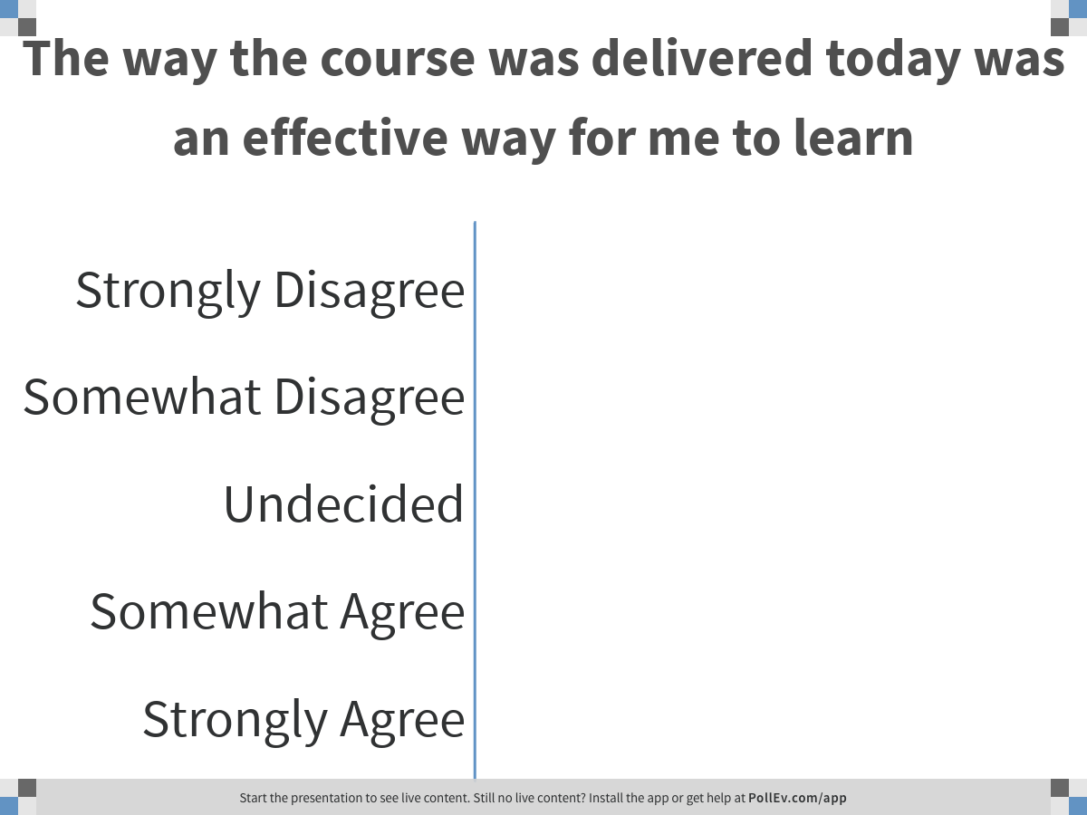
Notes:
Poll Title: The way the course was delivered today was an effective way for me to learn
https://www.polleverywhere.com/multiple_choice_polls/D1Vpcvsf8hlNYtnW5A9JG

Slide 165
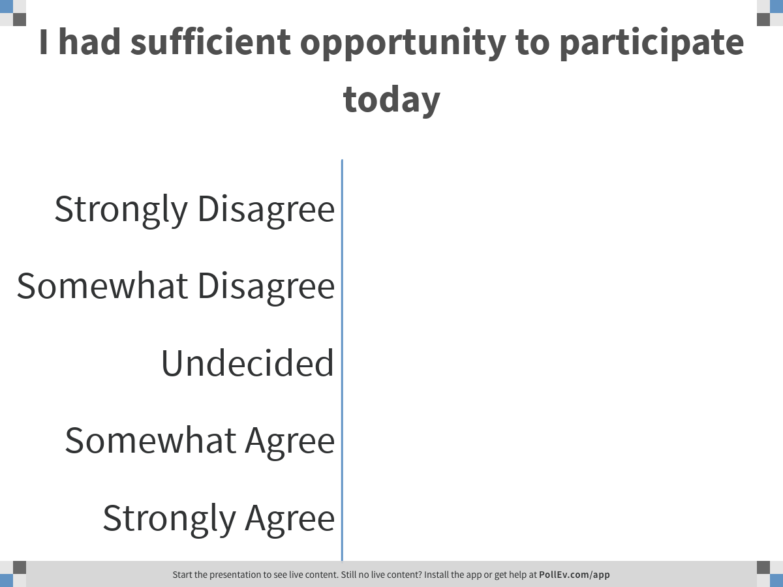
Notes:
Poll Title: I had sufficient opportunity to participate today
https://www.polleverywhere.com/multiple_choice_polls/NChQCqJe65KM6L1dlDhfx

Slide 166
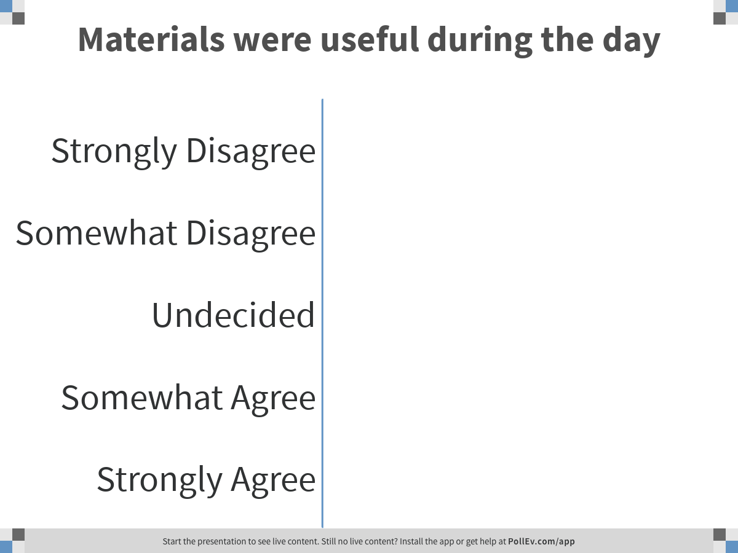
Notes:
Poll Title: Materials were useful during the day
https://www.polleverywhere.com/multiple_choice_polls/EAJwRhbH5WhOFWwLH9tVF

Slide 167
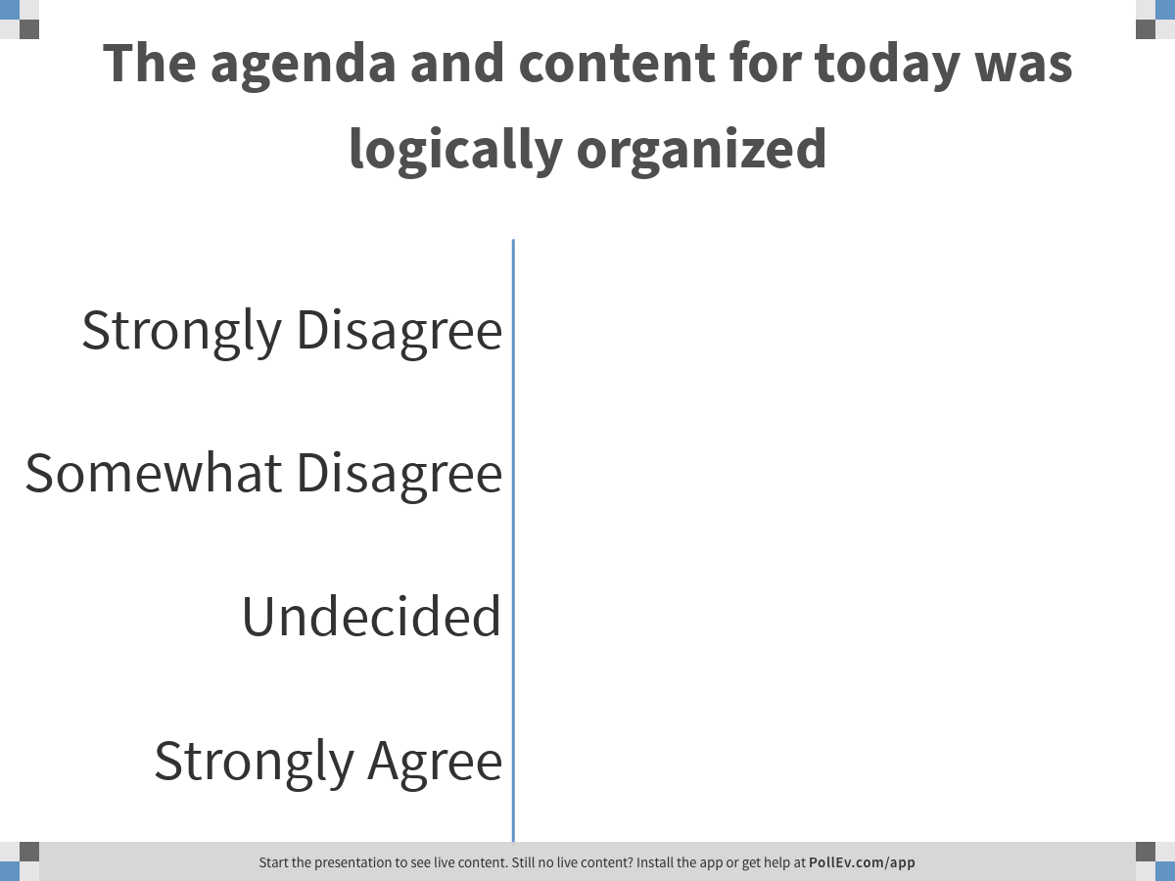
Notes:
Poll Title: The agenda and content for today was logically organized
https://www.polleverywhere.com/multiple_choice_polls/ye8PEv8YG6dvGwDRTkf8Y

Slide 168
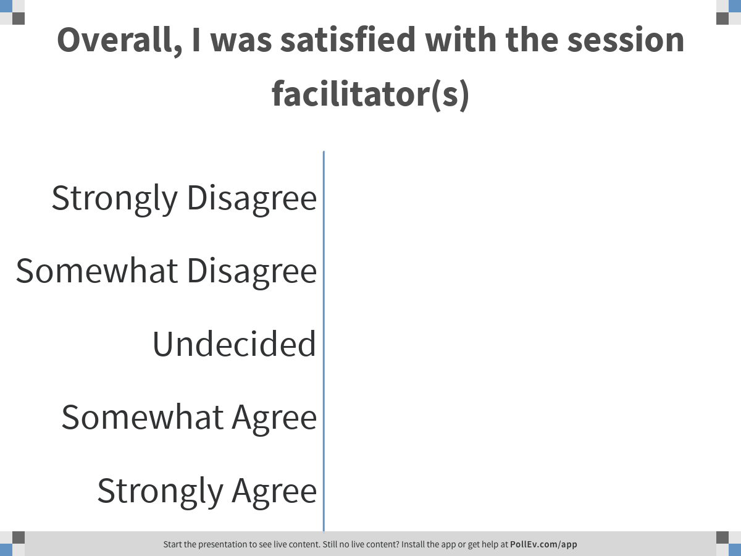
Notes:
Poll Title: Overall, I was satisfied with the session facilitator(s)
https://www.polleverywhere.com/multiple_choice_polls/ZgZymxy1fqe7hRIyn7XBb

Slide 169
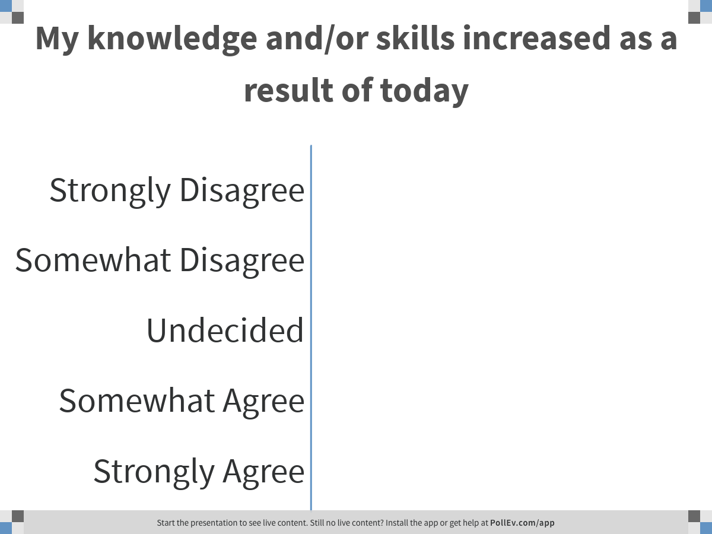
Notes:
Poll Title: My knowledge and/or skills increased as a result of today
https://www.polleverywhere.com/multiple_choice_polls/oLK0m6sz9gxnUejp4eONX

Slide 170
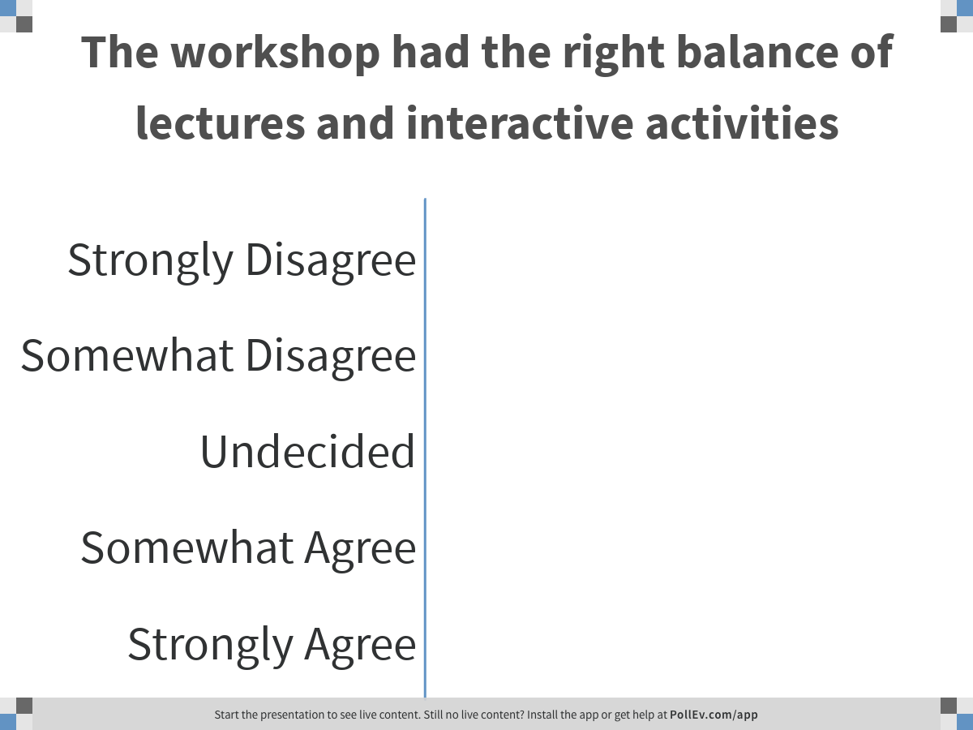
Notes:
Poll Title: The workshop had the right balance of lectures and interactive activities
https://www.polleverywhere.com/multiple_choice_polls/wSXUCIOwE8vx7XYdrUm6e

Slide 171
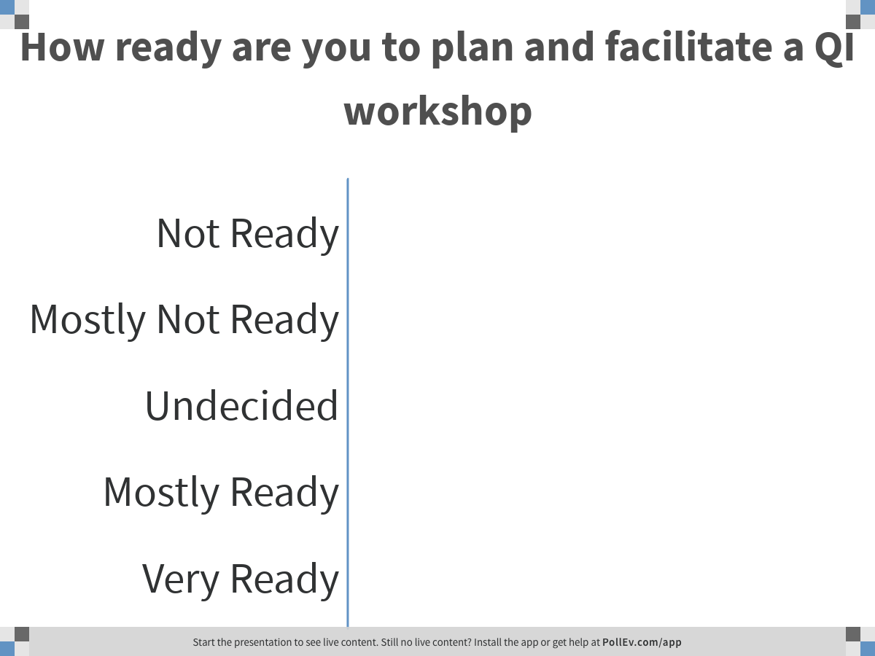
Notes:
Poll Title: How ready are you to plan and facilitate a QI workshop
https://www.polleverywhere.com/multiple_choice_polls/4LLODuJLmRZwkf5TtVPWV

Slide 172
Additional Comments about Today
What worked well today for you?
What should we do differently tomorrow?

Slide 173

Study Groups

Slide 174

"The nice thing about teamwork is you always have others on your side!”
Margaret Carty

Slide 175
What are Study Groups?
Groups of 5-7 of your peers working together for the next 3 months past this TOT session
Groups connect at least monthly to provide peer support and reflect on individual post-TOT QI trainings
Study groups provide
  Support and feedback for QI training skills
  Offer wisdom based on your experiences and successes
  Keep commitments to each other and to the TOT session
Find TOT colleagues you want to work with

Slide 176
Study Group Role
Safe group for idea testing/generating and problem solving
Provide key resource for skill feedback and improvement
Others’ strengths may assist in your growth (i.e., fill each others needs)
Be honest and up-front about your availability; set appropriate boundaries, but provide times you’re available
Share your strengths willingly; offer advice in your areas of strengths, as noted by your scores
Be just a phone call away

Slide 177
For Highest Chance of Success
Study Group members should
Agree on routine communications (calls, emails, etc.) and have a plan to “get in touch” in case of one drops off the radar
Connect with TOT faculty for questions, guidance, clarification or to Pump you up!
Know commonalities is group strengths and opportunities for improvements
Have a person(s) who can informally lead the group

Slide 178
Assignments
Today
On the way out, identify others you want to join in your Study Group
Write down your names on the flipchart
Tomorrow
Sit with your Study Group
Plan your first monthly call (details to come)

Slide 179

Breakfast 7:00AM and Session Start at 8:00AM

Slide 180
Quick Session Evaluation Via Poll
How helpful was today’s session to reach your goals for participating in the Learning Lab?
  [1-not at all helpful, 2-not so helpful, 3-somewhat helpful, 4-very helpful, 5-extremely helpful]
How engaged were you in today’s session?
  [1-not at all engaged, 2-rarely engaged, 3-somewhat engaged, 4-engaged, 5-extremely engaged]
How likely will you implement the lessons learned of this session in your improvement project?
  [1-very unlikely, 2-somewhat unlikely, 3-neither likely nor unlikely, 4-somewhat likely, 5-very likely]

Slide 181

Contact Information
Coaches
Justin Britanik, CQII Coach, justin@cqii.com
Khalil Hassam, CQII Coach, Khalil@cqii.com
Learn More
212-417-4730 (phone)
212-417-4684 (fax)
Info@CQII.org
This project is supported by the Health Resources and Services Administration (HRSA) of the U.S. Department of Health and Human Services (HHS) as part of an award totaling $1.5M. The contents are those of the author(s) and do not necessarily represent the official views of, nor an endorsement, by HRSA, HHS or the U.S. Government.

