Slide 1


Training Evaluation
Framework and Tools (TEFT)
Ryan White All Grantees
November 2012

Slide 2

Notes:
We thought we’d start with an introduction of the project, what I-TECH was asked to do, and then we’ll go right into talking about the framework that we’ve drafted. We’re just starting on our second year of a 2-year assignment to develop a framework and tools to support PEPFAR programs in documenting outcomes of training, with a focus on in-service training. Last year, PEPFAR initiated these 2 “headquarters operational plans” or HOPs, to support evaluation and quality improvement of in-service training.

Slide 3
I-TECH “HOP” Project:
Headquarters Operational Plan
Human Resources for Health Technical Working Group: “…to date PEPFAR has supported an estimated 3.7 million training and retraining encounters for health care workers. Despite this great achievement, there has been little to no evaluation of these training interventions.”
Synergies with USAID / HCI HOP project, “Framework for Quality Improvement of In-service Training”
I-TECH Deliverables:
    Framework, practical guidance and tools
Notes:
This HOP project relates to one of the key points in the SOPA on Human Resources for Health which emphasizes that there is a greater need to establish an evidence base for the training activities that are being conducted. There is a synergy with the other HOP project with the USAID / HCI team which involves developing a quality improvement framework for in-service training.
So the focus of the “HCI HOP” is design and planning of in-service training, and the focus of I-TECH’s HOP is evaluation of training. Our 2 projects have been collaborating, communicating, and sharing resources such as results of literature searches.
The deliverables for this project are a framework, with accompanying narrative, tools, and case examples. It is intended for this to be a practical tool to guide planning for outcome evaluation of training. It is targeted at a range of users, from local program implementers to staff with some expertise in M&E, to ministries as well. It’s not intended to be a sort of “Evaluation 101”, but it will provide links to resources on basic evaluation information. So at least some M&E and/or program expertise would be needed for this to be a useful tool, but should be useful for a range of users.
We have also been asked to collaborate with colleagues participating in the HCI HOP on a series of articles for publishing in the journal Human Resources for Health.

Slide 4
HOP Team
Project Lead: Gabrielle O’Malley
Team:
  Francie Petracca
  Tom Perdue
  Marrianne Holec
  Marcia Weaver
  Support : Xeno Acharya, Michelle Desmond, Hope O’Brien, Vivian Bertman, Stacey Lissit
Notes:
So Gabrielle put together a team, and these are the main folks that have worked on the project, contributing to various sections of it.

Slide 5
Progress to date
Key informant interviews (15) and surveys (30) – technical advisors, program managers, OGAC, HRH TWG
Framework development and vetting, revision
Review and categorization of literature
Developed tools to support decision-making; currently piloting
Developed illustrative case examples and guidance narrative
Posted on I-TECH website:
  http://www.go2itech.org/resources/TEFT
Notes:
Thinking about this task – to help support PEPFAR training programs to move from almost solely documenting outputs – numbers of participants trained, and numbers of trainings conducted – to evaluating outcomes, we did some formative work – how to contribute to the field of training evaluation and help move us in this direction of evaluating outcomes.
To date the formative work has included key informant interviews and a literature review, and the results of these are reflected in the draft framework.The framework has been developed, and has begun to be shared with partners for feedback. The framework has had a lot of resonance with the key informants we’ve talked with, so we think we’re on the right track with it.
A review of the literature has been conducted, and literature has been categorized with reference to components of the framework. This has also been shared with partners.
We’ve drafted tools to accompany the framework, and are currently pilot-testing those with colleagues working on a Leaders-in-Health training program in Namibia, and will be piloting them with several other groups this year. In fact, if you’d like to talk about piloting the framework and tools for a project you’re working on, we’d love to talk with you about that.
We also have drafted some case examples to help illustrate the concepts in the framework and tools, and as we move forward with piloting the tools, we hope to be able to add these real-life examples to our collection of cases.

Slide 6
Interview themes
Importance of documenting outcomes
  We’re getting a lot of pressure from the PEPFAR side to link everything to health outcomes.
Interest in longer-term effects (> 12 months)
      Check with people 12 months later or 18 months later, you’re in a position to be able to catch them and say, okay now let’s follow up with you a little bit more than we had before. Within 6 months, they kind of know what’s going on, but then after that, forget it.
Notes:
I’ll just share a little bit of the themes that came out of the interviews that we conducted.
The interviewees reinforced the idea that there’s a lot of attention being paid to documenting outcomes at this point, much more than in the earlier days of PEPFAR.
Another emphasis was on longer-term effects. Given that we so often have reports of outputs or very short term outcomes (such as pre-post test results), the interest is on longer term effects, out to 12 months or 18 months.

Slide 7
Interview themes
Not re-establishing the value of training; focus on what works and in what context
  “What different trainings are most effective, what is most cost-effective, these are the kinds of things, for this day and age that we should be talking about.”
Emphasis on mixed qualitative and quantitative methods
  I think it’s sort of you getting in there and doing more of the qualitative work… Getting in there and understanding a little more richness about their environment…
Notes:
It was emphasized that looking at training outcomes isn’t so much about whether or not training is a good thing, but more nuanced – asking questions about what works better, what achieves the best results, and of course what is the best “bang for your buck.”
Along with this was an emphasis on mixing qualitative with quantitative methods – to understand the context in which the training and its outcomes occur.

Slide 8
Interview themes
Many confounding factors – hard to study impacts
Takes time before impacts are seen; this is more expensive and difficult logistically
Often baseline has not been collected
  The thing with training, because it is one of multiple inputs to a health outcome, you could take 2 groups that are exactly the same, and one got the training, and one didn’t get the training, and you could compare them, but it’s challenging. It’s challenging finding a naive group, it’s challenging getting the conditions to stay similar, to get the person you trained to stay in the place for that time.
  Methodologically, it’s a nightmare.
Notes:
One of the main themes of the interviews was the difficulty we have in attributing any health outcomes that are seen to the training that was conducted, because there are so many confounding factors that exist at the same time as we’re conducting this training. So we set out to develop a framework that could help programs figure out how to deal with this.

Slide 9
Interview themes
Integrate capacity building framework with training eval framework
  …Using that model that comes out of the UNAIDS/World Bank – it’s the individual, the organization and the system. So we’re no longer saying, ‘train more individuals to do this’. That’s not all of it. They have to have someplace to work. They have to have the policy and institutions behind them to allow them to work...We’re trying to re-orient people’s thinking around capacity building as bigger than just people.
Notes:
Our colleagues at PEPFAR suggested that we integrate elements of the training framework with elements from the capacity-building frameworks that have been in discussion the last 10 years or so.

Slide 10
Organization–
systems
improvements
Population–
level
systems
improvements
Organization -
performance
outcomes
Population–
level
performance
outcomes
Individual–
knowledge,
attitude, skill
outcomes
Individual–
performance
outcomes
Individual– patient health outcomes
Training
Organization –
patient health
outcomes
(impacts)
Population –
patient health
Outcomes
(impacts)
Training evaluation Framework
Notes:
The framework, shown here, is centered on the colored arrow boxes, proceeding from the left to the right. These describe the causal chain of outcomes from a training intervention, starting with individual outcomes and moving out to organization-level outcomes and then system-level outcomes.
Note that this model reflects aspects of the training evaluation model developed by Kirkpatrick, which identified four levels at which trainings could be evaluated: Reaction, Learning, Behavior, and Results. It also looks a lot like a logic model, except in this model, we’re focusing on the Outcomes and Impacts side of the model. You can also see the “nested” boxes here that are part of that capacity-building model that our PEPFAR colleagues were interested in including.

Slide 11

Training evaluation Framework
Notes:
I’ll walk through it step-by-step, starting at the individual trainee level.

Slide 12

Individual–
knowledge,
attitude, skill
outcomes
Individual–
performance
outcomes
Individual–patient health outcomes
Training
Training evaluation Framework
Notes:
This section of the framework describes a training and its outcomes. The first white arrow shows the training intervention, followed by the outcomes that are possible at the individual level.
The purple arrow shows that providing a health care worker training leads to improvements in their content knowledge, skills, and/or attitudes.
The next level of outcome would be that the trainee applies their new learnings on the job. These are individual performance outcomes. In this framework, performance outcomes are always orange.
Finally, the blue arrow shows improvements in patient health resulting from the better care provided by the newly-trained health care worker. In this framework, patient health outcomes are always blue.

Slide 13
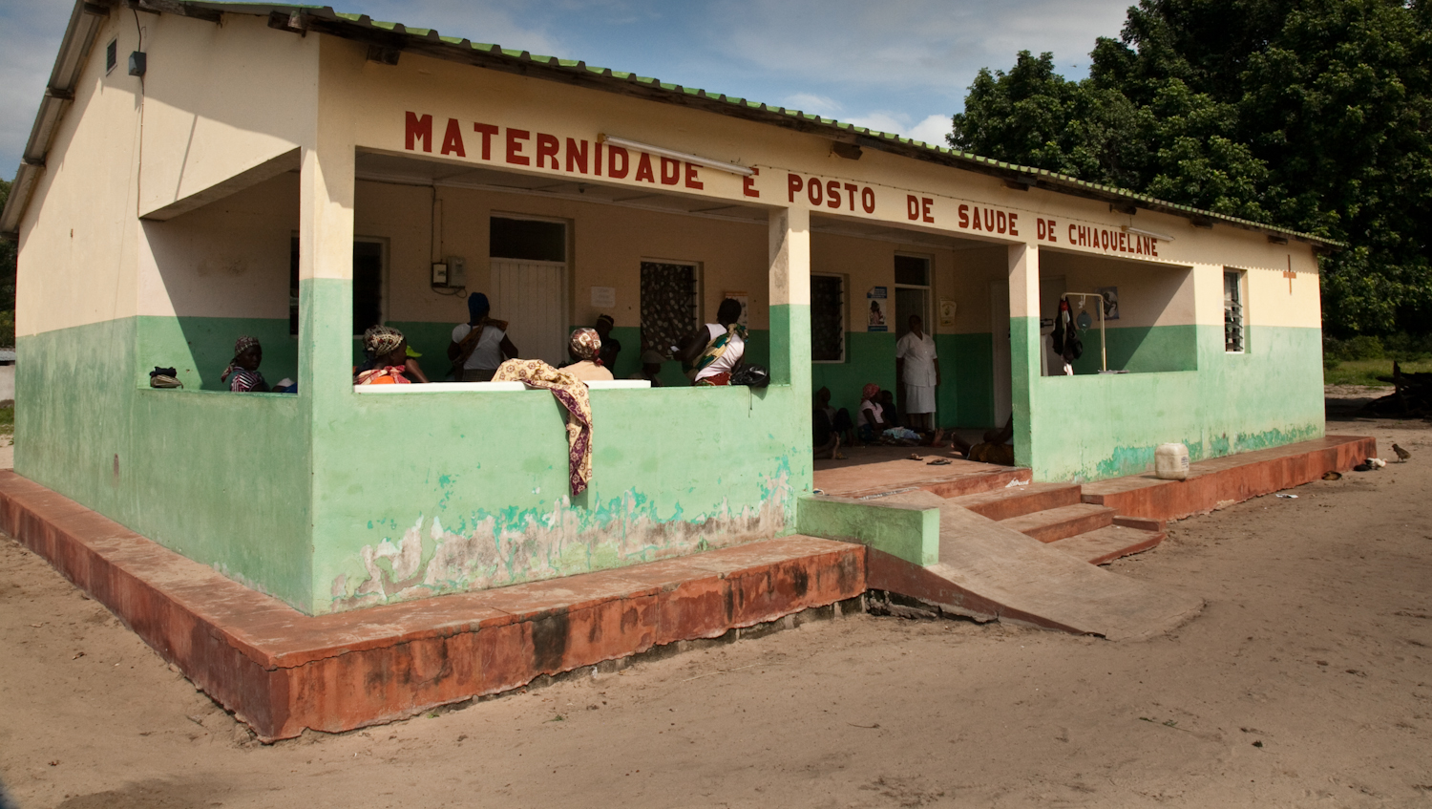
Training evaluation Framework
Notes:
Next we add the organization or “facility” level.

Slide 14
Organization
systems
improvements
Organization
performance
outcomes
Individual
knowledge,
attitude, skill
outcomes
Individual
performance
outcomes
Individual patient health outcomes
Training
Organization
patient health
outcomes
(impacts)
Training evaluation Framework
Notes:
At this level, the changed performance of the trainees may lead to overall performance changes at their facility or organization, and even to improvements in the systems the organization uses.
The systems improvements are shown in yellow, the organization-level performance outcomes are orange, and aggregated patient health outcomes or impacts are in blue.

Slide 15

Training evaluation Framework
Notes:
Next, we reach the level of the larger health system and the population.

Slide 16
Organization
systems
improvements
Population
level
systems
improvements
Organization
performance
outcomes
Population
level
performance
outcomes
Individual
knowledge,
attitude, skill
outcomes
Individual
performance
outcomes
Individual patient health outcomes
Training
Organization
patient health
outcomes
(impacts)
Population
patient health
outcomes
(impacts)
Training evaluation Framework
Notes:
As before, at this level systems improvements are yellow, performance outcomes are orange, and patient health outcomes or impacts are blue.
And again, the aggregated data from numerous organizations or facilities lead to changes at the system and population level.

Slide 17

Training evaluation Framework
Notes:
And finally, we consider the broader environment in which all of this is occurring. The social, cultural, political, environmental, and other factors that may be influencing, reinforcing, or confounding our intended outcomes.

Slide 18
Organization–
systems
improvements
Population–
level
systems
improvements
Organization -
performance
outcomes
Population–
level
performance
outcomes
Individual–
knowledge,
attitude, skill
outcomes
Individual–
performance
outcomes
Individual– patient health outcomes
Training
Organization –
patient health
outcomes
(impacts)
Population –
patient health
Outcomes
(impacts)
Training evaluation Framework
Notes:
These multiple capacity-building levels may already be familiar to you. They are described in the literature on international development and program design and evaluation. And in fact this framework can be used not just to consider program evaluation, but also as a framework for how to design training interventions that will have the greatest possible impact.

Slide 19
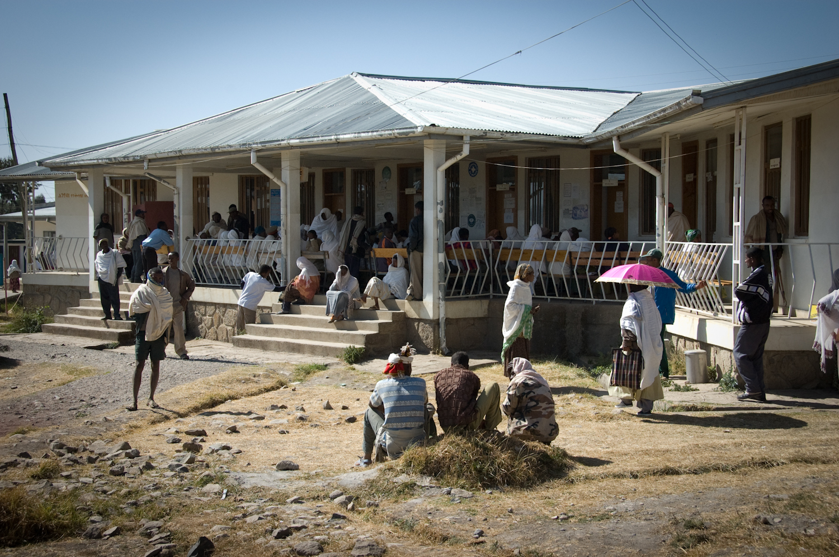
Notes:
The other aspect of the framework is the situational factors that play a huge part in determining whether out trainings can have their desired effects. Patients, health care workers, and health systems all function in complex environments.

Slide 20
Situational Factors
Trainee background knowledge
Trainee experience
Intrinsic motivation
Pt education level
Patient, trainee family demands
Training evaluation Framework
Notes:
So again, in the framework we’ve started with the individual level and then move out to organizational, population, and environmental to consider the various factors that can influence our outcomes.
For example, at the individual level, even if many other factors are favorable, a health care worker training may not be successful unless:
• the trainees are motivated to learn during the training
the trainees have the right background knowledge to absorb the new information,
Or the patient is able to come receive the treatment because they have family demands taken care of.

Slide 21
Situational Factors
Trainee background knowledge
Trainee experience
Intrinsic motivation
Pt education level
Patient, trainee family demands
Management support
HR – staffing levels, salaries, burnout
Available drugs, supplies, equipment and infrastructure
Facility systems – appointments, records, flow, referrals
Patient needs
Training evaluation Framework
Notes:
Similarly, at the organizational level, a health care worker might not be able to use the new skills she gained in the training because:
she does not have the medications or equipment she needs,
she is overburdened with a high patient load, or
the patients she sees require different care or expertise.

Slide 22
Situational Factors
Management support
HR – staffing levels, salaries, burnout
Available drugs, supplies, equipment and infrastructure
Facility systems – appointments, records, flow, referrals
Patient needs
National, regional, community systems
– labs, supply chain
National, regional policies
Partner programs
Available health workforce, including informal private,
attrition issues
Pre-service program
Retention factors,
e.g. pay scales
Trainee background knowledge
Trainee experience
Intrinsic motivation
Pt education level
Patient, trainee family demands
Training evaluation Framework
Notes:
And out at the population and health system level,
Are the systems in place to support integration of the newly-learned information?
Here we get into larger health workforce issues – are there enough workers available? Is attrition a large problem?

Slide 23
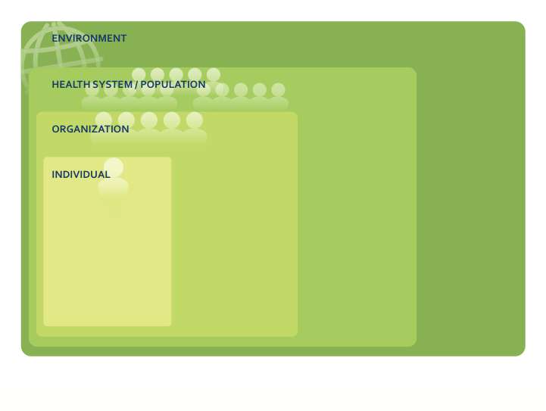
Situational Factors
Trainee background knowledge
Trainee experience
Intrinsic motivation
Pt education level
Patient, trainee family demands
Management support
HR – staffing levels, salaries, burnout
Available drugs, supplies, equipment and infrastructure
Facility systems – appointments, records, flow, referrals
Patient needs
National, regional, community systems
– labs, supply chain
National, regional policies
Partner programs
Available health workforce, including informal private,
attrition issues
Pre-service program
Retention factors,
e.g. pay scales
Political instability
Prevalent disease
Natural disasters
Food availability
Seasonal changes
Patient access to food, transportation
Available community support resources
Training evaluation Framework
Notes:
And out to the encompassing environmental level, where political, climate, and patient access issues can all impact whether our training can achieve its desired effect.
Note that as the number of situational factors increases, it becomes more challenging to tie your intervention to a given outcome.

Slide 24
Organization
systems
improvements
Population
level
systems
improvements
Individual
knowledge,
attitude, skill
outcomes
Individual
performance
outcomes
Individual patient health outcomes
Organization
performance
outcomes
Population
level
performance
outcomes
Training
Organization
patient health
outcomes
(impacts)
Population
patient health
Outcomes
(impacts)
INDIVIDUAL
Trainee background,
knowledge, experience, education
Intrinsic motivation
Family demands
ORGANIZATION
Management support
HR – staffing levels, salaries, burnout
Available drugs, supplies, equipment and infrastructure
Facility systems – appointments, records, flow, referrals
Patient needs
HEALTH SYSTEM/POPULATION
National, regional, community systems – labs, supply chain
National, regional policies
Partner programs
Available health workforce, including informal private,
attrition issues
Pre-service program
Retention factors, e.g. pay scales
ENVIRONMENT
Political instability
Prevalent disease
Natural disasters
Food availability
Seasonal changes
Patient access to food, transportation
Available community support resources

Slide 25
Training evaluation Framework
Notes:
So thinking about an example to fill in the framework…

Slide 26

Training evaluation Framework
Notes:
Let’s say that we are evaluating a training on HIV clinical staging, for health care workers in a district-level facility.

Slide 27
HCW can correctly stage patients
with HIV
HCW correctly initiates ARV for eligible patients
more often
Training
on HIV Staging
Patients tx by trained HCWs – Increased CD4
Training evaluation Framework
Notes:
The training is shown in the white arrow.
The first level of outcomes in the Framework is always the trainees’ content knowledge, skills, and attitudes, shown in the purple arrow.
In this instance, a skills assessment given after the training shows that the trainees can now correctly stage patients with HIV.
This outcome is that their skills have improved.
The second level, which is performance outcomes, is shown in the orange arrow. The trainees are observed in their workplaces by an expert clinician, and their staging matches the staging of the expert clinician to a certain standard of competency. The trainees also initiate antiretroviral treatment for eligible patients more often than they did before the training.
So, their on-the-job performance has also improved.
The third level examines patient health outcomes. Facility medical records show that patients who are treated by the trained health care workers have higher CD4 counts than the patients of health care workers who have not attended the training. The health of the patients treated by the trained health care workers has improved.

Slide 28

Facility-level Systems Improvements: Staging checklist used
Facility increase in correctly initiated eligible points
Training
on HIV Staging
HCW can correctly stage patients
with HIV
HCW correctly initiates ARV for eligible patients
more often
Patients tx by trained HCWs – Increased CD4
Facility-level: Increased CD4
Training evaluation Framework
Notes:
Now, let’s explore these three outcome levels at the facility or organizational level.
On reviewing data at the facility level, we find that the facility initiates a new system of using a checklist for staging patients, which is a facility level system improvement.
Motivated trainees at the facility have increased the number of patients who are correctly being initiated on HIV antiretroviral therapy, which is an organization performance outcome.
And the facility’s patients’ have an overall increased in their CD4 cell count, which is a Facility-level patient health outcome.

Slide 29

Facility-level Systems Improvements: Staging checklist used
Population-level Systems Improvements: All clinics use new checklist
Facility increase in correctly initiated eligible points
Population-level increase in correctly initiated
Training
on HIV Staging
HCW can correctly stage patients
with HIV
HCW correctly initiates ARV for eligible patients
more often
Patients tx by trained HCWs – Increased CD4
Facility-level: Increased CD4
Population-level: Reduced HIV morbidity
Training evaluation Framework
Notes:
Here we also see improvements in the systems, performance, and overall health outcomes.
At this point, we have identified training outcomes at each level….

Slide 30
Training evaluation Framework
Notes:
But remember, we still have to account for situational factors at every level, too. Let’s take a look at those.

Slide 31
Situational Factors
Background knowledge, experience
Intrinsic motivation
Pt education level
Family demands
Management support
HR – staffing levels, salaries, burnout
Available drugs, supplies, equipment and infrastructure
Facility systems – appointments, records, flow, referrals
Patient needs
National, regional, community systems
– labs, supply chain
National, regional policies
Partner programs
Available health workforce, including informal private,
attrition issues
Pre-service program
Retention factors,
e.g. pay scales
Political instability
Prevalent disease
Natural disasters
Food availability
Seasonal changes
Patient access to food, transportation
Available community support resources
Training evaluation Framework
Notes:
In this situation, the team was concerned about whether the participant selection was going to result in the “right” people attending the training – that is, the people who would have the background knowledge and experience to absorb the new information. Also thinking about national policies, would they actually be able to take the information they learned and apply it on the job? They also wanted to keep track of the available ART medications at the sites, since their health outcome – improved CD4 counts – would depend on this being in place.

Slide 32
Planning the Training Evaluation
Framework and tools support discussion, decision-making
  Intervention Scope
  Objectives of the training intervention
  Use of the evaluation findings
  Feasibility of the evaluation activities:
    Time Frame
    Financial and Human Resources
    Access to Data
  Situational Factors
Notes:
Now, we have mapped out our training intervention and the situational factors, and we are ready to make some decisions about the level at which we can reasonably evaluate the outcomes and impact of our training.
In short, we are asking: “What do we want to learn about the outcomes of our training, and what is it feasible for us to find out?”
I-TECH has developed a worksheet, called the Evaluation Considerations tool, to help you focus this conversation into six specific categories of consideration.
The six categories to consider are:
The scope of the intervention being evaluated
The objectives of the training intervention
The use of the evaluation findings, and
the feasibility of conducting various evaluation activities, including
the time frame for the evaluation
the financial and human resources available for the evaluation, and
your access to quality data
We’ve also developed a “situational factors worksheet” to help think about what the possible confounders might be for the evaluation, and what you might want to do to address these in your evaluation.

Slide 33
Web resources: http://www.go2itech.org/resources/TEFT
Notes:
Let’s take a look at the web resources for a few minutes.

Slide 34
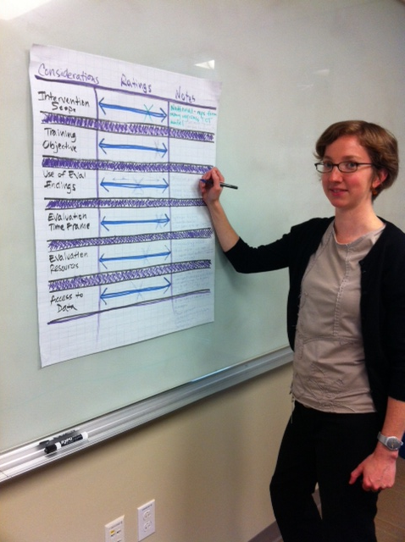
Next Steps
Feedback and revisions
Web interactivity
Piloting

Slide 35
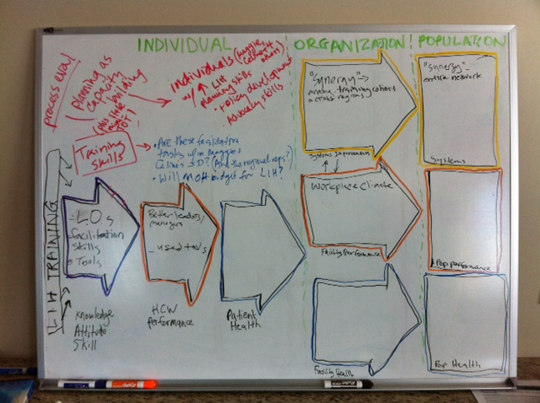

Slide 36

Notes:
Our intention in developing the Training Evaluation Framework and Tools is to help you be more thoughtful, specific, and logical in designing your training intervention, and in planning to evaluate its outcomes and impacts.

Slide 37

Notes:
Planning a training program evaluation is not exactly a step-wise process, but this framework and tools can help you systematically think about the design, situational factors, and scope of your evaluation.

Slide 38

Notes:
So coming back to the main purpose of this project, we have a picture of a young patient and their health worker, reminding us of the primary aim of our trainings and our mandate to help programs use their limited resources to ensure that health care worker trainings have the broadest possible impacts, and to improve the capacity of health care systems and the outcomes of patients.
We hope that the Training Evaluation Framework and Tools will help you reach that goal.

Slide 39
The I-TECH Training Evaluation
Framework and Tools (TEFT)
Download the framework and tools at
www.go2itech.org/teft

