Slide 1
Fee for Service Model for Medical Case Management
Kevin J. Burns, LCSW,
Executive Director
Kris Kershner,BA,
Finance Coordinator
Notes:
Please take notes and hold questions for breaks.

Slide 2
Disclosures
This continuing education activity is managed and accredited by Professional Education Service Group. The information presented in this activity represents the opinion of the author(s) or faculty. Neither PESG, nor any accrediting organization endorses any commercial products displayed or mentioned in conjunction with this activity.
Commercial support was not received for this activity.

Slide 3
Disclosures
Kevin J. Burns has no financial interest or relationships to disclose.
Kris Kershner has no financial interest or relationships to disclose.

Slide 4
Learning Objectives
At the conclusion of this workshop, the participant will be able to :
Summarize marketing plans to motivate insurance companies to invest in fee for service for case management programs.
Determine if a fee for service model for case management will be successful in their organization.
Understand how to initiate and grow a fee for service model for Case Management services/

Slide 5
Obtaining CME/CE Credit
If you would like to receive continuing education credit for this workshop, please visit:
http://www.pesgce.com/RyanWhite2012

Slide 6
Getting Started: Evaluate options
All states have TCM programs, except:
Florida
Texas
Delaware

Slide 7
Getting Started: Evaluate options
Explore Medicaid and Medicare reimbursement for Case Management, Social Work, Counseling
Review reimbursement rates
Review billable services
Best match with service portfolio
Staffing
Organizational culture

Slide 8
Case Management is Cost Effective
Case Management Increases:
Medication adherence
Adherence to primary care
Access to addictions treatment
Access to housing

Slide 9
Case Management is Cost Effective
Case Management Decreases:
hospitalizations
criminal behavior/re-incarceration
HIV risk behavior

Slide 10
Will a fee for service model work for my organization?
Your organizations Service Profile
What do your Case Managers do?
Functions
Case Identification, outreach and engagement (Intake)
Assessment
Planning
Coordination and Linkage
Monitoring and re-assessment
Discharge
Activities
Systems Level
Resource Development
Social Action
Program Evaluation
Client Level
Outreach
Medication adherence
Crisis Intervention
Counseling

Slide 11
Package your Service Portfolio
Billable services
Case Management
Assessment
Linkage
Outreach
Mental Health Services
Addictions
)

Slide 12
Package your Service Portfolio
Value Added Services
Access to Volunteer Programs
Volunteer Buddies, Mentors, cultural programs
Housing services
Education and Prevention Services
Access to non-Ryan White funded services
Access to emergency coverage (24/7
Other organizational resources
Emergency needs funds
Educational opportunities and career development

Slide 13
Will a fee for service model work for my organization?
Match with TCM billable services
Don’t be to literal.
Be creative
Think broadly
Use good judgment
Don’t over-reach

Slide 14
HRSA: Ryan White HIV/AIDS Program
Principles that Guided the Framework for this Policy:
“By law, the Ryan White HIV/AIDS Program is the payer of last resort…”
Source: http://hab.hrsa.gov/law/0707.htm

Slide 15
What is Fee for Service?
AKA: “Third Party Billing”
Client Services
Third Party Billing
Quite Simply:
Reimbursement for the services provided to eligible clients through insurance.
Notes:
Reimbursement from the State for eligible services provided to covered clients by approved case managers. Reimbursement for case management exists in an effort to reduce overall medical expenses for high need client s by supporting preventative care.
What is Fee For Service?
Billing for the services that you all provide on a daily a basis.
Direct Services drive Fee for Service and Fee for Service provides funding to help drive Direct Services.
Have DS answer. Give out candy.

Slide 16
Role of Fee for Service
Meets requirements for Ryan White Funding
Unrestricted Revenue
Provides Steady Cash Flow
Provides Stability by Diversifying Funding Streams
Notes:
Why is this important?
What does unrestricted vs restricted revenue mean? Why is it important?
Room for internal growth- billing has grown threefold in the last five years. Avenue for growth by increasing number of insurance providers. But relies on the infastructure of direct services. Can only grow to the point the number of funded case management positions. Which is why we need to maximize what we bill for each case manager.

Slide 17
Fee for Service Program Structure
Pennsylvania Department of Public Welfare (DPW)
Office of Medical Assistance Program (OMAP)
Targeted Case Management Program (TCM)
Medicaid
Health Choices
Aetna Better Health
Coventry Cares
Health Partners
Keystone Mercy Health Plan
United Healthcare Community Plan
Notes:
What makes Fee for Service possible?
Clients shift from Medicaid to a Health Choices provider.
Changes in the HC list, Americhoice is now United Healthcare, signed new contract with Aetna and working on contract with Coventry.
Health Choices: clients stay on Medicaid for one year,
Then transition to HC
Medicaid outsources the care to Private Insurance companies
They create a “Medical Assistance” offshoot to handle the medicaid clients
They get paid flat rate per client by the state, we bill for the services provided at the contracted rate per unit. Anything leftover is profit for the company

Slide 18
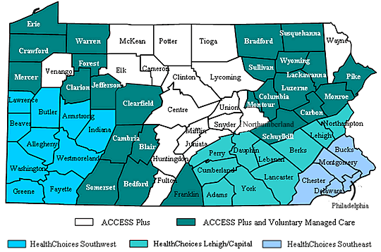
Source: PA Enrollment Services http://enrollnow.net/PASelfService/en_US/bycounty.html
Notes:
Map from PA DPW website- Replace with better map specific to FHCCP specific counties

Slide 19
The Billing Process
Compile Data
Extrapolate data from CAREWare
Process Billing
Verify services and case notes for each client for accuracy and eligibility
Receive Payment
Extract Data
Verify client insurance eligibility and document in CAREWare
Reconcile payments against claims using the accompanying remittance advice
Setup
Target Case Managers through the DPW Targeted Case Management Program
Negotiate contracts with participating Managed Care Organizations
Prepare claims and case notes for submission
Submit invoices either electronically or via hardcopy
Post revenue against Accounts Receivables
Pursue any outstanding monies with the Insurance Provider
Calculate invoices and book as a receivable
Case managers enter services and case notes into CAREWare
Notes:
What is the process by which we bill for FFS?
Steps 2-5 are repeated on a monthly cycle

Slide 20
Targeted Case Management
What is the role of case management?
What is a case manager?
Case manager will not be reimbursed for providing direct services to clients.
What does it mean to be a Targeted Case Manager?
Notes:
As defined by DPW: Case management is a service which provides clients with access to comprehensive medical and social services to encourage the cost effective use of medical care and community resources. Case management works to ensure the client's freedom of choice in addition to promoting the overall well-being of the individual.
As defined by DPW: A case manager is a coordinator and facilitator of necessary medical and social services. It is the case manager's role to locate appropriate resources and assist the client in gaining access to needed services.
TCM: approved by the state to provide services to clients under TCM program.

Slide 21
TCM Eligibility Requirements
One year of case management experience.
One of the following credentials:
Bachelor or Master of Social Work;
Bachelor or Master of Social Science;
Bachelor of Science in Nursing or equivalent nursing degree; or
Registered nurse licensed in Pennsylvania with one year experience working with the target group, and a combination of 12 semester hours in psychology, or other social welfare courses.
Documented case management training
Enrolled in the Medical Assistance Program.
Notes:
training which includes college credit, workshop certificates, formal in or out-service training, or on-the-job training.

Slide 22
The TCM Application
“Base Provider Enrollment” Application
Print directly from the Pennsylvania DPW website
Required Materials:
Social Security Card
Degree/Transcripts
Resume
Job Description
List of References
National Provider Identifier
Apply for on the National Plan and Provider Enumeration System (NPPES) website
Notes:
http://www.dpw.state.pa.us/Resources/Documents/PDF/PROMISe/EnrollmentInfo/omap_individ_baseapp.pdf
https://nppes.cms.hhs.gov/NPPES/Welcome.do
We require all CMs to have degrees. This may not be the case at other ASOs.

Slide 23
Contract Negotiation
Managed Care Organizations
Medical Assistance
Aetna Better Health
Coventry Cares
Health Partners
Keystone Mercy Health Plan
United Healthcare Community Plan
Be Mindful of:
Timely Filing Deadlines
Appeal Deadlines
Rate of Reimbursement
Prior Authorizations Requirement
Notes:
http://www.dpw.state.pa.us/Resources/Documents/PDF/PROMISe/EnrollmentInfo/omap_individ_baseapp.pdf
https://nppes.cms.hhs.gov/NPPES/Welcome.do
We require all CMs to have degrees. This may not be the case at other ASOs.

Slide 24
The Billing Process
Compile Data
Extrapolate data from CAREWare
Process Billing
Verify services and case notes for each client for accuracy and eligibility
Receive Payment
Extract Data
Verify client insurance eligibility and document in CAREWare
Reconcile payments with invoices using the remittance advice
Setup
Target Case Managers through the DPW Targeted Case Management Program
Negotiate contracts with participating managed care organizations
Prepare claims and case notes for submission
Submit invoices either electronically or via hardcopy
Post revenue against Accounts Receivables
Pursue any outstanding monies with the Insurance Provider
Calculate invoices and book as a receivable
Case managers enter services and case notes into CAREWare
Notes:
Second step
All of the ASOs present use CAREWare

Slide 25
Verifying Client Insurance
DPW Electronic Verification System (EVS)
Pennsylvania DPW Promise Provider Portal
Register using individual CM’s assigned MAID# and agency assigned MAID#
Verify monthly
Maintain private insurance information as reported by client in CAREWare. Cannot be verified in EVS.
Notes:
Once you have your contracts, verify client’s insurance data to sort out who will be billed for. This can be done by the Billing Department or by the Case Managers. We maintain the data at ActionAIDs but if a CM wants to double-check they can.
Once a CM is targeted they receive their MAID#. Setup Account using MAID# and enter client data.
https://promise.dpw.state.pa.us/portal/Default.aspx?alias=promise.dpw.state.pa.us/portal/provider

Slide 26
DPW: Services Provided by TCMs
Screening
Assessing
Developing and Implementing a Service Coordination Plan (SCP)
Linking and Coordinating Services
Facilitating
Monitoring
Reassessing

Slide 27
Billing for Case Management Services
Services are billable if…
They are provided by a Targeted Case Manager.
The client is not receiving services from another agency or facility during the same period of time.
The service is one that is recognized by the DPW

Slide 28
Billable Services
CM Collateral Contact
CM Emergency On-Call
CM Face to Face Encounter
CM Face to Face Home Visit
CM Intake
CM Paperwork
CM Phone w/ Client
CM PsychoSocial
CM Flowsheet
Notes:
Emergency On-Call is not paid for by AACO anymore.

Slide 29
Non-Billable Services
Through the TCM Program…
CM Hospital Stay
CM Household Members Paperwork
CM No show
CM Off-Site No Show
CM Phone Attempt/Message Left
CM Supervision
PLP
Services provided by anyone other than a TCM

Slide 30
The Billing Process
Compile Data
Extrapolate data from CAREWare and edit
Process Billing
Verify services and case notes for each client for accuracy and eligibility
Receive Payment
Extract Data
Verify client insurance eligibility and document in CAREWare
Reconcile payments against claims using the remittance advice
Setup
Target Case Managers through the DPW Targeted Case Management Program
Negotiate contracts with participating Managed Care Organizations
Prepare claims and case notes for submission
Submit invoices either electronically or via hardcopy
Post revenue against Accounts Receivables
Pursue any outstanding monies with the Insurance Provider
Calculate invoices and book as a receivable
Case managers enter services and case notes into CAREWare
Notes:
What is the process by which we bill for FFS?
Steps 2-5 are repeated on a monthly cycle

Slide 31
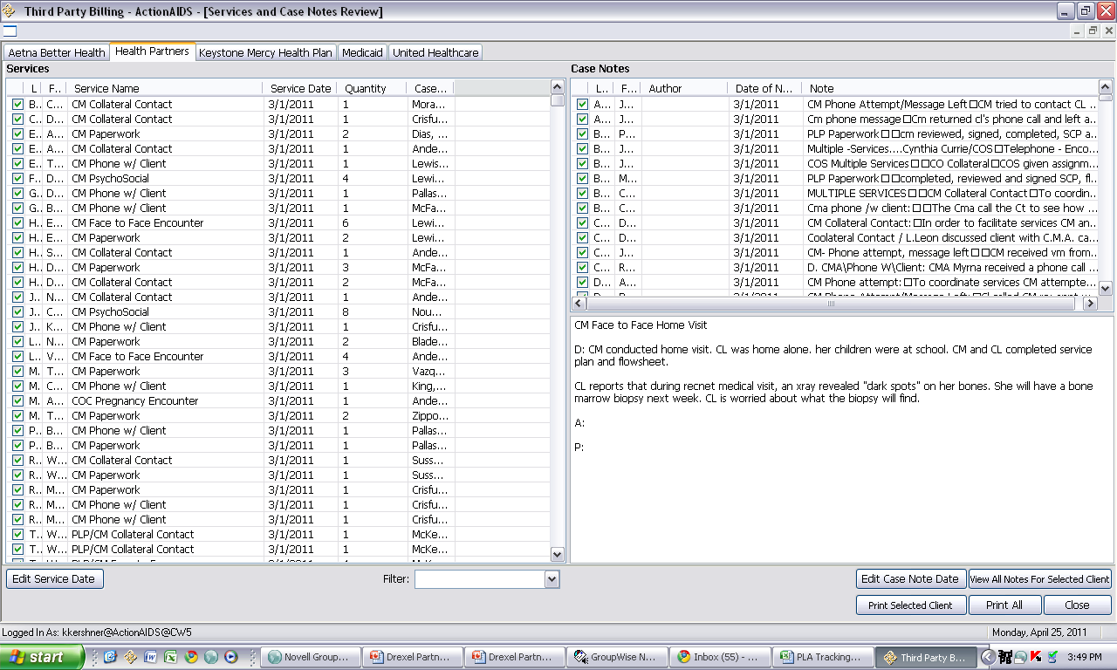
Third Party Module- provided by PHMC/AACO

Slide 32
Importance of Accurate Data Entry
Streamlines the billing process
Improperly billed services are denied
Negatively affects the bottom line
CAREWare data is used for many funders
Relationship with Insurance Providers
Notes:
Reversed- is when they take payments out as much as a year after paying them- aka accounting nightmare
Decreased revenue
Increase administrative costs
Reflect poorly in financial statements

Slide 33
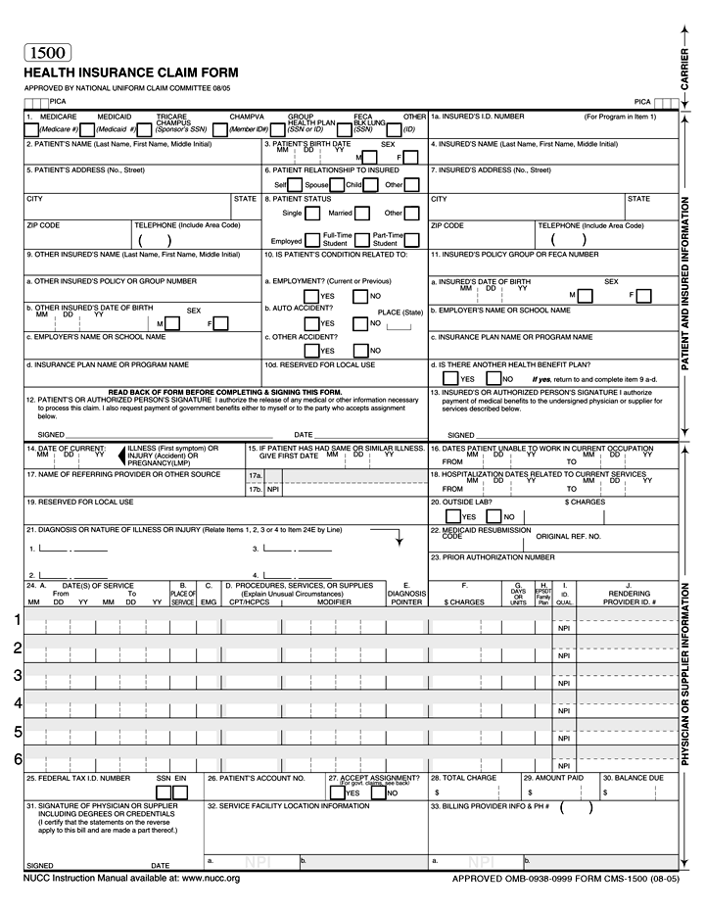
HCFA CMS 1500

Slide 34
Claim Preparation
Paper vs. Electronic Claim Submission
Medicaid: Individual Interactive CMS 1500 and
Electronic Data Interchange (EDI)
Most payers accept paper claims or EDI
Case Notes are usually not required
Save claims/case notes for reconciliation and audit
Notes:
Always maintain hardcopies of claims or case notes for payment reconciliation
Contact local Health Dept for administrative support around developing a software that coincides with CAREWare
Edit/verify services and case notes for billability

Slide 35
DPW Billing Guidelines
Monthly Limits:
Maximum 60 units/client
Rate of Reimbursement
1 Unit = 15 Minutes
Medicaid: 1 Unit = $7.50
Submission Guidelines
Medicaid allows 1 year from DOS to submit claims
Medicaid allows 90 days to appeal
Adjudication within 45 days of claim submission.
Notes:
Guidelines vary by MCO. Medicaid is the minimum base.

Slide 36
The Billing Process
Compile Data
Extrapolate data from CAREWare
Process Billing
Verify services and case notes for each client for accuracy and eligibility
Receive Payment
Extract Data
Verify client insurance eligibility and document in CAREWare
Reconcile payments against claims using the remittance advice
Setup
Target Case Managers through the DPW Targeted Case Management Program
Negotiate contracts with participating Managed Care Organizations
Prepare claims and case notes for submission
Submit invoices either electronically or via hardcopy
Pursue any outstanding monies with the Insurance Provider
Calculate invoices and book as a receivable
Case managers enter services and case notes into CAREWare
Post revenue against Accounts Receivables
Notes:
What is the process by which we bill for FFS?
Steps 2-5 are repeated on a monthly cycle

Slide 37
Accounting Tips
Book amount billed as a “Receivable”
Tally all claims and book with the month of submission.
Appealed claims are counted differently
No denials for Medicaid
Reconcile remittance advice against claims
Book any denied claims against accounts receivables.
Pursue any outstanding balances > 30 days past due.
Notes:
Billing is booked in the month in which the services were rendered even though it is processed the following month.
Medicaid accepts or rejects claims instantly if submitted through individual online claim system. There are no denials.
45 day payment deadline is MA guideline. MCOs that do not comply must pay interest on the claims.

Slide 38
Projecting Potential Revenue
Number of TCMs
x avg number of billable clients/TCM/month
x avg number of billable units/client
x avg rate of reimbursement
x avg rate of claims paid in full
Example:
5 Full Time TCMs
x 15 clients/TCM/month
x 10 billable units/client
x 7.50/unit
x 0.95 (billed - 5% denial rate)
Potential to earn $5,344/ month or $64,125/year
Notes:
Think about salaries of FT CMs. If you have 10 that’s $13,500 towards each of their yearly salaries off the top.

Slide 39
Projecting Potential Cost
Staff: Billing Associate
If billing for 5 Full Time TCMS…
Entire billing process will likely require 30-35 hours/month
Example:
+ $30,000 Salary
+ $6,600 Fringe (22%)
/ 2,000 hours/year
x 35 hrs/month
x 12 months/year
+ $500/year supplies & shipping
Potential cost $682/ month or $8,186/year
Notes:
Think about salaries of FT CMs. If you have 10 that’s $13,500 towards each of their yearly salaries off the top.

Slide 40
Projecting Potential Profit
+ Potential to earn:
$5,344 per month; $64,125 per year
- Potential cost:
$682 per month; $8,186 per year
= Potential Profit:
$4,662 per month; $55,939 per year
$55,939 per year / 5 TCMS = $ 11,189 towards TCM salary
Notes:
Think about salaries of FT CMs. If you have 10 that’s $13,500 towards each of their yearly salaries off the top.

Slide 41
Fee for Service & Government Funding
Does participating in Fee for Service mean that you are double billing for services already covered by government contracts?
… NO
…. Why?

Slide 42
Fee for Service & Government Funding
FFS Revenue is unrestricted
Government funding does not cover operating and indirect costs
FFS only provides reimbursement on a limited basis
Not all services are billable
Not all Case Managers are targetable
Not all clients are insurance eligible
60 unit limit/client/month
90% of CM salaries are allocated to government contracts… the other 10% is unrestricted revenue

Slide 43
Challenges
Details! Details! Details!
Accounting for processing errors
Claim resubmissions and follow-up
Electronic Billing using CAREWare
Maintaining documentation for yearly audit
Ensuring complete and accurate data in CAREWare
Notes:
agencies must go through a yearly audit if they receive over a certain amount in government contracts (500k?)
Insurance information
CM documented services and case notes

Slide 44
Keys to Making FFS Successful
Target all Case Managers
Verify client insurance eligibility monthly
Standardized, detailed and current information
Strategic client assignment
Electronic Billing
Notes:
. Billing records and accounting transactions
CM documentation of services and case notes
Insurance data
If all is equal, spread out billable clients equally amongst CMs

Slide 45
Questions?
Contact:
Kris Kershner
Finance Coordinator
ActionAIDS
kkershner@actionaids.org
P: 215.981.3350
F: 215.864.6931

