Slide 1
RWA 0130 Pilot testing a Spanish Patient Portal for online access to Electronic Health Records
Amy Sitapati, M.D.
Interim Director, Owen Clinic
Barbara Berkovich, MA
Ambulatory Systems Analyst

Slide 2

Disclosures
This continuing education activity is managed and accredited by Professional Education Service Group. The information presented in this activity represents the opinion of the author(s) or faculty. Neither PESG, nor any accrediting organization endorses any commercial products displayed or mentioned in conjunction with this activity.
Commercial Support was not received for this activity.

Slide 3
Disclosures
Amy Sitapati, MD
Has no financial interest or relationships to disclose
Barbara Berkovich, MA
Has no financial interest or relationships to disclose

Slide 4
Learning Objectives
At the conclusion of this activity, the participant will be able to:
Explain the challenges of translating the contents of the Medical record, financial and legal considerations for third party message translation.
Describe the different level of translation accuracy demanded by clinical, scheduling, and customer messages.
Describe successes and challenges in Spanish patient chart work experienced by patients and clinicians.

Slide 5
Audience Poll – by show of hands
?
What percentage of your patients are Spanish speakers?
  How many have online access to their patient charts:
  In English?
  In Spanish?
  Other Languages?
  Over 10%
  Over 25%
  Don’t know

Slide 6

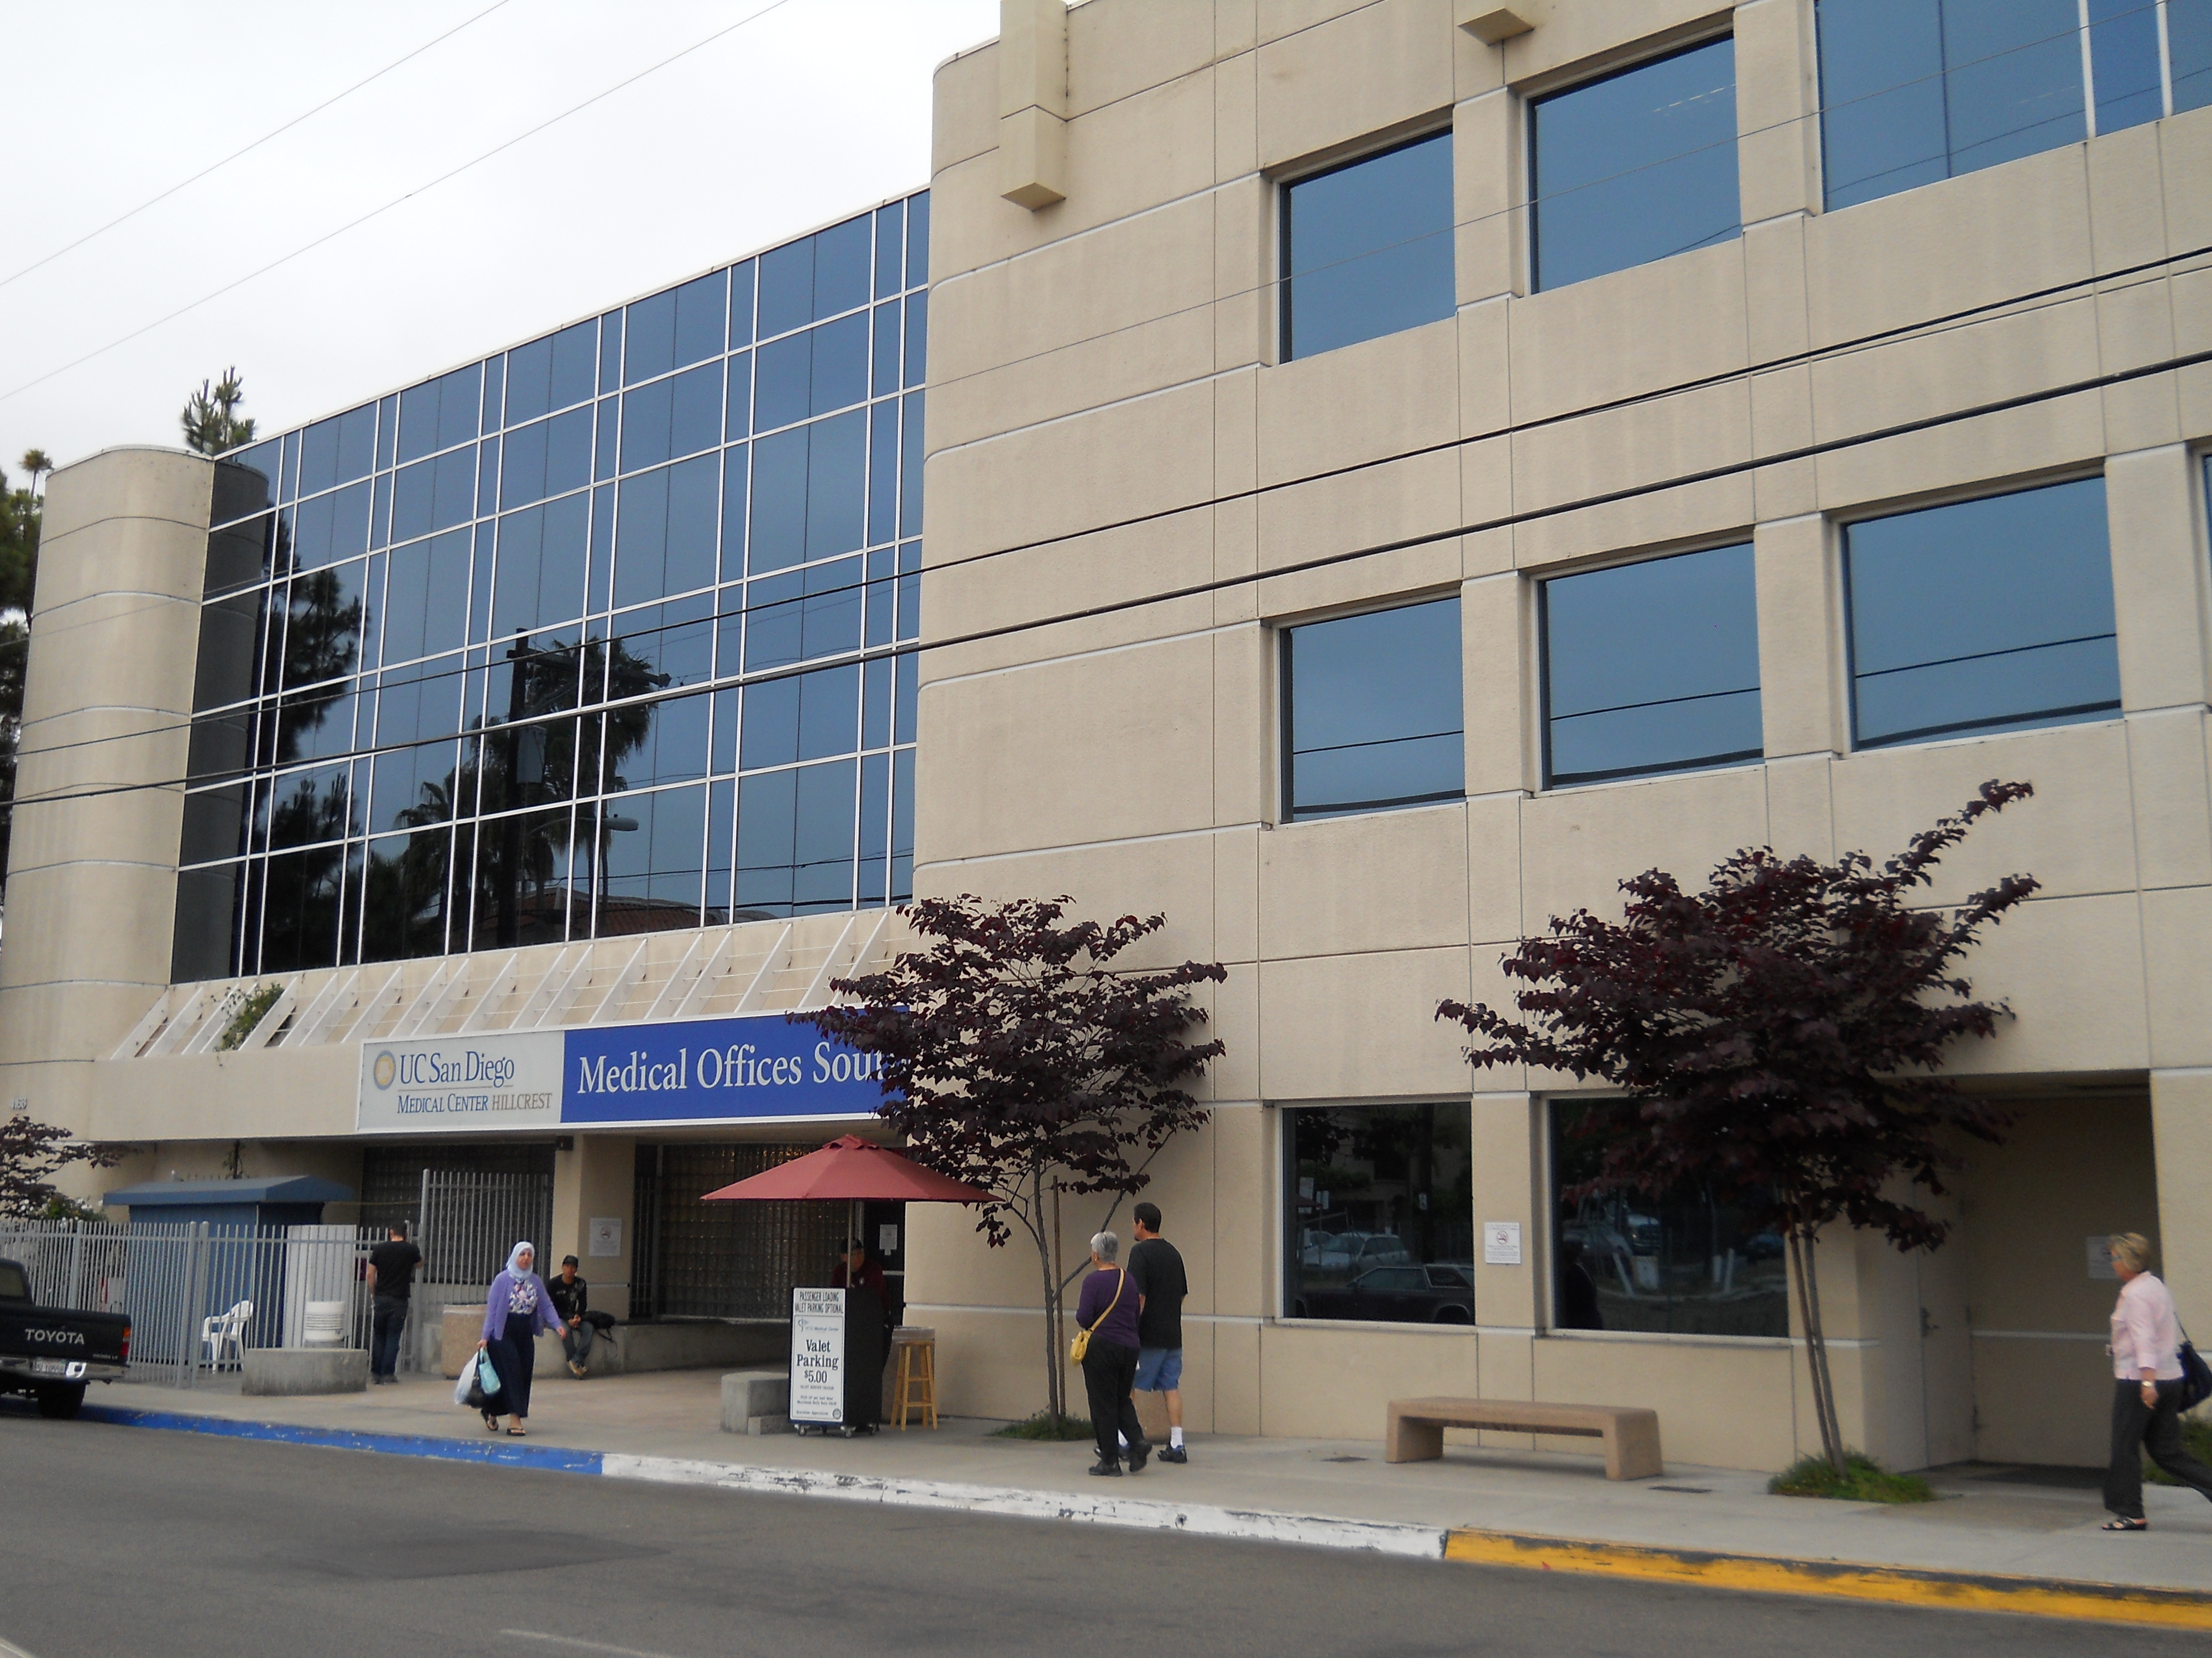


Who are we?
The OWEN CLINIC
University of California, San Diego
20 years of experience
3,000 HIV/AIDS patients
High proportion of Medi-Cal/ Medicare/ RW funding
Funded by California HIV/AIDS Research Program (CHRP) to serve as a pilot center for application of Patient Centered Medical Home in HIV
Site based focus to improve Retention

Slide 7
Who are we?
The OWEN CLINIC
University of California, San Diego
20 years of experience
3,000 HIV/AIDS patients
High proportion of Medi-Cal/ Medicare/ RW funding
Funded by California HIV/AIDS Research Program (CHRP) to serve as a pilot center for application of Patient Centered Medical Home in HIV
Site based focus to improve Retention

Slide 8
CY 2011 OSHPD Patient Discharge Data

Slide 9
San Diego County HIV/AIDS Prevalence
(Living: 12/31/11)
6
Prevalent* AIDS Cases, 2011 Rates per 100,000
 | Male | Female
White | 435.5 | 27.4
Black | 892.2 | 207.1
Hispanic | 421.9 | 53.9
Asian/Other | 97.2 | 17.1
TOTAL | 407.3 | 42.8
Prevalent* HIV (not AIDS) Cases, 2011 Rates per 100,000
 | Male | Female
White | 305.4 | 19.8
Black | 562.5 | 145.6
Hispanic | 245.2 | 32.5
Asian/Other | 76.1 | 8.0
TOTAL | 267.8 | 28.1
*Prevalent Cases: Living at December, 31 2011
Data Source: SD HHSA HIV/AIDS Epidemiology Unit
Epidemiology and Immunization Services Branch

Slide 10
Owen Clinic Patient Demographics
Distribution of Patients by Race/Ethnicity
 | 2011
Race/Ethnicity | # | %
Asian | 69 | 2.2%
Black | 449 | 14.6%
Hispanic | 788 | 25.6%
Native American | 11 | 0.4%
Pacific Islander | 4 | 0.1%
White | 1,572 | 51.2%
Other | 155 | 5.0%
Not Reported | 25 | 0.8%
Total | 3,073 | 100.0%

Slide 11
MyUCSDChart Use at UC San Diego
English
Approx 300,000 patients
Approx 30,000 activated
10 %
Spanish
Approx 17,000 patients
155 activated
0.91 %

Slide 12
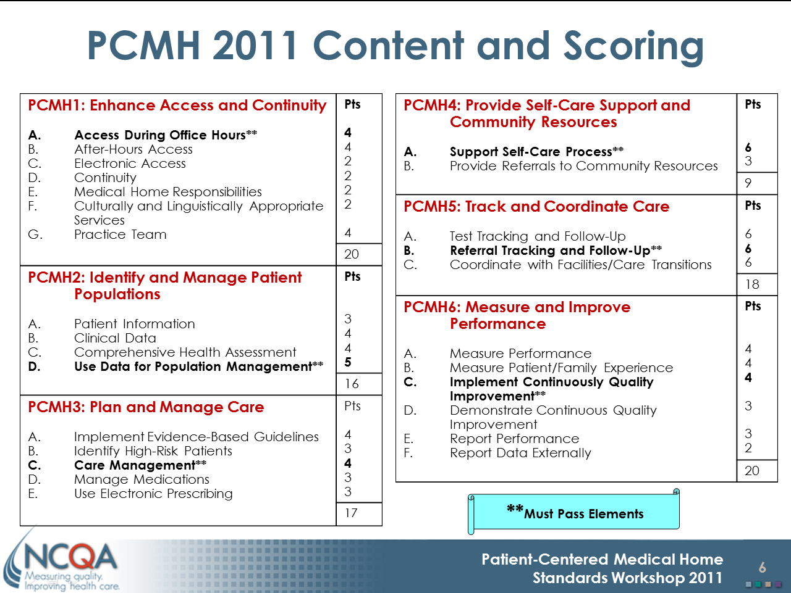
Patient Centered Medical Home
Source: National Committee for Quality Assurance http://www.ncqa.org

Slide 13

Why we started our Spanish MyChart project
  PCMH goal to increase patient engagement in underserved populations
  Spanish MyChart already existed
  Perceived as a quick win…
    we can do this in three months.

Slide 14
What we’ve accomplished…
Spanish patient portal for medical record review, and limited administrative messaging
But…. It does not adequately address the translation of information going into or coming out of the clinical medical record.
At UCSD, Spanish speaking patients still can’t
    Ask their doctor a question in Spanish
    View patient instructions from last visit in Spanish

Slide 15
Learning Objective 1
Explain the challenges of translating the contents of the Medical record, financial and legal considerations for third party message translation.
Presenter: Barbara Berkovich

Slide 16
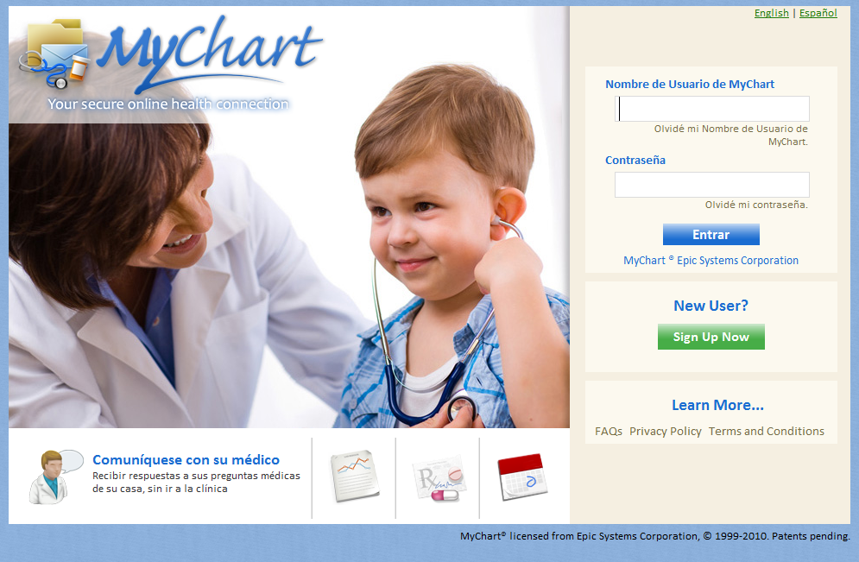
How do we get from model…
© 2012 Epic Systems Corporation. Confidential.

Slide 17
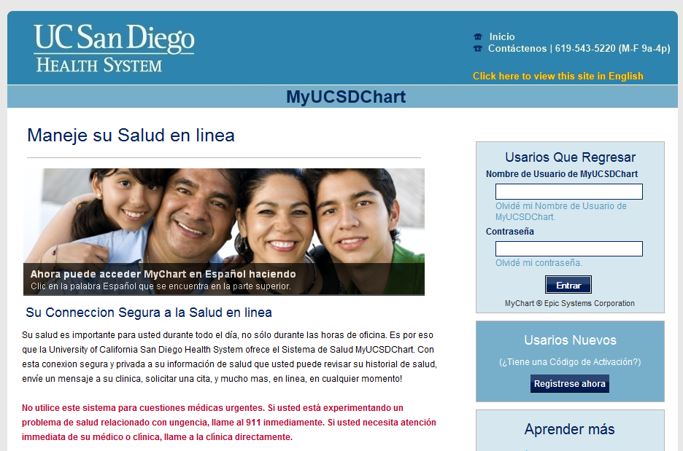
To a customized, branded MyChart?
© 2012 Epic Systems Corporation. Confidential.

Slide 18
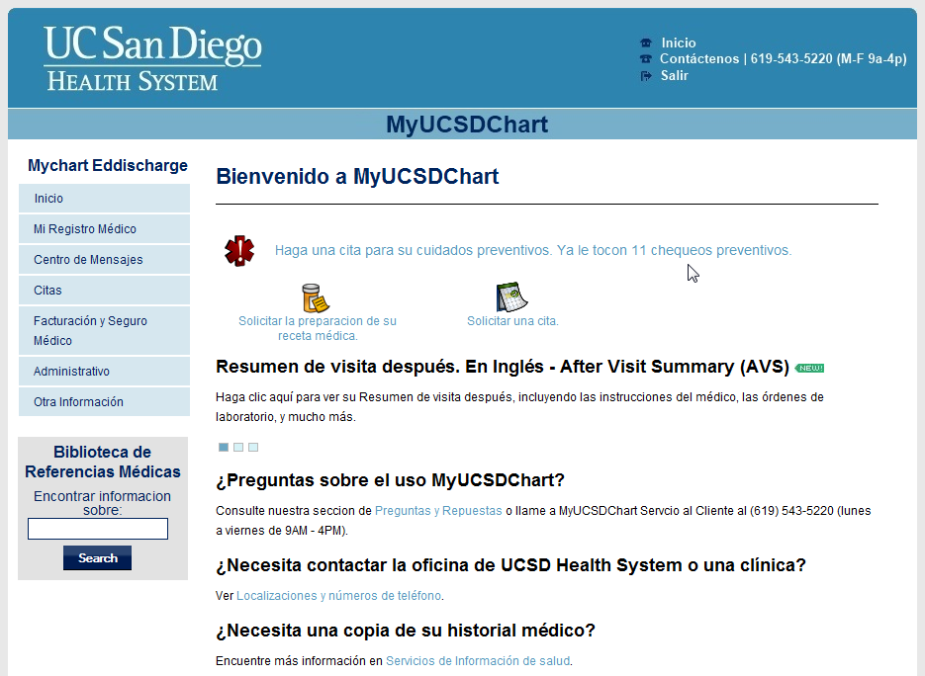
Static content – translate once
© 2012 Epic Systems Corporation. Confidential.
Notes:
Question: If I define static content as those text elements that only need to be translated once.
I counted 34 pages of content and figured that when we complete those…done!
I can tell you that there are 4 types of static content in MyChart. All changed in different places.
How many can you come up with?

Slide 19
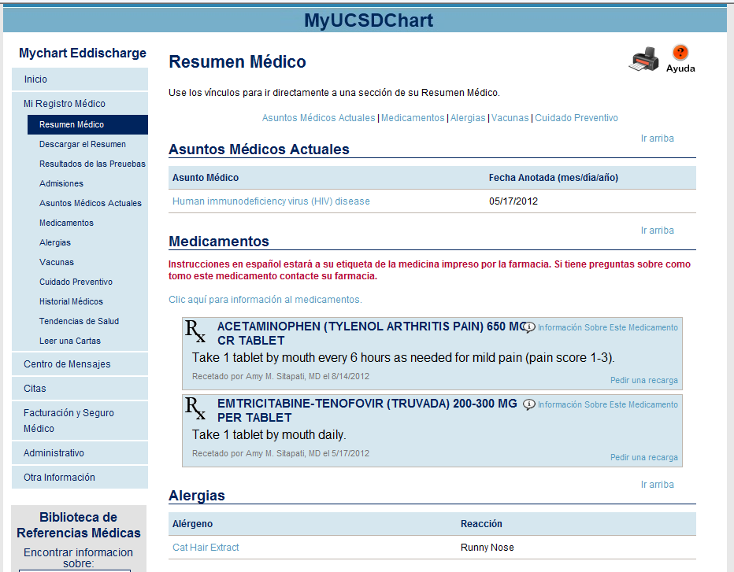
Medical Record Content is Dynamic
© 2012 Epic Systems Corporation. Confidential.
Notes:
Medical Record Data - What should be Translated? And Who should do it?
Problem List (Diagnoses)
Allergies
Vaccinations
Medications
Lab Tests
After Visit Summaries
Letters

Slide 20
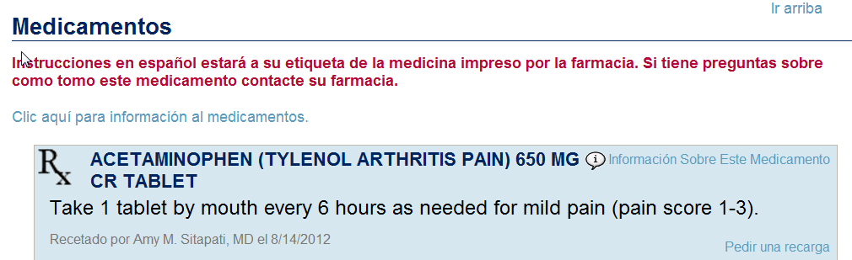
Spanish instructions will be on your medicine labels printed by the pharmacy. If you have questions about this medicine contact your pharmacy.
© 2012 Epic Systems Corporation. Confidential.

Slide 21
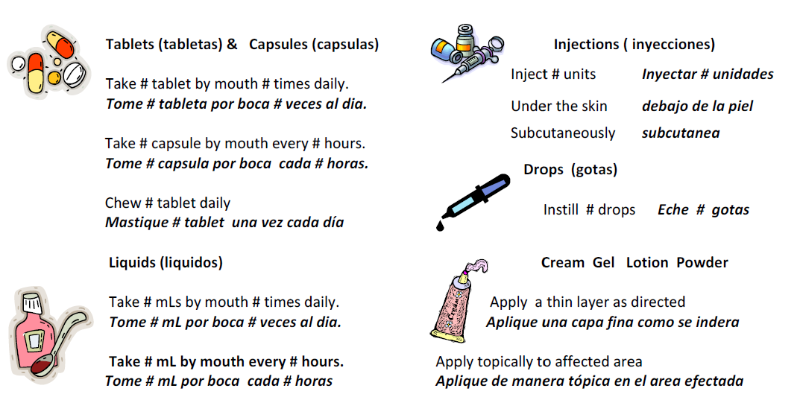

Slide 22

Content Linking
Links to external websites to provide additional information on diagnoses, medications, and labs.
Healthwise subscription
  Spanish is separate product and additional cost
Medline Plus (Free NIH website)
  Only the Problem list linking works
  Some concern about response time
Notes:
Use content linking – medline (NIH) or proprietary
Uses Epic native content linking capability (not too difficult)

Slide 23
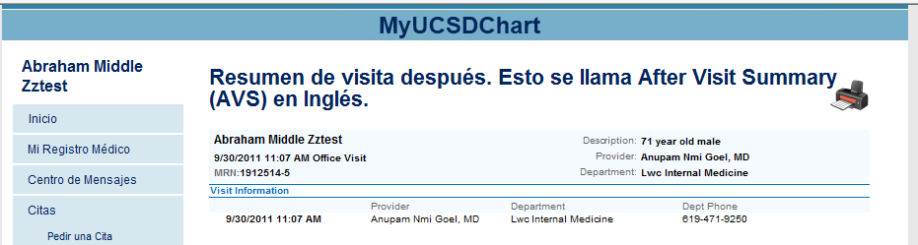
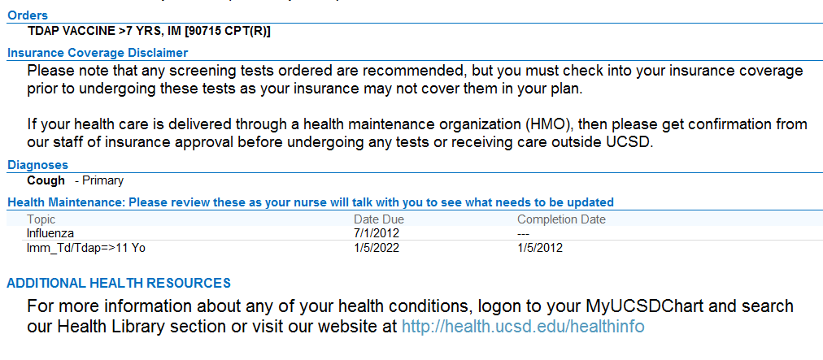
After Visit Summary – What goes in is what comes
© 2012 Epic Systems Corporation. Confidential.

Slide 24
Don’t forget links to external English-only sites
Links for Driving Directions and Medical Records landed on English Only Sites

Slide 25

Lessons learned
Account for hidden content in your web content translation plan
Plan your translation workflow to optimize turnaround time
Plan at least 120 hours to merge the model Spanish content with your custom Spanish content
(in html and xml files)
Prepare to convert future English web portal updates to Spanish
Figure out how to quantify web portal use. The MyChart system has no way to distinguish MyChart Spanish users from MyChart English users.

Slide 26
Learning Objective 2
Describe the different level of translation accuracy demanded by clinical, scheduling, and customer messages.
Presenter: Amy Sitapati, MD

Slide 27
Messaging Solutions
Message Type | Solution
System Messages | Bilingual
Customer Support | Currently has Spanish speaking staff
Scheduling | Form Driven
Medication Refill | Form Driven
Clinical messaging | This one’s tough

Slide 28

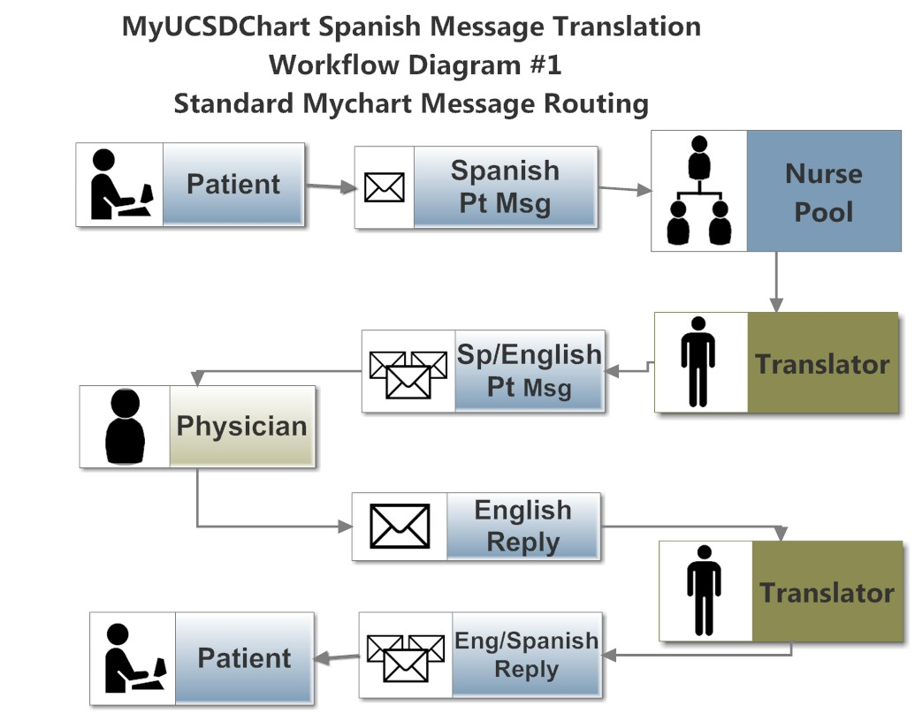
Our Experience with Clinical Messaging
Model 1 - Standard
4 hrs
+4 hrs
+4 hrs
+4 hrs
16 hrs
Notes:
Four touches x 4 hrs/touch = 16 hrs turnaround time

Slide 29
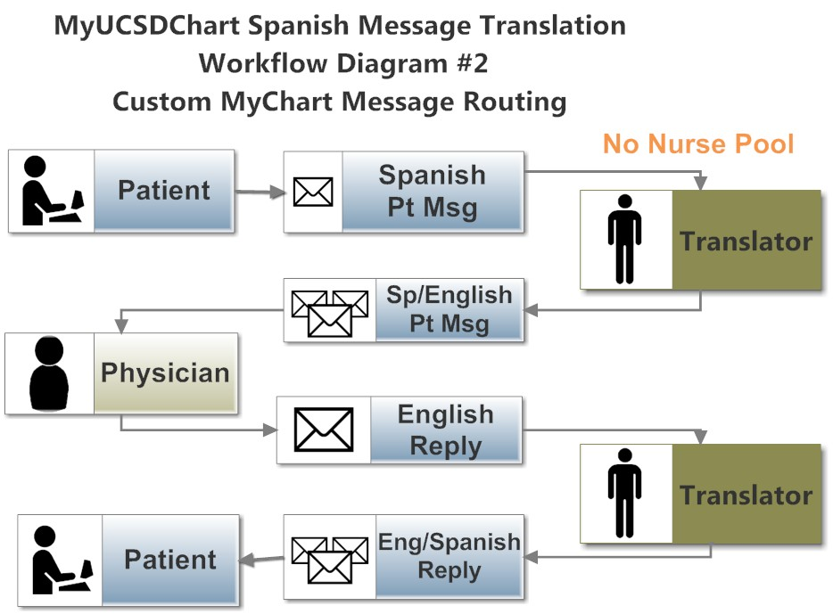
Our Experience with Clinical Messaging
Model 2- Custom
4 hrs
4 hrs
4 hrs
12 hrs
Notes:
Three touches x 4 hrs/touch = 12 hrs turnaround time.
Total turnaround time = # touches x time/touch
To reduce turnaound time, reduce # touches or time/touch

Slide 30

Organizationally, where does the translation task fit?
Translation Resource Inventory
Web programmer
Native Spanish speaker without formal training
Interpreter services
Professional Spanish translator
Free machine translation
Custom machine translation
Addressing: Time efficiency, low cost, 24/7 coverage,
Health literacy, Spanish competency
Notes:
Answer: All of the above
Refer to handout for specific of best match
Native Spanish speaker who is also a Health literate professional was on the “development team”
Negotiation of a Moderately good translation (didn’t exist); $$ cost of translation; $15/msg…no way….what about a dollar; what about $50/hr;

Slide 31
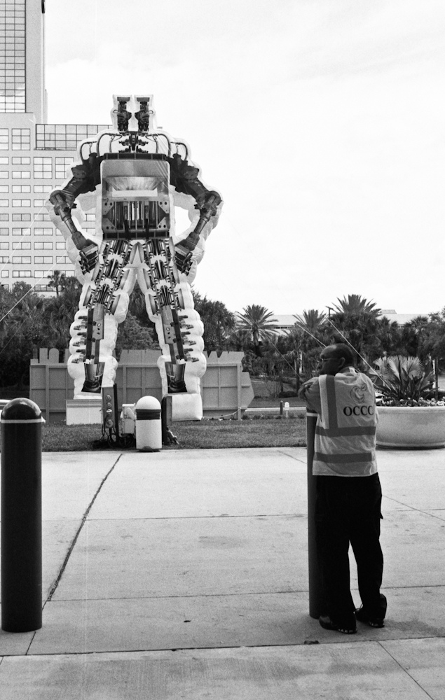
Audience Poll- Man vs Machine
  1. Human translator needed for EMR data
  2. Machine translation is the way to go
  3. There should only be English in the medical record

Slide 32
Human Translator Qualifications
Translation Services
…the term “translation” refers to the conversion of a document written in a source language to a document written in a target language.
Interpretation Services
… the term “interpretation” refers to the conversion of a verbal communication or a written document into a verbal communication in a target language.
From Second Biennial Report to the Legislature on Language Assistance http://www.dmhc.ca.gov/library/reports/news/11lar2l.pdf
Where does written
messaging translation fit?
Notes:
Downside is the high per message translation cost

Slide 33
Compliance and Risk Considerations
Current Laws and Regulations
(Important considerations)
  Federal
    HIPAA – Business Associate Agreement (BAA)
  State
    California SB 853: HC providers must provide language services
  Proposed Legislation
    SAFE-ID Act (Safeguarding Americans from Exporting Identification Data Act): proposed act prohibiting exportation of PI off-shore
  Institution Polices and Procedures
  Insurance requirements for third party providers of medical translation services
  Offshoring of medical translation services

Slide 34
Machine Translation
Goggle Translate (Free)
Microsoft Translate Tool (Free)
  The patient name was picked up as content and translated by the tool so that the test patient name, “Test X, Bob” was translated to “Prueba X, Bob”.
  Accuracy of translation can only be validated to a certain degree. Since it translates the content of the Medical Record on the fly, it’s impossible to predict and test every word that might be presented for translation.
  HIPAA privacy issues are a concern when translation occurs on a remote server outside the control of the institution

Slide 35
Who are the stakeholders?
  Executives
  Clinical champions
  Compliance
  Risk Management
  Regulatory
  Medical Records, etc.
  Our Spanish Communities

Slide 36
Our Translation Plan
Content Item | Translator
Website files (html/xml) | Web programmer/native spanish speaker
Legal documents (terms & conditions, privacy practices) | Third party translation service
Linked sites (within UCSD) | Enterprise Web Development
Clinical Messages | Third party translation service (discontinued post pilot)

Slide 37
Learning Objective 3
Describe successes and challenges in Spanish patient chart work experienced by patients and clinicians.
Presenter: Barbara Berkovich

Slide 38
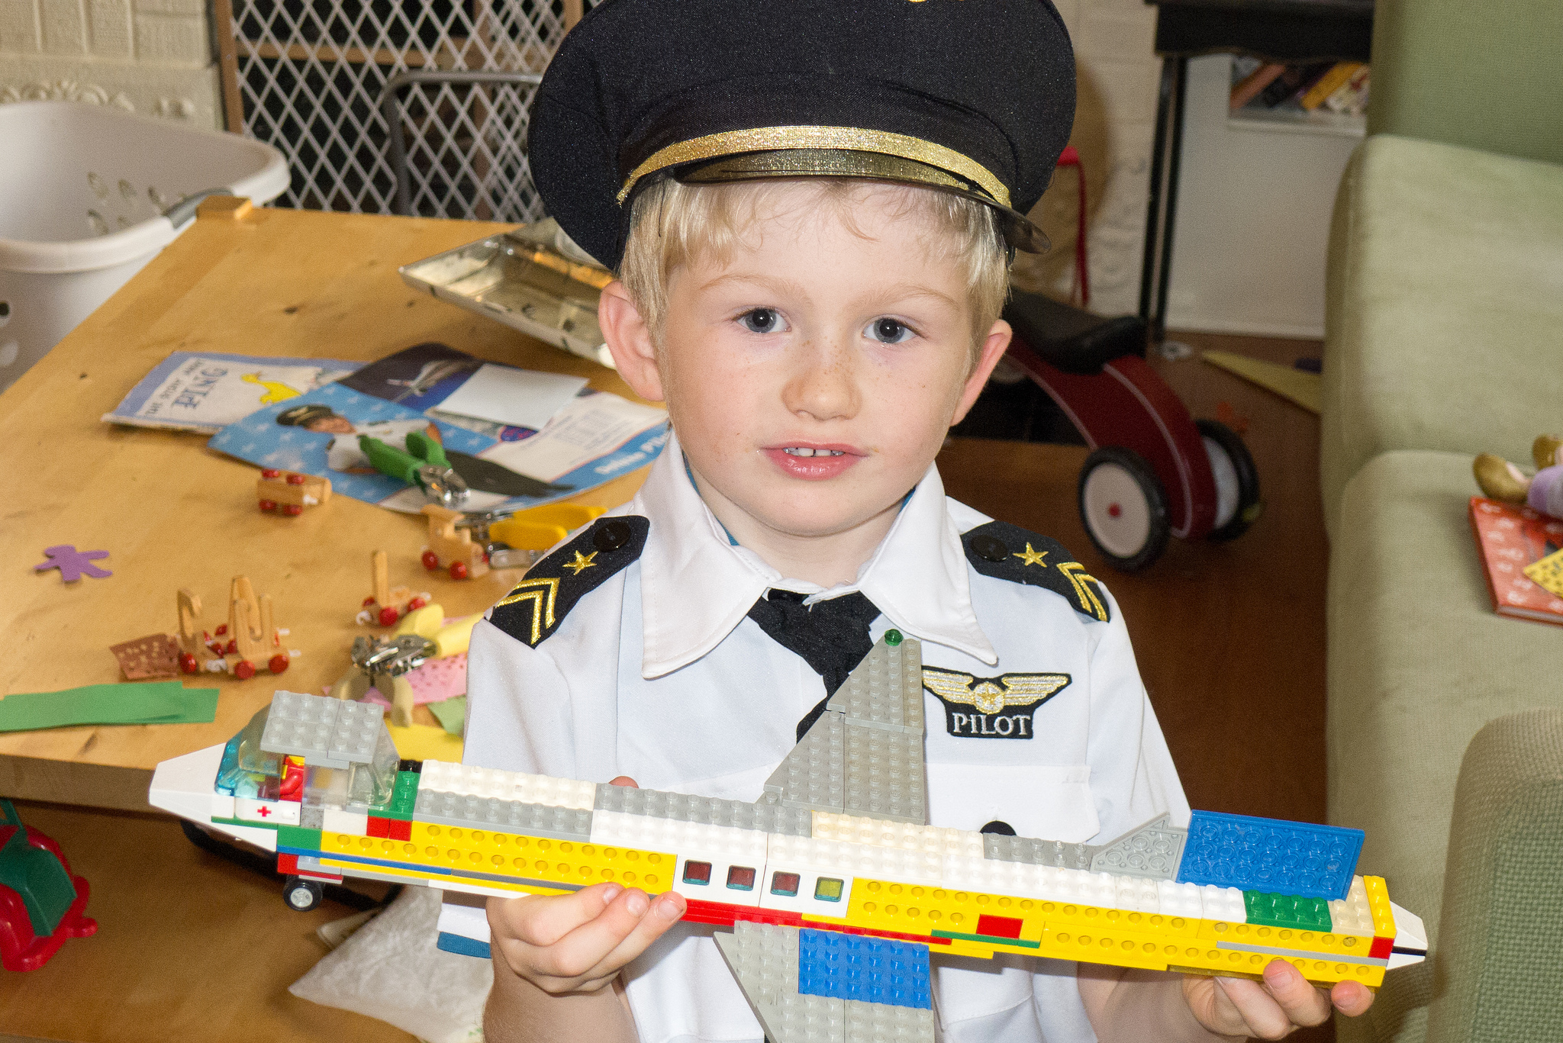
Our Pilot
Notes:
Dr. Sitapati speaks

Slide 39

Pilot Design
90 day pilot – limited in patient size (25)
Limited message size 500 character messages
Short period of time to build baseline of message volume per patient
Negotiate short contract with instead of $15/message lower rate est. <$2/message

Slide 40
Registration process
No difference in registration process (except language). Customer support group has Spanish speakers on staff
Anyone who needs help signing up can call Customer support.
Soft start
1 by 1 signup
Presentation to Family Advisory Board (FAB) for HIV/AIDS Mother, Child Adolescent Clinic
Provider training for MCA Clinicians

Slide 41
Patient Feedback after 90 days
Very few participants activated their MyChart access.
The ones that did activate it are very pleased with the program. Early adopters encouraged others to try it
because it:
  - Is easy to use
  - Processes pharmacy refills
  - Allows communication with their providers without the need to call busy clinic
  -Displays their lab results
  -Facilitates scheduling of their appointments
Some of the participants believed a SSN was required (it is not)

Slide 42
Getting ready for a Spanish Patient Portal
Inventory content pages for your portal
Assess your internal translation resources
Develop translation & maintenance plan
Obtain approvals and resource commitments
Start a dialogue about non-English content in Medical Records and Translator qualifications. Don’t proceed with clinical messaging without clear guidelines
Notes:
What about the issue with (1) lack of health and e-literacy in Spanish population (2) moved us to work on computer lab for EPIC patient training (3)

Slide 43
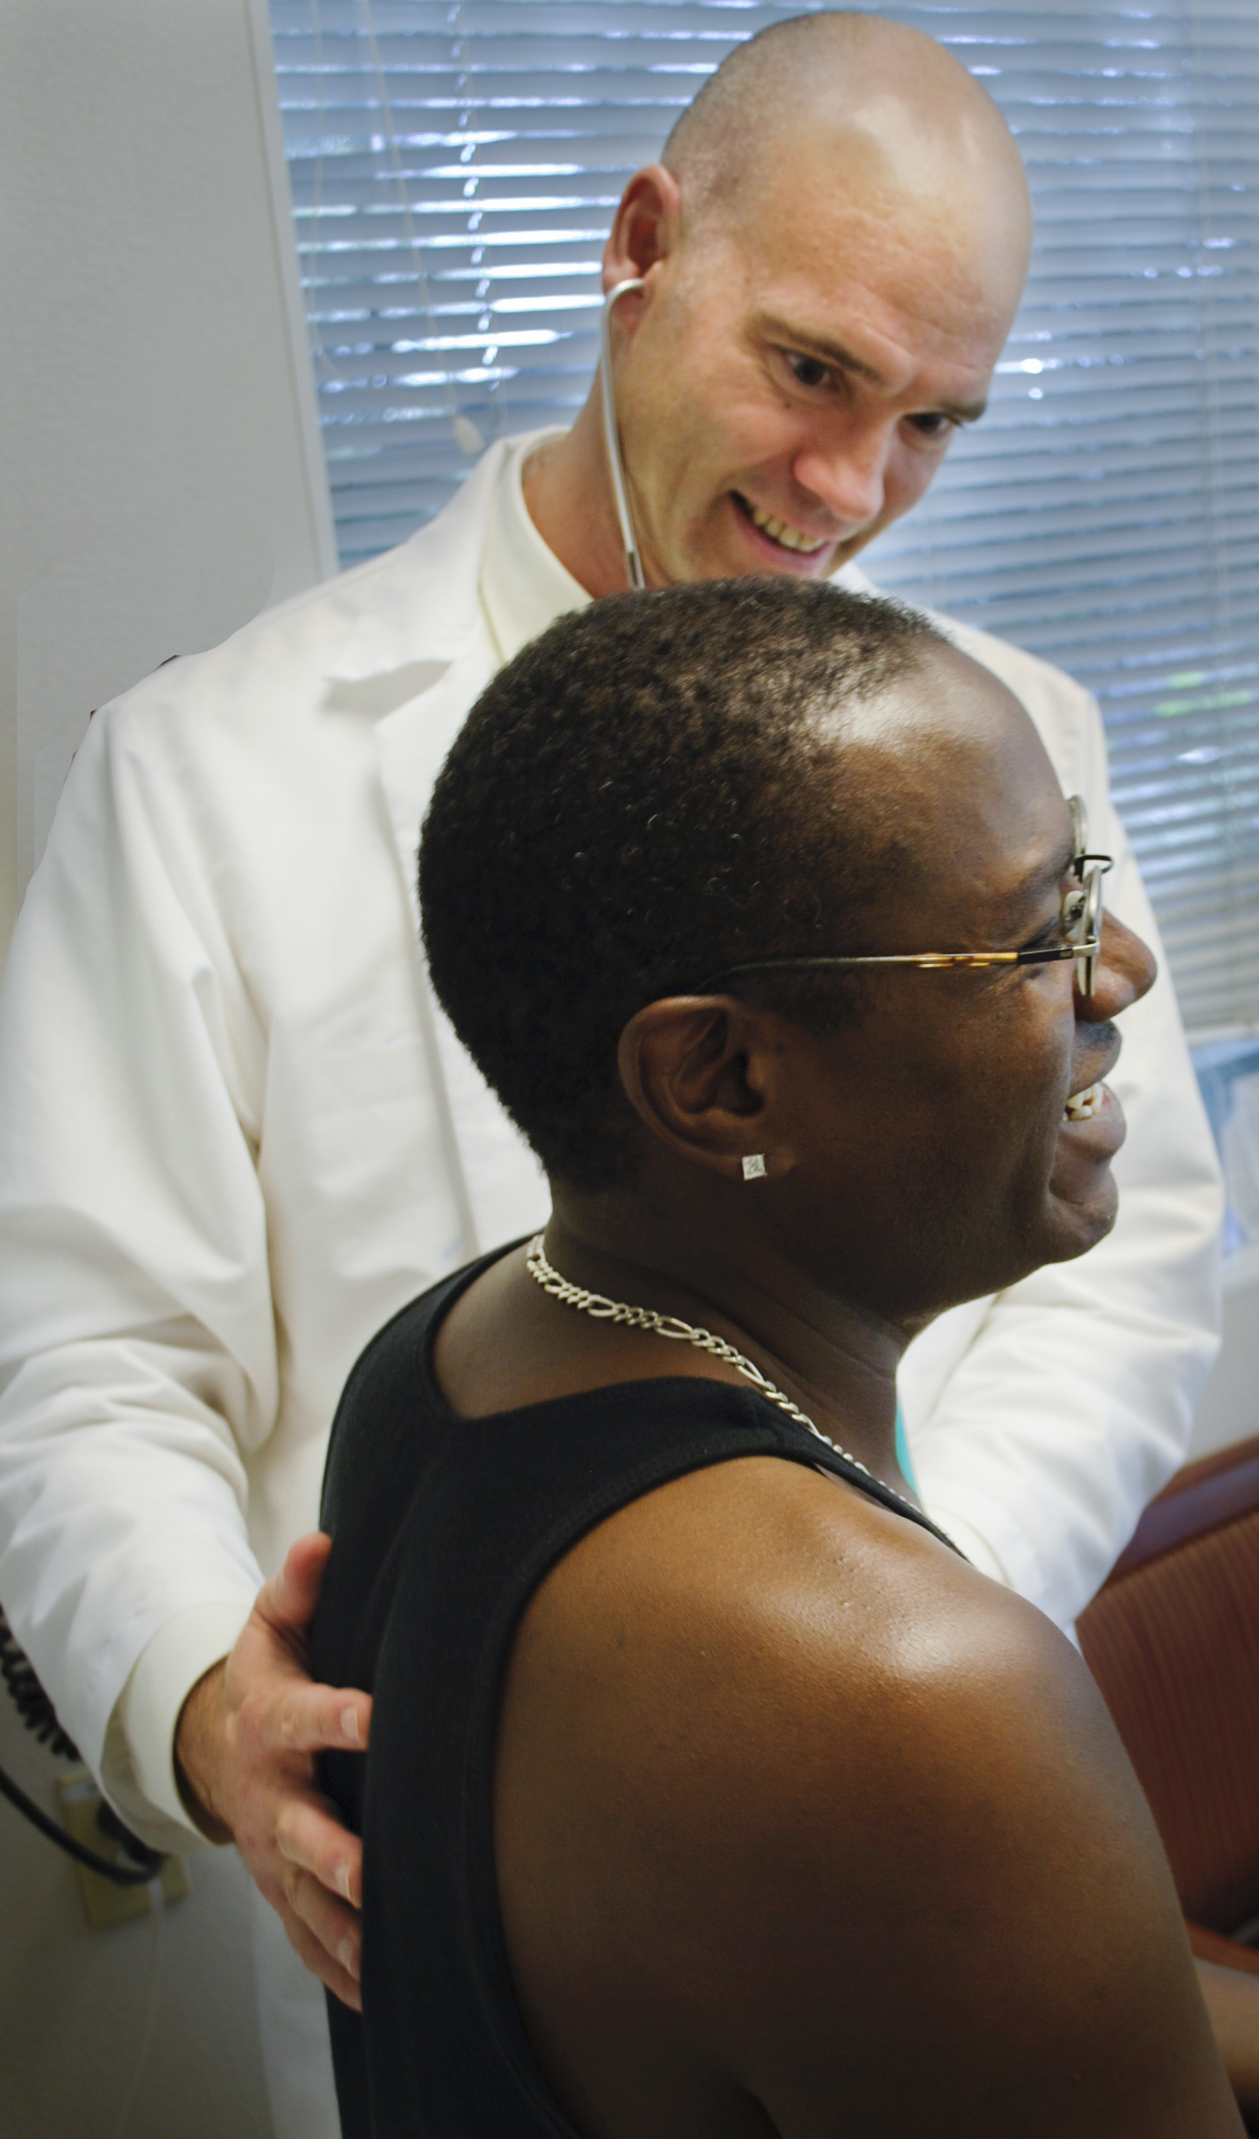
Why should we pursue Spanish Patient Web Portals?
We serve a global population
The Hispanic population of the US is 50.5 million(1); 14 million in California(1); 35 million Spanish speaking households in the US(2)
….And, it really comes down to the personal level as patients find new ways to receive efficient, effective, high quality healthcare with their providers
1. www.census.gov 2010 US census; 2. 2009 US census

Slide 44

Thanks
MyUCSDChart Administrator
Jeff Engel
OWEN ANCHOR TEAM
Moira Mar-Tang
Pavel Tseytlovskiy
Susan Benson
Dorothea Northcutt
Jan Limneos
Dr. Chris Mathews
CQI committee
The California HIV/AIDS Research Program; Award number: MH10-SD-640

Slide 45
Photo credits
The Owen Clinic ©2012 by Moira Mar Tang with Permission
Doctor-Patient ©2012 by Moira Mar Tang with Permission
Lucas the pilot and his huge airliner by dolanh
http://www.flickr.com/photos/reneeanddolan/7572298368/
http://creativecommons.org/licenses/by-nc-sa/2.0/deed.en
Man vs Machine Xiafan Luo http://www.flickr.com/photos/sailwings/7056635773/
http://creativecommons.org/licenses/by-nc-sa/2.0/deed.en

Slide 46
THE END
Thank you

Slide 47
Obtaining CME/CE Credit
If you would like to receive continuing education credit for this activity, please visit:
http://www.pesgce.com/RyanWhite2012

