Slide 1

Earlier Recognition of HIV:
Dilemmas for the Clinician
Ryan White Annual Conference
Washington, DC November 2012
Jeffrey Beal, MD
Jennifer Janelle, MD
Robert Lawrence, MD

Slide 2
Disclosures
This continuing education activity is managed and accredited by Professional Education Service Group. The information presented in this activity represents the opinion of the author(s) or faculty. Neither PSEG, no any accrediting organization endorses any commercial products displayed or mentioned in conjunction with this activity.
Commercial Support was not received for this activity.
CME http://www.pesgce.com/ryanwhite2012/

Slide 3

Disclosures
Jeffrey Beal, MD Has no financial interest or relationships to disclose
Jennifer Janelle, MD Has no financial interest or relationships to disclose
Robert Lawrence, MD Has no financial interest or relationships to disclose

Slide 4
Learning Objectives
At the end of this workshop the attendee will be able to:
Interpret the results and significance of new HIV testing technology and its effect on diagnosing HIV earlier. (comprehension)
Analyze the various dilemmas (contact and source identification, optimal timing of initiation of ARV therapy, issues of adherence and prevention related to therapy, etc.) brought about by earlier HIV diagnosis. (analysis)
Formulate an appropriate and personalized counseling and medical care plan for patients with primary or early HIV infection. (synthesis)

Slide 5
Outline for the Workshop
00-05 minutes: Introductions and Review of Objectives and Workshop Format
05-20 minutes: New HIV testing technology and earlier HIV diagnosis This short didactic will include a review of the new testing technology (4th generation tests, NAAT, LS-EIA, etc.) and a brief enumeration of the potential dilemmas.
20-30 minutes: Presentation of cases for discussion Review 3-5 clinical cases, and an outline of the objectives for case-based small group discussion.
30-70 minutes: Facilitated Break-Out Groups Working on case-based analysis of dilemmas and potential solutions and approaches.
70-90 minutes: Discussion, Presentation from work groups and Formulation of Approaches and Solutions for identified Dilemmas as a large group. Summary

Slide 6
Workshop Facilitators
Jeffrey Beal, MD PI and Clinical Director for Florida / Caribbean AETC, USF Medical Director for Bureau of HIV/AIDS Florida DOH
Robert Lawrence, MD Pediatric ID Specialist Clinical Professor University of Florida Faculty of the F / C AETC
Jennifer Janelle, MD Infectious Diseases Specialist, Clinical Assistant Professor, University of Florida Faculty of the F / C AETC

Slide 7
New HIV Testing
4th generation HIV Antigen Antibody tests automated testing for HIV p24 antigen and antibodies to HIV-1 and HIV-2 in serum and plasma
Nucleic Acid Testing – amplify and detect one or more of several target sequences in specific HIV genes (HIV-1 GAG, HIV-II GAG, HIV-env, HIV-pol). [different versions for different situations →Qualitative reverse-transcription PCR for HIV, HIV RNA PCR (quantitative), viral load]
Rapid HIV Testing, Point of Care Test (POCT) qualitative antibody immunoassays

Slide 8
Dilemmas with Actual Testing
False-negative results
False-positive results
Indeterminate Western Blots
Turn around times for results
Confirmatory testing in different situations
Patient perceptions, beliefs, concepts of health and illness relative to HIV, and their fears (e.g. “needle phobia”) about being tested
Timing of the testing in the different phases of HIV infection
Interpretation of the results – various algorithms

Slide 9
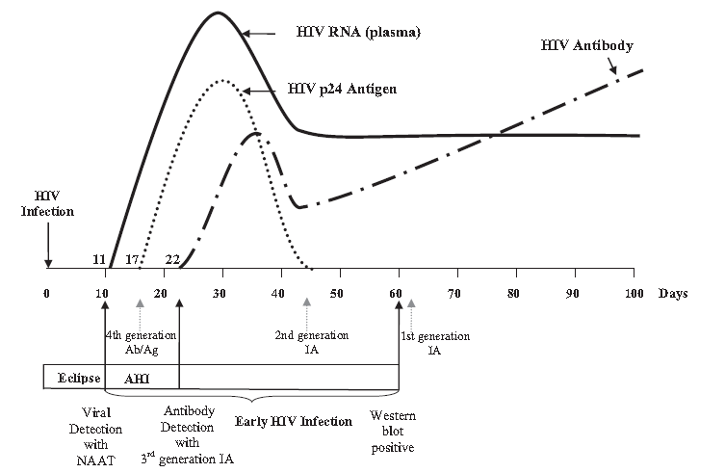
Markers of HIV Infection and Windows of Detection
P. Patel et al. / Journal of Clinical Virology 54 (2012) 42– 47
Notes:
1st HIV test in 1985 – 1st generation assay detected HIV-1 only, lacked sensitivity and specificity and were not able to detect the antibody response to the different HIV-1 clades
2nd generation assay – detects response to HIV-1 and HIV-2
3rd generation assay – detects HIV ½ antibodies 9-15 days after the first detection of p24 antigen, detects both IgG and IgM antibodies
A positive HIV diagnosis is now possible up to 26 days prior to positive results by Western blot, the recommended confirmation test

Slide 10
Common False-Positive HIV Results
Antibody (Ab) Testing
Western Blot - indeterminate
Influenza vaccination
Viral illness
Autoimmune disease
Renal failure
Cystic fibrosis
Multiple pregnancies
Blood transfusions
Liver disease
Parenteral substance abuse
Hemodialysis
Vaccinations against rabies or hepatitis B
Low titer of anti-HIV Abs
early seroconversion advanced AIDS
Infection with an unusual HIV type
Recipients of experimental HIV vaccines
Others: as for Ab testing

Slide 11
Confirmatory Western Blot
Determine the antigenic specificity of the antibodies in the patient’s serum
HIV-1 →gp160, gp120, p65, p55, gp41, p40, p31, p24
To be reported as positive: reactivity against → 2 of 3 of the following bands: gp41 gp120/160 (env, gp160) P24 (gag)
Highly specific for HIV infection

Slide 12
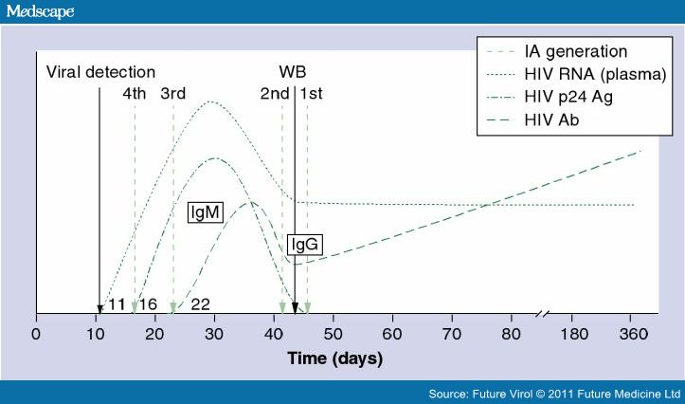
Rapid HIV Antibody Tests
FDA-Approved, January 2011
OraQuick ADVANCE – HIV 1/2 - Sens 99.3%, Spec 99.8%
Uni-Gold Recombigen - Sens 100%, Spec 99.7%
Reveal G-3 Rapid HIV-1 - Sens 99.8%, Spec 99.1%
Multispot HIV-1/HIV-2 - Sens 100%, Spec 99.9%
Clearview HIV1/2 Stat Pak - Sens 99.5%, Spec 99.8%
Clearview Complete HIV 1/2 - Sens 99.7%, Spec 99.6%
We do not endorse the use of any of these specific individual tests .

Slide 13
Prevalence Affects PPV and NPV
(Prevalence) (Sens)
PPV = ------------------------------------------------------------- (Prevalence) (Sens) + (1 – Prevalence)(1 – Spec)
Prevalence =10%, Sens = 98.9%, Spec = 99.7%
(10/100)(98.9/100)
PPV = -------------------------------------------------------- = 97.3% (10/100)(98.9/100) + (1-10/100)(1-99.7/100)
Prevalence = 1%, Sens = 98.9%, Spec = 99.7%
(1/100)(98.9/100)
PPV = -------------------------------------------------------- = 76.9%
(1/100)(98.9/100) + (1-1/100)(1-99.7/100)

Slide 14
HIV Testing
Need for testing: surveillance blood safety diagnosis - low risk high risk
Routine Ab tests – EIA, etc.
4th generation Ag / Ab test
Rapid Ab testing
All require confirmation, 2nd test (and occasionally a 3rd test)
Confirmatory testing Western Blot Qualitative RT PCR Nucleic Acid test (NAT) Viral load – RNA PCR* (not approved use)

Slide 15
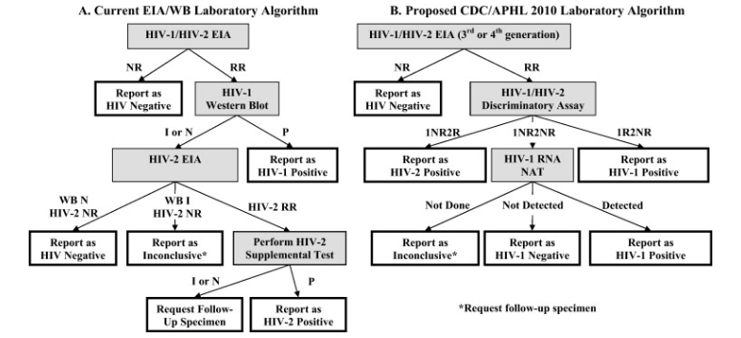
HIV Testing Algorithm
J Clin Virol. 2011 Dec;52 Suppl 1:S35-40. Epub 2011 Oct 21.

Slide 16
Dilemmas After the Diagnosis
Contact investigation
Source Investigation
Diagnosis of 1ry HIV infection – recent infections → higher transmission occurrences
Education re: prevention of transmission the virus and the illness initiation of therapy adherence
Initiation of therapy
Personalized counseling and medical plan

Slide 17
Clinical Picture of
Primary HIV Infection
Fever 20
Lethargy 12
Myalgia 8
Headache 8
Sore throat 19
Inflammed throat 17
Coated tongue 10
Enlarged tonsils 9
Cervical LNs 19
Axillary LNs 15
LNs at > 2 sites 11
Rash 15
Genital ulcer 2
Anal ulcer 2
Vomiting 8
Nausea 7
Diarrhea 6
Weight loss > 5 kg 4
Total # patients 20
Incubation 11-28 days
Gaines et al. BMJ 297:1363, 1988.

Slide 18
HIV Testing in Acute Infection
Medscape News HIV/AIDS, HIV Testing: The Cornerstone of HIV Prevention Efforts

Slide 19
Treatment as Prevention
HPTN 052, NCT00074581
Prospective study in 9 countries, 1763 “discordant” couples, 54% from Africa, 50% of infected individuals were men
CD4 counts between 350 and 550 cells / mm³
Randomly assigned 1:1 to receive ARVs immediately (early therapy) of after a decline in CD4 counts or HIV related symptoms (delayed therapy) [Enrollment May 2007 – June 2010]
Treatment “end points” → transmission to a partner or TB, severe bacterial infection, WHO stage 4 event or death
Cohen MS et al. Prevention of HIV-1 Infection with Early Antiretroviral Therapy. NEJM 2011;365:493-505. http://www.Nejm.org

Slide 20
Treatment as Prevention
HPTN 052, NCT00074581
39 HIV-1 transmissions were observed
Incidence rate = 1.2 per 100 person-years (95% CI 0.9 – 1.7)
28 cases were virologically linked to the infected partner
Incidence rate = 0.9 per 100 person-years (95% CI 0.6 – 1.3)
28 linked transmissions – only 1 occurred in the early therapy group
Hazard ratio = 0.04 (95% CI 0.01 – 0.27, p<0.001)
Subjects receiving early therapy had fewer treatment endpoints
Hazard ratio = 0.59 (95% CI 0.40 – 0.88, p=0.01)
Cohen MS et al. Prevention of HIV-1 Infection with Early Antiretroviral Therapy. NEJM 2011;365:493-505. http://www.Nejm.org

Slide 21
CASES
Situation
Dilemma
Primary HIV Infection
Rapid testing (ER, other locations)
Indeterminate Western Blot
Lost to follow-up
Surprising Positive Result
Accurate diagnosis, Confirmation,
Identification of a source, Risk of transmission during this phase, Timing of initiation of ARVs
.
Referral for Care, Confirmation, Repeat testing.
Repeat Testing, Confirmation, Counseling re: Prevention
Entry into Care, Disclosure,
Source + Contact Investigation
5. Disclosure, Contact + Source Investigation

Slide 22
Case #1
17 yo male
Acute onset of fever, sore throat, fatigue, weight loss
Rash – diffuse erythematous involving palms and soles
Joint pain and swelling – knees and ankles
Lymphopenia – ALC < 1000
Rapid HIV Ag +, + RPR and + TPHA, VL = 240,000, CD4 437 (17%)
Rx for syphilis and arthralgia immediately with clinical improvement
Repeat labs 3 weeks later, VL = 24,550 and CD4 = 457 (19%)
Dilemmas?

Slide 23
Case #2
29 yo male presents to the ER for the 4 time in 3 months, c/o of a cough and fatigue but no dyspnea or sputum
His sexual history is + for multiple partners, unprotected receptive anal and oral sex
You perform a rapid POCT HIV test which returns positive in 30 minutes
Dilemmas?

Slide 24
Case #3
A 20 year old female is referred to you for a repeatedly + HIV Elisa and an indeterminate Western Blot from testing done 3 weeks ago
She does report ETOH and marijuana use along with > 15 male sexual partners in the last 6 months
Dilemmas?

Slide 25
Case #4
18 yo male – HIV (-) in 2009
Evaluated for penile discharge →(+) GC → Rx’ed
HIV Testing →ELISA / WB (+) at that time VL = 17,800 and CD4 = 390 (22%)
Referred to specialty clinic → after his (+) tests, but does not show
RPR (+) and GC (+) again 5 months later
CD4 584 (38%), VL = 8200
Referred again to the specialty clinic and shows up at 9 months after original (+) test
Dilemmas?

Slide 26
Case #5
20 yo female tested in the 1st trimester of pregnancy + for HIV EIA and WB
VL = 13,440, CD4 = 497
A physician tells the woman that she will have to have a cesarean section and refers the patient to high-risk obstetrical services
The woman and the father of the baby are asking you why she has to have a cesarean section.
Dilemmas?

Slide 27
Case #6
17 yo male
10 days of headache, fever, sweats, chills, vomiting and lymphadenopathy
Evaluation revealed – pancreatitis, elevated LFTs, elevated Cr but a negative CT of the Abdomen
Elevated Ferritin, TG, with anemia and platelets < 150,000
BM biopsy →hemophagocytosis
VL > 10 million, Elisa +, WB negative, 4th Generation test + Ag, weakly + Ab
Dilemmas?

Slide 28

And Thanks to You!!....
For continuing to fight for those infected by and affected by HIV/AIDS!!

