Slide 1
Web and Social Media Institute
201: Maximizing Your Impact

Slide 2
Today’s Presenters
Making the Most of Social Media
Judy Collins, AETC National Resource Center
Using Multimedia Tools
Bruce Maeder, Northwest AETC/University of Washington
Writing Online
Aisha Moore, JSI and Alan Gambrell, Public Ink

Slide 3
Learning Objectives
Use social media (e.g., Facebook, Twitter, multimedia) to expand your reach.
Use multimedia tools and platforms to present information in varied formats.
Write content for online platforms.
Know how to access training to keep informed as technology and tools evolve.

Slide 4
Making the Most of Social Media Judy Collins, AETC NRC
Social Media and You
Why Use Social Media
Social Media Best Practices
Facebook
Twitter

Slide 5
What target audience do you represent?
Healthcare providers
Health educators
Case managers/social workers
Program managers/administrators
Trainer
Other

Slide 6
Are you a social media stalker?
Yes, I engage in social media to connect with:
colleagues
clients/patients
colleagues & clients/patients
Yes, I engage in social media, but only:
as an observer (no commenting or sharing)
personally
No, I do not engage in social media

Slide 7
Who do you follow on social media?
AIDS.GOV
CDC
AETC National Resource Center
TARGET Center
Other?
Jay Z and Beyonce

Slide 8
Why Use Social Media?
Share information, resources
Promote your website, activities and events
Stay engaged with patients/clients
Network & collaborate with colleagues & organizations
Bring awareness to a cause or issue

Slide 9
Who’s using social media in healthcare?
65% physicians using social media professionally
Nurses
Health educators
Healthcare administrators
“Doctors, Patients & Social Media,” QuantiaMD” September 2011
http://nicolaziady.com/wp-content/uploads/2012/01/doctors-patient-social-media.pdf

Slide 10
Social Media Best Practices
Develop a social media strategy, establish clear goals
Know the platform: language, admin panels & privacy settings
Know how/when to post updates, comment on or share information
Know your audience, establish a presence, then build an audience

Slide 11
Building an Audience
Like/follow relevant, interesting people & organizations
Post consistently, but with brevity. Include content that is credible & creates conversation
Don’t be selfish: comment, share & reply
Stay current: update your account(s) regularly
Invite friends/colleagues to join your network

Slide 12
Facebook
Average age: 38
Users prefer “collective” information
Post after 11am ET weekdays
Peak time: 1-3pm ET, especially 3pm ET on Wednesdays
http://pewinternet.org/~/media/Files/Reports/2011/PIP%20-%20Social%20networking%20sites%20and%20our%20lives.pdf
http://blog.bitly.com/post/22663850994/time-is-on-your-side

Slide 13
Twitter
Average age: 33
Most racially diverse of the mainstream SNS
Real time updates are checked more frequently
Peak time: 1-3pm ET early in the week
Avoid posting after 3pm ET Friday
http://pewinternet.org/~/media/Files/Reports/2011/PIP%20-%20Social%20networking%20sites%20and%20our%20lives.pdf
http://blog.bitly.com/post/22663850994/time-is-on-your-side

Slide 14
Utilize Facebook Custom Features
Schedule posts in advance
Use your admin panels
Target posts
Create custom tabs
Whenever possible, include visually stimulating content or videos

Slide 15
Participate in a Twitter “Tweet Chat”
What’s a “tweet chat?”
Pre-arranged chat
Tweets include a predefined #hashtag to identify the topic & link the updates together
Happens in real-time

Slide 16
Link Your Accounts Via Social Media Marketing Management Tools
Example: HootSuite
Schedule posts in advance
Post only once
Custom activity reports

Slide 17
Maximizing Your Social Media Impact: Recap
Stick to your social media strategy
Know the platforms
Utilize free online training & resources

Slide 19
Using Multimedia Tools Bruce Maeder, Northwest AETC/University of Washington
Components of an Effective Video
Demonstration: How to Create and Post a Video

Slide 21
Writing Online Aisha Moore, JSI and Alan Gambrell, Public Ink
Context: You and Your Audience
Challenges of Communicating Online
Tips and Best Practices
Group Exercise: Fix This
Resources

Slide 22
Context When Writing for Online, Ask:
Are you a journalist?
What do people want and need?
What is the competition?
What do people read online?
What time do you have?
How does this fit with your regular work?

Slide 23
Writing Online: Tips and Best Practices
A Very Quick Journalism 101
Tips: Things to Do
Tips: Things to Avoid

Slide 24
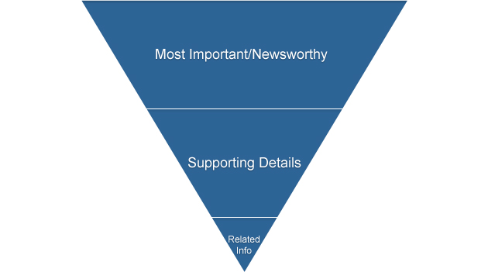
Journalism 101: Style
Straightforward: Explain and Inform
Brevity
Prioritize

Slide 25
Journalism 101: Basics of an Article
Headline
Lead Sentence
Nutshell Paragraph
Body Text
Who, What, When, Where, Why and How
Closing

Slide 26
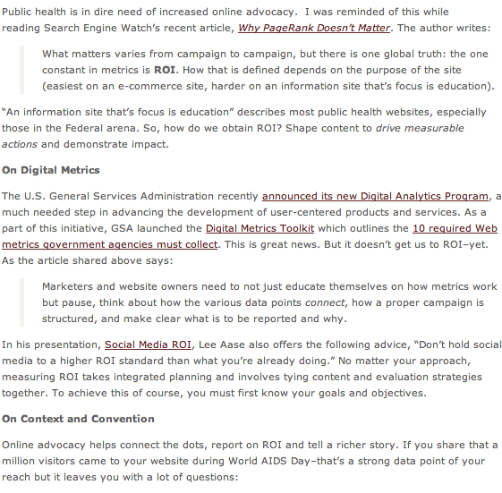
Writing Online: Things to Do
Source: “Shape Content for Action” . www.fly4change.com. October 15, 2012.
Notes:
Ask: How can my audience use this information?
Catchy/Controversial lead in
She makes her point within the first 100 words.
The paragraphs are short, no more than a few sentences
Writing on the Fly
Copy and paste but don’t plagarize
Provide relevant commentary if you are in a position to do so. Some government blogs maybe prohibited from doing so.
Break it up with headers

Slide 27
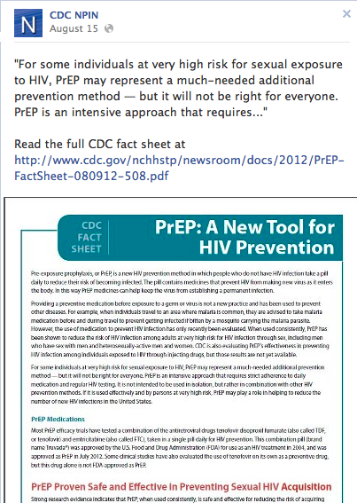
Writing Online: Things to Do

Slide 28
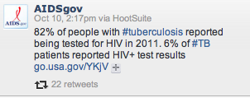
Writing Online: Things to Do

Slide 29
Writing Online: Things to Avoid
Up Front Clutter (agency names, authors, acronyms)
Laundry lists of services
Endorsement and enthusiasm
Too much…

Slide 30
Exercise: Fix This
Tweet
Facebook Post
Headline and Lead Sentence

